Slide 1
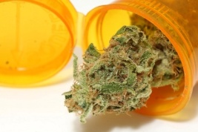



What HIV Providers Need To Know
Medical Marijuana
Trainer’s Name
Training Date
Training Location
Notes:
TITLE SLIDE
The purpose of this half-day, introductory training is to provide HIV clinicians (including, but not limited to physicians, dentists, nurses, and other allied medical staff, therapists and social workers, and counselors, specialists, and case managers) with an overview of medical marijuana, its use among individuals living with HIV, and strategies on how to work with HIV patients who are using medical marijuana.
“Test your Knowledge” questions have been inserted at the beginning and end of the presentation to gauge training participants’ experience and knowledge about medical marijuana, and assess change in the audience’s level knowledge after the key content has been presented. An answer key is provided in the Trainer’s notes for slides 5-11 and slides 115-118.
Audience Response System can be utilized, if available, when facilitating the Test Your Knowledge question sessions.
In addition, discussion activities have been inserted in the presentation (slide 14, slide 59, slide 89, and slides 97-98) to encourage dialogue among the training participants, and to illustrate how the information contained within the presentation can be used in clinical practice.

Slide 2
Training Collaborators
Pacific AIDS Education and Training Center
  Charles R. Drew University of Medicine and Science
  University of California, Los Angeles
Pacific Southwest Addiction Technology Transfer Center (HHS Region 9)
UCLA Integrated Substance Abuse Programs
Notes:
This PowerPoint presentation, Trainer Guide, and companion fact sheet were developed by Howard Padwa, Ph.D. (UCLA Integrated Substance Abuse Programs), Christine Grella, Ph.D. (UCLA Integrated Substance Abuse Programs), Beth Rutkowski, M.P.H. (Associate Director of Training of UCLA Integrated Substance Abuse Programs) and Thomas Freese, Ph.D. (Director of Training of UCLA Integrated Substance Abuse Programs and Principal Investigator/Director of the Pacific Southwest ATTC) through supplemental funding provided by the Pacific AIDS Education and Training Center, based at Charles R. Drew University of Medicine and Science. We wish to acknowledge Phil Meyer, L.C.S.W., Maya Talisa Gil-Cantu, M.P.H., and Tom Donohoe, M.B.A., from the PAETC.

Slide 3
Educational Objectives
At the end of this training session, participants will be able to…
Describe the mechanism of action of marijuana.
Discuss marijuana’s effects on health and its potential medical use.
Explain at least three reasons why individuals with HIV may use medical marijuana.
Discuss at least two strategies for effectively working with HIV patients who use medical marijuana.
Notes:
INSTRUCTIONS
To set the tone for the training, notify participants that medical marijuana may not always be problematic for patients. Also, highlight that the goal of the training is not to communicate that medical marijuana is “good” or “bad” per se, but rather to give participants information they need to develop a more informed understanding of medical marijuana and be able to more effectively interact with patients who are using medical marijuana or considering medical marijuana. Review the four educational objectives. Ask participants what else they are hoping to learn from the training session. Note these issues on the flipchart/white board, and refer back to audience-generated objectives as they are addressed throughout the course of the training session.
Additional Information for the Trainer(s)
Ask participants what else they are hoping to learn from the training session. Plant the seed early about the fact that medical marijuana may not be problematic for some patients. This training will not tell participants if marijuana is good or bad, just gives the facts so participants can have a more informed understanding of marijuana and how to communicate effectively with patients about their marijuana use.

Slide 4

Medical Marijuana and HIV:
What Do You Think?
Test Your Knowledge
Questions
Notes:
INSTRUCTIONS
The purpose of the following questions is to gauge participants’ opinions and experiences working with patients who use medical marijuana, and also to evaluate their current level of knowledge concerning various areas concerning medical marijuana and HIV. Read each question and the possible responses aloud, and give training participants time to jot down their response before moving on to the next question.
When the audience shares their responses to each slide, review their responses out loud. Slides 5-7 refer to providers’ experience or perception/opinion, and do not have a correct answer. Do not reveal the answers to the questions on Slides 8-11 until the end of the training session, as they will be asked again and answered on slides 115-118).

Slide 5
Is the use of medical marijuana a problem at your clinic?
Yes - clients/patients come to clinic stoned
No
Unsure/Undecided
Notes:
INSTRUCTIONS
Read the question and choices, and review audience responses out loud.

Slide 6
What percent of your patients use marijuana?
<5%
5-10%
11-30%
31-50%
over 50%
Notes:
INSTRUCTIONS
Read the question and choices, and review audience responses out loud.

Slide 7
Your patients use marijuana mostly for…
Physical symptoms
Mental health symptoms
To get high
Other
Notes:
INSTRUCTIONS
Read the question and choices, and review audience responses out loud.

Slide 8
#1: Marijuana has been shown to harm developing fetuses
True
False
Notes:
ANSWER KEY
Correct response is A (True)

Slide 9
#2: Marijuana is better than medicine for HIV-related symptoms
True
False
Not necessarily
Notes:
ANSWER KEY
Correct response is C (Not necessarily)

Slide 10
#3: If you are caught with marijuana in California and claim you are using it for medical reasons, you cannot be arrested
  True
  False
  It depends who catches you
Notes:
ANSWER KEY
Correct response is C (It depends who catches you)

Slide 11
#4: Marijuana is proven to be effective in treating symptoms associated with HIV
True
False
Unsure
Notes:
ANSWER KEY
Correct response is A (True)

Slide 12

Roadmap for the Training
Part 1: Understanding marijuana
Part 2: Medical marijuana
Part 3: Medical marijuana and HIV
Part 4: How to work with HIV patients who use medical marijuana
Notes:
KEY POINTS
Part 1 of the training will provide an overview of marijuana, how it works, who tends to use it, and its effects. Part 2 of the training will focus on the use of marijuana as a medicine and the legal questions surrounding medical marijuana. Part 3 of the training will focus on medical marijuana and use among people living with HIV. Finally, Part 4 of the training will focus on strategies that HIV providers can use when working with patients who are either using medical marijuana or considering using medical marijuana. Highlight that there is no clear “right” or “wrong” answer when it comes to medical marijuana use by people living with HIV, so providers should be able to share the facts with patients, and help them make informed decisions regarding medical marijuana in order to improve their overall health and well-being.

Slide 13
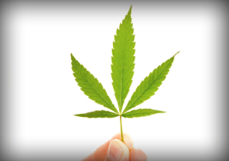
Part I
Understanding Marijuana
Notes:
TRANSITION SLIDE
Part 1 of the training will provide an overview of marijuana, how it works, who tends to use it, and its effects.
Image source:
http://teens.drugabuse.gov/drug-facts/marijuana.

Slide 14
“Marijuana”
What Do You Think?
When you think of marijuana, what comes to mind?
When you think of marijuana users, what kind of people come to mind?
When you think of marijuana and marijuana users, are your thoughts positive, negative, or mixed?
Notes:
INSTRUCTIONS
Break the audience into groups of 4-5 (or by table) to discuss the questions on the slide for 5-7 minutes. Then, bring the group back together to discuss for another 5 minutes; during the group de-brief, write down major points/concepts/keywords on a whiteboard or flip chart, highlighting stereotypes and common conceptions. Refer to salient points on the whiteboard/flip chart throughout the remainder of the training session. You will address many of the points participants make during this exercise on slides 15-17.

Slide 15

Who Uses Marijuana?
Joe (23 years old)
  First used at a party when he was 15, continued using through college
  Now uses when he goes out or is playing video games with friends
  Also uses when he’s stressed out
  On average, uses about four-five times/week
Notes:
INSTRUCTIONS
Slides 15-17 describe three different types of people who use marijuana. The purpose of these slides is to show that there is no single type of marijuana user, but many different types of people use the drug for many different reasons and in many different ways. Review the example described on the slide.

Slide 16

Who Uses Marijuana?
Maria & Terry
(46 & 48 years old)
  Used in college; stopped when she got pregnant
  Now smoke socially and when they go to concerts
  Maria uses when work stresses her out
  Terry uses for pain stemming from HIV-related neuropathy
Notes:
INSTRUCTIONS
Review the example described on the slide.

Slide 17

Who Uses Marijuana?
Elise (78 years old)
  Never used marijuana until she turned 63
  First used to improve her appetite during chemotherapy for breast cancer
  Cancer has returned and metastasized to her spine.
  Conventional painkillers don’t work; now uses several times a day for pain relief
Notes:
INSTRUCTIONS
Review the example described on the slide. Highlight that many different types of people of various ages use marijuana for a wide variety of reasons.

Slide 18
Marijuana Use is Common
Marijuana is the most commonly used illicit drug in the U.S.
Any use among general population age 12+ in past month:
  2011: 7%
  2008: 5.8%
Use is most common among people age 18-25 (19% of population)
48% of adults in the US report having used marijuana at some time in their life
SOURCES: SAMHSA 2012; Pew Charitable Trust, 2013 (reference list).
Notes:
KEY POINTS
Marijuana is the most commonly used illicit drug (rates of alcohol use are higher). The rate of current use (i.e., use in past month) has been increasing in recent years, from 5.8% in 2008 to 7% in 2011 of the general population aged 12 or older. It is most commonly used by young adults age 18-25; almost one-fifth of the population in this age group uses marijuana.
Additional Information for the Trainer(s)
Because of its increased prevalence, many people have either tried marijuana themselves or know of a friend or loved one who has tried the drug. As a result, public attitudes towards the drug have shifted in recent years. In 1990, only 16% of Americans favored the legalization of marijuana, and 81% wanted it to remain illegal. By 2013, 52% favored legalization, and just 45% want it to remain illegal. Young people are the most supportive of marijuana legalization. Sixty-five percent (65%) of Millennials – people who are now between the ages of 18 and 32 – favor legalizing the use of marijuana, up from just 36% in 2008. Yet, there also has been a striking change in long-term attitudes among older generations, particularly Baby Boomers. This change in attitudes is most likely driven by changes in the perception of harm or risk associated with marijuana use.
Among youth who first tried marijuana in the past year, the average age was 16.2 years old. This is important because the earlier people begin using marijuana, the more likely they are to become dependent later, and also experience negative effects on cognitive functioning, educational attainment, and income as adults, and they are more likely to develop mental disorders. Nevertheless, this relationship is one of correlation, so it does not prove causation. That is, youth with poorer cognitive skills may seek out marijuana use, and other factors (e.g., risk taking propensity, lower socioeconomic status, and exposure to childhood trauma or other environmental risks) may also underlie poorer educational attainment. Some longitudinal research has been performed, however, showing that people who started smoking marijuana as teenagers and used it heavily for decades lost IQ points over time, while those who started smoking as adults did not.
REFERENCES (refer to reference list for full citations):
SAMHSA, 2012.
Pew Charitable Trust, 2013.

Slide 19
Why Do People Use Marijuana?
Among people who used marijuana in the past year:
SOURCE: Pew Charitable Trust, 2013 (reference list).
Notes:
KEY POINTS
This chart highlights the findings from a study released in 2013 in which 47% of respondents who used marijuana in the past year reported using it just for fun, 30% reported using it for medical reasons, and 23% reported using it for fun and medical reasons. In other words, over half of the respondents who used marijuana in the past year used it at least in part for medical reasons.

Slide 20
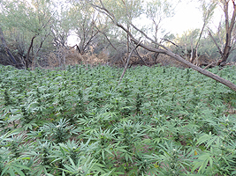
Marijuana: What is it?
Dry, shredded mix of leaves, flowers, stems, and seeds, usually from Cannabis sativa or Cannabis indica plant
Both are common subspecies of the hemp plant, which is common throughout the world
Contains over 400 chemical compounds
Common names: grass, weed, pot, reefer, Mary Jane, ganja
SOURCE: SAMHSA, 2012 (reference list).
Notes:
KEY POINTS
Marijuana is a dry shredded mixture of leaves, flower, stems, and seeds from common cannabis sativa and cannabis indica, which are two sub-species of the hemp plant. Hemp plants grow abundantly throughout the world. Marijuana gets its effects from many chemicals—it contains over 400 chemical compounds. Marijuana has many common street names—among the most widely used are “grass,” “weed,” “pot,” “reefer” “Mary Jane” and “ganja.”

Slide 21
How is Marijuana Used?
SMOKED | VAPORIZED | EATEN/DRUNK
Smoked in a pipe, bowl, cigarette | Inhaled through machine that converts active compounds into inhalable form | Consumed as ingredient in baked goods, candies, sodas
Rapid effects | Rapid effects | Takes time to reach brain, so effects are delayed
Burning marijuana releases toxins that can cause pulmonary problems | Does not release toxins that cause pulmonary problems | Does not release toxins that cause pulmonary problems
SOURCE: University of Utah, 2013 (reference list).
Notes:
KEY POINTS
The purpose of this slide is to review the three main ways that marijuana can be consumed. The most common way that marijuana is used is by being smoked, either in a pipe, a bowl, or rolled into a cigarette (also known as a “joint”). When smoked, marijuana has rapid effects. The process of burning marijuana, however, releases toxins from the plant, and these can cause serious pulmonary problems. An alternative way to use marijuana is with a vaporizer, which is a machine that converts the active compounds from marijuana into inhalable form, but without burning them. This allows users to have rapid effects like when they smoke, but without inhaling the toxins that are produced in the process of burning marijuana. A third method to consume marijuana is by eating or drinking it. In this form, marijuana is an ingredient in baked goods, candies, or sodas. When consumed orally within food or drink, marijuana takes time to reach the brain, since it first goes through the digestive system. When eaten, it does not release the toxins that cause pulmonary problems that are produced when marijuana is smoked.

Slide 22
Marijuana: Other Forms
Hashish
  Compressed resin of cannabis plant
  More concentrated and potent than marijuana plant
Hash Oil (“Wax”)
  Psychoactive chemicals extracted from cannabis plant with butane
  Three to four times as potent as marijuana plant
Synthetic Marijuana (“Spice”, “K2”)
  Herbal and chemical mixtures that produce experiences similar to marijuana
  The five most common active chemicals in synthetic marijuana are now illegal in the U.S.
SOURCES: NIDA 2012c; DEA 2013; Hallett, 2013 (reference list).
Notes:
KEY POINTS
Increasingly, people are using other more potent derivatives of marijuana or synthetic drugs that have similar effects. These forms of marijuana are not as common in the US, and there has not been as much research on their effects. Consequently, most of the information presented in this training will not focus on these forms of marijuana. Still, since patients may be using these forms of marijuana, it is important for HIV providers to be aware of these different types of marijuana and their effects. One commonly used alternative to the marijuana plant is hashish, which is a compressed resin derived from the cannabis plant. Hashish is more concentrated and potent that regular marijuana. Another form that has become increasingly common in the past few years has been hash oil, which is commonly referred to as “wax.” Hash oil is extracted from cannabis plants using butane, and contains high concentrations of the main psychoactive ingredients in marijuana. It is estimated that hash oil is three to four times as potent as regular marijuana. Another trend that has become common in recent years has been the use of synthetic marijuana, which is often called “spice” or “K2.” These are herbal and chemical mixtures that produce experience similar to marijuana. The Drug Enforcement Agency has classified the five most common chemicals in synthetic marijuana as illegal substances in the United States.
Additional Information for the Trainer(s)
The Pacific Southwest ATTC co-produced a Synthetic Drugs Training Curriculum, which is available for free download from: http://www.uclaisap.org/slides/synthetic-drug-training-package.html.

Slide 23
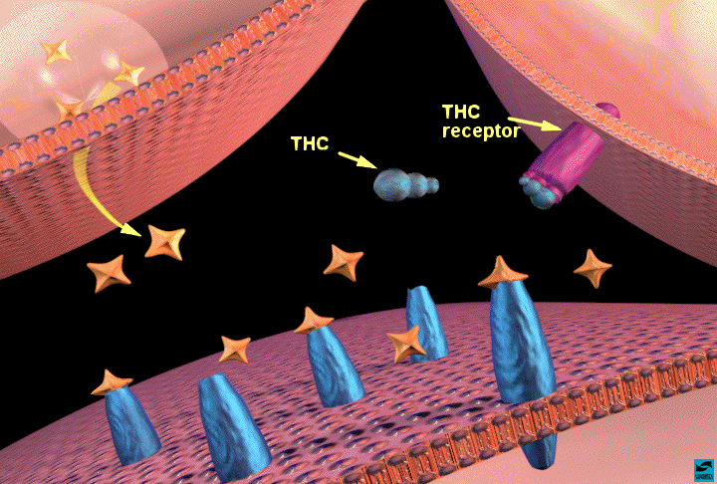
Marijuana: How Does it Work?
Contains over 60 cannabinoids: main active chemical is ∆-9-tetrahydrocannabinol (THC)
Stimulates “high” by triggering receptors in parts of brain that influence pleasure, memory, thinking, concentration, coordination
THC’s molecular structure is similar to that of neurotransmitters that affect cannabinoid receptors (affect pain, appetite, vomiting reflex)
Effects generally last 1-4 hours
SOURCES: Eddy, 2010; NIDA, 2012a, 2012b (reference list).
Notes:
KEY POINTS
THC works by acting on specialized cells called neurons in the brain (refer to illustration). Neurons do not touch each other, and the gap between them—called the synaptic space—needs to be bridged for messages to get from one neuron to the next. To get messages across the space, neurons release chemicals, or neurotransmitters. The receiving neuron contains special proteins called receptors that neurotransmitters will bind to, similar to the way a key fits into a lock. After a neurotransmitter has bound to a receptor, proteins called transporters or reuptake pumps will carry neurotransmitters back to the neurons that released them. The reason this process is important is that certain neurotransmitters and receptors are associated with specific emotional and functions. Any changes to these steps—the way neurotransmitters are released, the way receptors work, or the way transporters or reuptake pumps work—can have profound effects on sensation, perception, thought, mood, and behavior. When people take drugs, these processes are altered, leading to changes in the way they feel and behave. Marijuana gets its effects because it contains over 60 chemicals called cannabinoids. The main active chemical is a cannabinoid called delta-9-tetrahydorocannabinol, often referred to as THC. Cannabinoids trigger cannabinoid receptors, which are particularly dense in parts of the brain that affect pleasure, memory, thinking, concentration, and coordination. The effects of marijuana generally last 1-4 hours.

Slide 24
Marijuana: Immediate Effects
Altered Mood | Reduced Anxiety
Cognitive Impairment (Attention, Judgment) | Sedation/Drowsiness
Altered Perception | Sensory Intensification
Impaired coordination/balance | Increased heart rate
Hunger | Hallucinations (in large doses)
Effects can vary by strains
  Sativa: More euphoria, stress relief
  Indica: Relaxation, physical (especially pain) relief
  Sativa and Indica often combined, leading to variable effects
SOURCES: NIDA 2012a;b (reference list).
Notes:
INSTRUCTIONS
Review the immediate effects of marijuana described on the table. Highlight that these are the effects of the marijuana “high” and that for people who eat/drink marijuana, the effects are not as immediate. Then review the key points below.
KEY POINTS
The effects of marijuana can also vary by strain. Two main strains of marijuana exist—sativa and indica. Sativa marijuana tends to create stronger feelings of euphoria and stress relief. The effects are more mental than physical. Indica strands of marijuana create stronger feelings of physical relaxation and pain relief. Sometimes growers and dispensaries mix strains to create marijuana that has a specific type of effect. Marijuana users often talk about using either “sativa” or “indica”—the two most common sub-species in the US. Since preparations are not standardized, it is hard to tell the precise effects a sativa or indica strain would have; it depends on their chemical composition. Even if someone says they just use one type or another, it is difficult to know for sure the composition of what they’re actually consuming.
Additional Information for the Trainer(s)
Pharmacologically, C. indica landraces tend to have higher cannabidiol (CBD) content than C. sativa strains. Most commercially available indica strains have been selected for low levels of CBD (which is not psychoactive), with some users reporting more of a "stoned" feeling and less of a "high" fromC. indica when compared to C. sativa. The Cannabis indica high is often referred to as a "body buzz" and has beneficial properties such as pain relief in addition to being an effective treatment for insomnia and an anxiolytic, as opposed to sativa's more common reports of a "spacey" and mental inebriation, and even, albeit rarely, comprising hallucinations. Differences in the terpenoid content of the essential oil may account for some of these differences in effect.

Slide 25
Marijuana: Negative Effects on Behavior and Mental Health
Similar to alcohol/other drugs if misused (impairment)
Long term use has negative impact on learning and memory
Long term use reduces motivation (“amotivational syndrome”)
Associated with mental health problems
  Unclear if marijuana use is cause or effect
  Heavy use is highly associated with serious mental illness – particularly among those with high risk (e.g., family history)
SOURCES: Ben Amar, 2006; Bostwick, 2012; NIDA, 2012a, 2012b (reference list).
Notes:
INSTRUCTIONS
The purpose of this slide and the two slides that follow is to highlight that marijuana use can have serious negative effects. Introduce these slides by saying that people often say that marijuana is “harmless.” The information presented on these slides highlights that it is not at all a “harmless” drug.
KEY POINTS
Marijuana use can have very negative effects on behavior and mental health. Since marijuana is a psychoactive drug, it causes significant impairment, just like alcohol and other drugs. This means that when experiencing a marijuana “high” people are impaired, both physically and mentally. It is unsafe to drive, operate heavy machinery, or do other things that require concentration and physical coordination when under the influence of marijuana. Long-term marijuana use has a negative impact on learning and memory. Long-term marijuana use also causes amotivational syndrome, as it makes regular users less motivated to do things. Marijuana use is also associated with mental health problems and mental illness, particularly mood disorders. It is unclear if marijuana is what causes these problems, or if people who have mood disorders are more likely to use marijuana to self-medicate. Research also shows that heavy marijuana use is associated with serious mental illness, particularly among people who are at risk for serious mental illness because of family history.
Additional Information for the Trainer(s)
Serious mental illness differs from “mental illness” in general in that it lasts longer and is more disabling, often preventing people from working or functioning in their day to day lives. Among individuals who meet diagnostic criteria for marijuana abuse, 36% have had a mood disorder in their life, and 25% have had an anxiety disorder in their life. Among individuals who meet diagnostic criteria for marijuana dependence, 60.5% have had a mood disorder in their life, and 48.5% have had an anxiety disorder in their lifetime. Overall, marijuana dependence increases the odds of a co-occurring mood disorder by 6.5 times, and of an anxiety disorder by 4.6 times. Further, there is a significant gender difference with regard to major depression, with marijuana dependence increasing the odds for men by 4.6 times and 7.2 times for women.
REFERENCE:
Conway, K.P., Compton, W., Stinson, F.S., & Grant, B.F. (2006). Lifetime comorbidity of DSM-IV mood and anxiety disorders and specific drug use disorders: Results from the National Epidemiological survey on Alcohol and Related Conditions. Journal of Clinical Psychiatry, 67, 247-257.

Slide 26
Marijuana:
Negative Effects When Smoked
Can lead to respiratory illness
  One marijuana cigarette causes as many pulmonary problems as 4-10 tobacco cigarettes
  Increased risk for bronchitis, emphysema, lung cancer
Can cause cardiovascular complications
  Raises blood pressure & heart rate 20-100%
  4.8 times risk of heart attack in hour after use
SOURCES: Ben Amar, 2006; Bostwick, 2012; NIDA, 2012a, 2012b (reference list).
Notes:
KEY POINTS
When smoked, marijuana can also have serious health effects. Smoked marijuana can cause respiratory illness. In fact, marijuana can cause significantly more lung damage than tobacco cigarettes, and increases risk for many lung diseases and conditions. When marijuana is smoked, it can also cause cardiovascular complications. It raises the heart rate and blood pressure significantly, and in the first hour after use, people who smoke marijuana are at nearly five times the risk of having a heart attack.

Slide 27
Marijuana:
Negative Effects in Pregnancy
  There is increasing evidence that prenatal exposure may result in:
  Increased risk of motor, social, and cognitive disturbances.
  Higher rate of low birth weight infants, and childhood leukemia
  Marijuana has been found in breast milk although levels are generally considered subclinical.
SOURCE: Texas Tech University, Health Sciences Center, 2013 (reference list).
Notes:
KEY POINTS
Marijuana can also have significant effects on the offspring of mothers who use the drug. Research shows that mothers who use marijuana during pregnancy are more likely to have children with impaired motor skills, social skills, and cognitive problems. Mothers who use marijuana during pregnancy are more likely to give birth to children who are underweight, thus increasing children’s risk for many health problems. Also, maternal marijuana use is associated with increased risk for childhood leukemia among offspring. When mothers use marijuana while nursing, the drug can also get passed on to the baby through breast milk. Though the amounts of marijuana that are passed on have not been shown to damage babies’ health, it is still worth considering for mothers who are thinking about using marijuana while breastfeeding.
Additional Information for the Trainer(s)
Cannabis has enormous affinity for milk and produces a milk/plasma ratio of 8, although the levels in milk are generally considered subclinical. THC crosses the placenta readily, and there is increasing evidence that it may increase rates of growth retardation, adverse neurodevelopment following prenatal exposure. One report suggests that THC may produce changes in certain hormones by inhibiting prolactin, growth hormone and thyroid stimulating hormone secretions and stimulating the release of corticotropin. Recent longitudinal studies suggest an increased risk of motor, social and cognitive disturbances in offspring who were exposed to cannabis prenatally. One study indicated a increased incidence of reduced head circumference in young adolescents (9-12years of age) who were exposed in utero to heavy marijuana use. Prenatal exposure resulted in a higher rate of low birth weight infants, and childhood leukemia. Recent studies have suggested a reduction in long and short-term memory retrieval and retention in children exposed to prenatal cannabis. These children were also weak in planning, integration and judgment skills.
In a study of 42 postmortem fetal brain samples from pregnant women at mid gestation (18-22 weeks of gestational age) who voluntarily underwent saline induced abortion, a decrease in dopamine receptor (D2) mRNA expression in amygdala with significant prevalence in male fetuses. Extensive marijuana exposure in utero was associated with the lowest reported mRNA levels. Unfortunately, this study did not indicate whether this change is transient or permanent.
REFERENCE:
Texas Tech University, Health Sciences Center. (2013). Effects of Marijuana on the Fetus and Breastfeeding Infants. Available online at:
http://www.infantrisk.com/content/effects-marijuana-fetus-and-breastfeeding-infants.

Slide 28
Marijuana: Why Start Using It?
To get high
  Fun
  New experiences
To fit in
To socialize
To cope with physical/emotional discomfort
SOURCE: Bonn-Miller & Zvolensky, 2009 (reference list).
Notes:
INSTRUCTIONS
Before reviewing the points on the slide, ask the audience what reasons they think motivate people to start using marijuana, and write their responses down on your white board or flip chart. After you have gathered audience responses, click, and review the reasons people may start using marijuana that are listed on the slide.

Slide 29
Marijuana: Why Keep Using It?
Rely on it to alleviate mental/emotional distress
Like it, it’s fun
Use socially/to fit in
Rely on it to alleviate physical pain/discomfort or sleep problems
Habit/fear of stopping
Most people who continue using marijuana use it for many of these reasons
SOURCE: Padwa, under review (reference list).
Notes:
INSTRUCTIONS
The purpose of this slide is to highlight some of the reasons people continue may continue using marijuana once they’ve started. Review the points on the slide. After reviewing the points on the slide, ask the audience what reasons they think motivate people to continue using marijuana once they’ve started, and write their responses down on your white board or flip chart.

Slide 30
Marijuana Abuse/Dependence
SUD fall on a continuum of alcohol and drug use
PROBLEMATIC SUBSTANCE USE
Risky Substance Use
Substance Abuse
Substance Dependence
SUBSTANCE USE DISORDERS (SUD)
Notes:
KEY POINTS
Prolonged and heavy marijuana use can eventually lead to substance abuse and dependence, which together are known as substance use disorders. Substance use disorders fall on a continuum of problematic alcohol and drug use. Highly problematic levels of substance use—called substance abuse and substance dependence—are defined as “disorders,” instead of just “problematic” substance use. A substance use disorder is a state in which an individual compulsively uses alcohol or drugs even when faced with negative consequences. This behavior is reinforcing, or rewarding. A major feature of a substance use disorder is the loss of control in limiting intake of the addictive substance. When working with patients who use alcohol or drugs, it is important to figure out where patients fall on this spectrum; some may have serious problems and need to abstain from alcohol and drugs, while others may not need to stop all together, but reduce use to prevent adverse effects.

Slide 31
Marijuana:
Potential for Abuse/Dependence
Regular and prolonged use can change the way the brain works, leading to abuse or dependence
Marijuana abuse/dependence most common among individuals with mental health disorders
In 2011, 22.9% of people in US who received addiction treatment received treatment for marijuana use disorders
Average adult entering treatment for marijuana abuse/dependence has used daily for ten years, tried to quit six times
SOURCE: Compton et al., 2004; NIDA, 2012a, 2012b; SAMHSA, 2012 (reference list).
Notes:
KEY POINTS
Regular and prolonged use of marijuana can lead to profound changes in the way that the brain works, leading to marijuana abuse or dependence. In particular, individuals with mental health disorders are at risk for developing marijuana use disorders. In 2011, marijuana was the primary substance used by 22.9% of people entering addiction treatment in the United States. Marijuana addiction can be very difficult to break. The average adult entering treatment for marijuana abuse or dependence in the US has used marijuana daily for ten years, and tried to quit six times.

Slide 32
Marijuana Abuse/Dependence
DRUG | LIFETIME RISK OF DEPENDENCE
Nicotine | 32%
Heroin | 23%
Cocaine | 17%
Alcohol | 15%
Marijuana | 9%
SOURCE: Bostwick, 2012 (reference list).
Notes:
KEY POINTS
Although marijuana can be addictive, a smaller proportion of people who try marijuana ever become dependent on it when compared to other substances listed on the table. A major reason that such a low percentage of people who try marijuana ever become addicted is that such a large number of people try the drug but are not heavy users. This statistic should not be read to indicate that marijuana is not addictive; just that many people who try the drug never become heavy users.

Slide 33
Marijuana Abuse/Dependence
Most individuals use marijuana without developing SUD.
However, because use is so widespread, more people use marijuana problematically than other drugs.
In Los Angeles County, marijuana use accounts for more substance use disorders treatment admissions (23.3%) than any other drug, including alcohol (22%).
SOURCES: Los Angeles County DPH, 2011; NIDA, 2012a (reference list).
Notes:
KEY POINTS
As the previous slide illustrated, most people who try marijuana do not become addicted. However, since so many people use marijuana, even though only a small proportion develop marijuana use disorders, this leads to large overall numbers of people who experience difficulties because of their marijuana use. In Los Angeles County, marijuana is the most common substance for SUD treatment admissions, more common even than alcohol.

Slide 34
Marijuana: Signs of Abuse/Dependence
Tolerance/withdrawal
  Anger or Aggression
  Decreased Appetite / Weight Loss
  Irritability
  Nervousness / Anxiety
  Restlessness
  Sleep Difficulties / Strange Dreams
Preoccupation
Loss of control
Continued use in the face of adverse consequences
Cognitive distortions/denial
SOURCE: Budney et al., 2004 (reference list).
Notes:
KEY POINTS
Given how common marijuana use disorders are, it is important for clinicians and service providers to be aware of the signs of marijuana abuse and dependence. Many of the signs of marijuana tolerance and withdrawal are the opposite of what we think of as the effects that marijuana has. For example, instead of being mellow, people with marijuana abuse/dependence become angry and aggressive; instead of being calm, they become irritable; instead of getting the munchies, they have decreased appetite; instead of being relaxed and sleepy, they become nervous, restless, and have trouble sleeping. With marijuana dependence, we also see symptoms that are common to SUD related to other substance as well; pre-occupation with use, loss of control over use, continued use despite adverse consequences, and cognitive distortions about use and denial that use is a problem.

Slide 35
Marijuana Abuse/Dependence Treatment
Treatments are behavioral
  Motivational Enhancement Therapy
  Cognitive Behavioral Therapy
  Contingency Management
  Family-based Treatment
Only 10-30% success rate in achieving abstinence from marijuana after one year
No medications available, but drugs to treat withdrawal symptoms in development
SOURCE: NIDA, 2012b (reference list).
Notes:
KEY POINTS
Treatments for marijuana abuse and dependence are behavioral, generally involving the use of talk to restructure the way people approach marijuana use and the role that marijuana plays in their lives. Some of the common treatments include motivational enhancement therapies (motivating behavior change by highlighting how marijuana may be inhibiting the achievement of life goals), cognitive behavioral therapy (changing individuals’ beliefs and thought processes surrounding drug use), contingency management (using incentives and behavioral psychology techniques to motivate drug use behavior change), and family-based treatment. Though these approaches are successful, it is very difficult for people who abuse or are dependent on marijuana to stop using; only 10-30% of people who receive treatment for marijuana use disorders are able to remain abstinent from the drug one year later. There are currently no medications available to treat or manage marijuana dependence, though there are drugs currently being developed to help treat marijuana withdrawal symptoms.
Additional Information for the Trainer(s)
Currently, research with the following medications is being conducted to see if any of them have effects on marijuana abuse/dependence and marijuana withdrawal symptoms: Buspirone, diazepam, quetiapine, dronabinol + clonidine, lofexidine, Gabapentin, vilazodone, N-acetylcystein, zolpidem, nicotine patch, guanfacine, aprepitant, citicoline, tiagabine, escitalopram, oxytocin, H-coil Deep TMS. SOURCE: www.clinicaltrials.gov.

Slide 36
“It’s not your dad’s ‘pot’ anymore”
  Marijuana growers have worked to make the drug as potent as possible.
  In 1960s-70s average THC concentrations were 1-2%. Today, they are as high as 20%
SOURCES: Kleber, 2012; TRI, 2012 (reference list).
Notes:
KEY POINTS
This slide highlights the notion that growers have developed methods to make marijuana much more potent than it was twenty-thirty years ago. Data from DEA seizures (illustrated on the chart) shows that the THC levels in marijuana increased 150% from 1983-2007. More recent research shows that recently, marijuana has become even more potent, with THC levels of 20-30%. This is compared to levels of just 2%-3% in the 1970s. Because the potency of marijuana has been increasing, it is increasingly likely that its use may have negative consequences or side effects. This also highlights that common perceptions that marijuana is “harmless” are based on ideas from 30-40 years ago, when the drug was not nearly as potent as it is today. Since the drug has become much more powerful, it is more important to be aware of marijuana’s potential dangers today than in the past.

Slide 37
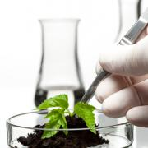
Part II
Medical Marijuana
Notes:
TRANSITION SLIDE
Part 2 of the training focuses on the use of marijuana as a medicine and the legal questions surrounding medical marijuana.

Slide 38
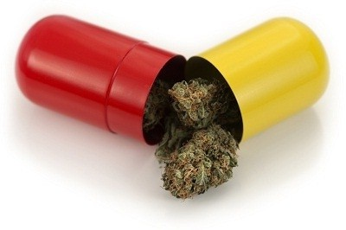
How Can Marijuana be a Medicine?
Marijuana affects:
  Pleasure/relaxation
  Memory/thinking
  Coordination
  Pain Control
  Appetite
  Vomiting Reflex
What medical problems do you think this would this be helpful for?
Notes:
INSTRUCTIONS
Review the points under the first bullet point, highlighting the areas that marijuana affects that were discussed in Part 1 of the training. Ask the audience to list the medical problems for which they think a drug that has these effects would be helpful. Write down responses on the white board/flip chart, and refer back to these points later in the discussion.

Slide 39
Marijuana’s Medical Potential: Research Evidence
Reduces nausea
Stimulates appetite
Pain relief
Controls muscle pain, spasms
Reduces tics (Tourette’s Syndrome)
Reduces convulsions (epilepsy)
SOURCE: Ben Amar, 2006 (reference list).
Notes:
INSTRUCTIONS
Review the points on the slide, highlighting that these are the areas where medical research has shown that marijuana has medical potential. Where appropriate, refer back to points/suggestions made by the audience during the presentation of the previous slide.

Slide 40
Marijuana’s Medical Potential:
Ongoing Clinical Trials
Studying potential of marijuana and marijuana-based medications to treat:
  Multiple Sclerosis
  High Heart Rate
  Non-Cardiac Chest Pain
  Chronic Obstructive Pulmonary Disease
  Sickle Cell Disease
  Spinal Cord Injury Pain
  Inflammatory Bowel Disease (Crohn’s disease)
  Liver Problems
  Cancer-Related Pain
  Brain Tumors
  Dementia
Many of these trials on individuals with multiple physical and/or mental health problems
SOURCE: U.S. National Institutes of Health, 2013. ClinicalTrials.gov.
Notes:
KEY POINTS
Though there is not yet strong research evidence that marijuana works as an effective medicine in the treatment of these conditions, there are currently trials going on exploring the drug’s potential in the treatment and management of the conditions listed on the slide, including multiple sclerosis, high heart rate, non-cardiac chest pain, lung disease, sickle cell disease, spinal cord injury pain, bowel disease, liver problems, cancer, and dementia. Much of this research doesn’t focus on the general population, but on individuals who are particularly hard to treat because they have multiple physical and/or mental health problems.

Slide 41
Different Kinds of Marijuana-Based Medicine
Botanical cannabis (plant): “Medical Marijuana”
Synthetic THC medications available in U.S. for nausea/appetite stimulation:
  Dronabinol (Marinol®) (FDA approved for HIV)
  Nabilone (Cesamet®) (FDA approved for cancer; HIV off-label)
Other medications not available in U.S.:
  Nabiximols (Sativex®) THC/cannabidiol mouth spray for pain relief, muscle spasms; currently being investigated by FDA
  Rimonabant (Accomplia®, Zimulti®) for treatment of obesity and nicotine dependence
  (selective cannabinoid receptor-1 blocker)
Notes:
KEY POINTS
Three major types of marijuana-based medicine exist: marijuana itself (botanical cannabis), synthetic THC medications, and other marijuana-based medications. The first kind, botanical cannabis, is what people mean when talking about “medical marijuana”. This is using the marijuana plant either by smoking, eating, or vaporizing, but for medical purposes instead of recreational ones. Two synthetic THC medications have been approved for use in the United States. The more common one is dronabinol, which goes by the trade name Marinol®, and is approved by the FDA for the treatment of nausea among people living with HIV. Another THC medication, nabilone, which goes by the trade name Cesamet®, has been approved by the FDA for the treatment of nausea among people with cancer. However, it can also be prescribed to people living with HIV off-label (safe and effective, but not as recommended by the FDA). Two other medications are based on marijuana, but they are not yet approved for use in the United States. The first, nabiximols, which goes by the trade name Sativex® , is a mouth spray that can be used for pain relief and to control muscle spasms. This medication is available in other countries, and is currently being investigated by the FDA, meaning that it may soon become approved for use in the United States as well. The other marijuana-based medication that is currently available in other countries is rimonabant, which goes under the trade names Accomplia ® and Zimulti ®, and can be used for the treatment of obesity and nicotine dependence.

Slide 42
Medical Marijuana vs. THC Medications:
Is Medical Marijuana Better?
THC medications still have psychoactive effects (make you high)
There are chemicals in medical marijuana that moderate THC’s psychoactive effects
  These chemicals are not present in medications
Medical marijuana is cheaper
  Not made/patented by pharmaceutical industry
SOURCE: Bostwick, 2012 (reference list).
Notes:
INSTRUCTIONS
The purpose of this slide and the four slides that follow is to compare the pros and cons of botanical cannabis (“medical marijuana”) compared to the synthetic THC medications that are currently available in the USA. Slides 42 and 43 highlight ways that medical marijuana may be preferable, Slides 44-45 highlight was that THC medications may be preferable, and Slide 46 summarizes the pros and cons of both side by side.
KEY POINTS
One thing to consider is that THC medications, like marijuana, have psychoactive effects that lead people to feel “high.” If anything, marijuana may be preferable to THC medications because there are chemicals in marijuana that moderate THC’s psychoactive effects that are not present in THC medications. Another advantage of medical marijuana is that it is significantly cheaper than THC medications, which are made by the pharmaceutical industry and subject to expensive patents. Even marijuana that is sold on the street (not through dispensaries) is cheaper than THC medications.

Slide 43
Medical Marijuana vs. THC Medications:
Is Medical Marijuana Better?
Smoked medical marijuana takes effect in minutes; THC medications take over an hour
  Instant feedback allows users to take more if needed for relief
  Due to rapid relief, may consume less if smoked
When swallowed, THC absorption is more erratic, and less concentrated
  THC effects more unpredictable and variable, possibly less effective
SOURCE: Bostwick, 2012 (reference list).
Notes:
KEY POINTS
Another advantage of medical marijuana, compared to THC medications, is that it takes effect in minutes instead of an hour. This means that users can tell if they got enough marijuana to feel its effects right away, and then stop consuming more once they have taken enough. Due to the rapid relief that comes from smoking marijuana, many researchers believe that people actually consume less if they smoke than if they take THC medications. The way the body absorbs THC medications is erratic and less concentrated, making their effects more unpredictable and variable than those of smoked medical marijuana.

Slide 44
Medical Marijuana vs. THC Medications:
Are THC Medications Better?
Medical Marijuana is not FDA approved
  FDA approval assures that medications are effective, safe, and properly labeled
  FDA cannot evaluate medical marijuana as a drug since it is a plant, not a standardized medical formulation
  Medical marijuana is different everywhere, depending on how it is bred, under what conditions it is grown, etc.
  No way to know if medical marijuana is pure. Can be contaminated by pesticides, mold, fungus.
SOURCE: Kleber, 2012 (reference list).
Notes:
KEY POINTS
One major drawback of marijuana is that unlike THC medications, it is not FDA approved. The FDA (Food and Drug Administration) is responsible for assuring that medications are effective, safe, and properly labeled. It is impossible for the FDA to evaluate medical marijuana as a drug since it is a plant, and not a manufactured pharmaceutical drug. Depending on the specific marijuana plant and where it was grown, it can have different concentrations of THC and other key chemical components. It is also difficult to know if medical marijuana is pure because it is a plant. Depending on how it is grown, it can be contaminated by pesticides, molds, and fungus. Given these issues, it is difficult for the FDA to approve marijuana as a medicine.

Slide 45
Medical Marijuana vs. THC Medications:
Are THC Medications Better?
Difficult to approve something that is smoked as “medicine”
  Negative effects of smoking
  Depending on type of marijuana, can undergo different types of chemical changes when burned
  No standard measurement of dosage (inhalations vary by the individual, unlike pills)
SOURCES: Kleber, 2012; TRI, 2012 (reference list).
Notes:
KEY POINTS
Another issue that complicates the use of medical marijuana is that it is hard to recommend a substance that is smoked as a medicine. When marijuana is smoked, it has negative effects on the lungs, just like any other substance that is smoked. Marijuana undergoes different types of chemical changes when it is burned, and it is difficult to predict precisely how these chemical changes might affect its medicinal properties. It is also difficult to use smoked marijuana as a medicine since it is difficult to standardize dosage. Unlike pills (which everyone digests the same way), people inhale differently, depending on their size, lung capacity, etc. Thus it is difficult to recommend standard dosages of smoked marijuana as one would for other medications.

Slide 46
Medical Marijuana vs. THC Medications
Advantages of Medical Marijuana | Advantages of THC Medications
Chemicals that moderate THCs psychoactive effects | FDA approved
Less expensive | Standardized medical formulation
More immediate relief | Purity
Instant feedback allows for moderation, possibly less consumption | Not smoked
Less erratic absorption than THC medications | Standardized dosing
Notes:
KEY POINTS
This is a summary slide. From the perspective of people who use medical marijuana, it is not necessarily clear if medical marijuana or THC medications are more effective. It may depend on personal preferences, or what people are more comfortable with. Which one’s better? It’s complicated.

Slide 47

Medical Marijuana vs. THC Medications
ACCORDING TO FEDERAL LAW, MARIJUANA IS ILLEGAL
  How can marijuana be used as a medicine
  while it is illegal?
Notes:
INSTRUCTIONS
The purpose of this slide is to introduce the legal questions surrounding medical marijuana into the discussion of the relative merits and drawbacks of medical marijuana and THC medications; it is critical to take these legal considerations into account when weighing the pros and cons of medical marijuana. The legal status of medical marijuana will be explored in detail on the following 11 slides.

Slide 48

Medical Marijuana and Federal Law
Controlled Substances Act (1970)
  Marijuana is a Schedule I drug: “No currently accepted medical use”
  No legal distinction between medical and recreational use
    Up to 1 year in federal prison, $100,000 fine for first possession offense
    Up to 5 years in federal prison, $250,000 fine for first manufacturing offense
SOURCE: Eddy, 2010 (reference list).
Notes:
KEY POINTS
Under the Controlled Substances Act of 1970, potentially addictive drugs are placed on a schedule by the Drug Enforcement Administration (DEA) based on their abuse potential and recognized therapeutic value. Marijuana is currently classified as a Schedule 1 substance, which means it has a high abuse potential and has NO accepted medical benefits (and therefore is NOT available by prescription). According to federal law, all marijuana use is illegal, whether it is “medical” or “recreational.” The distinction between the two types of use is not recognized by the federal government. The fines for violations involving Schedule 1 substances are severe. The first possession offense can lead to up to a year in federal prison and a fine of up to $100,000, and manufacturing offenses can carry penalties of up to five years in federal prison and a fine of $250,000.
Additional Information for the Trainer(s)
For perspective on the Controlled Substances Act scheduling system, below is a sample of some of the drugs placed on different schedules:
Other Schedule I drugs: Heroin, LSD, MDMA, quaaludes, GHB, mescaline, peyote, marijuana.
Schedule II: Morphine, cocaine, amphetamines, Oxycodone, Methadone
Schedule III: Barbiturates, non-narcotic analgesics, anabolic steroids, Marinol
Schedule IV: Valium, Librium, Xanax, Miltown, sleep aids (Ambien, Lunesta)
Schedule V: OTC cough medications w/codeine (e.g. Robitussin-C); anti-diarrheals (e.g., Lomotil)
The marijuana legalization/advocacy movement has petitioned the DEA to reclassify marijuana to a lower-level classification, in recognition that it is potentially less harmful than other Schedule 1 substances, and may have some therapeutic benefits, however, all of these challenges have been rejected by the DEA. At present, the Department of Justice has said that it will issue a policy statement regarding how they will proceed with regard to the recent (2012) voter-initiated legislation enacted in Colorado and Washington that decriminalized marijuana for recreational use, but have not thus far.

Slide 49

Medical Marijuana and Federal Law
Supreme Court ruled that medical necessity is no excuse to break federal law (2001)
FDA affirmed smoked marijuana is not considered medicine (2006)
SOURCE: Eddy, 2010 (reference list).
Notes:
KEY POINTS
Recent decisions at the federal level have reinforced the federal government’s anti-medical marijuana policies. In 2001, the Supreme Court ruled that medical necessity is no excuse to break federal laws concerning medical marijuana. In 2006, the FDA reaffirmed its position that it does not consider smoked marijuana a legitimate medicine.
Additional Information for the Trainer(s)
The 2001 Supreme Court Case was “U.S. v. Oakland Cannabis Buyers’ Cooperative.” The case involved a civil suit that the US Department of Justice filed in 1998 to close six medical marijuana distribution centers in northern California. The Oakland Cannabis Buyers Cooperative fought the injunction, but was eventually forced to close and appeal to the Ninth Circuit Court of Appeals. The key issue was whether a medical marijuana distributor could use medical necessity as a defense against federal marijuana distribution charges. In 1999 the Ninth Circuit ruled in favor of the Buyer’s cooperative, but the Supreme Court overruled this decision in the 2001 case in an 8-0 ruling that found medical necessity was not a valid defense against federal charges. This decision had no effect on state medical marijuana laws, which continued to protect patients and primary caregivers from arrest by state and local law enforcement agents in the states with medical marijuana programs.
On April 20, 2006, the FDA issued an interagency advisory restating the federal government’s position that “smoked marijuana is harmful” and has not been approved “for any condition or disease indication.” The one-page announcement did not refer to new research findings. Instead,
it was based on a “past evaluation” by several agencies within HHS that “concluded that no sound scientific studies supported medical use of marijuana for treatment in the United States, and no animal or human data supported the safety or efficacy of marijuana for general medical use.” Media reaction to this pronouncement was largely negative, asserting that the FDA position on medical marijuana was motivated by politics, not science. In Congress, 24 House Members sent a letter to the FDA acting commissioner requesting the scientific evidence behind the agency’s evaluation of the medical efficacy of marijuana. However, the FDA’s decision remained intact, and is still its policy today.

Slide 50
Marijuana and its Derivatives as Medicine: Federal Law
Investigational New Drug Program
  Individuals could apply for marijuana from the federal government
  Under 100 patients given marijuana in program
  Large numbers of people with HIV/AIDS applied
  Program shut to new enrollees in 1992 due to high demand
  Handful of people still getting drug through program today
Dronabinol (Marinol®) approved by FDA for cancer chemotherapy (1985) and HIV/AIDS (1992)
Nabilone (Cesamet®) approved by FDA 1985, became available for cancer chemotherapy in 2006
SOURCE: Eddy, 2010 (reference list).
Notes:
KEY POINTS
In spite of these decisions, there are a few exceptions to the federal opposition to the use of marijuana and its derivatives as medicine. One that is still in operation today, though limited, is the Investigational New Drug Program, which allows for individuals to apply for new experimental drugs—including marijuana—from the federal government. Originally, fewer than 100 patients were given marijuana under the program, but when the HIV epidemic broke out in the 1980s, larger numbers of people began applying. The program was shut to new enrollees 1992 because of high demand, but there are still a handful of people (under 15 across the country) who still get the drug through the program today. The other exceptions are the FDA approved THC medications Marionol® and Cesamet®.
Additional Information for the Trainer(s)
In 1975, a Washington, DC resident was arrested for growing marijuana to treat his glaucoma. He won his case by using the medical necessity defense, forcing the government to find a way to provide him with his medicine. In 1978, FDA created the Investigational New Drug (IND) Compassionate Access Program,32 allowing patients whose serious medical conditions could be relieved only by marijuana to apply for and receive marijuana from the federal government. Over the next 14 years, other patients, less than 100 in total, were admitted to the program for conditions including chemotherapy-induced nausea and vomiting (emesis), glaucoma, spasticity, and weight loss. Then, in 1992, in response to a large number of applications from AIDS patients who sought to use medical cannabis to increase appetite and reverse wasting disease, the George H.W. Bush Administration closed the program to all new applicants. Several previously approved patients remain in the program today and continue to receive their monthly supply of government-grown medical marijuana.

Slide 51
Medical Marijuana and State Law
18 states and the District of Columbia allow for the use of marijuana medically
  Through votes in state legislatures
  Through ballot measures
An unconventional approach to making decisions about medicine
  Only drug approved for medical use through political process rather than scientific trials and research
Over 200,000 individuals in California obtain marijuana through medical marijuana dispensaries
  In 2010, 69% of medical marijuana users in US were in California
SOURCES: Eddy, 2010; Reinarman et al., 2011; Borgelt et al., 2013 (reference list).
Notes:
KEY POINTS
Even though medical marijuana is still illegal under federal law, many states (18, plus the District of Columbia) now allow for the medical use of marijuana. Most of these laws were passed through votes in state legislatures or ballot measures approved by the voting public. This is a highly unconventional approach to making decisions about medicine. Normally, drugs are approved for medical use through scientific research and clinical trials; in the case of medical marijuana, approval came through political processes. Through 2010, California had the vast majority of medical marijuana users in the US, over 200,000. This statistic is probably out of date, however, because of changes to medical marijuana laws in other states.
Additional Information for the Trainer(s)
Most estimates of number of medical marijuana users in California and elsewhere are probably low. Estimates are based on number of applications for marijuana recommendations or prescriptions from physicians. However, many individuals who obtain medical marijuana share it with individuals in their social networks, and many also obtain through unlicensed dispensaries or delivery services that are “under the radar.” The issue of diversion is particularly relevant to underage (i.e., adolescents); a recent study in Colorado found that about half of adolescents in a drug treatment program indicated they had obtained marijuana from someone who had a medical marijuana “license,” and data from the National Survey on Drug Use and Health also shows that among youth aged 12 – 14 in the general population who reported past-year marijuana use, 70% obtained it for free from someone else, most often from a friend.

Slide 52
Medical Marijuana and State Law: California
California Compassionate Use Act (1996)
  Approved as Proposition 215 by 56% of California voters; amended in 2003 by SB 420
  First medical marijuana law and the most open to interpretation
  Legalized for treatment of many medical conditions (including HIV/AIDS) and “any other illness for which marijuana provides relief” (open to broad interpretation)
SOURCES: Eddy, 2010; Nunberg et al., 2011; Reinarman et al., 2011 (reference list).
Notes:
KEY POINTS
California was the first state to legalize medical marijuana with the Compassionate Use Act, which was approved by California voters as Proposition 215 in 1996. The California legislature amended the law in 2003. The Compassionate Use Act is the most open to interpretation of any medical marijuana laws. It legalized marijuana for the treatment of many medical conditions (including HIV/AIDS). It also stipulated that it could be used to treat “any other illness for which marijuana provides relief.” This phrase is open to interpretation, and means that the drug can be recommended for the treatment of any condition–whether or not there is medical evidence supporting its medical effectiveness.
Additional Information for the Trainer(s)
The individuals who drafted the Compassionate Use Act that legalized medical marijuana in California purposely left it open-ended with regard to “any other illness for which marijuana provides relief” because they believe that future research may provide evidence of marijuana’s widespread benefits to other illnesses that are not currently understood. Thus, they intentionally left the acceptable medical reasons for its use open-ended. This component of the legislation underlies why California’s medical marijuana policy is skeptically viewed as allowing many individuals without valid medical problems to obtain marijuana for “recreational” purposes. This is not the case in some other states, (e.g., New Mexico, Vermont), where distribution of medical marijuana is more strictly regulated by limiting the number of “valid” medical conditions for medical MJ use and requiring more extensive verification by physicians. There are currently bills in the California Legislature that propose establishing a state medical marijuana commission that would impose more uniform regulation on medical marijuana distribution within the state.

Slide 53
Medical Marijuana and State Law: California (continued)
California Compassionate Use Act (1996)
  Removed state penalties for use, possession, or growth with a physician’s recommendation
  Allows possession of amount needed for personal medical purposes (8 oz dried marijuana, 6 mature marijuana plants)
CA Medical Marijuana Program administers the Medical Marijuana Identification Card program
  The ID card is voluntary and there is a fee for registering
  The intent is to help law enforcement and qualified patients by creating an official ID that is recognized throughout the state.
SOURCES: Eddy, 2010; Nunberg et al., 2011; Reinarman et al., 2011 (reference list).
Notes:
KEY POINTS
The California Compassionate Use Act removed state penalties for use, possession, or growth of certain amounts of marijuana with a “recommendation” from a physician. The law in California allows for the possession of the amount of necessary needed for personal medical purposes—8 ounces of dried marijuana, and six mature marijuana plants (and 12 immature plants). The California Medical Marijuana Program (MMP) in the California Department of Public Health oversees medical marijuana, and is responsible for developing and maintaining an online registry and verification system for Medical Marijuana Identification Cards or “MMICs.” The MMIC is used to help law enforcement identify the cardholder as being able to legally possess certain amounts of medical marijuana under specific conditions. It is recognized statewide – but not necessarily out-of-state.
Additional Information for the Trainer(s)
From 2004 to June 11, 2013, a total of 68,479 cards had been registered. All patient information provided for the ID card is covered under HIPAA and cannot be released without the patient’s signature or a court subpoena. The Medical Marijuana Application System does not contain any personal information such as name, address, or social security number. It only contains the unique user ID number and when entered the only information provided is whether the card is valid or invalid. Individuals must apply in person in the county in which they reside; a photo is taken for the ID. Both state and county fees exist. County fees vary, but total cost generally ranges from $200-$300. Because of the high costs, only a minority of individuals decide to get the ID card. Medi-Cal provides for a 50 percent reduction in fee for recipients.

Slide 54
Medical Marijuana and State Law: California (continued)
Unlike other medications, doctors do not prescribe amount of marijuana, number of refills, content of medication, or route of administration
  Dispensary staff often recommend specifics
Doctor simply recommends the drug after one visit
  Cost of a visit generally $40-$100
  Patients obtain a “recommendation” for medical marijuana
  Grow marijuana personally, or purchase it at marijuana dispensaries
Doctor does not have to monitor patient progress (e.g., response to medicine, changes in symptoms)
SOURCES: Eddy, 2010; Nunberg et al., 2011; Reinarman et al., 2011 (reference list).
Notes:
KEY POINTS
In California, doctors do not prescribe marijuana like they do other medications – they don’t prescribe the amount of marijuana, how many refills patients should get, what the medication should contain, or how it should be taken (smoked, vaporized, eaten/drunk). Often, staff in dispensaries, which distribute marijuana directly to patients, recommend specific strains or routes of administration to patients. However, they do often make recommendations based on what patients say, rather than on specific information from the doctor who evaluated the patient or recommended marijuana. Doctors in California simply recommend marijuana to patients after one visit, and patients can either then grow it personally or purchase it at a dispensary. After issuing recommendations, doctors do not have to monitor patient progress, how they respond to marijuana, or changes in their symptoms.
Additional Information for the Trainer(s)
Doctors do not prescribe, but staff at Medical Marijuana dispensaries often may recommendations to consumers about which strains to use in order to produce the desired effects (i.e., sedation vs. energetic) or to “treat” specific conditions. Unlike with other medications, doctors do not monitor the effects of the medication (i.e., marijuana) on patients, whether symptoms are reduced or track effects of the “medication” with biological measures. By contrast, when you are being treated for hypertension, you will be required to return to your doctor regularly for follow-up visits where your blood pressure will be monitored to verify the effectiveness of the medication on lowering it. Other examples: monitor cholesterol levels with blood tests; monitor effects of chemo on treating cancer with X-rays or body scans to chart size of tumors, etc. This type of monitoring and follow-up does not have to occur for patients who use medical marijuana.

Slide 55
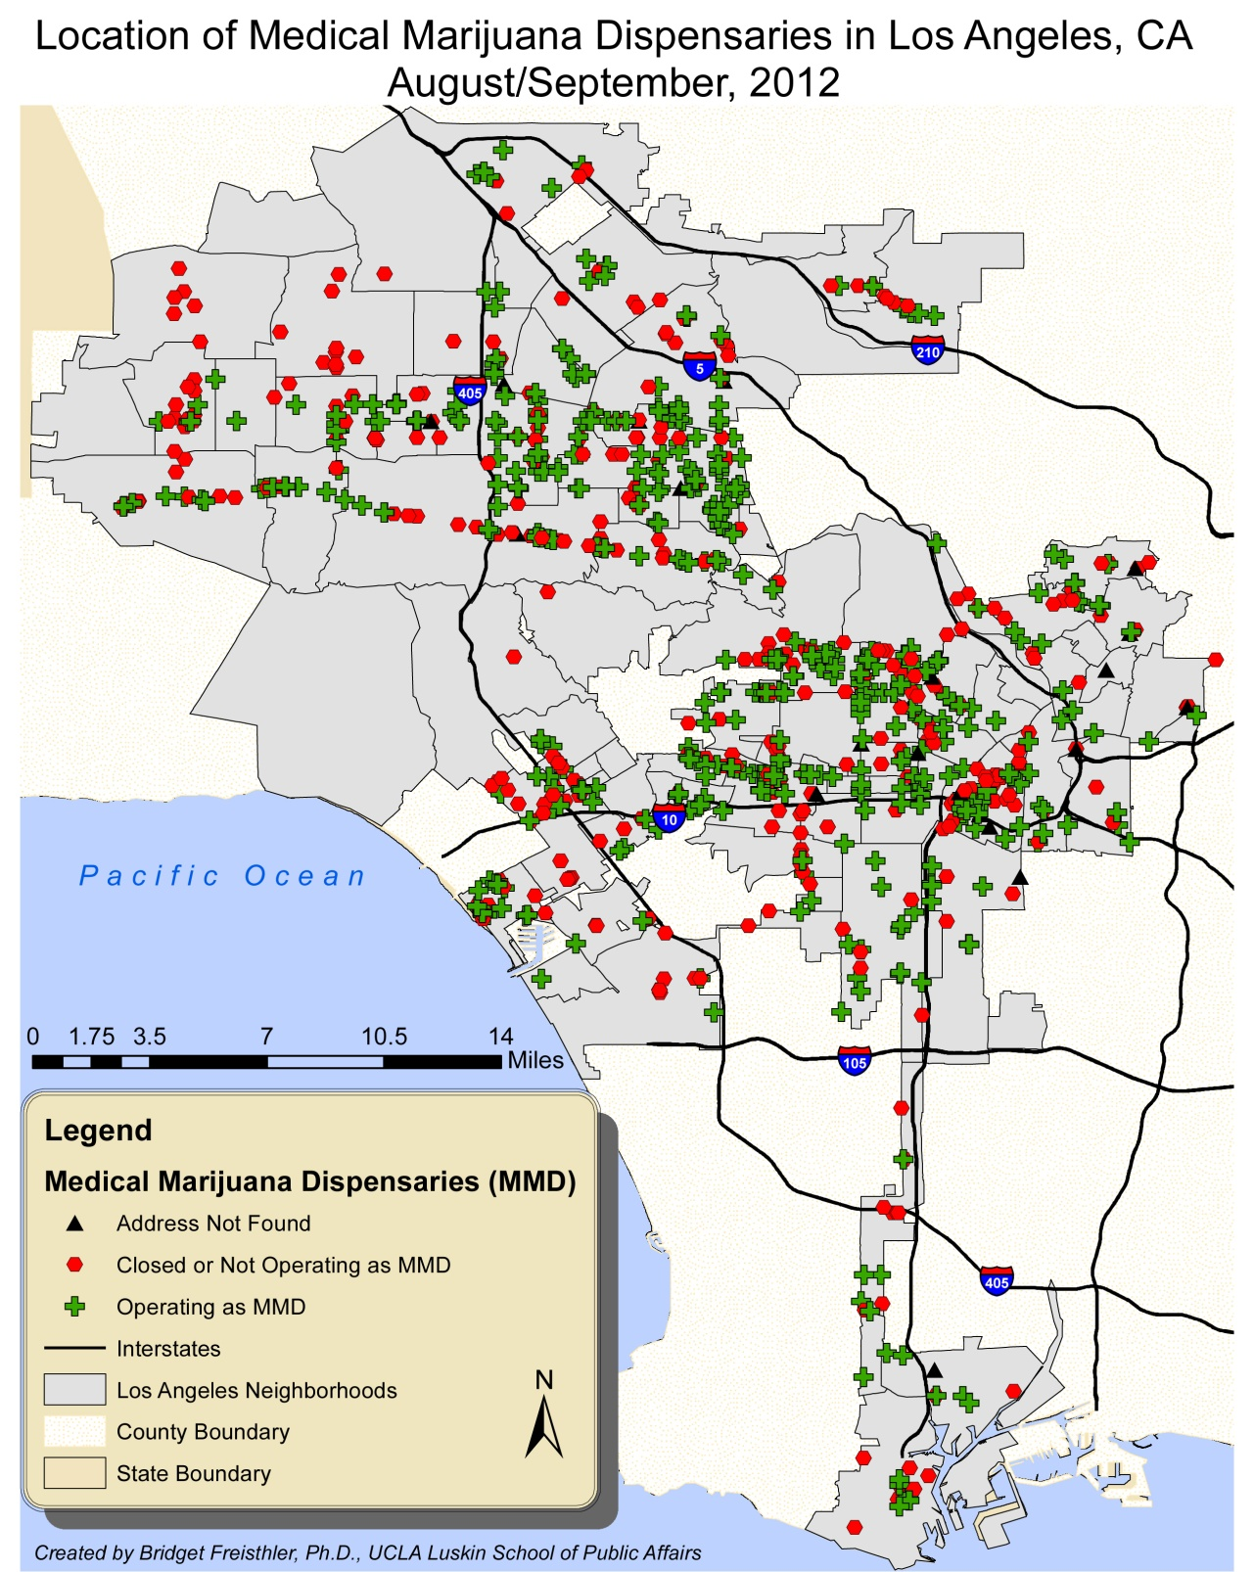
Medical Marijuana Dispensaries in Los Angeles County
Medical marijuana dispensaries developed as a means to cultivate and distribute medical marijuana
In 2007, the City of Los Angeles capped the number of licensed dispensaries at 187
Thousands of unregulated dispensaries still operate
Because of conflicts over land use and zoning, marijuana delivery services have developed
Notes:
KEY POINTS
Medical marijuana dispensaries have developed since 2003 as places that can cultivate and distribute medical marijuana. In 2007, the City of Los Angeles capped the number of licensed dispensaries that could operate in the city at 187, but thousands of unregulated dispensaries still are in operation. Because of conflicts over land use and zoning, delivery services that deliver marijuana directly to patients’ places of residence have developed.
Additional Information for the Trainer(s)
The original Compassionate Use Act was amended in 2003 by SB420, which allowed for the development of “collectives” or “cooperatives” to act as surrogate caregivers on behalf of patients in need of medical marijuana. This lead to the development of Medical Marijuana dispensaries that we have today. Dispensaries are regulated at the local (city) level, and may be restricted by zoning ordinances that limit them to certain areas (e.g., not adjacent to schools). Medical marijuana dispensaries developed as a means to cultivate and distribute marijuana to “patients” with doctor’s “recommendations” for its use (note: it is not a medical “prescription” but a “recommendation”). The dispensaries MUST be non-profit (which is the source of conflict with Federal government that views them as profit-driven--the equivalent of organized “drug dealing”). Dispensaries are often referred to as “collectives” and emphasize their role as “caregivers,” consistent with California based regulations that recognizes them as surrogate “caregivers” to patients.

Slide 56

Federal Law vs. State Law:
What Does it Mean?
Most drug arrests are made by local/state law enforcement, who enforce state laws
  Local/state law enforcement in CA operates under Compassionate Use Act (allows for medical marijuana)
  Federal law enforcement operates under Controlled Substances Act (does not allow for medical marijuana)
Federal law enforcement of marijuana laws is rare, varies depending on political climate
  Federal authorities have been shutting down dispensaries they believe are “profit-making” enterprises
SOURCE: Bostwick, 2012 (reference list).
Notes:
KEY POINTS
The current policy situation is very complicated since federal law and state law conflict. In practice, state law is generally the rule that is enforced. Most drug law enforcement is done by state and local law enforcement, who enforce state laws—these authorities allow for medical marijuana because they operate under the Compassionate Use Act. Federal law enforcement, on the other hand, does not allow for medical marijuana, since they operate under the Controlled Substances Act. However, federal law enforcement of medical marijuana laws is rare, and varies depending on the political climate. When federal authorities do crack down on medical marijuana, they take action against dispensaries that they believe are “profit making” drug dealing enterprises rather than non-profit distributors of medical marijuana.
Additional Information for the Trainer(s)
The current policy situation is very complicated and in conflict. Federal, state, and local (municipal) laws conflict to varying degrees. In California, regulation of medical marijuana is at the local level (municipal), although there are currently proposals in the state legislature to create a state-level regulatory system for medical marijuana, including for quality control and taxation. Other states have more highly regulated and centralized systems for medical marijuana distribution.

Slide 57
Federal Law vs. State Law:
What Does it Mean?
Supreme Court ruled that federal marijuana laws have precedence over state law (2005)
Can be charged with federal marijuana violations even if obeying state regulations
  Case would have to be brought by federal authorities
  Rare, but can/does happen
Supreme Court ruled that federal government cannot investigate physicians just because they recommend marijuana (2002)
SOURCE: Eddy, 2010 (reference list).
Notes:
KEY POINTS
In 2005, the Supreme Court ruled that federal marijuana laws do have precedence over state law when the two conflict. What this means is that patients can be charged with federal marijuana violations even if they are obeying state regulations. This could only happen, however, if the state was brought by the federal authorities, not state authorities. This happens rarely, but it can/does happen on occasion. It has been ruled by the Supreme Court, however, that the federal government cannot investigate physicians just because they recommend marijuana to a patient.
Additional Information for the Trainer(s)
Regarding the 2005 Supreme Court case stipulating that federal marijuana laws have precedence over state laws (Gonzales v. Raich): In response to DEA agents’ destruction of their medical marijuana plants, two patients and two caregivers in California brought suit. They argued that applying the Controlled Substances Act to a situation in which medical marijuana was being grown and consumed locally for no
remuneration in accordance with state law exceeded Congress’s constitutional authority under the Commerce Clause, which allows the federal government to regulate interstate commerce. In December 2003, the Ninth Circuit Court of Appeals in San Francisco agreed, ruling 2-1 that states are free to adopt medical marijuana laws so long as the marijuana is not sold, transported across state lines, or used for nonmedical purposes. Federal appeal sent the case to the Supreme Court. The issue before the Supreme Court was whether the Controlled Substances Act, when applied to the intrastate cultivation and possession of marijuana for personal use under state law, exceeds Congress’ power under the Commerce Clause. The Supreme Court, in June 2005, reversed the Ninth Circuit’s decision and held, in a 6-3 decision, that Congress’s power to regulate commerce extends to purely local activities that are “part of an economic class of activities that have a substantial effect on interstate commerce.” Raich does not invalidate state medical marijuana laws. The decision does mean, however, that the DEA may continue to enforce the CSA against medical marijuana patients and their caregivers, even in states with medical marijuana programs. Although Raich was not about the efficacy of medical marijuana or its listing in Schedule I, the majority opinion stated in a footnote: “We acknowledge that evidence proffered by respondents in this case regarding the effective medical uses for marijuana, if found credible after trial, would cast serious doubt on the accuracy of the findings that require marijuana to be listed in Schedule I.” The majority opinion, in closing, notes that in the absence of judicial relief for medical marijuana users there remains “the democratic process, in which the voices of voters allied with these respondents, may one day be heard in the halls of Congress.” Thus, the Supreme Court reminds that Congress has the power to reschedule marijuana, thereby recognizing that it has accepted medical use in treatment in the United States. Congress, however, does not appear likely to do so. Neither does the executive branch, which could reschedule marijuana through regulatory procedures authorized by the Controlled Substances Act.
Regarding the 2002 Supreme Court ruling that the federal government cannot investigate physicians just because they recommend marijuana: In the case Conant v. Walters (2002), a group of California physicians and patients filed suit in federal court, claiming a constitutional free-speech right, in the context of the doctor-patient relationship, to discuss the potential risks and benefits of the medical use of cannabis. A preliminary injunction, issued in April 1997, prohibited federal officials from threatening or punishing physicians for recommending marijuana to patients suffering from HIV/AIDS, cancer, glaucoma, or seizures or muscle spasms associated with a chronic, debilitating condition. The court subsequently made the injunction permanent in an unpublished opinion. On appeal, the Ninth Circuit affirmed, in a 3-0 decision, the district court’s order entering a permanent injunction. The federal government, the opinion states, “may not initiate an investigation of a physician solely on the basis of a recommendation of marijuana within a bona fide doctor-patient relationship, unless the government in good faith believes that it has substantial evidence of criminal conduct.”63 The Bush Administration appealed, but the Supreme Court refused to take the case.

Slide 58
Effects of Medical Marijuana Legalization
Marijuana use is more common in states that have medical marijuana laws
  It is unclear if higher rates of use are cause or effect of medical marijuana laws
Rates of marijuana abuse and dependence are higher in states that have medical marijuana laws
  Higher rates of abuse/dependence due to increased rates of use
  No increase in rate of dependence among users
SOURCE: Cerda et al., 2012 (reference list).
Notes:
KEY POINTS
It is clear that marijuana use is more common in states that have medical marijuana laws than in states that don’t. However, it is unclear if this is an effect of marijuana legalization, or its cause. It is highly likely that rates of marijuana use were already high in states that legalized medical marijuana, thus leading to softer attitudes towards marijuana and making it more likely that these states would pass more permissive medical marijuana legislation. Rates of marijuana use and dependence are higher in states that have medical marijuana laws. However, rates of dependence are not higher among users in these states. Among individuals who use marijuana in states that have medical marijuana laws, rates of marijuana dependence are the same as they are in states that do not have medical marijuana laws.

Slide 59
Role Play
Medical Marijuana
Your brother-in-law has chronic back pain, and is thinking about trying medical marijuana for it since no other medication or strategies have worked.
  What are the pros of medical marijuana?
  What are the cons of medical marijuana?
  What is your advice?
Notes:
INSTRUCTIONS
Split the audience into pairs. Have one person play the role of the brother-in-law and the other person the role the person giving advice in the scenario on the slide for 3 minutes. After 3 minutes, have the participants switch roles. Upon completion of the exercise, ask audience to share responses to each of the three questions on the slide that came up in the course of the role-play exercise. Write down audience responses on the flip-chart/white board during the course of the group discussion.

Slide 60


Who Uses Medical Marijuana?
People who have a history of non-medical marijuana use
  95% of California medical marijuana patients were using the drug even before they got physician approval
  Use can evolve from recreational to medical
  “(I used to use marijuana) with friends, going out to a concert or some event, party. But recently…I got medical marijuana for anxiety and depression, and now it’s not necessarily recreational. It’s more…to deal with the anxiety and depression.”
              -Individual who purchases marijuana at a dispensary in Los Angeles
SOURCES: Nunberg, 2011; Reiman, 2007; Bottorff, 2011; Janicheck & Reiman, 2012 (reference list).
Notes:
INSTRUCTIONS
This slide and the following slide are based on research studying the question of who uses medical marijuana and why. On each slide, follow the following steps: (1) Review the information on the slide; (2) click to advance forward once; (3) Read the quote out loud, which is from a real-life marijuana dispensary patient in Los Angeles.

Slide 61
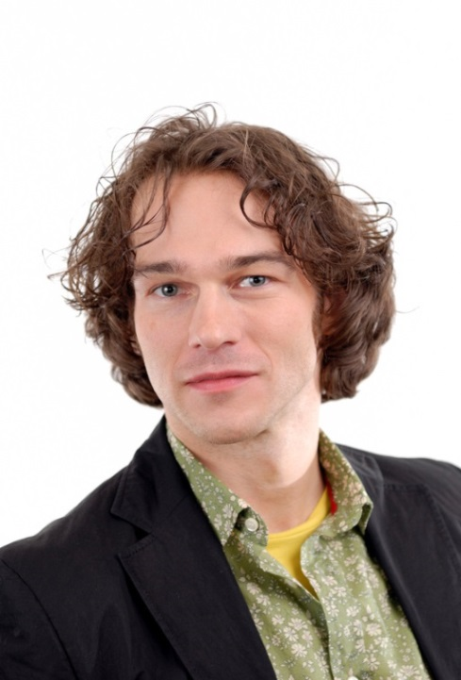

Who Uses Medical Marijuana?
People often prefer using medical marijuana instead of prescription medications
  58% of dispensary patients in Los Angeles said they used marijuana in place of prescription drugs for health problems
  Many people believe that marijuana is more effective than prescription medications, and/or they prefer it because they believe it has fewer side effects
  “I was taking all the prescription medications. I was shaking constantly, and I was taking…a medication (for) a side effect to counteract a side effect”
                -Individual who purchases marijuana at a dispensary in Los Angeles
SOURCES: Reiman, 2009; Bottorff et al., 2011; Nunberg et al., 2011; Grella et al., 2013 (reference list).
Notes:
INSTRUCTIONS
The content on this slide is based on research studying the question of who uses medical marijuana and why. On each slide, follow the following steps: (1) Review the information on the slide; (2) click to advance forward once; (3) Read the quote out loud, which is from a real-life marijuana dispensary patient in Los Angeles.

Slide 62
Who Uses Medical Marijuana?
People often use medical marijuana as a substitute for alcohol or other drugs
Among patients at dispensaries in Los Angles:
  41% used marijuana in place of alcohol
  30% used marijuana in place of other illicit drugs
SOURCES: Reiman, 2009; Bottorff et al., 2011; Nunberg et al., 2011; Grella et al., 2013 (reference list).
Notes:
KEY POINTS
Many individuals who use medical marijuana use it as a substitute for alcohol or other drugs. In Los Angeles, 41% of dispensary patients report using it as a substitute for alcohol, and 30% report using it as a substitute for other illicit drugs.
Additional Information for the Trainer(s)
These findings are important because they suggest that individuals may use medical marijuana as a substitute for alcohol or other drugs; this may be because they recognize that use of these other substances is causing them problems and having negative effects on their health or functioning. Use of marijuana may be viewed as safer and less harmful than these other substances. Yet, it’s unclear whether such individuals are aware of potential problems associated with use of marijuana, particular at a high level of use.

Slide 63
Why do People Use Medical Marijuana?
REASON FOR USE | % REPORTING REASON
Pain Relief | 82.6%
To Sleep | 70.6%
To Relax | 55.6%
Muscle Spasms | 41.3%
Anxiety | 38.1%
To Stimulate Appetite | 38.0%
Nausea | 27.7%
Depression | 26.1%
SOURCE: Reinarman et al., 2011 (reference list).
Notes:
INSTRUCTIONS
When people who go to marijuana dispensaries are asked what marijuana helps them with, these are the answers they give. Review the contents of the table with the audience.

Slide 64
Why do People Use Medical Marijuana?
DISORDER THAT REQUIRES TREATMENT | % CITING AS REASON FOR MJ USE
Chronic Pain | 58.2%
Mental Health Disorders | 22.9%
Sleep Disorders | 21.3%
Neurological Disorders | 16.6%
HIV | 1.6%
Cancer | 1.5%
Glaucoma | 1.3%
SOURCE: Reinarman et al., 2011 (reference list).
Notes:
INSTRUCTIONS
Review the information on the slide, highlighting that these are the disorders people in dispensaries claim are bringing them in for treatment. Click, and “HIV” and “Cancer” will become highlighted. This is important because these are the two conditions that have the strongest base supporting the medical use of marijuana, but they are very low on this list. Most people use marijuana for conditions that do not have very strong research evidence for medical marijuana use.

Slide 65
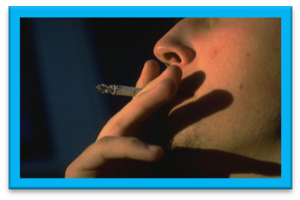
How do People Use Medical Marijuana?
67% of medical marijuana patients use the drug daily
Over 86% smoke the drug
SOURCE: Reinarman et al., 2011 (reference list).
Notes:
KEY POINTS
The vast majority of medical marijuana patients–two-thirds of them–report that they use the drug daily. Over 86% of dispensary patients use the drug by smoking it.

Slide 66

Part III
Medical Marijuana and HIV
Notes:
TRANSITION SLIDE
Part 3 of the training will focus on medical marijuana and use among people living with HIV.

Slide 67
Medical Marijuana and HIV
Between 23% and 56% of people living with HIV/AIDS have used marijuana in the past month
3-8 times more common than in the rest of the population
Most prevalent among young HIV+ gay men
  16% smoke marijuana weekly
  23% smoke marijuana daily
About 16% of HIV+ women use marijuana weekly
SOURCES: Kuo et al., 2004; Prentiss et al., 2004; Bonn-Miller et al., 2012; Bruce et al., 2013 (reference list).
Notes:
KEY POINTS
It is critical for providers working with people living with HIV to be knowledgeable about marijuana because significant numbers of people living with HIV use marijuana. Between 23% and 56% report that they used the drug in the previous month. This is a rate that is 3-8 times as high as the rate among the general population. Rates are highest among young gay men living with HIV—almost ¼ of them smoke marijuana daily. About 16% of women living with HIV use marijuana weekly.

Slide 68
Medical Marijuana and HIV:
What’s the Connection?
Marijuana can help relieve symptoms associated with HIV disease
Marijuana can help HIV+ individuals cope as they learn their diagnosis and engage in treatment
People living with HIV are likely to use medical marijuana for conditions/problems other than HIV
Notes:
KEY POINTS
Several reasons exist for why the rates of marijuana use are so high among individuals living with HIV. Marijuana can help relieve symptoms associated with HIV disease. Marijuana can be used to help individuals cope with the stress of receiving HIV diagnosis. Further, research shows that individuals living with HIV are likely to use medical marijuana not only to treat symptoms of HIV, but other medical conditions and problems, as well.

Slide 69
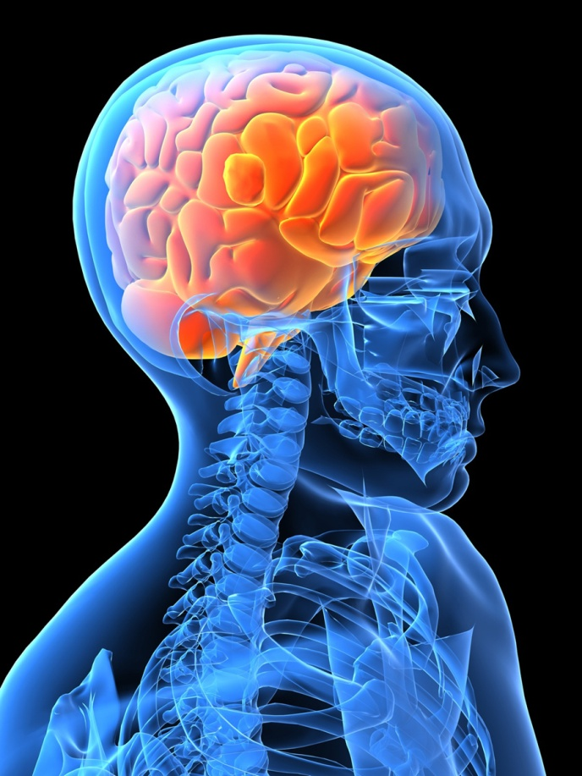
Medical Marijuana and HIV Symptoms: Neuropathy
Neurological complications associated with HIV disease
  Numbness/pain in hands and feet
  Normal stimuli (touch) can cause pain
  In late stages of disease, muscle weakness
  Often described as burning, shooting, tingling, stabbing, or like a vise or electric shock
Can also be a side-effect of antiretroviral medications
Notes:
INSTRUCTIONS
This slide and the three slides that follow address the ways that medical marijuana can be used to address direct symptoms of HIV.
KEY POINTS
One of the more painful symptoms of HIV comes from neuropathy, a set of neurological complications that include the symptoms described on the slide. Neuropathy can also be a side effect of the anti-retroviral medications used to manage HIV.

Slide 70
Medical Marijuana and HIV Symptoms: Neuropathy
Many medications normally used for neuropathy don’t mix well with antiretroviral medications
Marijuana helps dull/relieve feelings of physical pain by 34%
20%-28% of HIV+ individuals who use marijuana report using it as a pain reliever
Over 19% of individuals with neuropathy report using marijuana to manage pain
SOURCES: Furler et al., 2004; Prentiss et al., 2004; Abrams et al., 2007; Nicholas et al., 2010 (reference list).
Notes:
KEY POINTS
Marijuana may be useful for HIV-related neuropathy because many traditional neuropathy medications don’t well with antretrovirals. Marijuana is effective at helping reduce feelings of pain. Between 20% and 28% of individuals living with HIV who use marijuana report using it as a pain reliever. Almost 20% of people living with HIV who have neuropathy report using marijuana to manage pain.

Slide 71
Medical Marijuana and HIV Symptoms: Wasting Syndrome
Loss of 10% or more of body weight plus 30+ days of diarrhea, weakness, or fever
Causes
  HIV disease/infections interfere with nutrient absorption
  People with HIV need more calories than usual to maintain body weight due to increased immune system activity
  Low appetite common with HIV
Can occur even among people whose HIV is well-controlled with medications
Eating enough and getting adequate nutrition is key to avoiding wasting syndrome
Notes:
KEY POINTS
Another symptom of HIV disease that marijuana can help address is wasting syndrome. Wasting syndrome is defined as a loss of 10% or more of body weight plus over 30 days of diarrhea. It is caused by a variety of factors associated with HIV and it symptoms. Wasting syndrome can occur even among people whose HIV is well-controlled with medications. Eating enough and getting adequate nutrition is key to helping avoid wasting syndrome.

Slide 72

Medical Marijuana and HIV Symptoms: Wasting Syndrome
One of the strongest effects of the marijuana “high” is appetite stimulation
  53%-70% of HIV+ individuals who use marijuana report using it to stimulate their appetite
Marijuana also dulls the vomiting reflex
  33%-66% of HIV+ individuals who use marijuana report using it to control nausea
SOURCES: Sidney, 2001; Furler, 2004; Prentiss, 2004 (reference list).
Notes:
KEY POINTS
Marijuana can help address wasting syndrome because of its effect on appetite. As discussed earlier, marijuana stimulates hunger. Between 53% and 70% of people living with HIV report using it to stimulate their appetite. Marijuana also dulls the vomiting reflex. Between 1/3 and 2/3 of individuals living with HIV report using marijuana to control their nausea.

Slide 73
Medical Marijuana and Treatment: Learning HIV Diagnosis
Learning HIV+ diagnosis is jarring for most people
  Stress
  Shock
  Sadness/depression
  Feeling that diagnosis is unreal
Nearly ½ of HIV+ individuals meet criteria for anxiety or depression
Women have more psychological distress adjusting to life with HIV than men
SOURCES: Bing et al., 2001; van Servellen et al., 2002; Hult et al., 2009 (reference list).
Notes:
KEY POINTS
Marijuana can also be used by people living with HIV to cope with the stress of learning their diagnoses. Most people experience stress, shock, sadness, and denial when they learn their diagnosis. Nearly half of individuals living with HIV meet diagnostic criteria for anxiety or depression. Women are at particular risk, as they have more psychological distress and difficulty adjusting to life with HIV than their male counterparts.

Slide 74


Medical Marijuana and Treatment:
Learning HIV Diagnosis
Marijuana a way to cope with/mask feelings associated with adjusting to HIV diagnosis
20%-66% of HIV+ marijuana users report using it to cope with feelings of anxiety and depression
“Since coming up positive, I have really, really retreated from life and the best and most enjoyable way to do that is by smoking lots and lots of weed. Makes time fly, helps sleep, helps eat, makes things that are boring bearable…I don’t want to have to be reminded of it and I am all the time…at least if I stay inside and I’m stoned, being reminded of it won’t be embarrassing, like it would be out in public…and I won’t be potentially putting anyone else at risk” -21 year old HIV+ male
SOURCES: Furler et al., 2004; Prentiss et al., 2004; Corless et al., 2009; Bruce et al., 2013 (reference list).
Notes:
INSTRUCTIONS
(1) Read the two points on the slide, which highlight how individuals living with HIV may use marijuana to cope with or mask feelings associated with adjusting to life with HIV; (2) Click once to advance; (3) Read the quote from a real-life young male describing the way he used marijuana upon learning his HIV diagnosis.

Slide 75
Medical Marijuana and Treatment: Antiretroviral Therapy (ART)
ART can have serious side-effects, including nausea and neuropathy
ART side effects are a major reason people don’t stick with it
If side-effects are well-controlled, likely to remain engaged/adherent in treatment
Marijuana is often used to control ART side effects
  33% of HIV+ marijuana users control nausea with marijuana
  20-28% of HIV+ marijuana users control pain with marijuana
SOURCES: Chesney, 2003 ; Furler et al., 2004; Prentiss et al., 2004 (reference list).
Notes:
KEY POINTS
Another common reason for people living with HIV to use marijuana is to address the side-effects of anti-retroviral therapy, which include nausea and neuropathy. Side effects are a major reason people don’t stick with ART, so it is important to control them in order to help patients remain engaged in treatment. Marijuana is often used to control many of the symptoms that are common side effects of ART, such as nausea and pain.

Slide 76
Medical Marijuana and HIV:
Use For Other Reasons
Rates of HIV high among socioeconomically disadvantaged
  High rates of chronic health problems other than HIV
  Poor access to health care – later diagnosis
  High rates of drug use even prior to HIV infection
Comorbidities common, especially among people living with HIV over age 50
  94% have a chronic condition other than HIV (hypertension, chronic pain, hepatitis, arthritis)
  Self-medicate for physical/mental health symptoms associated with these conditions
SOURCES: Karon, 2001 et al.; Balderson et al., 2013 (reference list).
Notes:
KEY POINTS
Another reason marijuana use may be common among individuals living with HIV is because people with HIV tend to come from socioeconomically disadvantaged groups. This means that they are likely to have high rates of chronic health problems other than HIV, poor access to health care, and high rates of drug use compared to the rest of the population. All of these factors increase the likelihood that individuals living with HIV might use marijuana, either medically or recreationally. Other health problems are common among individuals living with HIV, especially those who are older than 50. Conditions such as hypertension, chronic pain, hepatitis, and arthritis are common among these older individuals living with HIV. It is not uncommon for them to self-medicate for these conditions with medical marijuana.

Slide 77
Who in the HIV Population Uses Marijuana Medically?
People who have chronic health conditions other than HIV/AIDS
People who have tried other alternative therapies
People who have experienced HIV/AIDS-related illness/symptoms
People who suffer from nausea; not as much people suffering from pain
SOURCES: Prentiss et al., 2004; Fogarty et al., 2007; Corless et al., 2009 (reference list).
Notes:
KEY POINT
This is a summary slide that reviews reasons for medical marijuana use among HIV-positive patients.

Slide 78
Why Do People Living With HIV Use Medical Marijuana?
When asked why they use medical marijuana, the most common answers are:
  To relieve anxiety/depression
  To improve appetite
  To relieve pain
SOURCE: Prentiss et al., 2004 (reference list).
Notes:
KEY POINTS
This slide presents data from a 2004 study that interviewed HIV+ individuals who used medical marijuana and asked them why they used it. The three most common answers were a) to relieve anxiety/depression, b) to improve appetite, and c) to relieve pain. It is likely that these will be the most common reasons for marijuana use among people living with HIV today, as well.

Slide 79
Medical Marijuana and HIV:
Is it always the Best Option?
CONDITION | PERCEIVED EFFECTIVENESS OF MARIJUANA COMPARED TO CONVENTIONAL TREATMENT
Anxiety | MJ slightly more effective than antianxiety medication
Depression | Antidepressants slightly more effective than MJ
Nausea | MJ slightly more effective than medication
Neuropathy | MJ slightly more effective than medication
Diarrhea | Medication slightly more effective than MJ
Fatigue | Medication slightly more effective than MJ
All Symptoms | Marijuana slightly more effective
Overall slightly more people living with HIV find marijuana more effective than other treatments; many prefer traditional treatment
There are risks associated with marijuana use for people living
with HIV
SOURCE: Corless et al., 2009 (reference list).
Notes:
INSTRUCTIONS
Review the table on the slide that presents data from an international study (including the US) asking people living with HIV about the relative effectiveness of marijuana and other medications in treating various HIV-related medical conditions and problems. In presenting the table, highlight that there is not strong evidence showing that medical marijuana is more effective than conventional treatments for many of the conditions that individuals living with HIV are likely to use it for. Highlight the following key points.
KEY POINTS
People living with HIV report that marijuana is slightly more effective than regular medication in addressing anxiety, nausea, and neuropathy. However, they also reported that medication was slightly more effective than marijuana at addressing depression, diarrhea, and fatigue. Though marijuana is slightly more effective for some conditions, it is not necessarily more effective than regular medication for all problems. Highlight that for each condition, the difference was only slight and that for many people marijuana may not be significantly more effective, or more effective at all. Given the risks associated with marijuana use, people living with HIV need to balance the potential risks of marijuana use with the potential drawbacks. The following nine slides will explore these risks in detail.

Slide 80
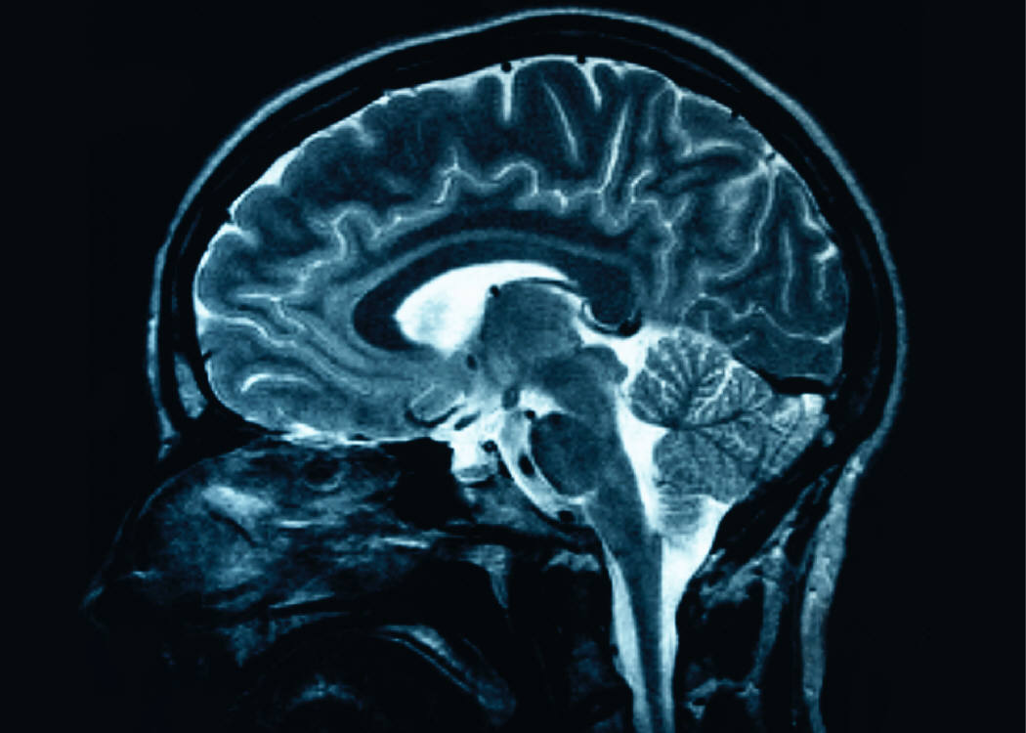
Medical Marijuana and HIV/AIDS: Reasons for Caution
In advanced disease stage, HIV enters nervous system, leading to HIV-Associated Neurocognitive Disorders (HAND)
  Symptoms: Confusion, forgetfulness, headaches
Three main types of HAND
  Asymptomatic Neurocognitive: Impairment: impaired cognitive ability, but able to function
  Mild Neurocognitive Disorder: Impaired cognitive ability, mild interference in daily activity
  HIV-Associated Dementia:
  Major impairments in cognition,
  daily functioning
Notes:
KEY POINTS
One of the major reasons people living with HIV should be cautious with marijuana is because HIV disease can cause HIV-Associated Neurocognitive Disorders (HAND) in advanced stages. The main symptoms of HAND include confusion, forgetfulness, and headaches. Three different types of HAND exist—asymptomatic neurocognitive HAND, mild neurocognitive disorders, and HIV-Associated Dementia.

Slide 81
Medical Marijuana and HIV/AIDS: Reasons for Caution
Long-term marijuana use impairs learning and memory
47% of HIV+ marijuana users report memory problems
Marijuana’s cognitive effects particularly strong for people experiencing HAND
Concern that cognitive impairment may compromise ART adherence
  Forgetting to take medication is the leading cause of ART non-adherence
  Use of most recreational drugs and alcohol is associated with lower ART adherence, less virological suppression, slower CD4 cell response rate
SOURCES: Chesney, 2003; Cristiani et al., 2004; Wooldridge et al., 2005 (reference list).
Notes:
KEY POINTS
Given the effects HIV can have on cognition, people living with HIV should be careful with marijuana, which also affects learning and memory. Almost half of HIV+ marijuana users report having memory problems, and the drug’s cognitive effects may be particularly strong for people experiencing HAND. Cognitive impairment may also compromise adherence to ART, since forgetting medication is the leading cause for ART non-adherence. Research shows that the use of most recreational drugs and alcohol is associated with lower ART adherence, less virologic suppression, and slower CD4 cell response rate.

Slide 82
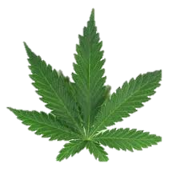
Medical Marijuana and HIV/AIDS: Reasons for Caution
Depending on how it is used, marijuana can lead to better or worse ART adherence
  When used to control nausea, increases ART adherence
  When used for indications other than nausea, associated with non-adherence
  Heavy cannabis use associated with non-adherence
SOURCES: Wilson et al., 2004; De Jong et al., 2005: Corless et al., 2009 (reference list).
Notes:
KEY POINTS
Research shows that depending on how it is used, marijuana can lead to better or worse ART adherence. If used to control nausea, marijuana can actually help improve ART adherence. However, if used for reasons other than nausea or used heavily, it is associated with non-adherence.

Slide 83
Medical Marijuana and HIV/AIDS: Reasons for Caution
Marijuana use is associated with increased occurrence and severity of mental health disorders
  Between one-third and one-half of individuals living with HIV have a mental health and/or substance use disorder
SOURCE: Klinkenberg & Sacks, 2004 (reference list).
Notes:
KEY POINTS
Another reason for caution is that marijuana is associated with increased occurrence and severity of mental health disorders. Individuals living with HIV are already at increased risk for these conditions, as between one-third and one-half have a mental health and/or substance use disorder. Given these risks, it is important for people living with HIV to be careful about behaviors that are risky for their mental health, such as marijuana use.
Additional Information for the Trainer(s)
Mental health problems may precede onset of HIV, or be a consequence of an HIV diagnosis. Research has shown that individuals with serious mental disorders are at higher risk for HIV than individuals without serious mental health disorders. This risk is compounded among individuals with multiple vulnerabilities, such as individuals who are homeless, have a history of trauma or exposure to violence and victimization, or live in poverty. Incidence of HIV is now highest among lower income and minority populations who often face multiple risk factors stemming from poverty, drug abuse, and lack of educational and economic resources.

Slide 84
Medical Marijuana and HIV/AIDS: Reasons for Caution
Marijuana increases risk for pulmonary disease, cardiovascular complications
  People living with HIV have higher rates of pulmonary disease than people without HIV
  HIV increases risk of cardiovascular disease
  ART associated with increased risk for cardiovascular complications
SOURCES: Crothers et al., 2006; Currier et al., 2008 (reference list).
Notes:
KEY POINTS
Marijuana can also be risky for people living with HIV because it increases risk for pulmonary disease and cardiovascular complications. These are conditions that people living with HIV are particularly at risk for, as well; they have higher rates of pulmonary disease and cardiovascular disease than people who do not have HIV. Furthermore, ART increases risk for cardiovascular complications. Given these risks, it is important for people living with HIV to be careful about behaviors that are risky for their pulmonary or cardiovascular health, such as marijuana use.

Slide 85
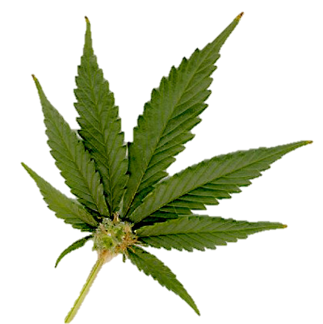
Medical Marijuana and HIV/AIDS: Reasons for Caution
People who use marijuana are more likely to use alcohol and tobacco
  Heavy alcohol use associated with decreased ART uptake, ART adherence, and viral suppression
  Tobacco increases risk of HIV-related oral lesions
  People living with HIV at increased risk for tobacco-related pulmonary disease
SOURCES: Palacio et al., 1997; Chandler et al., 2006; Crothers et al., 2006 (reference list).
Notes:
KEY POINTS
Marijuana can also cause problems for individuals living with HIV because its use is associated with alcohol and tobacco use. Heavy alcohol use is associated with decreased uptake and adherence to ART and decreased viral suppression, while tobacco increases risk for HIV-related oral lesions. People living with HIV are also at increased risk for tobacco-related pulmonary disease compared to the rest of the population.

Slide 86
Medical Marijuana and HIV/AIDS: Reasons for Caution
The psychoactive effects of marijuana can be strong, especially for people who aren’t used to them
“The ‘high’ for one class of users is the ‘acute toxic effect’ for another”
Mean concentration of THC has increased dramatically in recent years; long-term effects may be intensified
SOURCE: Bostwick, 2012 (reference list).
Notes:
KEY POINTS
For people living with HIV who have little experience using marijuana, the psychological effects of the drug may feel particularly strong and uncomfortable. What feels like a “good high” for someone who is used to using marijuana can feel like a “toxic effect” for someone not used to the drug. The risk of adverse effects is particularly great because marijuana has become much more potent in recent years. The long-term effects of the drug and the problems it can cause, therefore, may be more intense now than they were in the past.

Slide 87
Medical Marijuana and HIV/AIDS:
Reasons for Caution
Medical marijuana is not standardized the way other medications are
  When patients use marijuana, it’s unclear what they’re actually ingesting
  No current regulations to ensure product safety, quality control
Medical marijuana is currently illegal under federal law
Notes:
KEY POINTS
Other factors that make medical marijuana risky for individuals living with HIV are similar to those that make it risky for everyone else; it is not standardized, it is unclear what patients ingest when they use medical marijuana, and there are currently no regulations to ensure product safety or quality control. Another risk is the legal ramifications of getting caught using or in possession of marijuana, because marijuana is still illegal under federal law.

Slide 88
Medical Marijuana and HIV/AIDS: Reasons for Caution
People with HIV are living longer now because of early identification and effective therapies
  A chronic disease that can be managed, not necessarily a terminal illness
People with HIV should be concerned about their long-term health just like everyone else
Dependence on marijuana poses a risk to physical and mental health for everyone, whether or not they are HIV+
Notes:
KEY POINTS
In addition to the reasons listed above, people living with HIV should now be concerned with the risks associated with medical marijuana for everyone else. People living with HIV can manage the disease and live long lives, so they need to be concerned with their long-term health and well-being, just like everyone else. Dependence on marijuana poses a risk to physical and mental health for everyone, whether or not they are living with HIV.

Slide 89
Medical Marijuana and HIV/AIDS:
What is Your Experience?
What do you Think?
Have you had patients discuss medical marijuana with you before?
Did it seem to help them or make things worse?
Based on your experience and your knowledge of the benefits/risks, what do you think of HIV patients using medical marijuana?
Notes:
INSTRUCTIONS
Take 5-10 minutes to review the questions on the slide in an open discussion with the audience.

Slide 90

Part IV
Medical Marijuana and HIV – What to do about it
Notes:
TRANSITION SLIDE
Part 4 of the training will focus on strategies that HIV providers can use when working with patients who are either using medical marijuana or considering using medical marijuana.

Slide 91
If Patients are Using Marijuana
Screen for signs of abuse/dependence
  Tolerance/withdrawal
    Anger or Aggression
    Decreased Appetite / Weight Loss
    Irritability
    Nervousness / Anxiety
    Restlessness
    Sleep Difficulties / Strange Dreams
SOURCE: Budney et al., 2004 (reference list).
Notes:
KEY POINT
If providers have patients who are using marijuana, they should screen for signs of abuse and dependence. Several signs of abuse/dependence are listed on the slide.

Slide 92
If Patients are Using Marijuana
Other signs of abuse/dependence
  Preoccupation
  Loss of control
  Continued Use in the face of adverse consequences
  Cognitive Distortions/Denial
SOURCE: Budney et al., 2004 (reference list).
Notes:
KEY POINT
If providers have patients who are using marijuana, they should screen for signs of abuse and dependence. Several signs of abuse/dependence are listed on the slide.

Slide 93
If Patients are Abusing/Dependent on Marijuana
Motivational Interviewing
Refer to specialty SUD services
  Motivational Enhancement Therapy
  Cognitive Behavioral Therapy
  Contingency Management
  Family-based Treatment
Notes:
KEY POINTS
If patients screen positive for abuse or dependence on marijuana, HIV providers should use motivational interviewing techniques to help patients reach a point where they are ready to change their substance use behaviors. Some patients may need referral to specialty SUD services for their marijuana use. These services could include, among other things, motivational enhancement therapy, cognitive behavioral therapy, contingency management, and family-based treatment.
Additional Information for the Trainer(s)
Motivational interviewing (or motivational enhancement therapy) is a method for eliciting the patient’s own concerns about their substance use and ways that it may interfere with their own goals and objectives. It is non-confrontation and based on a model that change occurs along a continuum and that the intervention should be tailored to the individual’s current stage of “readiness to change.”

Slide 94

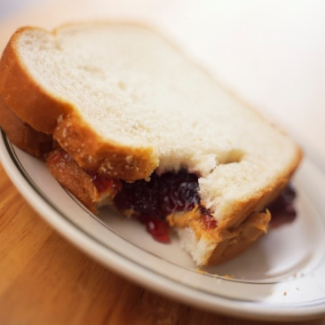

If Patients are not Abusing/Dependent: Three Steps
  Decisional Balance
  Feedback Sandwich
  Explore options
Notes:
KEY POINTS
This slide provides an overview of a three-step process HIV clinicians can use when working with patients who are using marijuana, but do not have marijuana use disorders. The first step is the decisional balance, the second step is the feedback sandwich, and the third step is exploring options. Teach of these steps will be described in detail in the following slides.

Slide 95
1. Decisional Balance
Have patient explore what they perceive to be the benefits/costs of using medical marijuana
The good things about marijuana
The not- so-good things about marijuana
The good things about changing
The not-so-good things about changing
Notes:
KEY POINTS
The decisional balance is a tool that can be used to help patients explore the perceived costs and benefits of marijuana use in a chart similar to the one on the slide. The two squares on the top of the chart capture the perceived benefits and drawbacks of patients’ current marijuana use. The squares on the bottom capture the perceived benefits and drawbacks of changing marijuana use behaviors. Upon completion of this exercise, providers should summarize the pros and cons of patient’s current marijuana use behaviors and potential behavior change with them. Providers need to be sure to use patients’ exact words to reflect what they said during the course of the exercise, and not add their own opinions or pros/cons to the summary.

Slide 96

2. Feedback Sandwich
Ask permission to give patient feedback on how marijuana may be affecting his/her health
Give feedback
  Acknowledge pros/cons patients mentioned
  Mention concerns about marijuana’s effects as they pertain to the patient (physical/behavioral health issues, regulatory/legal issues)
  Present information in a non-judgmental manner
Ask for patient response to feedback
Notes:
KEY POINTS
The second step in this process is the use of the “feedback sandwich,” which consists of three parts. First, ask the patient’s permission to give feedback on how marijuana may be affecting his/her health. It is important that if the patient says no, to respect their wishes, and come back to this exercise at a later time when they are more receptive to your feedback. Second, give feedback; acknowledge the pros and cons the patient mentioned, mention your concerns about marijuana that pertain to the patient (physical effects, mental health effects, legal risks). Throughout, be sure to present all information in a non-judgmental manner. Third, ask the patient for their response to your feedback.

Slide 97
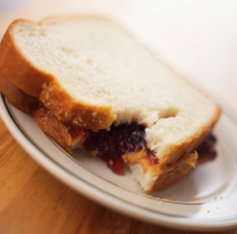
Decisional Balance/Feedback Sandwich: Role Play
  1. Decisional Balance
  2. Feedback Sandwich
  3. Explore options
Do this
Notes:
INSTRUCTIONS
Split the room into groups of two or three, and have them role play for a total of 10 minutes, with one person playing the role of provider and another person the role of patient who reports using medical marijuana. Participants in the “provider” role should use the Decisional Balance and Feedback Sandwich approaches to discuss marijuana use with participants in the “patient” role. After 5 minutes, have participants switch roles. When providing feedback, participants should refer to the information presented earlier in the presentation. Ask participants to keep the questions on slide 98 in mind as they do the role play.

Slide 98
Decisional Balance/Feedback Sandwich:
Role Play
How did it make you feel discussing marijuana use? How did it make you feel being asked?
What strategies did you use to get patient permission to give feedback about marijuana use?
How did you assure that you weren’t being judgmental when you presented your concerns about marijuana use?
How can you incorporate this knowledge into the way you talk about these issues with your patients?
Notes:
INSTRUCTIONS
At the conclusion of the exercise, reconvene the group and discuss their experiences for 5-10 minutes, using the questions on the slides as prompts. Write down responses on white board/flip chart during the course of the discussion.

Slide 99

3. Explore Options
If Steps 1 and 2 show that reducing marijuana use would benefit patient, explore additional strategies to achieve symptom relief
  Behavioral interventions
  Pharmacological
  interventions
  FDA-approved THC
  medication (Marinol ®)
More Marijuana
More Options
Notes:
KEY POINTS
The third step when working with patients who are using medical marijuana is to explore options if Steps 1 and 2 show that reducing marijuana would benefit the patient. This involves exploring additional strategies to achieve symptom relief, such as behavioral intervention, pharmacological interventions, and the use of FDA-approved THC medications. These options are explored in detail on the following slides.

Slide 100
Additional Strategies to Address
Anxiety/Depression
Most common reason people living with HIV report using medical marijuana is to cope with anxiety/depression
Diagnosis
  There is no biological “test”
  Through observation and interview
  Criteria laid out in the American Psychiatric Association’s Diagnostic and Statistical Manual of Mental Disorders
Notes:
KEY POINTS
One of the most common reasons people living with HIV report using medical marijuana is to cope with anxiety and depression. These patients may benefit from receiving appropriate mental health treatment. The first step to appropriate mental health treatment is diagnosis. No test is available to prove a diagnosis of anxiety or depression; rather, they are diagnosed through observation and interview, using criteria laid our in the APA’s Diagnostic and Statistical Manual of Mental Disorders (DSM).

Slide 101
Additional Strategies to Address Anxiety/Depression
Psychotherapy and group therapy
  Talk to learn about mental health conditions, moods, thoughts, and behavior
  Learn better coping and stress-management skills
Medications
  Antidepressants and anti-anxiety medications
  Work by altering neurotransmitter activity
Notes:
KEY POINTS
For individuals with anxiety and depression, treatment often involves the use of therapy, either individually or in groups. The main point of therapy is to learn about mental health conditions, and how the symptoms affect mood, thoughts, and behaviors. With this knowledge, patients can then learn better coping and stress-management skills. Some individuals with anxiety and depressions also benefit from the use of medications that treat depression and anxiety by altering neurotransmitter activity.

Slide 102
Additional Strategies to Address Nausea
Nausea often occurs in the first few weeks on many HIV medications
  Could be a sign of more serious problems; give proper evaluation of other causes
  If caused by medications, it may pass in a few weeks
Diet
  Eat small frequent meals and snacks
  The BRATT diet
    Bananas
    Rice
    Apple sauce
    Tea
    Toast
Notes:
KEY POINTS
For patients who use marijuana for nausea, it is important to evaluate whether nausea is an indicator of a more serious problem, or if it is being caused by antiretroviral medication (in which case it should pass within a few weeks). Changes to diet can help address nausea. Patients experiencing nausea should try to eat small and frequent meals, and stick with the “BRATT diet” (Bananas, Rice, Apple sauce, Tea, and Toast).

Slide 103
Additional Strategies to Address Nausea
Diet
  Dry crackers can help reduce nausea. Keep them by bed.
  Herbal tea (peppermint, ginger)
  Cold carbonated drinks (ginger ale, Sprite)
  Things to avoid:
    Alcohol
    Aspirin
    Caffeine
    Smoking
    Hot and spicy food
    Greasy/fried foods
Notes:
KEY POINTS
Other strategies to reduce nausea include eating dry crackers; patients should keep them near their bed in case they need them. Herbal teas and cold carbonated non-caffeinated drinks can also help stave off nausea. Patients should avoid things that can trigger nausea, such as alcohol, aspirin, caffeine, smoking, hot/spicy food, and greasy/fried food.

Slide 104
Additional Strategies to Address Nausea
Other tips
  When cooking, open windows so smell of food isn’t too strong
  Don’t lie down immediately after eating
  If vomiting does occur, refuel body with fluids (broth, carbonated beverages, juice, popsicles)
Notes:
KEY POINTS
Other tips to address nausea include keeping windows open so the smell of food doesn’t get too strong and to avoid lying down after eating. If vomiting does occur, patients should try to refuel their bodies quickly with fluids to replenish lost electrolytes.

Slide 105
Additional Strategies to Address
Nausea
Anti-emetic medications
  If nausea is related to taking medications, can be given approx. 30 minutes beforehand
  Effective medications include:
    Promethazine (Phenergan®)
    Prochlorperazine (Compazine®)
    Lorazepam (Ativan®)
  Doctor or pharmacist should be consulted to avoid negative medication side effects, negative interactions with HIV medications
Notes:
KEY POINTS
Some patients may benefit from anti-emetic medication, which helps avoid nausea, especially if they get nauseous when they take their HIV medications. For these patients, it is best to take anti-emetic medications thirty minutes before taking HIV medications. Some of the effective medications include promoethazine, prochlorperazine, and lorazepam. A doctor or pharmacist should always be consulted before taking anti-emetic medications, in order to avoid negative side effects or negative interactions with HIV medications.

Slide 106
Additional Strategies to Address Neuropathy and Pain
Non-pharmacological options:
  Physical therapy
  Exercise
  Relaxation techniques
  Guided imagery
  Massage
  Biofeedback
  Acupuncture
  Hot/cold compresses
  Deep breathing
  Meditation
  Hypnosis
  Distraction
Notes:
KEY POINT
This slide lists options other than medication that can be used to address neuropathy and pain that patients with HIV may experience and manage with marijuana.

Slide 107
Additional Strategies to Address
Neuropathy and Pain
Pharmacological options
  Mild pain
    Acetaminophen, nonsteroidal antinflammatory drugs (NSAIDs), cyclooxygenase-2 (COX-2) inhibitors
  Moderate pain
    Combination of mild pain medications with opioids (e.g. oxycodone or tramadol combined with NSAIDS)
  Severe pain
    Opioid agonist drugs
Medications for moderate/severe pain can be abused, and use needs to be monitored closely
Notes:
KEY POINTS
Some patients may also benefit from the use of medications to manage pain. Depending on the severity of patients’ pain, treatment with different types of medications (listed on the slide) may be appropriate. Medications that include opioids and opioid agonists have the potential to be abused, so their use needs to be closely monitored by the prescribing physician.

Slide 108
Additional Strategies to Address
Sleep Difficulties
Sleep is the second most common reason for medical marijuana use for among general population
Tips to help with sleep:
  Go to bed and wake up the same time every day
  Avoid caffeine and nicotine
  Avoid alcohol, large meals, and beverages before bed
  Don’t exercise late in the day
  Relax before bed (hot bath)
  Create a good sleeping environment without distractions (avoid noise, bright lights, TV/computer
  in bedroom)
Notes:
KEY POINTS
A major reason people report using medical marijuana is to help them sleep. The tips listed on the slide can help patients sleep better if they use medical marijuana for this purpose.

Slide 109
THC Medications
Dronabinol (Marinol®)
  Comes in capsules
  Is on Medi-Cal formulary
  Generally start by taking before lunch
  and dinner
  Can exacerbate mental health problems
Notes:
KEY POINTS
Some patients with HIV may benefit from the THC medication Marinol®. The medication comes in capsules, and is available on the Medi-Cal formulary. Generally Marinol® is used to stimulate the appetite and avoid nausea; patients usually began their course by taking it before lunch and dinner. One risk of Marinol® is that it can exacerbate mental health problems.

Slide 110
THC Medications
  Dronabinol (Marinol®)
    Should not be used while drinking alcohol or taking other drugs that affect the central nervous system
    Use of marijuana while taking dronabinol can lead to overdose
    Can cause feelings of marijuana high
    Can cause dizziness, confusion, sleepiness
Notes:
KEY POINTS
Marinol® is made from marijuana, so it should not be used while also using marijuana; this can lead to an overdose. Patients using Marinol® should also avoid alcohol and other drugs that affect the central nervous system. Marinol® can have effects similar to marijuana, including feeling “high”, dizzy, confused, and/or sleepy.

Slide 111
Take-Away Points
Marijuana is a potentially dangerous drug, with potentially serious physical and mental health consequences
Unlike other medicines, marijuana has not undergone FDA testing for safety and efficacy
Since not formally regulated by the FDA, there is no way to know what is actually in the marijuana
Though legal under several states’ laws, medical marijuana is illegal under federal law
Notes:
INSTRUCTIONS
Review the take-away points on the slide.

Slide 112
Take-Away Points
Medical marijuana provides real relief for several problems that patients living with HIV face
However, marijuana is not clearly superior to other, safer treatments for problems patients living with HIV have
Providers should educate patients about the risks associated with medical marijuana, and alternatives to its use
Notes:
INSTRUCTIONS
Review the take-away points on the slide.

Slide 113
Take-Away Points
Providers need to be aware of the signs of abuse/dependence, and know what to do if they identify it
Providers should weigh pros and cons of marijuana use with their patients, and educate them about potential risks of use
If the costs of marijuana use outweigh the benefits, providers should work with patients on additional strategies to manage symptoms and discomfort
Notes:
INSTRUCTIONS
Review the take-away points on the slide.

Slide 114
What Did You Learn?
Notes:
INSTRUCTIONS
The purpose of the following three questions is to see how much the audience learned about the factual questions that were first queried at the beginning of the training.

Slide 115
#1: Marijuana has been shown to harm developing fetuses
True
False
Notes:
ANSWER KEY
#1 – correct response is A (True)

Slide 116
#2: Marijuana is better than medicine for HIV-related symptoms
True
False
Not necessarily
Notes:
ANSWER KEY
#2 – correct response is C (Not necessarily)

Slide 117
#3: If you are caught with marijuana in California and claim you are using it for medical reasons, you cannot be arrested
  True
  False
  It depends who catches you
Notes:
ANSWER KEY
#3 – correct response is C (It depends who catches you)

Slide 118
#4: Marijuana is proven to be effective in treating symptoms associated with HIV
True
False
Unsure
Notes:
ANSWER KEY
#4 – correct response is A (True)

Slide 119

Questions?
Notes:
INSTRUCTIONS
Entertain any final questions from the audience.

Slide 120


THANK YOU FOR YOUR TIME!
For more information:
Tom Freese: tfreese@mednet.ucla.edu
Beth Rutkowski: brutkowski@mednet.ucla.edu
Maya Talisa Gil-Cantu: maya@HIVtrainingCDU.org
Pacific Southwest ATTC: www.psattc.org
PAETC Training calendar: www.HIVtrainingCDU.org
Notes:
FINAL SLIDE
This concludes the presentation. Thank the participants for their time and address any last-minute questions about the content. Encourage participants to reach out to the Pacific Southwest ATTC or Pacific AETC, should they have questions or concerns following the training session.

