Slide 1
California DHCS Recovery Incentives Program
Web Portal Training Document
reSET®, reSET-O® and Q2i Q2ieutics® are trademarks of Q2i Q2ieutics (US), Inc. © 2022 Q2i Q2ieutics (US), Inc. All rights reserved.

Slide 2

Table of Contents
CALIFORNIA DHCS CONTINGENCY MANAGEMENT PILOT PROGRAM
Q2i IM Web Portal Overview
Know Your Portal Role
Password Creation and Log-In
Managing Members (e.g., tracking progress, logging UDT results)
Managing Incentive Rewards
Analytics and Reports
Help Center and Support

Slide 3
Q2i IM
Web Portal Overview

Slide 4
Q2i
Web Portal Overview
Who is Q2i?
What is our role in this program?
Q2i is a digital health company focused on innovation, development, and supplying evidence-based technology that improves treatment for Substance Use Disorder (SUD).
Our mission is to design, develop, and supply the most advanced technologies that enable care teams to improve the success of their Substance Use Disorder treatment programs and interventions.
Our solutions consist of patient mobile applications connecting to a health care team portal.
Q2i improves connection, communication, support, and insight while increasing availability, accessibility and program success.
Q2i’s technology-enabled contingency management solutions are a significant scientific and clinical advancement that improves treatment for SUD.
Q2i will configure, delivery, and implement a
web-based, provider-facing portal that will support
this pilot program.
Q2i will train DHCS, Counties, Providers, and CM coordinators on the use of this portal.
Q2i will further support stakeholders through trainings, troubleshooting, and a support center accessible
via telephone.
Q2i will support Counties and Providers in accessing and analyzing data from this program to support
better outcomes.
Q2i’s California-based teams are available to Counties and Providers for education, training, and support.

Slide 5

Q2i Incentive Manager Portal
Web Portal Overview
Design Specifications
Accessibility through all modern web browsers – Chrome, Safari, Edge, and other Chromium-based browsers.
UDT information captured and archived for reporting and analysis
Automated incentive determination and distribution based upon
UDT events configured specifically to the DHCS Program rule sets
Comprehensive and extensible demographics and
program data capture
Highly extensible program reporting and business intelligence
Strict compliance with industry information security and privacy standards (e.g., NIST SP 800 Standards, FIPS 140-2 encryption standards via AES-256 encryption, etc.).
5

Slide 6
Q2i Incentive Manager Portal
Web Portal Overview
Privacy, Security, and Compliance
Privacy
Security
Compliance
Monitor platform with Netskope to identify and block any privacy data (PII / ePHI) data at rest or in transit and Spirion for data leakage
Follow federal guidelines data transfers requiring a secure transfer (encryption) and access control.
Monitor critical data transfer internally and externally using state of the art surveillance software
HIPAA attestations with annual external 3rd party review of information systems to validate via penetration tests
Follows NIST 800-53 and Defense in Depth frameworks
Monitored with CrowdStrike
SOC (24/7/365)
Monitor platform for compliance NIST (42CFR) and HIPAA Compliance using SecureFrame
Platform hosted on FedRAMP compliant AWS instance
FedRAMP compliant call center technology and service

Slide 7

Q2i Incentive Manager Portal
Web Portal Overview
Incentive Mechanics
UDT results are entered
System automatically assesses
member-specific circumstances
System automatically applies correct incentive amount
Incentive amount is “dispatched” meaning CM coordinator can select delivery method for member
Incentive transaction is logged
CM coordinator inputs UDT results into incentive manager
Incentive manager calculates incentive amount
Incentive manager securely stores UDT results and incentive information
Incentive manager disburses incentives (e.g., e-mail or printed hard copy)
Incentive manager compiles reports for providers, county representatives and DHCS

Slide 8
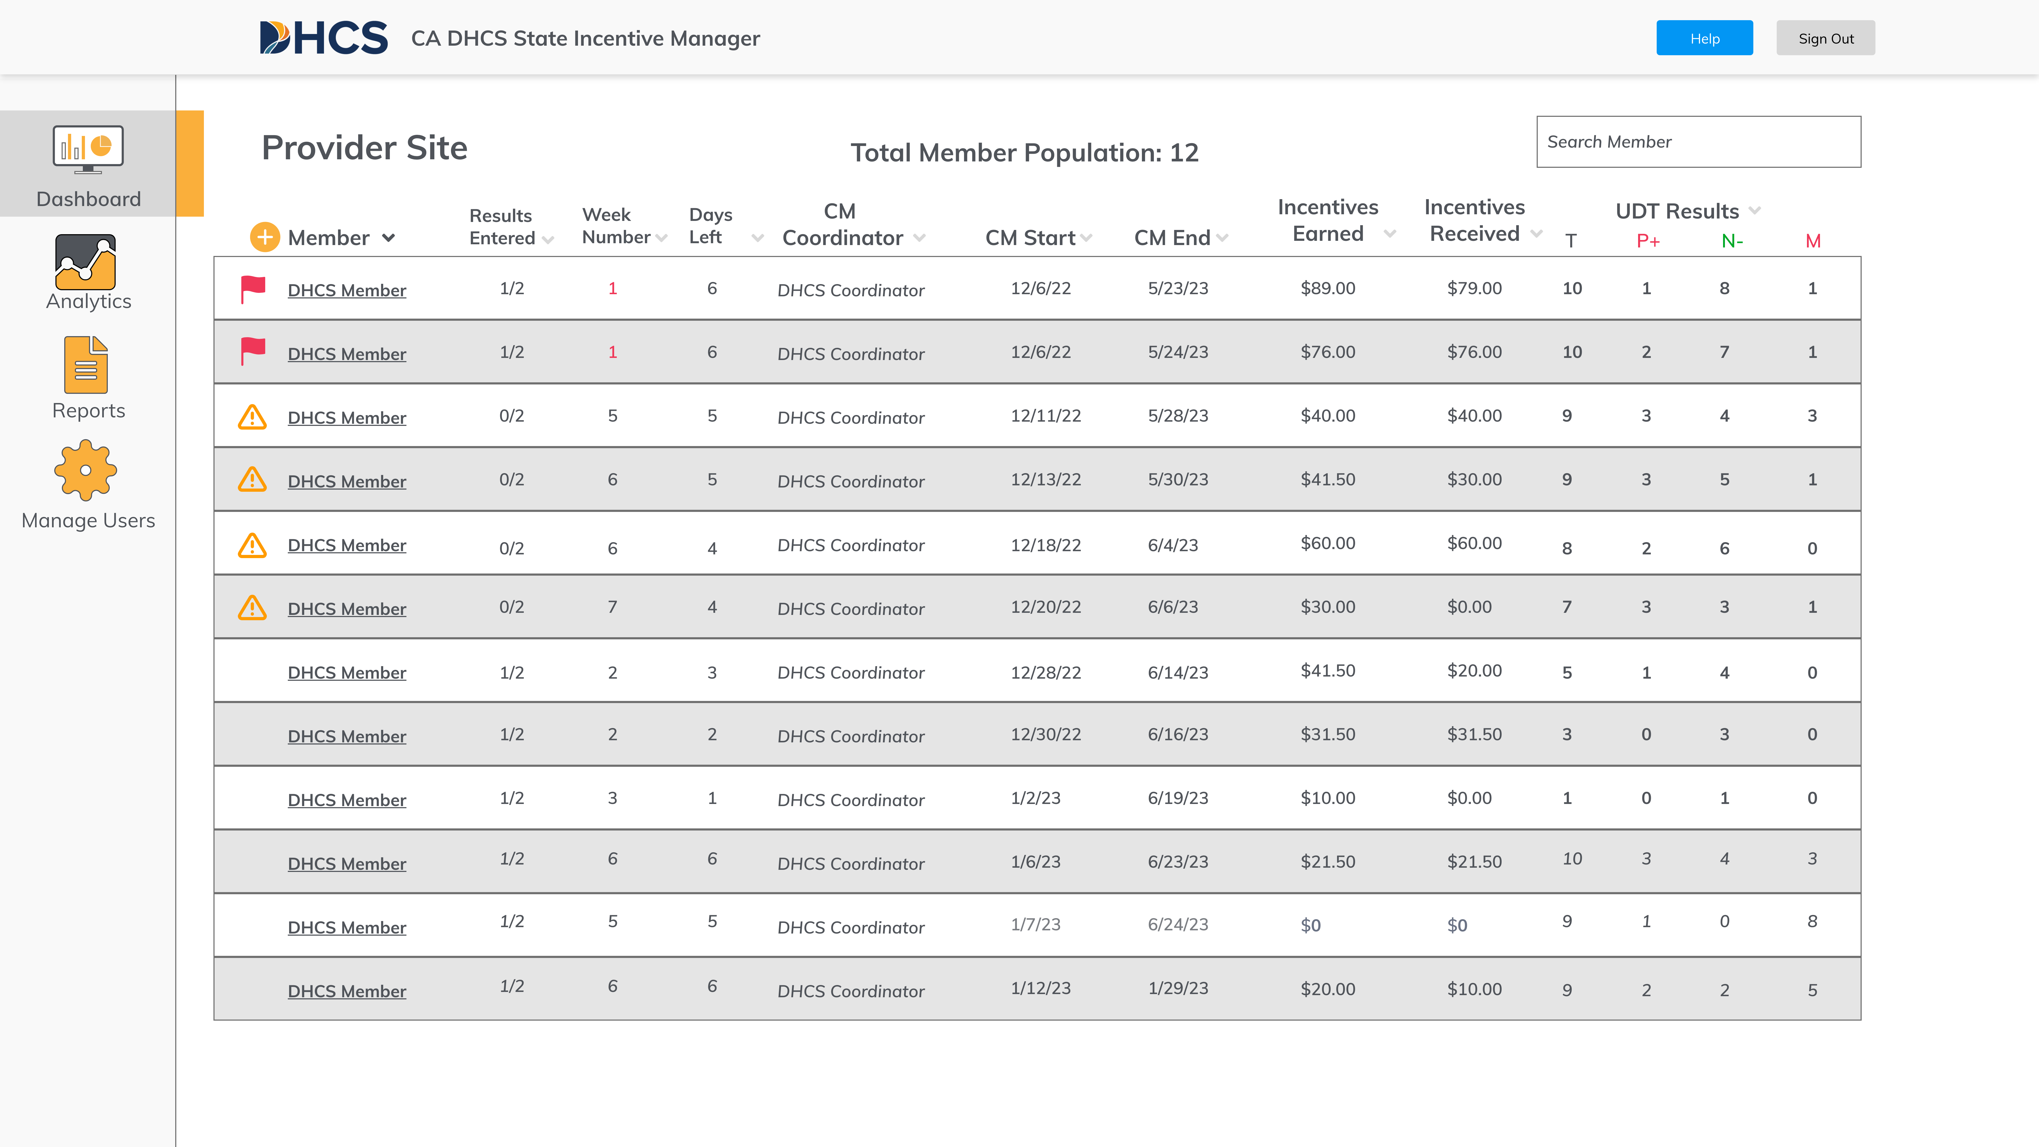
Q2i Incentive Manager Portal
Web Portal Overview
Key User Activities
DASHBOARD
Adding new users into the program
Managing member progress
Logging UDT results or absences
Calculating, Offering, and Dispensing
incentive rewards
Total Member Population: 12
Member
ANALYTICS
Generating and Analyzing population-level
analytics related to member progress
REPORTS
Compiling and Downloading standard reports for Counties and Provider organizations

Slide 9
Know your Portal Role

Slide 10
User Roles
Know your Portal Role
Overview
Stakeholder | Role | Eligibility Approver
DHCS Leadership | DHCS User | N/A
DHCS Administration | DHCS User | N/A
County Leadership | County User | DHCS
County Administrator | County User | DHCS
CM Supervisor | CM Coordinator | Q2i, DHCS or County
CM Coordinator | CM Coordinator | Q2i, DHCS or County
Backup CM Coordinator | CM Coordinator | Q2i, DHCS or County
Q2i | Administrator | Q2i
Support Team | Administrator | Q2i
Note: Members do not have roles in the system. Members are managed by CM coordinators

Slide 11

User Roles
Know your Portal Role
Access Rights
 |  | USER ACCOUNT CREATION |  |  |  | MEMBER MANAGEMENT |  |  |  |  |  | ANALYTICS AND REPORTS
 |  | DHCS | County | CM Coordinator |  | Add new member | Change member site / county | View Progress | Log UDT results | Dispense Incentives |  | State-level | County-level | Site-level
Admin
DHCS
County
CM Supervisor / Coordinator

Slide 12
User Roles
Know your Portal Role
Admin / DHCS
 |  | USER ACCOUNT CREATION |  |  |  | MEMBER MANAGEMENT |  |  |  |  |  | ANALYTICS AND REPORTS
 |  | DHCS | County | CM Coordinator |  | Add new member | Change member site / county | View Progress | Log UDT results | Dispense Incentives |  | State-level | County-level | Site-level | Member-level
DHCS
Who are you
What is your responsibility?
What are your access rights?
Q2i, DHCS leadership or DHCS administration
DHCS contractor (given DHCS leadership approval)
Managing the program
Assessing program outcomes
Monitoring for fraud, waste
and abuse
Creation of new users (except DHCS roles)
Addition or changes to member information
(i.e., changing site)
View all information related
to program

Slide 13
User Roles
Know your Portal Role
County
 |  | USER ACCOUNT CREATION |  |  |  | MEMBER MANAGEMENT |  |  |  |  |  | ANALYTICS AND REPORTS
 |  | DHCS | County | CM Coordinator |  | Add new member | Change member site / county | View Progress | Log UDT results | Dispense Incentives |  | State-level | County-level | Site-level | Member-level
County
Who are you
What is your responsibility?
What are your access rights?
County health leader or administrator
County leader (given DHCS leadership approval)
Build network providers
Participate in required trainings
Collect information from participating providers
Work with the State’s training
and technical assistance provider
to complete readiness and
fidelity reviews
Creation of CM coordinator users
Addition or changes to member information (i.e., changing provider)
View county-level, site-level and member-level information

Slide 14
User Roles
Know your Portal Role
CM Supervisor / Coordinator
 |  | USER ACCOUNT CREATION |  |  |  | MEMBER MANAGEMENT |  |  |  |  |  | ANALYTICS AND REPORTS
 |  | DHCS | County | CM Coordinator |  | Add new member | Change member site / county | View Progress | Log UDT results | Dispense Incentives |  | State-level | County-level | Site-level | Member-level
CM Supervisor / Coordinator
Who are you
What is your responsibility?
What are your access rights?
Licensed Practitioners of the Healing Arts (LPHAs) or Certified Peer Support Specialists
Substance use disorder (SUD) counselors that are certified / registered by a DHCS recognized organization and accredited with the National Commission for Certifying Agencies
Other trained staff under supervision of an LPHA
Collect CM services consent and enter member information
Collect and enter urine drug test (UDT) results and ensure delivery of incentive to member
Communicate with clinical staff regarding UDT results and any information of clinical relevance
Refer Members to treatment and recovery staff for follow-up
Create new member account
Manage member progress
and log UDT results
Select and dispense
incentive awards
View member level information

Slide 15
Password Creation and Log-In

Slide 16
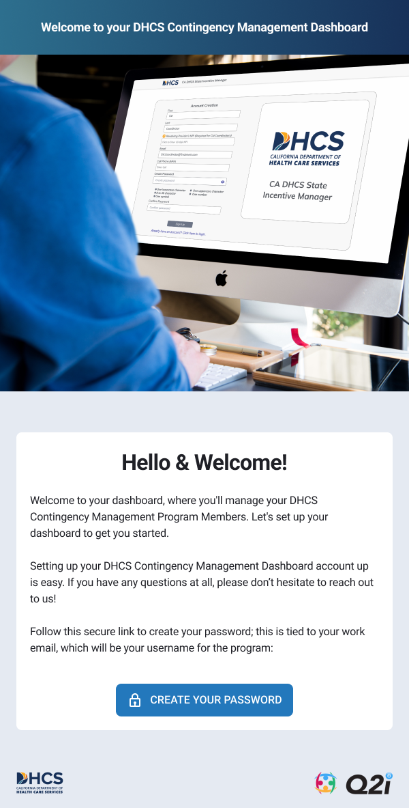
Welcome E-mail
Password Creation and Log-In
All
Each new user will receive a specific welcome email (not applicable to Members)
The email will introduce the user to the service
It will provide a unique link to create
a new password
This link will take you to a password creation page (see next page)
Please note this unique link will provision
access right as defined by user role.
Note: This link expires after 72 hours for security purposes.

Slide 17
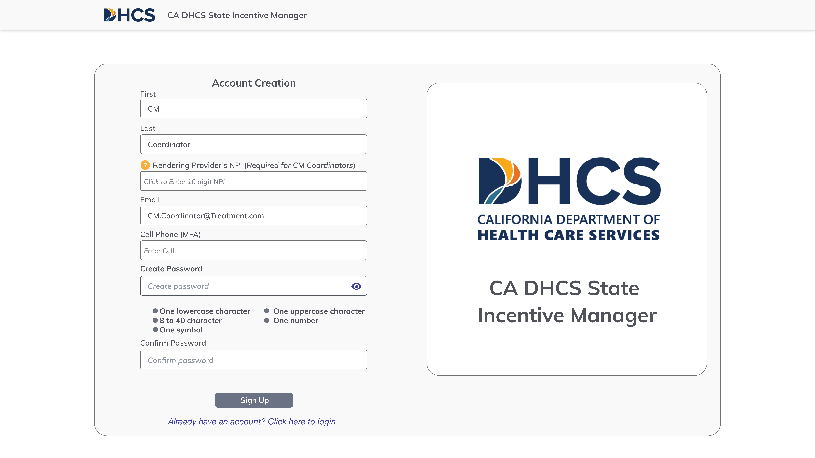
Password Creation
Password Creation and Log-In
All
Usernames will be the email address provided upon account creation
Passwords must comply with the following requirements:
  Contain at least 8 characters
  capital letter
  Number
  special character such as “$”

Slide 18
Managing Members

Slide 19
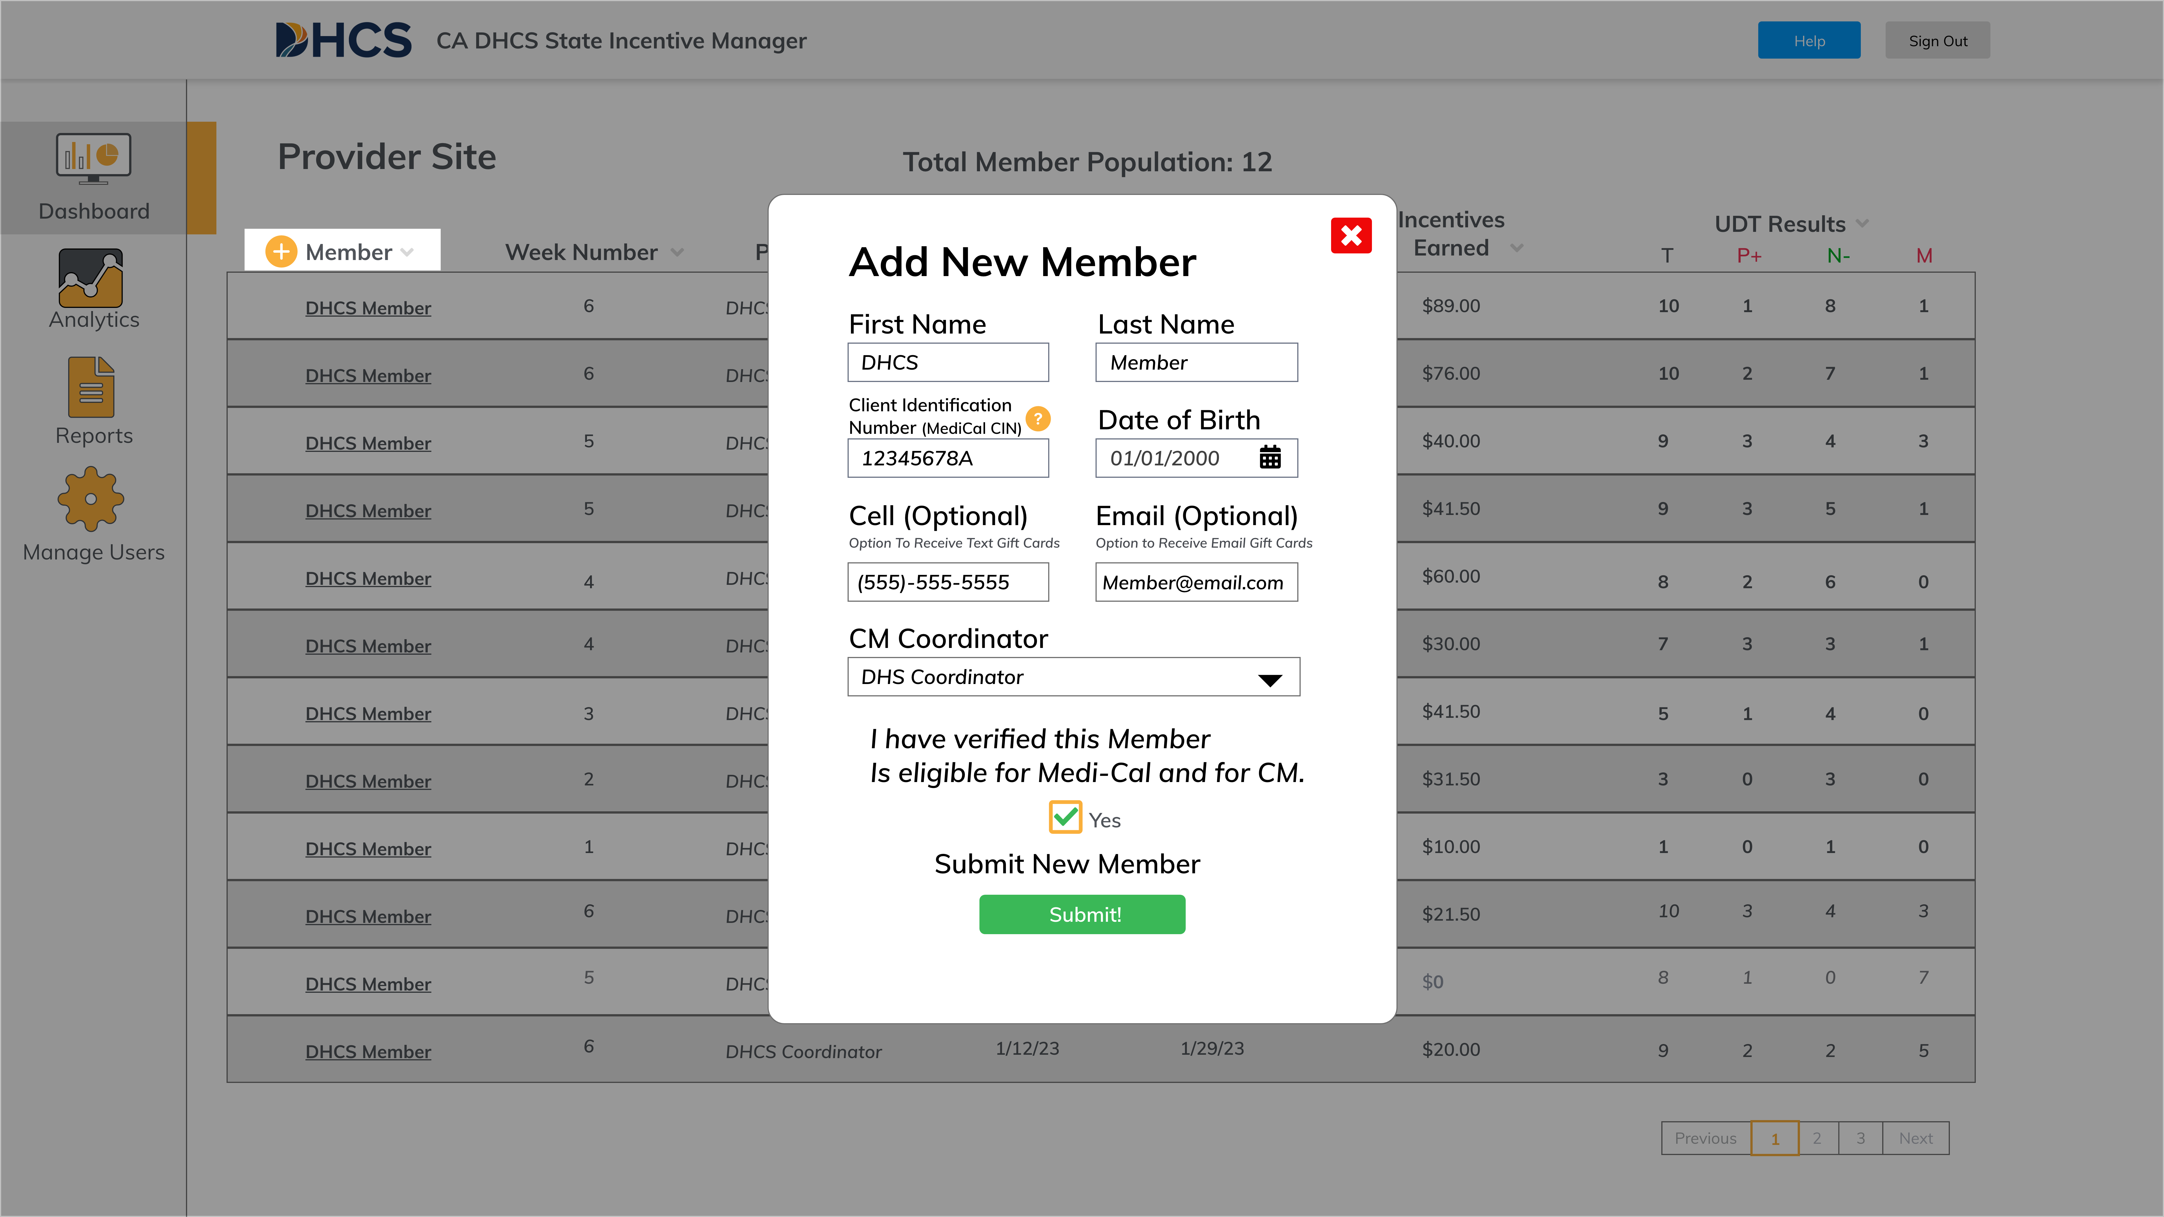
MEMBER
Managing Members
CM Coordinator
Open “dashboard pane”
Click “ ” button which is to the left of
“member” on the top of the data table
Input required patient information*
(including CIN/Member ID)
Input optional information (these fields
support incentive delivery)
Select associated provider
Verify Member program eligibility
+
* Note: The Members are only permitted to be enrolled at one site. Please see next page.

Slide 20
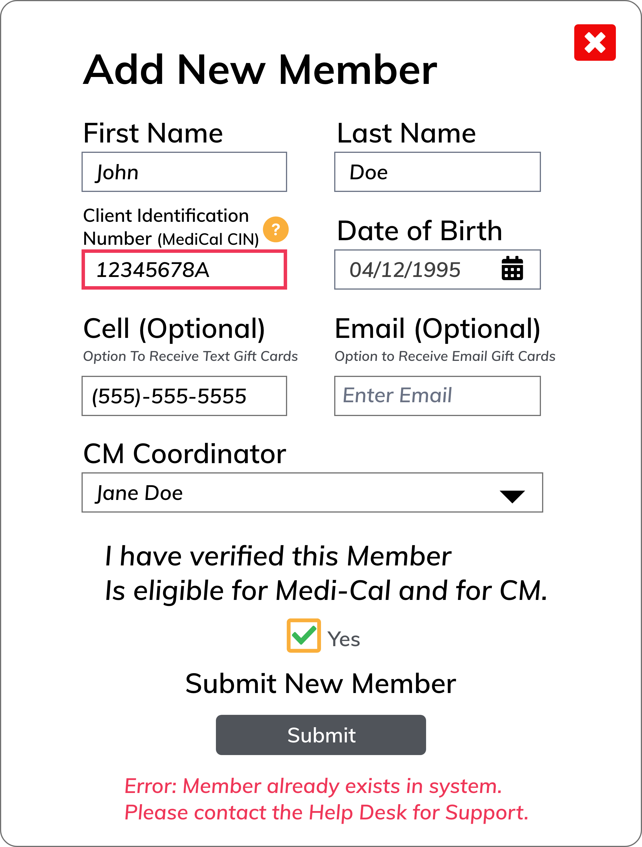
Double Entries
Managing Members
CM Coordinator
CM Coordinators may see error at right
This occurs when a member’s information (CIN or Member ID) has matched an existing entry
This functionality is a safeguard against Members who may try to enroll in multiple centers simultaneously – this is against protocol
This may occur because a member is seeking to transfer to your clinic from another.
  Please see guidance on changing member location

Slide 21
Member Location Changes
Adding New Users
CM Coordinator
Only Admin users can adjust treatment location. Below is the approval procedure:
CM Coordinator is informed by member about necessary location change
CM Coordinator assists member in site selection
CM Coordinator contacts new site to ensure they can accept the additional caseload
CM Coordinator calls the call center (find via help section) to inform them of the details of the necessary change
The call center will contact Q2i to make this change.
Note: All such changes must be logged in the electronic health record system

Slide 22
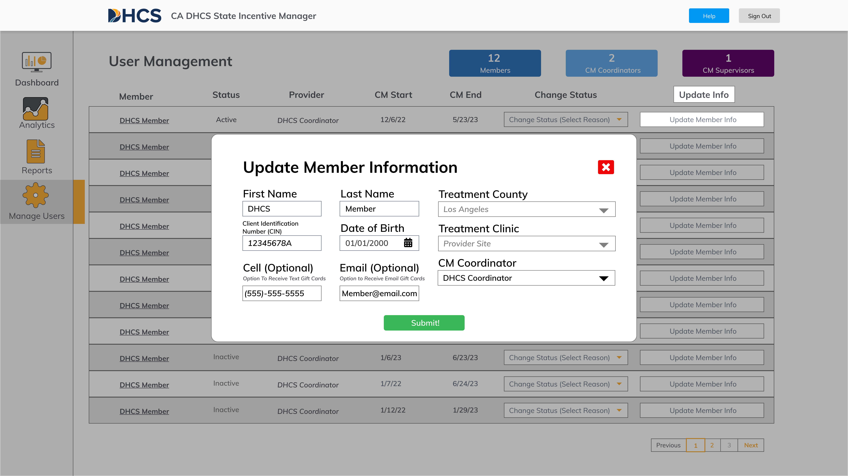
Member Information Changes
Adding New Users
CM Coordinator
Click “Manage Users” on left pane
Find relevant user
In data table, click “update info”
At any point, a can call the call center to assist with these changes. Contacts can be
found here.

Slide 23
Member Week & Alerts
Managing MEMBERS
CM Coordinator
During the first 12-weeks, 2 visit entries are required per week per Member within their cm week
During weeks 1-12, it is recommended that Members are scheduled on either a Monday/Thursday, or Tuesday/Friday Schedule
The icon represents a Member that only has either 1 or 0 visits entered for their week
The icon represents a Member that has no visits entered so far for their week
Member

Slide 24
Select Member
Managing Members
CM Coordinator
Open “dashboard pane”
Find member either by sorting
or searching
Click on the member’s name
(you will note that it is underlined)
This action will open that specific
patient’s chart (next page)

Slide 25
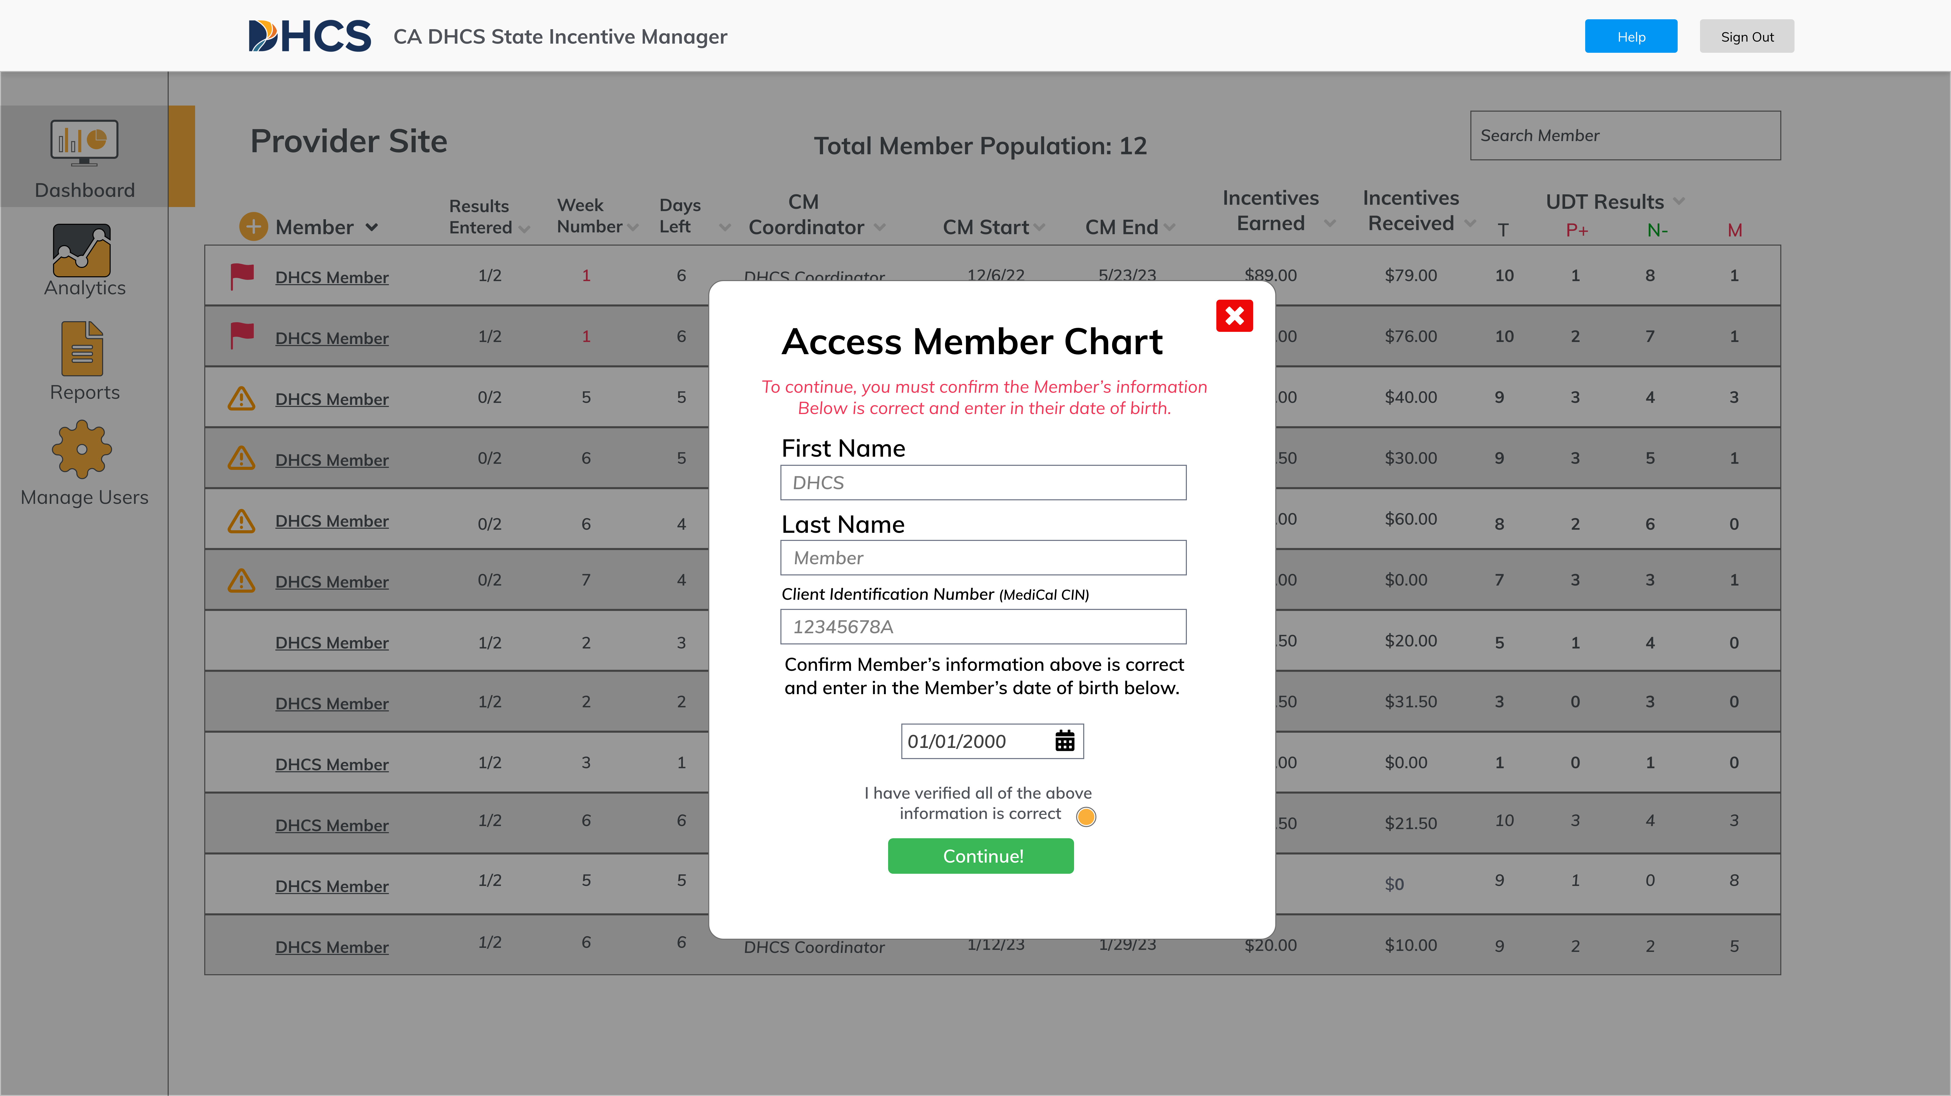
Access Member Chart
Managing Members
CM Coordinator
Click on the member’s name
(you will note that it is underlined)
Ask the Member to confirm their DoB then enter it in
Select the Radio Button to confirm the information is collect
This action will open that specific
patient’s chart (next page)

Slide 26
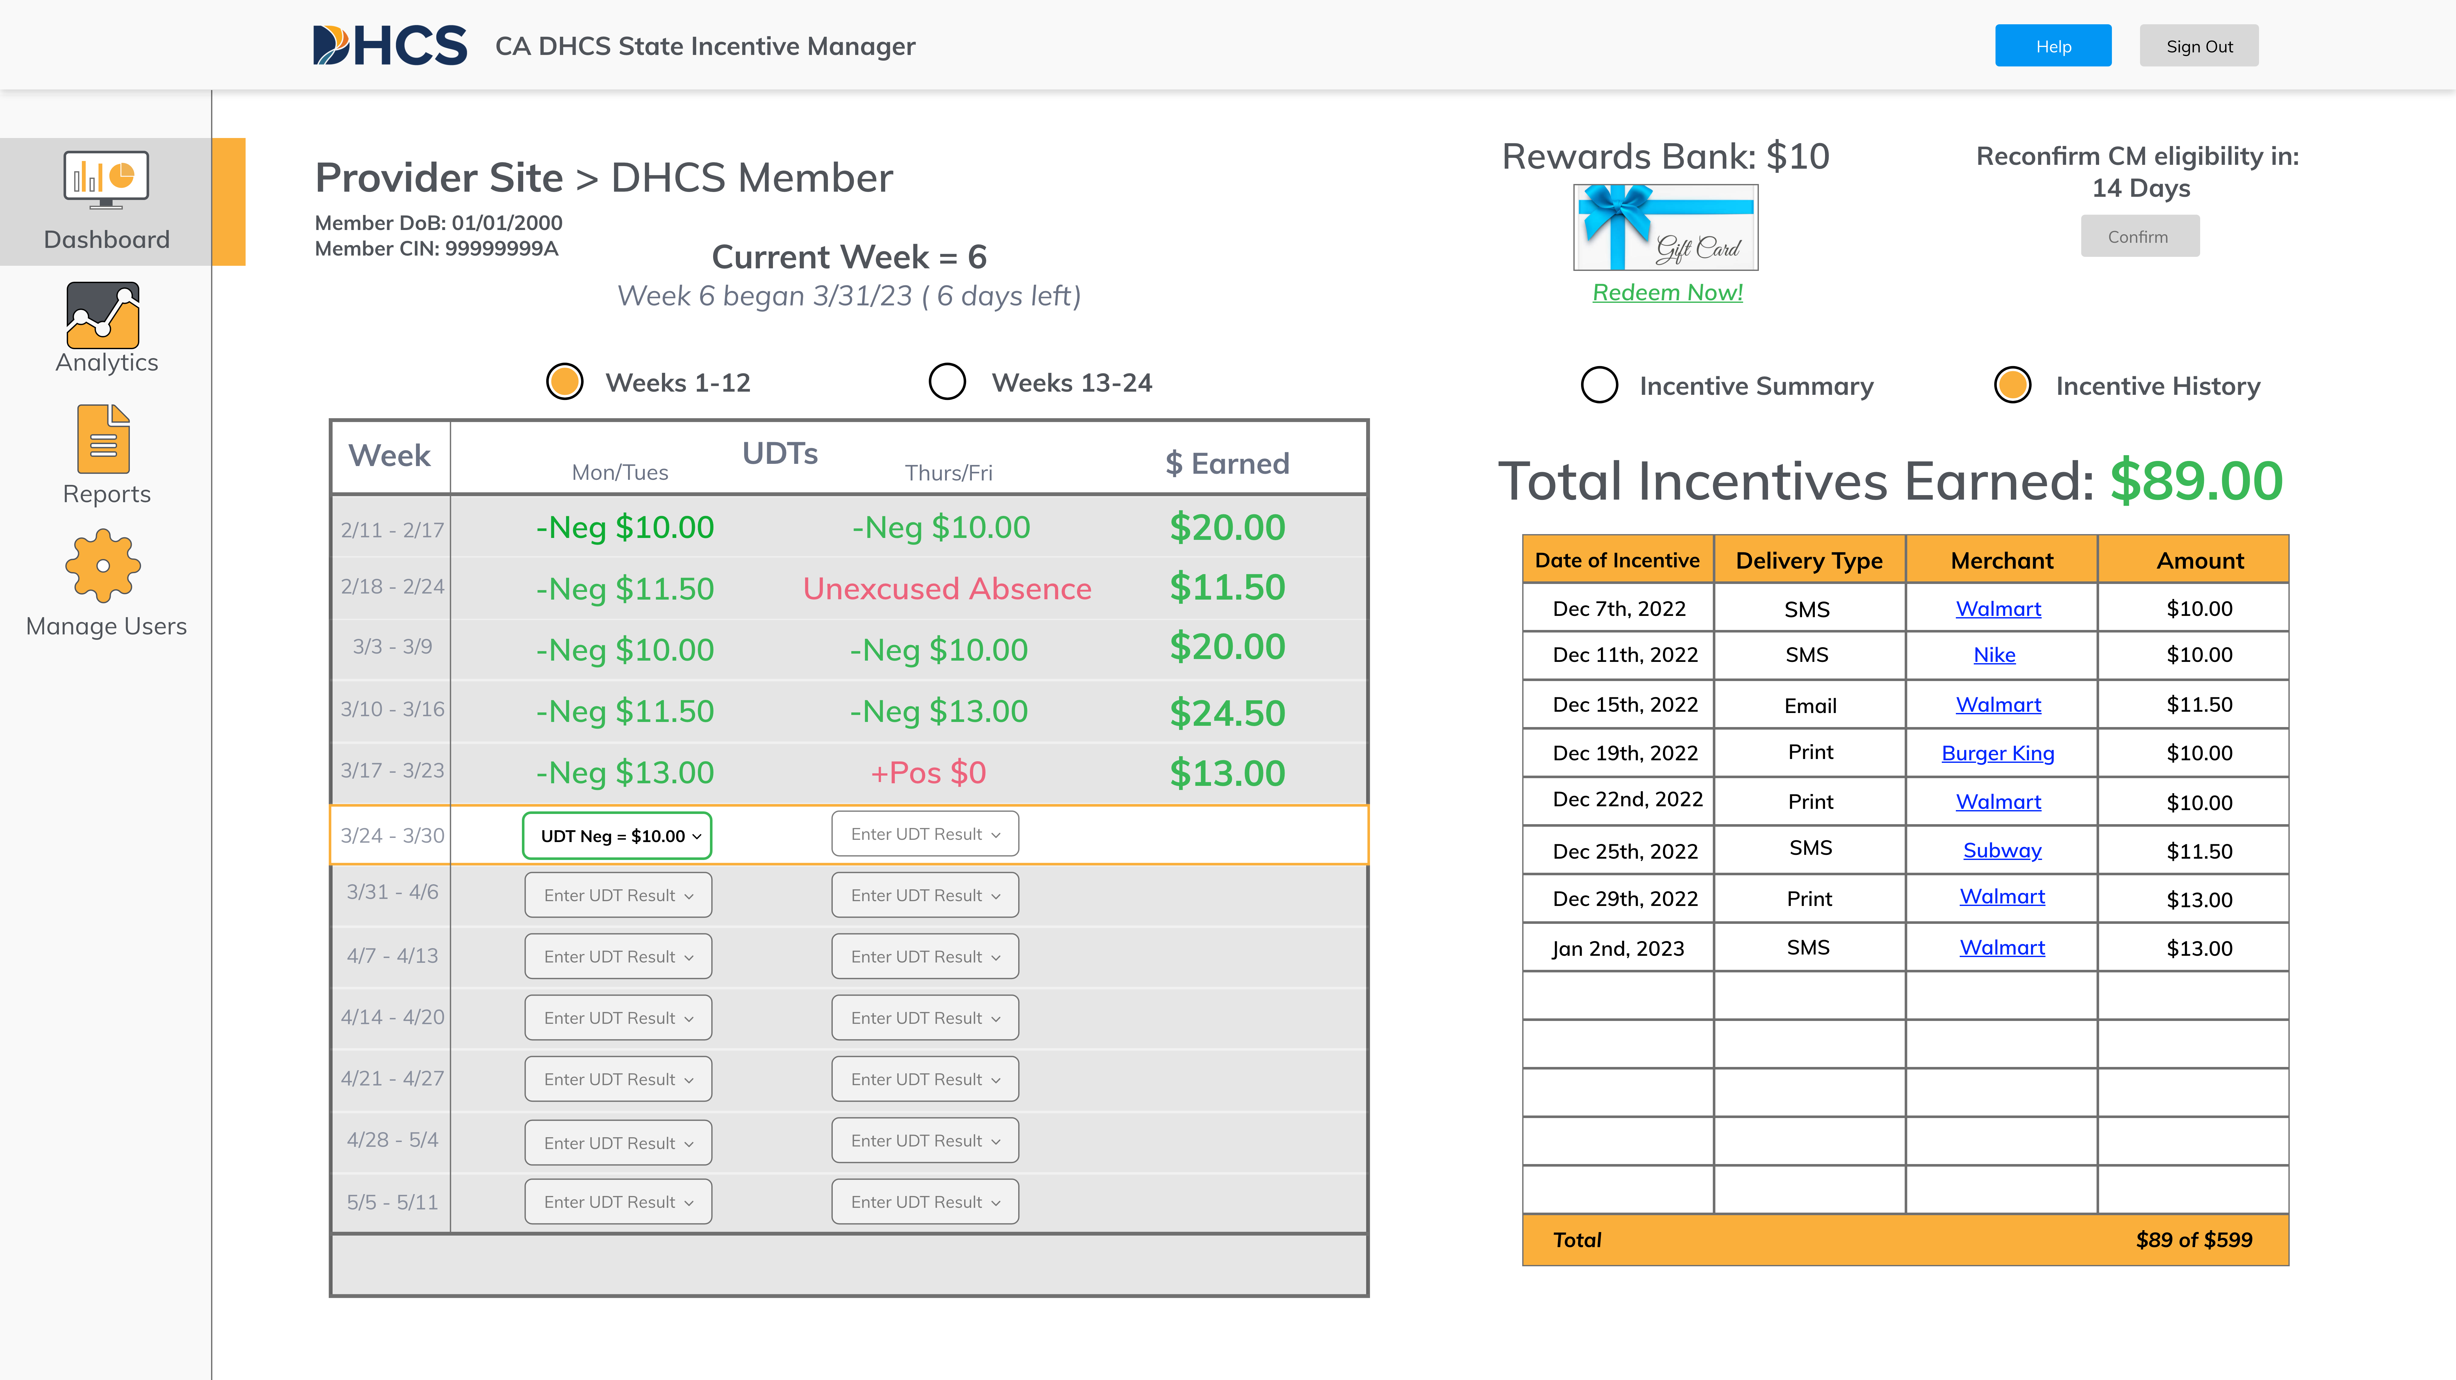
Member Chart
Managing Members
CM Coordinator
This page contains member-specific information: (from left to right)
UDT results by visit
Incentive earned by visit and week
Next UDT input
Rewards bank
Reconfirmation of eligibility for program
(completed monthly by CM coordinator)
Summary of incentives earned
Incentive history (date, delivery type,
merchant, and amount)

Slide 27
Member Pane
Managing Members
CM Coordinator
Every 30 days, the CM coordinator must attest to the members eligibility:
Navigate to the Member’s Pane
(screen on right)
Locate the “Reconfirm CM eligibility in:” section in the top right of the screen:
  The system has a countdown to 30 days
  The system will allow for attestation 14 days after the last attestation – giving 16 calendar days to attest
Simply click the “confirm button”
when this is available

Slide 28
Managing Incentive Rewards

Slide 29
Overview
Managing Incentive Rewards
CM Coordinator
How are rewards calculated?
How are rewards delivered?
What are the limitations on rewards?
Rewards will be earned after a negative urine drug test is logged in the system.
Rewards are calculated by the system using a well-defined schedule.
For weeks 1-12 (2 visits per week), the reward amounts start at $10 and will increase by $1.50 with each 2 consecutive negative UDTs. The rewards will “reset” to $10 after a positive UDT or unexcused absence. The reward will “recover” to the previous level after 2 consecutive
negative UDTs.
For weeks 13-24 (1 visit per week), the reward amounts do not change. Each negative UDT in weeks 13-18 equates to $15 in rewards; weeks 19-23 are $10;
week 24 is $21.
Rewards are offered as vendor-specific gift cards.
Rewards can also be “banked” to aggregate earnings to larger amounts.
Rewards can be delivered via text, email, or printed out in the office..
If shared via text or email, the reward can be added to an Apple or Google wallet.
As of pilot kick-off, the member is limited to $599 of total earnings (the reward schedule is oriented to this maximum).
Gift cards are only available for vendors who limialcohol, tobacco, cannabis, lottery tickets, and other gambling services.
Wal-Mart additionally restricts the purchase firearms or ammunition.

Slide 30
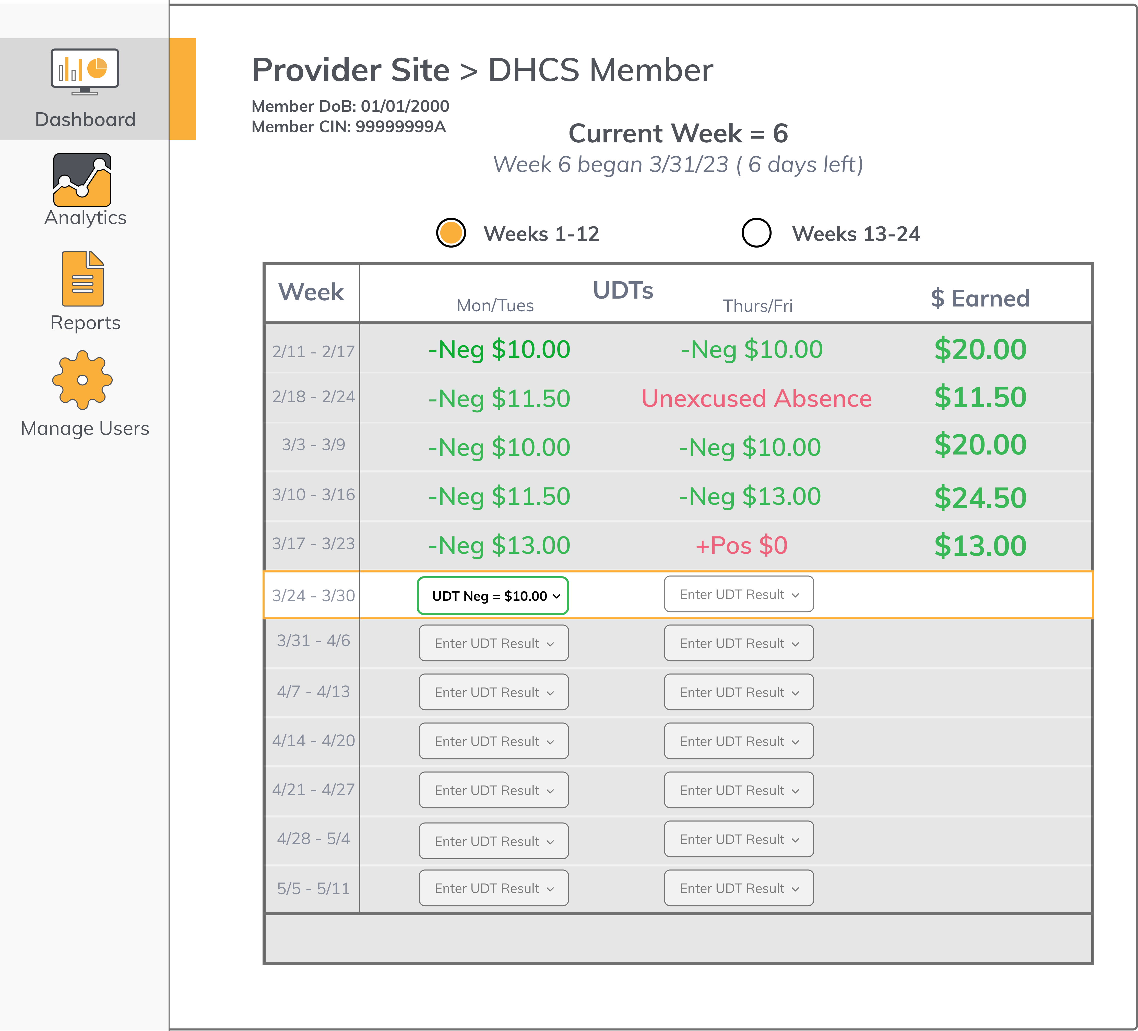
Reward Calculator
Managing Incentive Rewards
CM Coordinator
Navigate to the “Member pane”
Follow instructions for inputting appropriate result (i.e., UDT result or absence)
The system will automatically calculate the correct incentive award in advance of UDT input
If the UDT input is negative, the reward will be immediately available for dispense (see next page)
Rewards will be calculated for that particular visit given that week’s unique methodology (weeks 1-12; weeks 13-18; weeks 19-23; week 24)

Slide 31
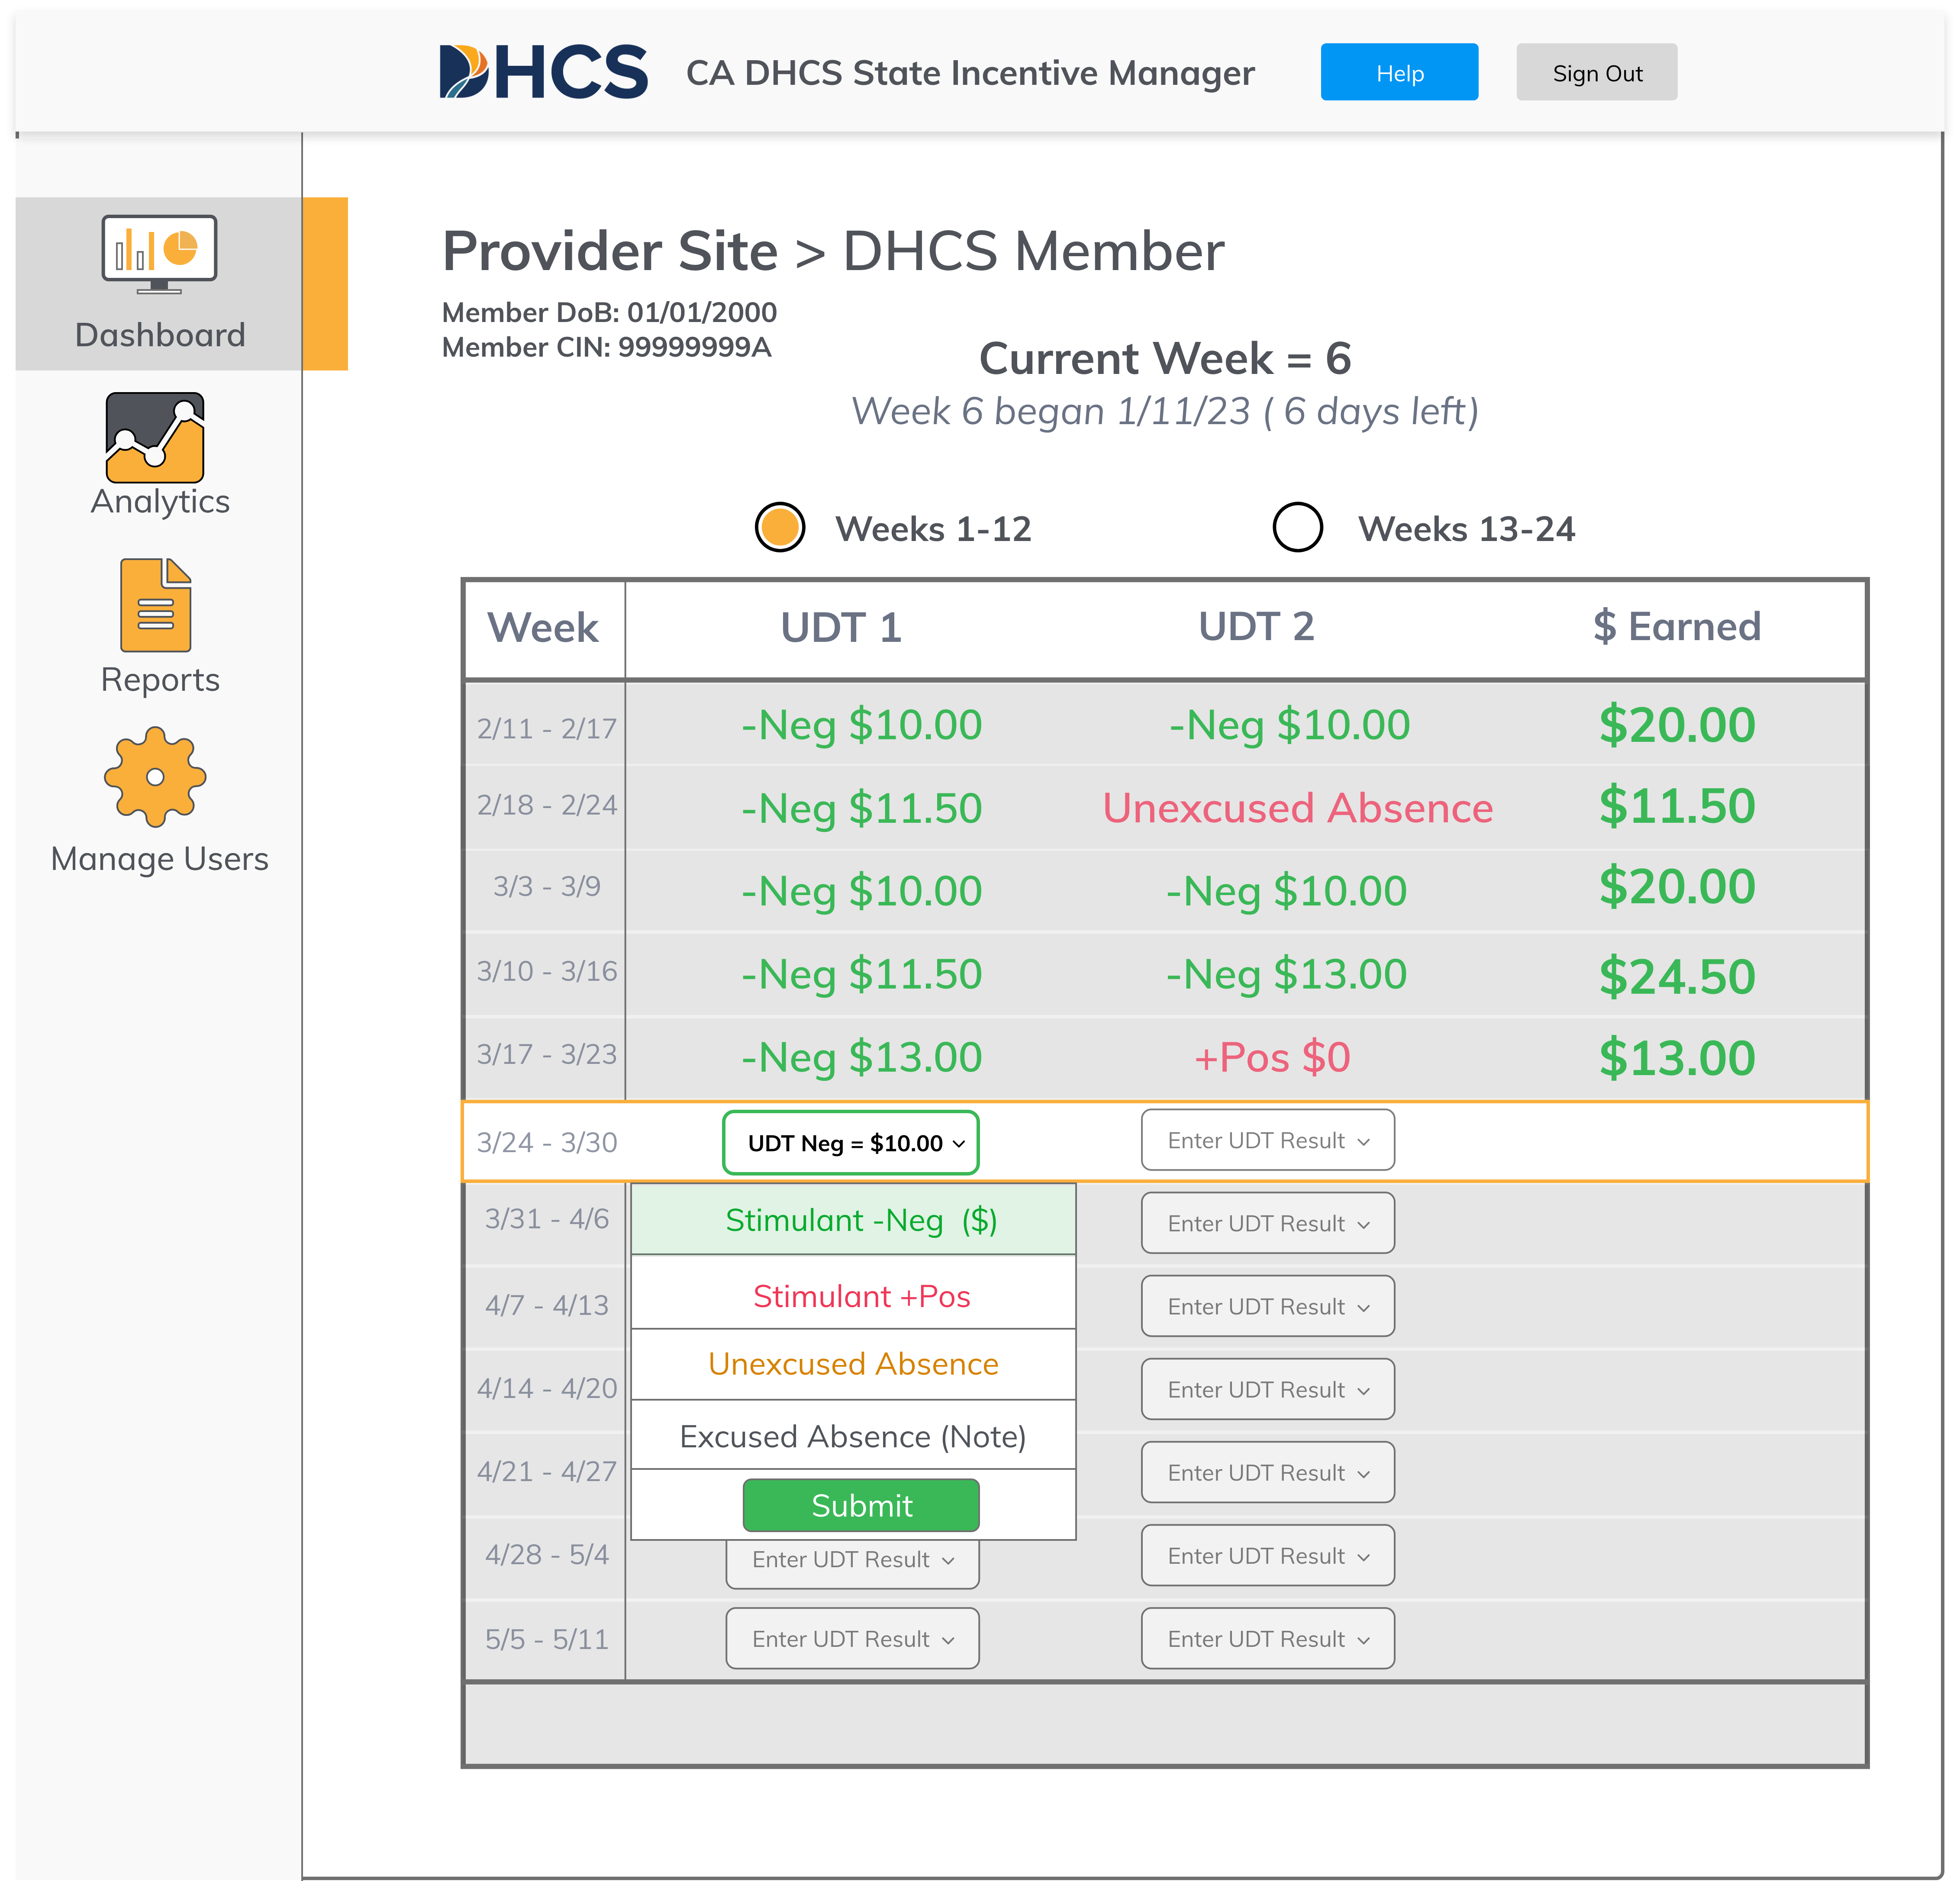
Enter UDT Results
Managing Members
CM Coordinator
Once you are on the Member Pane:
Identify the next available session
  This will be the “Enter UDT result” button which is not gray
  Other session buttons will not work when clicked on as they are locked
Click the “Enter UDT result” button (note: the text will change to the selected result)
From the dropdown list, select the relevant option*:
  If the UDT was negative for stimulants, select “Stimulant -Neg ($)”
  If the UDT was positive for stimulants, select “Stimulant +Pos”
The system will automatically calculate the correct incentive reward
Note: UDT results can only be input at least 48 hours after the previous input. This will be limited in the system.
* Please provide appropriate praise for stimulant-negative UDT and encouragement in the case of stimulant-positive UDT as directed by DHCS

Slide 32
Submit Selection
Managing Incentive Rewards
CM Coordinator
When you select the appropriate option during a visit (i.e., stimulant negative, stimulant positive, excused absence, unexcused absence) the submit button will become green
In order to submit the result, you must click the submit button
To avoid error, this button will not be ”clickable” until you select an input and the inputs will not be registered until you click submit

Slide 33
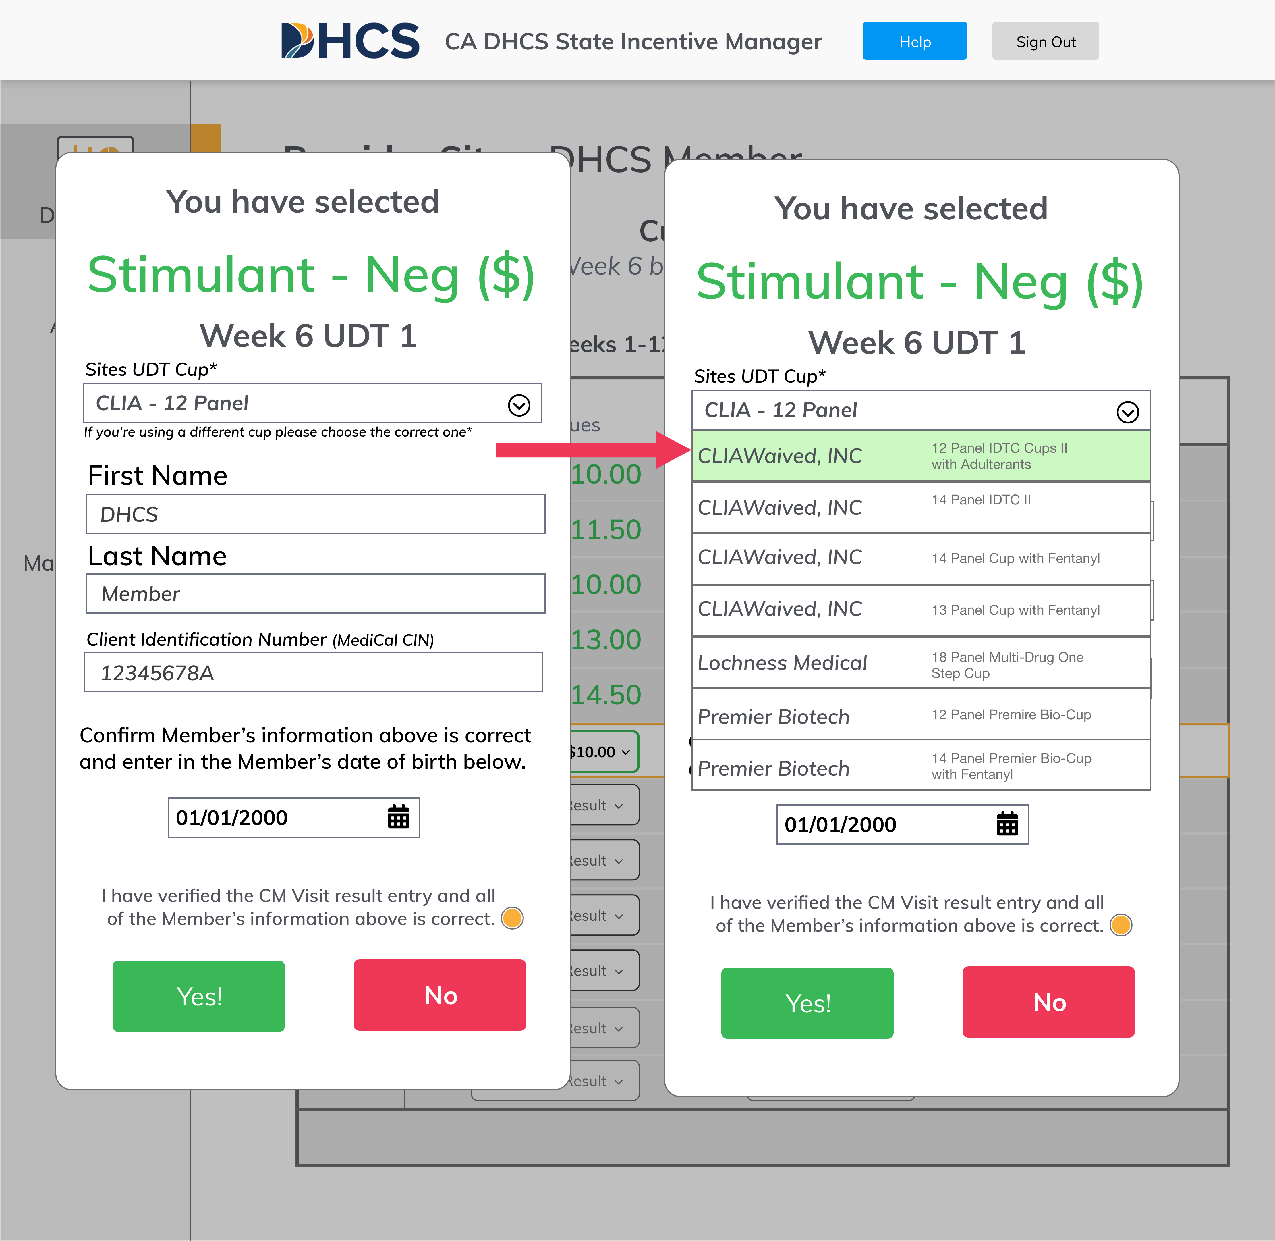
Confirm Selection
Managing Incentive Rewards
CM Coordinator
Before submitting either a Stimulant Negative or Stimulant positive result, you will be asked to confirm which of the 7 DHCS Approved UDT Cups was used
The IM Portal will default to your sites standard UDT Cup on file
If you are using a different one, you may select the correct one from the drop-down menu
You will be prompted to confirm the Member’s Date of Birth
Ask the Member for their Date of Birth, and enter it in.
Select the ‘Radio Button’ to confirm the information is correct
If you are certain of your input, please select “yes” when prompted
If not, select “no” and re-input your selection

Slide 34
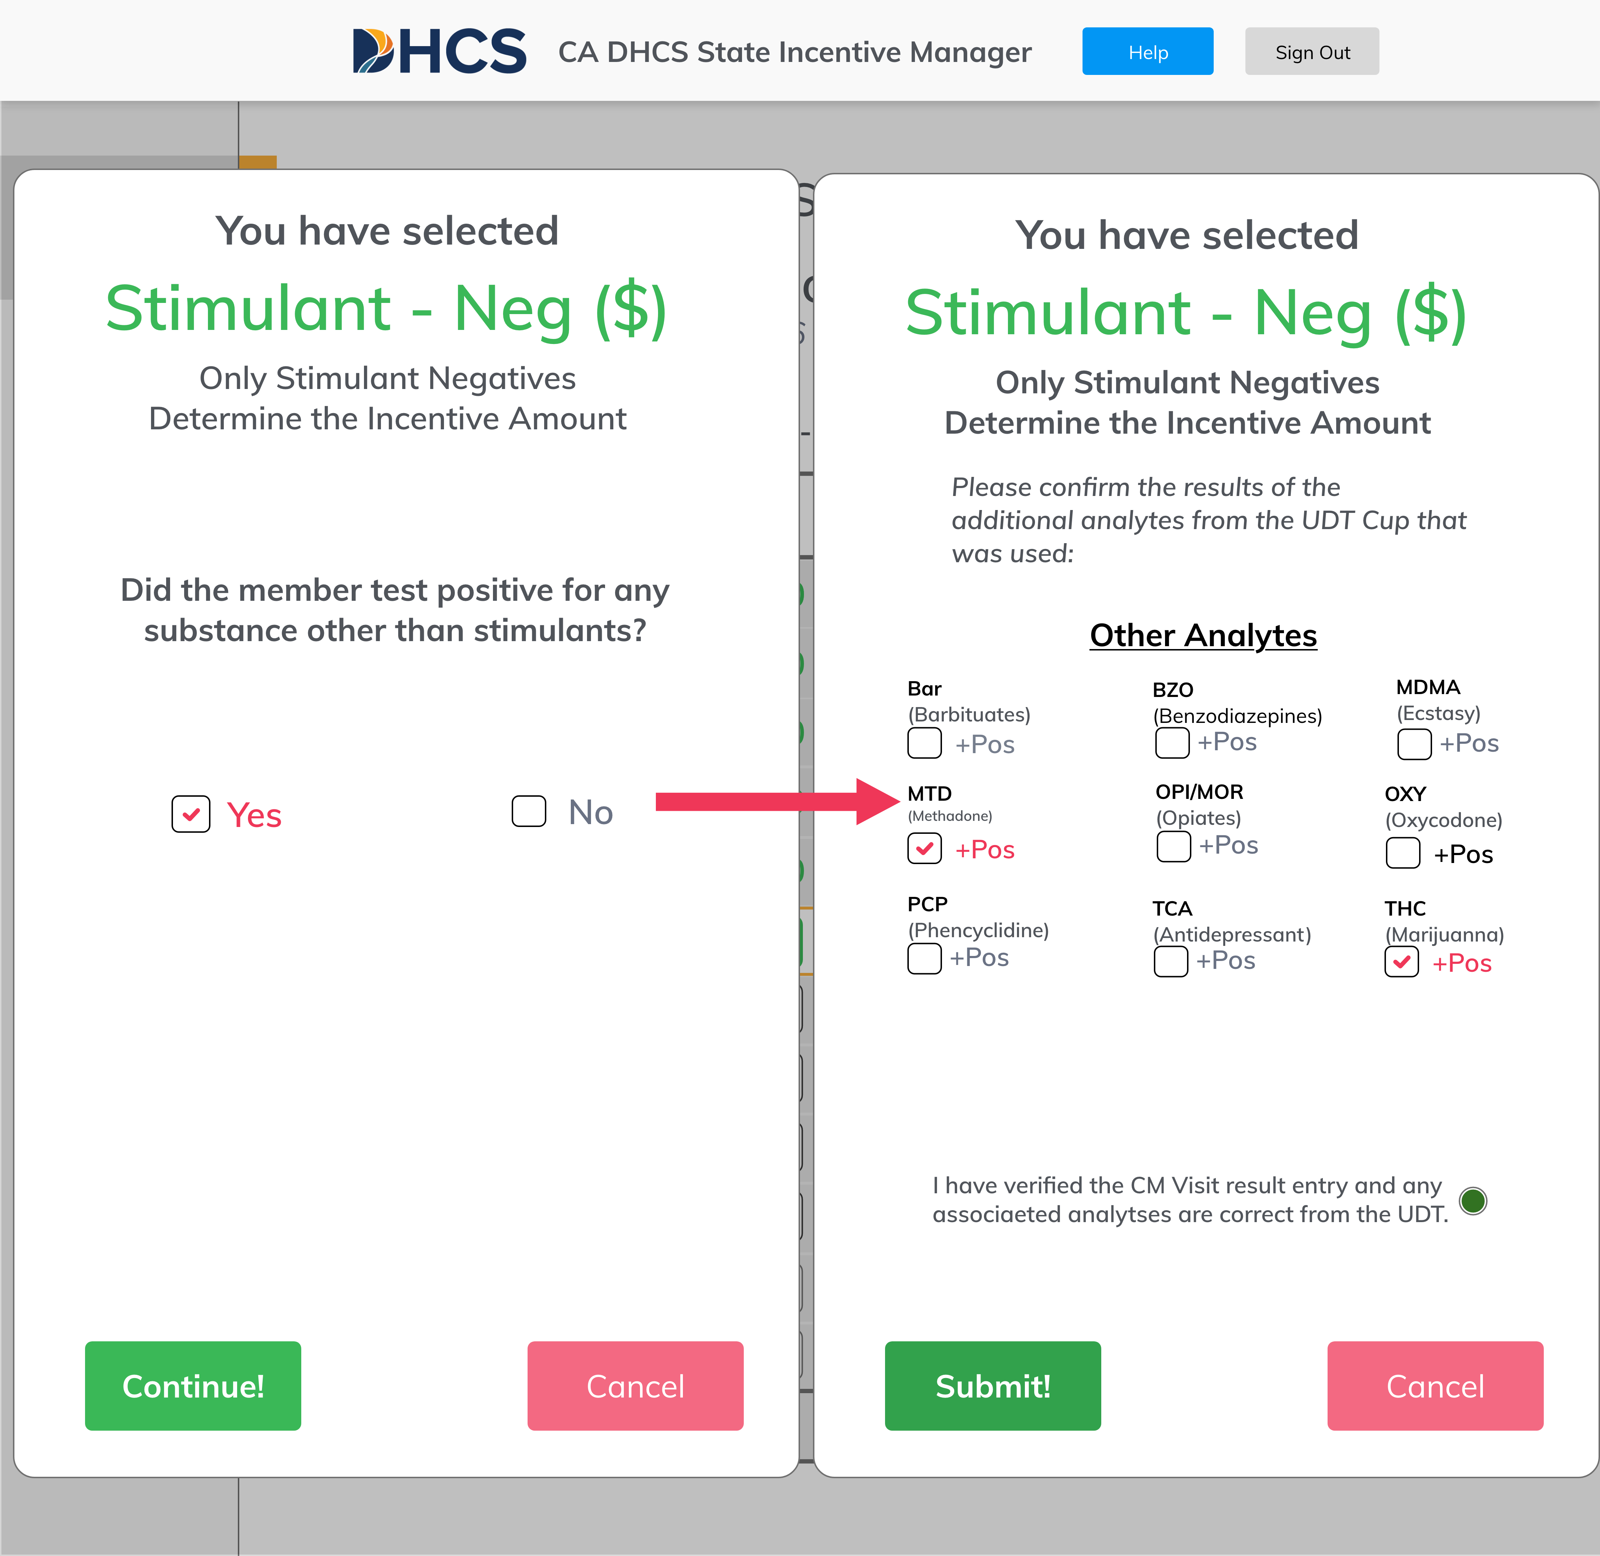
Analytes Selection
Managing Incentive Rewards
CM Coordinator
Only ‘Stimulant Negative’ UDTs award incentives
You will be asked to confirm if the Member tested positive for any additional substances
If ’no’ you may submit the entry and proceed
If ‘yes’ you will be asked to select which additional substances the Member tested positive for
The specific substances will automatically display based on the specific DHCS approved UDT cup you are using

Slide 35
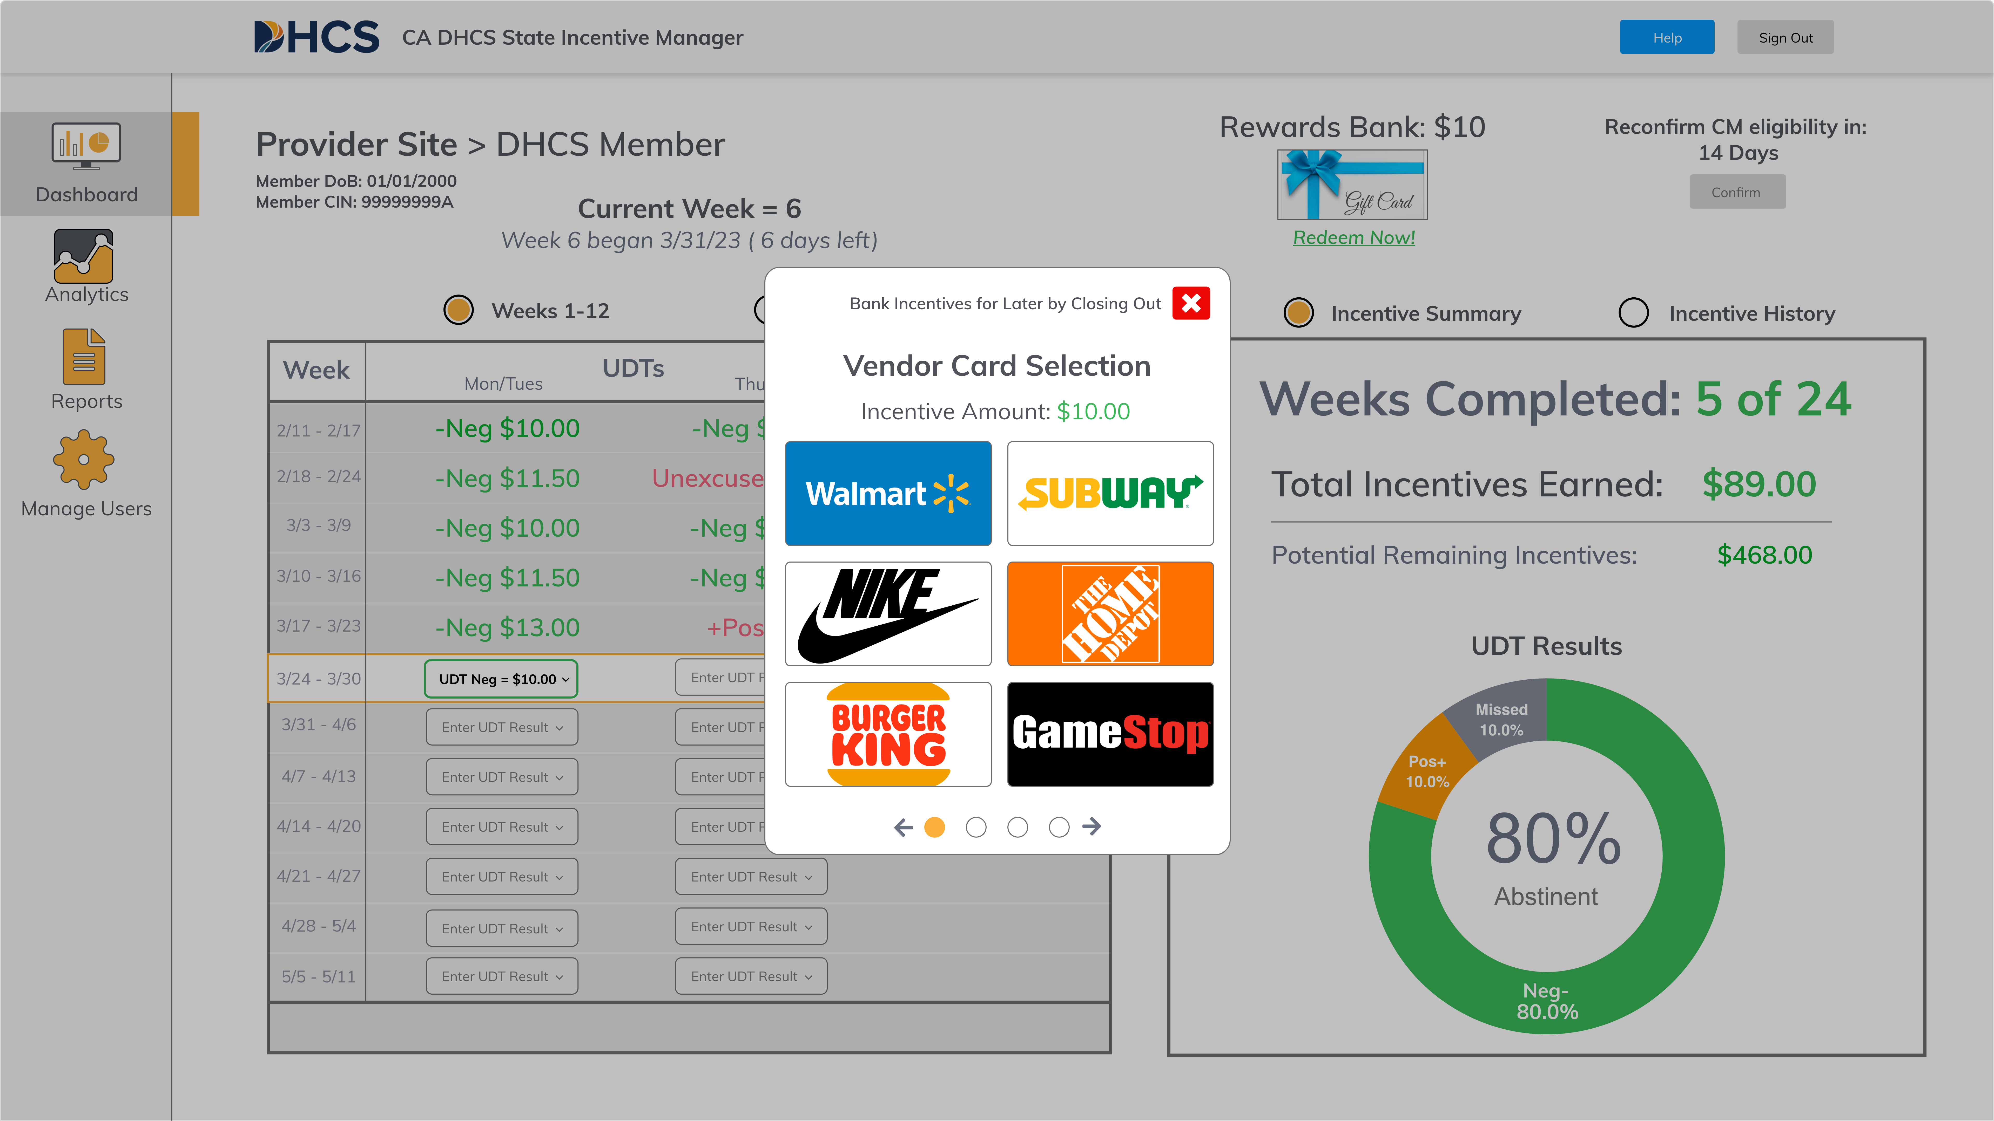
Reward Type Selection
Managing Incentive Rewards
CM Coordinator
Once a negative UDT is input, the system will offer the reward type selection.
CM coordinators will work with the Member to select the preferred vendor.
There are 2 options:
  Gift card for a specific vendor
  (see next page for list of vendors)
  Adding funds to a “bank”
Simply click the preferred option and proceed to “delivery type” selection
Notes:
Done

Slide 36






































Gift Card Vendors
Managing Incentive Rewards
CM Coordinator
Department Stores & Entertainment
Food & Drink
Clothing
Tools & General
Please remember gift cards cannot be used to purchase alcohol, tobacco, cannabis, firearms, ammunition, and/or lottery tickets or other gambling services.
*Wal-Mart gift card allows for the purchase of gasoline at participating locations.
** Chevron/Texaco gift card can be printed but can only be redeemed digitally through the free Chevron/Texaco app at the pump and not in store.

Slide 37
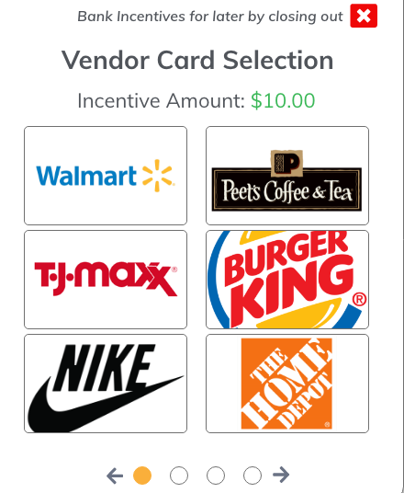
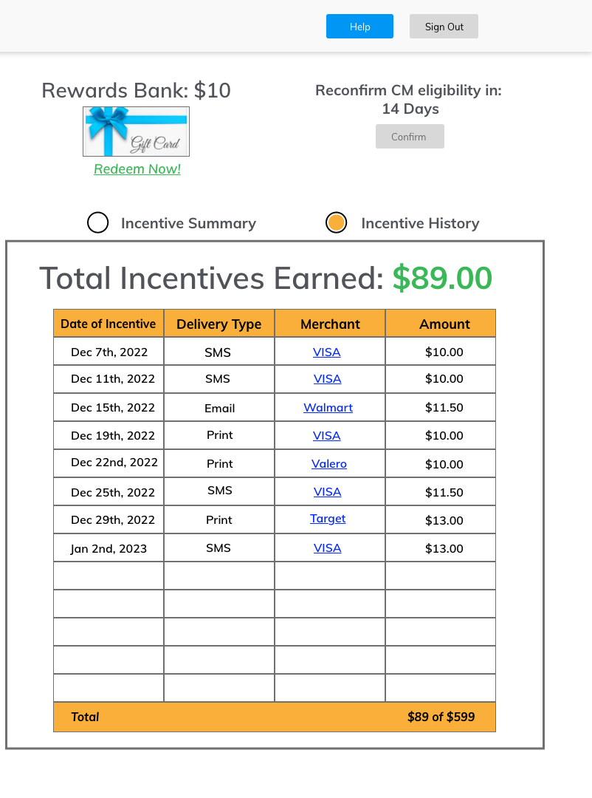
Rewards Bank
Managing Incentive Rewards
CM Coordinator
Rewards are also able to be “banked”
or saved:
If the member chooses not to to redeem the reward immediately, they can save earnings in the rewards bank
To select ”banking” as an option, click the “X” on the vendor selection
Once the rewards are banked, they can be converted into gift cards at any time by selecting the rewards bank.
This will return you to the vendor selection screen (previous page).

Slide 38
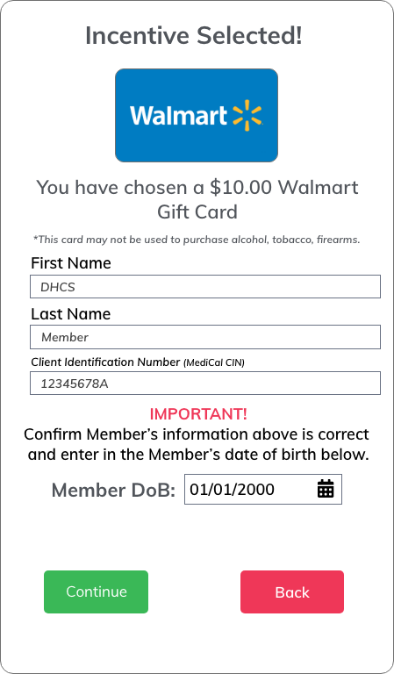
Rewards Bank Confirmation
Managing Incentive Rewards
CM Coordinator
Any banked rewards that are redeemed required Member date of birth validation:
Select member requested vendor gift card to be redeemed from the rewards bank.
Verify the members information is correct and enter in their date of birth.
If the member’s information and selection is correct, select “Continue” to proceed to select a delivery option.
If the member wants to choose a differed card, select ”Back” to choose another vendor.

Slide 39
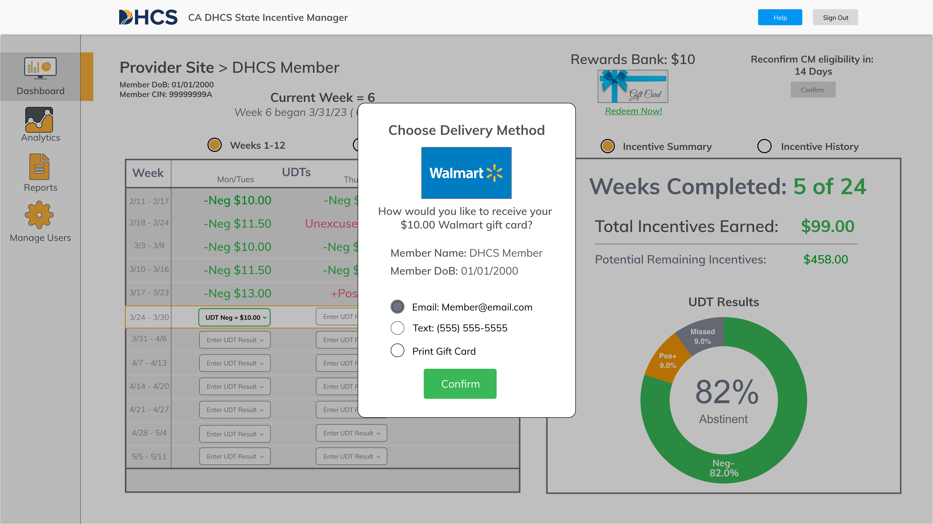
Reward Delivery Type Selection
Managing Incentive Rewards
CM Coordinator
Once a reward type is selected, the system will offer the delivery type option.
For vendor-specific gift cards, the Member can select text, email, or printed in person.
For “banking” of rewards, this screen
will not show up.
For texts, Members will be required
to input their phone number.
For emails, Members will be required to input their email address.
Text and email gift cards can be added
to Apple or Google wallets.

Slide 40
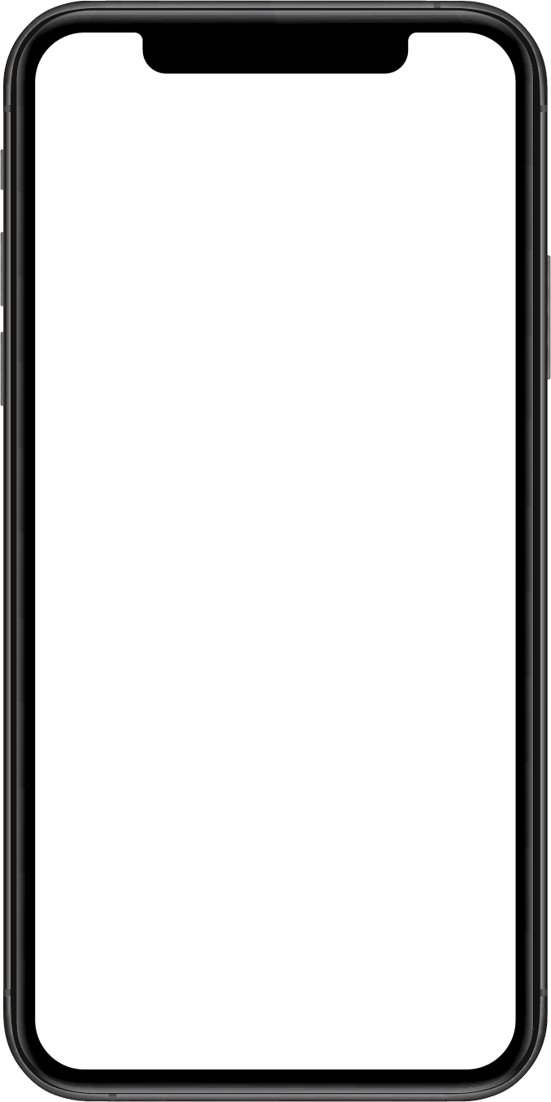
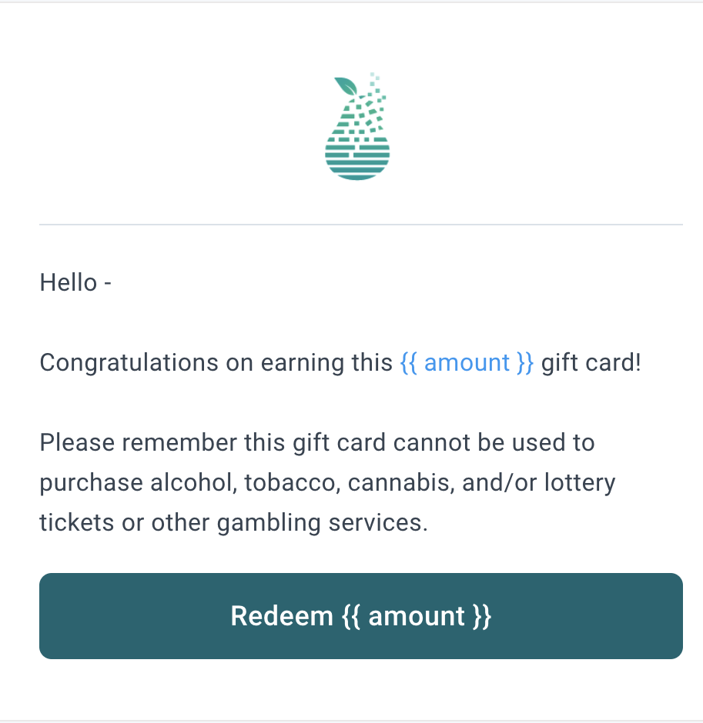
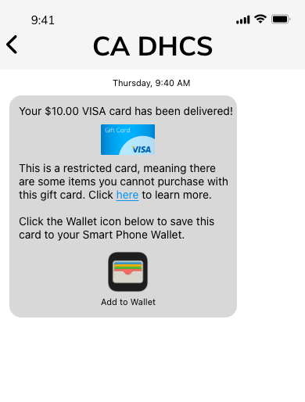
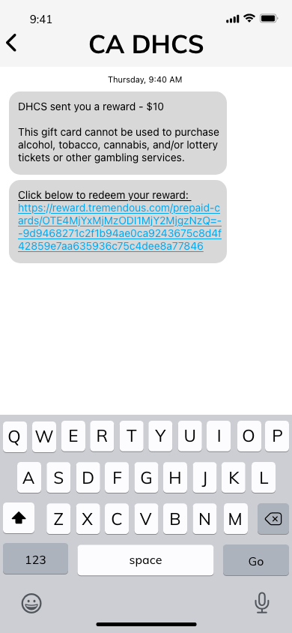
E-mailing or texting Rewards
Managing Incentive Rewards
CM Coordinator
Text Messages*
E-mails*
Gift Cards will be delivered by the same address each time:
The text message will come from same number each time
The email will come from Q2i via Tremendous (rewards@tremendous.com)
We recommend having the member save this contact (as shown at right)
The member can use
the code in the email or add to their Apple or Google Wallet
Gift Cards
Q2i
* Deleted messages cannot be regenerated. Please do not delete rewards texts or emails.
Notes:
Please add High-Res img into Phone Screen

Slide 41
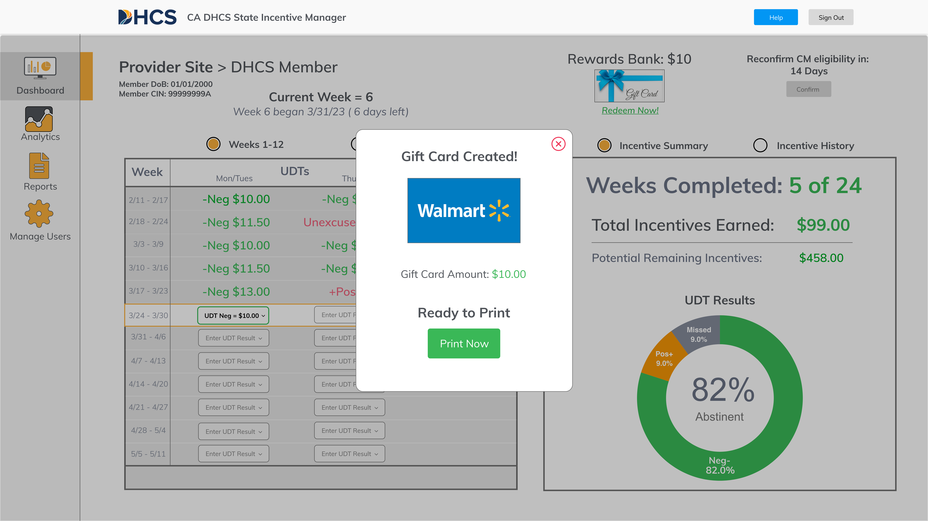
Printing Rewards
Managing Incentive Rewards
CM Coordinator
Rewards are available for printing in
the office immediately after the
rewards are earned:
Much of the effort here will be focused on linking a printer to the computer.
Once “Print Now” is selected, the print screen will come up as shown at right.
Please note that printed cards CANNOT be re-printed. Once these are generated, the member must
keep track of these rewards.

Slide 42
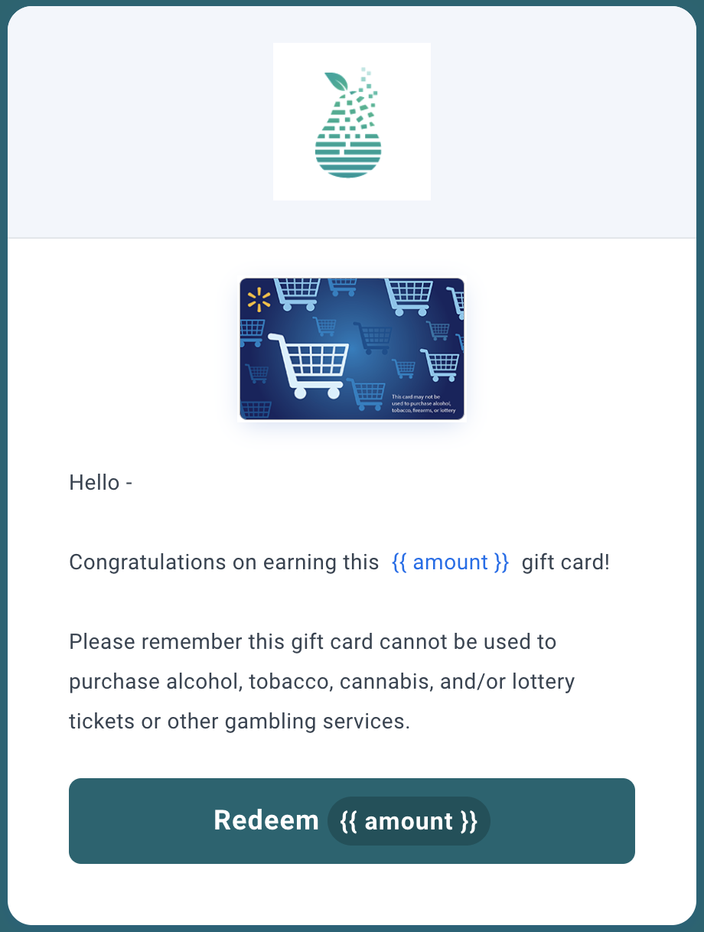
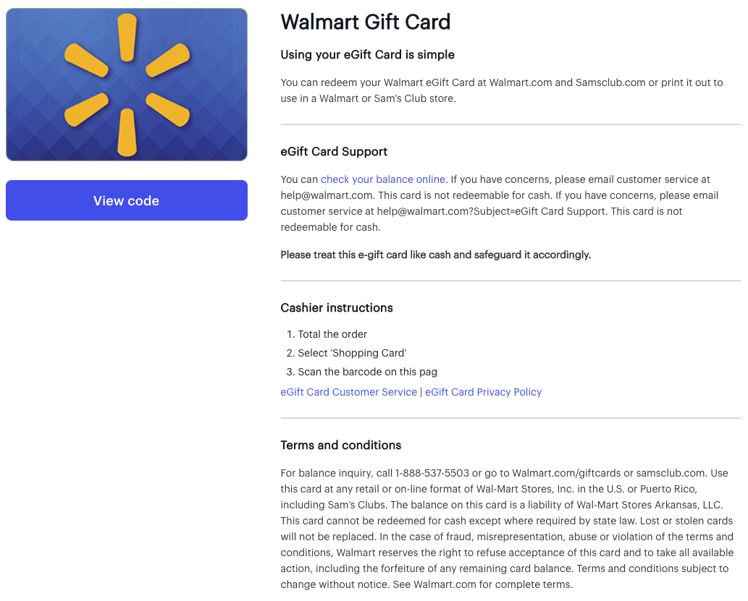
Printing Rewards
Managing Incentive Rewards
CM Coordinator
The portal will route you to a new tab in your browser:
You will click the “redeem” button on the screen
Then you will click “view code” on the subsequent screen
You will then be able to print the following screen for use

Slide 43
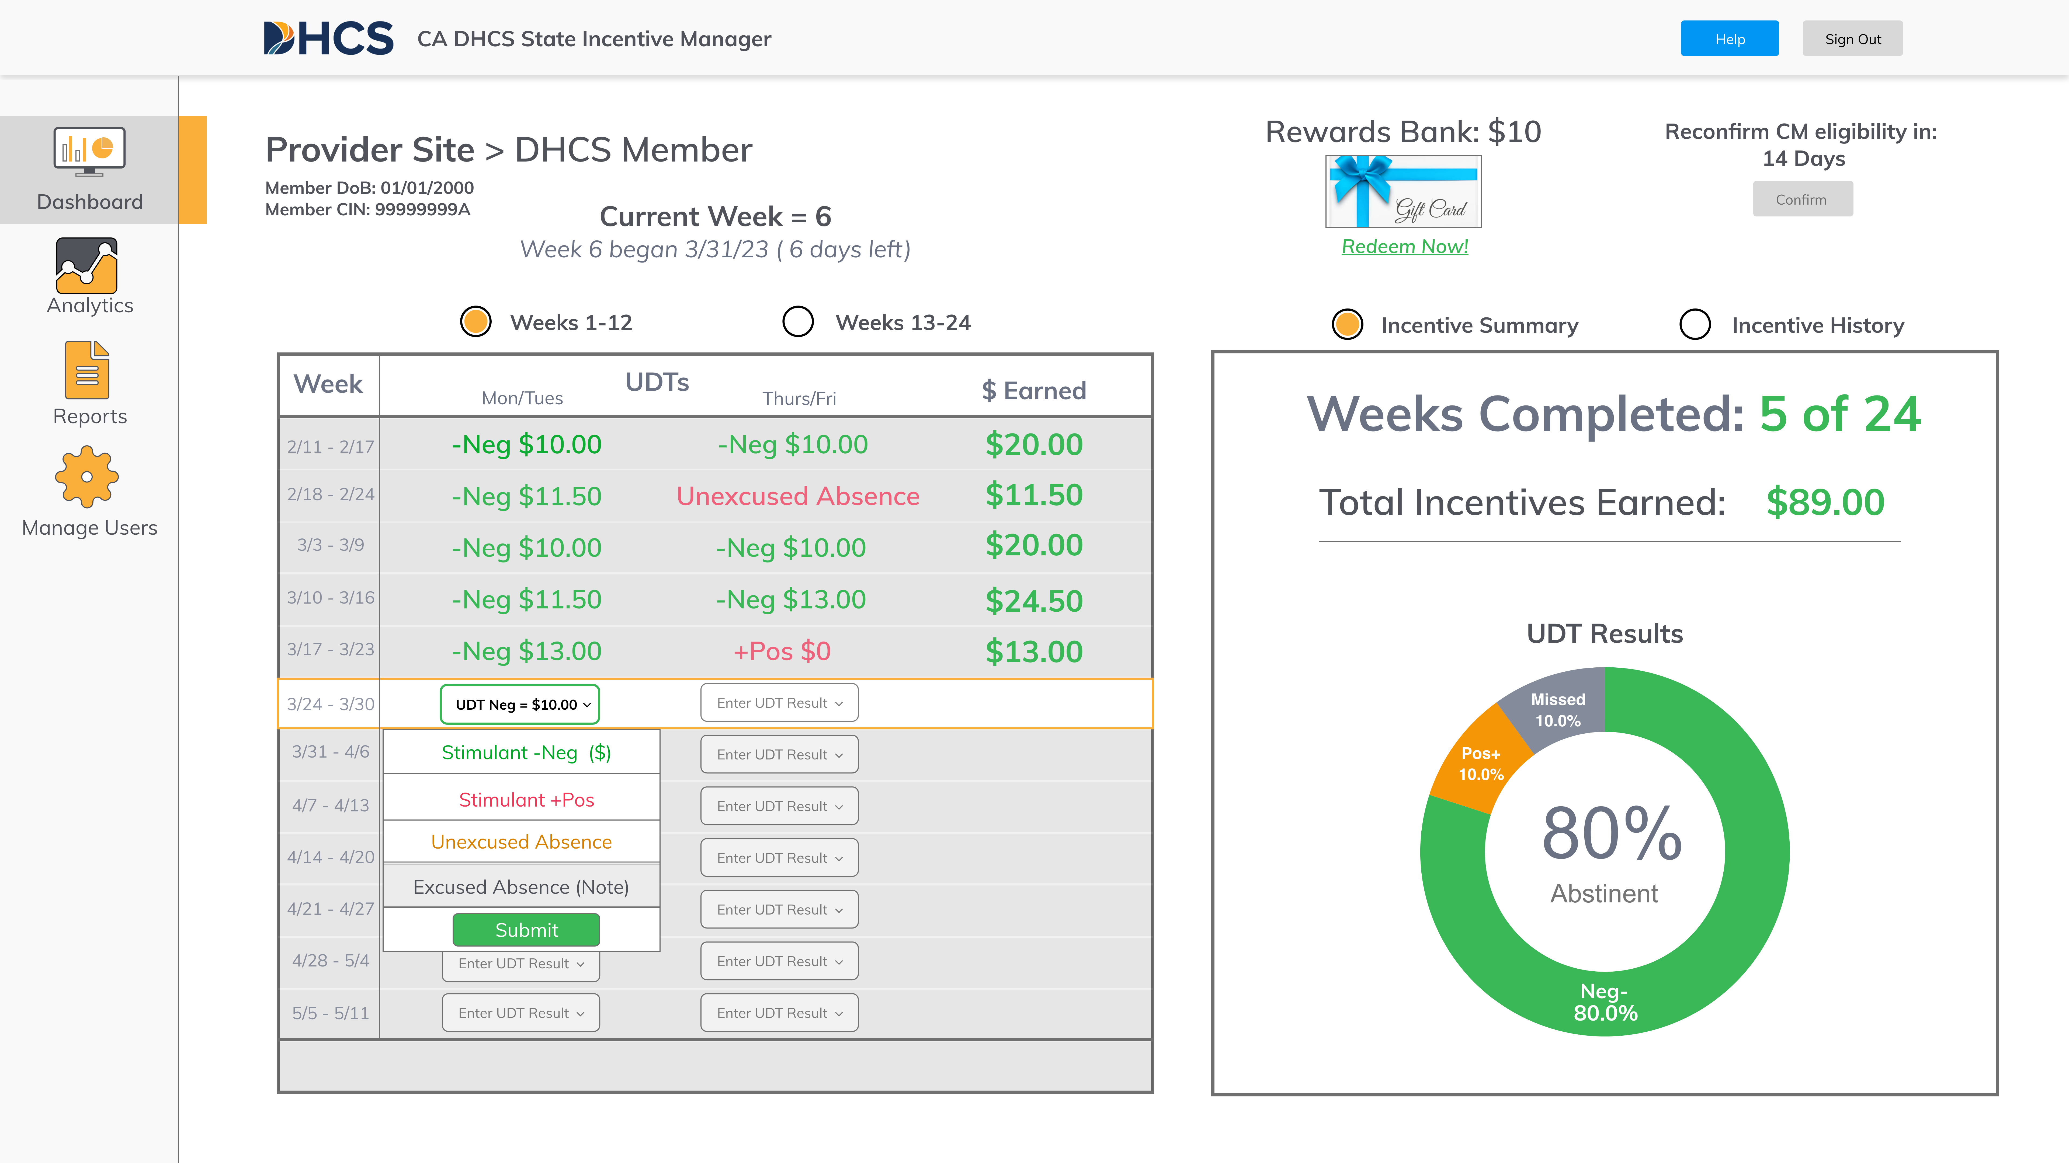
Managing Absences
Managing Incentive Rewards
CM Coordinator
In addition to logging a UDT result, you can also log absences:
Excused absences do not trigger a “reset” while unexcused absences do.
Excused absences can only be logged if:
  A member informs you in advance
  There is a valid reason for the absences
  The member presents valid documentation supporting the absence
  They have missed MAXIMUM 2 sessions in a row
Selections are made in the same way as UDT results (click submit button)

Slide 44
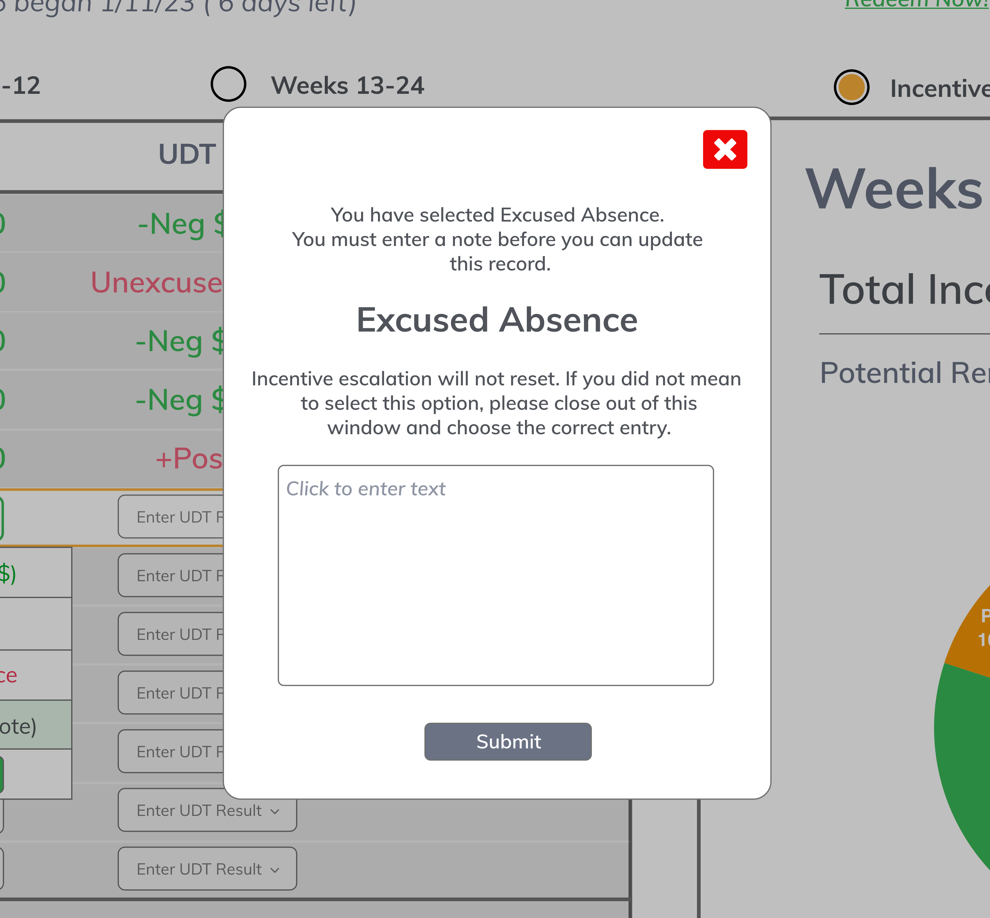
Submitting Excused Absences
Managing Incentive Rewards
CM Coordinator
In addition to confirming submission of the “excused absence”, you will be asked to input a note.
This note should capture the reasoning behind the excused absence.
Note: In the subsequent visit, you will be asked to confirm that documentation was provided to support this reasoning.
Note: You must track this information in your EHR as well.

Slide 45
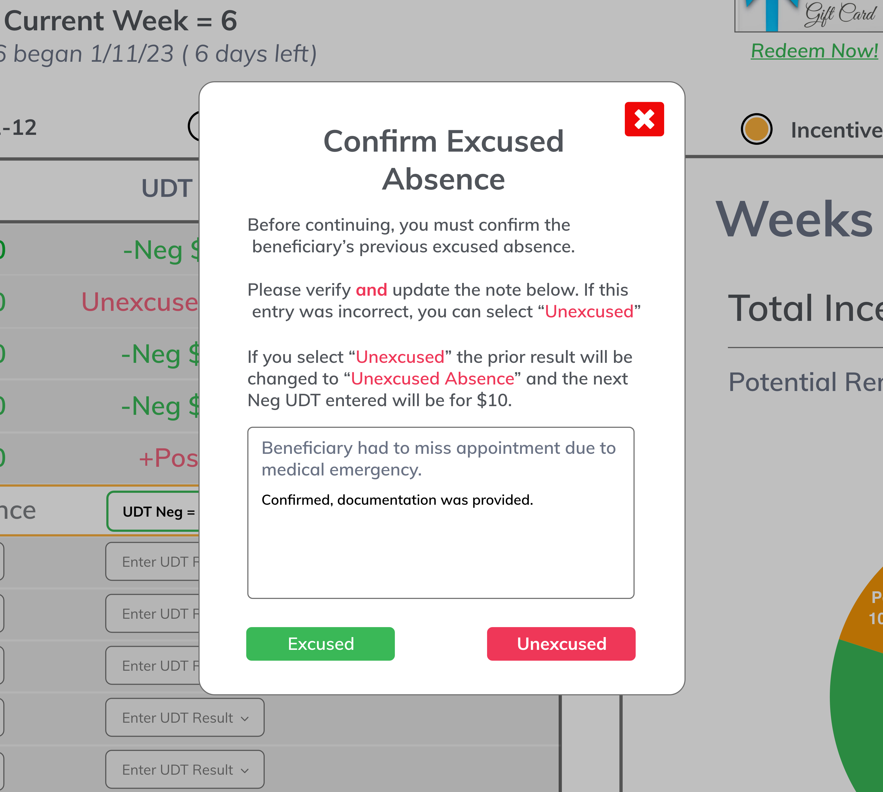
Confirming Excused Absences
Managing Incentive Rewards
CM Coordinator
In the subsequent visit, you will be asked to confirm your input:
If the member provides adequate documentation supporting their excused absence, please confirm.
You will confirm by clicking “excused”.
If the member does not provide documentation, you must reverse the excused absence.
You will change entry by clicking “unexcused”.
Note: Unexcused absences trigger a ”reset”.
Note: Only 2 excused absences are allowed in a row.

Slide 46
Missed Entries and Corrections
Managing Incentive Rewards
Missed Entries:
Weeks 1-12
  CM coordinators must make 2 entries per week per member (i.e., you must log unexcused absences on the day the absence occurred).
  If you do not do this, the system will automatically create an absence entry (for M-W or W-S).
  Upon subsequent visit, the system will prompt you with the same screen as confirming an excused absence (i.e., select excused or unexcused absence).
  If no entries are made in a week, they will be assumed as unexcused absences.
Weeks 13-24
  CM coordinators must make 1 entry per week per member (i.e., you MUST log unexcused absences on the day the absence occurred).
  If no entries are made in a week, they will be assumed as unexcused absences.
Incorrect Entries:
Input positive UDT when intended to do negative UDT
  Call the call center
  Keep member in the office
  This change will (ideally) be made within minutes
  Worst case, this will be made within 24-48 hours and the reward will be placed in the rewards bank
Input negative UDT when intended to do positive UDT
  Call the call center
  This change will be made within 24-48 hours
Input wrong type of absence
  Correct upon subsequent visit as shown on previous page

Slide 47
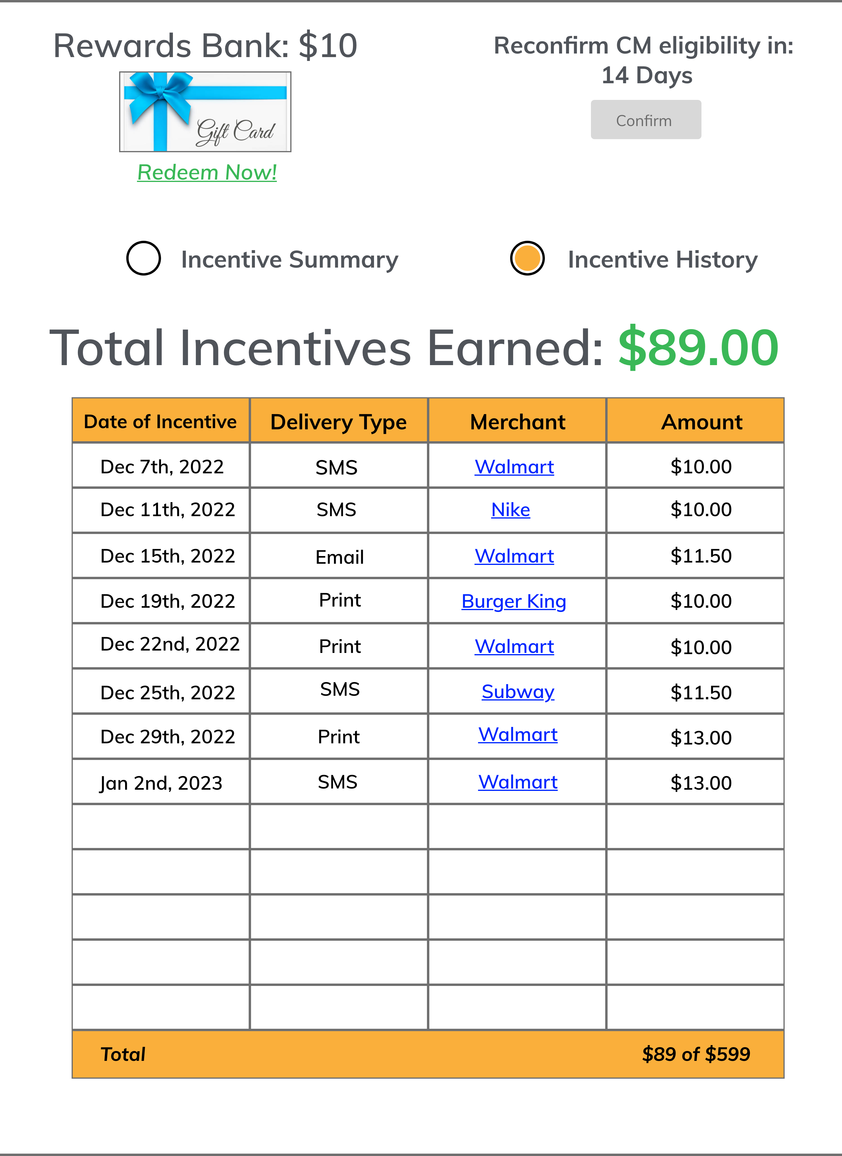
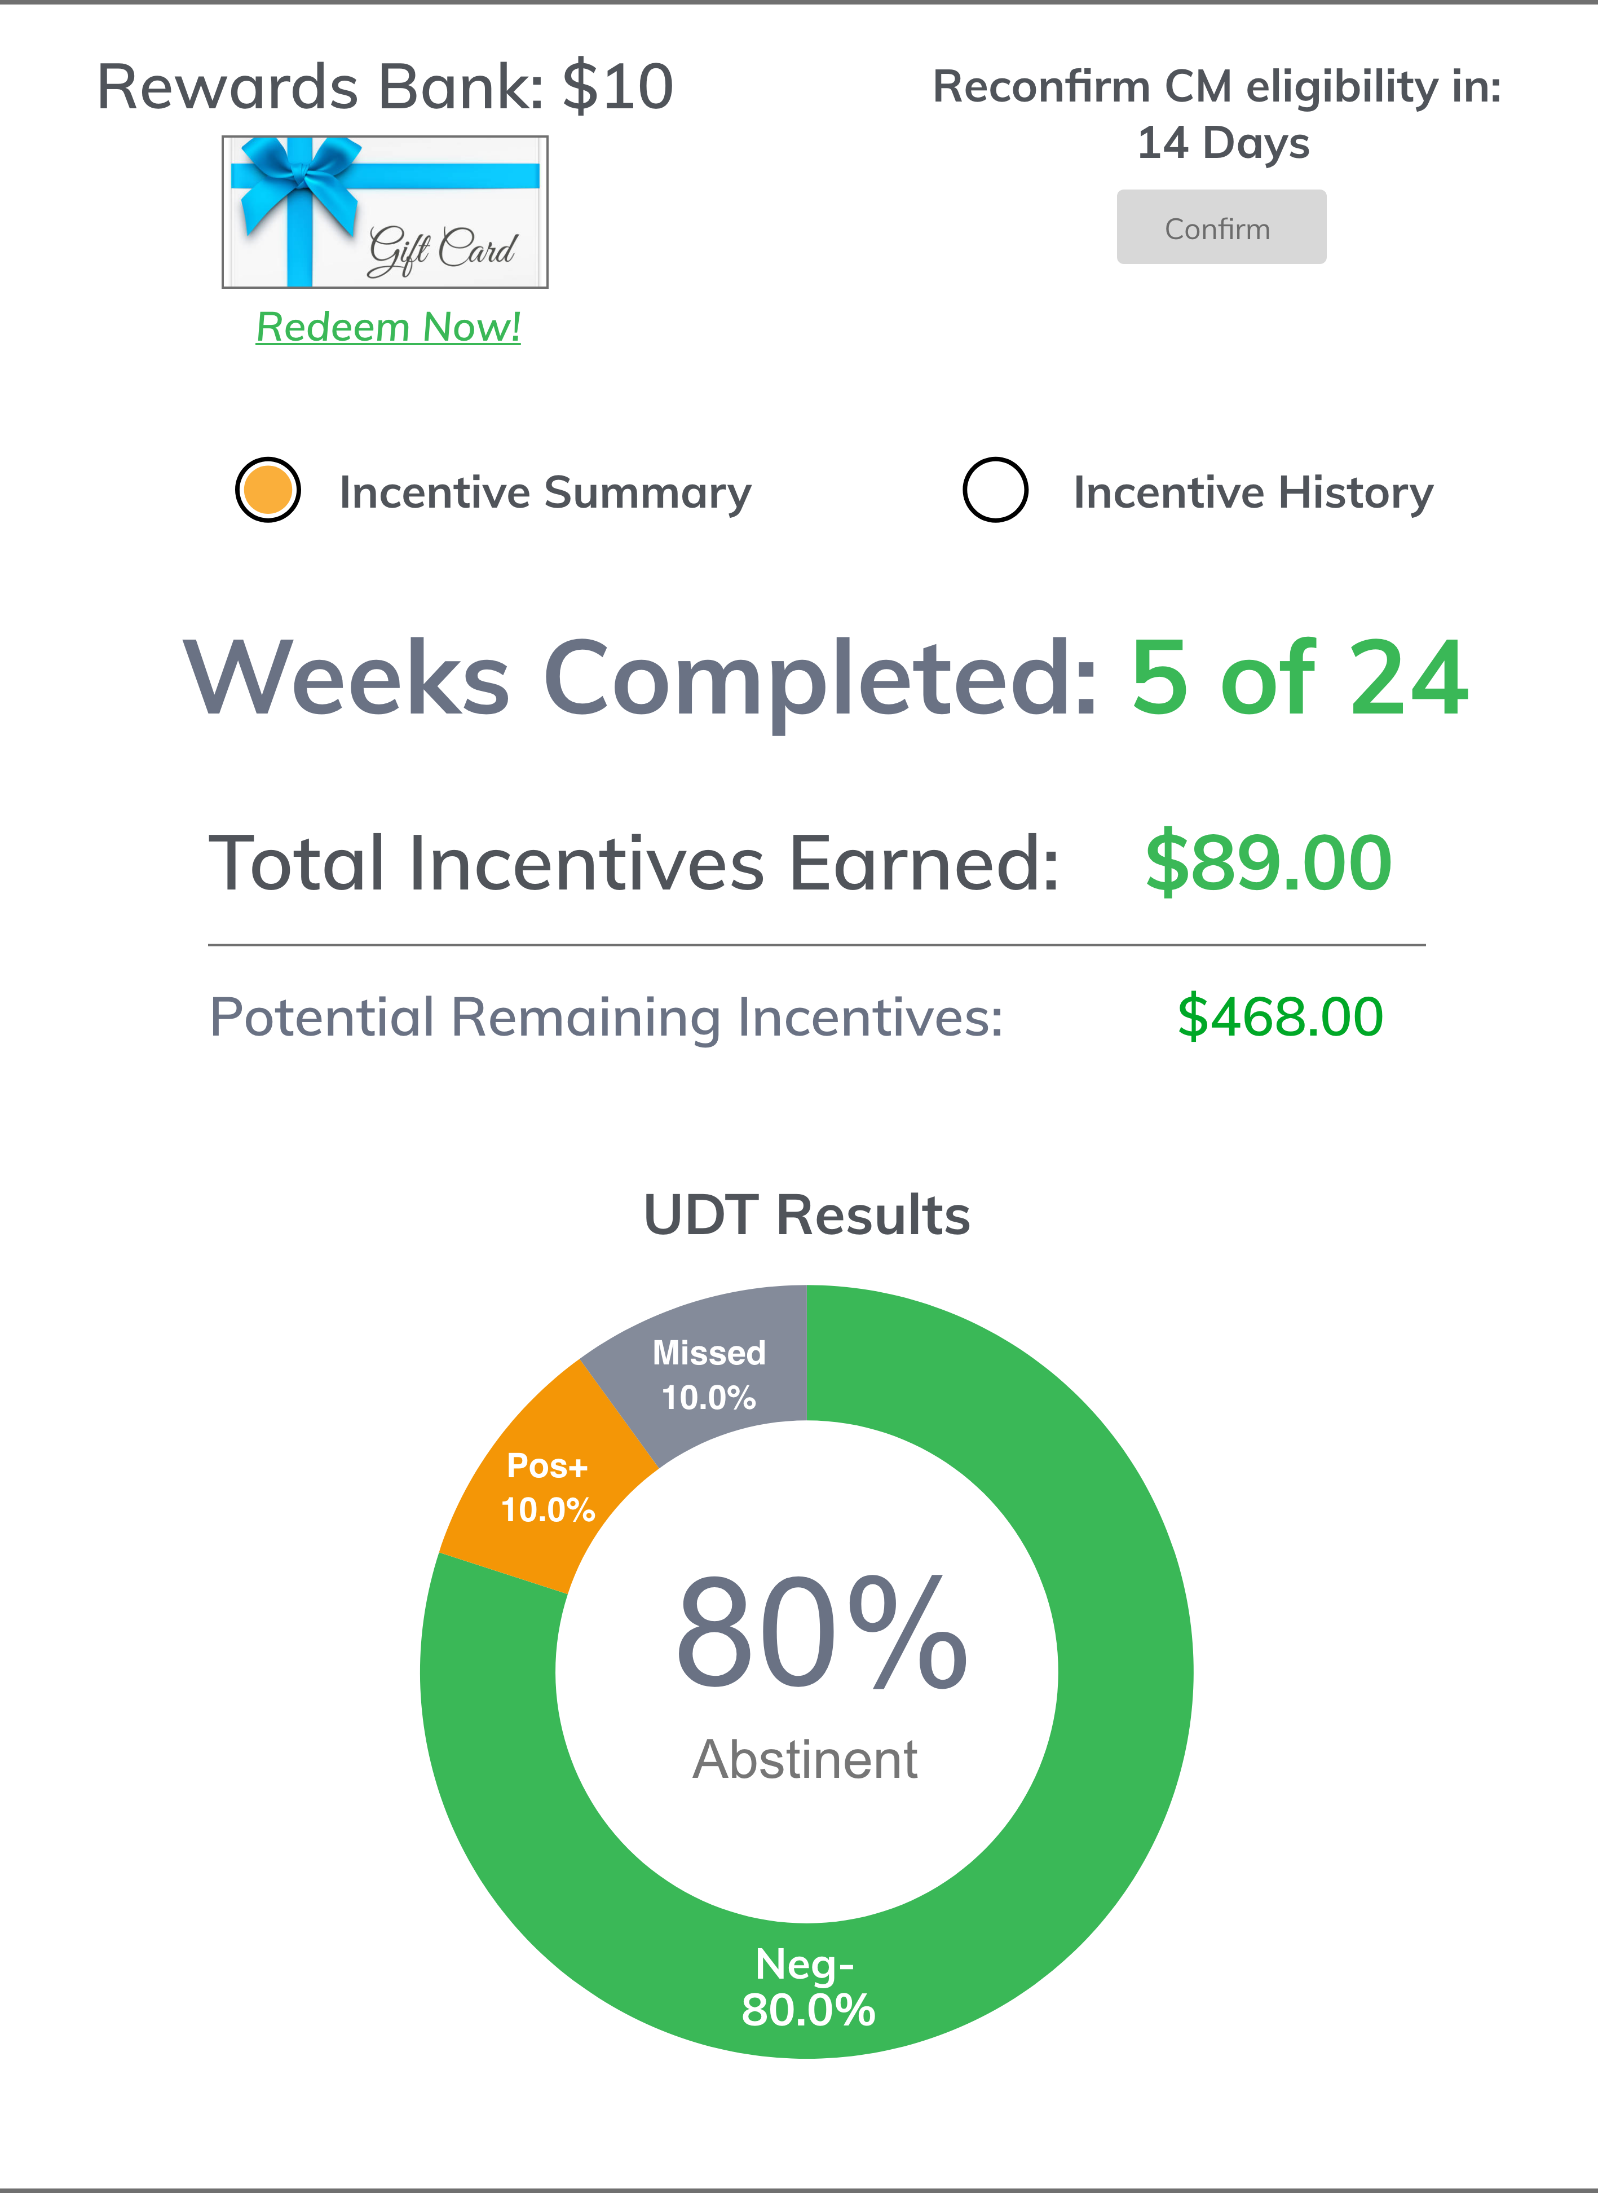
Rewards History
Managing Incentive Rewards
CM Coordinator
Rewards history can be seen
in two ways:
As a comprehensive list of
every reward earned:
  Date
  Delivery type
  Vendor
  Amount
As a summary of results
earned in total:
  Total earnings
  Percentages of sessions with
  negative UDT

Slide 48
Appropriate Disclaimer(s)
Managing Incentive Rewards
CM Coordinator
Incentive rewards cannot be used for the following uses:
  Alcohol
  Tobacco
  Gambling
  Cannabis
Vendor-specific gift cards are either for vendors who do not offer these items OR have inherent restrictions
Incentive rewards cannot be re-distributed once already delivered
“Please remember this gift card cannot be used to purchase alcohol, tobacco, cannabis, and/or lottery tickets or other gambling services.”
Wal-Mart additionally restricts the purchase firearms or ammunition.

Slide 49
Analytics and Reports

Slide 50
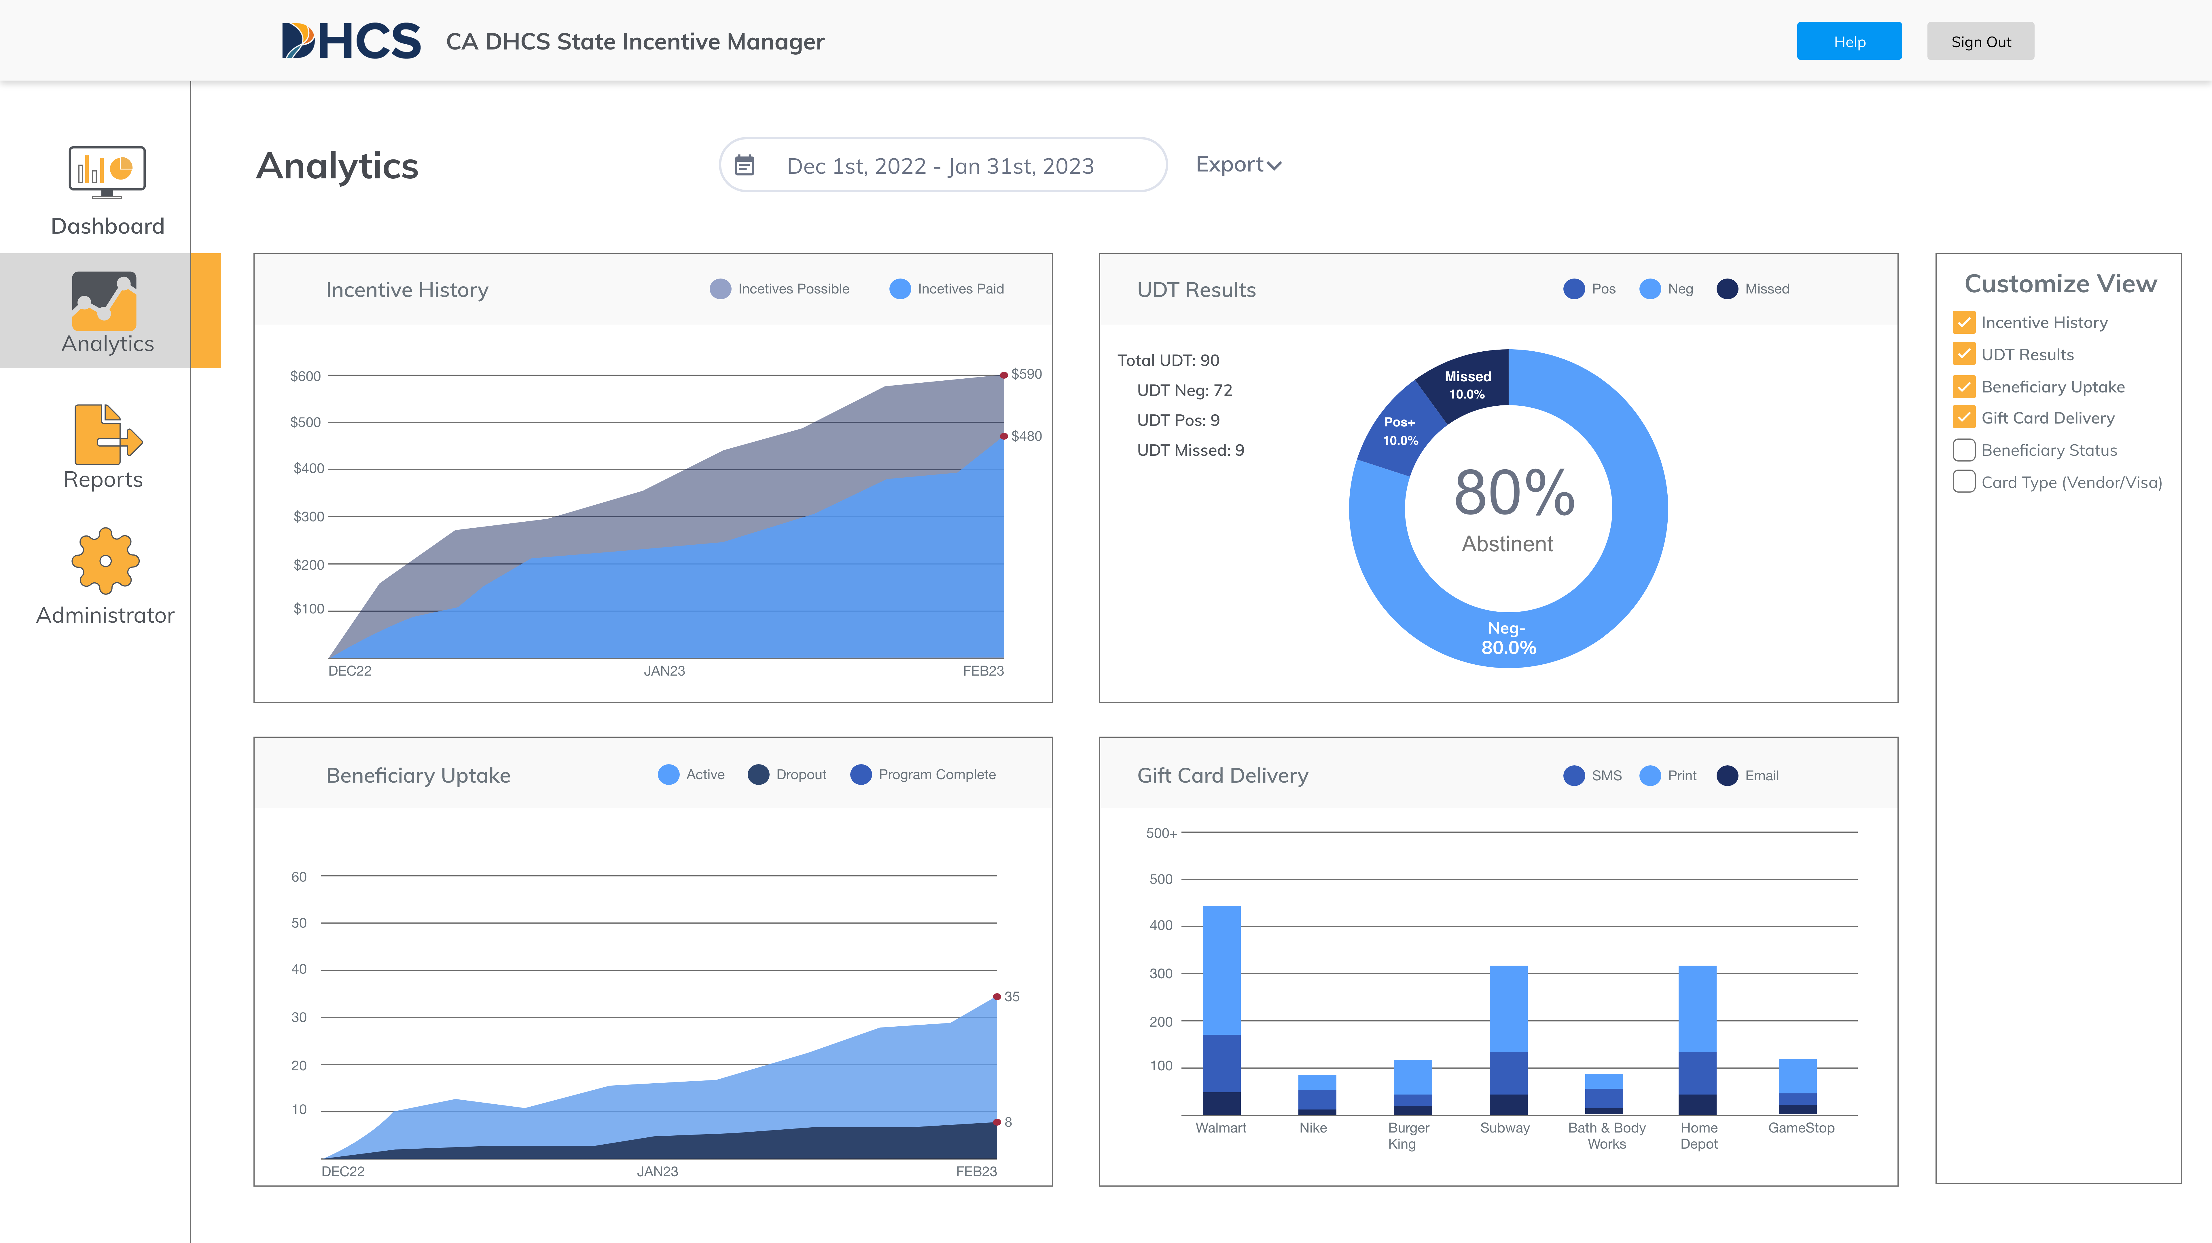
Analytics Pane
Analytics and Reports
CM Coordinator
The analytics pane is available by clicking “analytics” on the left pane.
The analytics pane is highly customizable by the user using the “customize view” pane on the right side
Data can be downloaded as charts (.pdf)
Data can be selected based on a
specific date range

Slide 51
Analytics Customization
Analytics and Reports
CM Coordinator
Analytics panes can be customized based several factors (as can be see at right)
Selections by county will filter the data available in the charts on the left
Other selections will add new charts to the left side (here shown as reward history, UDT results, Member Uptake, and reward delivery type)

Slide 52
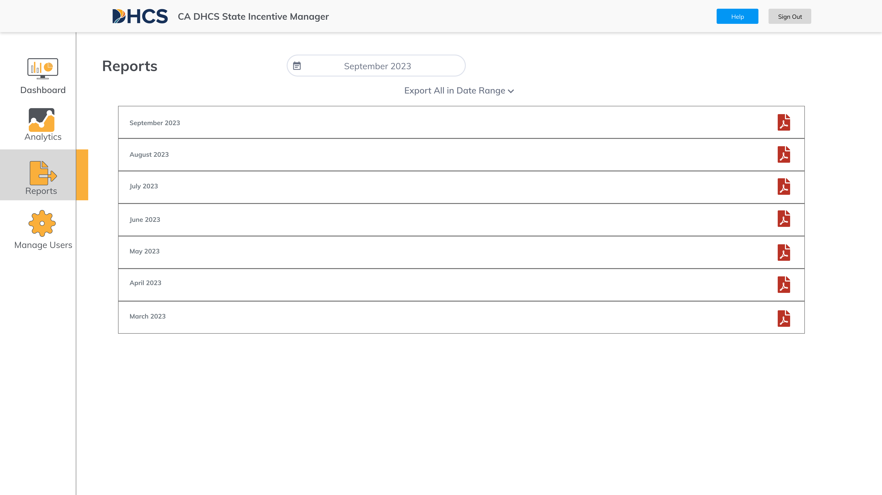

Analytics Report Pane
Analytics and Reports
CM Coordinator
Reports will be compiled automatically
by the system:
Reports are available monthly
Reports are available at all levels available for your role (see access rights) – you can select via dropdown
Reports can be selected for specific counties or providers – and at the aggregated levels
To select a report, click the “ ” icon
These reports do not contain any
member-level information (i.e., PHI).
These reports can be downloaded,
printed, or emailed.

Slide 53
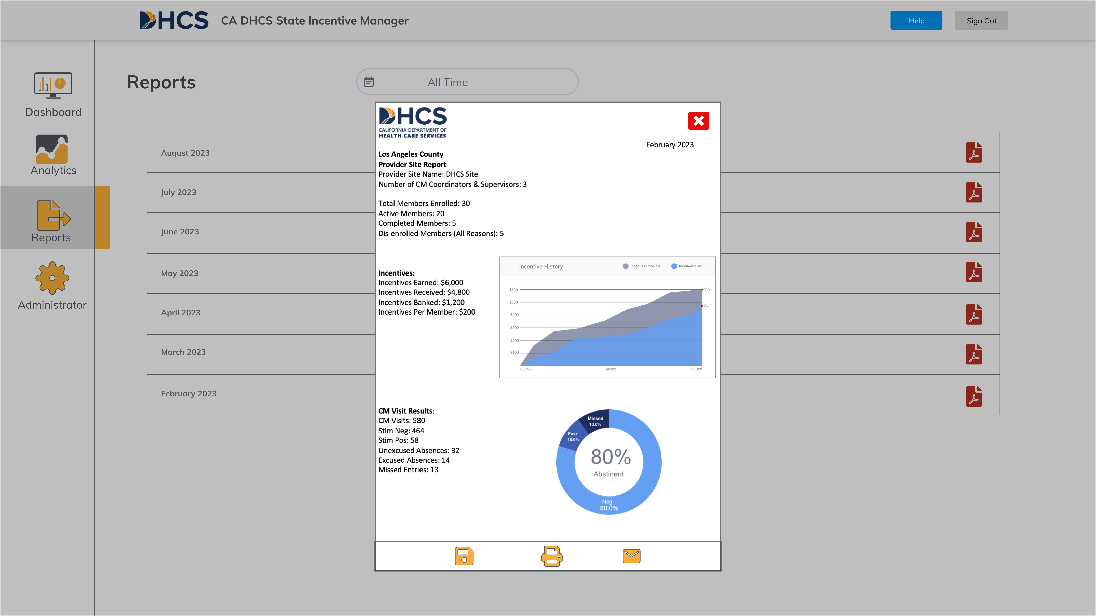
Reports
Analytics and Reports
CM Coordinator
Once a specific report is selected, it will be downloaded as a .pdf to your local machine.
Once these reports are downloaded you can open the .pdf file to view the contents
These reports do not contain any member-level information (i.e., PHI).
Number of Members: 930

Slide 54
Help Center and Support

Slide 55

Locating the Portal Help Center
Help Center and Support
From any pane you can find the help button
The button is in the same spot
for each portal view

Slide 56
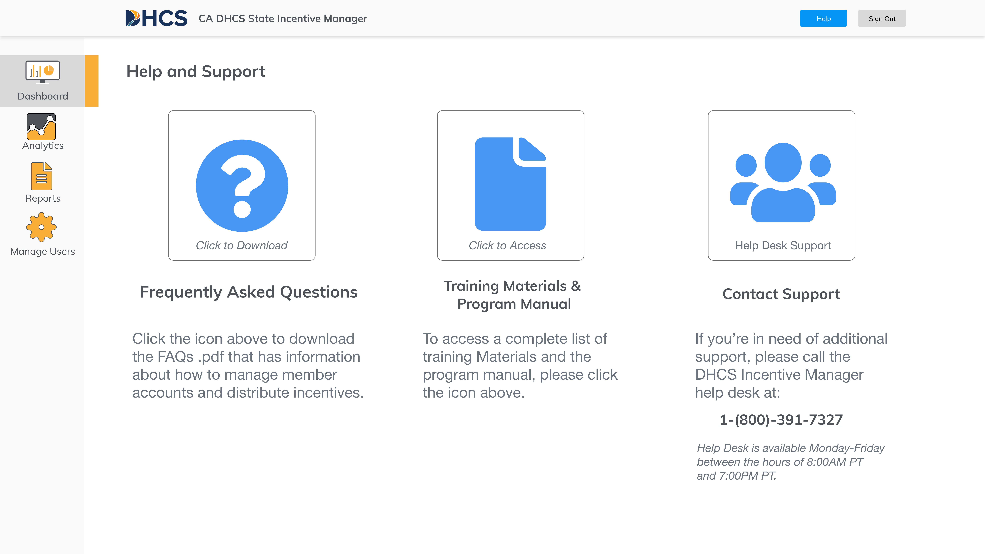
Overview of the Portal Help Center
Help Center and Support
There are 3 types of support available in the portal:
Frequently Asked
Questions Documents (.pdf)
Training Materials (UCLA site)
Call center available by phone
1
2
3
1
2
3
1 (800) 454-1698

Slide 57
Q2i Call Center
Help Center and Support
Call Center
DHCS Program Call Center +1 (800) 454-1698

