Slide 1
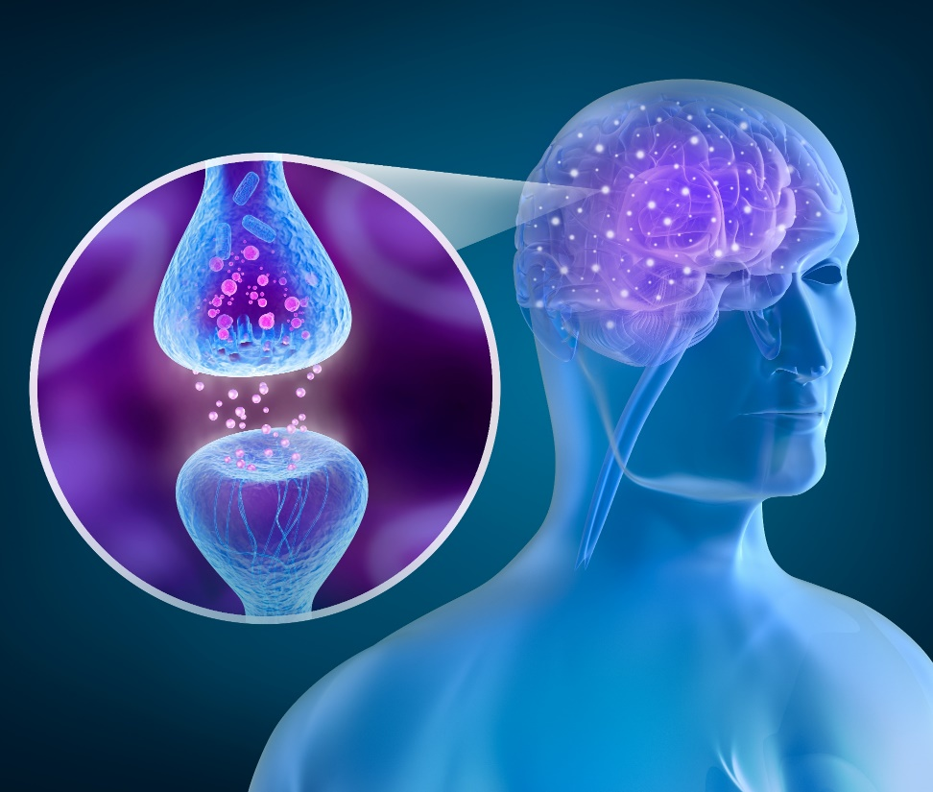
Part 1: Mechanism of Action of Opioids and the Impact on the User’s Brain and Body
Opioid Use Disorder (OUD) Curriculum Infusion Package (CIP)
Pacific Southwest Addiction Technology Transfer Center, HHS Region 9
Notes:
This is the first part in a 5-part Curriculum Infusion Package (CIP) on Opioid Use Disorders (OUD) developed in 2019 by the Pacific Southwest Addiction Technology Transfer Center. The main developers were Beth Rutkowski, MPH, and Nancy Roget, MS, with additional guidance and editing support provided by Drs. Thomas E. Freese and Michael Shafer.
The OUD CIP was developed for college and university faculty to infuse brief, science-based OUD-specific content into existing substance use disorder-related course syllabi (e.g., foundations of addiction, screening and assessment, etc.). Instructors can select the specific content to infuse throughout the duration of the course, depending on specific needs of the learners. Each slide contains notes for the instructor to provide guidance, as necessary. References are included in each slide and handouts when possible.
Part 1 provides a brief overview of addiction as a brain disease, a description of opioids and how they work in the brain and body, the acute and chronic effects of opioid use, the epidemiology of the opioid epidemic, and resources for continued learning.
If you require further information on this topic, please do not hesitate to contact the Pacific Southwest ATTC (http://www.psattc.org). You are free to use these slides and the pictures, but please give credit to the Pacific Southwest ATTC when using them by keeping the logo on each slide and referencing the Pacific Southwest ATTC at the beginning of your presentation.
The Pacific Southwest ATTC (HHS Region 9) is part of the SAMHSA-funded ATTC network that offers training/technical assistance (TA) services through a partnership with UCLA Integrated Substance Abuse Programs, Arizona State University School of Social Work , and University of Nevada-Reno Center for the Application of Substance Abuse Technologies. HHS Region 9 is comprised of Arizona, California, Hawaii, Nevada, and the six U.S.-affiliated Pacific Jurisdictions (American Samoa, Commonwealth of the Northern Mariana Islands, Federated States of Micronesia, Guam, Republic of the Marshall Islands, and Republic of Palau). For additional information, please access its website at http://www.psattc.org. Additional resources are available to enhance and support the information provided in this brief presentation.
IMAGE CREDIT:
Getty Images (purchased image).

Slide 2
Why Do People Use Drugs?
To feel good
and have novel:
Feelings
Sensations
Experiences
AND
To share them
To feel better
and lessen:
Anxiety
Worries
Fears
Depression
Hopelessness
Withdrawal
Notes:
Pose the question to the audience. After they have given you a few answers, click the mouse once and the “To feel good” column appears. Click the mouse again and the “To feel better” column appears. Make the point that substances are both positively (the “to feel good” column) and negatively (the “to feel better” column) reinforcing.
In other words, a major reason people take a drug is they like what it does to their brain.
Incorporate NIDA Reward Circuit Video here: https://youtu.be/DMcmrP-BWGk (1:48, NIDA, The Reward Circuit, not opioid specific)
REFERENCE:
National Institute on Drug Abuse. Bringing the full power of science to bear on drug abuse and addiction. Retrieved fromhttps://www.drugabuse.gov/sites/default/files/addictionscience.ppt.
IMAGE CREDIT:
National Institute on Drug Abuse website.

Slide 3
A Major Paradigm Shift Occurred in the Late 1990s
Recognizing addiction as a chronic, relapsing brain disorder characterized by compulsive drug seeking and use can impact society’s overall health and social policy strategies and help diminish the health and social costs associated with drug abuse and addiction.
SOURCE: Leshner. (1997)
Notes:
In 1997, Dr. Alan Leshner, then-Director of the National Institute on Drug Abuse, published what became a seminal article on how we conceptualize substance use and addiction. Until then, it had largely been considered to be a problem of self-discipline or a moral failing. Part of what he says in the article is this (advance the slide, and the sentence in the box will pull out). (Read the sentence) then ask “what parts of this statement strike you as being important, and why?” (typically people will point out “chronic, relapsing brain disorder”, “compulsive drug seeking and use”, “society’s overall health and social policy strategies”, and “diminish health and social costs”.) Engage in a discussion of why each of those is important in how we define addiction.
Decades of research have revealed addiction to be a disease that alters the brain. We now know that while the initial decision to use drugs is voluntary, drug addiction is a disease of the brain that compels a person to become singularly obsessed with obtaining and using drugs despite their many adverse health and life consequences.
REFERENCE:
Leshner, A. (1997). Addiction is a brain disease, and it matters. Science 278.

Slide 4
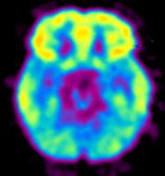
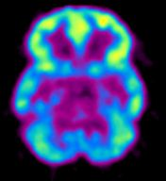
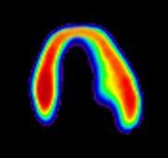
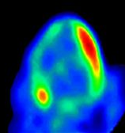
Addiction is Like Other Chronic Illnesses
Decreased Brain Metabolism
in Drug User
Decreased Heart Metabolism Heart Disease Patient
High
Healthy Brain
Diseased Brain/
Cocaine User
Low
Healthy Heart
Diseased Heart
Research supported by the National Institute on Drug Abuse addresses all of these components of addiction.
It is preventable
It is treatable
It changes biology
If untreated, it can last a lifetime
Notes:
Addiction is similar to other chronic diseases. Using imaging technology to measure metabolism (in this case, glucose uptake) in the brain and heart, one can see that both addiction and heart disease produce observable changes in organ function. In each pair of images shown above, the healthy organ shows greater activity (reds and yellows) than the diseased organ. In drug addiction, the frontal cortex, which is a part of the brain associated with judgment and decision-making, is significantly affected. Like heart disease, drug addiction can be prevented and treated successfully. If left untreated, however, its effects can last a lifetime.
Advances in medicine and scientific techniques have given researchers a clearer idea of what addiction is, including Magnetic Resonance Imaging (MRI), Positron Emission Tomography (PET), and advanced genetic research.
On a fundamental level, addiction is a brain disease, but it is not just a brain disease. “No single factor determines whether a person will become addicted to drugs. The overall risk for addiction is impacted by the biological makeup of the individual – it can even be influenced by gender or ethnicity, his or her developmental stages, and the surrounding social environment (e.g., conditions at home, at school , and in the neighborhood (NIDA, 2007).”
Addiction also has a strong genetic component. It is estimated that between 40 and 60% of an individual’s vulnerability to addiction is due to genetic factors. For instance, there may be a gene or genes that are “turned on” by environmental factors in childhood. “As with any other disease, vulnerability to addiction differs from person to person. In general, the more risk factors an individual has, the greater the chance that taking drugs will lead to abuse and addiction. Scientists estimate that genetic factors account for between 40 and 60% of a person’s vulnerability to addiction, including the effects of environment on gene expression and function (NIDA, 2010).”
REFERENCE:
NIH Pub No. 07-5605, February 2007.
IMAGE CREDITS: NIH, 2007.

Slide 5
What are Opioids?
Opiate: derivative of opium poppy
Morphine
Codeine
Opium
Opioid: any compound that binds to opiate receptors
Semi-synthetic (heroin = derived from morphine, buprenorphine from Thebaine, oxy + hydrocodone, oxy + hydromorphone)
Synthetic (dextropropoxyphene, fentanyl, methadone, tramadol)
Route of administration: oral, transdermal, intravenous, and implantable
Narcotic: legal designation
Notes:
Opiates are derived from the poppy plant Papaver somniferum and include morphine, codeine, and opium. There are also synthetic or semisynthetic (man-made) compounds produced from derivatives of the opium poppy. For instance, heroin is derived from morphine, and buprenorphine is derived from Thebaine. Synthetic compounds include Fentanyl, Methadone, and Tramadol. Opiates and opioids can be taken orally and intravenously. Additionally, there are implantable versions such as long-acting buprenorphine (probuphine), which is active for six months, and patches that can be placed on the skin to deliver the medication as in the case of fentanyl patches. Opioids are designated a “narcotic” and are incredibly effective at relieving pain, reducing severe coughs and diarrhea.
Opioids are usually prescribed to treat pain. They work by reducing the signaling of pain messages to the brain and reduce pain. They act on the opioid receptors to produce morphine-like effects. The onset of action for the various types of opioids depend on the route of administration, with injection and smoking being the quickest way to get the desired effect.
Is there a difference between the terms “opiate” and “opioid”? Yes, there is. Opiate is a term used to describe drugs or medications derived directly from the opium poppy. Opioids include all opiates, but also include chemicals that have been synthesized. Opioid is a broader term of encompassing opiates that operate on the opioid receptor and produce similar effects to that of morphine. Most noted for their pain relief and euphoric effects, opioids produce a predictable response and equally predictable set of side-effects.
IMAGE CREDITS:
Top: Wikimedia Commons.
Bottom: Flickr purchased image.

Slide 6
How Do Opioids Work in the Brain?
Opioids are highly addictive
Brain cells can become dependent on exogenous opioids to the extent that users require regular dosing in order to function in their daily routine
Opioids initially cause a rush of pleasure (euphoria)
Opioids slow down the way you think, slow down reaction time, and slow down memory – this, in turn, impacts the way a person who uses opioids acts and make decisions
Notes:
Four main types of opioid receptors exist, although most often the mu, delta, and kappa receptors are designated as being responsible for the notable analgesic properties of opioids. Opioids also activate the dopamine reward pathway resulting in a sense of euphoria. There are three types of opioid receptor interactions – full agonists, partial agonists, and antagonists.
Opioids act by attaching to and activating opioid receptor proteins, which are found on nerve cells in the brain, spinal cord, gastrointestinal tract, and other organs in the body. When these drugs attach to their receptors, they inhibit the transmission of pain signals. Opioids can also produce drowsiness, mental confusion, nausea, constipation, and respiratory depression, and since these drugs also act on brain regions involved in reward, they can induce euphoria, particularly when they are taken at a higher-than-prescribed dose or administered in other ways than intended.
IMAGE CREDITS:
Getty Images (purchased images).

Slide 7
Why are Opioids so Addictive?
Notes:
This slide contains a video clip that will play when the instructor clicks on the mouse one time. In order for this to work, the connection between the PowerPoint presentation and the video file must be maintained. When moving the PowerPoint file to another location on your computer or to another computer, make sure to always move the video file along with it. If the link becomes broken, the video will need to be reinserted. Delete the still video image that appears on the screen. From the insert menu in PowerPoint, select “movie.” Select the video file that was included for this training. When asked, indicate that the movie should play automatically. It will appear as a black box on the screen.
This video, entitled “Science Says, Why are Opioids So Addictive?” features Dr. Nora Volkow, Director of the National Institute on Drug Abuse. It provides a succinct review of why opioids are so addictive. Once the video is finished playing, engage students in a discussion of what they think about what they just saw and heard.
Video Duration: 1:54. Source: Associated Press/NIDA. Available for download from: https://youtu.be/aF4GtW5B3uc.
Additional video resources:
https://www.youtube.com/watch?v=NDVV_M__CSI (4.37, National Geographic)
https://www.youtube.com/watch?v=Mnd2-al4LCU (16:22, TEDMED Talk, Dr. Volkow)

Slide 8
What are the Acute Effects of Opioids?
Euphoria
Pain relief
Suppresses cough reflex
Histamine release
Warm flushing of the skin
Dry mouth
Drowsiness and lethargy
Sense of well-being
Depression of the central nervous system
Sedation
Pupil constriction
Slurred speech
Impaired attention/memory
Constipation, urinary retention
Nausea
Confusion, delirium
Seizures
Slowed heart rate
Respiratory depression
Notes:
This slide details the many acute effects of opioid use. People who use heroin report feeling a "rush" (a surge of pleasure or euphoria). However, there are other common effects, including:
dry mouth
warm flushing of the skin
heavy feeling in the arms and legs
nausea and vomiting
severe itching
clouded mental functioning
going "on the nod," a back-and-forth state of being conscious and semiconscious
Heroin often contains additives, such as sugar, starch, or powdered milk, that can clog blood vessels leading to the lungs, liver, kidneys, or brain, causing permanent damage. Also, sharing drug injection equipment and having impaired judgment from drug use can increase the risk of contracting infectious diseases such as HIV and hepatitis (see "Injection Drug Use, HIV, and Hepatitis").
REFERENCE:
National Institute on Drug Abuse; National Institutes of Health; U.S. Department of Health and Human Services. Available at: https://www.drugabuse.gov/publications/drugfacts/heroin.

Slide 9
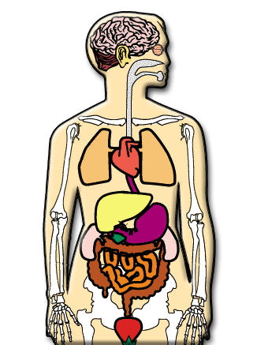
What are the Chronic Effects of Opioids?
Fatal overdose
Collapsed veins (intravenous use)
Elevated risk for infectious diseases (HIV/HCV)
Infection of the heart lining and valves
Pulmonary complications and pneumonia
Respiratory problems
Abscesses
Liver disease
Low birth weight and developmental delay
Constipation
Cellulitis
Notes:
People who inject drugs such as heroin are at high risk of contracting the HIV and hepatitis C (HCV) virus. These diseases are transmitted through contact with blood or other bodily fluids, which can occur when sharing needles or other injection drug use equipment. HCV is the most common blood born infection in the United States. HIV (and less often HCV) can also be contracted during unprotected sex, which drug use makes more likely.
Those who are physically dependent on an opioid and stop using the drug abruptly may have severe withdrawal. Withdrawal symptoms—which can begin as early as a few hours after the drug was last taken—include: restlessness; severe muscle and bone pain; sleep problems; diarrhea and vomiting; cold flashes with goose bumps ("cold turkey"); uncontrollable leg movements ("kicking the habit"); and severe heroin cravings.
Once the body becomes accustomed to an opioid being present, it may react if the opioid is removed. The intensity of the withdrawal symptoms will depend on the level of use (dose and type of opioid) and the frequency and duration of use (chronicity). Withdrawal symptoms are basically a rebound effect; those functions that have been depressed or altered by the opioid suddenly emerge again. Withdrawal symptoms are often the opposite of symptoms seen when actively using the opioid (e.g., people get constipated when taking opioids and have diarrhea when withdrawing). The length of withdrawal depends on the half-life of the opioid. Opioids with short half-lives (e.g., heroin) have acute withdrawal symptoms that peak at 3-4 days and then subside by days 3-7. Opioids with longer half-lives have longer acute withdrawal periods. Regardless of the length of the acute withdrawal, there are protracted withdrawal symptoms (e.g., aches and pains, general malaise) that persist for weeks or months after use ceases. Protracted withdrawal symptoms are less severe than the acute symptoms, but are still experienced as extremely disruptive and uncomfortable.
Researchers are studying the long-term effects of opioid addiction on the brain. Studies have shown some loss of the brain’s white matter associated with heroin use, which may affect decision-making, behavior control, and responses to stressful situations.
REFERENCES:
Li, W., Li, Q., Zhu, J., et al. (2013). White matter impairment in chronic heroin dependence: a quantitative DTI study. Brain Res, 1531, 58-64. doi:10.1016/j.brainres.2013.07.036.
Liu, J., Qin, W., Yuan, K., et al. (2011). Interaction between dysfunctional connectivity at rest and heroin cues-induced brain responses in male abstinent heroin-dependent individuals. PloS One, 6(10), e23098. doi:10.1371/journal.pone.0023098.
Qiu, Y., Jiang, G., Su, H., et al. (2013). Progressive white matter microstructure damage in male chronic heroin dependent individuals: a DTI and TBSS study. PloS One, 8(5), e63212. doi:10.1371/journal.pone.0063212.
National Institute on Drug Abuse; National Institutes of Health; U.S. Department of Health and Human Services. Available at: https://www.drugabuse.gov/publications/drugfacts/heroin.
IMAGE CREDIT:
National Institute on Drug Abuse website.

Slide 10
Who Misuses Opioids?
SOURCE: McCance-Katz. (2018)
Notes:
According to the Substance Use and Mental Health Services Administration (SAMHSA), 11.4 million people age 12 and older misused opioids in the past year. This equates to 4.2% of the U.S. population. Of those opioid misusers, the majority misused a prescription pain reliever (11.1 million; 97.2% of opioid users). Less than 1 million (886,000) used heroin.
REFERENCE:
McCance-Katz. (2018). Opioid’s Grip: Millions Continue to Misuse Rx Pain Relievers while Heroin Use Climbed then Stabilized. 2016 NSDUH Report: America’s Behavioral Health Changes and Challenges. Available at: https://www.samhsa.gov/sites/default/files/topics/data_outcomes_quality/nsduh-ppt-09-2017.pdf.

Slide 11
What will happen if Opioid Use Disorders are not adequately treated?
SOURCE: NY Times. (2017)
Notes:
This slide is part of a series of scenarios that were published by the NY Times in 2017 in a “The Upshot” article entitled Drug Deaths in America are Rising Faster than Ever. It featured new data compiled from a variety of health agency sources (e.g., Centers for Disease Control and Prevention) and provided a series of estimates of forecasted death rates across a 10+ year time period. In 2015, there were 33,091 opioid-related deaths in the U.S. Scenario #1, represented by the red line at the top of the curve, shows the forecasted rate of opioid deaths for 2027 if nothing is done to try and expand access to medication-assisted treatment and prevent people from developing an opioid use disorder. If left unaddressed, the opioid-related death rate will climb to a staggering 93,600 deaths. Scenarios #2-9 show different, partial attempts to address the national opioid epidemic. Scenario #10, represented by the blue line at the bottom of the curve, shows the forecasted rate of opioid deaths if a comprehensive strategy is employed. Scenario #10 makes a few assumptions – doctors prescribe fewer opioids, states embrace prescription drug monitoring programs, and insurers enact reforms to increase treatment access. In other words, if access to FDA-approved mediations is expanded, and states and medical providers work collaboratively to prevent people from developing an opioid use disorder or experiencing an opioid overdose, the rising rates of opioid overdoses can be reversed. If a comprehensive approach is taken, the opioid death rate can be reduced to 21,300 deaths, a 36% decrease over the rate seen in 2015.
REFERENCE:
NY Times. (2017). The Upshot: Death Rates in America are Rising Faster than Ever. Published June 5, 2017. Available at: http://NYTimes.com/Upshot.

Slide 12
Resources for Continued Learning
ATTC Network’s Taking Action to Address Opioid Misuse (https://attcnetwork.org/centers/global-attc/taking-action-address-opioid-misuse)
NIDA Opioid Resource Page (https://www.drugabuse.gov/drugs-abuse/opioids)
CDC Opioids Portal (https://www.cdc.gov/opioids/)
HRSA Opioid Crisis Page (https://www.hrsa.gov/opioids)
HHS Prevent Opioid Abuse and Addiction Page (https://www.hhs.gov/opioids/prevention/index.html)
SAMHSA Data Page (http://www.samhsa.gov/data)
Notes:
This slide contains links to additional resources for continued learning. Students are encouraged to explore the scope of the opioid problem in more detail.
Additional components of the PSATTC’s OUD CIP include the following:
Part 2: Review of the FDA-approved Medications for the Treatment of Opioid Use Disorders
Part 3: Prevention of Opioid Overdose Part 4: Stigma and Substance Use Disorders (SUDs)
Part 5: Recovery Supports and Treatment Recommendations
The full CIP is available for viewing and downloading from http://www.psattc.org.
This product was created by the Pacific Southwest Addiction Technology Transfer Center (PSATTC) under a cooperative agreement (5UR1TI080211) from the Substance Abuse and Mental Health Services Administration (SAMHSA). The opinions expressed are the views of the presentation developers and do not reflect the official position of the Department of Health and Human Services (DHHS), SAMHSA or CSAT. No official support or endorsement of DHHS, SAMHSA, or CSAT for the opinions described in this program is intended or should be inferred.

