Slide 1
Treatment Perceptions Survey (TPS)
DMC-ODS
Survey Period: October 21-25, 2024
Notes:
County administrators, please feel free to tailor/edit these slides specifically for your provider network.

Slide 2
Why Are Counties/Providers Administering the TPS?
Address the data collection needs of the DMC-ODS waiver evaluation required by the Centers for Medicare and Medicaid Services (CMS)
Fulfill the county’s External Quality Review Organization (EQRO) requirement of conducting a client satisfaction survey using a validated tool
Support DMC-ODS Quality Improvement efforts

Slide 3
How Was the TPS Developed?
Adult version was based on San Francisco County’s Treatment Satisfaction Survey
Youth version was based on Los Angeles County’s Treatment Perception Survey for Youth
Input from stakeholders (e.g., county BH administrators, DMC-ODS evaluation Advisory Group, EQRO, DHCS, Youth System of Care Evaluation Team at Azusa Pacific University )
Notes:
Some survey items and procedures were adapted from the Consumer Perceptions Survey (MHSIP) administered on the Mental Health side. This was a QI tool that was developed with input from many stakeholders.

Slide 4

When Do Counties Administer the Surveys and Submit Data to UCLA?
Year | Survey Period Dates | Deadline Dates for Sending Paper Forms to UCLA | Deadline Dates for Submitting Electronic Data Files to UCLA
2024 | October 21-25 | November 15 | December 6
Notes:
Counties that have executed DMC-ODS contracts (e.g., have gone live) are required to administer the TPS. They have the option of submitting paper forms that UCLA will scan into a data base or submit electronic data files.

Slide 5

Who Should be Surveyed?
Youth (12 -17 years old) and adult (18 years old and older) clients who receive services in person, by phone or video during the survey period
  Treatment settings: OP/IOP, Residential, OTP/NTP, Detox/WM (standalone), partial hospitalization
  Includes clients receiving face-to-face services outside the office (e.g., field-based settings)
  Clients need complete the survey once (per facility/provider) during the survey period
  Whether the client participates in the survey or not, it will in no way adversely affect the services they receive
Notes:
The procedures for administering the TPS to adults and youth are the same.
Please DO NOT survey clients who are younger than 12 years old. The youth survey is intended for individuals between 12 and 17 years of age. Clients who are 18 years or older should be asked to compete the survey for adults.
However, clients up to age 20 who are receiving these services in youth programs through the Early and Periodic Screening, Diagnostic & Treatment (EPSDT) benefit may be offered the survey for youth (rather than for adults) and will be included in the analysis.

Slide 6
Who Should Not be Surveyed?
Clients who are not receiving services during the survey period
Clients in immediate crisis (e.g., emergency situations)

Slide 7
2024 TPS Data Collection Options for Adults and Youth
Online survey
Customized provider links, QR codes
Available in English and 12 threshold languages
Paper survey forms
V10-Revision 6/29/23
Available in English and 12 threshold languages, and in 1-page and 2-page (large font) versions
Notes:
Please encourage providers to offer clients the online survey. If clients do not have access to a computer or smart phone, or if for whatever reason prefer to fill out a paper survey form (e.g., difficulty navigating the online survey), they may do so. UCLA will scan and process the paper survey forms. Please be sure to use the paper survey forms (version 10), which are posted on the TPS website. Providers may use either or both of the data collection options.

Slide 8
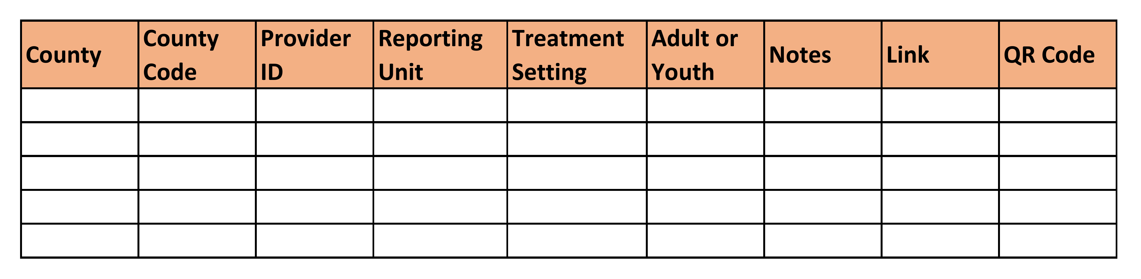
Sample Provider Spreadsheet
Provider Name/Address can be entered in “note”
County Coordinator will complete first 7 columns
UCLA will finalize the list by providing Link and QR Code
Notes:
UCLA will send each TPS County Coordinator its provider spreadsheet from the prior year for updating. UCLA will create customized survey links for each provider.

Slide 9
What is Important to Know About the Online Survey?
Secure and anonymous (no client identifiers collected)
Adult and Youth versions
Available in English and 12 threshold languages (Spanish, Arabic, Eastern and Western Armenian, Cambodian, Chinese, Farsi, Hmong, Korean, Tagalog, Russian, and Vietnamese)
Data collected using the online surveys are sent directly to UCLA
Daily counts (cumulative) will be sent to the county coordinator during the survey period
Notes:
The online survey uses the Qualtrics platform. Be sure to test the links as some firewalls may block access to the survey. If this happens, please check with your IT department. The links should work for clients away from the facility.
Providers are encouraged to test the links to become familiar with how the survey works.

Slide 10
How Are the Online Surveys Accessed?
UCLA will send customized/unique provider links/QR codes to TPS county coordinators based on updated provider lists.
County TPS coordinators send the unique links/QR codes to each provider.
Surveys can be accessed using a computer or smart phone.
  If the client is accessing the online survey at the facility/treatment setting, be sure the client can complete the survey in privacy.
Providers can email/text the links to clients or cut and paste the link into the chat box if using a video-conferencing platform (e.g., Zoom).
Clients click on the link or enter the URL using any browser (Google Chrome, Microsoft Edge, Microsoft Internet Explorer, Mozilla Firefox, and Apple Safari).
Clients can scan the QR code printed on paper (e.g., flyer) and/or shown on the screen if using a telehealth platform.
Notes:
Contact UCLA if your county has the Qualtrics platform and would like to administer the survey locally and submit electronic data files to UCLA.

Slide 11
TPS Paper Survey Forms (V10 - 6/29/23)
19 questions plus demographic items on the TPS Adult form
22 questions plus demographic items on the TPS Youth form.
Forms available in 13 languages, and in one-page and large print versions.
Be sure providers pre-fill the CalOMS Provider ID, and treatment setting using the fillable PDF files. Reporting Unit is optional.
Be sure clients use a black or dark blue pen.
Notes:
The paper survey forms (PDF files) are posted on the TPS website, and can be prefilled (CalOMS Provider ID, Report Unit [if required by the county], and treatment setting) using the fillable feature.

Slide 12
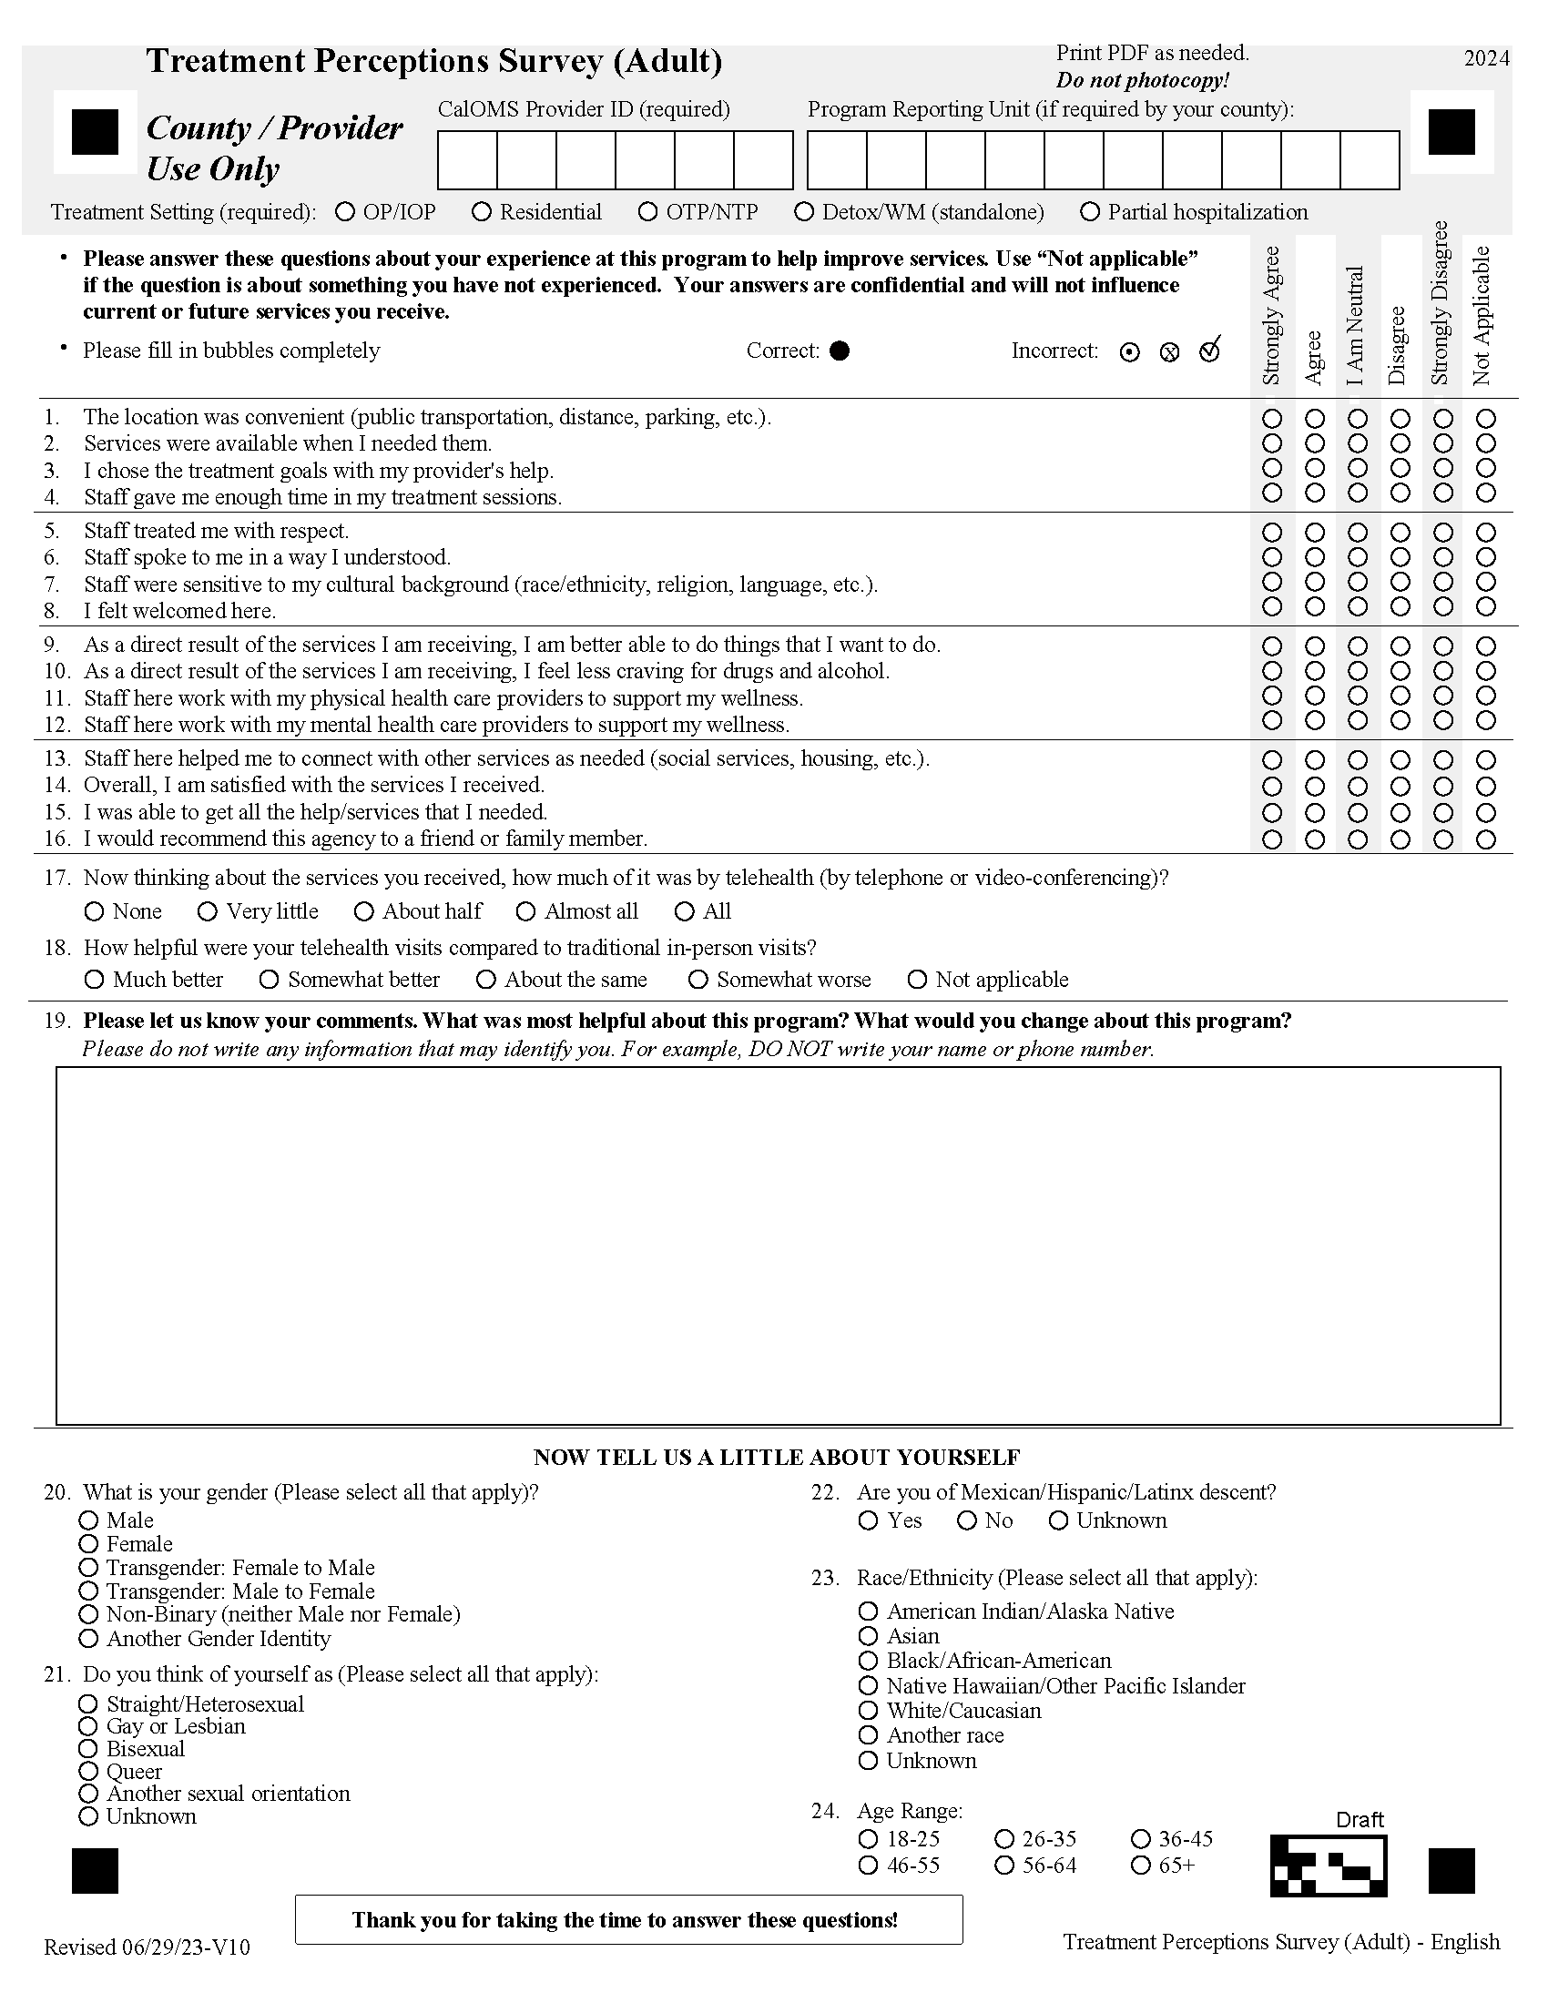

Slide 13
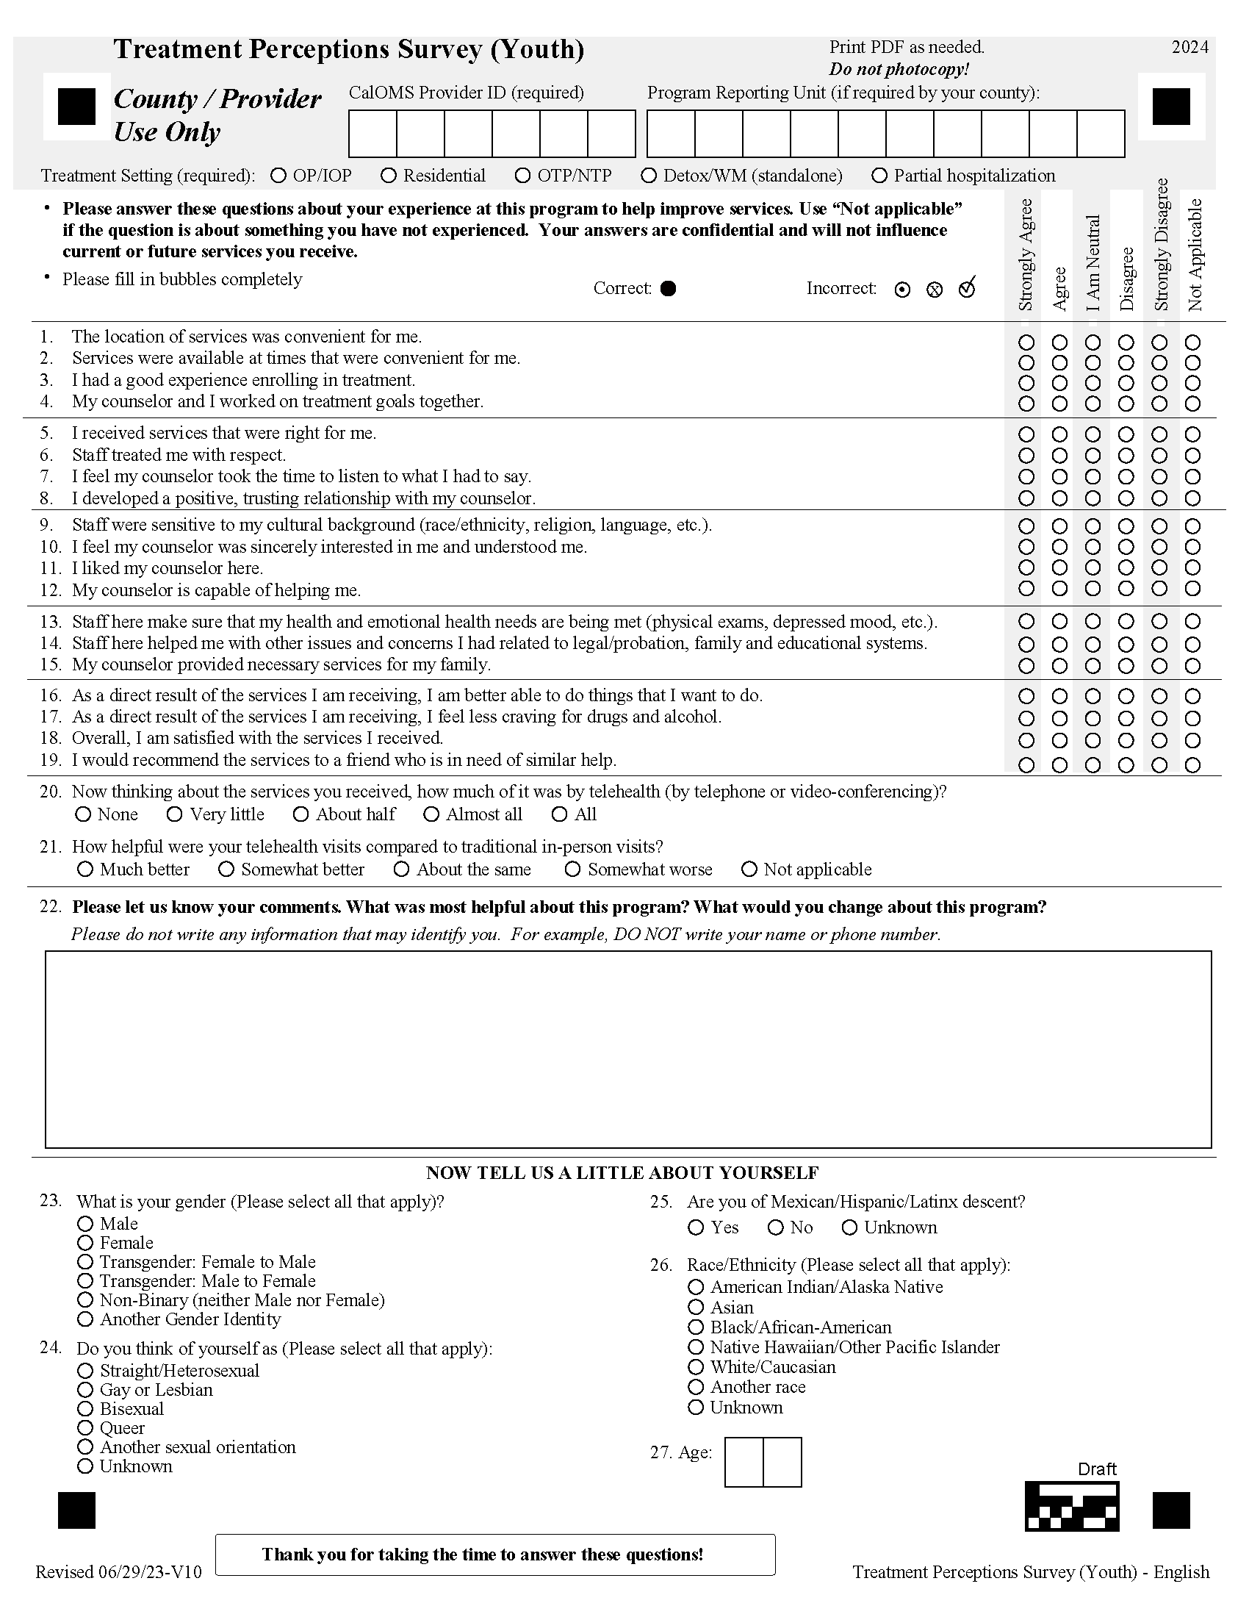

Slide 14
What Information Should Be Pre-filled?
Accurate information is required for UCLA to prepare county- and program-level summary reports for your county.
Fill in the information by using:
  the online fillable feature before printing the Adult and Youth TPS forms (PDFs); or
  a black or blue pen.
Notes:
This section is required to be pre-filled by the county coordinator or providers before offering the form to clients. The PDFs have a pre-fillable feature for the CalOMS Provider ID, Program Reporting Unit, and Treatment Setting. Please be sure that providers know their CalOMS Provider ID and Reporting Unit (if your county uses RUs) The appropriate treatment setting should also be filled in.
This information is required for purposes of the ODS evaluation and preparing county- and program-level reports. If the information is missing or inaccurate, the data may not be included in a program-level report or may be included in a report for the wrong program; comparisons across years at the program level may not be possible if the information changes from year to year.
Note: Some counties have found it helpful to fill in this information in the fillable PDF and print out the appropriate number of forms for each provider. Although this might be time and labor intensive, it will likely minimize problems associated with missing and inaccurate information.

Slide 15
How Should the Forms be Printed?
Download survey forms from PDF files that can be found on the TPS website. Please do not photocopy or enlarge/reduce the font of the survey forms.
Print in black/white on plain white paper.
Use both sides of the page (double-sided) when printing the 2-page (large print) forms. Do not staple or use paper clips to attach the pages.

Slide 16
How Should the Paper Survey
Forms Be Administered?
Offer youth paper survey forms to youth clients (12-17 years old) and adult paper survey adult clients (18 years or older) receiving services during the 5-day survey period.
  Clients need to complete only one form during the survey period.
  Whether the client completes the survey form or not, it will in no way adversely affect the services they receive.
Inform clients that the survey is anonymous. They should not write their names on the form.
Be sure clients use a black or dark blue pen on paper forms.
If clients make a mistake on the form, they should draw an “x” over the incorrect entry. Do not use white out.
Notes:
NTPs/OTPs: Because patients typically dose daily, they need complete only one survey form when they present for services during the survey period. Programs do not need to keep track of or monitor who has or has not completed a survey form. Staff can ask clients if they have already been offered survey forms during the survey period. If clients indicate that they have not been offered survey forms, staff can then hand them forms to complete.

Slide 17
What About Client Confidentiality?
Each participating provider must ensure their individual implementation of TPS procedures adheres to 42 CFR, part 2.
Direct service staff must not be present while the client completes the survey.
A family member, non-clinical staff person, consumer advocate, or volunteer may help the client complete the survey.
Staff are not to influence how a client responds or deny a client the opportunity to complete the survey.

Slide 18
Client Confidentiality – Paper Forms
If using paper survey forms, clients are to place completed forms directly into a ballot-type survey form collection box or large envelope.
Clients receiving services outside the office during the survey period should fill out a survey form and seal it in an envelope (provided by staff).
Staff should deposit the envelope into the survey collection box or large envelope with the other completed forms upon returning to the office.
Agency staff should package the completed forms for delivery/shipping to the designated county administrator who is coordinating the survey.

Slide 19
Special Note: Client Comments
It is the responsibility of the county coordinator to review the client comments prior to sending the forms to UCLA for anything that may need immediate attention.
If sending electronic data to UCLA, please do not include the client comments.
Notes:
UCLA does not have the resources to review client comments but will make the comments that are written within the comments box on the TPS form available to counties via the county’s folder in Box.
Note: Clients should not write their names or identifying information (e.g. phone number, address) in the Comments section or anywhere else on the TPS form.

Slide 20

How Should the County Submit Paper TPS Forms to UCLA for Scanning?
Compile completed survey forms from providers.
1
Complete and email the Shipment Form to UCLA.
UCLA will prepare FedEx shipping labels.
2
Pack the forms in a box/envelope and complete the Cover Sheet.
3
Be sure to seal/tape boxes well to prevent damage during shipping and to include the Cover Sheet.
Send the box(es)/envelope(s) to UCLA using the FedEx shipping label.
4
Notes:
Counties should review the forms to ensure that the CalOMS Provider ID, Reporting Units (if required by the county), and Treatment Settings are filled in accurately prior to submitting the forms (or data file) to UCLA.

Slide 21
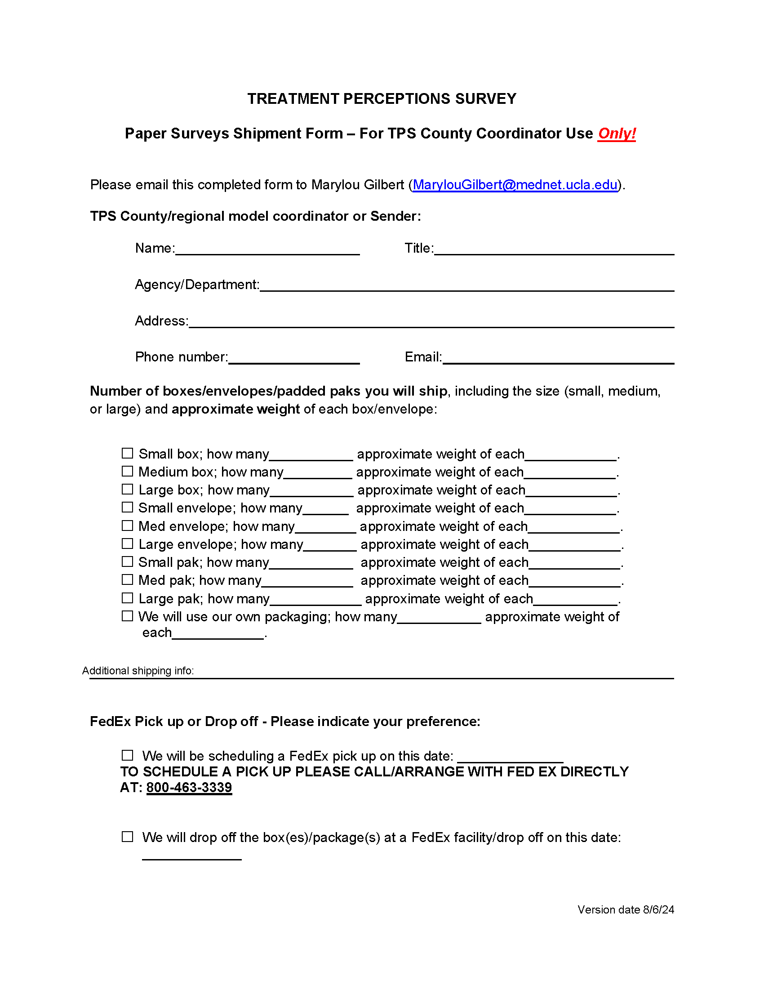


Shipment
Form
Notes:
The Shipment Form is available on the TPS website. Fill it out and email it to UCLA.

Slide 22
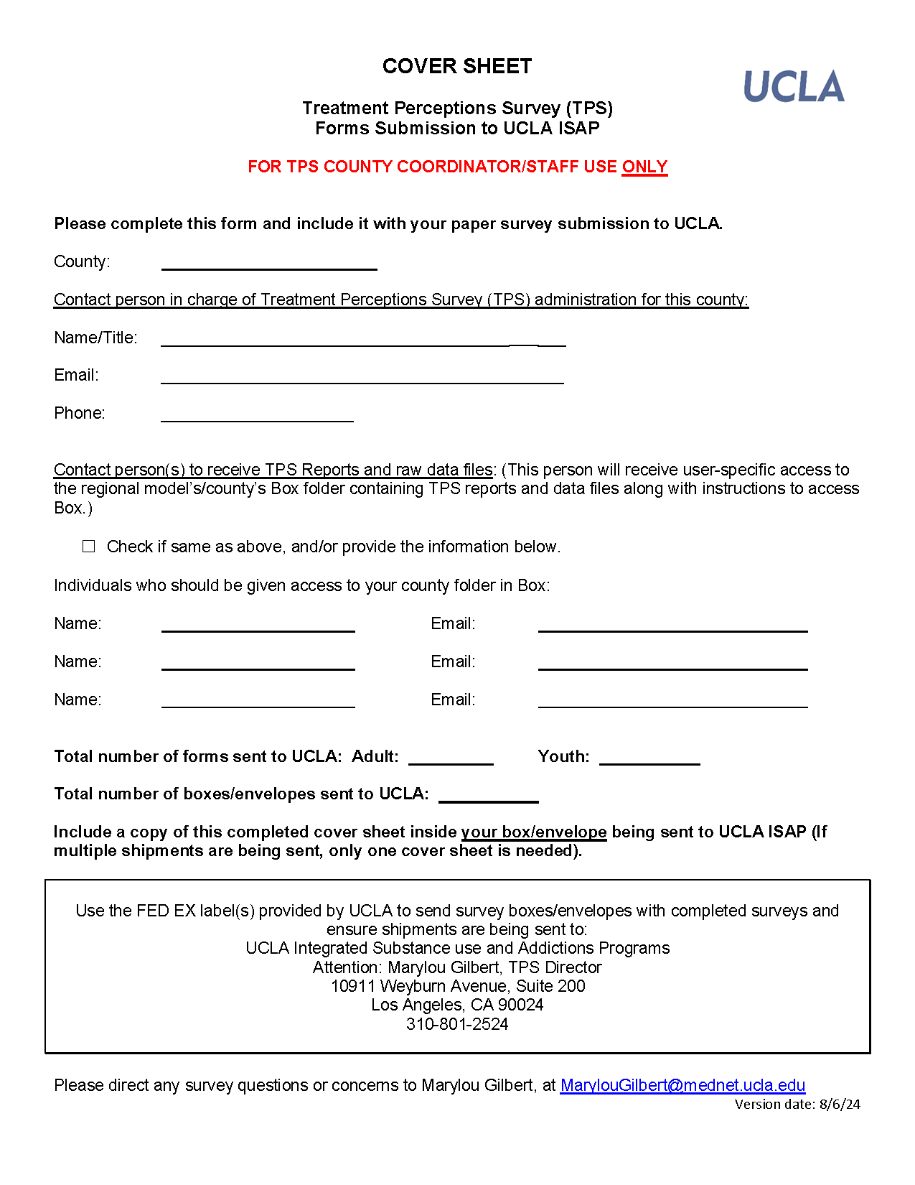

Cover Sheet
Notes:
This form is to be used by the TPS County Coordinator or other designated individual. Please be sure to complete and include this form with your shipment at the end of the survey period.

Slide 23
How Should the County Prepare and Submit Electronic TPS Data Files to UCLA?
Compile completed survey forms from providers.
1
Inform UCLA that your county will be submitting electronic data files rather than paper forms for scanning.
2
Follow the instructions posted on the TPS website for preparing and submitting electronic data.
3
Codebook
Uploading files to your county’s folder in UCLA Health Sciences Box
Notes:
This slide is for local processing counties only.
Information for counties that are submitting electronic TPS data are posted on the TPS website. Be sure to use the current Codebook when submitting your data.

Slide 24
What Are the County-Specific TPS Procedures?
--COUNTY TPS COORDINATORS--
PLEASE ADD COUNTY-SPECIFIC INSTRUCTIONS FOR YOUR PROVIDERS HERE.)
Notes:
County TPS Coordinators – please add a slide/slides with TPS procedures specific to your county (e.g., county TPS coordinator contact info, procedures, deadline for returning the forms to the county).

Slide 25

UCLA Will Conduct TPS Data Analysis and Reporting
UCLA will merge data into one data set for each county, where applicable (e.g., use of online, paper forms).
UCLA will analyze the data and prepare county- and program-level summary reports.
  Reports prepared within 3 months after receipt of completed survey forms or electronic data files.
UCLA will provide access to TPS raw data files, including comments.
Reports and data files will be accessible via the UCLA Health Science Box platform.
Notes:
Text typed into the Comments box of the survey will be included in the raw data files made available to the counties.
Raw survey data, including demographics and comments will be provided to the county.
UCLA’s Health Sciences Box – a secure HIPAA compliant file sharing platform – will be used to share files between UCLA and each county. If the county is not allowed to use this platform, please let UCLA know.
Programs that fill in the Program Reporting Unit field will receive Reporting Unit-level reports. Otherwise by default, reports will be prepared according to the CalOMS ID and treatment setting.
County-level summary reports will be shared with DHCS; county- and program-level summary reports, and raw data files will be shared with the EQRO.

Slide 26


What is the UCLA
Health Sciences Box?
It is a secure, HIPAA-compliant file-sharing platform.
Each county will have a separate folder.
UCLA will send an invitation to TPS county contacts to set up a free Box account.
County folders will contain county- and program-level summary reports and raw data files.
Counties should download the files as soon as possible.
Notes:
As mentioned earlier, the UCLA Health Sciences Box platform is being used to share files between counties and UCLA. Feel free to notify UCLA if you need more time to download the files.

Slide 27
What’s Posted on the TPS Website? https://www.uclaisap.org/dmc-ods-eval/html/client-treatment-perceptions-survey.html
Updates and Announcements
Technical Assistance Request
TPS Information Notice
FAQ
Presentation slides for county coordinators to adapt for providers in their network
Checklist for TPS county administrators/providers
Flyer templates for adult/youth (ENG/SPAN only)
Instruction Manual
Paper Survey Forms (dated: V10 – 6/29/23)
Statewide results
Important dates

Slide 28

Be sure to check the TPS web site periodically for updates (refresh the page each time you access):
https://uclaisap.org/client-treatment-perceptions-survey/
For questions or feedback, please contact Marylou Gilbert,
TPS Director at marylougilbert@mednet.ucla.edu

