Slide 1
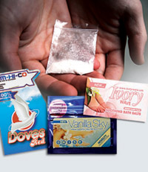
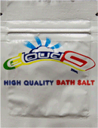
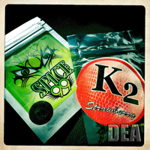
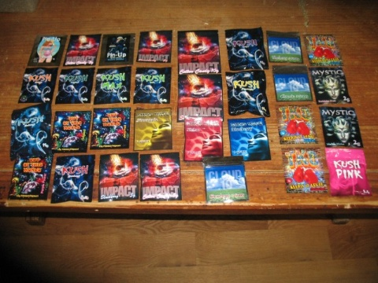
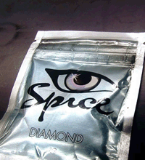



Will They Turn You into a Zombie?
What Clinicians Need to Know about Synthetic Drugs (2nd Edition)
TRAINER’S NAME
TRAINING DATE
TRAINING LOCATION
Notes:
**2nd Edition: 2013 updates**
The purpose of this educational training presentation is to provide clinicians from a variety of work and educational backgrounds (including, but not limited to physicians, dentists, nurses, other allied medical staff, therapists and social workers, counselors, specialists, and case managers working in substance use disorders, mental health, and other health-related settings) with a detailed overview of synthetic drugs, including substances known on the street as K2, Spice, and Bath Salts. The presentation defines key terms, describes the main classes of synthetic drugs commonly available, presents available data on the extent of use, provides information on identifying and assessing individuals who are using synthetic drugs, and concludes with some clinical implications of synthetic drug use. The duration of the presentation is approximately 3-3 ½ hours, depending on whether the presenter chooses to include all of the slides, or a selection of slides.
Slides 8-19 have been included for audiences who have little or no familiarity with psychoactive drugs and substance use disorder-related terminology. If you are presenting to an audience that is knowledgeable about substance use disorders, you may decide to hide these slides when presenting the rest of the information.
Case examples and clinical case studies have been inserted throughout the presentation to encourage dialogue among attendees, and to illustrate how the information presented can be used clinically.

Slide 2
Training Collaborators
South Southwest Addiction Technology Transfer Center
  University of Texas at Austin, School of Social Work
Pacific Southwest Addiction Technology Transfer Center
  UCLA Integrated Substance Abuse Programs
Centre for Addiction and Mental Health, Research Imaging Centre
Notes:
This PowerPoint presentation and companion Trainer Guide and reference list were developed by Jane Maxwell, Ph.D., Beth Rutkowski, M.P.H., and Doris Payer, Ph.D., through a collaboration between the South Southwest ATTC (1 UR1 TI024235, SAMHSA/CSAT), Pacific Southwest ATTC (1 UR1 TI024242, SAMHSA/CSAT), The University of Texas at Austin, School of Social Work, UCLA Integrated Substance Abuse Programs, and the Centre for Addiction and Mental Health (CAMH) Research Imaging Centre.
The opinions expressed herein are the views of the authors and do not reflect the official position of the Substance Abuse and Mental Health Services Administration, Center for Substance Abuse Treatment or the Centre for Addiction and Mental Health, Research Imaging Centre. No official support or endorsement of SAMHSA-CSAT or CAMH-RIC for the opinions described within this presentation is intended or should be inferred.

Slide 3
Special Acknowledgements
Dr. Volker Auwaerter, University Medical Center Freiburg, Germany
Dr. Michael Bauman, Intramural Research Program, NIDA
Dr. Raimondo Bruno, University of Tasmania
Mathias Forrester, Texas Department of State Health Services
Dr. Paul Griffiths, EMCDDA
James Hall, Nova Southeastern University
Dr. Barry Logan, National Medical Services Labs, Inc.
J. Randall Webber, JRW Behavioral Health Services
Notes:
The authors wish to acknowledge several colleagues for their important contributions to this educational presentation.

Slide 4
Introductions
Briefly tell us:
What is your name?
Where do you work and what you do there?
Who is your favorite musician or performer?
What is one reason you decided to attend this training session?
Notes:
INSTRUCTIONS
In an effort to break the ice and encourage group interaction, take a few minutes to ask training participants to briefly share the answers to one or more of the four questions featured on the slide. You can ask for several volunteers to share their responses, if the size of your audience prevents all participants from sharing.

Slide 5
What are we talking about?
(Insert U.S. Navy Bath Salts video)
Notes:
OPTIONAL ACTIVITY – INSTRUCTIONS
**Allow 10 minutes to show the brief video (6:37 in length) and facilitate a brief conversation with the audience about what they thought of the video**
The source for the U.S. Navy video entitled “Bath Salts: It’s Not a Fad, it’s a Nightmare” is: http://www.youtube.com/watch?v=iEdMFTamc7c. Save the video to your computer as an MP4 file. Be sure to practice with the video ahead of time. If you have difficulty playing the video, refer to the instructions below or the trainer’s guide for alternate ways of accessing it.
**How to Insert the Video: This slide should contain a short video clip that will play when the trainer clicks on the static image. In order for this to work, the video needs to be inserted into the presentation. You can access the video from the link included above. Alternately, the video will be included in the package of training materials that is posted to the PSATTC Products and Resources page (www.psattc.org). From the INSERT menu in PowerPoint, select “video (or movie).” Select the “Bath Salts” video file. When prompted, indicate that the movie should play automatically and full screen. Once the video is inserted into the PowerPoint presentation, you need to maintain a direct connection between the PowerPoint presentation and the video file. When moving the PowerPoint file to another location on your computer or to another computer, make sure to always move the “Bath Salts” video file along with it. If the link becomes broken, the video will need to be reinserted.
To play the video, hover over the video image to make the video controls appear. Click on the play button to show the “Bath Salts” video. The video should display full screen.

Slide 6
“Tales of Bath Salts and Zombie Cannibalism”
Bath Salts made headlines in summer 2012 when a story of possible cannibalism was reported in Miami, FL
The Miami-Dade Medical Examiner found no traces of bath salts, LSD, or synthetic marijuana in the perpetrator's system
The sole psychoactive substance detected was cannabis (marijuana)
Notes:
This slide illustrates what we do and do not know about synthetic drugs. Unlike the classic illicit drugs we are more familiar with, such as heroin or cocaine, these synthetic drugs have only appeared in the United States in the past few years and because they are constantly changing, our knowledge of them is not as comprehensive as we would like. Unlike other drugs, which have been subjected to years of toxicological and pharmaceutical testing and numerous clinical trials and research on the users, what we know about synthetic drugs is often based on newspaper stories, pro-drug websites, and “street” information from users or from individuals who really do not know the facts. The newspaper story here is a good example of the problems in trying to understand strange behaviors when we may not even know what actual drug has been used.
As an example, in June 2010, NIDA’s Community Epidemiology Work Group, which is composed of 22 members from across the U.S. who meet twice per year to report on recent drug trends, focused on “mephedrone,” a term people were using to describe synthetic cathinones. The first article in the U.S. that reported the results of analysis using GC/MS (Gas Chromatography/Mass Spectrometry) came out nearly a year later in May 2011 (Spiller et al.), and the results were not mephedrone, but were MDPV.
REFERENCES:
The Real Victims of the Zombie Bath Salt Apocalypse, By Nick Carbone, July 5, 2012 (Time Magazine NewsFeed)
http://newsfeed.time.com/2012/07/05/the-real-victims-of-the-zombie-bath-salt-apocalypse/#ixzz26l6yEucQ
“It’s become a nearly unquestioned assumption in the annals of bizarre, violent crime: the weirder and more inhuman the assault, the more likely the perpetrator is to have been abusing the synthetic drug known as “bath salts”. Chew a guy’s face off? Bath salts! Throw your intestines at police? Bath salts! Bite a random stranger? Bath Salts! But as it turns out, this hastily slapped-together hypothesis has more than a few holes. For one thing, the case that kicked off the whole zombie cannibal bath salt hysteria — in which 31-year-old Rudy Eugene chowed down on the face of homeless Miami man Ronald Poppo — turned out to be completely unrelated to the drug. Eugene was listed as having only marijuana in his system when he was killed by police after refusing to stop chewing on Poppo’s face.”
“The Cannabis Cannibal? Miami Face-Eater Didn’t Take ‘Bath Salts’”, available at: http://healthland.time.com/2012/06/27/the-cannabis-cannibal-miami-face-eater-didnt-take-bath-salts/
“The Miami-Dade medical examiner’s office said it sought the help of an outside forensic toxicology lab, which has confirmed the absence of “bath salts,” synthetic marijuana and LSD…The ME’s office said that within the limits of current technology by both laboratories, marijuana was the only drug found in Eugene’s system.”
Spiller, H.A., Ryan, M.L., Weston, R.G., & Jansen, J. (2011). Clinical experience with and analytical confirmation of “bath salts” and “legal highs” (synthetic cathinones) in the United States. Clinical Toxicology, 49, 499-505.

Slide 7
Have your heard these other media reports about “Bath Salts”?
The man who slashed himself to remove the “wires” in his body
The mother who left her demon-ridden 2-year-old in the middle of the highway
The 21-year-old son of a family physician who, after snorting bath salts once, shot himself following 3 days of acute paranoia and psychosis, including hallucinations of police squad cars and helicopters lined up outside his house to take him away
SOURCE: Slomski, A. (2012). JAMA.
Notes:
“Bath salts” are intended to mimic the hallucinogenic and euphoric highs of methamphetamine or cocaine. At lower doses, they’ve also been marketed as a substitute for methylphenidate (Ritalin) to sharpen mental concentration and as an aphrodisiac. Adding to the attraction is the cheap price; a 200-mg package of bath salts—which may be 3 hits—sells for as little as $15 to $20.

Slide 8
Educational Objectives
At the end of this presentation, participants will be able to:
Identify the key characteristics and effects of synthetic drugs, most notably synthetic cannabinoids and synthetic cathinones.
Explain the neurobiology of synthetic drug use, and the differential impact of synthetic drugs vs. “classic” illicit drugs, such as marijuana and cocaine.
Describe the current information available on the availability and patterns of synthetic drug use in the United States.
List at least three strategies for communicating the dangers involved with synthetic drug use.
Notes:
INSTRUCTIONS/KEY POINTS
Briefly review each of the educational objectives with the audience.

Slide 9
An introduction to KEY terms and definitions
Notes:
The next section of the presentation introduces participants to several important terms and concepts that will help set the stage for a more in-depth overview of synthetic drugs. The slides focus on a description of psychoactive substances, designer/synthetic drugs, substance use disorders, craving, tolerance, and withdrawal. If you are presenting to a SUD-savvy audience, you may decide to skip over some of the slides you feel are not essential to review.
Please note that, as mentioned in the earlier slide, there is a dearth of high-quality research about these drugs and in some instances, a Google search of pro-drug web sites may be the only way to learn anything about these drugs. As the drugs become more well known, we expect to see studies on them that are as rigorous and scientific as those on heroin and cocaine, but until we have that knowledge, this training presentation and accompanying materials have been prepared to give the field a sense of what is currently known about these drugs (as of September 2012).
Photo credit: DEA, 2013.

Slide 10
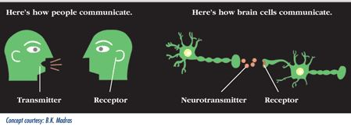
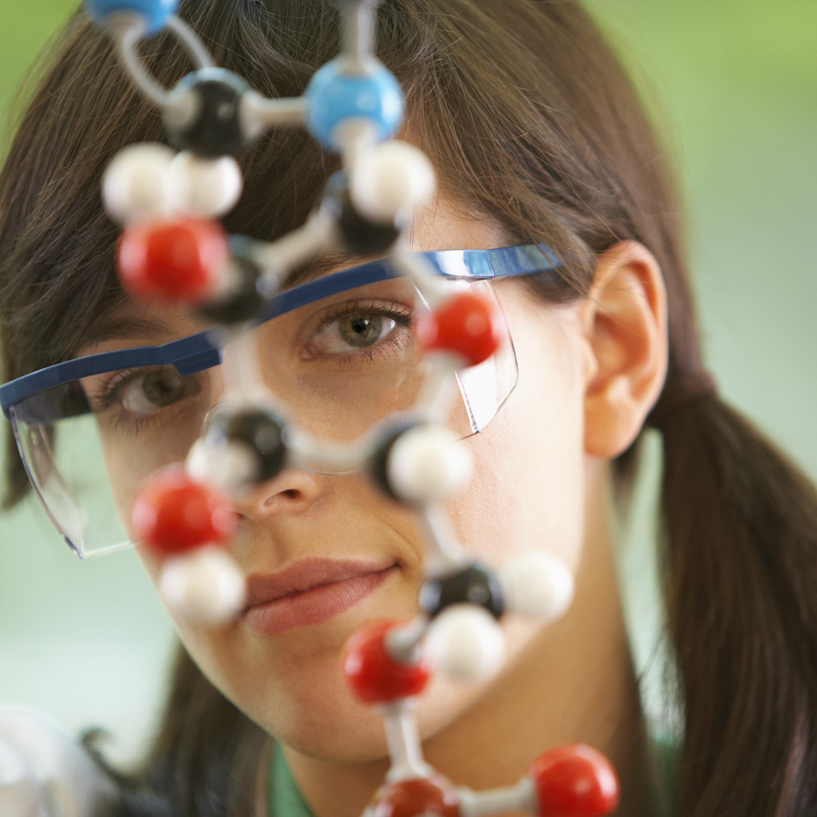
How Psychoactive Substances Work
Because of their chemical structure, alcohol and drugs have dramatic effects on neurotransmitters in CNS
Effects on:
  Mental processes
  Behavior
  Perception
  Alertness
SOURCE: NIDA. (2010). Drugs, Brains, and Behavior: The Science of Addiction.
Notes:
Most substance use disorders involve psychoactive substances. A psychoactive substance affects human behavior by interfering with brain chemistry and neurotransmitter activity. Alcohol and drugs that are commonly abused are psychoactive because of their chemistry. When absorbed into the body, alcohol and drugs interact with the cells and modify the way many cells, organs, and systems function. Because of their chemical structure, they have particularly dramatic effects on neurotransmitters in the Central Nervous System (CNS).
Neurotransmitters are endogenous chemicals that transmit signals from a neuron to a target cell across a synapse (the point of connection between two neurons). Neurotransmitters are packaged into synaptic vesicles clustered beneath the membrane in the axon terminal, on the presynaptic side of a synapse. They are released into and diffuse across the synaptic cleft, where they bind to specific receptors in the membrane on the postsynaptic side of the synapse. Release of neurotransmitters usually follows arrival of an action potential at the synapse, but may also follow graded electrical potentials. Low level "baseline" release also occurs without electrical stimulation. Many neurotransmitters are synthesized from plentiful and simple precursors, such as amino acids, which are readily available from the diet and which require only a small number of biosynthetic steps to convert.
Neurotransmitter image credit: Bertha K. Madras (http://www.drugabuse.gov/sites/default/files/images/soa_013.gif, Accessed October 2013).
Some drugs, such as marijuana and heroin, have chemical structures that are similar to neutral neurotransmitters, so they can lock on to and activate receptor cells. Other drugs, such as amphetamine or cocaine, cause neurons to release abnormally large amounts of neurotransmitters, or prevent their reuptake. By interfering with the way neurotransmitters function, drugs and alcohol affect many mental processes and behavior. Things like memory, attention, behavior, perception, and alertness are all changed because of what drugs and alcohol do to the neurotransmitters in the CNS.
Additional Information for the Trainer(s)
When absorbed into the body, drugs interact with and modify cells, organs, and bodily systems by:
• Altering the way the body normally functions (increasing, slowing, or enhancing bodily processes, or level or quality of functioning),
• Altering the operation of tissues, organs, and systems,
• Affecting hormones and enzymes, and
• Impacting processes such as digestion, respiration, circulation, and mental functioning.
REFERENCE:
NIDA. (2010). Drugs, Brains, and Behavior: The Science of Addiction. Rockville, MD: U.S. Department of Health and Human Services, National Institutes of Health.

Slide 11
Commonly Used Psychoactive Substances
SUBSTANCE | EFFECTS
Alcohol (liquor, beer, wine) | euphoria, stimulation, relaxation, lower inhibitions, drowsiness
Cannabinoids (marijuana, hashish) | euphoria, relaxations, slowed reaction time, distorted perception
Opioids (heroin, opium, many pain meds) | euphoria, drowsiness, sedation
Stimulants (cocaine, methamphetamine) | exhilaration, energy
Club Drugs (MDMA/Ecstasy, GHB) | hallucinations, tactile sensitivity, lowered inhibition
Dissociative Drugs (Ketamine, PCP, DXM) | feel separated from body, delirium, impaired motor function
Hallucinogens (LSD, mushrooms, Mescaline) | hallucinations, altered perception
SOURCE: National Institute on Drug Abuse.
Notes:
INSTRUCTIONS
The purpose of this slide is to provide an overview of the most commonly used psychoactive substances—alcohol and other drugs. Review each substance and its main effects with the audience. Tell the audience that this chart can be referenced in daily clinical practice: if they notice clients acting unusually energetic, tired, or odd, it could be because they are under the influence of one of these substances. It is important to note that these categories are not definitive. For example, ecstasy is often counted among stimulants and/or hallucinogens, and the club drugs category often includes Ketamine.
For a fun and basic lesson on how the “classic” drugs work in the brain, participants may wish to view the “Mouse Party,” available at http://learn.genetics.utah.edu/content/addiction/drugs/mouse.html.
Additional Information for the Trainer(s)
Alcohol: Many Americans drink alcohol at least occasionally. For many people, moderate drinking is probably safe. Moderate drinking is one drink a day for women or anyone over 65, and two drinks a day for men under 65. Some people should not drink at all, including children, pregnant women, people on certain medicines and people with some medical conditions. Anything more than moderate drinking can be risky. Binge drinking - drinking five or more drinks at one time - can damage health and increase risk for accidents, injuries and assault (1).
Alcohol can cause neurotransmitters to relay information too slowly, creating feelings of drowsiness. It can trigger mood and behavioral changes, including depression, agitation, memory loss, and seizures. Long-term, heavy drinking causes alterations in neurons that can affect motor coordination, temperature regulation, sleep, mood, learning, and memory. One neurotransmitter particularly susceptible to even small amounts of alcohol is glutamate, which affects memory. Researchers believe that because it interferes with glutamate, alcohol causes some people to temporarily “black out,” or forget much of what happened during a night of heavy drinking. Alcohol also causes an increased release of serotonin, another neurotransmitter, which helps regulate emotional expression (2).
Marijuana is derived from a plant containing more than 400 chemicals. Tetrahydrocannabinol (THC) is the main psychoactive ingredient in marijuana. It binds to cannabinoid (CB) receptors, which are highly concentrated in areas of the brain that control pleasure, memory, thought, concentration, sensory and time perception, appetite, pain, and movement coordination. This is why marijuana can have wide ranging effects, including: short-term memory loss, difficulty learning/retaining information, slowed reaction time, impaired motor coordination, impaired judgment and decision-making, an increased heart rate, and an altered mood. Long-term marijuana abuse can lead to dependence, poorer educational outcomes and job performance, respiratory problems, and cognitive impairment. For some people, it can also increase risk of psychosis (3).
Opioids resemble natural chemicals that have binding sites on receptors. Opioids affect parts of the brain that control emotions, and create feelings of pleasure, relaxation, and contentment. They also act on the brainstem, which controls automatic body functions, and they affect the spinal cord as well. If swallowed as pills, opioids take longer to reach the brain. If they are injected, they act faster and can produce a quick, intense feeling of pleasure followed by a sense of well-being and a calm drowsiness. While prescription pain relievers can be highly beneficial if used as prescribed, opioids as a general class of drugs have a high potential for abuse (4).
Stimulants: Cocaine is a powerfully addictive stimulant drug that can be snorted or dissolved in water and then injected. Crack is the street name given to the form of cocaine that can be smoked. The term “crack” refers to the crackling sound produced by the rock as it is heated. Injecting or smoking cocaine produces a quicker, stronger high than snorting. Cocaine works by acting on the neurotransmitter dopamine, which is associated with pleasure and movement. Normally dopamine is released by a neuron in response to a pleasurable signal (e.g., the smell of good food), and then recycled back into the cell that released it. Cocaine works by preventing dopamine from being recycled, so the pleasurable feelings caused by dopamine become amplified. With repeated use, cocaine can cause long-term changes in brain, which may eventually lead to abuse or dependence (5).
Methamphetamine is a white, odorless, bitter-tasting crystalline powder that easily dissolves in water or alcohol and is taken orally, snorted, injected, or smoked. Methamphetamine increases the release of dopamine and blocking its reuptake. Dopamine is involved in reward, motivation, the experience of pleasure, and motor function. Methamphetamine’s ability to release dopamine rapidly creates an intense euphoria, or “rush.” Chronic use leads to structural and functional changes in areas of the brain associated with emotion and memory, causing many emotional and cognitive problems for chronic users (6).
MDMA (Ecstasy) is a synthetic, psychoactive drug that is chemically similar to the stimulant methamphetamine and the hallucinogen mescaline. The drug produces feelings of increased energy, euphoria, emotional warmth, and distortions in time, perception, and tactile experiences. MDMA is taken orally, usually as a capsule or tablet. MDMA gets its main effects by acting on neurons that use the neurotransmitter serotonin. The serotonin system plays an important role in regulating mood, aggression, sexual activity, sleep, and sensitivity to pain. MDMA binds to the serotonin transporter, thus increasing and prolonging the serotonin signal. MDMA has similar effects on another neurotransmitter—norepinephrine, which can cause increases in heart rate and blood pressure. MDMA also releases dopamine, but to a much lesser extent. The drug can produce confusion, depression, sleep problems, drug craving, and severe anxiety. MDMA can be harmful to the brain, causing long-lasting damage to neurons (7).
GHB (Xyrem) is a central nervous system (CNS) depressant. It has been approved for use in the treatment of narcolepsy. GHB acts on at least two sites in the brain: the GABA_{B} receptor and a specific GHB binding site. At high doses, GHB’s sedative effects may result in sleep, coma, or death (8). The subjective effects are described as very similar to alcohol, and the dosing range is very tight before negative effects (unconsciousness, vomiting) begin to occur.
Ketamine is a dissociative anesthetic that distorts perceptions of sight and sound, and can produce feelings of detachment. Ketamine acts on a type of glutamate receptor in the brain. Low-dose intoxication results in impaired attention, learning ability, and memory. At higher doses, ketamine can cause dreamlike states and hallucinations; and at very high doses still, ketamine can cause delirium and amnesia (8).
Hallucinogens: Compounds found in some plants and mushrooms (or their extracts) have hallucinogenic effects, causing profound distortions in perceptions of reality when consumed. Hallucinogens specifically work on certain serotonin receptor subtypes. Under the influence of hallucinogens, people see images, hear sounds, and feel sensations that seem real but are not. Some hallucinogens also produce rapid, intense emotional swings. While the exact mechanisms that make hallucinogens work are unclear, research shows that these drugs work, at least partially, by temporarily interfering with neurotransmitters and receptors. The most common hallucinogens are LSD, peyote, psilocybin, and PCP. PCP and DXM are also dissociative drugs (9).
SOURCES:
(1) National Institutes of Health. (2012). MedlinePlus: Alcohol. Available at: http://www.nlm.nih.gov/medlineplus/alcohol.html.
(2) National Institute on Alcohol Abuse and Alcoholism (NIAAA). (2010). Beyond Hangovers: Understanding Alcohol’s Impact on your Health. Rockville, MD: U.S. Department of Health and Human Services, National Institutes of Health.
(3) National Institute on Drug Abuse (NIDA). (2011). NIDA Topics in Brief: Marijuana. Rockville, MD: U.S. Department of Health and Human Services, National Institutes of Health.
(4) NIDA. (2009). Mind over Matter: Opiates. Rockville, MD: U.S. Department of Health and Human Services, National Institutes of Health.
(5) NIDA. (2010). NIDA DrugFacts: Cocaine. Rockville, MD: U.S. Department of Health and Human Services, National Institutes of Health.
(6) NIDA. (2010). NIDA DrugFacts: Methamphetamine. Rockville, MD: U.S. Department of Health and Human Services, National Institutes of Health.
(7) NIDA. (2010). NIDA DrugFacts: MDMA/Ecstasy. Rockville, MD: U.S. Department of Health and Human Services, National Institutes of Health.
(8) NIDA. (2010). NIDA DrugFacts: Club Drugs. Rockville, MD: U.S. Department of Health and Human Services, National Institutes of Health.
(9) NIDA. (2009). NIDA DrugFacts: Hallucinogens. Rockville, MD: U.S. Department of Health and Human Services, National Institutes of Health.

Slide 12
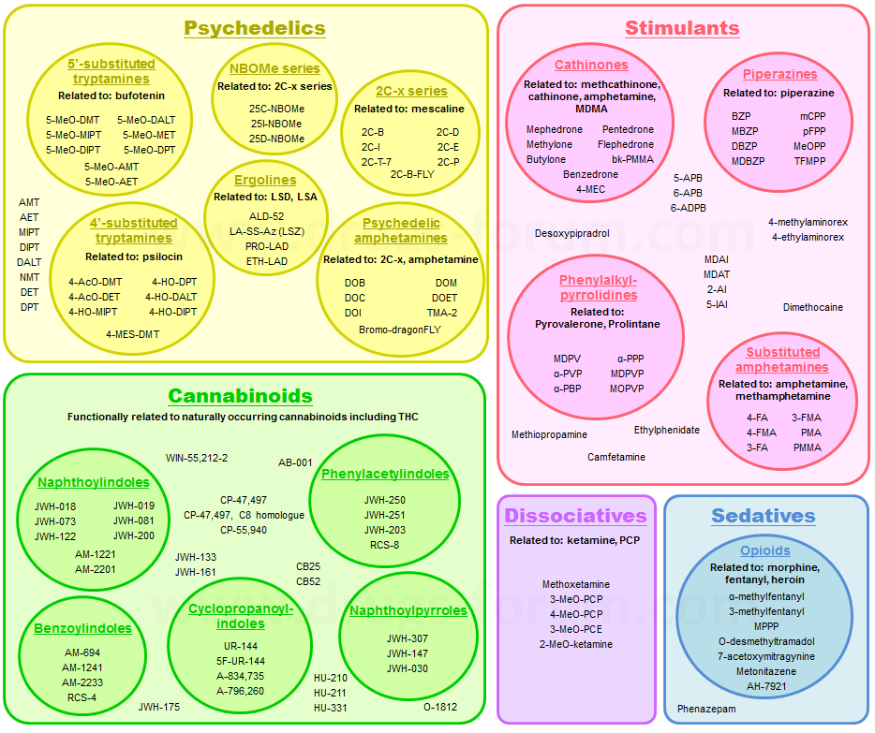
“Designer” Psychoactive Substances
SOURCE: http://www.drugs-forum.com, updated 2013.
Notes:
This slide summarizes several groups of psychoactive substances, including the older plant-derived versions and the latest chemical substances, which mimic some of the effects of those drugs derived from plants. Synthetic drugs are chemical creations that are made to cause the same changes in the user’s body as illegal drugs derived from plants (e.g., marijuana, cocaine). Today, we will talk about each of these categories. The first set of substances is tryptamines, which are featured in the yellow box. The tryptamines are related to psilocin, and they have hallucinogenic effects. Psilocybin is obtained from certain mushrooms that contain psilocin. The drugs in the 2C-x circle (yellow box) are synthetic hallucinogens which are becoming more common today. The green box contains the chemicals known as synthetic cannabinoids, which will be covered in more detail in a few minutes. Dissociatives (purple box) are related to ketamine and PCP. Opioids/sedatives (in the blue box) originate from the opiate poppy, but there are now synthetic psychoactive opioid substances that are used recreationally. One such synthetic opioid is MPPP, which is a synthetic analog of pethidine (known as Demerol in the U.S.); other synthetic opioids are variations of fentanyl and tramadol. Several types of stimulants are included in the pink/red box. The piperazines are central nervous system stimulants, and users can combine BZP and TFMPP to produce effects similar to ecstasy. The phenethylamines are based on beta ketones, which are central nervous system stimulants, and serve as the foundation of synthetic cathinones. Also included in the pink/red box are psychedelic and cyclized amphetamines, which are similar to amphetamine. The 2C-x drugs are related to mescaline, which is a hallucinogen that is found in the peyote cactus.

Slide 13
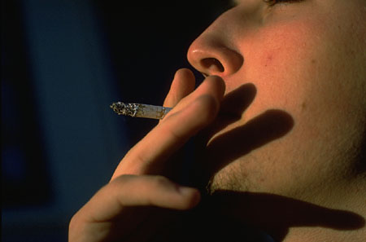
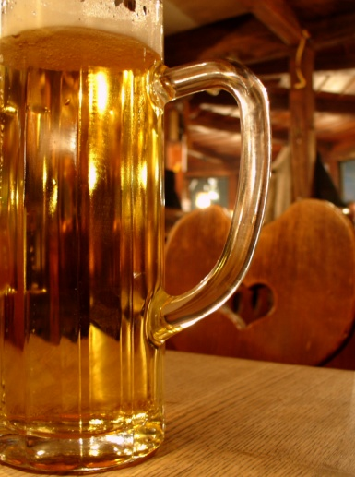
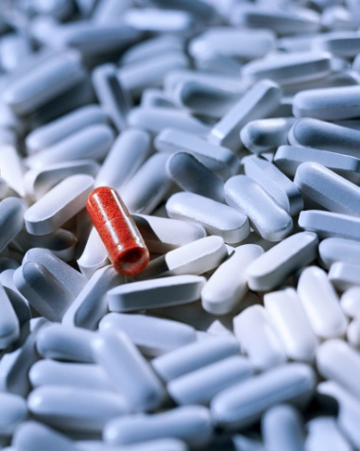
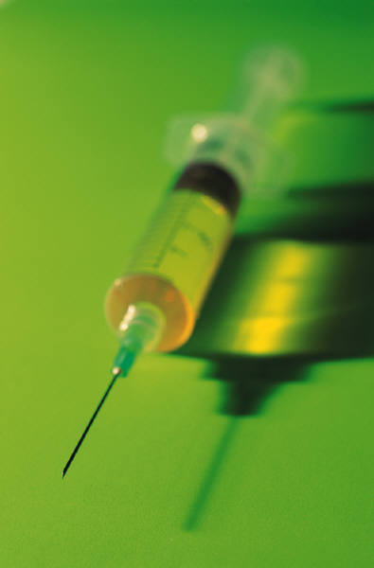

Why People Use Psychoactive Substances
Why Start?
  Experimentation
  Peer Pressure
  Medical
Why Continue?
  Relieve stress/pain
  Function better
  Have fun/relax
  Cope with mental health disorders
SOURCE: NIDA. (2010). Drugs, Brains, and Behavior: The Science of Addiction.
Notes:
While there are many reasons for the initiation into and continued use of alcohol and drugs, key motivators pivot around the main factors included in the slide. People may start to experiment because of peer pressure, or for medical reasons—particularly as a way to alleviate physical pain. After initiation to alcohol/drug use, there are many reasons people continue to use these substances—they may be good ways to relieve stress or pain, or ways to help people function better in specific situations. For example, alcohol may help some people feel more at ease in social situations, while stimulant drugs like cocaine may help some people stay alert and focused while working. Also, because of their effects on neurotransmitters, these substances may help alleviate the symptoms of mental health disorders for some individuals. These motivators are not mutually exclusive. They may co-occur for many people.

Slide 14
After repeated drug use, “deciding” to use drugs is no longer voluntary because
DRUGS CHANGE THE BRAIN!
SOURCE: NIDA. (2010). Drugs, Brains, and Behavior: The Science of Addiction.
Notes:
Drug addiction is considered a brain disease because drugs change the structure of the brain and how it works. As a result of scientific research, we also know that addiction is a disease that affects behavior. These brain changes can be long lasting, and can lead to the harmful behaviors seen in people who abuse drugs. We have identified many of the biological and environmental factors and are beginning to search for the genetic variations that contribute to the development and progression of the disease. Scientists use this knowledge to develop effective prevention and treatment approaches that reduce the toll drug abuse takes on individuals, families, and communities. Despite these advances, many people today do not understand why individuals become addicted to drugs or how drugs change the brain to foster compulsive drug abuse.
Additional Information for the Trainer(s)
At first, people may perceive what seem to be positive effects with drug use. They also may believe that they can control their use; however, drugs can quickly take over their lives. Over time, if drug use continues, pleasurable activities become less pleasurable, and drug abuse becomes necessary for abusers to simply feel "normal." Drug abusers reach a point where they seek and take drugs, despite the tremendous problems caused for themselves and their loved ones. Some individuals may start to feel the need to take higher or more frequent doses, even in the early stages of their drug use.
The initial decision to take drugs is mostly voluntary. However, when drug abuse takes over, a person's ability to exert self-control can become seriously impaired. Brain imaging studies from drug-addicted individuals show physical changes in areas of the brain that are critical to judgment, decision making, learning and memory, and behavior control. Scientists believe that these changes alter the way the brain works, and may help explain the compulsive and destructive behaviors of addiction.

Slide 15
Substance Use Disorder (SUD)
Risky user
Addiction
Alcoholic
Addict
Abuser
Substance abuse
Chemical Dependence
Dependence
The language we use matters
Abuse
Drug Addict
Recreational user
Substance Misuse
Notes:
This slide provides several examples of terms that are used to describe the act of ingesting alcohol and other drugs, and terms to describe the individual who is ingesting these substances. A movement also exists within the alcohol and other drug treatment field to use the term “substance use disorder,” as opposed to substance misuse, abuse, or addiction.

Slide 16
What is a Substance Use Disorder?
A substance use disorder (SUD) is a continuum of problematic use of substances:
  On one end of the continuum are people who are using at risky levels. They may not be having problems yet, but are at risk of developing them if current level of use continues.
  On the other end, SUD is a complex, chronic, relapsing brain disease characterized by compulsive, and at times, uncontrollable drug craving, seeking, and use that persist even in the face of extremely negative consequences.
SOURCE: NIDA. (2010). Drugs, Brains, and Behavior: The Science of Addiction.
Notes:
The term “drug addiction” has been replaced with “substance use disorder” in the definition provided. A substance use disorder is a state in which an individual engages in a compulsive behavior, even when faced with negative consequences. This behavior is reinforcing, or rewarding. A major feature of a substance use disorder is the loss of control in limiting intake of the addictive substance. The most recent research indicates that the reward pathway may be even more important in the craving associated with addiction, compared to the reward itself. Scientists have learned a great deal about the biochemical, cellular and molecular bases of addiction; it is clear that substance use disorders are a disease of the brain.

Slide 17
Some Additional Important Terminology
Psychological craving
Tolerance
Withdrawal symptoms
Notes:
This slide reviews three important concepts related to substance use disorders. Tell the audience that each concept will be reviewed in more detail in the subsequent slides.

Slide 18


Psychological Craving
Psychological craving is a strong desire or urge to use drugs. Cravings are most apparent during drug withdrawal.
Notes:
Review the definition of psychological craving. You can provide the audience with a few examples. For instance, a woman who quit smoking years ago, but who still feels cravings when exposed to certain situations (friends who smoke, parties, coffee time).

Slide 19

Tolerance
Tolerance is a state in which a person no longer responds to a drug as they did before, and a higher dose is required to achieve the same effect.
SOURCE: Krasnegor, N.A. (Ed.). (1978). Behavioral Tolerance: Research and Treatment Implications,
NIDA Research Monograph 18. Rockville, MD: Department of Health, Education, and Welfare.
Notes:
Review the definition of tolerance. You can provide the audience with a few examples. For instance, a man who has been drinking heavily for a while who is able to drink more than other people and not feel the effects of alcohol because he has developed a tolerance for the drug. Ask your audience to provide some examples, as well.
Additional Information for the Trainer(s)
The most common change produced by prior experience with a drug is a decrease in responsiveness to its effects. When an organism becomes less sensitive to the actions of a drug by virtue of past experience with the drug, we refer to this change as acquired tolerance.

Slide 20

Withdrawal
The following symptoms may occur when substance use is reduced or discontinued:
Tremors, chills
Cramps
Emotional problems
Cognitive and attention deficits
Hallucinations
Convulsions
Death
SOURCE: APA. (2013). Diagnostic and Statistical Manual of Mental Disorders, Fifth Edition.
Notes:
The effects of withdrawal are the opposite of those seen with intoxication. The slide contains a listing of several possible withdrawal symptoms. Ask participants to provide examples of withdrawal symptoms from their experience with clients.
It is important to note that specific withdrawal symptoms will differ slightly, depending on the substance in question. For example, sedative/hypnotic/anxiolytic withdrawal is associated with autonomic hyperactivity (e.g., sweating or pulse rate greater than 100), increased hand tremor, insomnia, nausea or vomiting, transient visual, tactile, or auditory hallucinations or illusions, psychomotor agitation, anxiety, or grand mal seizures. Stimulant/cocaine withdrawal is associated with dysphoric mood and two or more of the following: fatigue, vivid, unpleasant dreams, insomnia or hypersomnia, increased appetite, or psychomotor retardation or agitation. Opioid withdrawal is associated with dysphoric mood, nausea or vomiting, muscle aches, lacrimation or rhinorrhea, pupillary dilation, piloerection, or sweating, diarrhea, yawning, fever, or insomnia. Cannabis withdrawal is associated with irritability, anger, or aggression, nervousness or anxiety, insomnia, decreased appetite or weight loss, restlessness, or depressed mood.
Additional Information for the Trainer(s)
In the fifth edition of the Diagnostic and Statistical Manual of Mental Disorders (DSM-5), the revised chapter of “Substance-Related and Addictive Disorders” includes substantive changes to the disorders grouped there plus changes to the criteria of certain conditions. Substance use disorder in DSM-5 combines the DSM-IV categories of substance abuse and substance dependence into a single disorder measured on a continuum from mild to severe. Each specific substance (other than caffeine, which cannot be diagnosed as a SUD), but nearly all substances are diagnosed based on the same overarching criteria. In this overarching disorder, the criteria have not only been combined, but strengthened. Whereas a diagnosis of substance abuse previously required only one symptom, mild substance use disorder in DSM-5 requires two or three symptoms from a list of 11. In DSM-IV, the distinction between abuse and dependence was based on the concept of abuse as a mild or early phase and dependence as the more severe manifestation. In practice, the abuse criteria were sometimes quite severe. The revised substance use disorder, a single diagnosis, will better match the symptoms that people experience. Additionally, the diagnosis of dependence caused much confusion. Most people link dependence with “addiction” when in fact dependence can be a normal body response to a substance. The DSM-5 was released in June 2013.

Slide 21
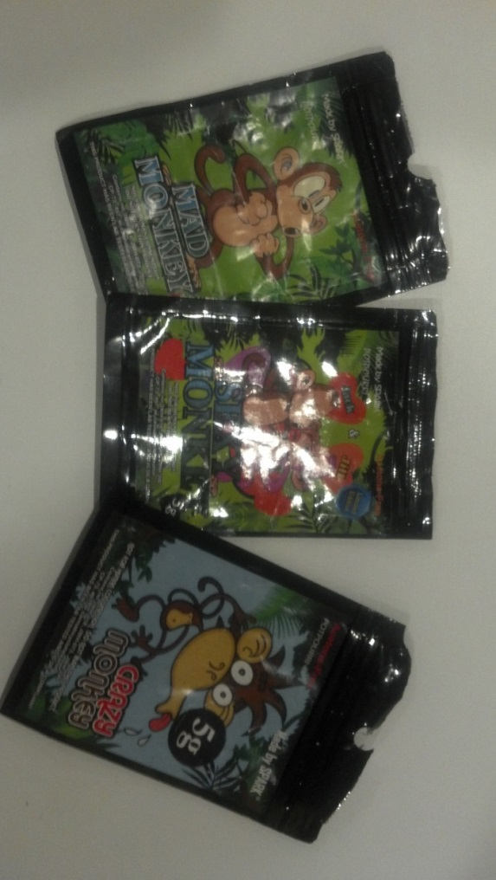
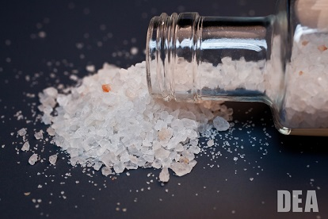
A Review of synthetic DRUGS
Notes:
The next section of the presentation describes, in detail, a variety of psychoactive drugs, including synthetic cannabinoids and synthetic cathinones. Synthetic drugs are chemical creations that are made to cause the same changes in the user’s body as illegal drugs that are derived from plants (e.g., marijuana, cocaine). The use and abuse of synthetic drugs can produce serious health effects, including addiction, and in extreme cases, death. It is important to mention that sometimes, the authors refer to specific slang/street terms, such as Spice and Bath Salts or new terms that have appeared since this presentation was created. At other times, the authors refer to the class of substance, such as synthetic cannabinoids or cathinones. In the last six months, the term Spice, which referred to synthetic marijuana and to synthetic cannabis, has fallen into disuse with new terms such as “Crazy Clown” appearing as the drugs change their chemical make-up to stay legal. In the past year, the term “Bath Salts,” has fallen into non-use because it refers to packets whose contents are unknown and ever-changing, coupled with the fact that toxicologists are now more accurately able to identify substances previously marketed as “bath salts.” The authors will use terms such as synthetic cathinones, phenethylamines, tryptamines, and piperazines throughout the remainder of this presentation and will minimize the use of street names or slang terms.
Photo credit: Brenda Wiewel, LA CADA, March 2013.
Note to the Trainer(s):
This would be a good time to explain to the participants that these synthetic drugs are sold either through head shops or gas stations as “legal highs” and are not intended for human consumption, or they can be bought on the Internet. As new laws have been passed banning the sale of these drugs in the different states, new chemical variations are created, which may be legal since they differ from the chemical structure that has been deemed illegal. Thus, depending on the state and the legislation, synthetic drugs may still be available in retail stores, or new versions may become available instead.

Slide 22
User Report #1 (Drug not specified)
“This is the worst experience I’ve ever had”
“The most anxiogenic substance I’ve ever used”
“Nausea, vomiting, heart pounding like I’m going to have a heart attack”
“Not sure whether I just said that, thought it, or read it”
2 hours later: “Will never take this again”
SOURCE: J. Randall Webber, MPH, CADC, “Emerging Drugs of the 21st Century, July 2013.”
Notes:
This slide and the following slide include reports from individuals who used synthetic drugs. In the first report, the specific type of drug is not specified. In the second report, the user ingested “Apocalypse” which is a synthetic cannabinoid. We include these reports to illustrate the great variation in the effects of synthetic drugs from user to user.
Anxiogenic= a substance that causes anxiety

Slide 23
User Report #2 (Synthetic Cannabinoid)
3 individual “hits” from a small pipe
“Organic” taste/no chemical odor or taste
5 minutes: “Feels like cannabis”
10 minutes: “Like an intense cannabis high”
“More than 3 puffs might be too much”
SOURCE: J. Randall Webber, MPH, CADC, “Emerging Drugs of the 21st Century, July 2013.”
Notes:
This slide and the previous slide include reports from individuals who used synthetic drugs. In the first report, the specific type of drug is not specified. In the second report, the user ingested “Apocalypse” which is a synthetic cannabinoid. We include these reports to illustrate the great variation in the effects of synthetic drugs from user to user.

Slide 24
“Designer” Psychoactive Substances
Two classes:
Stimulants: mephedrone, MPDV, piperazines, “bath salts”
Psychedelics: 2C-B, mescaline, DMT, etc.
Differences in users:
Stimulant users similar to other ecstasy users; (shifting to mephedrone and MPDV due to shortage of Ecstasy?)
Psychedelic users started ecstasy use earlier; were more frequent users; used multiple substances; had more legal, mental health, and social problems.
SOURCE: Bruno et al. (2012). Drug and Alcohol Dependence, 124(1-2), 19-25.
Notes:
This slide highlights the results from an Australian study of ecstasy users who also used either 2C-B psychedelics or synthetic cathinones. Those who used the psychedelics had started ecstasy use earlier, used the drugs more frequently, had higher rates of use of other drugs, and had more legal, mental health, and social problems. As we work with users of recreational drugs, we should pay attention to the differences found in this study.

Slide 25
Examples of Major Synthetic Psychedelics
DRUG NAME | DESCRIPTION
2C-I | Phenethylamine, via PiHKAL; stimulant and hallucinogen Slow onset (1 hr); long duration of action (8-10 hr.)
2C-B | Phenethylamine, via PiHKAL; visuals Faster onset; shorter duration than 2C-I
5-MeO-DMT | Tryptamine; naturally occurring (toad, shamantic brews) Smoked: almost immediate, very intense, short effect (<30 min)
DMT | Tryptamine; naturally occurring Smoked: almost immediate, very intense, short effect (<20 min)
SOURCE: Slide courtesy of R. Bruno et al., 2011, with revisions by James Hall, 2012.
Notes:
This slide features several examples of major psychedelic drugs, including the drug name and a brief description. It might be helpful for you to keep this table handy to use as a reference tool as you hear your clients or patients refer to these types of synthetic drugs.
Additional Information for the Trainer(s)
2C-B description: PiHKAL = Phenethylamines I have known and loved (PiHKAL: A Chemical Love Story, 1991 book by Dr. Alex Shulgin and Ann Shulgin); Visuals = Visual hallucinations
5-MeO-DMT description: DMT is a naturally occurring psychedelic compound of the tryptamine family; its presence is widespread throughout the plant community. DMT occurs in trace amounts in humans where it functions as a trace amine neurotransmitter. The following is additional information regarding the “toad, shamantic brews” referenced in the 5-MeO-DMT description:
2012 and the Psychedelic Shamans, by Thomas Razzeto/The Psychedelic Effects of the 5-MeO-DMT from the Bufo Toad – In his book Tryptamine Palace, James Oroc describes the effects of the psychedelic chemicals from this toad. The main chemical is called 5-MeO-DMT and it has different effects from other types of DMT from different sources such as the vines used to make the ayahuasca brew that is well known in South America. Oroc states that he had the experience of becoming “consciousness without identity.” Since this is commonly reported by others who have used this drug, it is extremely likely that the Maya shamans also had this experience.

Slide 26
Examples of Major Synthetic Stimulants
DRUG NAME | DESCRIPTION
Mephedrone | 4-methyl-methcathinone; “Miaow” Similar to cocaine and MDMA (ecstasy)
Methylone | β-MDMA: 3,4-methylenedioxy-methcathinone; “Explosion” Similar to cocaine and MDMA (ecstasy)
MDPV | 3,4-methylenedioxyprovalerone; MDPV; “NRG-1” (Brandt, 2010); “Ivory Wave” Stimulant with rapid onset; 2-4 hour duration of action
BZP | 1-benzyl-piperazone Similar to amphetamine 1/10 potency of d-methamphetamine
SOURCE: Slide courtesy of R. Bruno et al., 2011, with revisions by James Hall, 2012.
Notes:
This slide features several examples of major stimulant drugs, including the drug name and a brief description. The names listed in quotes are common street names used to describe each specific synthetic stimulant. It might be helpful for you to keep this table handy to use as a reference tool as you hear your clients or patients refer to these types of synthetic drugs.
Additional Information for the Trainer(s)
Methylone description: β-MDMA stands for beta ketone-MDMA
MDPV description: NRG-1 (Napthylpyrovalerone) is another name for MDPV

Slide 27
From the term “Bath Salts” to…
Synthetic Cathinones
Mephedrone, methylone, 4-MEC
Stimulants related to methcathinone, MDMA, amphetamines
2C- Phenethylamines
Psychedelics related to mescaline
Some were created in the past to imitate MDMA
Tryptamines
5-MeO-DMT & 4-AcO-DMT
Psychedelics related to psilocin & bufotenin
Piperazines
BZP & TFMPP
Stimulants
And Dissociatives related to ketamine and PCP and Opioids related to morphine, fentanyl, and heroin.
Notes:
A year ago (2012) we commonly used the term “bath salts” as a catch-all term, but as toxicologists have refined their methods, and are now able to define more substances, it has become easier to talk about at least four or five different groups of synthetic drugs. Synthetic Cathinones include mephedrone and methylone, and are stimulants that are related to MDMA and amphetamines. Psychedelics related to mescaline are in the 2C-Phenethylamine category. Psychedelics related to psilocin are categorized as Tryptamines, and other stimulants such as BZP and TFMPP are in the Piperazines category. In addition, we are seeing a return of Dissociative drugs such as ketamine and phencyclidine (PCP) and opioids related to morphine, fentanyl, and heroin. Throughout this presentation, we will spend some time describing each of these categories.

Slide 28
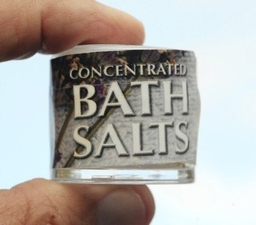
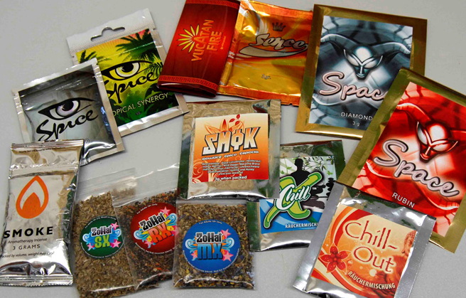
Synthetic
Drugs
Not really “Spice,” “Bath Salts,” “Incense,” or “Plant Food”
Chemically-based; not plant derived
Complex chemistry
Constantly changing to “stay legal”
Need to prove “intended to use” to convict in some areas
Notes:
This slide summarizes the dilemma we are faced with because these drugs have many different “names” that are given to mask the fact they are chemical substances that have been created to produce some sort of a “high.” Although the chemical composition of some of them is known, the rogue chemists producing them are constantly changing the formulations so they can stay ahead of the latest federal and state legal definitions and laws to avoid prosecution.
Synthetic cannabinoids in herbal incense products were first detected in the United States in November 2008, by the Drug Enforcement Administration’s (DEA) forensic laboratory. These products were first encountered by U.S. Customs and Border Protection. Spice and Bath Salts are advertised as being “all natural,” safe to use, and legal but, in fact, they are none of those things. The packages often say “not for human consumption,” “for novelty use,” or “use as directed” (but without any directions for use on the package). The colorful and professional packaging and wording often changes as the laws are amended. In some jurisdictions, depending on how the laws are written, the prosecutor must prove the person intended to use the product (not just possess it), which makes it even more difficult to reduce availability of these substances.
People were abusing synthetic cathinones in Russia and Eastern Europe for several decades before the drugs appeared in Western Europe and the UK in the early 2000s.

Slide 29
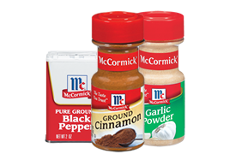

Synthetic Cannabinoids
Spice vs. “Spice”
Notes:
This slide may seem silly at first glance, but it is important to emphasize that synthetic drugs sold as “spice” (picture on the right) are NOT the same as common household spices like cinnamon and garlic powder (picture on the left).

Slide 30
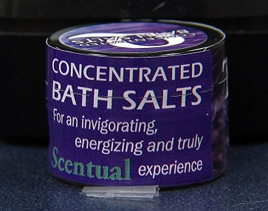
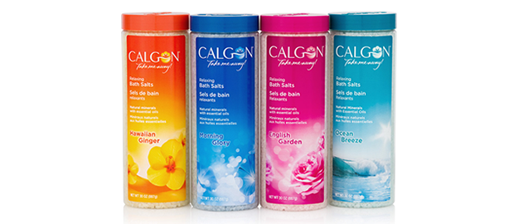
Synthetic Cathinones
Bath Salts vs. “Bath Salts”
Notes:
Unlike traditional bath salts sold, for example, as Epsom salts in large containers, psychoactive “bath salts” are often sold in small 200-500 mg quantities at elevated prices ($25-$75/package). Manufacturers seeking to evade regulations label “bath salts” for use as aromatic potpourri, not intended for ingestion or intranasal use. Alternative marketing strategies include “bath salts” sold as plant food or insect repellant, with labels stipulating “not for human consumption.” Advertisements also promote bath salt products as being safe, producing euphoria, and having sexual or energizing effects.
REFERENCE:
Miotto, K., Striebel, J., Cho, A.K., & Wang, C. (2013). Clinical and pharmacological aspects of bath salt use: A review of the literature and case reports. Drug and Alcohol Dependence, 132(1-2), 1-12.

Slide 31
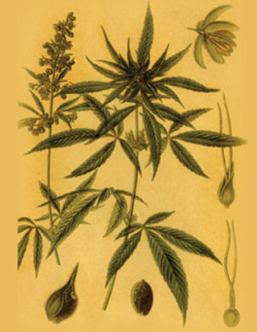
Marijuana (Cannabis)
Often called pot, grass, reefer, MJ, weed, herb
A mixture of the dried, shredded leaves, stems, seeds, and flowers of Cannabis sativa—the hemp plant
Most commonly used drug in the U.S.
Delta-9-tetrahydrocannabinol (THC) is the main active ingredient in marijuana
Common effects include: euphoria, relaxation, heightened sensory perception, laughter, altered perception of time, and increased appetite
May also produce anxiety, fear, distrust, or panic, and can lead to severe mental health problems for some users.
SOURCE: NIDA. (2010). NIDA DrugFacts: Marijuana.
Notes:
Marijuana is the most commonly used illicit drug of abuse in the United States. It is usually smoked as a cigarette (joint) or in a pipe. It is also smoked in blunts, which are cigars that have been emptied of tobacco and refilled with a mixture of marijuana and tobacco. This mode of delivery combines marijuana's active ingredients with nicotine and other harmful chemicals. Marijuana can also be mixed in food or brewed as a tea. As a more concentrated, resinous form, it is called hashish; and as a sticky black liquid, hash oil. Marijuana smoke has a pungent and distinctive, usually sweet-and-sour odor. Short-term effects of marijuana use include euphoria, distorted perceptions, memory impairment, and difficulty thinking and solving problems.
THC acts upon specific sites in the brain, called cannabinoid receptors, kicking off a series of cellular reactions that ultimately lead to the "high" that users experience when they smoke marijuana. Some brain areas have many cannabinoid receptors; others have few or none. The highest density of cannabinoid receptors are found in parts of the brain that influence pleasure, memory, thinking, concentrating, sensory and time perception, and coordinated movement. Not surprisingly, marijuana intoxication can cause distorted perceptions, impaired coordination, difficulty with thinking and problem solving, and problems with learning and memory. Research has shown that, in chronic users, marijuana's adverse impact on learning and memory can last for days or weeks after the acute effects of the drug wear off. As a result, someone who smokes marijuana every day may be functioning at a suboptimal intellectual level all of the time.
Additional Information for the Trainer(s)
Recent research sponsored by the National Institute on Drug Abuse identified a link between marijuana use and psychosis and marijuana use and lowered IQ. Research shows that marijuana use can: (1) lead to addiction; (2) increase the risk of chronic cough or bronchitis; and (3) increase the risk of schizophrenia in vulnerable individuals. The age of onset of marijuana use is directly associated with age at onset of psychosis and age of first hospitalization. Marijuana use may increase the risk of anxiety, depression, and amotivational syndrome, and new research findings suggest that the neurotoxic effect of cannabis on the adolescent brain and cessation did not fully restore functioning.
REFERENCE:
NIDA. (2012). Messages from the Director: Marijuana’s Lasting Effects on the Brain (September 2012). Available at: http://www.drugabuse.gov/about-nida/directors-page/messages-director/2012/09/marijuanas-lasting-effects-brain.
Photo credit: NIDA, September 2012.

Slide 32
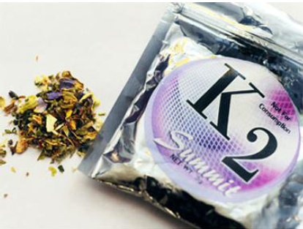
Synthetic Cannabinoids
Wide variety of herbal mixtures
Marketed as “safe” alternatives to marijuana
Brand names include: “Spice,” “K2,” fake weed, “Yucatan Fire,” “Skunk,” “Moon Rocks,” herbal incense, “Crazy Clown,” “Herbal Madness”
Labeled “not for human consumption”
Contain dried, shredded plant material (inert) and chemical additives that are responsible for their psychoactive effects.
SOURCE: NIDA. (2012). NIDA DrugFacts: Spice (Synthetic Marijuana).
Notes:
Spice, sometimes known as an “herbal marijuana alternative,” looks like plant material or potpourri and is similarly coated in chemicals that mimic the effects of marijuana when it is smoked or steeped for a hot drink. These synthetic drugs are attractive to users because the chemicals used to create them defy detection in traditional drug tests. Labels on Spice products often claim that they contain “natural” psychoactive material taken from a variety of plants. Spice products do contain dried plant material, but chemical analyses show that their active ingredients are synthetic (or designer) cannabinoid compounds.
Spice and K2 is known by a variety of brand names, including: Zohai, Genie, K3, Bliss, Nice, Black Mamba, Incense, Yucatan Fire, Skunk, Smoke, ChillX, Highdi’s Almdröhner, Sence, Earth Impact, Gorillaz, Galaxy Gold, Space Truckin, Solar Flare, Moon Rocks, Blue Lotus, Aroma, Scope, Sky, OG, Potpourri, Bombay Blue, and even fake weed. Spice is sold in colorful three-ounce plastic pouches decorated with psychedelic designs. Experts point out that due to the variation in chemical additives used in Spice, K2, and other synthetics, users don’t know exactly what they’re getting in each packet and the effects can therefore be unpredictable. (SOURCE: Logan et al., 2012, Journal of Forensic Sciences). According to the U.S. Drug Testing Laboratories (2011), over 250 synthetic cannabis compounds have been identified to date.
REFERENCE:
Logan, B.K., Reinhold, L.E., Xu, A., Diamond, F.X. (2012). Identification of synthetic cannabinoids in herbal incense blends in the United States. Journal of Forensic Sciences, 57(5), 1168-1180.
Photo credit: NIDA, April 2012.
Note to Trainer(s) regarding terminology used in this presentation:
As the authors worked to update the content for this presentation (August-November 2013), some of the more recent references use the term “synthetic cannabimimetic” in lieu of synthetic cannabinoid. This very recent shift in the language used to describe this specific class of synthetic drugs highlights the rapidly evolving information on the use of synthetic drugs in the United States and beyond. For consistency sake, the authors made the decision to use the term synthetic cannabinoid when referring to synthetic marijuana/cannabis.

Slide 33
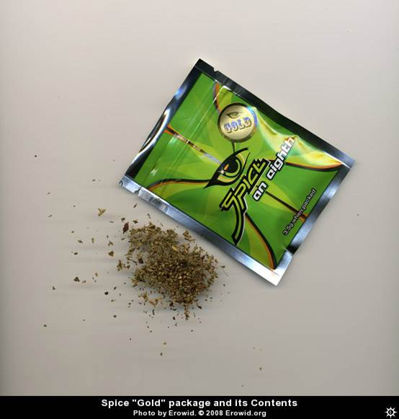
Synthetic Cannabinoids
Mainly abused by smoking (alone or with marijuana); may also be prepared as an herbal infusion for drinking.
Many of the active chemicals most frequently found in synthetic cannabis products have been classified by the DEA as Schedule I
controlled substances,
making them illegal to buy,
sell, or possess.
Multiple “generations” of drugs.
SOURCE: NIDA. (2012). NIDA DrugFacts: Spice (Synthetic Marijuana).
Notes:
Manufacturers of Spice products attempt to evade legal restrictions by substituting different chemicals in their mixtures. The DEA continues to monitor the situation and evaluate the need for updating the list of banned cannabinoids. The five banned active chemicals are JWH-018, JWH-073, JWH-200, CP-47, 497, and CP-47, 497-C8. Most states have also banned the products, but the list of banned substances varies by state and the states keep revising the lists to try to control new products that are developed to get around the current laws. Toxicology laboratories are developing tests for these drugs, but as of September 2012, only 17 of all the synthetic cannabis variations can be identified in urine tests developed by one lab and most of the blood and oral fluid tests only identify 12.
Different “generations” of cannabinoids have been marketed over time. First generation products, such as JWH-018, JWH-073, JWH-081, JWH-200, and JWH-205 (brand names include “K2,” “Spice,” “Black Mamba,” and “Red Dragon,” just to name a few) were the initial products found in the U.S. Those gave way to second generation products, including JWH 122, JWH-201, and AM-2201 (“K3,” “Splice,” “Apocalypse,” “Destiny,” “Cloud Ten,” “Head Trip,” and house mixes. Third generation products include UR-144 and XLR-11. Fourth generation products include A-834, A-835, AB-fubinaca, AB-pinaca, AKB-48, PB-22, URB-597, and URB-754. On a DEA tele-briefing held on November 13, 2013, a DEA representative reported that there are even reports of fifth and sixth generation synthetics appearing in the United States. A newly formulated synthetic drug appears on the streets approximately every four-six days, which makes the comprehensive control of these substances a very daunting task.
Photo credit: Erowid, 2012.

Slide 34
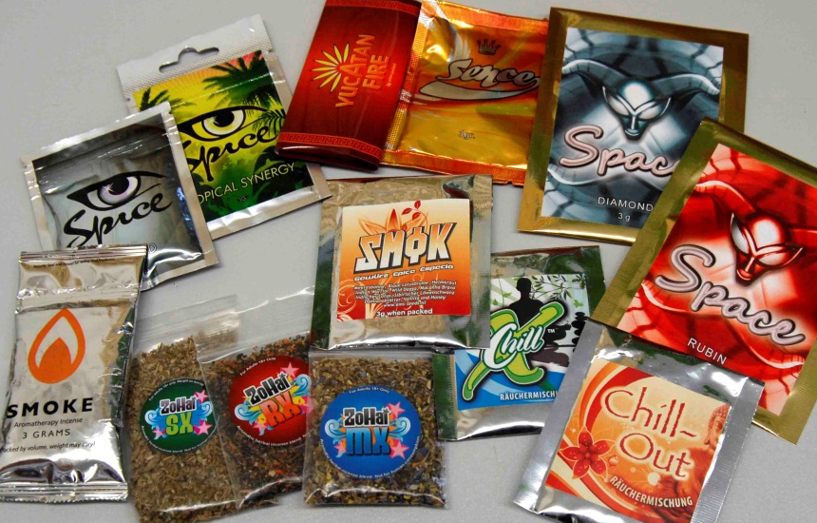
Synthetic Cannabinoids:
The Major Compounds
a) Naphthoylindoles
b) Cyclohexylphenoles
CP-47,497-C8
JWH-018
JWH-073
Sts-135
Pb-22
JWH-081
UR-144
JWH-122
A-796,260
Urb-602
JWH-007
AM-2201
MAM-2201
AKB48
AM-1220
XLR-11
5-Fluoropentyl-JWH-122
SOURCE: Agudelo et al. (2012). Effects of Synthetic Cannabinoids on the Blood Brain Barrier, Presented at 74th Annual CPDD.
Notes:
Synthetic cannabinoid receptor agonists, often referred to as ‘synthetic cannabinoids,’ are a large family of chemically unrelated structures functionally similar to Δ 9-tetrahydrocannabinol (THC), the active principle of cannabis. Like THC, they bind to the same cannabinoid receptors in the brain and other organs as the endogenous ligand anandamide (anandamide is a molecule that acts as a neurotransmitter, and that has a structure very similar to that of THC, the active constituent of cannabis. It is messenger molecule that plays a role in many bodily activities, including appetite, memory, pain, depression, and fertility - hence its name, which is derived from the word 'ananda' which means 'extreme delight' or 'bliss' in the Sanskrit language).
Synthetic cannabinoids were developed over the past 40 years as potential pharmaceutical agents, often intended for pain management. However, it proved difficult to separate the desired properties from unwanted psychoactive effects (1).
This slide depicts two of the more common chemical structures, but so far, little is known about metabolism and toxicology of the synthetic cannabinoid compounds. It cannot be assumed that the risks associated with the use of synthetic cannabinoids will be necessarily comparable to those seen with THC, and indeed there are some reasons for concerns that these drugs may have a greater potential to cause harm. Because the synthetic cannabinoids in the ‘Spice’ products have only been tested in the laboratory (in vitro or in animals), the health risk of the inhaled smoke is unknown. In the case of JWH-018, it can be speculated that, due to structural features, there may be a certain carcinogenic potential. Furthermore, accidental overdosing with a risk of severe psychiatric complications may be more likely to occur because the type and amount of cannabinoid may vary considerably from batch to batch even within the same product. In general, there may be a risk of the appearance of a full CB receptor agonist leading to life-threatening conditions if overdosed (unlike THC, which acts only as a partial agonist). What is clear is that further studies are needed to assess these risks reliably (2).
When tested, Spice has been found to contain over 250 artificial chemical compounds, including the ones above and new ones that we will talk about later. None of these chemicals are guaranteed safe for human consumption and the ingredients are not listed nor are instructions for use. Perhaps most worrisome: HU-210 has been found to be between 100 to 800 times more potent than THC, the main active chemical in marijuana (3).”
REFERENCES:
(1) Agudelo, M., Yndart, A., Morrison, M., Napuri, J., Samikkanu, T., Reddy, V.P., & Nair, M.P. (2012). Effects of Synthetic Cannabinoids on the Blood Brain Barrier. Presented at the 74th Annual College on Problems of Drug Dependence, La Quinta, California.
(2) EMCDDA. (2009). Thematic paper – Understanding the “Spice” phenomenon. Luxembourg: Office for Official Publications of the European Communities.
(3) Devane, W.A. et al. (1992). A novel probe for the cannabinoid receptor. Journal of Medical Chemistry 35(11), 2065-2069.

Slide 35
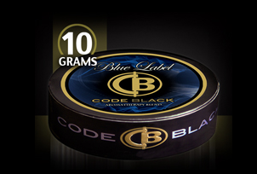
The Emergence of
Synthetic Cannabinoids
JWH-018/073 arrived early and have come and gone.
JWH-250 arrived a little later and has also cycled out.
JWH-081 was part of a second wave that has already completed its cycle.
JWH-122 was part of the same wave but has persisted in popularity and is part of the current scene.
AM-2201 was part of the same second wave and has gained in popularity, probably currently the most prevalent.
JWH-022 and JWH-210 are showing signs of increasing popularity.
Recent emergent drugs are the adamantoyl (AM-1248) and tetramethylcyclopropyl (XLR-11 and UR-144) indoles which are ahead of the latest attempts to schedule these drug classes.
SOURCE: Logan, B.K. (2012). Testing Strategies to Monitor Novel/Emerging/Designer Drug Use in At-Risk Populations,
Presented at 74th Annual CPDD.
Notes:
This slide shows the way the chemical formulas of Spice products change (quite rapidly at times) and come and go (or don’t go away) over time (1). This pattern of emerging compounds shows how difficult it is to develop toxicology tests that can identify the current synthetic cannabinoid drugs, as they each emerge and become a problem. “The family of JWH compounds is the most numerous, and although their chemical structures differ greatly from those of THC, they have a higher affinity to CB1 and/or CB2 receptors and are more potent than THC (2).”
It is important to note that other psychoactive substances besides cannabinoids can be found in Spice products. One such substance is the synthetic opioid O-desmethyltramadol, an active metabolite of the opioid tramadol. And Oleamide (cis-9,10-octadecenoamide), a fatty acid derivative with cannabinoid-like activity and hypnotic properties is one of the most frequently non-cannabinoid ingredients associated with Spice products (2).
REFERENCES:
(1) Logan, B.K. (2012). Testing Strategies to Monitor Novel/Emerging/Designer Drug Use in At-Risk Populations. Presented at the 74th Annual College on Problems of Drug Dependence, La Quinta, California.
(2) Fattore, L. & Fratta, W. (2011). Beyond THC: The new generation of cannabinoid designer drugs. Frontiers in Behavioral Neuroscience, 5(60), 1-12.

Slide 36
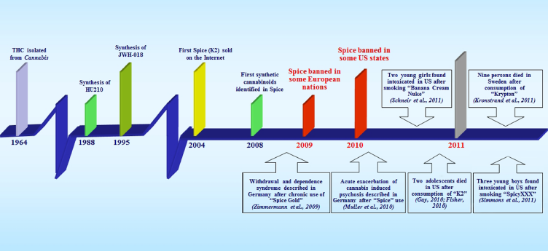
Timeline of Synthetic Cannabinoid Products
SOURCE: Fattore & Fratta. (2011). Frontiers in Behavioral Neuroscience, 5(60), 1-12.
Notes:
This slide maps the creation (synthesis) and spread of Spice products worldwide. At the beginning of 2009, legislation in several European countries subjected all products containing CP-47, 497, CP-47, 497-C8, and JWH-018 to the Narcotics Law, so that Spice and the other cannabinoid-containing “natural” mixtures were no longer accessible in head shops and online stores. What happened, however, is that the banning of these certain ingredients led to the development of a new generation of cannabimimetic substances – JWH-073, JWH-019, JWH-250, and JWH-398.
The brightly colored vertical bars across the left-hand part of the figure indicate key milestones in the availability of specific synthetic cannabinoids. The boxes with arrows highlight adverse effects associated with synthetic cannabinoid use, as well as a couple of recent notable case examples.

Slide 37
Factors Associated with Synthetic Cannabinoid Popularity
They induce psychoactive effects
They are readily available in retail stores and online
The packaging is highly attractive
They are perceived as safe drugs
They are not easily detectable in urine and blood samples
SOURCE: Fattore & Fratta. (2011). Frontiers in Behavioral Neuroscience, 5(60), 1-12.
Notes:
Many factors are associated with the recent popularity of Spice products, especially among younger users. Spice smokers find the effects similar to those of marijuana; Spice is often referred to as a “legal high;” regulatory mechanisms are difficult to enforce when products are available on the Internet; and Spice is marketed as a natural herb and intuitive language on packaging makes it attractive to young and drug-naïve individuals.

Slide 38
Six States Report Cases of Kidney
Damage Linked to Synthetic Cannabinoids
Sixteen cases of kidney damage reported by CDC
  All admitted to hospital
  Five required hemodialysis
Fifteen of the patients were male; ranged in age from 15 to 33, no history of kidney disease
In early Feb 2013, UA-Birmingham reported 4 cases of previously healthy young men, whose acute kidney injury was associated with synthetic marijuana
  Symptoms of nausea, vomiting, and abdominal pain
  All four men recovered kidney function, and none required dialysis
SOURCE: Join Together Online. (2013). Story published February 15, 2013.
Notes:
Hemodialysis is a treatment for advanced kidney failure. It involves filtering a person’s blood to remove waste and extra fluids, and returning the clean blood to the body.

Slide 39
Synthetic Cannabinoid Use Leads to Dangerous Symptoms in Pregnant Women
Leads to symptoms similar to those caused by dangerous conditions known as preeclampsia and eclampsia
  Preeclampsia is marked by high blood pressure and a high level of protein in the urine
  Preeclampsia can lead to eclampsia, which can cause a pregnant woman to develop seizures or coma, and in rare cases is fatal
SOURCE: Join Together Online, May 8, 2013.
Notes:
Synthetic cannabinoid use during pregnancy can lead to symptoms similar to those caused by dangerous conditions known as preeclampsia and eclampsia. Preeclampsia is marked by high blood pressure and a high level of protein in the urine. It can lead to eclampsia, which can cause a pregnant woman to develop seizures or coma, and in rare cases is fatal.

Slide 40
Case Example: Synthetic Cannabinoid Use among Pregnant Woman
A woman (35 weeks pregnant) suffered a seizure and appeared agitated
  High blood pressure and protein in urine, treated for eclampsia
  An emergency C-section was performed (baby in distress)
The woman screened negative for drugs, but an anonymous caller reported the woman regularly smoked “Spice Gold,” a synthetic cannabinoid.
  Spice Gold cannot be detected with a standard urine test.
The baby tested negative for drugs.
The woman required psychiatric care for psychotic behavior the day after delivery.
  “This was not a pregnancy problem but a drug problem. Eclampsia is cured with delivery of the baby, but she did not get better after delivery.” (Dr. Cindy Lee)
SOURCE: Join Together Online, May 8, 2013.
Notes:
At the American College of Obstetricians and Gynecologists annual meeting held in May 2013, a doctor described the case of a woman who said she was about 35 weeks pregnant, who suffered a seizure and appeared agitated. She had high blood pressure and protein in her urine, so the doctors treated her for eclampsia. They performed an emergency cesarean section because the baby was in distress. The woman screened negative for drugs, but an anonymous caller reported the woman regularly smoked Spice Gold, a type of synthetic marijuana. Spice Gold cannot be detected with a standard urine test. The baby tested negative for drugs. The woman required psychiatric care for psychotic behavior the day after delivery. “This was not a pregnancy problem but a drug problem,” Dr. Cindy Lee said in a news release. “Eclampsia is cured with delivery of the baby, but she did not get better after delivery.” The doctors noted obstetricians and gynecologists should be aware of emerging drugs, and consider the possibility patients may be taking them when making a diagnosis.

Slide 41

Khat
Pronounced “cot”
Stimulant drug derived from a shrub (Catha edulis) native to East Africa and southern Arabia
Use is considered illegal, because one of its chemical constituents, cathinone, is a Schedule I drug
Khat found in the U.S. often comes in by mail from Africa
SOURCE: NIDA. (2011). NIDA DrugFacts: Khat.
Notes:
The main psychoactive ingredients in khat are cathine and cathinone, chemicals that are structurally similar to, but less potent than amphetamine, yet result in similar psychomotor stimulant effects. Chewing khat leaves can induce a state of euphoria and elation as well as feelings of increased alertness and arousal. The user can also experience an increase in blood pressure and heart rate. The effects begin to subside after about 90 minutes to 3 hours, but can last 24 hours. At the end of a khat session (some of which last for 8-10 hours), the user may experience a depressive mood, irritability, loss of appetite, and difficulty sleeping. Chewing the leaves and twigs of the plant produces amphetamine-like euphoric effects, and also is associated with green drool.
In 2006, there were 10 million khat users worldwide. Users may also dry out the khat and brew it as a tea. Khat has been used for hundreds of years in places such as East Africa (Horn of Africa), Saudi Arabia, and Yemen.
Photo credit: DEA, September 2012.

Slide 42

Synthetic Cathinones
Could be MDPV, 4-MMC, mephedrone, or methylone
Sold on-line with little info on ingredients, dosage, etc.
Advertised as legal highs, legal meth, cocaine, or ecstasy
Taken orally or by inhaling
Serious side effects include tachycardia, hypertension, confusion or psychosis, nausea, convulsions
Labeled “not for human consumption” to get around laws prohibiting sales or possession
SOURCE: Wood & Dargan. (2012). Therapeutic Drug Monitoring, 34, 363-367.
Notes:
Synthetic cathinones, also known as Bath Salts, are one of the latest additions to a growing list of substances young people can use to get high. Bath Salts is a powder laced with a cocktail of chemicals that comes in either capsules or in loose form. A user can either swallow the capsule whole or use the powder, mixed with liquid, and injected. Sometimes it is snorted directly up the nose. It is said to replicate a cocaine or ecstasy high (1).
Synthetic cathinones are related to the parent compound cathinone, one of the psychoactive principals in khat. The synthetic powder is sold legally online and in drug paraphernalia stores under a variety of names, such as Ivory Wave, Purple Wave, Red Dove, Blue Silk, Zoom, Bloom, Cloud Nine, Ocean Snow, Lunar Wave, Vanilla Sky, White Lightning, Scarface, and Hurricane Charlie. Because these products are relatively new to the drug abuse scene, knowledge about their precise chemical composition and short- and long-term effects is limited, yet the known information warrants a proactive stance to understand and minimize any potential dangers to the public’s health.
These products often contain various amphetamine-like chemicals, such as methylenedioxypyrovalerone (MPDV), mephedrone and pyrovalerone. These drugs are typically administered orally, by inhalation, or by injection, with the worst outcomes apparently associated with snorting or intravenous administration. Mephedrone is of particular concern because, according to the United Kingdom experience, it presents a high risk for overdose. These chemicals act in the brain like stimulant drugs (indeed they are sometimes touted as cocaine substitutes); thus they present a high abuse and addiction liability. Consistent with this notion, these products have been reported to trigger intense cravings not unlike those experienced by methamphetamine users, and clinical reports from other countries appear to corroborate their addictiveness. They can also confer a high risk for other medical adverse effects. Some of these may be linked to the fact that, beyond their known psychoactive ingredients, the contents of "bath salts" are largely unknown, which makes the practice of abusing them, by any route, that much more dangerous (2).
Additional Information for the Trainer(s)
The list of synthetic cathinones is long: butylone, dimethylcathinone, ethcathinone, ethylone, 3- and 4- flouromethcathinone, methadone, mephedrone, methlenedioxypyrovalerone (MDPV), methylone and pyrovalerone, among others. Bupropion is the only cathinone derivative that has a medical indication in the U.S. and Europe. The first synthetic cathinone, methcathinone, was produced in 1928.
REFERENCES:
(1) Wood, D.M. & Dargan, P.I. (2012). Use and acute toxicity associated with the novel psychoactive substances diphenylprolinol (D2PM) and desoxypipradrol (2-DPMP). Clinical Toxicology, 50, 727-732.
(2) Volkow, N. (2011). Message from the Director: “Bath Salts” – Emerging and Dangerous Products. Rockville, MD: National Institute on Drug Abuse.

Slide 43
Synthetic Cathinones are β-keto (‘bk’) Analogs of Amphetamine
Notes:
This slide shows how rogue chemists can simply add another molecule to the original formula to change it so it no longer meets the definition of the drug as set by law. Numerous synthetic cathinone derivatives have become popular for use as “legal highs.” Exactly when these derivatives gained popularity amongst club goers and others seeking new drugs of abuse is difficult to pinpoint, but mentions in Internet drug forums began in 2007. Synthetic cathinones that have been found in these products include butylone, dimethylcathinone, ethcathinone, ethylone, 3 and 4-fluoromethcathinone, mephedrone, methedrone, MDPV, methylone, and pyrovalerone.
Studies have identified two general classes of chemicals in bath salt mixtures – compounds with stimulant activity related to amphetamines, and compounds with serotonergic effects that appear to contribute to the hallucinogenic properties of these mixtures. The amphetamine related compounds are derivatives of cathinone that differ from amphetamine in the beta carbon, or the carbon attached to the aromatic ring.
REFERENCE:
Prosser, J.M. & Nelson, L.S. (2012). The toxicology of bath salts: A review of synthetic cathinones. Journal of Medical Toxicology 8(1), 33-42.

Slide 44
Sources and Continuing Availability
A number of synthetic marijuana and bath salt products appear to originate overseas and are manufactured in the absence of quality controls and devoid of governmental regulatory oversight.
The large profits from sales, plus the fact that these chemicals can be easily synthesized to stay one step ahead of control, indicate there is no incentive to discontinue retail distribution of synthetic cannabinoid products under the current statutory and regulatory scheme.
SOURCES: ONDCP, 2012; EMCDDA, 2011.
Notes:
Law enforcement personnel have also encountered the manufacture of herbal incense products in such places as residential neighborhoods. These products and associated synthetic cannabinoids are readily accessible via the Internet. While the drugs may be made by rogue chemists in China or India, a study by the European Monitoring Centre for Drugs and Drug Addiction (EMCDDA) found that in 2011, the United Kingdom and the United States accounted for 83% of the online shops selling “legal highs.” English was the most common language of these websites, but it is difficult to establish the actual country of origin (1-2).
REFERENCES:
(1) Office of National Drug Control Policy (ONCDP). (2012). Synthetic Drugs (a.k.a., K2, Spice, Bath Salts, etc.). Available at: http://www.whitehouse.gov/ondcp/ondcp-fact-sheets/synthetic-drugs-k2-spice-bath-salts.
(2) EMCDDA. (2011). Annual Report, 2011: The State of the Drugs Problem in Europe. Luxembourg: Office for Official Publications of the European Communities (p. 96).

Slide 45
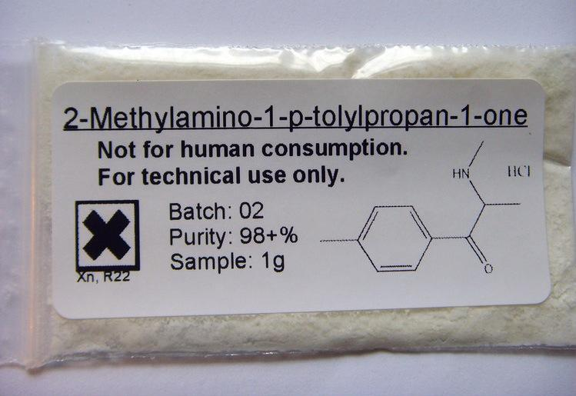
Challenges with Chromatography Screening
Lack of availability of the reference standard for new drugs
Variable quality of reference standards
Lack of purity and labeled internal standards
Chemical similarity of new drugs within a class requires great care with identification
Sensitivity (correctly IDs the drug)
SOURCE: Logan et al. (2012). Journal of Forensic Sciences, 57(5), 1168-1180.
Notes:
This slide explains the difficulties toxicologists face when attempting to identify some of these synthetic drugs. While traditional chemical techniques can identify many of the compounds in them, there are products that contain no identifiable drug. In addition, there is no homogeneity in the various packages of the same brand, nor a standard chemical combination that can be used to identify the substance. Products purchased after the November 2010 DEA scheduling are more likely to contain new versions of the drug. The synthetic cannabis market is extremely dynamic with new compounds being substituted for existing ones as legislation attempts to restrict their distribution or use.

Slide 46

Synthetic Drug Testing Protocol – What to Consider
Questions to consider when selecting a toxicology laboratory:
  For which synthetic drugs should you test?
  How many derivatives/formulations can
  the laboratory detect with
  their test?
  Are the newest generations
  (4th and above such as the AM,
  XLR, and UR versions) detected?
  How much does the test cost?
Notes:
Testing for synthetic/designer drugs is challenging to employers, courts, and treatment providers. Legislation to regulate possession, use and sale of these drugs varies widely from state to state. Formulations of the drugs are in constant flux, making relevant legislation and testing a challenge. Testing for synthetic drugs is not widely available and is often expensive.
An effective testing program for designer drugs must address the following: (1) does it test for all the current versions of the drug or does it only test for the versions that existed several years ago? (2) is the test affordable?
Some toxicology laboratories have synthetic drug testing kits but the number and types of drugs to be tested varies. Some only test for the first generation JWH drugs, while others test for a variety of cannabinoid and cathinone drugs. In this presentation, you will learn about the latest varieties, and use them as the guide in choosing the test panel. A recent study planned to only test for 10 cannabinoids but added in two more and found that only 5 specimens tested positive for the panel of 10 but all 118 tested positive when the panel was expanded to 12.
REFERENCE:
Wish, E.D., Artigiani, E.E. and Billing, A. S. (2013). Community Drug Early Warning System: The CDEWS Pilot Project. Office of National Drug Control Policy. Washington, DC.
Photo credit: Join Together Online, September 2013.

Slide 47
Human Exposure Calls to U.S. Poison Centers on Synthetic Cannabinoids and Cathinones and the Effect of Federal Regulations
SOURCE: American Association of Poison Control Centers, 2010-2013 data.
Notes:
Federal Efforts to Ban Synthetic Cannabinoids:
March 2011: DEA places JWH-018, JWH-073, JWH-200, CP-47, 497, and CP-497 C8 homologues into temporary Schedule I.
July 2012: Synthetic Drug Abuse Prevention Act places more than a dozen synthetic cannabinoid homologues permanently into Schedule I.
April 2013: Notice of Intent published to temporarily schedule UR-144, XLR 11, and AKB48.
Federal Efforts to Ban Synthetic Cathinones:
Oct 2011: DEA exercised its emergency scheduling authority to control some of the synthetic substances used to manufacture bath salts; these synthetic stimulants are now designated as Schedule I substances.
July 2012: Congress passed and President Obama signed the Synthetic Drug Abuse Prevention Act (MDPV and mephedrone Schedule I).
April 3013: DEA places methylone into Schedule I.
Even with new laws and penalties, many users continue to use synthetic drugs, namely synthetic cannabinoids and synthetic cathinones. These graphs represent the latest calls made to U.S. poison control centers. The vertical line in each graph indicates the date in which the control laws went into effect. Notice that even after the laws took effect, people continued to use synthetic drugs and continued to report unpleasant (adverse) effects, leading them to call their local poison control center. In other words, even as the laws change, people continue to seek out and use illegal drugs. It is important to keep in mind that when the number of exposure calls decrease, part of the reason is as we learn more about these synthetic drugs, ER staff don’t need to call the Poison Control Center as much as they did in the past. Medical personnel are more familiar with the cases that are coming in, and do not need to seek outside advice from a Poison Control Center.
According to the October 29, 2013 issue of Join Together Online, a total of 26 synthetic drugs were banned in 2012; 250 other formulations are still available and sold in the United States. Chemists continually introduce slight variations of banned products and sell them under a different brand name and stay one step ahead of the federal legislation.

Slide 48
“New Zealand’s Designer Drug Law Draws Global Interest”
The law, enacted in July 2013, represents a U-turn from the traditional approach of retroactively banning synthetic drugs
New Zealand will attempt to regulate designer drugs, allowing their sale if they go through rigorous safety testing similar to that for pharmaceuticals
Giving users a high wouldn't be a reason to ban them
SOURCE: Maxwell, J.C. (In Press). Drug and Alcohol Dependence.
Notes:
In July 2013 in New Zealand, a law was passed which offers drug designers the chance of getting official approval for their products. If they can persuade a new “Psychoactive Substances Regulatory Authority” that their pills and powders are low risk, they will be licensed to market them, whether or not they get people high. Drugs will have to undergo clinical trials, which the government expects to take around 18 months—much less than for medicines, because the drugs will be tested only for toxicity, not for efficacy. Drugs that are already banned internationally, such as cocaine and cannabis, are ineligible. Only licensed shops will sell the drugs, without advertising and not to children. This offers an alternative approach that could be more effective than retroactive banning of substances, since the government would not regulate the chemical ingredients but instead target the control of these drugs through the effects of the substance, such as stimulation or depression of the central nervous system and association with dependency, hallucinations, or disturbances in motor function or behavior, regardless of the chemical components.
REFERENCES:
(1) Maxwell, J.C. (In Press). Psychoactive substances—Some new, some old: A scan of the situation in the U.S. Drug and Alcohol Dependence, e-Pub ahead of print.
(2) The Economist. (2013). Available at: http://www.economist.com/news/leaders/21583270-new-zealands-plan-regulate-designer-drugs-better-trying-ban-them-and-failing-new.
(3) CBS News. (2013). Available at: http://www.cbsnews.com/8301-202_162-57596751/new-zealands-designer-drug-law-draws-global-interest/.

Slide 49
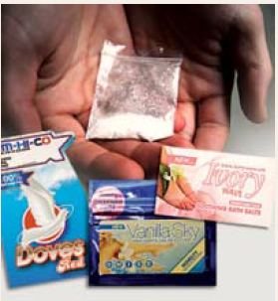
the Effects of synthetic DRUGS
Notes:
Health warnings have been issued by numerous State and local public health authorities and poison control centers describing the adverse health effects associated with the use of synthetic cannabinoids, substituted cathinones, and their related products.
Photo credit: Wikipedia, 2012.

Slide 50
“People high on these drugs can get very agitated and violent, exhibit psychosis, and severe behavior changes…some have been admitted to psychiatric hospitals and have experienced continued neurological and psychological effects.”
(Dr. Rick Dart, AAPCC President)
SOURCE: Dimond, D. This Spice Can Kill You. Posted 8/8/12 at 2:49 p.m.
Notes:
As was previously mentioned, several recent sensational media stories have reported people "going crazy" after taking Bath Salts or Spice and committing suicide, murder, or other violent crimes. Users are said to feel a surge in energy, a flush of fever and delusions of invincibility. The American Association of Poison Control Centers (AAPCC) reports an increasing number of calls from those who've had serious symptoms after using Bath Salts or Spice. These synthetically manufactured drugs can cause vomiting, hallucinations, and such high blood pressure that lasting heart problems have been reported along with cases of deadly heart attacks. The slide features a quote from Dr. Rick Dart, President of AAPCC. The purpose of this section is to describe the documented effects of synthetic cannabinoids and cathinones.

Slide 51
Short-Term Effects of
Synthetic Cannabinoids
Loss of control
Lack of pain response
Increased agitation
Pale skin
Seizures
Vomiting
Profuse sweating
Uncontrolled spastic body movements
Elevated blood pressure
Elevated heart rate
Heart palpitations
In addition to physical signs of use, users may experience severe paranoia, delusions, and hallucinations.
SOURCE: Join Together Online, December 4, 2012.
Notes:
Short term effects include loss of control, lack of pain response, increased agitation, pale skin, seizures, vomiting, profuse sweating, uncontrolled spastic body movements, elevated blood pressure, heart rate and palpitations. In addition to physical signs of use, users may experience severe paranoia, delusions, hallucinations and increased agitation.

Slide 52
Cannabis vs. Synthetic Cannabinoids: Effects Seen in Clinical Cases
Most symptoms are similar to cannabis intoxication:
  Tachycardia
  Reddened eyes
  Anxiousness
  Mild sedation
  Hallucinations
  Acute psychosis
  Memory deficits
Symptoms not typically seen after cannabis intoxication:
  Seizures
  Hypokalemia
  Hypertension
  Nausea/vomiting
  Agitation
  Violent behavior
  Coma
SOURCES: Hermanns-Clausen et al. (In Press), Addiction; Rosenbaum et al. (2012). Journal of Medical Toxicology; Forrester et al. (2011). Journal of Addictive Disease; Schneir et al. (2011). Journal of Emergency Medicine.
Notes:
Due to the paucity of medical literature and research regarding synthetic cannabinoids, the clinical effects are primarily known from case reports and case series. Effects of synthetic cannabinoids are similar to those produced by marijuana, such as: elevated mood, relaxation, and altered perception. In some cases, the effects are even stronger than those reported for marijuana. Some users have reported psychotic effects, including extreme anxiety, paranoia, and hallucinations.
So far, there have been no scientific studies of Spice’s effects on the human brain, but it is known that the cannabinoid compounds found in Spice products act on the same cell receptors as THC, the primary psychoactive component of marijuana. Some compounds found in Spice, however, bind more strongly to those receptors, which could lead to a much more powerful and unpredictable effect. Because the chemical composition of many products sold as Spice is unknown, it is likely that some varieties also contain substances that could cause dramatically different effects than the user might expect.
Spice abusers who have been taken to Poison Control Centers report symptoms that include rapid heart rate, vomiting, agitation, confusion, and hallucinations. Spice can also raise blood pressure and cause reduced blood supply to the heart (myocardial ischemia), and in a few cases it has been associated with heart attacks. Regular users may experience withdrawal and addiction symptoms. Based on the more unpleasant effects of cannabinoid intoxication, one would wonder why anyone would voluntarily ingest any of these substances, except perhaps to avoid testing positive for cannabis (1-5).
Additional Information for the Trainer(s)
Tachycardia = heart rate that exceeds the normal range
Hypokalemia = a lower than normal amount of potassium in the blood
REFERENCES:
(1) Hermanns-Clausen, M., Kneisel, S., Szabo, B., Auwater, V. (In Press). Acute toxicity due to the confirmed consumption of synthetic cannabinoids: Clinical and laboratory findings. Addiction.
(2) Rosenbaum, C.D., Carreiro, S.P., & Babu, K.M. (2012). Here today, gone tomorrow…and back again? A review of herbal marijuana alternatives (K2, Spice), synthetic cathinones (Bath Salts), Kratom, Salvia divinorum, methoxetamine, and piperazines. Journal of Medical Toxicology, 8(1), 15-32.
(3) Forrester, M.B., Kleinschmidt, K., Schwarz, E., & Young, A. (2011). Synthetic cannabinoid exposures reported to Texas poison centers. Journal of Addictive Disease, 30(4), 351-358.
(4) Schneir, A.B., Cullen, J., & Ly, B.T. (2011). “Spice” girls: Synthetic cannabinoid intoxication. Journal of Emergency Medicine, 40(3), 269-299.
(5) National Institute on Drug Abuse (NIDA). (2012). Drug Facts: Spice (Synthetic Marijuana). Rockville, MD: U.S. Department of Health and Human Services, National Institutes of Health.

Slide 53
Synthetic Cannabinoids:
Other Considerations
  Unlike cannabis, synthetic
  cannabinoids have no therapeutic
  effects
    Example: no cannabidiol (anti-anxiety), so mood effects unpredictable
Packets can contain other psychoactive substances: opioids, oleamide, harmine/harmaline (MAO-Is) that can interact with the synthetic cannabinoid
Cancer-causing potential of inhaling smoke from these compounds unknown
SOURCE: Doris Payer, #CHSF2013.
Notes:
Unlike cannabis, which contains far more compounds than THC alone, many of which have their own effects on brain and body, synthetic cannabinoid compounds have no therapeutic potential - so you are getting a strong cannabinoid effect without any modulation that might be present when smoking cannabis. One example is that cannabis smoke also contains cannabidiol, which can prevent anxiety, but in the absence of this modulator, mood effects from synthetic cannabinoids can be unpredictable. Another issue is that synthetic cannabinoid packets may contain other psychoactive ingredients, like opiates or MAO-Is, which can interact with the cannabinoids present, as well as other substances that might be ingested at the same time. Finally, as much as smoking cannabis may be bad for the user’s lungs, we have NO idea the damage smoking these synthetic compounds might do to the user.

Slide 54
“A Tale of Two Cases” – Case #1
33 year-old male
Employed as an imaging technician
Stable 8-year marriage
Previous drug use: marijuana, alcohol, tobacco
Used “herbal incense” daily
After 3 months of use, suddenly experienced a panic attack
Immediately discontinued all alcohol/drug use
Repeated episodes of anxiety still occurring after 18 months of abstinence
SOURCE: J. Randall Webber, MPH, CADC, “Emerging Drugs of the 21st Century, July 2013.”
Notes:
**GROUP ACTIVITY** – provide 7-10 minutes for this discussion.
This slide and the subsequent slide detail two individuals who used synthetic marijuana (“herbal incense”). As you will see in just a few minutes, the subjective effects of “herbal incense” differed greatly between the two users. Inform participants that you will be reading them the two cases, and they will have time as a large group to discuss the cases once you are finished reviewing each one.
INSTRUCTIONS
Read Case #1 aloud and proceed to the next slide.

Slide 55
“A Tale of Two Cases” – Case #2
16 year-old female
In treatment for alcohol dependency
History of bi-polar disorder
Smoked 3 “hits” of “herbal incense”
10 minutes later (8:00 p.m.), experienced psychotic episode
Following observation at hospital, returned to normal (12:00 a.m.)
Next day, no apparent after-effects
SOURCE: J. Randall Webber, MPH, CADC, “Emerging Drugs of the 21st Century, July 2013.”
Notes:
**GROUP ACTIVITY** – provide 7-10 minutes for this discussion.
This slide and the previous slide detail two individuals who used synthetic marijuana (“herbal incense”). As you see, the subjective effects of “herbal incense” differed greatly between the two users. Inform participants that after you finish reading the second case, they will have time as a large group to discuss the differences in the two cases.
INSTRUCTIONS
Read Case #2 aloud and proceed to the next slide.

Slide 56
Group Discussion: Why the Discrepancy in Reported Effects?
What factors do you think played a role in the differential effects of “herbal incense” on these two users?
SOURCE: J. Randall Webber, MPH, CADC, “Emerging Drugs of the 21st Century, July 2013.”
Notes:
**GROUP ACTIVITY** – provide 7-10 minutes for this discussion.
The purpose of this discussion is to highlight the fact that users really do not know what they are getting when they purchase and ingest a synthetic cannabinoid. In these two scenarios, the users reported ingesting herbal incense, but had extremely different experiences with the drug.
Elicit responses from the audience to the question portrayed on this slide.
Possible factors include:
Use of other drugs (including alcohol)
Varying potency
“hot spots”
Overdose
Presence of different cannabinoids
“Knock-offs”
User/environment characteristics, such as setting and set (age, psychological stability, previous experience with psychoactive drugs, immediate support system)
Sensationalism (some user reports taken out of context)
Family history of mental health or substance use issues
Anti- or pro-drug attitudes
Agency funding/Visibility

Slide 57
Clinical Symptoms of Synthetic Cathinone Use in Patients Admitted to the Emergency Department (N=236)
Agitation | 82%
Combative/Violent behavior | 57%
Tachycardia | 56%
Hallucinations | 40%
Paranoia | 36%
Confusion | 34%
Myoclonus/Movement disorders | 19%
Hypertension | 17%
Chest pain | 17%
CPK elevations | 9%
SOURCE: Spiller et al. (2011). Clinical Toxicology, 49, 499-505.
Notes:
When individuals are asked why they use synthetic cathinones, the desired effects they seek are an increase in energy, empathy, openness, and libido (sex drive). These desired effects are very similar to the effects that stimulant users seek to achieve when using cocaine or methamphetamine or ecstasy. The acute symptoms reported by users can include euphoria, alertness, energy, talkativeness, increased sexual arousal, and the compulsion to re-dose frequently. Some case reports describe extremely aggressive and psychotic behavior with increased physical strength, as sometimes described in PCP intoxication. The clinical effects of synthetic cathinone intoxication are consistent with sympathomimetic toxicity and include hypertension, tachycardia, hyperthermia, dehydration, and psychomotor agitation. The patients may also report palpitations, headache, chest pain, trismus, bruxism, tremors, insomnia, and paranoia (1). Although much can be drawn from the structural and chemical similarities between synthetic cathinones and amphetamines, continued studies are needed to understand the particular properties including the long-term effects of synthetic cathinones (2).
The enduring high and extreme behavior seen with synthetic cathinone intoxication may stem from the combination of the compounds present in a packet. Mephedrone acts like methamphetamine in increasing dopamine concentrations; MDPV mimics the way in which cocaine inhibits the reuptake of dopamine, resulting in the brain staying flooded with dopamine. MDPV is purported to be 10 times more potent than cocaine, and when it binds to dopamine receptors, it does not let go when you take the drug away.
Bath Salts have been linked to an increasing number of ER visits across the U.S. Physicians and clinicians at U.S. poison control centers have indicated that ingesting or snorting "bath salts" containing synthetic stimulants can cause chest pains, increased blood pressure, increased heart rate, agitation, hallucinations, extreme paranoia, and delusions. This slide shows the problems reported by patients who took synthetic cathinones in a 2011 article by Spiller and colleagues. The symptoms are ranked by most commonly reported to least commonly reported. Tachycardia is another term for heart rate that exceeds the normal range. Myoclonus is a brief, involuntary twitching of a muscle or group of muscles. CPK (creatine phosphokinase) elevations are an increase in CPK, which is used as a marker of myocardial infarction (heart attack), rhabdomyolysis (severe muscle breakdown), muscular dystrophy, and acute renal failure.
REFERENCES:
(1) Spiller, H.A., Ryan, M.L., Weston, R.G., & Jansen, J. (2011). Clinical experience with and analytical confirmation of “bath salts” and “legal highs” (synthetic cathinones) in the United States. Clinical Toxicology, 49, 499-505.
(2) Cheng, S., Yeo, J., Brown, E., & Regan, A. (2012). Bath salts and synthetic cannabinoids: A review. American Academy of Emergency Medicine, 19(2), 19-22.

Slide 58
Effects of Mephedrone
Intended Effects:
Euphoria
Stimulation
Enhanced music appreciation
Decreased hostility
Improved mental function
Mild sexual stimulation
Unintended (Adverse) Effects:
Bruxism (teeth grinding)
Dilated pupils
Poor concentration
Problems focusing visually
Poor short-term memory
Hallucinations
Delusions
SOURCE: J. Randall Webber, MPH, CADC, “Emerging Drugs of the 21st Century, July 2013.”
58
Notes:
Mephedrone, also known as 4-methylmethcathinone (4-MMC) or 4-methylephedrone, is a synthetic stimulant drug of the amphetamine and cathinone classes. Slang names include ”drone” and “MCAT.” It is reportedly manufactured in China, comes in the form of tablets or a powder, which users can swallow, snort or inject, producing similar effects to MDMA, amphetamines, and cocaine.
The metabolism of mephedrone has been studied in rats and humans and the metabolites can be detected in urine after usage. Despite similarities to known neurotoxins such as methamphetamine and cathinone derivatives, mephedrone does not appear to produce neurotoxic effects in the dopamine system.
Mephedrone was first synthesized in 1929, but did not become widely known until it was rediscovered in 2003. By 2007, mephedrone was reported to be available for sale on the internet, by 2008 law enforcement agencies had become aware of the compound, and by 2010, it had been reported in most of Europe, becoming particularly prevalent in the United Kingdom. Mephedrone was first made illegal in Israel in 2008, followed by Sweden later that year. In 2010, it was made illegal in many European countries and in December 2010, the EU ruled it illegal. In Australia, New Zealand and the USA, it is considered an analog of other illegal drugs and can be controlled by laws similar to the Federal Analog Act.
The left column highlights several possible intended effects of mephedrone ingestion specifically. The right column highlights unintended or adverse effects of mephedrone ingestion. Anecdotally speaking, some of the overdoses that have been reported by the media recently, and MDMA pills submitted for testing are actually testing positive for mephedrone/methylone and not MDMA.
REFERENCE:
Angoa-Perez, M., Kane, M.J., Francescutti, D.M., Sykes, K.E., Shah, M.M., Mohammed, A.M., Thomas, D.M., & Kuhn, D.M. (2012). Mephedrone, an abused psychoactive component of ‘bath salts’ and methamphetamine congener, does not cause neurotoxicity to dopamine nerve endings of the striatum. Journal of Neurochemistry, 120(6), 1097-1107.

Slide 59
Effects of Methylone
Central Nervous System stimulation
Euphoria or dysphoria
Anxiolysis/Anxiogenesis
Increase in sociability
Insomnia
Restlessness
De-realization/
De-personalization
Hallucinations
Psychosis
Tachycardia (rapid pulse)
Hypertension (high BP)
Hyperthermia
Sweating
Dilated pupils
Nystagmus
Trismus (inability to open the mouth)
Bruxism (teeth grinding)
Anorexia
Nausea and vomiting
SOURCE: J. Randall Webber, MPH, CADC, “Emerging Drugs of the 21st Century, July 2013.”
Notes:
Methylone, also known as M1, 3,4-methylenedioxy-N-methylcathinone, MDMC, or bk-MDMA, is an entactogen and stimulant of the phenethylamine, amphetamine, and cathinone classes. It was originally patented by Jaboc Peyton and Alexander Shulgin in 1996 as an antidepressant. Methylone is a close structural analogue of MDMA, differing by the addition of a β-ketone group. This slide highlights several possible adverse effects of ingesting methylone specifically. Dysphoria is a state of feeling unwell or unhappy. An anxiogenic substance is one that causes anxiety, whereas an anxiolytic agent is one that inhibits anxiety. Nystagmus is involuntary eye movement.

Slide 60
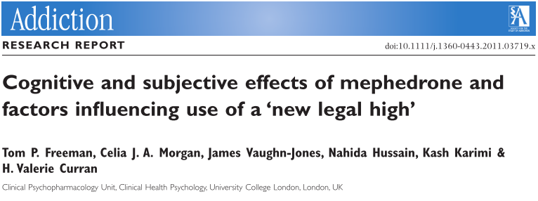
Synthetic Stimulants:
Cognition
Same changes in mental state as classic stimulants: impulsive acts, decision-making, judgment → can lead to risky behavior in nightlife context
Single human study: 20 mephedrone users snorting in own homes (vs. drug-free visit, vs. controls)
  Regardless of high vs. not: worse memory than controls, some personality differences (schizotypy, depression)
  High caused drug-wanting, “speedy” effects, increased speed of movement, worse working memory
SOURCE: Doris Payer, #CHSF2013.
Notes:
Cognitive function is the ability of the brain to “do its thing,” and can be impacted by stimulant use, which in addition to mental state while under the influence of the drug, also includes long-term abilities, like memory, reasoning, etc.
In general, research on synthetic stimulants finds the same changes in mental state while high as are seen with classic stimulants such as cocaine or methamphetamine; behavior becomes more impulsive, decision-making is impaired, and judgment becomes worse. While this is part of the thrill of doing the drug, it can lead to risky behaviors like unsafe sex, aggression, impaired driving, etc. (in addition to taking more drug and winding up in a binge).
Amazingly, there has actually been a human study here (although again behavioral, no neurobiological), where researchers visited 20 mephedrone users on two occasions, once while high and once when they were not under the influence, and compared them to non-users. The researchers found that in general, regardless of being high or not, the mephedrone users had more memory impairment than the controls, and some personality differences (including schizotypy, which is a personality pattern on the schizophrenia spectrum, and depression), which suggests either that it is a certain type of crowd that is drawn to these types of drugs, or that these are some of the long-term effects - or both. Results from comparing the high vs. not high sessions were not too surprising; after getting high, people wanted more and felt speedy and hyperactive, but also showed more impaired working memory (the ability to keep things in mind or “online” in your head), which again can be risky when trying to do complex tasks.
REFERENCE:
Freeman, T. P., Morgan, C. J. a, Vaughn-Jones, J., Hussain, N., Karimi, K., & Curran, H. V. (2012). Cognitive and subjective effects of mephedrone and factors influencing use of a “new legal high”. Addiction (Abingdon, England), 107(4), 792-800.

Slide 61
Bath Salts in Michigan
Case Report – MMWR, May 2011
First report to summarize epidemiology of bath salt ED cases
Based on 35 people who had ingested, inhaled, or injected bath salts and subsequently visited a Michigan Emergency Department (ED) between 11/13/10 and 3/31/11
Patients presented with hypertension, tachycardia, tremors, motor automatisms, mydriasis, delusions, and paranoia
No relationship found between route of administration and severity of illness
SOURCE: Cheng, Yeo, Brown, & Regan. (2012). American Academy of Emergency Medicine, 19(2), 19-22.
Notes:
The Michigan Department of Community Health (MDCH) instituted a mandate requiring hospitals to report all cases of possible bath salts intoxication. The MDCH also started an investigation into bath salt abuse, and ultimately identified 35 patients who visited a Michigan ED during the period between November 13, 2010, and March 31, 2011. The patients ranged from 20-55 years of age: 19 (54%) were men and 16 (46%) were women. Twenty-four (69%) of the patients identified had a self-reported history of drug abuse, with 11 (31%) reporting poly-substance abuse and 12 (34%) intravenous drug abuse. Sixteen patients (46%) had a history of mental illness reported in their medical records including bipolar disorder, schizophrenia and depression. The method of abuse varied as 22 (63%) of the patients injected the drug, 9 (26%) snorted it, and 4 (11%) had ingested it.
The clinical findings in the investigation (published in the CDC’s Morbidity and Mortality Weekly Report) were consistent with stimulant intoxication. Of the 35 identified patients, 32 (91%) had neurologic symptoms, 27 (77%) had cardiovascular symptoms, and 17 (49%) had psychological symptoms. Agitation (66%) and tachycardia (63%) were the two most common symptoms found in these patients. Delusions/hallucinations were also a frequent symptom seen in 40% of patients. Seventeen of the 35 patients were hospitalized, 15 were treated then discharged from the ED, 2 left against medical advice, and 1 was dead on arrival to the ED. Of the 17 hospitalized patients, 9 were admitted to the ICU, 5 to the general floor, and 3 were admitted directly to a psychiatric unit. Treatment consisted of supportive care, and benzodiazepines were used to control agitation.
Although bath salt abuse has been documented nationwide, this report is the first to summarize the epidemiology of a number of ED cases. The investigation demonstrated collaboration between public health, law enforcement and health care. The Marquette County Health Department issued an emergency order to decrease local bath salt abuse locally. In addition, a statewide system was established to mandate reporting of detected cases in other counties. These methods demonstrate the importance of identifying a potentially dangerous substance in a timely manner and implementing appropriate strategies to reduce further drug-related morbidity and mortality.

Slide 62
Maine Reports Serious Infections Linked with Injection of Bath Salts
Four cases of invasive Group A streptococcal infections
Dangerous because it can cause infections of heart and bloodstream
Two patients developed Streptococcal Toxic Shock Syndrome
  Can cause rapid drop in blood pressure and organ failure
One patient developed necrotizing fasciitis, a disease that progresses quickly, destroying muscles, fat, and skin tissue
SOURCE: Join Together Online. (2012). Story published December 13, 2012.
Notes:
In December 2012, Maine public officials reported four cases of serious infections that resulted from people injecting “bath salts.” All four patients had to be hospitalized for invasive “Group A” streptococcal infections. “It can be very dangerous because it can cause infections of your heart and infections of your bloodstream,” said Dr. Sheila G. Pinette, Director of the Maine Center for Disease Control and Prevention. “It’s very serious if you get a strep infection. Our major concern is to try and discourage this type of drug use.”
Two of the patients developed Streptococcal Toxic Shock Syndrome, which can cause a rapid drop in blood pressure and organ failure. One patient developed necrotizing fasciitis, a disease that progresses quickly, destroying muscles, fat and skin tissue.
About one-quarter of patients with necrotizing fasciitis die, as do more than 35 percent with Streptococcal Toxic Shock Syndrome, the Maine health agency noted in a health alert. Early signs of the syndrome include fever, low blood pressure, abrupt onset of severe pain, often in the arm or leg, dizziness, confusion, and a flat red rash over large areas of the body.

Slide 63
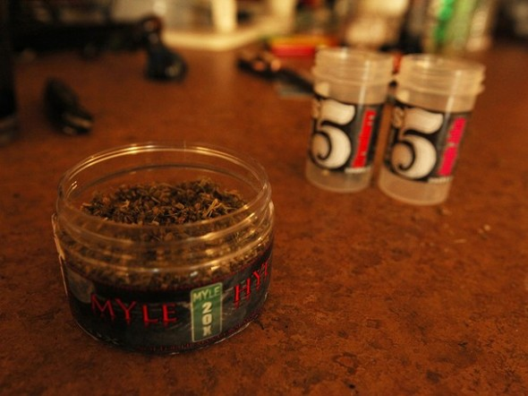
the Neurobiology of synthetic drug USE
Notes:
This section of the presentation will focus on the neurobiological concerns of synthetic drug use (focusing on stimulants, cannabinoids, psychedelics, and dissociatives), and the differential neurobiological impact of synthetic drugs vs. “classic” drugs (marijuana, cocaine, methamphetamine, etc.).
Photo credit: National Geographic Channel, 2013.

Slide 64
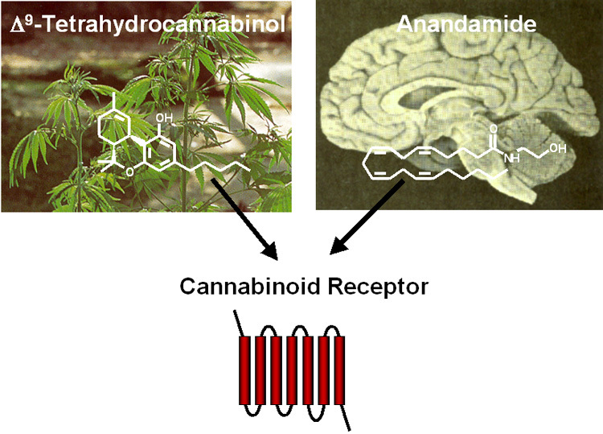
Cannabinoids
Neurobiological Concerns:
  Shown to induce dopamine release (although less directly than stimulants) → brain reward signal →potential for compulsive use/addiction
  Shown to impact regions of the brain responsible for coordination, problem-solving, sense of time, motivation, etc. → impaired when high
  Effects on regions underlying learning and memory → possible long-term effects
  Possible link to psychosis and schizophrenia
SOURCE: Doris Payer, #CHSF2013.
Notes:
First, a few words about addictive potential. What is generally true about drugs is that if they manage to increase the level of dopamine in the brain’s reward system, we need to be concerned. The brain’s reward system includes dopamine neurons (neuron = brain cell) whose bodies are housed in the brainstem, in an area called the ventral tegmental area (abbreviated VTA), and send their axons to another area, called the nucleus accumbens (abbreviated NAc). The axon is the long part of the brain cell where, at its tip, the neurotransmitter is released. This dopamine release, and consequent binding to the receptor on the receiving cell in the nucleus accumbens, is the brain’s signal for “this is good, I like this, I will pursue this feeling,” which is normally useful for things like food, sex, or other actions and behaviors essential to survival. What drugs of abuse have in common is that they manage to manipulate nerve cells into releasing dopamine into the nucleus accumbens, thereby creating a “fake” signal for “this is good for survival, get more.”
Here, what we worry about from a neurobiological perspective is compulsive use. Cannabis smoking induces dopamine release in the brain reward system, although in less direct ways than stimulants (but whether there is an addictive syndrome is still under debate). Another concern is the profile of impairments while on the drug, like coordination, problem solving, judgment, etc, basically being stoned and some of the negative behavioral consequences this can have. Other concerns include long-term effects, such as a link between cannabis smoking and psychosis, although we still don’t know the exact nature of the link.

Slide 65
“Classic”
Cannabinoids
Endocannabinoid system
(“endo” = within)
Only recently discovered, unusual, not well understood
  Receptors: CB1 (brain), CB2 (immune system)
  Transmitters: Anandamide, 2-AG
THC: binds to CB1 receptor
  But not very well (low affinity) and not
  very good at inducing effects (partial agonist)
  But unlike endocannabinoid transmitters, not degraded immediately, so CB1 activation is extended/exaggerated compared to anandamide
SOURCE: Doris Payer, #CHSF2013.
Notes:
Cannabis acts on the brain’s endocannabinoid system (endo = within), that is, the brain has its own system involving chemicals similar to what is in cannabis that we had no idea about until people started wondering how cannabis worked. The endocannabinoid system is involved in a variety of physiological processes including appetite, pain-sensation, mood, and memory; it also mediates the psychoactive effects of cannabis. Not much is known about this system because it was only recently discovered and is unconventional, but what we do know is that it involves cannabinoid receptors CB1 and CB2, to which chemicals (including those in cannabis) bind.
The neurotransmitters anandamide and 2-AG are the body’s own chemicals originally meant to bind to these receptors, and are lipid molecules that are synthesized on an as-needed basis. The way this system works is in reverse: the transmitters (anandamide, 2-AG) are synthesized post-synaptically (in the receiving brain cell), and the receptors sit on the pre-synaptic (sending) brain cell. When endocannabinoids are released and activate their receptors, they decrease the sending neuron’s likelihood of firing and releasing its neurotransmitter. For example, cannabis decreases activity of a neuron that normally inhibits the dopamine neuron in the reward system. The likelihood of this neuron sending its inhibitory signal is decreased, and with this inhibition released, the dopamine neuron is free to fire and give lots of reward signal, which is why cannabis is rewarding.
THC, the active compound in cannabis, also binds to the CB1 receptor, and that is how it achieves its effects. However, it is not a very good ligand at CB1 (ligand = molecule that binds to something) – it has low affinity (lots needed to achieve effect), and when it does bind, it is only a partial agonist (magnitude of effect caused by a single binding event is lower than full agonist). The reason you get high off of THC but not off of endocannabinoids is that the endocannabinoids are degraded quickly while THC is not, so the activation of CB1 receptors is extended and exaggerated when THC is bound.

Slide 66
Synthetic Cannabinoids
No structural similarity to THC, but same effects profile
  Bind to CB1 and CB2 receptors
  Same types of physical effects
  & impairments
  In animals: signs of “high” similar, but at 2-14x lower dose
The problem: Stronger & longer-lasting than THC
  Better binding to receptors (high affinity/potency) AND each binding event has greater effect (full agonist)
    4x higher affinity for CB1, 10x for CB2
    Longer half-life so effects longer lasting
  Products of break-down (metabolites) also psychoactive
  Together: More, more-likely, and longer-lasting adverse effects (especially if dosing is based on cannabis)
SOURCE: Doris Payer, #CHSF2013.
Notes:
Synthetic cannabinoids are made up of a combination of compounds and are named after the company/person who first synthesized them. For example, John W. Huffman, an organic chemist at Clemson University, synthesized analogues and metabolites of THC, such as JWH-018.
Synthetic cannabinoids are not structurally similar to THC, but have essentially the same effect profile because like THC, they manage to bind to CB1 and CB2 receptors. This means the effects, impairments, and experience are similar to THC, which in animals is measured by the “tetrad test,” where lower movement, rigid muscles, lower body temperature, and less pain somehow translate into the human “high” experience. These effects, however, are seen at a much lower dose of synthetic cannabinoids compared to cannabis.
Even though the effects don’t seem all that different qualitatively from cannabis, synthetic cannabinoids are much stronger and longer lasting than THC. That is, even though they use the same brain targets as THC, they do more severe things to those targets. Synthetic cannabinoids have a much higher affinity and potency at the cannabinoid receptors than THC (less needed to get more effect), they are full agonists (cause full magnitude of effect, whereas THC as a partial agonist causes less effect), and they have a longer half-life (measure of how long it takes for chemical to be broken down & eliminated), so effects are longer lasting. Some of the compounds also have metabolites (products of break-down) that are themselves psychoactive, so even as the compounds are broken down, the high lasts. Together, this means that even though the desired effects might be qualitatively similar to cannabis, they might be overwhelming, and the likelihood and prevalence of adverse effects is increased. Possible adverse effects include seizures, anxiety, agitation, memory changes, sedation, confusion, and increased risk of psychosis.
REFERENCES:
(1) Seely, K. a, Lapoint, J., Moran, J. H., & Fattore, L. (2012). Spice drugs are more than harmless herbal blends: a review of the pharmacology and toxicology of synthetic cannabinoids. Progress in neuro-psychopharmacology & biological psychiatry, 39(2), 234-43.
(2) Fattore, L., & Fratta, W. (2011). Beyond THC: The New Generation of Cannabinoid Designer Drugs. Frontiers in Behavioral Neuroscience, 5(September), 60.
(3) Rosenbaum, C. D., Carreiro, S. P., & Babu, K. M. (2012). Here today, gone tomorrow…and back again? A review of herbal marijuana alternatives (K2, Spice), synthetic cathinones (bath salts), kratom, Salvia divinorum, methoxetamine, and piperazines. Journal of Medical Toxicology : Official Journal of the American College of Medical Toxicology, 8(1), 15-32.
(4) Vardakou, I., Pistos, C., & Spiliopoulou, C. (2010). Spice drugs as a new trend: mode of action, identification and legislation. Toxicology Letters, 197(3), 157-62.

Slide 67
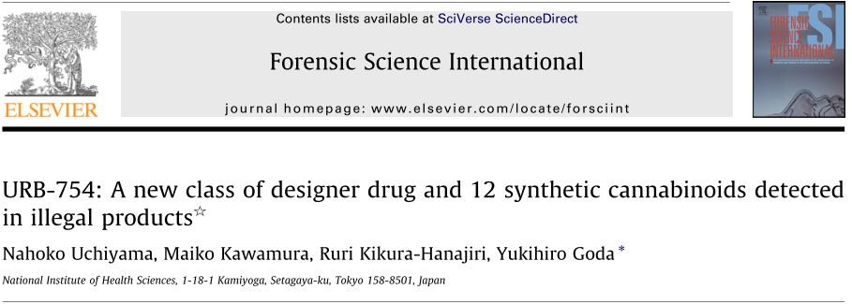
Synthetic Cannabinoids:
“The Next Generation”
New compound, URB-754: Does NOT bind to CB receptors itself, but inhibits enzyme that breaks down endocannabinoids
  More endocannabinoid around → more binding to receptors
AND, one “spice” sample was found to contain URB + a cathinone, which reacted with one another and together created a whole new psychoactive compound
SOURCE: Doris Payer, #CHSF2013.
Notes:
This slide provides a word of caution about a recent report that showed a new type of synthetic cannabinoid. Unlike the previous generation we just talked about, this compound doesn’t itself bind to the CB1 receptor, but rather inhibits the enzyme that deactivates endocannabinoids (the body’s own cannabinoid transmitters, anandamide and 2AG), so levels that are naturally produced by your body stay elevated. Unlike direct CB receptor activation, the consequences of this mechanism have not been investigated.
Another thing the study found was that one of the packets contained this new URB compound along with a cathinone, and they interacted and formed a whole OTHER compound, whose psychoactive profile we can’t even begin to fathom.
REFERENCE:
Uchiyama, N., Kawamura, M., Kikura-Hanajiri, R., & Goda, Y. (2013). URB-754: A new class of designer drug and 12 synthetic cannabinoids detected in illegal products. Forensic science international, 227(1-3), 21–32.

Slide 68
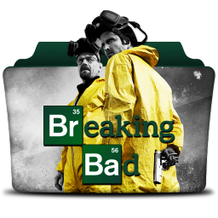
Stimulants
Neurobiological Concerns
  Addiction
    Compulsive chase and use
  Physical health
    Cardio-vascular (heart rate, blood pressure, etc.)
    Body temperature
    Long-term brain changes
  Mental state
    Risky decisions, impaired judgment, impulsive acts, etc.
SOURCE: Doris Payer, #CHSF2013.
Notes:
Neurobiological concerns of stimulants include addictive potential, physiologic consequences (i.e., physical rather than mental changes), and cognitive effects (mental state while under the influence of the drug and beyond). Addictive potential matters because even though recreational use is by far the most common pattern, the ‘compulsive’ pursuit of the drug is easy to slip into here, and is a pattern that is much more difficult to manage, so better to avoid (‘compulsive’ refers to the urge to do something again and again even if it’s not pleasurable anymore or the person is aware of negative consequences.) Physical changes like blood pressure and heart rate are relevant, because this is what tends to send people to emergency rooms, and users worry about long-term brain damage or “holes in the brain.” Mental state is relevant because it can lead to impulsivity and poor decision making and judgment, which can then lead to risky behaviors in social settings and other real-world situations.
Photo credit: Icon Archive beta (www.iconarchive.com), August 2013.

Slide 69
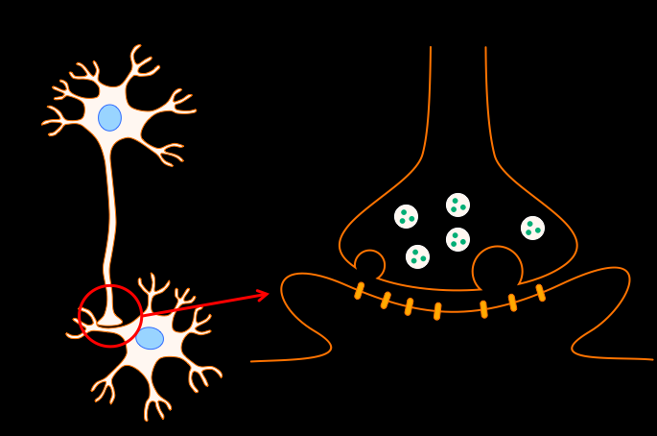
“Classic” Stimulants
Synapse
Direct action on synapse
Amphetamine, cathinone: induce
dopamine release
Cocaine, methylphenidate (Ritalin): block dopamine removal
MDMA: additional effects on serotonin
  Dopamine effects less strong, so less “reward,” so animals do not self-administer as much
  Synthetic stimulants are variations on this theme, BUT: “Very subtle structural modifications can yield profoundly different behavioural, neurochemical, and neurotoxicological effects.”
SOURCE: Doris Payer, #CHSF2013.
Notes:
The synapse is the point where two brain cells interact; one releases the neurotransmitter and the other receives it. The two cells don’t actually touch; there is a physical gap into which the transmitter is released. Research has shown that classic stimulants most definitely act on the dopamine synapse and directly induce the brain “reward” signal. Amphetamines and cathinones increase dopamine by inducing release from the pre-synaptic cell (the sending cell); the drugs get into the tip where neurotransmitter is released and cause dopamine to flow out.
Cocaine and Ritalin work by blocking dopamine from being sucked back into the pre-synaptic cell after release, which is one of the usual ways to stop the signal. That is, after dopamine is released and has had a chance to bind to the receiving (post-synaptic) cell for a while, it is usually recycled back into the sending cell through a protein called the dopamine transporter, and this ends the signal. Cocaine and Ritalin block the dopamine transporter, so it can’t take the dopamine back out of the synapse, leaving dopamine to hang around the synapse and continue binding to the receptors, so the reward signal keeps going.
MDMA, as an amphetamine derivative, works the way other amphetamines do, but has additional effects on the serotonin system (another important neurotransmitter). Specifically, MDMA releases serotonin and bocks serotonin recycling, similar to what amphetamine and cocaine do for dopamine. With MDMA, the serotonin effects outweigh the dopamine effects -- that’s why there is less potential for compulsive use: animals don’t self-administer it to the same degree.
These are the classic examples of what stimulants do; the synthetic stimulants are variations on this theme. But, as one paper on research chemicals noted, very subtle structural modifications can yield profoundly different behavioral, neurochemical, and neurotoxicological effects, so we are well advised to do the research on specific chemicals rather than assuming that what applies to the classics applies here, too.

Slide 70
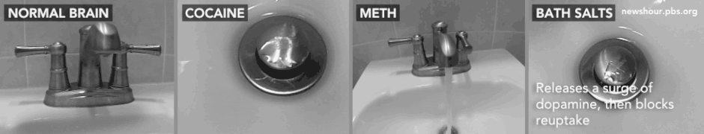
Synthetic Stimulants
In general: dopamine ⬆ and animals like/want/work for drug
  Sign of high abuse potential
  Recreational use can progress easily to compulsive use
SOURCE: Doris Payer, #CHSF2013.
Notes:
In the case of synthetic stimulants, much like the classics, research also finds a definite excess of dopamine. Animals like and will work for these stimulants, which means in humans, there IS a high risk for abuse and addiction with these compounds. That is, the neurochemistry of this class of drugs predicts that even though most users are recreational users, addiction is really easy to fall into here.
The image at the bottom of the slide helps to explain by analogy how the dopamine excess comes about. Imagine the faucet is the releasing cell, the water is dopamine, and the sink is the synapse. In the normal brain, dopamine is released at a moderate rate, as-needed. As discussed, cocaine prevents the dopamine from getting back out of the synapse (sink) after release, creating an excess. Likewise, methamphetamine causes an excess, this time by cranking up the release. Synthetic stimulants crank up dopamine release AND block removal, so a massive excess comes about very quickly.

Slide 71
Synthetic Cathinones
Block transporters (removal)
  Rank at DAT: MDPV/pyrovalerone >>
  cocaine, amphetamine/MA,
  methcathinone, naphyrone >
  mephedrone, butylone, methylone, etylone,
  flephedrone, MDEA > cathinone, MDMA, MBDB
  Rank at SERT: MDEA, MDMA, naphyrone > MBDB,
  cocaine, ethylone, mephedrone, butylone >> rest
  Rank at NET (fight/flight): MDPV, pyrovalerone > amph/MA, methcathinone > cathinone, mephedrone, flephedrone, naphyrone > MDMA, cocaine, methylone > MDEA, butylone, ethylone, MBDB
SOURCE: Doris Payer, #CHSF2013.
Notes:
Cathinones block transporters (the protein responsible for getting the transmitter back out of the synapse to stop the signal) AND cause transmitter release, as well. Aside from dopamine, which mediates the “reward” effects here, stimulants also affect two other neurotransmitter systems: serotonin and norepinephrine. Serotonin mediates the touchy-feely effects and norepinephrine the fight-or-flight response/“speedy” effects. Each of these neurotransmitters has its own transporter that takes it back out of the synapse after release: the dopamine transporter (DAT), the serotonin transporter (SERT), and the norepinephrine transporter (NET).
The point of this slide is that research has looked at how well different cathinones block transporters and/or cause release. Based on this, we can get some clues about what the experience and/or potential for abuse is going to be.
Starting with the dopamine transporter (the classic target of cocaine), the rank is that MDPV and pyrovalerone have MUCH higher affinity (affinity = how tightly it binds) than even cocaine, along with amphetamine and methamphetamine (MA), and methcathinone, which in turn have higher affinities than mephedrone and most of the other cathinones, which in turn have higher affinities than cathinone itself, along with the etactogens, MDMA and MBDB.
The latter have more effects on the serotonin system than the dopamine system, and this is reflected by their rank at SERT: MDEA and MDMA are the best at blocking here, followed by cocaine, mephedrone, and some others, all of which have much higher affinity than any of the rest of the compounds, so these tend to be grouped together as having ecstasy-like effects.
Regarding norepinephrine, the system responsible for the fight/flight response, MDPV again has the highest affinity, which is even higher than that of amphetamine, methamphetamine, and methcathinone, which is higher than cathinone, mephedrone, which is higher than MDMA and cocaine, and so forth, so we can start to get some idea of which compounds are going to induce the greatest speediness and effects on heart rate, blood pressure, etc.
REFERENCE:
Simmler, L.D., Buser, T.A., Donzelli, M., Schramm, Y., Dieu, L.-H., Huwyler, J., Chaboz, S., et al. (2013). Pharmacological characterization of designer cathinones in vitro. British journal of pharmacology, 168(2), 458-70.

Slide 72
Synthetic Cathinones
Also release
  Dopamine: Amph/MA, cathinone,
  methcathinone, mephedrone*,
  flephedrone > MDMA (potency low)
  Serotonin: MDMA, MDEA, MBDB, methylone, ethylone, butylone, mephedrone
    Amph/MA, methcathinone, flephedrone only at very high concentrations
Pyrovalerone, naphyrone, MDPV: NO dopamine or serotonin release, but still extremely good at blocking removal – 10x cocaine
SOURCE: Doris Payer, #CHSF2013.
Notes:
In addition to blocking removal, synthetic cathinones also manage to release neurotransmitters directly. Here, the best releaser of dopamine is still amphetamine and methamphetamine, but cathinone and methcathinone are good at it too, along with mephedrone and flephedrone, all of which are better at it than MDMA. Note that mephedrone is potent at getting dopamine released, so even though the subjective experience is described as MDMA-like, it gets more dopamine released than MDMA so has stronger addictive potential.
In terms of serotonin release, MDMA still reigns supreme, along with a number of other research chemicals. Note here that amphetamine, methamphetamine, methcathinone, etc., really don’t have much effect on serotonin release, that is why they lack entactogenic properties.
Another thing to note is that pyrovalerone, naphyrone, and MDPV were found to have no neurotransmitter releasing action, but that doesn’t mean they have lower abuse liability because they are still the most potent reuptake blockers (i.e., blockers of neurotransmitter removal), 10 times more so than cocaine.
REFERENCE:
Simmler, L.D., Buser, T.A., Donzelli, M., Schramm, Y., Dieu, L.-H., Huwyler, J., Chaboz, S., et al. (2013). Pharmacological characterization of designer cathinones in vitro. British journal of pharmacology, 168(2), 458–70.

Slide 73
Synthetic Cathinones vs.
“Classic” Stimulants
Mephedrone originally thought to be
more like MDMA than amphetamine
b/c of serotonin effects, but dopamine
release more like amphetamine
→ greater abuse liability
In and out of brain faster than MDMA → greater potential for repeated binge use
Effects on body temperature regulation different from MDMA: “Adverse effects cannot be extrapolated from previous observations on MDMA” (Shortall)
MDPV: greater self-administration than even MA
SOURCE: Doris Payer, #CHSF2013.
Notes:
Other notable differences between classic stimulants and synthetic cathinones include the fact that many of these compounds cross the blood-brain barrier more easily than MDMA (i.e., get into the brain more easily) and have a faster rate of clearance from the brain (they are in and out of the brain faster than MDMA), so there is a greater potential for repeated binge use. Body temperature is affected differently from MDMA, so you can’t necessarily use the same harm reduction measures you would in the case of MDMA.
Finally, there was a study that showed self-administration of MDPV by animals was greater than even methamphetamine, so this is something to pay close attention to because we know a lot about the addiction potential of methamphetamine.
REFERENCE:
Shortall, S.E., Green, A.R., Swift, K.M., Fone, K.C.F., & King, M.V. (2013). Differential effects of cathinone compounds and MDMA on body temperature in the rat, and pharmacological characterization of mephedrone-induced hypothermia. British Journal of Pharmacology, 168(4), 966-77.

Slide 74
Synthetic Stimulants:
Physical Concerns
Norepinephrine (fight/flight) system: hyper-active
movement, body temperature regulation, cardio-vascular
effects
Especially MDPV
  Better than cocaine (x10) at producing hyper-active movement,
  increased heart rate & blood pressure
  Itself does not disrupt body temperature regulation (like MA or MDMA do), but heart rate/blood pressure interact with room temperature (Fantegrossi)
Neurotoxicity (“brain damage”): some evidence for serotonin and dopamine depletion in animals
  Mephedrone NOT toxic to dopamine cells (several reports)
  **BUT: Mephedrone enhances toxic effects of amph/MA and MDMA! (Angoa-Perez) → co-administration frequent, even if accidental
SOURCE: Doris Payer, #CHSF2013.
Notes:
Aside from addictive potential and effects on the brain, another thing worth mentioning is the physiological aspect, i.e., what happens below the neck. These effects, which include changes in heart rate, blood pressure, activity, and body temperature, have to do with the norepinephrine system, which is involved in the body’s fight or flight response.
MDPV seems to be the one to watch, since it can induce more powerful effects on these functions than other drugs. Importantly, even though MDPV itself does not disrupt the body’s temperature regulation, there are important interactions with ambient temperature (the temperature of the space the body is in, like a hot room), which in a nightlife setting is worth paying attention to.
Regarding neurotoxic effects, which refers to long-term physical changes (sometimes considered “damage”), we don’t know anything about it in humans - it is hard to test for even in classic stimulants, let alone the novel compounds that have barely been studied in humans. But in animals, there is some evidence for depletion of important neurotransmitters in the brain, which suggests that long-term changes have taken place. Of note, mephedrone does not seem to have the same toxic effects on the dopamine system as amphetamine, which is surprising because everyone expected it to be toxic given its similarity to methamphetamine and MDMA (which definitely have toxic effects in animals) -- several studies have now failed to find evidence supporting this expectation. But, very importantly, one report found that mephedrone enhances the toxic effects of amphetamine, methamphetamine, and MDMA - this is important because these substances are often taken together (intentionally or unintentionally).
REFERENCES:
(1) Fantegrossi, W.E., Gannon, B.M., Zimmerman, S.M., & Rice, K.C. (2013). In vivo Effects of Abused “Bath Salt” Constituent 3,4-methylenedioxypyrovalerone (MDPV) in Mice: Drug Discrimination, Thermoregulation, and Locomotor Activity. Neuropsychopharmacology : official publication of the American College of Neuropsychopharmacology, 38(4), 563-73.
(2) Angoa-Pérez, M., Kane, M.J., Briggs, D.I., Francescutti, D.M., Sykes, C.E., Shah, M.M., Thomas, D.M., et al. (2013). Mephedrone does not damage dopamine nerve endings of the striatum, but enhances the neurotoxicity of methamphetamine, amphetamine, and MDMA. Journal of neurochemistry, 125(1), 102-10.
(3) Angoa-Pérez, M., Kane, M.J., Francescutti, D.M., Sykes, K.E., Shah, M.M., Mohammed, A.M., Thomas, D.M., et al. (2012). Mephedrone, an abused psychoactive component of “bath salts” and methamphetamine congener, does not cause neurotoxicity to dopamine nerve endings of the striatum. Journal of neurochemistry, 120(6), 1097-1107.
(4) Baumann, M.H., Ayestas, M.A., Partilla, J.S., Sink, J.R., Shulgin, A.T., Daley, P.F., Brandt, S.D., et al. (2012). The designer methcathinone analogs, mephedrone and methylone, are substrates for monoamine transporters in brain tissue. Neuropsychopharmacology : official publication of the American College of Neuropsychopharmacology, 37(5), 1192-203.

Slide 75
MDPV Addiction Potential
August 2013 journal Neuropharmacology
Animal self-administration
Found to be more rewarding than methamphetamine and poses a substantial threat for compulsive use that is potentially greater than that for methamphetamine
SOURCE: Aarde et al. (2013). Neuropharmacology.
Notes:
Recreational use of the cathinone derivative 3,4-methylenedioxypyrovalerone (MDPV; “bath salts”) has increased worldwide in past years, accompanied by accounts of health and legal problems in the popular media and efforts to criminalize possession in numerous jurisdictions. Minimal information exists on the effects of MDPV in laboratory models. This study determined the effects of MDPV, alongside those of the better studied stimulant D-methamphetamine (METH), using rodent models of intravenous self-administration (IVSA), thermoregulation and locomotor activity. Male Wistar rats were trained to self-administer MDPV or METH (0.05 mg/kg/infusion, i.v.) or were prepared with radiotelemetry implants for the assessment of body temperature and activity responses to MDPV or METH (0e5.6 mg/kg s.c.). METH and MDPV were consistently self-administered within 10 training sessions (mg/kg/h; METH Mean ¼ 0.4 and Max ¼ 1.15; MDPV Mean ¼ 0.9 and Max ¼ 5.8). Dose-substitution studies demonstrated that behavior was sensitive to dose for both drugs, but MDPV (0.01e0.50 mg/kg/inf) showed greater potency and efficacy than METH (0.1e0.25 mg/kg/inf). In addition, both MDPV and METH increased locomotor activity at lower doses (0.5e1.0 mg/kg, s.c.) and transiently decreased activity at the highest dose (5.6 mg/kg, s.c.). Body temperature increased monotonically with increasing doses of METH but MDPV had a negligible effect on temperature. Stereotypy was associated with relatively high self-administered cumulative doses of MDPV (w1.5 mg/kg/h) as well as with non-contingent MDPV administration wherein the intensity and duration of stereotypy increased as MDPV dose increased. Thus, MDPV poses a substantial threat for compulsive use that is potentially greater than that for methamphetamine.

Slide 76
Piperazines
BZP, TFMPP: Release dopamine and serotonin, but less than MDMA or
MA
mCPP: serotonin release; human study: no reinforcing or stimulant-like effects (unlike MA/MDMA) (Tancer)
**BZP + TFMPP sometimes taken together because
  Roughly adds up to to low-dose MDMA → but combination induces seizures (Baumann)
SOURCE: Doris Payer, #CHSF2013.
Notes:
In addition to the cathinones (upper left hand circle in the figure), there are other categories of synthetic stimulants worth discussing. One such category is the piperazines, and not surprisingly, these compounds also mainly release dopamine and also a bit of serotonin, but are less potent than either MDMA or methamphetamine. mCPP almost exclusively releases serotonin. This is one of the very few cases where studies have been conducted in humans (although only behavioural, not neurobiological), and they showed that mCPP had no reinforcing or stimulant-like physiologic effects, so there is probably not much of a dopamine component to mCPP. One thing to note with regards to animal studies: when you put BZP and TFMPP together, their neurochemical effects basically add up to low dose MDMA, but this combination also increases a user’s risk of seizures.
REFERENCES:
(1) Tancer, M., & Johanson, C.-E. (2003). Reinforcing, subjective, and physiological effects of MDMA in humans: A comparison with d-amphetamine and mCPP. Drug and Alcohol Dependence, 72, 33-44.
(2) Baumann, M.H., Clark, R.D., Budzynski, A.G., Partilla, J.S., Blough, B.E., & Rothman, R.B. (2004). Effects of “Legal X” piperazine analogs on dopamine and serotonin release in rat brain. Annals of the New York Academy of Sciences, 1025, 189-97.

Slide 77
PMA/PMMA
Serotonin effects different from MDMA:
delayed peak (risk of redose/overdose
while waiting), effects last longer,
serotonin syndrome
Evidence for long-term serotonin depletion (but not as pronounced as MDMA)
Dopamine not affected long-term
**Can interact with MAO-Is and temperature to produce unexpected effects (Stanley)
SOURCE: Doris Payer, #CHSF2013.
Notes:
In terms of stimulants such as PMA and PMMA (which are more likely adulterants), one thing worth pointing out is that they can interact with MAOI antidepressant medications and temperature, which can make for unexpected effects, so this is something that matters in the context of nightlife health.
REFERENCE:
Stanley, N., Salem, A., & Irvine, R.J. (2007). The effects of co-administration of 3,4-methylenedioxymethamphetamine (“ecstasy”) or para-methoxyamphetamine and moclobemide at elevated ambient temperatures on striatal 5-HT, body temperature and behavior in rats. Neuroscience, 146(1), 321-9.

Slide 78
Dissociative Anesthetics
Neurobiological Concerns
  Addiction/dependence
  Dissociation
  Mental state that mimics psychosis
  Interaction with other sedative drugs
  (e.g., alcohol)
“Classic” dissociatives (PCP, Ketamine)
  Block receptor in the glutamate system (NMDA)
    → Slows everything down
  Bind to brain opiate receptors
  Block removal of dopamine, serotonin, norepinephrine from the synapse (“reward”)
SOURCE: Doris Payer, #CHSF2013.
Notes:
The next class of drugs to discuss is the dissociative anesthetics – the classics are PCP and ketamine (which is actually a PCP derivative). These drugs are used in clinical practice as anesthetics, but are also used recreationally because they produce a dissociated out-of-body state. Neurobiological concerns include addiction and dependence. Also, a dissociated state can be dangerous in situations where “having your wits about you” might be necessary. Concern of psychotomimetic effects also exists, which refers to a mental state that mimics psychosis/schizophrenia. Lastly, concern exists regarding the interaction of dissociatives with other sedatives/tranquilizers, including, very importantly, alcohol.
PCP and ketamine work by blocking a receptor in yet another neurotransmitter system, the glutamate system. Glutamate is the brain’s general “go” system – when it is active, things in the brain are more likely to fire. By blocking the brain’s “go” system at one of its receptors (a subtype called NMDA receptor), many functions of the brain are slowed down. Classic dissociatives additionally bind to receptors in the brain opiate system, and act on the norepinephrine, serotonin, and dopamine systems - that’s why taking these drugs is rewarding, reinforcing, and can lead to dependence.

Slide 79
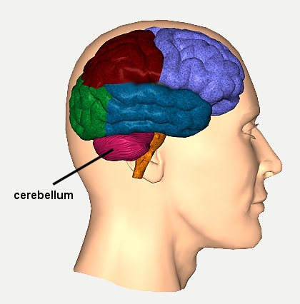
Synthetic Dissociatives
Methoxetamine
Same as classics, but additionally:
Higher likelihood of abuse
  Blocks more dopamine and serotonin
  removal from synapse (also 3-MeO-PCE)
  Binds to & activates receptors: dopamine,
  serotonin, opiate systems
Similar effects profile as ketamine, BUT
  Takes longer to come on → risk of redosing
  Side effects more severe
    Mood disturbance/suicide attempts
    Possibly toxic to cerebellum
  Lasts longer → unwanted side effects
SOURCE: Doris Payer, #CHSF2013.
Notes:
In the case of the novel dissociatives, the most commonly described one is methoxetamine, and it has a nearly identical effect profile to ketamine. But, as was the case with synthetic cannabinoids vs. cannabis, methoxetamine’s effects are stronger compared to ketamine, and it also has additional effects: It has stronger effects on the dopamine, serotonin, and opiate systems (blocks removal of the neurotransmitters from the synapse after their release so they hang around and bind to their receptors longer, AND itself binds to and activates those systems’ receptors) so it has a higher likelihood for abuse. The effects on the serotonin transporter have also been found for 3-MeO-PCE.
And although the effect profile is similar, methoxetamine has a longer delay of onset (takes longer to feel an effect), which can lead to redosing while waiting for the initial dose to kick in if someone is used to ketamine timing (which can end up inadvertently being too much when the effects do set in). It also has a longer duration of action (takes longer to go away), which also leads to longer-lasting unwanted side effects. The side effects are important to consider here because the side effects profile also seems to be more severe than with ketamine, involving things like mood disturbances and possible toxicity in the cerebellum, a part of the brain necessary for coordination and movement.
REFERENCE:
Corazza, O., Assi, S., & Schifano, F. (2013). From “Special K” to “Special M”: The evolution of the recreational use of ketamine and methoxetamine. CNS Neuroscience and Therapeutics, 19(6), 454-460.

Slide 80
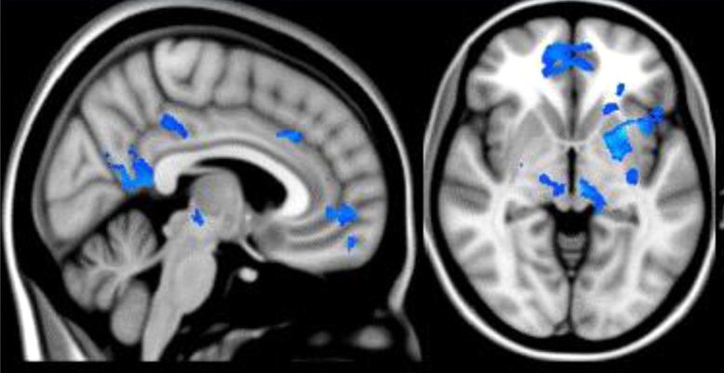
Psychedelics
Neurobiological Concerns
  Long-term psychosis
  Unpredictable effects while high
  Low abuse potential (no “reward circuitry” dopamine component, animals won’t self-administer)
“Classic” Hallucinogens
(LSD, psilocybin, 2-cx, mescaline)
Very few human studies, have to
rely on animal “head twitch”
models
5-HT_{2A} (sub-type of serotonin receptor) main site of action;
correlation between binding and hallucinogenic properties → necessary & sufficient.
SOURCE: Doris Payer, #CHSF2013.
Notes:
The final drug category that will be discussed in this section are the psychedelics. Here, the neurobiological concerns include mainly psychosis and hard to predict acute effects. Traditionally, addictive potential has not been much of a concern here, since there is no reward circuitry dopamine component to hallucinogen use, and it is really hard to get animals to self-administer them. That said, it should be noted that people can become too attached to the experience of an altered state, and use compulsively for that reason alone.
The brain picture is from one of very few human studies on hallucinogens where researchers gave subjects psilocybin and scanned their brains. What they found was actually a decrease in activity, including in the striatum, circled in yellow here, where the reward system dopamine synapses are located. This suggests that compulsive use and addiction are likely not factors here, and it is more of a de-coupling of regions that normally talk to each other that causes the experience.
The classic hallucinogens are LSD and psilocybin. Very few human studies exist that look at hallucinogen effects, and animal models have to rely on a “head twitch model.” In short, the experience is still a mystical one that neuroscience can’t fully explain.
Studies have shown, however, that the serotonin 5-HT_{2a} receptor is the main site of action (the serotonin system has a number of receptors, 5-HT₁, 5-HT₂, etc., and of those, each has subtypes, 5-HT_{1A, B}, etc.) and level of activation of this receptor very strongly correlates with hallucinogenic properties, so it seems to be necessary and sufficient.

Slide 81
Synthetic Psychedelics
Potency at 5-HT₂ receptors:
LSD ~= DOI > DOB >> DOM >
5-MeO-DMT > DMT
Can roughly rank hallucinogenic properties
But also have additional action on serotonin system
5-MeO-DIPT (Foxy)
Blocks SERT (serotonin removal from synapse, like cocaine, SSRIs)
Rats find it “like LSD, but not exactly”
  Same for 2C-T-7
  May be less intense: also activates 5-HT_{1A}, which inhibits 5-HT_{2A}
Potential long-term effects
  Toxic to petri-dish serotonin system (Nakagawa, Sogawa)
  Giving it to adolescent rats → worse cognitive function as adults → serotonin system damage? (Compton)
SOURCE: Doris Payer, #CHSF2013.
Notes:
With the novel psychedelics, we can deduce their hallucinogenic properties from how well they bind to and activate a certain type of serotonin receptor, called 5-HT₂. The first bullet refers to evidence that potency (how much needed to produce effect) is still the strongest for LSD, but that it is about equal to some of the more novel compounds, such as DOI, which is in turn slightly more potent than DOB. Together these have much higher potencies than some of the other compounds, like DOM, 5-MeO-DMT, and DMT.
This can tell us something about the hallucinogenic properties of these compounds, but the novel psychedelics also have actions on the serotonin system that are different from the straight 5-HT_{2A} action.
For example, 5-MeO-DIPT, or “Foxy,” also blocks reuptake at the serotonin transporter, which, if you remember from the stimulants, prevents removal of serotonin from the synapse after release, causing more to hang around and bind to receptors. Also, animals can tell the difference between this compound and LSD. It only partially substitutes, meaning that if you train a rat to recognize LSD and then ask it if some new compound feels the same (by seeing if the rat behaves the same), the behavioral rat answer is “somewhat.” This means there are properties to this drug that go beyond the hallucinogenic. But it is hard to test in animals how it’s different. One possibility is that it’s a less intense experience because it also activates the 5-HT_{1A} receptor (another subtype of serotonin receptor), which inhibits 5-HT_{2A} (the main site of hallucinogenic action).
Another thing to keep in mind with synthetic psychedelics is that there are some potential long term effects on the brain. 5-MeO-DIPT induces neurotoxicity (damage to brain cells) in vitro (in test tubes), and when given to rats in their adolescence, they show some cognitive deficits as adults, which may point to a compromised serotonin system.
REFERENCE:
(1) Nakagawa, T., & Kaneko, S. (2008). Neuropsychotoxicity of abused drugs: molecular and neural mechanisms of neuropsychotoxicity induced by methamphetamine, 3,4-methylenedioxymethamphetamine (ecstasy), and 5-methoxy-N,N-diisopropyltryptamine (foxy). Journal of pharmacological sciences, 106(1), 2-8.
(2) Sogawa, C., Sogawa, N., Tagawa, J., Fujino, A., Ohyama, K., Asanuma, M., Funada, M., et al. (2007). 5-Methoxy-N,N-diisopropyltryptamine (Foxy), a selective and high affinity inhibitor of serotonin transporter. Toxicology letters, 170(1), 75-82.
(3) Compton, D.M., Dietrich, K.L., Selinger, M.C., & Testa, E.K. (2011). 5-methoxy-N,N-di(iso)propyltryptamine hydrochloride (Foxy)-induced cognitive deficits in rat after exposure in adolescence. Physiology & behavior, 103(2), 203-209.

Slide 82
Synthetic Psychedelics:
Other Considerations
5-MeO-DMT interacts
with MAO-Is
  (unlike classics)
  DMT and bufotenine (active metabolite) stay in system longer (Jiang et al.)
SOURCE: Doris Payer, #CHSF2013.
Notes:
Another consideration with synthetic psychedelics is drug-drug interactions that do not necessarily exist with classic hallucinogens. One example is that 5-MeO-DMT interacts with MAOI antidepressant drugs in a way that prolongs exposure to DMT and one of its active metabolites (break-down product that itself also has psychedelic properties), so the trip lasts longer than potentially intended.
REFERENCE:
Jiang, X.-L., Shen, H.-W., Mager, D. E., & Yu, A.-M. (2013). Pharmacokinetic Interactions between Monoamine Oxidase A Inhibitor Harmaline and 5-Methoxy-N,N-Dimethyltryptamine, and the Impact of CYP2D6 Status. Drug Metabolism and Disposition: The Biological Fate of Chemicals, 41(5), 975-86.

Slide 83

the EPIDEMIOLOGY OF synthetic
DRUG USE
Notes:
Comprehensive epidemiological data regarding the extent of synthetic drug use in the United States remains quite limited. Most of the data available originates from law enforcement reports, poison control calls, toxicology results, case reports, and new questions added to existing survey instruments. The next portion of the presentation will provide attendees with an overview of patterns and trends in synthetic cannabinoid and synthetic cathinone use among select drug abuse epidemiology indicators. No single drug abuse indicator can tell the full story of the extent or impact of synthetic drugs. Therefore, data from several available indicators are presented in an attempt to paint as clear a picture of who uses synthetic drugs, and the populations in which use is most prevalent.

Slide 84
Emerging Drug Items Identified in U.S. NFLIS Forensic Labs: 2010-2012
SOURCE: U.S. DEA, Office of Diversion Control, NFLIS data, 2012.
Notes:
This slide provides an indication of the number of items (e.g., seizures, samples, pills, powders, unknown substances) sent to forensic laboratories across the U.S. that were identified as containing synthetic cannabinoids or synthetic cathinones. The National Forensic Laboratory System (NFLIS) organized by the Drug Enforcement Administration collects reports from most of the state and local police toxicology laboratories and from some medical examiners on the number of items of specific drugs identified in each laboratory. It is important to mention that the numbers of cannabinoid and cathinone items identified are low in comparison to illicit drugs. In 2012, there were 460,497 cannabis items identified and 229,595 cocaine items identified.
Additional Information for the Trainer(s)
The DEA National Forensic Laboratory Information System (NFLIS) systematically collects results from drug chemistry analyses conducted by state and local forensic laboratories across the country. As a national drug forensic laboratory reporting system, NFLIS provides timely and detailed analytical results of drugs seized by law enforcement. It is a unique source of information for monitoring and understanding drug abuse and trafficking in the United States, including the diversion of legally manufactured drugs into illegal markets. Findings from NFLIS can also supplement existing drug data sources, including information from drug demand surveys and drug testing programs.
Over 300 state and local forensic laboratories in the United States perform nearly two million drug analyses each year. As of March 2012, 48 state laboratory systems and 91 local laboratory systems, representing 288 individual laboratories, are participating in NFLIS. In 2011, approximately 1.7 million drug analysis records were reported to NFLIS. This information is made available through semiannual, annual, and special reports. These reports include findings on major drug categories such as narcotic analgesics, depressants and tranquilizers, hallucinogens, anabolic steroids, and stimulants. They provide statistically representative national and regional drug item estimates for the most frequently identified drugs. National case estimates for the most frequently identified drugs are also presented.
NFLIS is one resource of information utilized by DEA to carry out its core mission. The NFLIS information system supports DEA’s ability to track national, regional, and local drug patterns, including providing timely and geographically specific information on emerging drug problems.

Slide 85
Number of Unique Types of Synthetic Drugs Identified Nationally: NFLIS (2010-2012)
SOURCE: U.S. DEA, Office of Diversion Control, NFLIS data, 2012.
Notes:
This graph shows the increases in the number of different chemical formulations which have been seized and identified for synthetic cannabinoids and cathinones by forensic laboratories located throughout the United States.

Slide 86
Calls Received by U.S. Poison Control Centers for Human Exposure to Synthetic Marijuana, 2010 to July 2013
There was 1 cannabinoid
death in 2010 and 4 in 2011
SOURCE: American Association of Poison Control Centers, updated August 30, 2013.
Notes:
According to the American Association of Poison Control Centers, 2,906 calls relating to human exposure to synthetic marijuana were received in 2010. Twice that number (6,968) were received in 2011, and 5,205 received in 2012, and 1,413 had been received as of June 30, 2013. The decrease may be due to fewer exposures due to changes in the scheduling as of March 2011, July, 2012, and June, 2013. The term “exposure” means someone has had contact with the substance in some way; for example, ingested, inhaled, absorbed by the skin or eyes, etc. Not all exposures are poisonings or overdoses.

Slide 87
Past Year Drug Use by 12th Grade Students: MTF, 2012
SOURCE: Monitoring the Future Survey, 2012 results.
Notes:
Monitoring the Future is an ongoing study of the behaviors, attitudes, and values of American secondary school students, college students, and young adults. Each year, a total of approximately 50,000 8th, 10th and 12th grade students are surveyed (12th graders since 1975, and 8th and 10th graders since 1991). In addition, annual follow-up questionnaires are mailed to a sample of each graduating class for a number of years after their initial participation. The Monitoring the Future Study has been funded under a series of investigator-initiated competing research grants from NIDA, a part of the National Institutes of Health. MTF is conducted at the Survey Research Center in the Institute for Social Research at the University of Michigan.
According to the 2012 Monitoring the Future survey, one in nine (11.3%) of high school seniors used synthetic cannabis once over the past year, making it the second most frequently used illicit drug, after marijuana, among high school seniors. Smaller percentages of respondents used MDMA, hallucinogens, cocaine, or synthetic cathinones. Easy access and the misperception that synthetic marijuana products are natural and therefore harmless have likely contributed to their popularity.

Slide 88
Percentage of U.S. Students (Grades 9 to 12) Reporting Past Year Alcohol and Other Drug Use, 2012 (N=3,884)
SOURCE: Adapted by CESAR from The Partnership for a Drug-Free America and the MetLife Foundation, The Partnership Attitude Tracking Study (PATS): Teens and Parents, 2013.
Notes:
More high school students report using synthetic marijuana than any other substance besides alcohol and marijuana, according to data from a survey of 9th to 12th graders recently released by the Partnership for a Drug-Free America. Alcohol and marijuana were the most prevalent substances used, with 57% reporting alcohol use and 39% reporting marijuana use in the past year in 2012. The third most prevalent substance used was synthetic marijuana (12%). Use of all other substances was reported by 10% or less of high school students. Similar results have been found by other surveys of high school students (see CESAR FAX, Volume 21, Issue 5).

Slide 89
Emergency Room Visits
Related to Synthetic Cannabis and Cathinones: DAWN, 2011
 | % Male | % Under Age 21 | % Sent to ICU or Sub. Abuse Treatment | % Discharged Home
Synthetic Cannabis | 70% | 55% | 3% | 78%
Synthetic Cathinones | 76% | 14% | 12% | 55%
SOURCE: OAS, SAMHSA-CSAT. (2013). Drug Abuse Warning Network, 2011 data.
Notes:
This table summarizes the key differences between synthetic cannabis and synthetic cathinone using patients who were treated in a national sample of emergency departments in 2011. A higher percentage of synthetic cannabinoid patients were under the age of 21, as compared to synthetic cathinone patients. The synthetic cathinone patients were less likely to be discharged home and 12% were sent to the Intensive Care Unit or to a substance abuse treatment program.
According to Texas statewide treatment admissions data, synthetic cannabis admissions were young males (mean age = 23), 45% used daily, 70% had legal problems, and many of whom had not finished high school. These demographic characteristics may explain their use of synthetic cannabis to avoid a positive drug test in a school, employment, or criminal justice setting.

Slide 90
Synthetic Cannabinoids Identified in U. S. NFLIS Forensic Labs
55 variations reported in 2012
n=41,458
19 variations reported in 2010
n=3,286
44 variations reported in 2011
n=23,688
SOURCE: U.S. DEA, Office of Diversion Control, NFLIS data, 2010-2012.
Notes:
This slide shows not only the increases in the number of synthetic cannabinoids/synthetic marijuana items seized and submitted to forensic laboratories across the U.S. between 2010 and 2012, but the number of variations and the changes in the primary variations. Notice that in 2010, almost all the cannabinoids were JWH variations, but by 2012, the JWH variations were only a small proportion of these cannabinoids, with the AM, XLR, and UR varieties becoming dominant.
Earlier, we mentioned a new drug testing method that can identify 12 different varieties of synthetic marijuana—in contrast, as of 2012, there were at least 55 known varieties. The number of varieties and the inability to test for all of them is the reason why some people who have to undergo drug tests for their jobs or for their probation or parole may try to avoid a “positive” test by using a synthetic cannabinoid instead of cannabis. However, their employer or probation/parole officer may use a new drug test methodology and they will test positive!

Slide 91
Calls Received by U.S. Poison Control Centers for Human Exposure to Synthetic Cathinones, 2010 to July 2013
There were no synthetic cathinone fatalities in 2010 but there were 18 in 2011
SOURCE: American Association of Poison Control Centers, updated August 30, 2013.
Notes:
According to the American Association of Poison Control Centers, the number of calls related to synthetic cathinone exposure received by poison control centers across the country increased by more than 20 times in 2011 alone, up from 304 in 2010 to 6,136. Synthetic cathinones seem to be primarily used by people who are between 20 and 29 years old. However, poison centers have seen synthetic cathinone exposures in a wide range of ages, from younger than 6 to older than 59. The term “exposure” means someone has had contact with the substance in some way; for example, ingested, inhaled, absorbed by the skin or eyes, etc. Not all exposures are poisonings or overdoses, but the effects of the exposure are serious enough for the individual or someone with him or her to call the poison center or EMS to report problems.

Slide 92
Synthetic Cathinones Identified in U.S. NFLIS Forensic Labs
17 varieties identified
in 2010
n=731
34 varieties identified
in 2011
n=6,949
48 varieties identified
in 2012
n=14,239
SOURCE: U.S. DEA, Office of Diversion Control, NFLIS data, 2010-2012.
Notes:
The number of cathinone varieties almost tripled between 2010 and 2012 and the number of items seized and examined went up almost 20 times. It is important to notice that in 2010, MDPV was the leading variety of cathinone, but by 2012, there were more cases of methylone.

Slide 93
Psychedelic Drug Use and Baby Boomers
32 million Americans have used any psychedelic drug at least once in their lifetimes— about 17% of all American adults between the ages of 21-64.
Overall rates of lifetime psychedelic use are roughly the same among the 'baby boomers' and younger adults
Lifetime psychedelic drug use among baby boomers aged 50 to 64 was on par with that of younger adults aged 21-25, about 15%.
The highest rate was among adults aged 30-34 (over 20%)
Adults over the age of 65 largely missed the advent of psychedelic drugs in popular culture, since only 1% reported using them.
SOURCE: http://www.medicaldaily.com/psychedelic-drug-use-united-states-common-now-1960s-generation-245218#.Ugzg8FaFeGA.email.
Notes:
National Survey on Drug Use and Health (NSDUH) survey data from 2010 tell us whether or not the person has ever used such drugs, but only if they used the drug in the past month, past year, or “ever”. Men were more likely to have used psychedelics than women, regardless of age categories. There were, however, generational differences in the types of psychedelic drugs most commonly used. LSD, mescaline, and peyote were more common among older adults, while younger adults were more likely to use psilocybin mushrooms. The researchers attribute the difference to the rising worldwide use of psilocybin since the 1970s. A 2009 paper suggested that this increase is due to the wide availability of information on the Internet about how to cultivate the mushrooms, compared to what previous generations had access to. Krebs and Johansen conclude that psychedelic drugs have not declined in popularity among young Americans since the 1960s.

Slide 94
Synthetic Drug Use in Europe
Seventy-three (73) new psychoactive substances were officially notified for the first time in 2012 via the EU Early warning system (EWS).
This continues the upward trend of substances reported in a single year: from 49 in 2011, 41 in 2010 and 24 in 2009.
In 2012, the list of substances reported was dominated by 30 synthetic cannabinoids
Over 280 new psychoactive substances are currently monitored by the EWS.
SOURCE: EMCDDA-Europol News Release, May 2013.
Notes:
The number, type, and availability of new drugs in Europe continued to increase in 2012, according to a report released in May 2013 by the EMCDDA and Europol. Until around 10 years ago, most new psychoactive substances appearing on the European drug scene were produced in underground laboratories or sourced from diverted medicines and sold directly on the illicit drug market. While this still occurs, the emergence of a thriving ‘legal highs’ business on the Internet and in specialized shops in urban areas has marked a fundamental shift in the drug market. Today, these substances, often produced in China and India, are now imported into Europe in bulk where they are processed, packaged and sold as 'legal highs'. They may also end up on the street where they are sold as substitutes for amphetamine, ecstasy, heroin or cocaine.

Slide 95
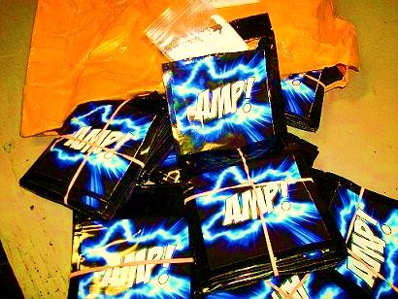
OTHER NOTABLE SYNTHETIC DRUGS – “NEW AND OLD”
Notes:
This next section describes other notable synthetic drugs that have been reported on the streets, highlighting both new formulations as well as others that have been in existence for quite some time.

Slide 96
What will be Covered in this Section?
MDMA/ecstasy, and Molly
Piperazines
2C-Phenethlyamines
Psilocybin/Psilocin
Dextromethorphan
PCP
Kratom
Krokodil
Benzo Fury
Syrup/Sizzurp/Drank
Dabs/Vapor Pens
Notes:
The “new and old” section of the presentation is meant to briefly describe substances that have yet to be covered in this presentation, or to describe previously mentioned substances in a bit more detail. The substances that will be featured in this section are as followed:
Stimulants: MDMA/ecstasy, Molly; Piperazines
Psychedelics: Psilocybin/Psilocin; 2C-Phenethlyamines
Dissociatives: Dextromethorphan; PCP
Others: Kratom (opioid); Benzo Fury (stimulant/hallucinogen); Syrup/Sizzurp/Drank; Dabs/Vapor Pens

Slide 97
Not Just New Drugs: Some Old Ones are Reappearing: 2010-June 2013
SOURCE: U.S. DEA, Office of Diversion Control, NFLIS data, 2010-2013.
Notes:
This bar graph shows how MDMA has been the most common of the party drugs identified by toxicology laboratories. The number of items examined by NFLIS laboratories in 2012-13, however, dropped significantly. The circles indicate other psychoactive substances or synthetic drugs that have been showing an uptick in recent years, such as psilocin, and 2C-X.

Slide 98
MDMA (Ecstasy)
3, 4-methylenedioxy-methamphetamine
Street terms: Adam, E, X, XTC, love drug, Molly
A synthetic, psychoactive drug with both stimulant and hallucinogenic properties similar to methamphetamine and mescaline
Adverse effects: enhanced physical activity, sweating, lack of coordination, mental confusion, jaw clenching, hyperthermia, and agitation
NIDA. (2010). NIDA InfoFacts: MDMA (Ecstasy).
Notes:
MDMA is a synthetic drug that has stimulant and psychoactive properties. It is taken orally as a capsule or tablet. Street names include XTC, X, Adam, hug, beans, love drug. Short-term effects include feelings of mental stimulation, emotional warmth, enhanced sensory perception, and increased physical energy. Adverse health effects can include nausea, chills, sweating, teeth clenching, muscle cramping, and blurred vision. MDMA can interfere with the body's ability to regulate temperature; on rare occasions, this can be lethal.
In addition to the physical effects, long-term neurotoxic effects of MDMA, particularly in the serotonergic system, are not fully known. One study found ecstasy poly-drug users were significantly more impaired on a recognition task for complex visual patterns and spatial working memory as a function of task difficulty. Studies have suggested use of MDMA affects depression, other mood disorders, impulsiveness or hostility, psychotic symptoms, and anxiety and panic disorders.
In addition, the slang term “Molly” (short for molecule) has again become popular, with references to it in poison control cases.

Slide 99
Glimpses of MDMA Situation in U.S.: 1999-2013
SOURCES: http://www.ecstasydata.org/stats_substance_by_year.php; U.S. DEA, Office of Diversion Control,
NFLIS data, 2006-2012.
Notes:
Figure on left side of slide: Websites exist on the Internet that report the purity of ecstasy pills that are sent to them for testing. It is not known whether the results of such analyses are accurate, but if we assume they are, the graph on the left-hand side of the slide shows the purity of MDMA pills with no adulterants (red line) and the proportion of MDMA in pills that also contained other substances such as caffeine, codeine, methamphetamine, or nothing (blue line). It is possible that some of the new synthetic drugs have emerged because some drug abusers are searching for other stimulant/ hallucinogenic drugs to replace MDMA.
Figure on right side of slide: According to recent NFLIS data, since about 2010 there has been a drastic decline in the number of items identified as MDMA by forensic laboratories.
Additional Information for the Trainer(s)
Australian EDRS reports drop in MDMA use from 52% in 2003 to 27% in 2011. Both Australia and UK report an MDMA “drought” and there are reports of a shift from PMK to safrole to make MDMA. Some experts predict the return of high quality MDMA but from China, not BeneLux sources. Four principal precursors can be used in the manufacture of MDMA and related drugs: safrole, isosafrole, piperonal and 3,4-methylenedioxyphenyl-2-propanone (PMK). Safrole is the key starting material in so far as the other three can be synthesized from it.
There is anecdotal evidence that other novel stimulants, such as PMA, PMMA, and MDPV have replaced MDMA in ecstasy pills, which may be responsible for many of the “ecstasy overdoses” reported in the media recently.

Slide 100
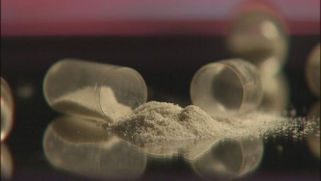
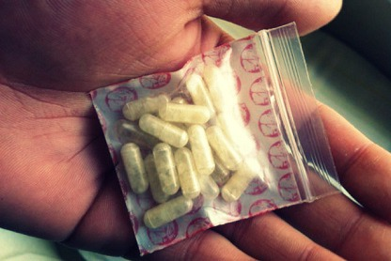
What is “Molly”?
Ecstasy pills with little MDMA and lots of caffeine, meth, assorted drugs? OR
A pure crystalline form of MDMA, most often sold as a powder filled capsule? OR
Methylone? Bath salts?
Reports of desired effects of euphoria,
but also increased paranoia, agitated
delirium, scary hallucinations,
psychotic episodes, violent or
destructive self-harm behavior,
including death
Bottom line - Molly usually is not a pure form of MDMA, but may be a drug that can be very dangerous since its contents are unknown
SOURCE: Join Together Online. (2013). Story published June 24, 2013.
Notes:
Molly is the powder or crystal form of MDMA, the chemical used in ecstasy. Many powders sold as Molly, however, do not contain any MDMA. The DEA considers MDMA to be a Schedule I controlled substance, which means it has a high potential for abuse, and no accepted use in medical treatment. Dr. John Halpern, a psychiatrist at Harvard who has conducted several MDMA studies, said some powders sold as Molly are synthetic versions that are designed to imitate the drug’s effects. The drug is now thought to be as adulterated as ecstasy once was, he noted, adding, “You’re fooling yourself if you think it’s somehow safer because it’s sold in powdered form.” Molly has been a popular drug at music festivals. It has also been popularized by rappers. The drug costs between $20 and $50 a dose. Dr. Robert Glatter, an emergency room physician at Lenox Hill Hospital in New York, says he now sees about four patients a month who come in with common side effects of Molly, including teeth grinding, dehydration, anxiety, insomnia, loss of appetite and fever. More serious side effects can include uncontrollable seizures, high blood pressure, elevated body temperature and depression.
In September, 2013, there was one death at the Electric Zoo music festival due to taking pure MDMA and another involving a mix of methylone and MDMA. Home testing kits are available that can determine some of the compounds contained in a capsule, which may help a user avoid unintended harm and a visit to the ER.
Photo credits: Join Together Online, June 24, 2013 (top photo); Join Together Online, November 12, 2013 (bottom photo).

Slide 101
Piperazines
Frenzy, Bliss, Charge, Herbal ecstasy, A2, Legal Z, Legal E.
Mainly available over internet and sold as ecstasy pills that are “safe.”
Two classes: (1) benzylpiperazines (BZP) and (2) phenylpiperazines (TFMPP).
Mimics effects of ecstasy (MDMA); dangerous with seizure disorders, psychiatric illness, or coronary disease.
Adverse events included hypertension, reduced consciousness, psychotic episode, hallucinations, tachycardia, hyperthermia, coma. Could be toxic if combined with MDMA or amphetamines.
SOURCE: Arbo, Bastos, & Carmo. (2012). Drug and Alcohol Dependence, 122(3), 165-258.
Notes:
Piperazines are often used as industrial chemicals, but due to their stimulant and hallucinogenic effects, piperazines have also entered the club or party scene. It is a central nervous system stimulant and it has effects similar to other stimulants such as amphetamine and MDMA, especially if BZP and TFMPP are combined. It has street name of “legal ecstasy.” Piperazines of concern include BZP, TFMPP, and 1-(3-chlorophenyl)-piperazine (meta-chlorophenylpiperazine, mCPP). While mCPP is found in the illicit market, it is also a metabolite and starting material for the synthesis of several prescription drugs (e.g., trazodone, nefazadone) (1-3).
REFERENCES:
(1) Arbo, M.D., Bastos, M.L., & Carmo, H.F. (2012). Piperazine compounds as drugs of abuse. Drug and Alcohol Dependence, 122(3), 174-185.
(2) Wilkins, C. & Sweetsur, P. (In press). The impact of the prohibition of benzylpiperazine (BZP) ‘legal highs’ on the prevalence of BZP, new legal highs and other drug use in New Zealand. Drug and Alcohol Dependence, E-pub ahead of print available at: http://ac.els-cdn.com/S0376871612002463/1-s2.0-S0376871612002463-main.pdf?_tid=7fdabc62-ffd0-11e1-aacd-00000aab0f26&acdnat=1347780856_b9b4c4ddeb7e93c6203a6d6714ec608a
(3) U.S. Drug Enforcement Administration, Office of Diversion Control. (2012). National Forensic Laboratory Information System Special Report: Emerging 2C-Phenethylamines, Piperazines, and Tryptamines in NFLIS, 2006-2011. Springfield, VA: Author.

Slide 102
Piperazines
TFMPP is not controlled at the federal level but is controlled by at least 10 states.
Levels of use peaked in 2009 and have declined since.
SOURCE: U.S. DEA, Office of Diversion Control, NFLIS data, 2005-2012.
Notes:
The use of BZP (benzylopiperazine) and TFMPP (trifluoromethyl-phenylpiperazine) in the U.S. peaked in 2009, when the two substances were combined to produce properties similar to MDMA. Since then, the number of items identified in local toxicology laboratories has decreased.

Slide 103
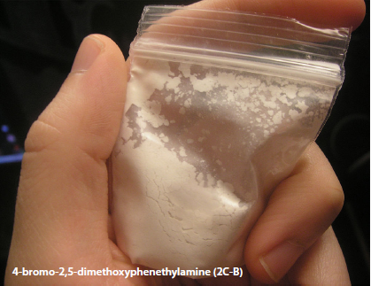
2C-Phenethylamine
A broad range of compounds that share a common phenylethan-2-amine structure.
Some are naturally occurring neurotransmitters (Dopamine and Epinephrine), while others are psychoactive stimulants (Amphetamine), entactogens (MDMA), or hallucinogens (the 2C-X series of compounds).
2 C-X can be snorted or dissolved into a liquid and placed on blotter paper under the tongue.
May last 6-10 hours; onset takes 15 min -120 to 2 hours.
Reports of seizures and renal failure.
SOURCE: U.S. DEA, Office of Diversion Control. (2012). National Forensic Laboratory Information System Special Report: Emerging 2C-Phenethylamines, Piperazines, and Trypamines in NFLIS, 2006-2011.
103
Notes:
Earlier, we talked about the 2C drugs and the study of the users of hallucinogenic drugs when we looked at the chart with all the different colored boxes (slide 11). Phenethylamines are ingested for their stimulant and hallucinogenic effects on the central nervous system. One category of phenethylamines that has received attention in recent years contains 2,5-dimethyoxy or 2C derivatives, such as 4-bromo-2,5-dimethyoxyphenethylamine (2C-B) or 2,5-dimethyoxy-4-iodophenethylamine (2C-I) (1).
Additional Information for the Trainer(s)
According to Erowid, common street names of 2C-Phenethylamine include: Nexus; Bees; Venus; Bromo Mescaline; BDMPEA. 2C-B is a synthetic psychedelic that first gained popularity as a legal Ecstasy replacement in the mid-1980s. It is known for having a strong physical component to its effects and a moderate duration.
According to EMCDDA, the specific scientific risk assessments of 2C-I, 2C-T-2 and 2C-T-7 have been extremely difficult due to the lack of peer-reviewed scientific data. However, information based on analogy to partially related compounds such as 2C-B (phenethylamine-based) and DOB (amphetamine-based 2C-I is typically available in powder or tablet form. A seized tablet was white in appearance, had an ‘i’ logo and was approximately 6.1 mm x 2.7 mm in size, weighing 120 mg (Denmark, 2002).
As 2C-I comes in powder or tablet form, the primary route of administration is oral. Neither insufflation (snorting) nor any other routes (e.g. intravenous administration) are mentioned in 2C-I user reports. Original studies by Shulgin involved oral administration of doses of 2C-I of 15 to 20 mg. User reports have mentioned oral doses of 3 to 25 mg (typically 20 mg).
In general, although users have described 2C-I as ‘powerful’ and a ‘strong stimulant’ with hallucinogenic properties, there is virtually no mention of adverse effects such as nausea, vomiting or muscle cramps (as reported for 2C-T-2 and 2C-T-7) in users purporting to have taken only 2C-I. However, the nature of the reports suggests that this may be due to selective reporting rather than absence of such symptoms. Some users report stomach tension, nausea, vomiting, and jaw tension in instances of combining 2C-I with one or more of the following: 5-methoxy-dipropyltryptamine, cannabis, alcohol, caffeine, tryptophan, alprazolam and clonazepam. It has been noted by users of 2C-I that the desired effect may be delayed, sometimes resulting in users taking additional (sometimes higher) doses. No deaths or instances of non-fatal intoxication involving 2C-I have occurred, but as the names change (2Cxxx) and additional toxicology items are identified, more serious effects may be reported. As with clinical toxicological investigations, the lack of reference material may compromise the analysis of post-mortem cases. There have been no scientific studies involving 2C-I users. Limited subjective user reports indicate that 2C-I produces various psychedelic effects (generally comparable to other hallucinogens, particularly 2C-B) and feelings of empathy (similar to MDMA).
Isolated user reports compare 2C-I to 2C-B, due to an apparent similarity in their effects. However, some users describe the effects of 2C-I as being ‘deeper, more purely psychedelic and less sensory’ and, in some cases, less intense. As mentioned above, various users have reported delayed onset of the desired effects compared to related drugs (e.g. 2C-B or MDMA), which may result in additional doses or other drugs being taken, thus increasing the risk of toxicity or accidental overdose (2).
REFERENCES:
(1) U.S. Drug Enforcement Administration, Office of Diversion Control. (2012). National Forensic Laboratory Information System Special Report: Emerging 2C-Phenethylamines, Piperazines, and Tryptamines in NFLIS, 2006-2011. Springfield, VA: Author.
(2) EMCDDA. (2011). Annual Report, 2011: The State of the Drugs Problem in Europe. Luxembourg: Office for Official Publications of the European Communities.

Slide 104
2C-Phenethylamines
Almost all of the 2C-phenethylamines are produced in Asia, principally China, but some small labs in the U.S. are capable of producing 2C (usually 2C-B).
In 2011, DEA offices throughout the country began noting the increasing availability and abuse of 2C at raves and in nightclubs, particularly by teenagers and young adults.
NFLIS labs nationwide identified 253 reports of phenethylamines in 2010, 336 in 2011, 828 in 2012, and 230 through May 2013.
Notes:
Little scientific evidence related to the action of 2C-I on neurotransmitter systems has been published to date, so discussion of the neuropharmacological aspects at the risk assessment meeting was based on speculative comparison with partially related compounds such as 2C-B (based on phenethylamine) and DOB (based on amphetamine), both involving bromine as opposed to iodine. Studies involving a bromine-substituted analogue, 2C-B (4-bromo-2,5-dimethoxyphenethylamine), have shown it to be a partial agonist for 5-HT2 (5-HT2A and 5-HT2C) serotonergic receptors and 1-adrenergic receptors. At 10-6M, 2C-B also acted as a competitive 5-HT antagonist, but, at higher concentrations (2.8 x 10-5M), it acted as a non-competitive 5-HT antagonist. In addition, DOB (4-bromo-2,5-dimethoxyamphetamine) was found to have a high affinity for 5-HT2 receptors, whereas 2C-B was also found to have significant affinity for 5-HT1A, 5-HT1B and 5-HT1C receptors and thus was deemed to be less selective than its amphetamine-based analogue, DOB. At present there are no animal or human data concerning general toxicity, reproductive toxicity, neurotoxicity or the mutagenicity and carcinogenic potential of 2C-I. Only subjective evidence is available from limited user self-reports involving observations of some adverse effects and toxic symptoms.
Additional Information for the Trainer(s)
In 2013, Páleníček and colleagues published a paper in the Journal of Psychopharmacology in which they described behavioral, neurochemical, and pharmaco-EEG profiles of a new synthetic drug 4-bromo-2,5-dimethoxyphenethylamine (2C-B) in rats. They found that 2C-B had a biphasic effect on locomotion with initial inhibitory followed by excitatory effect; amphetamine induced only hyperlocomotion. Both drugs induced deficits in the PPI; however they had opposite effects on ASR. 2C-B increased dopamine but decreased 3,4-dihydroxyphenylacetic acid (DOPAC) in the NAc. Low doses of 2C-B induced a decrease in EEG power spectra and coherence. On the contrary, high dose of 2C-B 50 mg/kg had a temporally biphasic effect with an initial decrease followed by an increase in EEG power; decrease as well as increase in EEG coherence was observed. Amphetamine mainly induced an increase in EEG power and coherence in theta and alpha bands. Increases in the theta and alpha power and coherence in 2C-B and amphetamine were temporally linked to an increase in locomotor activity and DA levels in NAc. In conclusion, 2C-B is a centrally active compound similar to other hallucinogens, entactogens and stimulants. Increased dopamine and decreased DOPAC in the NAc may reflect its psychotomimetic and addictive potential and monoaminoxidase inhibition. Alterations in brain functional connectivity reflected the behavioral and neurochemical changes produced by the drug; a correlation between EEG changes and locomotor behavior was observed.
REFERENCE:
Páleníček, T., Fujáková, M., Brunovský, M., Horáček, J., Gorman, I., Balíková, M., Rambousek, L., et al. (2013). Behavioral, neurochemical and pharmaco-EEG profiles of the psychedelic drug 4-bromo-2,5-dimethoxyphenethylamine (2C-B) in rats. Psychopharmacology, 225(1), 75-93.

Slide 105
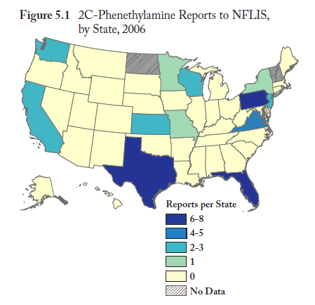
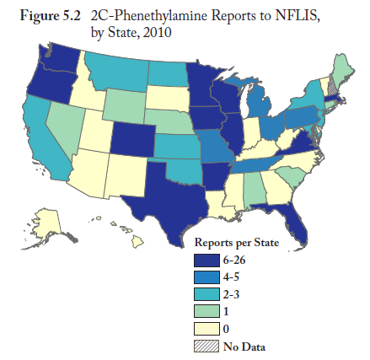
Spread of 2C-Phenethylamine throughout the United States
SOURCE: U.S. DEA, Office of Diversion Control. (2012). National Forensic Laboratory Information System Special Report: Emerging 2C-Phenethylamines, Piperazines, and Trypamines in NFLIS, 2006-2011.
Notes:
This series of maps shows the spread of 2C-Phenethylamine across the nation. Darker shades of blue indicate a greater number of reports per state. In 2006, only three states had between 6 and 8 reports of 2C-P; by 2010, 11 states had 6-26 reports of 2C-P. In 2006, there were 28 cases, as compared to 228 in 2010.

Slide 106
2C-C-NBOMe, 2C-I-NBOMe,
Mescaline-NBOMe
Analogs of the 2C-X family of phenethylamines
Strongly active at the sub-milligram dose (a Super Potent drug)
Most 25I and 25C is sold as pure powder
  Weighing and handling pure high-potency chemicals such as LSD or 25I-NBOMe should be performed wearing eye protection, gloves, and a filter mask
Perhaps the greatest risk of the wide availability of pure NBOMe powders is confusing one white powder for another, or simply misunderstanding the difference between one psychedelic or stimulant drug and another
In 2011, 10 items of the NBOMe family were seized and identified in NFLIS forensic laboratories, as compared to 447 in 2012.
SOURCES: Erowid and DEA’s National Forensic Laboratory Information System, 2013.
Notes:
This slide describes a new set of 2C drugs, which have nearly no history of human consumption prior to 2010. They are considered “super potent” drugs. The way that 25I and 25C is sold (as a pure powder) creates an inherently hazardous situation, because users may not be aware of the safety procedures necessary for handling super-potent compounds. More than one of the documented 25I- or 25C- related deaths have followed insufflation of ten or more times the appropriate dosage.
In the November 5, 2013 issue of Join Together Online, “N-Bomb” was reported as being seen on the streets of St. Louis, MO. Also known as “Smiles,” its chemical name is 25I-NBOMe. It is made from mescaline, and is similar to LSD. It is ingested as a liquid, powder, or on a blotter. The drug can be harmful to kidneys, and can trigger mental health issues.
Effective November 15, 2013, the United States Drug Enforcement Administration (DEA) made the synthetic phenethylamines 25I-NBOMe, 25C-NBOMe, and 25B-NBOMe Schedule I, illegal drugs under the Controlled Substances Act (CSA) for the next two years.
The actual chemical names of today’s controlled synthetic drugs are:
2-(4-iodo-2,5-dimethoxyphenyl)-N-(2-methoxybenzyl)ethanamine (25I-NBOMe);
2-(4-chloro-2,5-dimethoxyphenyl)-N-(2-methoxybenzyl)ethanamine (25C-NBOMe); and
2-(4-bromo-2,5-dimethoxyphenyl)-N-(2-methoxybenzyl)ethanamine (25B-NBOMe).
There is no approved medical use for these particular synthetic drugs, nor has the Food and Drug Administration approved them for human consumption. No published studies exist on their safety for human use. The NBOMe compounds are substantially more potent than other hallucinogenic compounds, and the data suggest that extremely small amounts of these drugs can cause seizures, cardiac and respiratory arrest, and death. Indeed, these compounds have been linked to the deaths of at least 19 Americans aged 15 to 29 between March of 2012 and August of 2013. In addition, synthetic drugs like these have no consistent manufacturing and packaging processes and may contain drastically differing dosage amounts, a mix of several drugs, and unknown adulterants. Users are playing Russian roulette when they abuse them.
This action is based on a finding by DEA Deputy Administrator Thomas Harrigan that the placement of these synthetic drugs into Schedule I of the CSA is necessary to avoid an imminent hazard to public safety. The DEA published a Notice of Intent to do this on October 10, 2013, giving makers, sellers, and other possessors of these drugs a month to rid themselves of their current stocks and to cease making or buying more. During the next two years, DEA will work with the U.S. Department of Health and Human Services to determine if these drugs should be made permanently illegal.

Slide 107
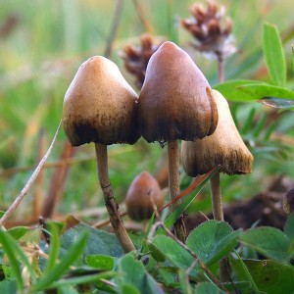
Psilocybin vs. Psilocin
Psilocybin and psilocin are naturally occurring psychedelics with a long history of human use. Both are present in 'psychedelic' or 'magic' mushrooms.
Psilocybin, the better known
of these two chemicals, is
metabolized after ingestion
into psilocin, which is the
primary active chemical.
Notes:
Psilocybin is a naturally occurring psychedelic compound produced by more than 200 species of mushrooms. Psilocybin is quickly converted by the body to psilocin, which has mind-altering effects similar (in some aspects) to those of LSD, mescaline, and DMT. The effects generally include euphoria, visual and mental hallucinations, changes in perception, a distorted sense of time, and spiritual experiences, and can include possible adverse reactions such as nausea and panic attacks.
Although increasingly restrictive drug laws of the late 1960s curbed scientific research into the effects of psilocybin and other hallucinogens, its popularity as an entheogen (spirituality-enhancing agent) grew in the next decade, largely owing to the increased availability of information on how to cultivate psilocybin mushrooms. Some users of the drug consider it an entheogen and a tool to supplement practices for transcendence, including meditation. The intensity and duration of the effects of psilocybin are variable, depending on species, dosage, individual physiology, and set and setting.
As previously stated, once ingested, psilocybin is rapidly metabolized to psilocin, which then acts on serotonin receptors in the brain. The mind-altering effects of psilocybin typically last from two to six hours, although to individuals under the influence of psilocybin, the effects may seem to last much longer, since the drug can distort the perception of time. Psilocybin has a low toxicity and a relatively low harm potential, and reports of lethal doses of the drug are rare.

Slide 108
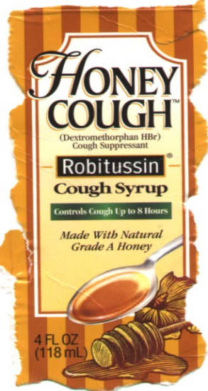
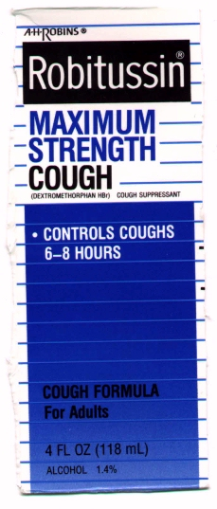

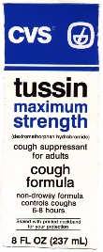
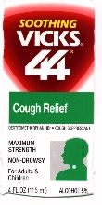
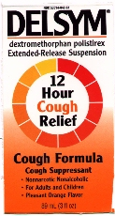
What is DXM? Dextromethorphan is a psychoactive drug found in common over the counter cough medicines.
SOURCE: NIDA. (2001). NIDA Research Report Series: Hallucinogens and Dissociative Drugs.
Notes:
Dextromethorphan (DXM or Robo) is used to temporarily relieve cough caused by the common cold, the flu, or other conditions, when taken in high doses can produce effects similar to those of PCP and ketamine. Like PCP and ketamine, dextromethorphan acts as an NMDA receptor antagonist. The most common source of abused dextromethorphan is "extra-strength" cough syrup, which typically contains 3 milligrams of the drug per milliliter of syrup. At the doses recommended for treating coughs (1/6 to 1/3 ounce of medication, containing 15 mg to 30 mg dextromethorphan), the drug is safe and effective. At much higher doses (4 or more ounces) dextromethorphan produces dissociative effects similar to those of PCP and ketamine.
REFERENCE:
NIDA. (2001). NIDA Research Report Series: Hallucinogens and Dissociative Drugs (printed March 2001). Rockville, MD: U.S. Department of Health and Human Services, National Institutes of Health.

Slide 109
Dextromethorphan (DXM)
Dextromethorphan’s slang names include “Robo;” people refer to using DXM as “robo-tripping.”
At high doses, may produce dissociative hallucinations (distance from reality, visual effects with eyes open and closed; perceptual changes, drug liking, mystical-type experiences similar to use of psilocybin.
Can also produce tachycardia, hypertension, agitation, ataxia, and psychosis at high doses.
Users of DXM engage in “dose dependent” behaviors in which they try to gauge the amount of the drug they take to produce the desired effects, which they call “plateaus”. Plateau is the mildest effect and the 5th plateau will guarantee a trip to the hospital.
SOURCES: Reissig et al. (2012). Psychopharmacology, 223(1), 1-15; http://dxm.darkridge.com/text/beginners.htm.
Notes:
Depending on the audience, you can discuss the descriptions of some of the effects of dextromethorphan (1). The following is a description of the “plateaus” that users have described on one pro-drug website (2).
1st plateau (100-250mg): Great for conversation, yet can be a powerful trip. It all depends on the mindset. Usually one is very empathetic, and has great insights to everything. Also, the physical aspects (“robo walk,” the drippy feeling, etc.) are present. The 1st plateau, when in a good, carefree mode, can be good for a party, or concert, though you should try and act normal, of course.
2nd plateau (250-450mg): All the effects of the 1st plateau are present, with the addition of more euphoria, a decreased sense of time and a decreased sense of surroundings.
3rd plateau (450-800mg): Many of the effects of the first two plateaus are present, yet they seem to take on a totally different "shape". This is hard to explain. Visual (closed-eye-visual, mostly) hallucinations are present, mostly spirals, or visions of fluid. Insights are extraordinary. One may tend to shut him/herself away from other people in order to explore themselves at this plateau. This is definitely not a party plateau. I've found that this plateau could be some sort of "transition" between the physical and the mental that occurs on some sort of "highway". The spiraling shapes and the fluid could be the highway that the transition is made on. This is often comparable to space. While on this highway, thoughts and feelings of one's life will pop up. General thinking becomes deeper and more enhanced.
4th plateau (800-1800mg): The highway can be crossed at this plateau. What is on the other side of the highway could be anything. Alien encounters, out of body experiences, etc. are not uncommon. I haven't had reports on any of these things, though. I don't have to mention that the 4th plateau is not for beginners. Note that anything above 1200 mg is really dangerous and should not be done without close access to a hospital and a smart trip-sitter. Actually, for all intents and purposes, it shouldn't be done over 1000mg.
5th plateau (1800mg-????): There have been some reports of a 5th plateau. They include nothing of what is typically a DXM trip. It involves profuse sweating, extreme nausea, and blackouts. After effects can last up to 2 days afterwards. This is pretty much a DXM overdose. Obviously, this is not fun. I've only included it here because there is a distinct point beyond the fourth plateau where all the fun effects of DXM are replaced by negative effects. I call it "the point of no return". Unless you want to go through a physical and mental hell, don't try and hit this point.
REFERENCES:
(1) Reissig, C.J., Carter, L.P., Johnson, M.W., Mintzer, M.Z., Klinedinst, M.A., & Griffiths, R.R. (2012). High doses of dextromethorphan, an NMDA antagonist, produce effects similar to classic hallucinogens. Psychopharmacology, 223(1), 1-15.
(2) Darkridge.com, Additional information available at: http://dxm.darkridge.com/text/beginners.htm.

Slide 110
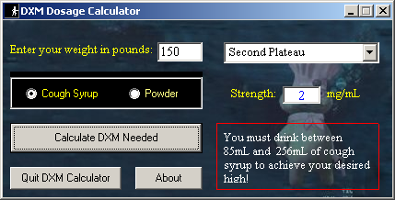
Notes:
A number of DXM dosing calculators exist on the Internet that can be used to calculate the amount of the drug needed to reach a certain plateau or high based on weight and strength of the DXM product. This is just one example of a DXM dosage calculator. The notes for slide 66 contain more details on the five plateaus.

Slide 111
Phencyclidine
PCP, Angel Dust, Killer Weed
Dissolved in embalming fluid (“Fry,” “Amp,” “Water, Water”)
Swallowed, sniffed, smoked on joints dipped in “Fry”
Users report out-of-body strength
SOURCE: NIDA. (2009). NIDA Drug Facts: Hallucinogens – LSD, Peyote, Psilocybin, and PCP.
Notes:
PCP is a synthetic drug sold as tablets, capsules, or white or colored powder. It can be snorted, smoked, or eaten. PCP was developed in the 1950s as an IV anesthetic. It was never approved for human use because of problems identified during clinical studies, including intensely negative psychological effects. Street names include: angel dust, ozone, wack, and rocket fuel.
PCP is also a "dissociative" drug, distorting perceptions of sight and sound and producing feelings of detachment. Ketamine is also a dissociative drug, as is dextromethorphan (DXM) in high doses. Users can experience several unpleasant psychological effects, with symptoms mimicking schizophrenia (delusions, hallucinations, disordered thinking, extreme anxiety). PCP is addictive—its repeated abuse can lead to craving and compulsive PCP-seeking behavior, despite severe adverse consequences. Persons exhibiting some of the psychological and physical symptoms caused by PCP often resemble people experiencing problems because of use of synthetic cathinones.
Users of dissociative drugs practice “dose dependent” or “dose specific” behaviors in which they try to gauge the amount of the drug they take to produce the desired effects. Some of the “puffers” (small bottles or containers that dispense a specific amount of a substance) seen in head shops are for this purpose.

Slide 112
A Few Other Substances to
Throw in the Mix…
Kratom – opioid-like effects
Krokodil – cheap heroin replacement
Salvia divinorum – hallucinogenic effects
Methoxetamine – “legal ketamine”
Benzo Fury (5-APB) – stimulant and hallucinogenic effects
SOURCE: Rosenbaum et al. (2012). Journal of Medical Toxicology, 8(1), 15-32.
Notes:
Kratom is a plant product derived from Mitragyna speciosa Korth, which has opioid and stimulant-like effects, and has been used for the treatment of chronic pain and amelioration of opioid-withdrawal in Southeast Asia. The plant leaves can be brewed into tea, smoke, or chewed. Large doses can lead to stupor symptoms (1).
Salvia divinorum (Shepherdess’ herb; Mexican mint) is a hallucinogen herb with unique pharmacology that has therapeutic potential but has been banned in many states due to concerns regarding its psychiatric effects. It is usually smoked but its effects are considered unpleasant by many and after one such experience, they won’t use again. People who abuse Salvia generally experience hallucinations or “psychotomimetic” episodes (a transient experience that mimics a psychosis). Subjective effects have been described as intense but short-lived, appearing in less than 1 minute and lasting less than 30 minutes. They include psychedelic-like changes in visual perception, mood and body sensations, emotional swings, feelings of detachment, and importantly, a highly modified perception of external reality and the self, leading to a decreased ability to interact with one’s surroundings. This last effect has prompted concern about the dangers of driving under the influence of salvia (2).
Methoxetamine (3-MeO-2-Oxo-PCE) has recently become available via the Internet and is marked as “legal ketamine.” It is close to a chemical analog of ketamine and PCP and the effects are described by some as similar to ketamine or high-dose DXM (1).
Benzo Fury (5-APB; 5-(2-aminopropyl) benzofuran) is believed to give users a sense of euphoria, impacting the brain in the same way as stimulants and hallucinogens. The effect has been most closely compared with ecstasy.
REFERENCES:
(1) Rosenbaum, C.D., Carreiro, S.P., & Babu, K.M. (2012). Here today, gone tomorrow…and back again? A review of herbal marijuana alternatives (K2, Spice), synthetic cathinones (Bath Salts), Kratom, Salvia divinorum, methoxetamine, and piperazines. Journal of Medical Toxicology, 8(1), 15-32.
(2) NIDA. (2009). NIDA DrugFacts: Salvia. Rockville, MD: U.S. Department of Health and Human Services, National Institutes of Health.

Slide 113
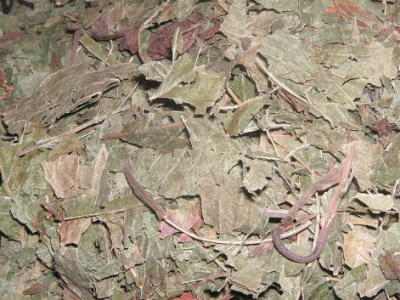

Kratom
Structurally similar to some hallucinogens but no hallucinogenic activity or effects
Acts on opioid receptors
Not scheduled in U.S.
Seems to be a stimulant in lower doses
  Mitragynine
Seems to be a sedative at higher doses
  7 hydroxymitragynine
Often produces a mixed effect
Onset of effects within 5 to 10 minutes of ingestion; effects last for several hours
SOURCE: Ken Dickenson, MS, RPh, Hon DSc, July 2013 (Emerging Drug Trends 2013: Beyond Synthetics and Bath Salts).
Notes:
M.speciosa (also known as Kratom) is native to Thailand and Malaysia. Mitragynine, one of the alkaloids found in the leaves of M.speciosa, has psychoactive properties and is used as an opium or heroin substitute by Malayans. M.speciosa leaves are used extensively in Thailand (also in Malaysia) to increase work output and tolerance to direct sunlight, and are usually chewed, smoked or drunk as tea to achieve the desired effect. The leaves are chewed 3 to 10 times a day, with stimulant effects occurring after 5 to 10 minutes. M.speciosa was regulated as a narcotic drug in Thailand and carried the same restrictions and penalties as cocaine. The U.S. DEA classifies Kratom as “a chemical of concern.”
The short-term (immediate) side effects include: dry mouth, increased or decreased urination, loss of appetite, and nausea and/or vomiting. Prolonged side effects include: anorexia/weight loss, depression, and addiction.

Slide 114
Krokodil
Russian cheap replacement drug for heroin made from cooking down desomorphine with gasoline, paint thinner, alcohol, iodine, red phosphorous (match heads), etc.
In Russia, lack of clean needles and methadone, high cost of heroin, poverty, high numbers of HIV+ individuals, etc.
No confirmed cases of desomorphine in the U.S. since 2 were identified in 2004.
Injuries that look like krokodil can be due to shared dirty needles, bacteria, toxic adulterants, gangrene, staph infection, MRSA.
Notes:
Desomorphine (Dihydrodesoxymorphine or dihydrodesoxymorphine-D) is a synthetic morphine analogue synthesized in the 1930s in the United States. Its street names are “Krokodil” and “Crocodil”. Desomorphine produces an opiate-like action with a fast onset and brief action. As a powerful morphine derivative, it is about ten times more potent than morphine.
Krokodil became popular in Russia about 10 years ago as a cheap replacement for heroin. It costs about three times less than heroin, and produces a similar, but much shorter, high. Krokodil is made from over-the-counter codeine-based headache pills, mixed with gasoline, paint thinner, alcohol or iodine. When a person injects the drug, it destroys tissue, and turns the skin scaly and green, giving it a crocodile-like appearance. The drug can also cause blood poisoning, festering sores and abscesses. The skin injuries can eventually develop into severe tissue damage leading to thrombophlebitis and gangrene. These conditions usually result in limb amputation or sometimes death.
According to recent posts on the Linkedin.com “Emerging Drugs of Abuse" group, many of the photos from Russia look like untreated cases of multiple septic abscess or else patches of entrenched gangrene resulting from tissue damage or phlebitis, and some look like untreated cases of necrotizing fasciitis (probably commensal skin bacteria, like golden staph). Similar presentations may appear outside of Russia, but that certainly doesn't guarantee that krokodil is the cause. It may just mean there are people injecting something (which may contain solvents or toxins) and that those people don't have access to sterile injecting equipment/education about aseptic injection/the ability to practice good injecting hygiene and aren't seeking medical attention until the infection is very serious.
According to a story published in Join Together online on October, 14, 2013, the Drug Enforcement Administration (DEA) says it has not seen evidence of the flesh-eating drug krokodil surfacing in the United States, despite recent reports in Arizona and Illinois of people using the drug. “We, the DEA, are not seeing cases of it,” agency spokeswoman Dawn Dearden told FoxNews.com. “Nothing’s been turned into any of our labs. As far as the DEA is concerned, we have not seen any cases.” Last week, doctors at a suburban Chicago hospital reported they are treating three people who used krokodil. Last month, Arizona health officials reported two cases of people who used the drug.

Slide 115

Benzo Fury
Active ingredient is 5-APB
Stimulant and hallucinogenic properties
Fairly easy to buy via the Internet, at music festivals, and in clubs - priced at around $15 per pill.
User-reported effects include:
  Increased happiness, euphoria, extreme mood lift, increased self-acceptance, increased intimacy, closed-eye hallucinations, increased sexual interest
SOURCE: Ken Dickenson, MS, RPh, Hon DSc, July 2013 (Emerging Drug Trends 2013: Beyond Synthetics and Bath Salts).
Notes:
Benzo Fury is currently one of the most popular “legal 'highs” in the UK and is also sold in the U.S. It is believed to give users a sense of euphoria, working on brain tissue in the same way as stimulants and hallucinogens. The effect has been most closely compared with ecstasy. Side effects include loss of appetite, hallucinations, and paranoia.
UK-based researchers have studied the effects of 5-APB (5-(2-aminopropyl) benzofuran) on samples of the brains of rats, comparing them with those caused by cocaine and amphetamine. In particular they looked at serotonin receptors that are affected by hallucinogenic drugs and at a protein called DAT that pumps the neurotransmitter dopamine back in to nerve cells. They found that 5-APB behaves a little like amphetamine - that is, like a stimulant with addictive potential - and a bit like a hallucinogen, acting via serotonin receptors. “This finding is significant because it demonstrates some 'legal highs' may have addictive properties which are unlikely to be well-known amongst the users of these drugs. In addition, its effects on the serotonin receptors - known as 5-HT_{2A} receptors - would suggest it may lead to high blood pressure by causing constriction of the blood vessels, which would make the drug more dangerous.”
Photo credit: www.drugfree.org.

Slide 116
“Syrup” in Texas
  Codeine cough syrup continues to be abused.
  Cut with Karo syrup, jolly ranchers, and soft drink.
  Hip-Hop/Rap music on syrup continues to drive this phenomenon.
  Also available as a non-alcoholic soft drink pre-packaged to introduce to youth or ready to add the syrup.
Notes:
In order to drink codeine cough syrup, which has a taste to discourage abuse, a sweet substance, such as Karo syrup or jolly ranchers other other sweet candies are dissolved with the cough syrup and a soft drink. Drinking codeine syrup has been a problem in select areas of the U.S. (such as Texas) since the late 1990s, and it has been popularized and continues to be popular through rap or hip-hop music that “glorifies” the drinking of this substance.
REFERENCE:
Elwood, W.N. (1999). Leaning on syrup: The misuse of opioid cough syrup in Houston. Available online at: http://www.utexas.edu/research/cswr/gcattc/documents/sippingonsyrup.pdf.

Slide 117

New “Relaxation” Drinks:
Drank and Lean
Valerian Roots
Melatonin
Rose Hips
“Slow Your Roll”
“Slow Motion Potion”
Notes:
Drank and Lean are made of codeine/promethazine cough syrup, soda (such as Mountain Dew/Sprite), and fruit candy (such as Jolly Rancher). It may have originated as early as the 1960s, and became popular in Texas in the early 1990s. It spread through the southern states, then nationwide. It’s mentioned in rap and hip-hop music (2000: “Three Mafia” song “Sippin’ on Some Syrup”, "Rainbow Colors“ (feat. Lil’ Flip) and use by singers such as Lil’ Wayne). Side effects from the codeine (opiate) include sedation, pain relief, and euphoria. Side effects from the promethazine (antihistamine) include sedation; it potentiates codeine, and may be more lethal than the codeine.

Slide 118

“Sizzurp”
Cognac, Vodka, and Fruit Flavor
Notes:
Sizzurp, which contains alcohol, is sold in liquor stores, although there are different stories as to whether or not it continues to be bottled and sold in U.S.-based alcohol outlets.

Slide 119
Dabs, BHO, Honey, Budder
Dabs, shatter wax and vaporizer pens contain hash oil (“wax”). Supposedly 80%-90% THC. Different methods available on the Internet.
Butane Honey Oil or Butane Hash Oil is a golden resin created by placing dried and ground marijuana into a special pvc filter. Butane gas is shot in through one end of the filter while the other end is placed in a bowl full of water. The filter spews out the fresh oil in to the cold water where it sinks to the bottom. The bottom is scraped and the oil is ready to use.
Users touch the heated knife point or the pin to the Budder on the end of a pin and inhale fumes (and sit down).
Notes:
This slide describes a method reported on the Internet regarding how to make Dabs, shatter wax, etc. that can be used in vaporizer pens (see next slide for a picture of the pen). Besides placing in a pen that is similar to an electronic cigarette, the wax can be heated on the end of a knife or pin and inhaled.

Slide 120

Vapor Pens
Advertised for “patients”
Cost $100-$200
Potency varies
Higher percentage of THC
No odor. Similar to electronic cigarettes
Pen-style vaporizers contain 100-150 hits
Some can be recharged and refilled
SOURCE: http://potappetit.com/the-pen-is-mightier-than-the-bong-or-mini-vaporizers-got-the-right-stuff/.
Notes:
Vapor pens are similar to electronic cigarettes in that they can be used to heat and smoke hash oil or THC with no odor. This is a fairly new method of using THC and while those who are involved in using THC may know about it, people who work with youths should become familiar with it in order to identify those whose use may not be obvious because of the lack of the odor.

Slide 121

Case studies, sample Treatment protocols and concluding thoughts
Notes:
This final section of the presentation contains a couple of case examples (small group activities), two sample clinical treatment protocols, key points, and resources for continued learning. Synthetic drug composition and dosage varies significantly, making diagnosis challenging, and leading to greater risk of overdose and other adverse reactions.
Photo credit: NIDA, 2013.

Slide 122
Case Study #1
You are a professional in a setting working with youth (e.g., counselor, educator, tutor, etc.). During your normal duties, you overhear a group of youth talking about their interest in trying a new synthetic drug they heard about from one of their older siblings.
What messages would you want to communicate?
What strategies would you use to maintain trust but also being able to point out the possible dangers from using one of these synthetic drugs?
What initial assessment questions would you want to ask?
What alternative activities would you explore to using these drugs?
Notes:
NOTE: Case Study #1 deals with prevention messages, while Case Study #2 deals with treatment issues. Your first option is to select the Case Study that is most appropriate to your audience and have the training participants complete the Case Study using the following instructions. Alternately, you can divide the participants in half and have one group work on the prevention Case Study and the other group work on the treatment Case Study. If you select option #2, please keep in mind you will need a longer debriefing period to review both discussions.
INSTRUCTIONS
Read the case study aloud.
Ask participants to break into pairs or small groups (depending on the size of the audience), and spend 5-10 minutes discussing the questions.
De-brief as a full group for 5-10 minutes. Ask for volunteers to briefly share responses to the discussion questions.
CONSIDERATIONS FOR DEBRIEFING
How would you discuss this issue in terms of maintaining trust but also being able to point out the possible dangers from using one of these synthetic drugs? You will not know the dosage level, the contents (which are constantly changing), where the drug originated (probably China), or why the user is seeking the stimulant effects of the synthetic substance. If the substance in question is synthetic cannabis, why are they taking it, given that it has much worse symptoms than regular marijuana? What if there is a possibility that the synthetic marijuana taken is one that is identified by a new toxicology test? Are there other ways to relax and be happy rather than using cannabis (synthetic or not). This conversation could lead into a discussion of what you would tell a regular marijuana user.

Slide 123
Case Study #2
A nineteen year old male reports using “spice” 7-8 times along with marijuana. He stopped using spice about 45 days ago, and stopped marijuana about 30 days ago. While on these drugs, his thoughts became disorganized, and he was having grandiose ideas. Since he discontinued his use of drugs, his behavior can best be described as manic. He sleeps 4-5 hours over a two-day period, and then sleeps 22 hours straight. He is constantly moving around, sings loudly, and has delusions about becoming a rap star. He has been hospitalized three times, and the psychiatrists keep saying “he is mentally ill and his drug use probably caused the onset.”
Notes:
NOTE: Case Study #1 deals with prevention messages, while Case Study #2 deals with treatment issues. Your first option is to select the Case Study that is most appropriate to your audience and have the training participants complete the Case Study using the following instructions. Alternately, you can divide the participants in half and have one group work on the prevention Case Study and the other group work on the treatment Case Study. If you select option #2, please keep in mind you will need a longer debriefing period to review both discussions.
INSTRUCTIONS
Read the case study aloud.
Ask participants to break into pairs or small groups (depending on the size of the audience), and spend 5-10 minutes discussing the questions.
De-brief as a full group for 5-10 minutes. Ask for volunteers to briefly share responses to the discussion questions.

Slide 124
Case Study #2, continued
What additional information do you need to know before figuring out a treatment plan?
What kind of intervention does this young man need?
Do you believe he has stopped using spice and marijuana altogether?
Where do you go from here?
Notes:
CONSIDERATIONS FOR DEBRIEFING
Assessment should include information on substance use and mental health symptoms. Just because there is a time connection between the onset of symptoms does not mean that the mental health symptoms resulted from Spice use. The client should be medically evaluated for any issues he is facing in addition to being evaluated for danger to self and others. Depending on his use history, this youth may need only a brief intervention with follow-up, a brief treatment, or a full treatment episode. More information is needed to determine this. Assessment and intervention should be as comprehensive as possible, including assessment for alcohol, over-the-counter medicines, prescription medications, synthetic drugs, and illicit drugs.
Additional Information for the Trainer(s)
According to a Letter to the Editor published in Schizophrenia Research in 2010, it is established that cannabis consumption cannot only trigger psychotic episodes but also predisposes for the development of lasting paranoid schizophrenia in a dose dependent manner. Patients with a positive family history are at a higher risk for such drug induced schizophrenic disorders. Cross-reactions between different drugs to trigger recurrence of schizophrenic episodes are rare.
REFERENCE: Mϋller, H., Sperling, W., Köhmann, M., Hutner, H.B., Kornhuber, J., and Maler, J.-M. (2010). Letter to the Editor. Schizophrenia Research, 118, 309-310.

Slide 125
Synthetic Cannabinoids – Clinical Presentation
Persistent depression
Memory problems (can last for several weeks)
Blunted affect
Difficulty focusing
Difficulty participating in clinical until stabilized
Users also report elevated mood, relaxation, and altered perception
Psychotic effects, such as extreme anxiety, paranoia, and hallucinations
SOURCE: NYS OASAS. (2012). Clinical Guidance of Synthetic Drugs of Abuse, draft document.
Notes:
Synthetic marijuana users who have been taken to Poison Control Centers report symptoms that include rapid heart rate, vomiting, agitation, confusion, and hallucinations. The drug can also raise blood pressure and cause reduced blood supply to the heart (myocardial ischemia), and in a few cases has been associated with heart attacks. Regular users may experience withdrawal and addiction symptoms.

Slide 126
Sample Clinical Treatment Protocol for Synthetic Cannabinoid Users
Direct individual to emergency room via ambulance
Consult a regional Poison Control Center
Acute management consists of:
  Supportive care with the use of benzodiazepines, if needed, to control agitation and anxiety
  Observe until resolution of abnormal vital signs, vomiting, and psychiatric symptoms
SOURCE: Cheng, Yeo, Brown, & Regan. (2012). American Academy of Emergency Medicine, 19(2), 19-22.
Notes:
Any patient with unfavorable symptoms after a synthetic cannabinoid exposure should be directed to an emergency room via ambulance as it is difficult to ascertain the exact drugs involved in synthetic cannabinoid exposure. A Regional Poison Control Center should be consulted. Acute management consists of supportive care with the use of benzodiazepines, if needed, for the control of agitation and anxiety. In general, all patients should be observed until the resolution of abnormal vital signs, vomiting, and psychiatric symptoms. It is important to note that the common symptoms described with synthetic cannabinoid exposure such as agitation and tachycardia are not typical of those seen with marijuana exposure, making the diagnosis more difficult. Although there is no antidote for HMA exposure, there are agents being studied. CB1 antagonists, such as SR141716, have been found that may reverse the psychotropic effects of marijuana. Animal models have also shown that naltrexone may attenuate THC’s effects. These agents may become more relevant if the use of synthetic cannabinoids continue to rise.

Slide 127


Recognizing Synthetic Cathinone Intoxication
Present with severe sympathetic stimulation:
  Tachycardia
  Hypertension
  Hyperthermia
  Seizures
Present with profoundly
altered mental status:
  Severe panic attacks
  Agitation
  Paranoia
  Hallucinations
  Suicidal behavior
SOURCE: NYS OASAS. (2012). Clinical Guidance of Synthetic Drugs of Abuse, draft document.
Notes:
Patients report nausea, vomiting, fatigue, flushed face, sweating and that the high is fast but the crash is heavy. In some cases they have reported using synthetic salts when coming off heroin. Patients say it is a horrible high but they are drawn back to it. As a psychoactive experience the reports are varying and can appear similar to amphetamines and/or hallucinogens with increased energy, euphoria and hallucinations or other distortions of perception.
The 2013 Miotto et al. article in Drug and Alcohol Dependence lists several additional bath salt clinical case reports.

Slide 128
Sample Clinical Treatment Protocol for Synthetic Cathinone Users
Supportive care
Aggressive sedation with benzodiazepines (for agitation, seizures, tachycardia, and hypertension)
Significant hyperthemia may require passive or active cooling
Lab studies including electrolytes, renal and liver function tests, cardiac markers, and creatine kinase should be considered
SOURCE: Cheng, Yeo, Brown, & Regan. (2012). American Academy of Emergency Medicine, 19(2), 19-22.
Notes:
After initial assessment of airway, breathing, and circulation, supportive care is the mainstay of therapy based on management of other sympathomimetic conditions. Aggressive sedation with benzodiazepines is indicated for agitation, seizures, tachycardia, and hypertension. Extreme hypertension that persists despite benzodiazepines may be treated with titratable vasodilators. Beta blockers should be avoided due to the potential to cause unopposed alpha-adrenergic stimulation, worsening the hypertension. Significant hyperthermia may require passive or active cooling. All moderately to severe symptomatic patients should have an electrocardiogram (ECG), be placed on a cardiac monitor, and receive serial temperature checks. Lab studies including electrolytes, renal and liver function tests, cardiac markers and creatine kinase should be considered, as should testing for co-ingestants or adulterants. Asymptomatic patients with no other suspected co-ingestions or psychiatric symptoms generally may be discharged. In a case series of 35 patients who presented to the ED after using bath salts, 26% were admitted to an intensive care unit.
Benzodiazepines are generally recommended to treat the sympathetic overstimulation caused by synthetic cathinones. Administering anti-psychotic medication to treat symptoms of drug-induced psychosis may lower the threshold for seizures, which is already a concern with substances such as MDPV. High doses of sedatives may be necessary to prevent users from harming themselves and others. MDPV produces psychoactive effects with as little as 3-5 mg, but packages may contain doses up to 50 mg.

Slide 129
What do you do if someone has taken a Synthetic Drug?
Call your local poison center at 1-800-222-1222
  57 poison centers around the country have experts waiting to answer your call.
  The experts at the Center can help you decide whether someone can be treated at home, or whether he or she must go
  to a hospital.
Dial 9-1-1 immediately if they:
  Stop breathing
  Collapse
  Have a seizure
…or if they have taken
one of these and are having physical symptoms or behaving in a way that is concerning to you
SOURCE: American Association of Poison Control Centers (AAPCC). (2012). Facts about Bath Salts.
Notes:
Poison centers are open 24 hours a day, seven days a week, every day of the year for poisoning emergencies and for informational calls. The centers have physicians who are experts in toxicology on staff, as well as trained staff to answer calls to help identify pills, explain the effects, etc. The centers also provide expert advice and work with rural EMS staff and small hospitals that do not normally see unusual cases. They also serve as an early warning system on the emergence of dangers to children of new chemical products and they were the first to identify synthetic cathinones and publish information on chemical nature of these drugs and document the first reports of adverse reactions in the US.
The common telephone help number is 1-800-222-1222.

Slide 130
In Summary: Key Points
Lack of information on the chemical contents, dosage levels, and consistent quality of the products is a major problem since users are taking drugs about which they know little, which makes provision of health care for adverse events more difficult.
Despite widespread Internet availability and use among certain populations, health care providers remain largely unfamiliar with synthetic drugs and the multiple variations which have appeared recently.
130
Notes:
INSTRUCTIONS
This slide contains some summary statements or take-home points. Read each bullet and ask participants if they have any questions.

Slide 131
In Summary: Key Points
Research is needed to better understand the side effects and long-term consequences associated with the use of synthetic cannabinoids and synthetic cathinones.
More toxicological identification of these new drugs, more information on the sources of them, as well as their distribution and patterns of use is needed to curtail future increases in use.
131
Notes:
INSTRUCTIONS
This slide contains some summary statements or take-home points. Read each bullet and ask participants if they have any questions.

Slide 132
In Summary: Key Points
We do not have human neurobiological data or long-term data, but we can extrapolate a few key points from the existing literature:
  Synthetics vs. Classics: Neurobiological concerns hold up, plus more
  In all cases, neurobiology predicts abuse potential
  In general, synthetic versions are not a simple substitute for “classics” – effects tend to be more intense (including side effects), some unexpected, and some new interactions that were not a concern before
SOURCE: Doris Payer, #CHSF2013.
Notes:
INSTRUCTIONS
This slide contains some summary statements or take-home points. Read each bullet and ask participants if they have any questions.

Slide 133
Resources for Continued Learning
American Association of Poison Control Centers, www.aapcc.org
Drug Enforcement Administration, www.dea.usdoj.gov
European Monitoring Centre for Drugs and Drug Addiction, www.emcdda.europa.eu
National Institute on Drug Abuse, www.nida.nih.gov
Office of National Drug Control Policy, www.ondcp.org
Pacific Southwest ATTC, www.psattc.org
Refer to the Synthetic Drugs Reference List**
Notes:
**A full reference list has been developed by the Pacific Southwest ATTC and South Southwest ATTC, and is available at the end of the trainer manual. It can be printed and distributed as a handout for attendees.

Slide 134
Thank you for your time!
For more information:
Jane C. Maxwell: jcmaxwell@austin.utexas.edu
Beth Rutkowski: brutkowski@mednet.ucla.edu
Doris Payer: doris.payer@camh.ca
Pacific Southwest ATTC and South Southwest ATTC: http://www.psattc.org
http://www.attcnetwork.org/regcenters/index_southsouthwest.aspt
Notes:
This concludes the presentation. Thank the participants for their time and address any last-minute questions about the content. Encourage participants to reach out to the Pacific Southwest ATTC or South Southwest ATTC, should they have questions or concerns following the presentation.

