Slide 1



The Nature of Addiction and HIV
Trainer Name
Trainer Name
Training Date
Training Location
Notes:
The purpose of this introductory training is to provide HIV clinicians (including, but not limited to physicians, dentists, nurses, and other allied medical staff, therapists and social workers, and counselors, specialists, and case managers) with a detailed overview of the neurobiology of addiction, the impact of HIV on the brain and central nervous system (CNS), and the detrimental impact of the intersectionality of multiple stigmatized identities. The training includes a 174-slide PowerPoint presentation, Trainer Guide, and a companion 2-page fact sheet. The duration of the training is approximately 2 ½-3 hours, depending on the level of participation and discussion by the training participants.
This title slide should be customized to each training with the name of the trainer(s), training date, and training location.
“Test Your Knowledge” questions have been inserted at the beginning and end of the presentation to assess a change in the audience’s level of knowledge after the key content has been presented. An answer key is provided in the Trainer’s notes for slides 4-13 and slides 164-173.

Slide 2
Training Collaborators and Special Acknowledgments
LA Region Pacific AIDS Education and Training Center
Pacific Southwest Addiction Technology Transfer Center
UCLA Integrated Substance Abuse Programs
Notes:
This PowerPoint presentation, Trainer Guide, and companion fact sheet were developed by James Peck, Psy.D., Beth Rutkowski, MPH (Associate Director of Training of UCLA ISAP) and Thomas E. Freese, PhD (Director of Training of UCLA ISAP and Director of the Pacific Southwest ATTC) through supplemental funding provided by the Pacific AIDS Education and Training Center, based at Charles R. Drew University of Medicine and Science. We wish to acknowledge Phil Meyer, LCSW, Kevin-Paul Johnson, Maya Gil Cantu, MPH, and Thomas Donohoe, MBA, from the LA Region PAETC.

Slide 3

Test Your Knowledge
Notes:
The purpose of the following 10 questions is to test the pre-training level of addiction and HIV
knowledge amongst the training participants. The questions are formatted as either multiple choice
or true/false questions. Read each question and the possible responses aloud, and give training
participants time to jot down their response before moving on to the next question. Do not reveal the
answers to the questions until the end of the training session (when you re-administer the questions
that appear on slides 164-173).

Slide 4
Pre-Test Question
Which of the following neurotransmitters are involved in addiction?
  Dopamine
  Norepinephrine
  Serotonin
  All of the above
Notes:
Read the question and choices, and review audience responses out loud.
Answer: d) all of the above

Slide 5
Pre-Test Question
2. Dopamine transporters may take up to _________ to fully return to normal functioning.
6 months
One year
Two years
Five years
Notes:
Read the question and choices, and review audience responses out loud.
Answer: c) two years

Slide 6
Pre-Test Question
3. Almost half of HIV-seropositive individuals will have some degree of neurocognitive impairment.
True
False
Notes:
Read the question and choices, and review audience responses out loud.
Answer: a) True

Slide 7
Pre-Test Question
4. Intersectionality refers to the interaction of multiple stigmatized social identities, such as:
Race and socioeconomic status
Gender and sexual orientation
HIV status and substance use
All of the above
Notes:
Read the question and choices, and review audience responses out loud.
Answer: d) all of the above

Slide 8
Pre-Test Question
5. A person that has experienced 4 or more Adverse Childhood Experiences is ______ more likely to engage in IV drug use as an adult:
60%
90%
200%
1350%
Notes:
Read the question and choices, and review audience responses out loud.
Answer: d) 1350%

Slide 9
Pre-Test Question
6. There is evidence to suggest that damage to the brain from long-term or severe substance use can be both functional and structural.
True
False
Notes:
Read the question and choices, and review audience responses out loud.
Answer: a) True

Slide 10
Pre-Test Question
7. Environmental risk factors potentially involved in developing an addiction include:
Parents’ attitude toward alcohol and drugs
Poor school achievement
Peer influences
Childhood trauma
All of the above
Notes:
Read the question and choices, and review audience responses out loud.
Answer: e) All of the above

Slide 11
Pre-Test Question
8. All opiates are opioids but not all opioids are opiates.
True
False
Notes:
Read the question and choices, and review audience responses out loud.
Answer: a) True

Slide 12
Pre-Test Question
9. The persistence of detectable HIV viral load in the central nervous system is a risk factor for:
Anxiety
Depression
Psychosis
Parkinson’s Disease
Notes:
Read the question and choices, and review audience responses out loud.
Answer: b) Depression

Slide 13
Pre-Test Question
10. Having a history of childhood abuse predicts depression, risky sexual behavior, and methamphetamine use in men who have sex with men (MSM).
True
False
Notes:
Read the question and choices, and review audience responses out loud.
Answer: a) True

Slide 14
Educational Objectives
At the end of this training session, participants will be able to:
Describe addiction in terms of neurobiology
Identify at least two neurotransmitters involved in producing the effects of alcohol and other drugs
Discuss at least two ways that HIV increases vulnerability to substance use disorders and addiction
Describe the impact of HIV stigma and LGBT stigma as risk factors for substance use disorders and addiction
Notes:
Briefly review each of the educational objectives with the audience.

Slide 15
Activity
Write down your own definition of “addiction”
  List 5 words or phrases that come to mind when you think of a person with that condition
Form groups of 5-6 people
  Discuss the 5 terms each of you listed
  What are some commonalities and differences between your definitions?
  Develop a definition the whole group agrees on
Notes:
INSTRUCTIONS:
Have the audience follow the instructions on the slide. Give them 10-15 minutes to work in groups. Have several groups read out the definition they settled on. Ask how they arrived at that definition. Reflect the important aspects of addiction that they identify back to the entire room.

Slide 16
Clarifying Terms
Substance Use Disorder (SUD): a diagnostic term referring to recurrent use of alcohol or other drugs (AOD) that causes “clinically and functionally significant” impairment, i.e. work, school, home, health
  Classified as mild, moderate, or severe
Addiction: a term used to indicate the most severe, chronic stage of SUD, when there is substantial loss of self-control, indicated by compulsive drug-taking despite the desire to stop using the substance
  “Addiction” = DSM-5 Substance Use Disorder, Severe
Source: SAMHSA, 2016
Notes:
DSM-5 eliminates the term “addiction” as a diagnostic term because of its uncertain definition and its potentially negative connotation. We generally now refer diagnostically to “Substance Use Disorder”, reserving “Addiction” for the most severe substance use disorders.
Reference: Substance Abuse and Mental Health Services Administration (US); Office of the Surgeon General (US). (2016). Facing Addiction in America: The Surgeon General's Report on Alcohol, Drugs, and Health. Washington (DC): U.S. Department of Health and Human Services.

Slide 17
How Do We Conceptualize “Addiction”?
Not everyone accepts neurobiological framework
Addiction as a brain disease “challenges deeply ingrained values about self-determination and personal responsibility”
Appears to some people to be making excuses for someone’s irresponsible, destructive actions instead of punishing harmful and often illegal behavior
If it’s a disease of the brain, why can some people stop on their own, with no treatment at all? If some people can do that, why can’t everyone with an addiction do it?
Source: Volkow & Koob, 2016
Notes:
Make the point that we are going to discuss addiction from a neurobiology perspective, but that not everyone accepts that framework. Pose the questions on the last bullet point as rhetorical questions that we are going to try to answer today.
Reference: Koob, C.F., & Volkow, N.D. (2016). Neurobiology of addiction: A neurocircuitry analysis. JAMA Psychiatry, 3(8), 760-773.

Slide 18


Why do people take drugs?
To feel good
To have novel:
Feelings
Sensations
Experiences
AND
To share them
To feel better
To lessen:
Anxiety
Worries
Fears
Depression
Hopelessness
Withdrawal
Source: NIDA
18
Notes:
Pose the question to the audience. After they have given you a few answers, advance the slide once and the “To feel good” column appears. Advance the slide again and the “To feel better” column appears. Make the point that substances are both positively (the “to feel good” column) and negatively (the “to feel better” column) reinforcing.
Reference: National Institute on Drug Abuse. Bringing the full power of science to bear on drug abuse and addiction. Retrieved from: https://www.drugabuse.gov/sites/default/files/addictionscience.ppt.

Slide 19
In other words:
A Major Reason People
Take a Drug is they Like
What It Does to Their Brain
19
Notes:
Make the point that a major reason people take drugs is because they like the impact of them on their brain (in terms of the effects on the previous slide).
Image credit: NIDA website, https://www.drugabuse.gov/.

Slide 20

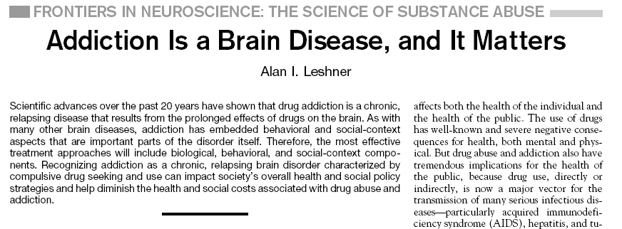

Source: Leshner, 1997
20
Notes:
Introduce the slide by saying “in 1997 Dr. Alan Leshner, then-Director of the National Institute on Drug Abuse, published what became a seminal article in how we conceptualize substance use and addiction. Until then it had largely been considered to be a problem of self-discipline or a moral failing. Part of what he says in the article is this (advance the slide, and the sentence in the box will pull out). (Read the sentence) then ask “what parts of this statement strike you as being important, and why?” (typically people will point out “chronic, relapsing brain disorder”, “compulsive drug seeking and use”, “society’s overall health and social policy strategies”, and “diminish health and social costs”.) Engage in a discussion of why each of those is important in how we define addiction.
Reference: Leshner, A. (1997). Addiction is a brain disease, and it matters. Science, 278.

Slide 21
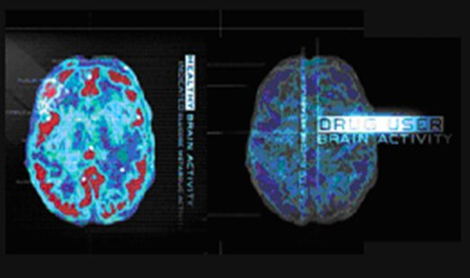
What is Addiction?
Addiction is A Brain Disease
Characterized by:
  Compulsive Behavior
  Continued use of drugs despite negative consequences
  Persistent changes in the brain’s structure and function
Source: NIDA
Notes:
Decades of research have revealed addiction to be a disease that alters the brain. We now know that while the initial decision to use drugs is voluntary, drug addiction is a disease of the brain that compels a person to become singularly obsessed with obtaining and abusing drugs despite their many adverse health and life consequences.
Reference: National Institute on Drug Abuse. Bringing the full power of science to bear on drug abuse and addiction. Retrieved from: https://www.drugabuse.gov/sites/default/files/addictionscience.ppt.

Slide 22
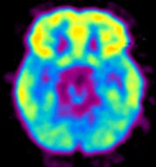
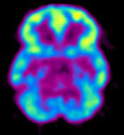

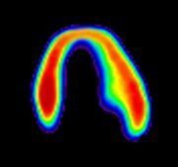
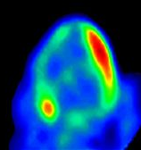
Addiction is Like Other Diseases…
  It is preventable
  It is treatable
  It changes biology
  If untreated, it can last a lifetime
Decreased Heart Metabolism in Heart Disease Patient
Decreased Brain Metabolism
in Drug User
High
Healthy Brain
Diseased Brain/
Cocaine User
Low
Healthy Heart
Diseased Heart
Research supported by NIDA addresses all of these
components of addiction.
Source: NIDA
Notes:
Addiction is similar to other chronic diseases. Using imaging technology to measure metabolism (in this case, glucose uptake) in the brain and heart, one can see that both addiction and heart disease produce observable changes in organ function. In each pair of images shown above, the healthy organ shows greater activity (reds and yellows) than the diseased organ. In drug addiction, the frontal cortex, which is a part of the brain associated with judgment and decision-making, is significantly affected. Like heart disease, drug addiction can be prevented and treated successfully. If left untreated, however, its effects can last a lifetime.
Reference: National Institute on Drug Abuse. Bringing the full power of science to bear on drug abuse and addiction. Retrieved from: https://www.drugabuse.gov/sites/default/files/addictionscience.ppt.

Slide 23

Science of Addiction
Advances in medicine and scientific techniques have given researchers a clearer idea of what addiction is:
  Magnetic resonance imaging (MRI)
  Positron emission tomography (PET) scan
  Advanced genetic research
Notes:
23
Over the past 20 years, imaging studies and advanced genetic research have given us a much clearer idea of what addiction is, and how it manifests in the brain.
Image Credit: Fotolia, purchased image, 2018.

Slide 24
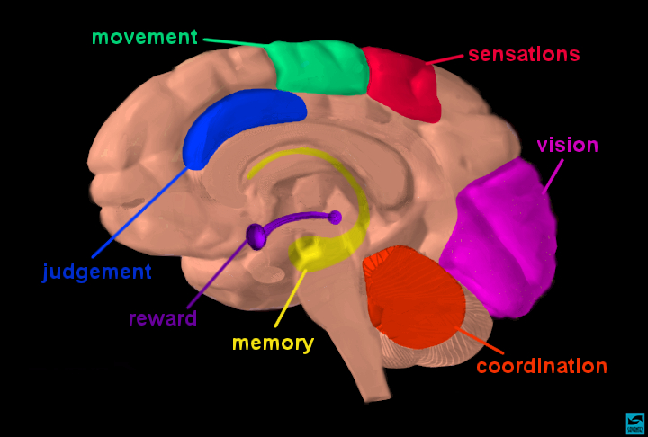
Source: NIDA
Notes:
This slide depicts a cartoon image of the human brain. Say “alcohol and drugs impact many different parts of the brain, including”:
Prefrontal Cortex = judgement/executive level decision making
Nucleus accumbens = cognitive processing of aversion, motivation, pleasure, reward, and reinforcement
Limbic system = center of emotions, learning, and memory; cingulate gyri, hypothalamus, amygdala (emotional reactions), and hippocampus (learning & memory).
Cerebellum – coordination
Reference: National Institute on Drug Abuse. Bringing the full power of science to bear on drug abuse and addiction. Retrieved from: https://www.drugabuse.gov/sites/default/files/addictionscience.ppt.

Slide 25
Neurotransmitters
n(y)o͝orōˈtranzmidər noun
a chemical substance that is released at the end of a nerve fiber by the arrival of a nerve impulse and, by diffusing across the synapse or junction, causes the transfer of the impulse to another nerve fiber, a muscle fiber, or some other structure.
25
Notes:
In order to talk about effects that substances have in the brain, we need to define neurotransmitters.

Slide 26
Major Neurotransmitters
Involved in SUD
Dopamine
Serotonin
Norepinephrine
GABA
Glutamate
Source: Galanter, Kleber, & Brady, 2015
Notes:
Explain the listed neurotransmitters as follows:
Dopamine: the brain’s central pleasure chemical
Serotonin: involved in mood regulation
Norepinephrine: energy and mood
GABA: the brain’s central inhibitory neurotransmitter – it slows us down
Glutamate: the brain’s central excitatory neurotransmitter – it speeds us up
Reference: Galanter, M., Kleber, H.D., & Brady, K.T. (2015). Textbook of Substance Abuse Treatment, 5th Ed. Arlington, VA: American Psychiatric Publishing.

Slide 27

Normal Dopamine Transmission
Source: Eyes of the World Media/UCLA, 2008
Notes:
This slide shows how neurotransmission works, specifically for dopamine. What is schematically illustrated in this slide is a nerve terminal (top), the synaptic cleft or space between the neurons, and the post-synaptic or receiving portion of a dendrite on a neighboring neuron. Dopamine is contained in vesicles (round storage sites) in the nerve terminal; dopamine receptors are present on the receiving (bottom) neuron.
When a signal comes down the axon, dopamine (shown in orange) is released into the synapse. It then crosses the synaptic cleft to the second neuron, where it binds to and stimulates dopamine receptors (shown in blue), generating a signal in the second neuron. The dopamine is then released from the receptor and crosses back to the first neuron where it is picked up by dopamine transporters (reuptake molecules; shown in purple) for re-use.
Video Source: Eyes of the World Media Group/UCLA. Meth Inside Out: Brain & Behavior. (2008). Retrieved from: https://www.youtube.com/watch?v=MGEJ_GQVOqg.

Slide 28
Natural Rewards Elevate
Dopamine Levels
FOOD
SEX
200
200
NAc shell
150
150
DA Concentration (% Baseline)
100
100
15
% of Basal DA Output
Empty
10
50
Box
Feeding
Copulation Frequency
5
0
0
0
60
120
180
Scr
Scr
Scr
Scr
Time (min)
Bas
Female 1 Present
Female 2 Present
Sample
Number
1
2
3
4
5
6
7
8
9
10
11
12
13
14
15
16
17
Mounts
Intromissions
Ejaculations
Source: Bassareo & Di Chiara, 1999; Fiorino & Phillips, 1997
Notes:
Natural rewards stimulate dopamine neurotransmission. Eating something that you enjoy or being stimulated sexually can cause dopamine levels to increase. In these graphs, dopamine is being measured inside the brains of animals. Its increase is shown in response to food or sex cues. This basic mechanism of controlled dopamine release and reuptake has been carefully shaped and calibrated by evolution to reward normal activities critical for our survival.
References: Bassareo, V., & Di Chiara, G. (1999). Differential responsiveness of dopamine transmission to food-stimuli in nucleus accumbens shell/core compartments. Neuroscience, 89(3), 637-641.
Fiorino, D.F., & Phillips, A.G. (1997). Dynamic changes in nucleus accumbens dopamine efflux during the Coolidge effect in male rats. Journal of Neuroscience, 17(12), 4849-4855.

Slide 29
Methamphetamine and
Dopamine Transmission
Source: Eyes of the World Media/UCLA, 2008
Notes:
This next video explains what happens to dopamine transmission when a drug like methamphetamine is introduced into the brain. Explain that the process is similar for all the neurotransmitters we’ll discuss.
Video Source: Eyes of the World Media Group/UCLA. Meth Inside Out: Brain & Behavior. (2008). Retrieved from: https://www.youtube.com/watch?v=dsFpe4IiF8w.

Slide 30
Effects of Drugs on Dopamine Release
1500
1000
500
0
METHAMPHETAMINE
COCAINE
400
Accumbens
Accumbens
300
DA
DOPAC
% of Basal Release
HVA
% Basal Release
200
100
0
1
2
3hr
0
Time After Methamphetamine
Time After Cocaine
250
Accumbens
NICOTINE
250
Accumbens
ETHANOL
200
Accumbens
200
Dose (g/kg ip)
Caudate
0.25
150
0.5
% of Basal Release
1
% of Basal Release
2.5
100
150
0
100
0
1
2
3 hr
0
0
1
2
3
4hr
Time After Nicotine
Time After Ethanol
Source: Shoblock & Sullivan, 2003; Di Chiara & Imperato, 1988
Notes:
Nearly all drugs of abuse increase dopamine neurotransmission, either directly or indirectly. This slide shows the increase in brain dopamine (DA) levels (measured in animals) following exposure to various drugs of abuse. All of the drugs depicted in this slide have different mechanisms of action, however they all increase activity in the brain reward pathway by increasing dopamine neurotransmission. It is because drugs activate these brain regions⎯usually more effectively and for longer periods of time than natural rewards⎯that they have an inherent risk of being abused.
The dopamine release profile for opioids is similar to that of alcohol.
References: Di Chiara, G., & Imperato, A. (1988). Drugs abused by humans preferentially increase synaptic dopamine concentrations in the mesolimbic system of freely moving rats. Proceedings of the National Academy of Science U.S.A., 85(14), 5274-5278.
Shoblock, J.R., Sullivan, E.B., Maisonneuve, I.M., & Glick, S.D. (2003). Neurochemical and behavioral differences between d-methamphetamine and d-amphetamine in rats. Psychopharmacology (Berl), 165(4), 359-369.

Slide 31
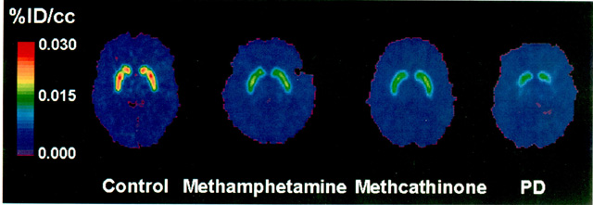
Decreased Dopamine Transporter Binding in METH Users Resembles that in Parkinson’s Disease
Control Meth PD
Source: McCann U.D.. et al.,1998
Notes:
The scan on the far left of the screen depicts the brain of a non-methamphetamine using control. Notice the bright colors in the reward center. Brighter colors mean higher glucose metabolism, so more activity in the reward pathways. The center scan is the brain of a methamphetamine user who has been matched to the control in terms of age, race, etc. Notice that there are no bright red and orange colors in the reward center. Symptomatically, this might show up as depression. The scan on the far right depicts the brain of a Parkinson’s Disease patient. Notice that like the center scan, this scan lacks the bright red and orange colors in the reward center. Parkinson’s Disease is a movement disorder that impacts similar areas of the brain as does meth. A meth user ends up looking more like a Parkinson’s patient than a non using control.
This is not to say that methamphetamine users will eventually become Parkinson’s patients, but it does help to explain why some methamphetamine users exhibit muscle twitching (known as “tweaking”) and other strange movements.
Reference: McCann U.D., Wong, D.F., Yokoi, F., Villemagne, V., Dannals, R.F., & Ricaurte, G.A. (1998). Reduced Striatal Dopamine Transporter Density in Abstinent Methamphetamine and Methcathinone Users: Evidence from Positron Emission Tomography Studies with [¹¹C]WIN-35,428. Journal of Neuroscience 18(20), 8417-8422.

Slide 32
But Dopamine is only Part of the Story
Research has shown that other neurotransmitter systems are also affected:
  Serotonin
    Regulates mood, sleep, etc.
  Glutamate
    Regulates learning and memory, etc.
    Source: NIDA
Notes:
Dopamine is an important brain chemical in drug abuse and addiction, but other brain systems and brain chemicals are also involved. Serotonin and glutamate neurotransmitter systems, for example, are among those affected. These neurotransmitters are important regulators of mood, sleep, learning and memory, and more.
Reference: National Institute on Drug Abuse. Bringing the Full Power of Science to Bear on Drug Abuse and Addiction. Retrieved from: https://www.drugabuse.gov/sites/default/files/addictionscience.ppt.

Slide 33
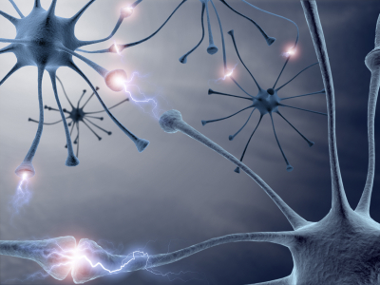
Prolonged Drug Use Changes
The Brain In Fundamental and
Long-Lasting Ways
    Source: NIDA
Notes:
Make the point that sustained drug use changes the brain in profound and long-lasting ways, which we will look at next.
REFERENCE: National Institute on Drug Abuse. Bringing the Full Power of Science to Bear on Drug Abuse and Addiction. Retrieved from: https://www.drugabuse.gov/sites/default/files/addictionscience.ppt.

Slide 34
AND…
We Have Evidence That
These Changes Can Be Both
Structural and Functional
    Source: NIDA
Notes:
These long-term changes can be both structural and functional, and affect many aspects of our ability to function in our daily lives.
REFERENCE: National Institute on Drug Abuse. Bringing the Full Power of Science to Bear on Drug Abuse and Addiction. Retrieved from: https://www.drugabuse.gov/sites/default/files/addictionscience.ppt.

Slide 35
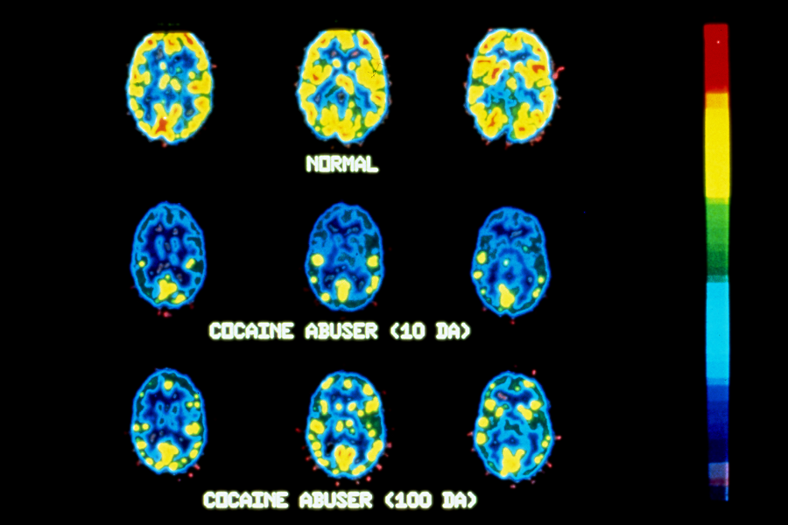
Long-Term Impact of Cocaine Use
Normal
Cocaine User (10 Days)
Cocaine User (100 Days)
    Source: NIDA, 2007; Volkov et al., 1993; Volkov et al, 1992
Notes:
Brain glucose metabolism with PET – chronic cocaine users vs. normal controls; chronic cocaine users were tested 1-6 weeks after last use of cocaine and again after 3-month drug-free period
Cocaine users had significantly lower metabolic activity in 16 of the 21 left frontal regions and 8 of the 21 right frontal regions. These decreases persisted after 3-4 months of detoxification and were correlated with dose and years of use. Conclusion – reduced frontal metabolism in neurologically intact cocaine users that persist even after 3-4 months of detoxification.
References: National Institute on Drug Abuse. Bringing the Full Power of Science to Bear on Drug Abuse and Addiction. Retrieved from: https://www.drugabuse.gov/sites/default/files/addictionscience.ppt.
Volkow, N.D., Fowler, J.S., Wang, G.-J., Hitzemann, R., Logan, J., Schlyer, D., Dewey, S., & Wolf, A.P. (1993). Decreased dopamine D2 receptor availability is associated with reduced frontal metabolism in cocaine abusers. Synapse, 14, 169-177.
Volkow, N.D., Hitzemann, R., Wang, G.-J., Fowler, J.S., Wolf, A.P., & Dewey, S.L. (1992). Long-term frontal brain metabolic changes in cocaine abusers. Synapse 11, 184-190.

Slide 36


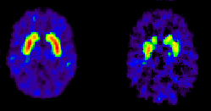
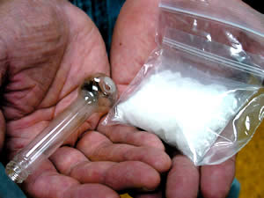
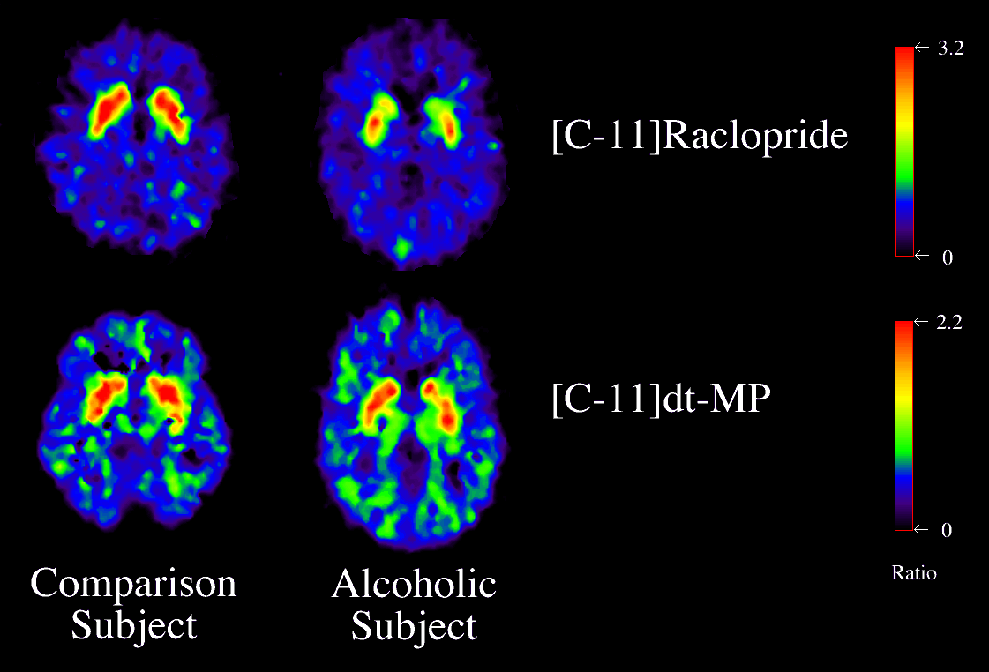

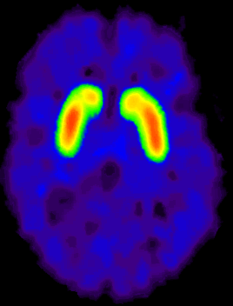
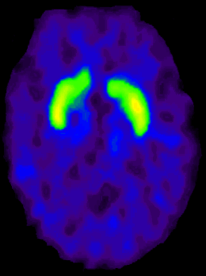
Dopamine D2 Receptors are Lower in Addiction
DA
Cocaine
DA
DA
DA
DA
DA
DA
DA
DA
DA
DA
DA
Meth
Reward Circuits
Non-Drug User
DA D2 Receptor Availability
Alcohol
DA
DA
DA
DA
DA
DA
Heroin
Reward Circuits
control
addicted
Drug User
    Source: NIDA
Notes:
Repeated drug exposure also changes brain function. Positron emission tomography (PET) images show similar changes in brain dopamine receptors resulting from addiction to different substances. Dopamine D2 receptors are one of five types of receptors that bind dopamine in the brain. The brain images on the left are those of controls, while those on the right are from individuals addicted to cocaine, methamphetamine, alcohol, or heroin. The striatum (which contains the reward and motor circuitry) shows up as bright red and yellow in the controls (in the left column), indicating numerous D2 receptors. Conversely, the brains of addicted individuals (in the right column) show a less intense signal, indicating lower levels of D2 receptors. This reduction likely stems from repeated over-stimulation of the dopamine receptors. Brain adaptations such as this contribute to the compulsion to abuse drugs, because it is much more difficult to experience pleasure.
Reference: National Institute on Drug Abuse. Bringing the Full Power of Science to Bear on Drug Abuse and Addiction. Retrieved from: https://www.drugabuse.gov/sites/default/files/addictionscience.ppt.

Slide 37
Cognitive and
  Memory Effects
Notes:
This slide introduces a section on cognitive and memory effects of drugs.
Image credit: NIDA Website, https://www.drugabuse.gov/.

Slide 38
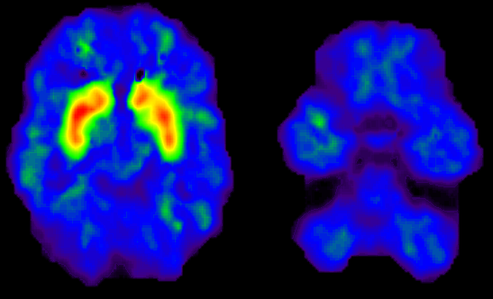
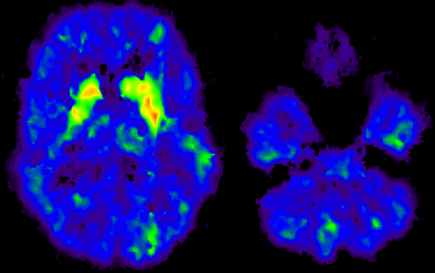
Dopamine Transporters in
Methamphetamine Users
Motor Activity
2.0
1.8
(Bmax/Kd)
1.6
Dopamine Transporter
1.4
1.2
Normal Control
1.0
7
8
9
10
11
12
13
Time Gait
(seconds)
2
Memory
1.8
1.6
Dopamine Transporter
Bmax/Kd
1.4
1.2
Methamphetamine User
1
16
14
12
10
8
6
4
p < 0.0002
Delayed Recall
(words remembered)
Source: NIDA
Notes:
Another example: Methamphetamine abuse decreases dopamine transporter activity and compromises mental function. The brain image at the top left is a PET image from a normal control subject. The striatum is brightly lit in red and yellow, indicating the presence of many dopamine transporters, which contrasts with the brain of a methamphetamine abuser (bottom left). What does this mean functionally? The graphs on the right show the relationship between performance on a motor (upper right) and a memory task (lower right) and methamphetamine-driven decreases in dopamine transporters. The magnitude of the decline in the dopamine transporter binding is positively correlated with the extent of motor and memory impairment; thus the greater the decline, the greater the impairment in memory and motor reaction time.
Reference: National Institute on Drug Abuse. Bringing the Full Power of Science to Bear on Drug Abuse and Addiction. Retrieved from: https://www.drugabuse.gov/sites/default/files/addictionscience.ppt.

Slide 39
How much does the brain heal?
Notes:
Drug use can kill brain cells. Many drugs, including alcohol, are neurotoxic, meaning they are poisonous to portions of the brain. Long-term, high-dose methamphetamine use, for instance, can produce neurotoxicity, thereby destroying neurons and permanently eliminating certain types of brain function. The good news is that many of the changes that methamphetamine causes to neurons in specific parts of the brain appear to recover over time. In effect, the brain “heals.”
What happens when neurons are destroyed? Depends on which part of the brain. If in the limbic system, anything from how people experience pleasure to learning and memory may be impaired. If in the prefrontal cortex, reasoning and decision-making will be impaired.
This information can be one of the most important and motivating facts that a substance user can learn – that it appears that the brain does heal over time.
Image credit: NIDA Website, https://www.drugabuse.gov/.

Slide 40
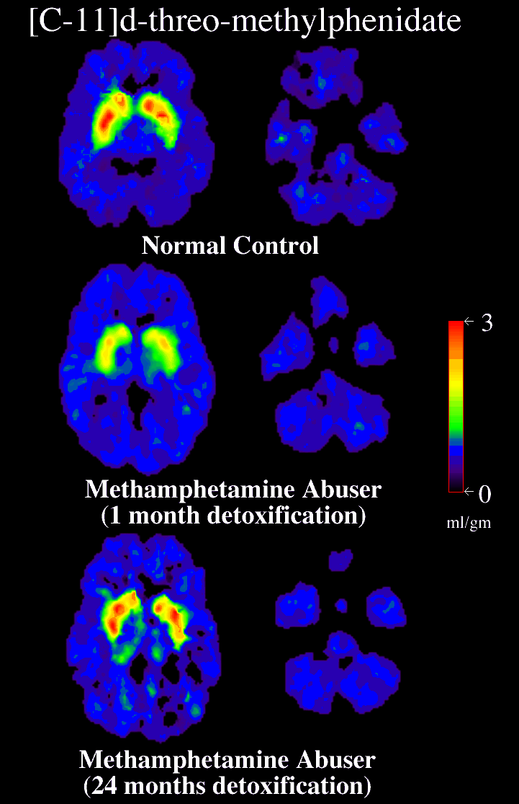
Partial Recovery of Brain Dopamine Transporters in Methamphetamine User
After Protracted Abstinence
3
0
ml/gm
Normal Control
METH User
(1 month detox)
METH User
(24 months detox)
Source: Volkow et al., 2001
Notes:
In this study, researchers examined the PET scans of chronic methamphetamine users who had achieved two years of abstinence from methamphetamine. The scans showed a return to virtually normal dopamine levels. While this is good news, and suggests that the brain has an amazing ability to repair itself, the subjects in the study did not regain all of the lost cognitive function associated with the damage, which could suggest an incomplete recovery.
While the fact that the brain recovers is good news, the not-so-good news is that the recovery takes months, not days. Treatment and recovery are long-term processes.
Reference: Volkow, N.D., Chang, L., Wang, G.-L., Fowler, J.S., Franceschi, D., Sedler, M., Gatley, S.J., Miller, E., Hitzemann, R., Ding, Y.-S., & Logan, J. (2001). Loss of dopamine transporters in methamphetamine abusers recovers with protracted abstinence. The Journal of Neuroscience, 21(23), 9414-9418.

Slide 41

What does this mean for clients/patients?
Notes:
Pose the question to the audience: “what does the fact that brain mechanism recovery may take a long time mean for our clients/patients?” Answer: that we need to be mindful that people aren’t necessarily going to change and get better overnight, and that treatment episodes may need to be longer than previously thought.
Image credit: Fotolia, purchased image, 2018.

Slide 42
Addiction is, Fundamentally,
a Brain Disease
...BUT
It’s Not Just a Brain Disease
    Source: NIDA, 2007
Notes:
Addiction is, on a fundamental level, a brain disease, but it’s not just a brain disease. This slide transitions to a section on environmental and biological influences.
Reference: National Institute on Drug Abuse. (2007). Drugs, Brains, and Behavior: The Science of Addiction. NIH Pub No. 07-5605, February 2007.

Slide 43
Environmental factors (e.g., conditions at home, at school, and in the neighborhood) also play a role
    Source: NIDA, 2007
Notes:
Explain the diagram. In particular, stress the interaction between biological factors and environmental factors along with aspects of the substance itself as determinants of developing an addiction. Each of these factors is explained in more detail on the next 3 slides.
“No single factor determines whether a person will become addicted to drugs. The overall risk for addiction is impacted by the biological makeup of the individual – it can even be influenced by gender or ethnicity, his or her developmental stage, and the surrounding social environment (e.g., conditions at home, at school, and in the neighborhood (NIDA, 2007).”
Reference: National Institute on Drug Abuse. (2007). Drugs, Brains, and Behavior: The Science of Addiction. NIH Pub No. 07-5605, February 2007.

Slide 44
Addiction Environmental Risk Factors
Child abuse/neglect (adverse childhood experiences)
Parents’ attitude toward alcohol & drugs
Peer influences
Poor school achievement
Poverty
Community attitudes i.e. legalization of marijuana
    Source: NIDA, 2007
Notes:
In addressing the question of “who becomes addicted to alcohol and/or drugs, and who doesn’t?” there is no simple answer. Many environmental factors play a role, including experiencing childhood abuse and/or neglect, parents’ attitudes toward alcohol and drugs, peer influences, poor school achievement, poverty, and community attitudes including phenomena like the growing legalization of marijuana for recreational purposes.
Reference: National Institute on Drug Abuse. (2007). Drugs, Brains, and Behavior: The Science of Addiction. NIH Pub No. 07-5605, February 2007.

Slide 45
Addiction Biological Risk Factors
Genetics i.e. family history of addiction
Co-occurring psychiatric conditions
Age at first use
    Source: NIDA, 2007
Notes:
Continuing from the previous slide on why do some people become addicted and some don’t…there are also biological risk factors, including genetics (for instance, is there a family history of addiction?), does the individual have a psychiatric condition (which increases vulnerability to addictions), and how old were they when they first used alcohol and/or drugs? The younger they were, the more likely they are to develop an addiction.
REFERENCE: National Institute on Drug Abuse. (2007). Drugs, Brains, and Behavior: The Science of Addiction. NIH Pub No. 07-5605, February 2007.

Slide 46
Vulnerability to addiction differs from person to person
Between 40 and 60 percent of a person’s vulnerability to alcohol and tobacco addiction is due to genetic influences
    Source: NIDA, 2007
Notes:
46
Addiction also has a strong genetic component. It is estimated that between 40 and 60% of an individual’s vulnerability to addiction is due to genetic factors. For instance, there may be a gene or genes that are “turned on” by environmental factors in childhood.
“As with any other disease, vulnerability to addiction differs from person to person. In general, the more risk factors an individual has, the greater the chance that taking drugs will lead to abuse and addiction. Scientists estimate that genetic factors account for between 40 and 60 percent of a person’s vulnerability to addiction, including the effects of environment on gene expression and function.”
Reference: National Institute on Drug Abuse. (2007). Drugs, Brains, and Behavior: The Science of Addiction. NIH Pub No. 07-5605, February 2007.
Image Credit: Fotolia, purchased image, 2018.

Slide 47
Summary
No one factor determines whether any given individual will become addicted to alcohol or drugs
It is the combination of environmental and biological factors, along with aspects of the drug itself (when it was first used, how it was first used, cost, and availability), that determine susceptibility to addiction
So we must evaluate each individual’s risk factors
Notes:
Summarize the previous 3 slides and make the point that we must evaluate risk factors of each individual in order to determine who is most likely to develop a substance use disorder. It is therefore vital to complete a comprehensive history on intake.

Slide 48
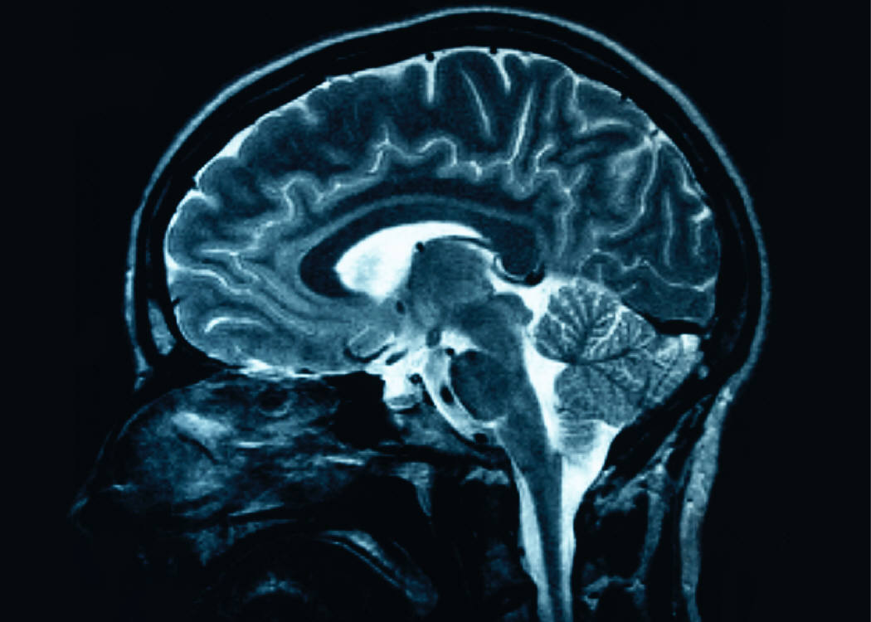
Drug addiction is a chronic brain disorder
The brain shows distinct changes after drug use that can persist long after the drug use has stopped
    Source: NIDA, 2007
Notes:
48
The brain changes that occur as a result of ongoing drug use can be long lasting, and can persist long after the user has stopped using drugs. Studies show the brain can recover and return towards normal, but this recovery process takes time (exact time depends upon a number of factors, including how long and how heavily they have used the substance). What happens when neurons are destroyed? Depends on which part of the brain. If in the limbic system, clients may have difficulty experiencing pleasure, may appear depressed, may have problems with learning and memory. If in the prefrontal cortex, reasoning and decision-making will be impaired. This is why so many people with substance use disorders seem to make bad decisions.
Reference: National Institute on Drug Abuse. (2007). Drugs, Brains, and Behavior: The Science of Addiction. NIH Pub No. 07-5605, February 2007.
Image credit: NIDA Website, https://www.drugabuse.gov/.

Slide 49
A Few Examples:
Marijuana, Methamphetamine,
and Opioids
Notes:
Now we will look at the effects of a few drugs: marijuana, methamphetamine, and opioids, and see what happens both acutely and long-term.

Slide 50
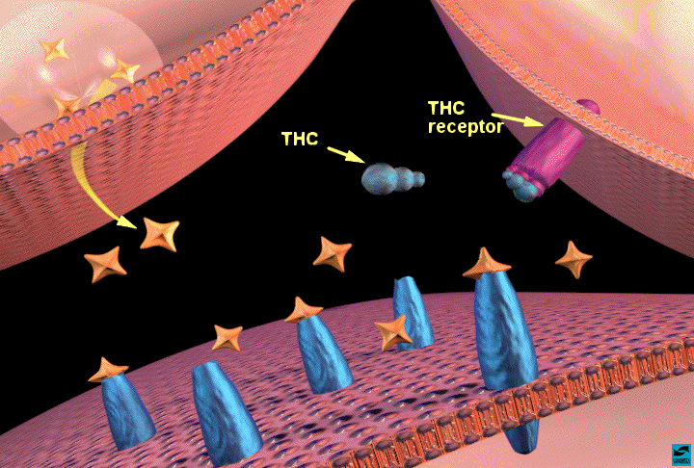
Marijuana: How Does it Work?
Contains over 100 cannabinoids: main active chemical is ∆-9-tetrahydrocannabinol (THC)
Stimulates “high” by triggering receptors in parts of brain that influence pleasure, memory, thinking, concentration, coordination
THC’s molecular structure is similar to that of neurotransmitters that affect cannabinoid receptors (affect pain, appetite, vomiting reflex)
Effects generally last 1-4 hours
50
SOURCES: NIDA, 2012a; NIDA 2012b.
Notes:
THC (tetrahydrocannabinol – one of the main psychoactive ingredients in marijuana) works by acting on specialized cells called neurons in the brain (refer to illustration). Neurons do not touch each other, and the gap between them—called the synaptic space—needs to be bridged for messages to get from one neuron to the next. To get messages across the space, neurons release chemicals, or neurotransmitters. The receiving neuron contains special proteins called receptors that neurotransmitters will bind to, similar to the way a key fits into a lock. After a neurotransmitter has bound to a receptor, proteins called transporters or reuptake pumps will carry neurotransmitters back to the neurons that released them. The reason this process is important is that certain neurotransmitters and receptors are associated with specific emotional and functions. Any changes to these steps—the way neurotransmitters are released, the way receptors work, or the way transporters or reuptake pumps work—can have profound effects on sensation, perception, thought, mood, and behavior. When people take drugs, these processes are altered, leading to changes in the way they feel and behave. Marijuana gets its effects because it contains over 60 chemicals called cannabinoids. The main active chemical is a cannabinoid called delta-9-tetrahydorocannabinol, often referred to as THC. Cannabinoids trigger cannabinoid receptors, which are particularly dense in parts of the brain that affect pleasure, memory, thinking, concentration, and coordination. The effects of marijuana generally last 1-4 hours.
References: NIDA 2012(a). Drug Facts: Marijuana. Retrieved from: http://www.drugabuse.gov/sites/default/files/marijuana_0.pdf.
NIDA 2012(b). Research Report Series: Marijuana Abuse. Retrieved from:
http://www.drugabuse.gov/sites/default/files/rrmarijuana.pdf.

Slide 51
Marijuana Effects on the Brain
THC connects to cannabinoid receptors found in the parts of the brain that influence pleasure, memory, thought, concentration, sensory and time perception, and coordinated movement.
The short-term effects of marijuana include:
  problems with memory and learning
  distorted perception
  difficulty in thinking and problem solving
  loss of coordination
  increased heart rate
Source: Galanter, Kleber, & Brady, 2015
Notes:
Make the point that cannabinoid receptors are found in numerous parts of the brain and body, resulting in the phenomena listed in the bullet points.
Reference: Galanter, M., Kleber, H.D., & Brady, K.T. (2015). Textbook of Substance Abuse Treatment, 5th Ed. Arlington, VA: American Psychiatric Publishing.

Slide 52
Marijuana Effects on the Brain
Long-term marijuana effects include
  increase in the activation of the stress-response system
  changes in the activity of nerve cells containing dopamine
Notes:
Make the point that cannabinoid receptors are found in numerous parts of the brain and body, resulting in the phenomena listed in the bullet points.
Reference: Galanter, M., Kleber, H.D., & Brady, K.T. (2015). Textbook of Substance Abuse Treatment, 5th Ed. Arlington, VA: American Psychiatric Publishing.

Slide 53
Marijuana: Negative Effects on Behavior and Mental Health
Similar to alcohol/other drugs if misused (impairment)
Long term use has negative impact on learning and memory
Long term use reduces motivation (“amotivational syndrome”)
Associated with mental health problems
  Unclear if marijuana use is cause or effect
  Heavy use is highly associated with serious mental illness – particularly among those with high risk (e.g., family history)
Sources: Ben Amar, 2006; Bostwick, 2012.
Notes:
Marijuana use can have very negative effects on behavior and mental health. Since marijuana is a psychoactive drug, it causes significant impairment, just like alcohol and other drugs. This means that when experiencing a marijuana “high” people are impaired, both physically and mentally. It is unsafe to drive, operate heavy machinery, or do other things that require concentration and physical coordination when under the influence of marijuana. Long-term marijuana use has a negative impact on learning and memory. Long-term marijuana use also causes amotivational syndrome, as it makes regular users less motivated to do things. Marijuana use is also associated with mental health problems and mental illness, particularly mood disorders. It is unclear if marijuana is what causes these problems, or if people who have mood disorders are more likely to use marijuana to self-medicate. Research also shows that heavy marijuana use is associated with serious mental illness, particularly among people who are at risk for serious mental illness because of family history.
Additional Information for the Trainer(s)
Serious mental illness differs from “mental illness” in general in that it lasts longer and is more disabling, often preventing people from working or functioning in their day to day lives. Among individuals who meet diagnostic criteria for marijuana abuse, 36% have had a mood disorder in their life, and 25% have had an anxiety disorder in their life. Among individuals who meet diagnostic criteria for marijuana dependence, 60.5% have had a mood disorder in their life, and 48.5% have had an anxiety disorder in their lifetime. Overall, marijuana dependence increases the odds of a co-occurring mood disorder by 6.5 times, and of an anxiety disorder by 4.6 times. Further, there is a significant gender difference with regard to major depression, with marijuana dependence increasing the odds for men by 4.6 times and 7.2 times for women.
References: Ben Amar M. (2006). Cannabinoids in medicine: a review of their therapeutic potential. J Ethnopharmacology, 105, 1‐25.
Bostwick, J.M. (2012). Blurred boundaries: the therapeutics and politics of medical marijuana. Mayo Clinic Proceedings, 87, 172‐186.

Slide 54
Neuropsychological Performance in
Long-Term Cannabis Users
Administered neuropsychological tests to 63 current heavy cannabis users who had smoked cannabis at least 5,000 times in their lives and to 72 control subjects who had smoked no more than 50 times in their lives.
Differences between the groups after 7 days of supervised abstinence were reported. However, no deficits were found after 28 days abstinence, after adjusting for various potentially confounding variables.
Suggest that cognitive deficits associated with long-term cannabis use are reversible and related to recent cannabis exposure.
Source: Pope et al., 2001.
Notes:
Pope and colleagues examined the long-term cognitive effects of cannabis use. The recruited three groups of users – (1) current heavy users who smoked cannabis at least 5,000 times in their lives and were daily smokers at the start of the study; (2) former heavy users who had also smoked at least 5,000 times but fewer than 12 times in the last three months; and (3) controls who smoked no more than 50 times in their lives. In the study, the participants went through a 28-day “washout” from cannabis use, and on days 0, 1, 7, and 28, participated in a neuropsychological test battery to assess cognitive functioning. They found that at days 0, 1, and 7, the current heavy users scored significantly lower than control subjects. But by day 28, there were virtually no significant differences among the groups. This suggests that cognitive deficits may be reversible and related to recent cannabis exposure, instead of irreversible and related to cumulative lifetime use of cannabis.
Reference: Pope, H.G., Gruber, A.J., Hudson, J.I., Huestis, M.A., & Yurgelun-Todd, D. (2001). Neuropsychological performance in long-term cannabis users. Archives of General Psychiatry, 58(10), 909-915.

Slide 55


Neurologic Impact of Marijuana
When cannabis users were asked to rate the effects of their own cannabis use as positive, neutral, or negative, they gave overwhelmingly negative ratings of the effects that cannabis had had on their…
Social life (70%):
Physical health (81%) :
Mental health (60%) :
Cognition (91%) :
Memory (91%) :
Career (79%) :
SOURCE: Gruber et al., 2003.
Notes:
*ANIMATIONS*
This slide has animations. Introduce the content in the first bullet first. Then, one by one, click the mouse one time for the domain name and images of people to animate in. A total of six domains and associated data are included. Be sure to practice ahead of time.
This is the same group of study participants described on the previous slide. Gruber and colleagues to assess the neurologic impact of long-term heavy cannabis use in a variety of life domains. This slide details the results of the study. In several domains, the majority of individuals (or on some cases, vast majority) of individuals felt that cannabis negatively impacted their lives. Additional details are included below:
RESULTS:
Gruber and colleagues found no significant differences between the two groups on reported levels of income and education in their families of origin. However, the heavy users themselves reported significantly lower educational attainment (P < 0.001) and income (P = 0.003) than the controls, even after adjustment for a large number of potentially confounding variables. When asked to rate the subjective effects of cannabis on their cognition, memory, career, social life, physical health and mental health, large majorities of heavy users (66-90%) reported a 'negative effect'. On several measures of quality of life, heavy users also reported significantly lower levels of satisfaction than controls.
CONCLUSION:
Both objective and self-report measures suggest numerous negative features associated with long-term heavy cannabis use. Thus, it seems important to understand why heavy users continue to smoke regularly for years, despite acknowledging these negative effects. Such an understanding may guide the development of strategies to treat cannabis dependence.
Reference: Gruber, A.J., Pope, H.G., & Yurgelun-Todd, D. Attributes of long-term heavy cannabis users: A case-control study. Psychological Medicine, 33(8), 1415-1422.

Slide 56
Methamphetamine
Acute Physical Effects
Increases
Heart rate
Blood pressure
Pupil size
Respiration
Sensory acuity
Energy
Decreases
  Appetite
  Sleep
  Reaction time
Source: Galanter, Kleber, & Brady, 2015
Notes:
At the outset, methamphetamine is a seductive drug because its effects during the early stages of use are very pleasurable and reduce appetite and fatigue. People take the drug to help them work longer hours, lose weight, study longer, become more athletic, and have more and better sex. When a person uses methamphetamine, heart rate and blood pressure increase, as do pupil size, sensory acuity, and energy. Concomitantly, it decreases appetite, sleep, and reaction time. People find these effects useful.
Reference: Galanter, M., Kleber, H.D., & Brady, K.T. (2015). Textbook of Substance Abuse Treatment, 5th Ed. Arlington, VA: American Psychiatric Publishing.

Slide 57
Methamphetamine
Acute Psychological Effects
Increases
Confidence
Alertness
Mood
Sex drive
Energy
Talkativeness
Decreases
Boredom
Loneliness
Timidity
Source: Galanter, Kleber, & Brady, 2015
Notes:
Like the initial medical effects of methamphetamine, the initial psychological effects are also generally pleasant: methamphetamine increases confidence, alertness, positive mood, sex drive, energy, and talkativeness. It also decreases boredom, loneliness, and timidity.
Reference: Galanter, M., Kleber, H.D., & Brady, K.T. (2015). Textbook of Substance Abuse Treatment, 5th Ed. Arlington, VA: American Psychiatric Publishing.

Slide 58
Methamphetamine
Chronic Physical Effects
Tremor
Weakness
Dry mouth
Weight loss
Cough
Sinus infection
Sweating
Burned lips; sore nose
Oily skin/complexion
Headaches
Diarrhea
Anorexia
Source: Galanter, Kleber, & Brady, 2015
Notes:
Over time, the effects of methamphetamine change. As methamphetamine is repeatedly applied to the brain, it changes brain chemistry, structure, and function. Some structures of the brain develop tolerance to the drug’s effects and require an increased dosage to produce the desired effects. However, other areas of the brain become sensitized to the effects of methamphetamine, causing even small doses to produce very powerful reactions. Simply put, over time, part of the brain reacts to the drug by needing more of it, while other parts of the brain respond in exactly the opposite manner. Methamphetamine is a powerful stimulant that causes the heart to work harder and strains the vascular system. Chronic use can cause heart attacks and strokes. It increases blood pressure and thickens heart valves. Methamphetamine constricts blood vessels on the skin surface, causing the skin to feel tingly. Users will frequently vigorously scratch their skin in response to this sensation (meth bugs, speed bumps). Some of the effects to the left are due to the method the user uses to get the drug into his/her body. And what started as a weight loss of a few pounds ends up being an uncontrollable level of weight loss.
Infective Endocarditis (i.e., staphylococcus aureus) is frequent among people who inject drugs (PWID). About 8-16% of hospital admissions for PWIDs are accounted for by infective endocarditis. Essentially, an organism colonizes the heart (mostly the right side). Most common symptoms of endocarditis are chest pain, cough, fever, chills, and arthralgia. The condition can be treated with antibiotics or surgery.
Reference: Galanter, M., Kleber, H.D., & Brady, K.T. (2015). Textbook of Substance Abuse Treatment, 5th Ed. Arlington, VA: American Psychiatric Publishing.

Slide 59
Methamphetamine
Chronic Psychological Effects
Confusion
Concentration
Hallucinations
Fatigue
Memory loss
Insomnia
Irritability
Paranoia
Panic reactions
Depression
Anger
Psychosis
Source: Galanter, Kleber, & Brady, 2015
Notes:
As dramatic as the chronic physical effects of methamphetamine are, the chronic psychological effects are even more profound. During initial stages of use, methamphetamine produces feelings of optimism, enthusiasm, and sociability. Over time, however, these positive effects are replaced with much more troublesome and pathological symptoms. In fact, the major presenting problems for methamphetamine users are psychological symptoms such as confusion, depression, anxiety, delusions, paranoid reactions, hallucinations, and suicidal ideation.
Reference: Galanter, M., Kleber, H.D., & Brady, K.T. (2015). Textbook of Substance Abuse Treatment, 5th Ed. Arlington, VA: American Psychiatric Publishing.
.

Slide 60


What are Opioids?
Opiate: derivative of opium poppy
  Morphine
  Codeine
Opioid: any compound that binds to opioid receptors
  Semisynthetic (i.e. hydrocodone, oxycodone, heroin, buprenorphine)
  Synthetic (i.e. fentanyl (30-50x as potent as heroin), methadone)
  Oral, transdermal and intravenous formulations
Narcotic: legal designation
Source: Galanter, Kleber, & Brady, 2015
Notes:
Opiates are direct derivatives of the opium poppy plant. They are opium itself, morphine, and codeine. Opioids are any compound that binds to opioid receptors in the brain and body. They include the opiates but also include synthetic and semi-synthetic compounds. The term “narcotic” is more of a legal designation for drugs that is used less and less in drug treatment settings because of its negative connotation.
Reference: Galanter, M., Kleber, H.D., & Brady, K.T. (2015). Textbook of Substance Abuse Treatment, 5th Ed. Arlington, VA: American Psychiatric Publishing.
Image credits:
Top right: Wikimedia Commons.
Top left: Pixabay.com Free Photo.

Slide 61
Effects of Opioids
Opioids are highly addictive
Brain cells can become dependent to the extent that users need it in order to function in their daily routine (without necessarily getting “high”).
Opioids initially cause a rush of pleasure
Opioids reduce cognitive processing, slow down reaction time, and impair memory, all of which affects behavior and impairs decision-making abilities.
Source: Galanter, Kleber, & Brady, 2015
Notes:
Make the point that opioids are highly addictive and people can become physiologically dependent on them very quickly. It is important for training participants to understand that individuals who are physiologically dependent on opioids can need drugs just to be able to function normally, without even necessarily getting high.
REFERENCE: Galanter, M., Kleber, H.D., & Brady, K.T. (2015). Textbook of Substance Abuse Treatment, 5th Ed. Arlington, VA: American Psychiatric Publishing.

Slide 62

Acute Effects of Opioids
  Euphoria
  Pain relief
  Suppresses cough reflex
  Histamine release
  Warm flushing of the skin
  Dry mouth
  Drowsiness and lethargy
  Sense of well-being
  Depression of the central nervous system
Source: Galanter, Kleber, & Brady, 2015
Notes:
Read the bullet points on the slide detailing the acute effects of opioids.
Reference: Galanter, M., Kleber, H.D., & Brady, K.T. (2015). Textbook of Substance Abuse Treatment, 5th Ed.
Arlington, VA: American Psychiatric Publishing.
Image credit: Wikimedia Commons

Slide 63
Acute Effects of Opioids
Sedation
Pupil constriction
Slurred speech
Impaired attention/memory
Constipation, urinary retention
Nausea
Confusion, delirium
Seizures
Slowed heart rate
Respiratory depression
Source: Galanter, Kleber, & Brady, 2015
Notes:
63
Read the bullet points on the slide detailing the additional acute effects of opioids.
REFERENCE: Galanter, M., Kleber, H.D., & Brady, K.T. (2015). Textbook of Substance Abuse Treatment, 5th Ed. Arlington, VA: American Psychiatric Publishing.

Slide 64
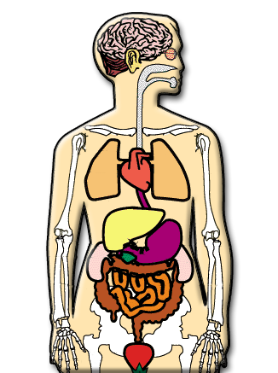
Long-Term Effects of Opioids
Fatal overdose
Collapsed veins (intravenous use)
Infectious diseases
Higher risk of HIV/AIDS and hepatitis
Infection of the heart lining and valves
Pulmonary complications & pneumonia
Respiratory problems
Abscesses
Liver disease
Low birth weight and developmental delay
Constipation
Cellulitis
Source: Galanter, Kleber, & Brady, 2015
Notes:
Read the bullet points on the slide detailing the longer-term effects of opioids.
REFERENCE: Galanter, M., Kleber, H.D., & Brady, K.T. (2015). Textbook of Substance Abuse Treatment, 5th Ed. Arlington, VA: American Psychiatric Publishing.

Slide 65
Opioids: Withdrawal
Withdrawal symptoms:
  Intensity of withdrawal varies with level and chronicity of use
  Cessation of opioids causes a rebound in functions depressed by chronic use
  First signs occur shortly before next scheduled dose
  For short-acting opioids (e.g., heroin), peak of withdrawal occurs 36 to 72 hours after last dose
  Acute symptoms subside over 3 to 7 days
  Ongoing symptoms (PAWS) may linger for weeks or months
Source: Galanter, Kleber, & Brady, 2015
Notes:
Read the bullet points on the slide detailing the withdrawal effects of opioids. Make the point that
the severity of withdrawal symptoms depends on how often and how heavily someone has been
using opioids. On the final bullet point, PAWS stands for “post-acute withdrawal syndrome”, which
can include cravings, exhaustion, and cognitive impairment that does not go away for week or even
months.
Reference: Galanter, M., Kleber, H.D., & Brady, K.T. (2015). Textbook of Substance Abuse Treatment, 5th Ed.
Arlington, VA: American Psychiatric Publishing.

Slide 66
Symptoms of Opioid Withdrawal
Dysphoric mood
Nausea or vomiting
Diarrhea
Tearing or runny nose
Dilated pupils
Muscle aches
Goosebumps
Sweating
Yawning
Fever
Insomnia
Source: Galanter, Kleber, & Brady, 2015
Notes:
Read the bullet list of additional opioid withdrawal symptoms.
Reference: Galanter, M., Kleber, H.D., & Brady, K.T. (2015). Textbook of Substance Abuse Treatment, 5th Ed. Arlington, VA: American Psychiatric Publishing.

Slide 67
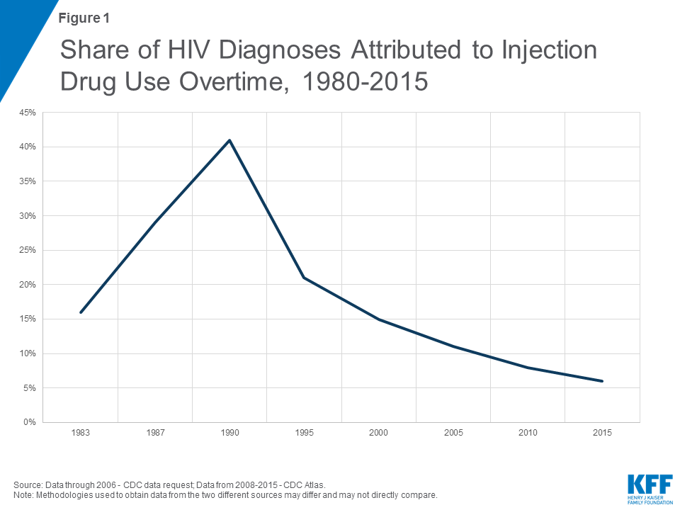
67
Notes:
The overall number of HIV diagnoses attributed to injection drug use has dropped from a high of about 40% in 1990 to about 6% in 2015.
Reference: Kaiser Family Foundation (2018). Share of HIV diagnoses attributed to injection drug use over time, 1980-2015. Retrieved from: https://www.kff.org/hivaids/issue-brief/hiv-and-the-opioid-epidemic-5-key-points/.

Slide 68
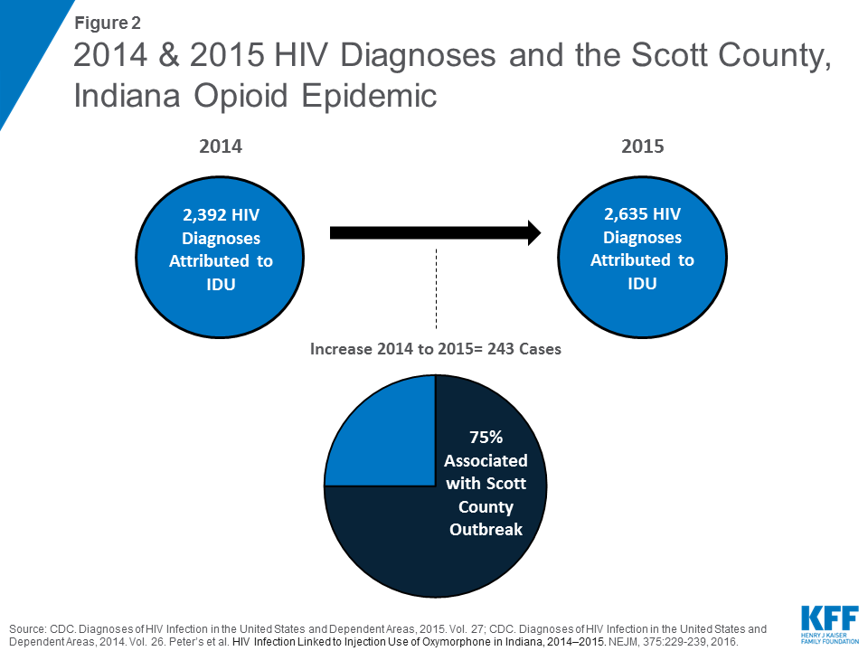
68
Notes:
An increase of 243 cases of HIV diagnoses attributed to injection drug use (an approximately 10% increase) was seen between 2014 and 2015. Seventy-five percent (75%) of these were attributed to one county in Indiana, which has been one of the epicenters of the opioid crisis.
Reference: Kaiser Family Foundation (2018). 2014 & 2015 HIV diagnoses and the Scott County, Indiana opioid epidemic. Retrieved from: https://www.kff.org/hivaids/issue-brief/hiv-and-the-opioid-epidemic-5-key-points/.

Slide 69
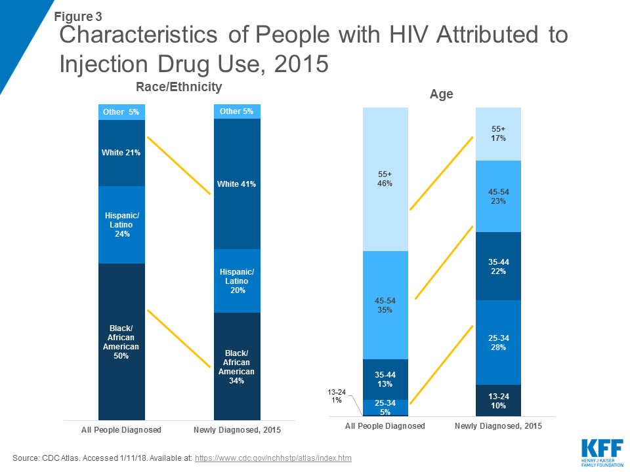
69
Notes:
Fewer of the new IDU-related HIV diagnoses in 2015 were African-American and more were Caucasian-American. This likely reflects the movement of the opioid epidemic into largely White, poor, rural areas. Additionally, new diagnoses in 2015 tended to be much younger than the overall population of IDU-related HIV cases (60% were under the age of 45 vs. 80% 45 and older in the broader population). The increase was especially large among ages 13-24 and ages 25-34.
Reference: Kaiser Family Foundation (2018). Characteristics of people with HIV attributed to injection drug use, 2015. Retrieved from: https://www.kff.org/hivaids/issue-brief/hiv-and-the-opioid-epidemic-5-key-points/.

Slide 70
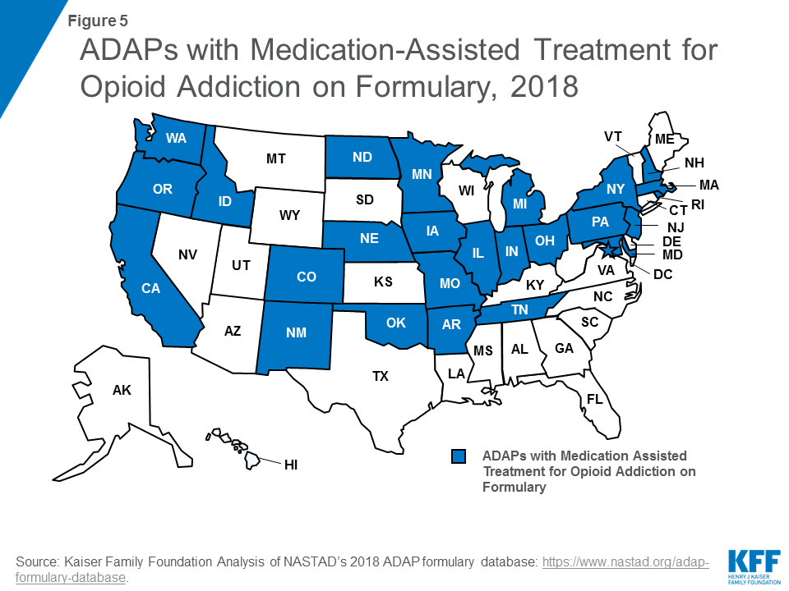
70
Notes:
This is a map showing ADAP (AIDS Drug Assistance Program) programs in states that include medication-assisted treatment (MAT) for opioid addiction on their formulary. California is one of these states. Therefore HIV care recipients on ADAP who have an opioid addiction in CA do have access to MAT.
Reference: Kaiser Family Foundation (2018). Analysis of NASTAD’s 2018 ADAP formulary database. Retrieved from: https://www.kff.org/hivaids/issue-brief/hiv-and-the-opioid-epidemic-5-key-points/.

Slide 71
Why is it Especially Important to Educate Adolescents that Substance Use is Dangerous to Them?
Notes:
This slide and the following slide are transition slides to a small section on the impact of substances on adolescent brain development. The key point is that adolescent brains are still under development and therefore alcohol and other drugs have a greater impact on them than they do on adult brains.

Slide 72

What are the Impact of Substances Specifically on Adolescent
Brain Development?
Notes:
Ask the audience if they have any idea how adolescent brains in particular might be affected by alcohol and other drugs.
Image credit: Fotolia, purchased image, 2018.

Slide 73



Addiction is a Developmental Disease: It Starts Early
67%
26%
First Marijuana Use, (Percent of Initiates)
5.5%
1.5%
<12
12-17
18-25
>25
Source: NIDA
Notes:
Addiction is a developmental disease that usually begins in adolescence. For example, 67% of those who try marijuana for the first time are between the ages of 12 and 17. Prevention efforts are therefore of primary importance—to stop drug abuse before it ever starts.
Reference: National Institute on Drug Abuse. Bringing the Full Power of Science to Bear on Drug Abuse and Addiction. Retrieved from: https://www.drugabuse.gov/sites/default/files/addictionscience.ppt.

Slide 74
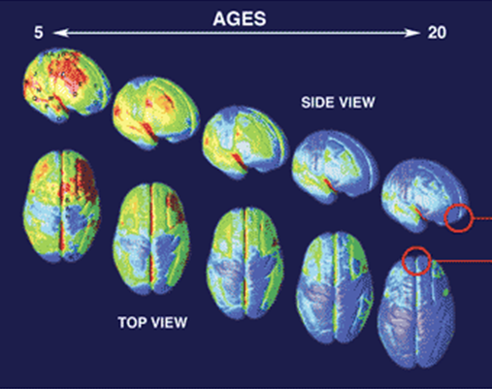
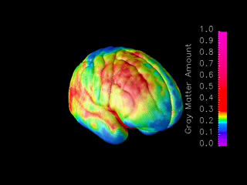
Brain Development
Ages 5-20 years
MRI scans of healthy children and teens compressing
15 years of brain development (ages 5–20).
Red indicates more gray matter, blue less gray matter.
Neural connections are pruned back-to-front.
The prefrontal cortex ("executive" functions), is last to mature.
SOURCE: Gagtay, et al., 2004.
Source:NIDA’s Science of Addiction
http://www.drugabuse.gov/ScienceofAddiction/
Notes:
74
Constructed from MRI scans of healthy children and teens, the time-lapse movie, from which the above images were extracted, compresses 15 years of brain development (ages 5–20) into just a few seconds. Red indicates more gray matter, blue less gray matter. Gray matter wanes in a back-to-front wave as the brain matures and neural connections are pruned. Areas performing more basic functions mature earlier; areas for higher order functions mature later. The prefrontal cortex, which handles reasoning and other "executive" functions, emerged late in evolution and is among the last to mature. Studies in twins are showing that development of such late-maturing areas is less influenced by heredity than areas that mature earlier.
**ANIMATION**
This slide has complex animations and the trainer should practice prior to training. A step-by-step guide is provided below.
The first bullet comes in automatically at the beginning of the slide. Provide the following description:
This slide demonstrates the neural pruning through animations. This is a series of MRI scans from healthy children showing brain development as they age from 5 to 20 years.
Move forward to reveal the next bullet, and present the information:
Red indicates more gray matter and blue indicates less gray matter.
Move forward and a small brain image will briefly appear on the lower right and then a short movie will automatically play full screen showing brain maturation. Once it stops, the small image of the brain will appear again on the lower right of the slide. Move forward to reveal the next bullet:
As you can see, the pruning occurs from the back of the brain toward the front.
Move forward to reveal the last bullet:
This means that the prefrontal cortex (responsible for executive functioning, like decision-making) is the last to mature.
References: National Institute on Drug Abuse. (2007). Drugs Brains, and Behavior: The Science of Addiction (NIH Pub No. 07-5605). Retrieved from: http://www.drugabuse.gov/ScienceofAddiction.
Gogtay, N., Giedd, J.N., Lusk, L., Hayashi, K.M., Greenstein, D., Vaituzis A.C. …. Thompson, P.M. (2004). Dynamic mapping of human cortical development during childhood through early adulthood. Proceedings of the National Academy of Sciences, 101, 8174-8179.
74

Slide 75
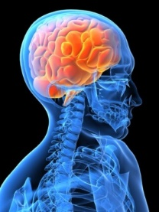

The Interaction between the Developing Nervous System and Drugs of Abuse Leads to:
Difficulty in decision making
Difficulty understanding the
consequences of behavior
Increased vulnerability to memory
and attention problems
This can lead to:
Increased experimentation
Opioid (and other substance) addiction
Source: Fiellin, 2008
Notes:
In reality, the exact impact of substance use on the developing brain is not known. However, when we look at the impact on the adult brain and understand normal development, several things seems true about this interaction, including that it may lead to difficulties in decision making and understanding the consequences of behavior (Fiellin, 2008). Additionally, it may increase the risk of memory and attention problems. These impairments, in turn, may lead to increased experimentation across a variety of behaviors; and increase the risk of addiction to a variety of substances (Fiellin, 2008).
Reference: Fiellin, D.A. (2008). Treatment of adolescent opioid dependence: No quick fix. Journal of the American Medical Association, 300(17), 2057-2059.
Images credit: NIDA Website, https://www.drugabuse.gov/.

Slide 76
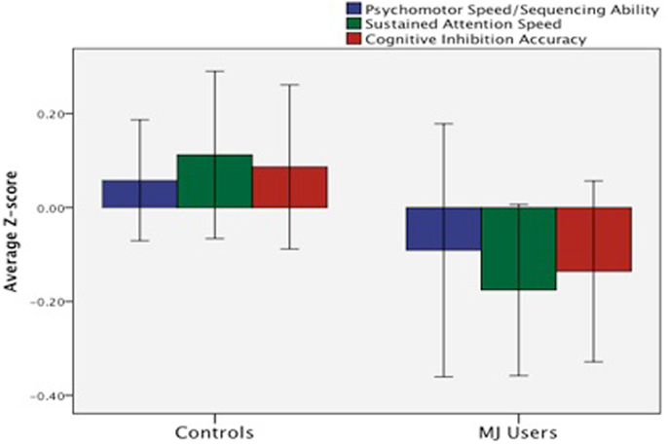
Marijuana and the Adolescent Brain
Human studies suggest early onset (prior to 16-18 yo) associated with more severe cognitive consequences.
  Poorer attention
  (Ehrenriech et al., 1999)
  Executive functioning
  (sustained attention,
  cognitive inhibition,
  abstract reasoning)
  (Fontes et al., 2011)
76
Notes:
Details of several studies are provided on the next two slides. Make the point that beginning marijuana use prior to age 16 seems to result in poorer attention and concentration, and more impaired executive functioning (sustained attention, ability to cognitively inhibit impulses, and abstract reasoning).
Reference: Lisdahl, K.M., Gilbart, E.R., Wright, N.E., & Shollenbarger, S. (2013). Dare to delay? The impacts of adolescent alcohol and marijuana use onset on cognition, brain structure, and function. Frontiers in Psychiatry, 1(4), 53.

Slide 77
Marijuana and the Adolescent Brain
Longitudinal research demonstrates that early onset marijuana use associated with lower IQ
    Drop from childhood “average” to adult “low average”
    Never achieved predicted adult IQ trajectory even with sustained abstinence in adulthood
  Source: Meier et al., 2012
Notes:
People who began using marijuana in their teenage years and then continued to use marijuana for many years lost about 8 IQ points from childhood to adulthood, whereas those who never used marijuana did not lose any IQ points. The amount people smoked also made a difference. Those who smoked the most – at least every day – saw the greatest drop in IQ, the full 8 points. And the younger they were when they started using cannabis, the greater the IQ decline. It wasn’t just IQ. Adults who smoked marijuana as teenagers did worse in tests of memory and decision-making than adults who hadn’t smoked marijuana.
Reference: Meier, M.H., Caspi, A., Ambler, A., Harrington, H., Houts, R., Keefe, R.S., et al. (2012). Persistent cannabis users show neuropsychological decline from childhood to midlife. Proceedings of the National Academy of Sciences, 109(40), E2657-E2664.

Slide 78
Marijuana and the Adolescent Brain
  Overall, studies suggest that regular adolescent MJ use may cause brain structural changes associated with
    poorer cognitive functioning (psychomotor speed, executive functioning, emotional control, and learning & memory)
  This may indicate a large proportion of youth are experiencing cognitive difficulties that may negatively impact their performance, leading to increased school difficulty and reduced grades
  Source: Lisdahl et al., 2013; Medina et al., 2007
Notes:
Additional studies indicate neuropsychological impairment in adolescent marijuana users that may negatively impact school performance, leading to increased school difficulties and reduced grades.
References: Lisdahl, K.M., Gilbart, E.R., Wright, N.E., & Shollenbarger, S. (2013). Dare to delay? The impacts of adolescent alcohol and marijuana use onset on cognition, brain structure, and function. Frontiers in Psychiatry, 1(4), 53.
Medina, K.L., Hanson, K.L., Schweinsburg, A.D., Cohen-Zion, M., Nagel, B.J., & Tapert, S.F. (2007). Neuropsychological functioning in adolescent marijuana users: Subtle deficits detectable after a month of abstinence. Journal of the International Neuropsychological Society, 13(5), 807-820.

Slide 79
A major contributor to the development of substance use disorders: trauma
Notes:
This is a transition slide to a section on childhood trauma and its relationship with substance use disorders.

Slide 80
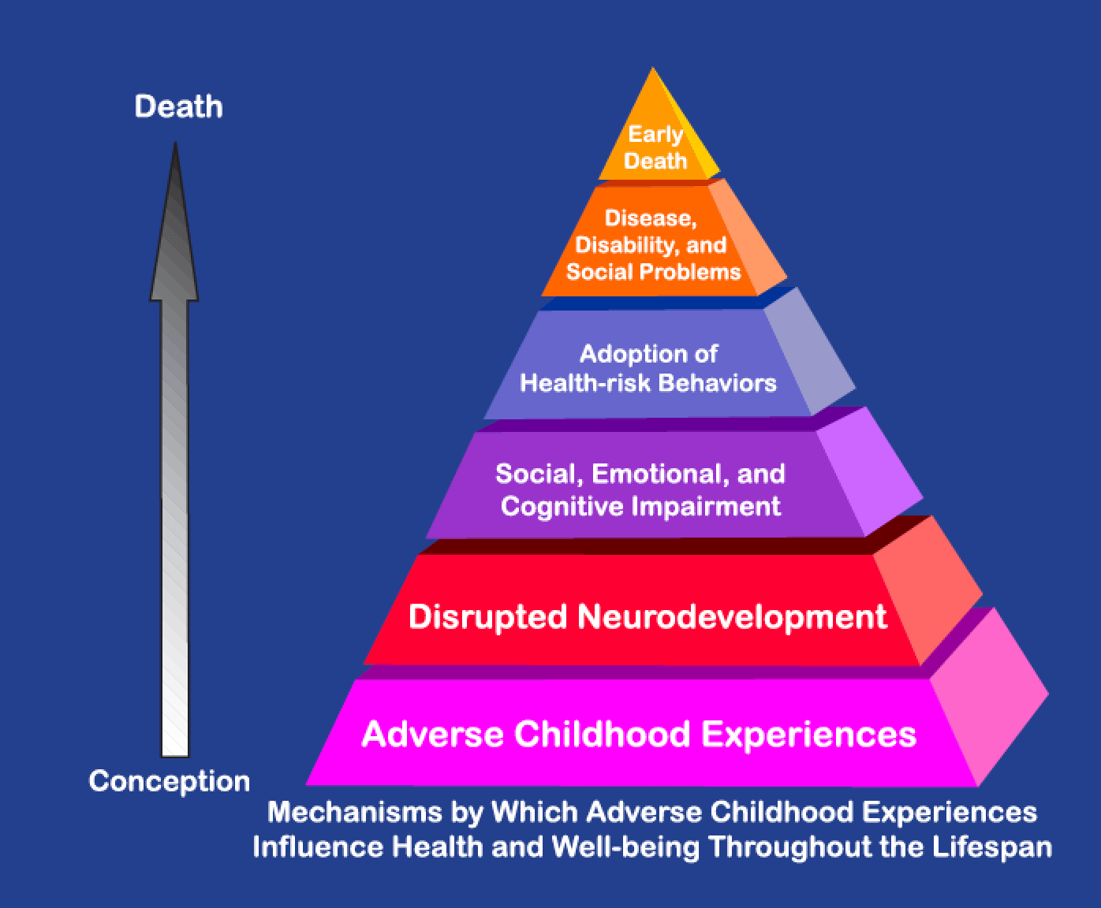
Adverse Childhood Experiences Study (ACE)
Ongoing collaborative research between the CDC and Kaiser Permanente
Over 17,000 Kaiser patients participating in routine health screening volunteered to participate in the study
Data reveal staggering proof of the health, social, and economic
risks that result from
childhood trauma
Source: CDC
Notes:
The ACE Study is ongoing collaborative research between the Centers for Disease Control and Prevention in Atlanta, GA, and Kaiser Permanente in San Diego, CA and represents one of the largest investigations ever conducted to assess associations between childhood maltreatment and later-life health and well-being. The Co-Principal Investigators of the study are Robert F. Anda, MD, MS, with the CDC; and Vincent J. Felitti, MD, with Kaiser Permanente. Over 17,000 Kaiser patients participating in routine health screening volunteered to participate in the study. Data resulting from their participation continues to be analyzed; it reveals staggering proof of the health, social, and economic risks that result from childhood trauma. The CDC provides access to the peer-reviewed publications resulting from The ACE Study (http://www.cdc.gov/violenceprevention/acestudy/). To date, more than 50 scientific articles have been published and more than100 conference and workshop presentations have been made.
The ACE Study findings suggest that certain experiences are major risk factors for the leading causes of illness and death as well as poor quality of life in the United States. It is critical to understand how some of the worst health and social problems in our nation can arise as a consequence of adverse childhood experiences. Realizing these connections is likely to improve efforts towards prevention and recovery.
Additional Information for the Trainer(s)
The ACE Pyramid represents the conceptual framework for the study. During the time period of the 1980s and early 1990s, information about risk factors for disease had been widely researched and merged into public education and prevention programs. It was also clear, however, that risk factors, such as smoking, alcohol abuse, and sexual behaviors for many common diseases were not randomly distributed in the population. In fact, it was known that risk factors for many chronic diseases tended to cluster, that is, persons who had one risk factor tended to have one or more other risk factors too. Because of this knowledge, the ACE Study was designed to assess what we considered to be “scientific gaps” about the origins of risk factors. These gaps are depicted as the two arrows linking Adverse Childhood Experiences to risk factors that lead to the health and social consequences higher up the pyramid. Specifically, the study was designed to provide data that would help answer the question: “If risk factors for disease, disability, and early mortality are not randomly distributed, what influences precede the adoption or development of them?” By providing information to answer this question, we hoped to provide scientific information that would be useful for developing new and more effective prevention programs. The ACE Study takes a whole life perspective, as indicated on the orange arrow leading from conception to death. By working within this framework, the ACE Study began to progressively uncover how adverse childhood experiences (ACE) are strongly related to development and prevalence of risk factors for disease and health and social well-being throughout the lifespan.
Reference: Centers for Disease Control and Prevention, National Center for Injury Prevention and Control, Division of Violence Prevention. The ACE Pyramid. Retrieved from: https://www.cdc.gov/violenceprevention/acestudy/ACE_graphics.html.

Slide 81
The ACE Questionnaire
Verbal or emotional intimidation/abuse
Physical abuse/hitting
Sexual abuse
Emotional neglect/feeling unloved or supported
General neglect, basic needs not met
Parents ever separated or divorced
Witnessed domestic violence or abuse against a caregiver
Household drinker or drug user
Depressed or mentally ill household member
Incarcerated family member
SOURCE: Felitti et al., 1998
Notes:
Read the bullet points, which represent the items on the ACE (Adverse Childhood Experiences) questionnaire.
Reference: Felitti, V.J., Anda, R.F., Nordenberg, D., et al. (1998). Relationship of childhood abuse and household dysfunction to many of the leading causes of death in adults. The Adverse Childhood Experiences (ACE) Study. American Journal of Preventive Medicine, 14(4), 245-258.

Slide 82
Major Findings of the ACE Study
ACEs such as childhood abuse, neglect, and exposure to other traumatic stressors are common
Almost two-thirds of the ACE Study participants reported at least one ACE, and more than one of five reported three or more ACE
The short- and long-term outcomes of these childhood exposures include a multitude of health and social problems
SOURCE: Felitti et al., 1998
Notes:
Childhood abuse, neglect, and exposure to other traumatic stressors which are termed adverse childhood experiences (ACE) are common. Almost two-thirds of ACE study participants reported at least one ACE, and more than one in five reported three or more ACE’s. The short- and long-term outcomes of these childhood exposures include a multitude of health and social problems.
Reference: Felitti, V.J., Anda, R.F., Nordenberg, D., et al. (1998). Relationship of childhood abuse and household dysfunction to many of the leading causes of death in adults. The Adverse Childhood Experiences (ACE) Study. American Journal of Preventive Medicine, 14(4), 245-258.

Slide 83


Results of the ACE Study
Interpersonal abuse
Environmental dysfunction
SOURCE: Felitti et al., 1998
Notes:
Reveal the categories by advancing the slide. On the “interpersonal abuse” side of the chart, make the point that high rates of physical and emotional abuse, and especially sexual abuse, were found in the childhoods of the study participants. Advance the slide. On the “environmental dysfunction” side of the chart, especially high were histories of parents not being present (i.e. child neglect), mental illness, and highest of all (advance the slide a final time) was a history of substance abuse.
Reference: Felitti, V.J., Anda, R.F., Nordenberg, D., et al. (1998). Relationship of childhood abuse and household dysfunction to many of the leading causes of death in adults. The Adverse Childhood Experiences (ACE) Study. American Journal of Preventive Medicine, 14(4), 245-258.

Slide 84



The ACE Study
28% of men and 14% of women report having experienced childhood sexual abuse
66% of people in substance abuse treatment report childhood abuse or neglect
90% of women with alcohol dependence reported childhood sexual abuse or severe physical abuse
SOURCE: Felitti et al., 1998
.
Notes:
Advance the slide once, and the first statistic appears (14% of women and 28% of men reported a history of childhood sexual abuse. Advance the slide again, and the 2nd statistic appears: 66% of people in substance abuse treatment report a history of childhood abuse or neglect. Advance the slide again, and the 3rd statistic appears: 90% of women with alcohol dependence report childhood sexual abuse or severe physical abuse.
REFERENCE: Felitti, V.J., Anda, R.F., Nordenberg, D., et al. (1998). Relationship of childhood abuse and household dysfunction to many of the leading causes of death in adults. The Adverse Childhood Experiences (ACE) Study. American Journal of Preventive Medicine 14(4): 245-258.

Slide 85
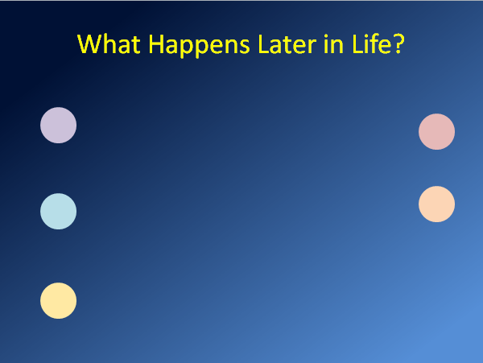
Childhood Experience and Alcoholism
What Happens Later in Life?
Childhood Experiences and COPD
Childhood Experiences and
Suicide Attempt
Childhood Experiences and
IV Drug Use
Childhood Experience and Smoking by Age 14
SOURCE: Felitti et al., 1998
Notes:
This slide presents information that resulted from Felitti and Anda’s initial work on Adverse Childhood Experiences and the connection to later life health impairments/risk behaviors. Click to advance the slide. The circle with title “Smoking by Age 14” will animate into the center.
Set up the slide by saying that you will be discussing different health impacts and the risk of developing those health impacts as a result of early childhood adversities. The first circle that show represents the general risk for someone with zero ACEs. On the next click, the circle that appears represents the increased risk for someone with one Adverse Childhood Experience, click again for two, click again for three, and click again for four. The intent is to show the compounding impact of Adverse Childhood Experiences.
Once you get to the “Four or More” circle, note the increased risk for Smoking by the Age of 14: someone with four or more ACEs is 315% more likely to smoke regularly by the age of fourteen versus someone with zero ACEs.
Click again and the circle will disappear and the next health impact (“COPD”) will animate to the center.
Continue through for the remaining four health impacts:
COPD: 250% greater risk of COPD with four or more ACEs
Alcoholism: 700% more likely with four or more ACEs
Suicide: 1200% more likely to attempt suicide with four or more ACEs
IV drug use: 1350% more likely to use IV drugs with four or more ACEs
Once you’ve gone through the “four or more” for IV drug use, click again for the scale to change. The next overlay adds the risk of IV drug use with 6 or more ACEs: 4600% more likely!
Reference: Felitti, V.J., Anda, R.F., Nordenberg, D., et al. (1998). Relationship of childhood abuse and household dysfunction to many of the leading causes of death in adults. The Adverse Childhood Experiences (ACE) Study. American Journal of Preventive Medicine, 14(4), 245-258.

Slide 86
Summary
Experiences of childhood trauma such as physical, sexual, and emotional abuse, neglect, and mental illness and/or substance use in the family contribute greatly to the development of substance use disorders in adulthood
SOURCE: CDC
Notes:
Summarize the previous five slides by emphasizing that childhood trauma plays a major role in the development of substance use disorders and therefore trauma needs to be addressed in mental health or substance use treatment.
Reference: Centers for Disease Control & Prevention. Adverse Childhood Experiences. Retrieved from: https://www.cdc.gov/violenceprevention/acestudy/index.html.

Slide 87
Break
Notes:
Take a 10-15 minute break at this point.

Slide 88
Why is it important to frame addiction in A chronic disease model?
Notes:
Pose this question to the audience. “Switching gears a bit, why is it important to frame addiction in a chronic disease model?”

Slide 89
Chronic Nature of Addiction
Substance Use Disorders (SUD) are chronic relapsing disorders similar to other chronic diseases such as diabetes, asthma, hypertension, and cardiovascular disease.
Source: NIDA
Notes:
Make the point that addiction, or severe substance use disorders, are a “chronic relapsing condition”, similar to the other listed diseases.
Reference: National Institute on Drug Abuse. Bringing the Full Power of Science to Bear on Drug Abuse and Addiction. Retrieved from: https://www.drugabuse.gov/sites/default/files/addictionscience.ppt.

Slide 90
Why are we Comparing SUD to these Particular Illnesses?
  No Doubt They Are Illnesses
  All Chronic Conditions
  Influenced by Genetic, Metabolic and Behavioral Factors
  No Cures - But Effective Treatments Are Available
Source: NIDA
Notes:
Make the points listed in the bullet points about the chronic diseases listed on the previous slide.
Reference: National Institute on Drug Abuse. Bringing the Full Power of Science to Bear on Drug Abuse and Addiction. Retrieved from: https://www.drugabuse.gov/sites/default/files/addictionscience.ppt.

Slide 91

Relapse Rates Are Similar for
Drug Dependence and
Other Chronic Illnesses
100
90
80
70
60
Percent of Patients Who Relapse
50 to 70%
50 to 70%
50
40
40 to 60%
30
30 to 50%
20
10
0
Hypertension
Asthma
Drug
Dependence
Type I
Diabetes
Source: McLellan et al., 2000
Notes:
Make the point that Type I diabetes, hypertension, and asthma all have “relapse rates” i.e. a lapse in medications, a recurrence of symptoms, in the 30-70% range. This is very similar to the approximately 40-60% relapse rates in substance use disorder treatment. This contradicts what has often been said disparagingly about substance abuse treatment, i.e., that only about half of individuals succeed in treatment, unlike with other diseases.
Reference: McClellan, A.T., Lewis, D.C., O’Brien, C.P., & Kleber, H.D. (2000). Drug dependence, a chronic medical illness: Implications for treatment, insurance, and outcomes evaluation. Journal of the American Medical Association, 284(13),1689-1695.

Slide 92


Treating a Biobehavioral Disorder Must Go Beyond Just Fixing the Chemistry
We Need to Treat the
Whole Person!
Pharmacological Treatments
(Medications)
Behavioral Therapies
Medical Services
Social Services
In Social Context
Source: NIDA
Notes:
Make the point that addiction requires treatment that addresses its complexity. Addiction brain chemistry needs to address the whole person. “Fixing it” can include medications, behavioral therapies, and ancillary support services.
Reference: National Institute on Drug Abuse. Bringing the Full Power of Science to Bear on Drug Abuse and Addiction. Retrieved from: https://www.drugabuse.gov/sites/default/files/addictionscience.ppt.

Slide 93
Four Legs of Addiction
Think of this concept as a chair, with each leg representing a component of a patient’s treatment plan.
Psychological
Biological
Spiritual
Social
All four legs are required to “support” the patient, and if one leg is missing, the chair will be unstable and unable to accomplish its goal.
Source: NIDA
Notes:
Alcohol and drug addiction is affected by many factors, including development, physiology, genetics, social influence, personality, coping discrepancies, spiritual values, reinforcement, conditioning, abuse, self-regulated use, and dependence. All of these factors point to initial use, and can be linked to one or more other factors. A person’s treatment plan should be holistic in nature and address the multiple needs and aspects of the individual, such as sexual orientation, gender differences, homelessness, family dynamics, children/prenatal care, legal issues, disabilities, employment issues, developmental needs, co-occurring disorders, and cultural, racial/ethnic, and religious norms.
Reference: National Institute on Drug Abuse. Bringing the Full Power of Science to Bear on Drug Abuse and Addiction. Retrieved from: https://www.drugabuse.gov/sites/default/files/addictionscience.ppt.

Slide 94
Full recovery is a challenge but it is possible …
Notes:
The point to make here is that people do recover from substance abuse and addiction. Research bears this out.
Reference: National Institute on Drug Abuse. Bringing the full power of science to bear on drug abuse and addiction. Retrieved from: https://www.drugabuse.gov/sites/default/files/addictionscience.ppt.

Slide 95
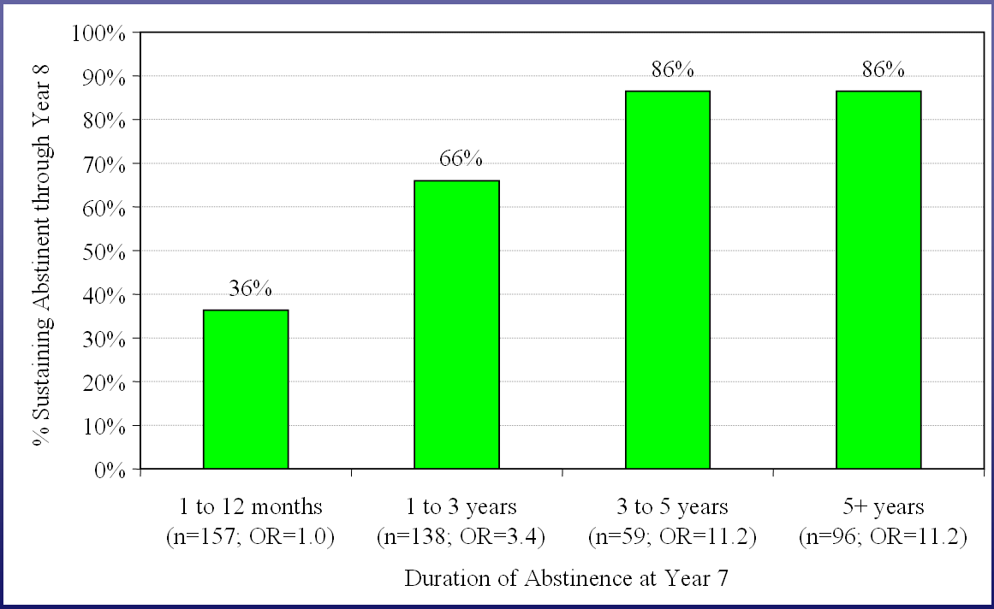
Extended Abstinence is Predictive of Sustained Recovery
After 5 years – if you are abstinent, you probably will stay that way.
It takes a year of abstinence before less than half relapse
SOURCE: Dennis et al, 2007
Notes:
Extended abstinence is predictive of sustained recovery. The odds of remaining abstinent rise if patients have been abstinent for 1 to 3 years. After 3 years, the recovery odds remain high and stable. Therefore, as with other chronic diseases, addiction requires an ongoing and active disease management strategy.
**ANIMATION**
Click to advance the slide once and the graphic appears “It takes a year of abstinence before less than half relapse.” Click again and the graphic “After 5 years – if you are abstinent, you probably will stay that way.” Make the point that by 3-5 years of abstinence, only 14% relapse.
Reference: Dennis, M.L., Foss, M.A., & Scott, C.K. (2007). An eight-year perspective on the relationship between the duration of abstinence and other aspects of recovery. Evaluation Review, 31(6), 585-612.

Slide 96
Lessons from Chronic Illness
Medications relieve symptoms, but…behavioral change is necessary for sustained benefit.
For instance, naltrexone can help with alcohol or opioid use, but learning to recognize and avoid triggering people, places, and events is also necessary.
Source: SAMHSA, 2018
Notes:
Just like with chronic diseases, addiction medications can relieve symptoms (ex: high blood pressure medications) but people need to make behavioral changes (i.e. diet, exercise) for sustained benefit.
Reference: Substance Abuse and Mental Health Services Administration. (2018). Treatment Improvement Protocol 63: Medications for Opioid Use Disorder.

Slide 97
Lessons from Chronic Illness
  2. Treatment effects usually don’t last very long after treatment stops.
  For example, if you stop taking blood pressure medication, hypertension returns. If substance use is treated as an acute problem with short-term treatment, the treatment effects also tend to wane.
Source: SAMHSA, 2018
Notes:
Again, just like with medications for other chronic diseases, the effects of treatment don’t usually last long after treatment stops (i.e. high blood pressure, high cholesterol, diabetes).
Reference: Substance Abuse and Mental Health Services Administration. (2018). Treatment Improvement Protocol 63: Medications for Opioid Use Disorder.

Slide 98
Lessons from Chronic Illness
  3. Some form of monitoring, support and ongoing treatment is needed.
  This could include support groups, individual therapy, urine testing, or self-help groups such as AA/NA
Source: SAMHSA, 2018
Notes:
Again, just like with hypertension, diabetes, and asthma, you don’t just treat it once and then forget about it. You need ongoing monitoring and treatment.
Reference: Substance Abuse and Mental Health Services Administration. (2018). Treatment Improvement Protocol 63: Medications for Opioid Use Disorder.

Slide 99
Lessons from Chronic Care
Patient retention is critical – the longer they stay in treatment, the better the outcomes
Make treatment attractive, perhaps culturally-specific
Offer options/alternatives i.e. residential, outpatient, group, individual, etc.
Increase monitoring/management – urine drug screening is experienced as beneficial for some people
Source: SAMHSA, 2018
Notes:
Make the points listed in the bullet points.

Slide 100
Summary
Drugs affect the brain in ways that are long term, but reversible.
These brain changes profoundly influence cognition, emotions and behavior.
There are multiple forms of treatment that can be effective in treating addicted individuals.
Addiction and many psychiatric illnesses are chronic illnesses and like other chronic disorders, require ongoing treatment and support.
Notes:
This slide summarizes the points that have been made on the previous 11 slides.

Slide 101
Neurochemical impact of hiv
Notes:
This begins a new section on some of the impacts of HIV on the brain and central nervous system.

Slide 102
HIV and the Brain
HIV enters the brain soon after acute infection by migrating across the blood-brain barrier
It appears to produce a reservoir of virus that is able to replicate in the central nervous system (CNS), and can rebound if combination antiretroviral therapy (cART) is interrupted
Source: Joseph et al., 2015; Gianella et al., 2016
Notes:
Make the points that: HIV crosses the blood-brain barrier soon after acute infection; it appears to produce a reservoir in the central nervous system that can replicate and that can rebound if antiretroviral treatment is interrupted.
References: Joseph., S., Arrildt K., Sturdevant C., & Swanstrom., R. (2015). HIV-1 target cells in the CNS. Journal of Neurovirology, 21, 276-289.
Gianella, S., Kosakovsky-Pond, S., Oliveira, M., Scheffler, K., Strain, M.C.,…Ellis, R.J. (2016). Compartmentalized HIV rebound in the central nervous system after interruption of antiretroviral therapy. Virus Evolution, 2(2), vew020.

Slide 103
HIV and the Brain
Almost half of HIV-seropositive individuals have some degree of neurocognitive impairment (NCI), classified as HIV-associated dementia (HAD), HIV-associated neurocognitive disorders (HAND), or asymptomatic neurocognitive impairment (ANI)
Asymptomatic neurocognitive impairment can be identified by neuropsychological testing even though there may not be any noticeable functional impairment
Source: Heaton et al., 2010
Notes:
Almost half of HIV-positive individuals will have some degree of neurocognitive impairment. These are classified as HIV-Associated Dementia (HAD), HIV-Associated Neurocognitive Disorders (HAND), or Asymptomatic Neurocognitive Impairment (ANI). Explain that asymptomatic neurocognitive impairment can be detected by neuropsychological testing even if there is no noticeable daily functional impairment, and tends to progress to HAND.
Reference:
Heaton, R., Clifford, D., Franklin, D., Woods, S., Ake, C., Vaida, F.,…CHARTER Group. (2010). HIV-associated neurocognitive disorders persist in the era of potent antiretroviral therapy: CHARTER Study. Neurology, 75, 2087-2096.

Slide 104
HIV and the Brain
This proportion (of neurocognitive impairment) has not changed since the initiation of cART; however, cART has significantly reduced the proportion of HIV-associated dementia, with Asymptomatic Neurocognitive Impairment now accounting for most cases of neurocognitive impairment
Source: Heaton et al., 2010; McArthur et al., 2010
Notes:
Make the point that while the proportion of PLWH experiencing some degree of cognitive impairment has not changed since the initiation of combination antiretroviral treatment, the proportion of HIV-associated dementia has decreased significantly, and asymptomatic neurocognitive impairment now accounts for most of the total neurocognitive impairment (in other words, this is a significant improvement).
References: Heaton, R., Clifford, D., Franklin, D., Woods, S., Ake, C., Vaida, F.,…CHARTER Group. (2010). HIV-associated neurocognitive disorders persist in the era of potent antiretroviral therapy: CHARTER Study. Neurology, 75, 2087-2096.
McArthur, J., Steiner, J., Sacktor, N., & Nath, A. (2010). Human immunodeficiency virus-associated neurocognitive disorders: mind the gap. Annals of Neurology, 67, 699-714.

Slide 105
HIV and the Brain
Early initiation of cART rapidly reduces HIV burden in cerebrospinal fluid (i.e. viral replication in the brain) just as it does in plasma
However, reduction or control of HIV replication in the brain by cART does not seem to eliminate the milder forms of NCI
This may be due to various factors such as ongoing low-grade viral replication and inflammation in the CNS or cumulative exposure and possible toxicity of antiretroviral medications
Source: Ene, 2018
Notes:
A very recent study has shown that beginning antiretroviral treatment soon after infection reduces virus in cerebrospinal fluid (and therefore in the brain) just as it does in blood plasma, but that doesn’t seem to eliminate milder forms of neurocognitive impairment. This may be due to ongoing low-grade viral replication and/or inflammation in the central nervous system. It may also be due to the cumulative exposure to and possible long-term toxicity of antiretroviral medications themselves.
Reference: Ene, L. (2018). Human immunodeficiency virus in the brain – culprit or facilitator? Infectious Diseases: Research and Treatment, 11, 1-9.

Slide 106
HIV and the Brain
Immune activation of the CNS occurs with acute infection, then escalates, then decreases but is not entirely managed with cART
Persistent inflammation and immune activation seems to be one of the causes of neurocognitive impairment
Source: Dahl et al., 2014; Ene, 2018
Notes:
Activation of the central nervous system part of the immune system escalates after acute infection, then decreases with antiretroviral treatment. However, it is not completely suppressed. That persistent immune activation and inflammation appears to be one of the causes of neurocognitive impairment.
References: Dahl. V., Peterson, J., Fuchs, D., Gisslen, M., Palmer, S., & Price, R. (2014). Low levels of HIV-1 RNA detected in the cerebrospinal fluid after up to 10 years of suppressive therapy are associated with local immune activation. AIDS, 28, 2251-2258.
Ene, L. (2018). Human immunodeficiency virus in the brain – culprit or facilitator? Infectious Diseases: Research and Treatment, 11, 1-9.

Slide 107
HIV and the Brain
“Cerebrospinal fluid HIV escape” is the term used to describe instances when HIV is detected in the CSF of patients stabilized on cART when the plasma viral load has been suppressed below detectable levels
The persistence of detectable viral load in the CSF has been associated with increased risk for depression
Source: Hammond et al., 2016
Notes:
HIV virus is sometimes detected in the cerebrospinal fluid (and thus the brain) even when patients are stabilized on antiretroviral treatment and have an undetectable plasma viral load. This persistence of virus in the brain is associated with increased risk for depression.
Reference: Hammond, E., Crum, R., Treisman, G., Mehta S., Clifford D., Ellis R.,...CHARTER Group. (2016). Persistent CSF but not plasma HIV RNA is associated with increased risk of new-onset moderate-to-severe depressive symptoms; a prospective cohort study. Journal of Neurovirology, 22, 479-487.

Slide 108
HIV and the Brain
Because HIV CSF escape demonstrates the ability of HIV to independently evolve in the central nervous system despite cART, it will be important for new medication development to focus on targeting the reservoir of virus in the CNS
Source: Joseph et al., 2016
Notes:
“HIV cerebrospinal fluid escape” demonstrates the ability of the virus to independently exist in the central nervous system despite antiretroviral treatment. It will thus be important for new medication development to target that reservoir of virus in the CNS.
Reference: Joseph, J., Cinque, P., Colosi, D., Dravid, A., Ene, L., Fox, H., …Spudich, S. (2016) Highlights of the Global HIV-1 CSF Escape Consortium Meeting. Journal of Virus Eradication, 2(4), 243-250.

Slide 109
HIV and the Brain
HIV-1 TAT protein expression is associated with anhedonia and increased sensitivity to methamphetamine-induced brain reward function in mice
The TAT protein is associated with viral replication
This suggests that HIV itself contributes to co-occurring depression in PLWH, even in those with adequate viral suppression
It also suggests that PLWH are more susceptible to methamphetamine dependence than non-PLWH
Source: Kesby, Markou, & Semenova; 2016
Notes:
The HIV-1 TAT protein is one of the primary proteins involved in viral replication. From studies in mice, it appears that expression of that protein is associated with depression symptoms (anhedonia) and increased sensitivity to methamphetamine effects in the brain. This suggests that even individuals with an undetectable viral load may be vulnerable to depression. It also suggests that PLWH are more vulnerable to developing dependence on methamphetamine than non-PLWH.
Reference: Kesby, J., Markou, A., & Semenova, S. (2016). The effects of HIV-1 regulatory TAT protein expression on brain reward function, response to psychostimulants, and delay-dependent memory in mice. Neuropharmacology, 109, 205-215.

Slide 110
HIV and the Brain
Despite effective cART, PLWH have lower gray matter volume, widespread white matter abnormalities, and persistent systemic immune activation
Findings suggest these are the lingering effects of untreated HIV infection rather than ongoing injury, i.e. the damage occurred prior to the beginning of antiretroviral treatment – emphasizes the importance of getting people on meds early
Source: van Zoest et al., 2018
Notes:
Despite being on antiretroviral medications, PLWH still show various kinds of brain damage and systemic immune activation. However, the findings suggest that these are the lingering effects of HIV before it was treated, rather than while on antiretroviral treatment. This damage to brain tissue may not manifest in any sort of observable way to the individual. It also emphasizes the importance of starting medications as soon as possible after infection.
Reference: Van Zoest, R., Underwood, J., De Francesco, D., Sabin, C., Cole, J., Wit, F.,…COBRA Collaboration. (2018). Structural brain abnormalities in successfully treated HIV infection: associations with disease and cerebrospinal fluid biomarkers. Journal of Infectious Diseases, 217, 69-81.

Slide 111
Summary of HIV & the Brain
Even with an undetectable plasma viral load, HIV can still be impacting the brain in ways that increase susceptibility to depression and addiction.
Source: Kesby, Markou, & Semenova; 2016
Notes:
Summarize this section by emphasizing that even with an undetectable viral load, HIV can still be impacting the brain in ways that increase susceptibility to depression and substance dependence.
Reference: Kesby, J., Markou, A., & Semenova, S. (2016). The effects of HIV-1 regulatory TAT protein expression on brain reward function, response to psychostimulants, and delay-dependent memory in mice. Neuropharmacology, 109, 205-215.

Slide 112
HIV and substance use
Notes:
Having discussed HIV and the brain, this slide is a transition to a section on HIV and substance use, particularly methamphetamine. Methamphetamine is the drug on which most of the research with HIV has been conducted.

Slide 113
HIV and Substance Use
In a recent review of HIV care enrollees (N=10,652) in 7 sites across the U.S., an average of 48% met criteria for a substance use disorder (range 21-71%)
Age (younger) and gender (male) predicted greater substance use
Approximately 20% met criteria for a substance use disorder for multiple substances
Source: Hartzler et al., 2017
Notes:
Make the point that in a recent study looking at over 10,000 people in HIV care nationally, almost half of them met criteria for a substance use disorder. Younger age and male gender predicted having a substance use disorder. Approximately 20% met criteria for a SUD for multiple substances.
Reference: Hartzler, B., Dombrowski, J.C., Crane, H.M., Eron, J.J., Geng, E.H., Mathews, W.C.,…Donovan, D.M. (2017). Prevalence and predictors of substance use disorders among HIV care enrollees in the United States. AIDS & Behavior, 21(4), 1138-1148.

Slide 114
Substance Use Among
HIV Care Recipients
Source: Hartzler et al., 2017
Notes:
In the study mentioned on the previous slide, marijuana was the most frequently used substance, followed by alcohol, methamphetamine, cocaine, and non-prescription opioids. Make the point that if prescription opioids had been included, the opioids number might well have been higher.
Reference: Hartzler, B., Dombrowski, J.C., Crane, H.M., Eron, J.J., Geng, E.H., Mathews, W.C.,…Donovan, D.M. (2017). Prevalence and predictors of substance use disorders among HIV care enrollees in the United States. AIDS & Behavior, 21(4), 1138-1148.

Slide 115
Substance Use by Race/Ethnicity
Source: Hartzler et al., 2017
Notes:
In this same study, significantly fewer African-Americans met criteria for a substance use disorder than Caucasians or Hispanics.
Reference: Hartzler, B., Dombrowski, J.C., Crane, H.M., Eron, J.J., Geng, E.H., Mathews, W.C.,…Donovan, D.M. (2017). Prevalence and predictors of substance use disorders among HIV care enrollees in the United States. AIDS & Behavior, 21(4), 1138-1148.

Slide 116
SUD and HIV Risk
Substance Use Disorders among HIV-seropositive individuals increase risk of HIV transmission due to:
  Sharing of syringes
  Intoxicated involvement in unprotected sex
  Sexual violence and victimization
  Unaware of HIV status
  Unsuppressed viral load
Source: Hartzler et al., 2017
Notes:
Make the point that substance use disorders among PLWH increase risk of HIV transmission due to the listed factors. So not only is HIV a risk factor for substance use, substance use is a risk factor for HIV transmission.
Reference: Hartzler, B., Dombrowski, J.C., Crane, H.M., Eron, J.J., Geng, E.H., Mathews, W.C.,…Donovan, D.M. (2017). Prevalence and Predictors of Substance Use Disorders Among HIV Care Enrollees in the United States. AIDS & Behavior 21(4): 1138-1148.

Slide 117
Methamphetamine and Its Impact on
HIV Infection and Disease Progression
Methamphetamine use:
  Lowers sexual inhibitions, impairs judgment, and provides energy and confidence to engage in sexual activity for long periods of time
  Causes erectile dysfunction
  Causes mucosal dryness
  Decreases adherence to HIV treatment and medical follow-up
  Increases HIV replication
  Accelerates progress of HIV-related dementia
SOURCE: Yeon & Albrech, 2007
Notes:
The connection between crystal meth use and HIV transmission has been well established by researchers. Individuals who use methamphetamine are more likely to become infected with HIV and transmit the virus to others. Studies have also documented more substantial brain damage and cognitive impairment in people who use meth and are infected with HIV, as compared to people living with HIV who do not use meth.
Reference: Yeon, P.A., & Albrecht, H. (2007). Crystal meth and HIV/AIDS: The perfect storm? NEJM Journal Watch, December 3, 2007.

Slide 118
Methamphetamine Use May Accelerate
HIV Reproduction
In test tube studies, when methamphetamine is added to immune cells, it significantly increases HIV replication
  Particularly in CD4 cells and monocytes (white blood cells)
In mouse models, methamphetamine activated a portion of the HIV genetic code (long terminal repeat – LPR), prompting cells to release a protein tied to more rapid HIV disease progression
SOURCE: Toussi et al., 2009
Notes:
According to a paper published by Toussi and colleagues in 2009, methamphetamine speeds up HIV replication in both test tube and animal studies. This slide details the key findings from the test tube studies and mouse model studies.
Reference: Toussi, S.S., Joseph, A., Zheng, J.H., Dutta, M., Santambrogio, L., & Goldstein, H. (2009). Short communication: Methamphetamine treatment increases in vitro and in vivo HIV replication. AIDS Research and Human Retroviruses, 25(17), 1117-1121.

Slide 119
The Effect of Methamphetamine on the Brain of a Person Living with HIV
HIV and meth are thought to have synergistic cognitive and neurological impacts
In the presence of HIV, methamphetamine can cause:
  Even greater dopamine release and cellular damage
  Additive damage to the frontal cortex and basal ganglia, which can cause:
    Difficulty in adhering to antiretroviral regimen
    Deficits in attention/working memory, abstract decision-making, and processing speed
SOURCE: Cherner, 2013.
Notes:
Cherner published an article in the APA Psychology and AIDS Exchange Newsletter in 2013 about the effects of methamphetamine on the brain of a person infected with HIV. This slide details the key findings.
Reference: Cherner, M. (2013). The HIV+ brain on drugs: Focus on methamphetamine. American Psychological Association, Psychology and AIDS Exchange Newsletter.

Slide 120
Functional Deficits due to HIV and Methamphetamine Use
What is the burden that methamphetamine use and HIV disease impose on an individual’s daily functioning?
UCSD researchers assessed and found impairment in daily functioning in four key areas:
  Everyday cognitive symptoms (memory, communication, intellectual performance)
  Basic activities of daily living (housekeeping, home repairs, bathing, dressing)
  Instrumental (skilled) activities of daily living (medication and financial management, grocery shopping, planning social activities)
  Employment
SOURCE: Blackstone et al., 2013.
Notes:
Blackstone and colleagues from the University of California, San Diego Translational Methamphetamine AIDS Research Center conducted a study to assess daily functioning among nearly 800 individuals who are HIV positive and use methamphetamine. They found impairment in daily functioning in four key areas – everyday cognitive symptoms, instrumental (skilled) activities of daily living, basic activities of daily living, and employment.
Reference: Blackstone, K., Iudicello, J.E., Morgan, E.E., Weber, E., Moore, D.J., Franklin, D.R.,…TMARC Group. (2013). HIV infection heightens concurrent risk of functional dependence in persons with chronic methamphetamine use. Journal of Addiction Medicine, 7(4), 255-263.

Slide 121
Methamphetamine and HIV
Combined HIV infection and methamphetamine use increase the likelihood of neural injury in the central nervous system
History of childhood abuse predicts depression, risky sexual behavior, and methamphetamine use in MSM
Source: Soontornniymokij et al., 2016; Lopez-Patton et al, 2016.
Notes:
More recent findings indicate that the combination of HIV and methamphetamine increases the likelihood of damage to the central nervous system. Among men who have sex with men (MSM), a history of childhood abuse predicts depression, risky sexual behavior, and methamphetamine use.
References: Soontornniyomkij, V., Kesby, J.P., Morgan, E.E., Bischoff-Grethe, A., Minassian, A., Brown, G.G., Grant, I., & Translational Methamphetamine AIDS Research Group. (2016). Effects of HIV and methamphetamine on brain and behavior: Evidence from human studies and animal models. Journal of Neuroimmune Pharmacology, 11(3), 495-510.
Lopez-Patton, M., Kumar, M., Jones, D., Fonseca, M., Kumar, A.M., & Nemeroff, C.B. (2016). Childhood trauma and meth abuse among men who have sex with men: Implications for intervention. Journal of Psychiatry Research, 72, 1-5.

Slide 122
Summary
Substance use is a risk factor for HIV
Substance use is common among PLWH
Substance use and HIV have additive, negative effects on the brain and on daily functioning
Notes:
This is a summary slide for the past 9 slides.

Slide 123
Additional risk factors for substance use disorders
Intersectionality: how multiple stigmatized identities contribute to substance use risk
Notes:
This is a transition slide to the intersectionality section of the training.

Slide 124
Intersectionality
Intersectionality: “A theoretical framework for understanding how multiple social identities such as race, gender, sexual orientation, SES, and disability intersect at the micro level of individual experience to reflect interlocking systems of privilege and oppression (i.e. racism, sexism, heterosexism, classism) at the macro social-structural level.”
Source: Bowleg, 2012
Notes:
Explain the concept of intersectionality as defined in the quote.
Reference: Bowleg, L. (2012). The problem with the phrase Women and Minorities: Intersectionality – an important theoretical framework for public health. American Journal of Public Health, 102(7), 1267-1273.

Slide 125
Intersectionality
“Acknowledging the existence of multiple intersecting identities is an initial step in understanding the complexities of health disparities from multiple historically oppressed groups”
Source: Bowleg, 2012
Notes:
Explain the concept of intersectionality. Make the point that we’re talking about health disparities among historically oppressed groups and some of the factors that drive them.
Reference: Bowleg, L. (2012). The problem with the phrase Women and Minorities: Intersectionality – an important theoretical framework for public health. American Journal of Public Health, 102(7), 1267-1273.

Slide 126
Intersectionality
Originally developed by African-American critical thinkers and activists as a way to “conceptualize multiple disadvantages experienced by Black women that could not be captured by approaches that treated race and gender as distinct entities”
Source: Gkiouleka, Huijts, Beckfield, & Bambra, 2018
Notes:
This slide explains the historical origin of intersectionality. Make the point that treating race and gender as two distinct entities isn’t adequate enough to explain the health disparities experienced by Black women.
Reference: Gkiouleka, A., Huijts, T., Beckfield, J., & Bambra, C. (2018). Understanding the micro and macro politics of health: inequalities, intersectionality, and institutions – a research agenda. Social Science & Medicine, 200, 92-98.

Slide 127
Intersectionality
May include qualities like immigration status, HIV status, or substance user.
Posits that the combination of multiple disadvantaged statuses has an interactive effect on health greater than the additive effect of that combination, i.e. adding effects of 2 individual qualities
Source: Gkiouleka, Huijts, Beckfield, & Bambra, 2018
Notes:
Make the point that intersectionality includes more than race or gender, like immigration status, HIV status, or substance user, and the point that the combination of multiple disadvantaged statuses has an interactive effect on health that is greater than the additive effect of that combination.
Reference: Gkiouleka, A., Huijts, T., Beckfield, J., & Bambra, C. (2018). Understanding the micro and macro politics of health: Inequalities, intersectionality, and institutions – a research agenda. Social Science & Medicine, 200, 92-98.

Slide 128
Intersectionality
Internalized substance use stigma is associated with poor outcomes including worse mental health and less engagement in substance use treatment services
Internalized substance use stigma and internalized HIV stigma combined have a greater association with depression symptoms than either type of stigma alone
Sources: Luoma et al., 2007; Earnshaw et al., 2015
Notes:
Individuals with internalized substance use stigma have worse mental health and less engagement in substance abuse treatment. In addition, internalized substance use stigma and internalized HIV stigma have an additive effect on depression symptoms, i.e. those with both types of internalized stigma have a greater likelihood of depression than those with one type of stigma.
References: Luoma, J.B., Twohig, M.P., Waltz, T., Hayes, S.C., Roget, N., Padilla, M., & Fisher, G. (2007). An investigation of stigma in individuals receiving treatment for substance abuse. Addictive Behavior, 32(7), 1331-1346.
Earnshaw, V.A., Smith, L.R., Cunningham, C.O., & Copenhaver, M.M. (2015). Intersectionality of internalized HIV stigma and internalized substance use stigma: Implications for depressive symptoms. Journal of Health Psychology, 20(8), 1083-1089.

Slide 129
Intersectionality
Black & Latina sexual minority women are 4 times more likely to have substance use problems than heterosexual women of color and twice as likely as White sexual minority women, highlighting the importance of taking into consideration multiple intersecting social identities.
Source: Mereish & Bradford, 2014
Notes:
It is important when working with clients/patients to take into consideration the effects of multiple intersecting stigmatized identities, such as Black and Latina sexual minority women.
Reference: Mereish, E. & Bradford, J. (2014). Intersecting identities and substance use problems: sexual orientation, gender, race, and lifetime substance use problems. Journal of Studies on Alcohol and Drugs, 75, 179-188.

Slide 130
Intersectionality
Example: Black MSM PLWH may be stigmatized in White communities due to their race, in Black communities due to their sexual orientation, and in Black and gay communities due to their serostatus
Source: Bluthenthal et al., 2012
Notes:
A good example of how multiple stigmatized identities interact is with African-American men who have sex with men living with HIV. They may be stigmatized in White communities due to their race, in Black communities due to their sexual orientation, and in both Black and gay communities due to their HIV serostatus.
Reference: Bluthenthal, R.N., Palar, K., Mendel, P., Kanouse, D.E., Corbin, D.E., & Derose, K.P. (2012). Attitudes and beliefs related to HIV/AIDS in urban religious congregations: Barriers and opportunities for HIV-related interventions. Social Science & Medicine, 74(10), 1520-1527.

Slide 131
Source: Lacombe-Duncan, 2016
Notes:
Make the point that the chart shows the intersecting systems of oppression of Black transgender women living with HIV that reduce access to healthcare, including HIV-related stigma, transphobia, sexism, racism, and substance use stigma.
Reference: Lacombe-Duncan, A. (2016). An intersectional perspective on access to HIV-related healthcare for transgender women. Transgender Health, 1(1), 137-141.

Slide 132
Stigma Exercise
Think about a time in your life when you felt lonely or rejected for being seen as different from others.
This does not need to be an example of stigma toward people living with HIV or other marginalized groups; it could be any form of stigmatization for being seen as different in some way from the majority.
Source: Kidd, Stockton, & Nyblade, 2015
Notes:
Read the instructions on the slide, then give the participants a minute or two to think of an experience.
Reference: Kidd R., S. Clay, M. Stockton, L. Nyblade. (2015). Facilitator’s Training Guide For A Stigma-Free Health Facility. Washington, DC: Futures Group, Health Policy Project.

Slide 133
Stigma Exercise
Share your experience with someone around you and answer these questions:
How did the stigmatizing experience make you feel?
How did it affect your life?
Source: Kidd, Stockton, & Nyblade, 2015
Notes:
Debrief with the whole group, ask for volunteers to share their experience.
At the end, summarize what the volunteers have shared and add: “this experience helps us get an inside understanding of how it feels to be stigmatized, i.e. shamed and/or rejected. It helps put us in the shoes of PLWH or other marginalized groups.
Reference: Kidd R., S. Clay, M. Stockton, L. Nyblade. (2015). Facilitator’s Training Guide For A Stigma-Free Health Facility. Washington, DC: Futures Group, Health Policy Project.

Slide 134
HIV Stigma
HIV-related stigma has been a significant barrier to HIV prevention and treatment efforts
Attention to stigma has steadily increased over the course of the epidemic, but it continues to be a substantial barrier more than 30 years after the start of the epidemic
Source: Earnshaw & Chaudoir, 2009
Notes:
Make the point that HIV-related stigma has been a significant barrier to HIV prevention and treatment efforts since the beginning of the epidemic. Even though progress has been made over the last 30 years, it continues to be a significant barrier.
REFERENCE: Earnshaw, V.A. & Chaudoir, S.R. (2009). From conceptualizing to measuring HIV stigma: a review of HIV stigma mechanism measures. AIDS & Behavior, 13(6), 1160-1177.

Slide 135
HIV Stigma
3 important stigma mechanisms:
  Enacted stigma: degree to which PLWH believe they have actually experienced prejudice and discrimination
  Anticipated stigma: degree to which PLWH expect they will experience prejudice and discrimination
  Internalized stigma: degree to which PLWH endorse/believe society’s negative beliefs and feelings about HIV
Source: Earnshaw & Chaudoir, 2009
Notes:
Explain the 3 stigma mechanisms: enacted stigma, anticipated stigma, and internalized stigma.
Reference: Earnshaw, V.A. & Chaudoir, S.R. (2009). From conceptualizing to measuring HIV stigma: a review of HIV stigma mechanism measures. AIDS & Behavior, 13(6), 1160-1177.

Slide 136
HIV Stigma
Why is the intersectionality of stigma important?
Because it leads to worse health outcomes, for example:
  People who experience a high degree of anticipated stigma may be less likely to disclose their HIV status because they fear they will be socially rejected
Source: Earnshaw & Chaudoir, 2009
Notes:
Pose the question to the audience and then read the 2nd bullet point.
Reference: Earnshaw, V.A. & Chaudoir, S.R. (2009). From conceptualizing to measuring HIV stigma: a review of HIV stigma mechanism measures. AIDS & Behavior, 13(6), 1160-1177.

Slide 137
HIV Stigma
People who experience a high degree of internalized stigma may suffer poor psychological well-being and social isolation.
People who experience a high degree of enacted stigma may experience increased psychological distress (i.e. PTSD), which in turn negatively impacts physical health outcomes
Source: Earnshaw & Chaudoir, 2009
Notes:
Explain the listed potential effects of internalized and enacted stigma.
Reference: Earnshaw, V.A. & Chaudoir, S.R. (2009). From conceptualizing to measuring HIV stigma: a review of HIV stigma mechanism measures. AIDS & Behavior, 13(6), 1160-1177.

Slide 138
HIV Stigma
In one study:
  Enacted stigma predicted substance use
  Anticipated stigma predicted depression
  Internalized stigma predicted sexual risk behavior
Source: Hatzenbuehler, Nolen-Hoeksema, & Erickson, 2008
Notes:
Read the bullet points about effects of stigma.
Reference: Hatzenbuehler, M.L., Nolen-Hoeksema, S., & Erickson, J. (2008). Minority stress predictors of HIV risk behavior, substance use, and depressive symptoms: results from a prospective study of bereaved gay men. Health Psychology, 27, 455-462.

Slide 139

LGBT Stigma and Stress
139
Notes:
The purpose of this section is to provide an overview of LGBT stigma and stress, and the negative effects both have on LGBT individuals, which can lead to unhealthy coping behaviors like substance use.
Reference: Center of Excellence for Racial/ethnic Minority Young Men Who Have Sex with Men and other Lesbian, Gay, Bisexual, and Transgender populations (YMSM+LGBT COE). (2016). A Provider’s Introduction to Substance Abuse Treatment for Lesbian, Gay, Bisexual, and Transgender Individuals, Second Edition. Rockville, MD: Substance Abuse and Mental Health Services Administration.
Image credit: Center of Excellence for Racial/ethnic Minority Young Men Who Have Sex with Men and other Lesbian, Gay, Bisexual, and Transgender populations (YMSM+LGBT COE), 2016.

Slide 140
LGBT Stigma and Stress:
Foremost, it might be helpful for providers to gain insight on how stigma can impact LGBT individuals.
  One way to describe the impact of stigma is referred to as “minority stress:”
    Defined as chronically high levels of stress faced by members of stigmatized minority groups.
    Minority stress can be experienced from enacted stigma, violence, and an ongoing sense of real and perceived threat to one’s safety and well-being.
Source: Center of Excellence, 2016
Notes:
Minority stress results from daily and on-going negative social conditions experienced by LGBT individuals. This stress is perpetuated by general social prejudices against LGBT individuals and communities, as well as discriminatory systems and laws.
Reference: Center of Excellence for Racial/ethnic Minority Young Men Who Have Sex with Men and other Lesbian, Gay, Bisexual, and Transgender populations (YMSM+LGBT COE). (2016). A Provider’s Introduction to Substance Abuse Treatment for Lesbian, Gay, Bisexual, and Transgender Individuals, Second Edition. Rockville, MD: Substance Abuse and Mental Health Services Administration.
Additional Resource: https://www.americanprogress.org/issues/lgbt/report/2012/03/09/11228/why-the-gay-and-transgender-population-experiences-higher-rates-of-substance-use/.

Slide 141

LGBT Stigma and Stress:
Minority stress may be caused by a number of factors, such as poor social support and low socioeconomic status.
However, the most understood causes of minority stress are:
  Interpersonal prejudice or biased attitude toward another.
  Discrimination-based behavior toward another.
Source: Center of Excellence, 2016
141
Notes:
Homophobic, biphobic, and transphobic prejudices often stem from the belief that being LGBT is bad or wrong.
Examples of how these beliefs are expressed include:
A person asking a gay male couple with a child which man is the "real” parent.
Two women embracing in public getting taunted with homophobic remarks.
Transgender person being asked about their anatomy and other invasive questions.
REFERENCE: A Provider’s Introduction to Substance Abuse Treatment for Lesbian, Gay, Bisexual, and Transgender Individuals, Second Edition. (2016). Center of Excellence for Racial/ethnic Minority Young Men Who Have Sex with Men and other Lesbian, Gay, Bisexual, and Transgender populations (YMSM+LGBT COE).
Additional Resource:
https://www.americanprogress.org/issues/lgbt/report/2012/03/09/11228/why-the-gay-and-transgender-population-experiences-higher-rates-of-substance-use/
Image credit: A Provider’s Introduction to Substance Abuse Treatment for Lesbian, Gay, Bisexual, and Transgender Individuals, Second Edition. (2016). Center of Excellence for Racial/ethnic Minority Young Men Who Have Sex with Men and other Lesbian, Gay, Bisexual, and Transgender populations (YMSM+LGBT COE).

Slide 142
LGBT Stigma and Stress:
In 2014, the Centers for Disease Control and Prevention listed the following impact of minority stress and risk factors on the Healthy People 2020 Report:
  LGBT youth are 2 to 3 times more likely to attempt suicide.
  LGBT youth are more likely to be homeless.
Source: Center of Excellence, 2016
Notes:
Additional examples of minority stress in literature and research:
Same-sex individuals are twice as likely as heterosexuals to have experienced discrimination in their lifetime. They are five times more likely to indicate that discrimination has interfered with having a full and productive life. And perceived discrimination correlated with mental disorders including substance use disorders.
Reference: Center of Excellence for Racial/ethnic Minority Young Men Who Have Sex with Men and other Lesbian, Gay, Bisexual, and Transgender populations (YMSM+LGBT COE). (2016). A Provider’s Introduction to Substance Abuse Treatment for Lesbian, Gay, Bisexual, and Transgender Individuals, Second Edition. Rockville, MD: Substance Abuse and Mental Health Services Administration.

Slide 143
LGBT Stigma and Stress:
  Impact of minority stress and risk factors cont.:
  Lesbians are less likely to get preventive services for cancer.
  Lesbians and bisexual females are more likely to be overweight or obese.
  Gay men are at higher risk of HIV and other STDs, especially among communities of color.
Source: Center of Excellence, 2016
Notes:
Perceived or actual discrimination, shame and stigma from behavioral health providers directed towards LGBT people can cause an avoidance or delay in screening and care, which can exacerbate problems and create more harm.
For example, the connections between minority stress, depression, weight gain and obesity, diabetes, smoking, cortisol levels and inflammation among a lesbian individual – who avoids healthcare services because she perceives “all healthcare providers to be homophobic” exacerbates her health problems and her symptoms become worse.
Reference: Center of Excellence for Racial/ethnic Minority Young Men Who Have Sex with Men and other Lesbian, Gay, Bisexual, and Transgender populations (YMSM+LGBT COE). (2016). A Provider’s Introduction to Substance Abuse Treatment for Lesbian, Gay, Bisexual, and Transgender Individuals, Second Edition. Rockville, MD: Substance Abuse and Mental Health Services Administration.

Slide 144

LGBT Stigma and Stress:
  Impact of minority stress and risk factors cont.:
  Transgender individuals have a high prevalence of HIV/STDs, victimization, mental health issues, and suicide.
  LGBT populations have the highest rates of tobacco, alcohol and other drug use.
Source: Center of Excellence, 2016
Notes:
A theme throughout this section is the need for improved behavioral health care systems to meet the needs of LGBT people.
Reference: Center of Excellence for Racial/ethnic Minority Young Men Who Have Sex with Men and other Lesbian, Gay, Bisexual, and Transgender populations (YMSM+LGBT COE). (2016). A Provider’s Introduction to Substance Abuse Treatment for Lesbian, Gay, Bisexual, and Transgender Individuals, Second Edition. Rockville, MD: Substance Abuse and Mental Health Services Administration.
Image credit: Center of Excellence for Racial/ethnic Minority Young Men Who Have Sex with Men and other Lesbian, Gay, Bisexual, and Transgender populations (YMSM+LGBT COE), 2016.

Slide 145

LGBT Stigma and Stress:
Examples of unconscious bias:
  “I have no problem with gay people when they don’t wear it on their sleeve.”
  “She’s really pretty, I couldn’t tell she was transgender.”
  “How do you know you’re gay if you’ve never been with [a person of the opposite sex]?”
Source: Center of Excellence, 2016
145
Notes:
Examples of unconscious bias about sexual orientation and gender identity:
When asking a man if married, responding “What does your wife do ?” To a woman: What does your husband do?
Asking a man if he has a girlfriend ? Asking a woman if she has a boyfriend?
Asking an openly identified transgender person upon meeting them personal questions about surgeries or when they changed their sex, questions that within most social conventions are deemed too personal to ask when first meeting.
Reference: Center of Excellence for Racial/ethnic Minority Young Men Who Have Sex with Men and other Lesbian, Gay, Bisexual, and Transgender populations (YMSM+LGBT COE). (2016). A Provider’s Introduction to Substance Abuse Treatment for Lesbian, Gay, Bisexual, and Transgender Individuals, Second Edition. Rockville, MD: Substance Abuse and Mental Health Services Administration.
Image credit: Center of Excellence for Racial/ethnic Minority Young Men Who Have Sex with Men and other Lesbian, Gay, Bisexual, and Transgender populations (YMSM+LGBT COE), 2016.

Slide 146
LGBT Stigma and Stress:
LGBT clients may experience all the same traumatic events as heterosexual individuals:
  Examples: domestic violence growing up, childhood abandonment, adult sexual violence, and other events.
However, there may be specific, additional traumas related to a client’s sexual orientation or gender identity.
Source: Center of Excellence, 2016
Notes:
Here is an example of how LGBT clients might experience additional trauma:
A bisexual woman is currently in an abusive, same-sex romantic relationship. The woman does not access supportive services for the domestic violence because she feels counseling programs would not understand her relationship with another woman. This perception is based on her experiences with her family and friends, who have a hard time understanding and accepting it. There were a few times she sought support from her family after she was badly beaten. The family blamed her for being in a same-gender relationship and cited her same-sex relationship as the root cause of the abuse. They continuously pressure her to get back together with her ex-boyfriend, because she would be much happier, safer, and sexually satisfied.
Reference: Center of Excellence for Racial/ethnic Minority Young Men Who Have Sex with Men and other Lesbian, Gay, Bisexual, and Transgender populations (YMSM+LGBT COE). (2016). A Provider’s Introduction to Substance Abuse Treatment for Lesbian, Gay, Bisexual, and Transgender Individuals, Second Edition. Rockville, MD: Substance Abuse and Mental Health Services Administration.

Slide 147

LGBT Stigma and Stress:
Examples of LGBT-related traumas:
  Bullied as a child or teen because of presumed sexual orientation or gender expression.
  Anxiety, distress and negativity experienced in the initial coming out experience:
    Example: being “outed” in an unsafe environment.
Source: Center of Excellence, 2016
147
Notes:
“Coming out” can be good for one’s health. Measures of psychiatric symptoms, hormone levels throughout the day, and a battery of over twenty biological markers found lesbians, gay men, and bisexuals who were out to family and friends had lower levels of psychiatric symptoms including anxiety, depression and burnout. However, it is important to note the opposite may be true if people come out in a hostile or dangerous environment.
Reference: Center of Excellence for Racial/ethnic Minority Young Men Who Have Sex with Men and other Lesbian, Gay, Bisexual, and Transgender populations (YMSM+LGBT COE). (2016). A Provider’s Introduction to Substance Abuse Treatment for Lesbian, Gay, Bisexual, and Transgender Individuals, Second Edition. Rockville, MD: Substance Abuse and Mental Health Services Administration.
Image credit: Center of Excellence for Racial/ethnic Minority Young Men Who Have Sex with Men and other Lesbian, Gay, Bisexual, and Transgender populations (YMSM+LGBT COE), 2016.
Additional Resources:
www.glaad.org/news/gay-good-coming-out-improves-mental-health-say-researchers
www.psychosomaticmedicine.org/content/early/2013/01/18/PSY.0b013e3182826881.abstract
www.humanstress.ca/study-demonstrates-health-benefits-of-coming-out-of-the-closet.html

Slide 148
LGBT Stigma and Stress:
LGBT-related traumas cont.:
  Continuing to come out and anxiety associated with potential negative social, professional, and familial reactions.
  Anti-LGBT verbal, physical or sexual assault (gay bashing).
  Prior therapy or healthcare focused on trying to "cure" or invalidate LGBT sexual orientation or gender identity.
Source: Center of Excellence, 2016
Notes:
Additional examples of LGBT-related traumas include the following:
Institutions that stigmatize LGBT individuals and identities such as some religious or faith-based communities, military, and/or educational settings.
Dealing with misconceptions and invalidation from a wide range of service providers including social service, behavioral health and medical providers.
Reference: Center of Excellence for Racial/ethnic Minority Young Men Who Have Sex with Men and other Lesbian, Gay, Bisexual, and Transgender populations (YMSM+LGBT COE). (2016). A Provider’s Introduction to Substance Abuse Treatment for Lesbian, Gay, Bisexual, and Transgender Individuals, Second Edition. Rockville, MD: Substance Abuse and Mental Health Services Administration.

Slide 149
LGBT Stigma and Stress:
Putting it all together – impact of minority stress, unconscious bias, and trauma:
Mental and Physical Health Concerns
Instances of LGBT-related violence or harassment
Healthy or Unhealthy Coping Strategies Based on Available Resources
Exposure to LGBT-related stigma over time
Minority stress and trauma
LGBT Identity
Healthy Living
Source: Center of Excellence, 2016
Notes:
The purpose of this graphic is to illustrate the impact of minority stress, unconscious bias and trauma for an LGBT individual. Make the point that healthy or unhealthy coping strategies and available resources can determine whether an LGBT individual develops mental health, substance use, or medical problems.
Reference: Center of Excellence for Racial/ethnic Minority Young Men Who Have Sex with Men and other Lesbian, Gay, Bisexual, and Transgender populations (YMSM+LGBT COE). (2016). A Provider’s Introduction to Substance Abuse Treatment for Lesbian, Gay, Bisexual, and Transgender Individuals, Second Edition. Rockville, MD: Substance Abuse and Mental Health Services Administration.

Slide 150
Summary
Multiple stigmatized identities intersect to produce worse outcomes than the combination of individual identities
We must be mindful of not further stigmatizing the patients/clients we work with, i.e. those with HIV, substance users, those of minority sexual orientation or gender identity
Notes:
This is a summary of the stigma section of the training. Make the points that multiple stigmatized identities intersect to produce greater health disparities than individual identities, and that as providers we need to be mindful of not further stigmatizing our patients/clients by how we treat them.

Slide 151
can people recover from substance use disorders, and if so, how?
Notes:
This is a transition slide to the final section of the training, which is a brief introduction to the concept of recovery.

Slide 152
Defining Recovery
“The experience ( a process and a sustained status) through which individuals, families, and communities impacted by severe alcohol and other drug (AOD) problems utilize internal and external resources to voluntarily resolve these problems, heal the wounds inflicted by AOD-related problems, actively manage their continued vulnerability to such problems, and develop a healthy, productive, and meaningful life.”
Source: White, 2007
Notes:
Read the definition, then ask the question “what aspects of this definition strike you as being important?” Reflect their responses and use them to discuss what those terms mean.
Reference: White, W.L. (2007). Addiction recovery: Its definition and conceptual boundaries. Journal of Substance Abuse Treatment, 33(3), 229-241.

Slide 153
SAMHSA, 2012
Notes:
Use this graphic to introduce SAMHSA’s 10 guiding principles of recovery.
Reference: Substance Abuse and Mental Health Services Administration (SAMHSA). (2012). SAMHSA’s Working Definition of Recovery: 10 Guiding Principles of Recovery. Retrieved from: https://store.samhsa.gov/shin/content/PEP12-RECDEF/PEP12-RECDEF.pdf.

Slide 154
Guiding Principles of Recovery
Recovery emerges from hope
Recovery is person-driven
Many pathways
Recovery is holistic
Supported by peers & allies
Supported through relationships & social networks
Culturally-based and influenced
Supported by addressing trauma
Source: SAMHSA, 2012
Notes:
Discuss each bullet point. See the SAMHSA reference below for more detailed descriptions of each principle.
Reference: SAMHSA. (2012). SAMHSA’s Working Definition of Recovery: 10 Guiding Principles of Recovery. Retrieved from: https://store.samhsa.gov/shin/content/PEP12-RECDEF/PEP12-RECDEF.pdf.

Slide 155
Guiding Principles of Recovery
Recovery involves individual, family, and community strengths and responsibility
  Taking a strengths-based perspective
  Personal responsibility for self-care and recovery
  Community responsibility for providing opportunities & resources to address discrimination
Recovery is based on respect
  Community, systems, and societal acceptance and appreciation for people affected by mental health and substance use problems— including protecting their rights and eliminating discrimination—are crucial in achieving recovery.
Source: SAMHSA, 2012
Notes:
Read the bullet points.
Reference: SAMHSA. (2012). SAMHSA’s Working Definition of Recovery: 10 Guiding Principles of Recovery. Retrieved from: https://store.samhsa.gov/shin/content/PEP12-RECDEF/PEP12-RECDEF.pdf.

Slide 156
How Do People Recover?
National sample of adults who “used to have a problem with alcohol or drugs, but no longer do”
Tend to be
  male (60%)
  25-49 years old (45%)
  Non-Hispanic White (61%)
  Employed (48%)
  Living with family or relatives (46%)
Only 46% self-identify as “being in recovery”
  Does stigma play a role in not identifying this way?
Source: Kelly et al., 2017
Notes:
These data are from a nationally representative sample of people who endorsed having had a problem with alcohol or drugs but don’t currently, i.e. they have “recovered.”
Read the bullet points on the demographics of this group, and then make the point that only 46% self-identify as being in recovery. The authors speculate that one of the reasons for this may be the stigma attached to the term “in recovery.”
Reference: Kelly, J.F., Bergman, B., Hoeppner, B.B., Vilsaint, C., & White, W.L. (2017). Prevalence and pathways of recovery from drug and alcohol problems in the United States population: Implications for practice, research, and policy. Drug and Alcohol Dependence, 181,162-169.

Slide 157
How Do People Recover?
Most common primary substances:
  Alcohol
  Cannabis
  Cocaine
Approx. half reported signs of severe SUD:
  Substance use before age 15
  Use of 3 or more substances
  History of arrest
Source: Kelly et al., 2017
Notes:
Among those who have “recovered”, the most common substances were alcohol, cannabis, and cocaine. About half the sample reported signs of severe substance use disorders, such as beginning substance use prior to age 15, using at least 3 different substances, and having a history of arrest.
Reference: Kelly, J.F., Bergman, B., Hoeppner, B.B., Vilsaint, C., & White, W.L. (2017). Prevalence and pathways of recovery from drug and alcohol problems in the United States population: Implications for practice, research, and policy. Drug and Alcohol Dependence, 181, 162-169.

Slide 158
How Do People Recover?
54% were in “assisted problem resolution pathway”
46% were in “unassisted” pathway i.e. “natural recovery”
Of those in “assisted” pathway, most commonly used services/supports were:
  Self-help groups i.e. AA, NA (45.1%)
  Professional SUD treatment, equally split between outpatient and residential settings (27.6%)
  Recovery support services i.e. faith-based, sober living, recovery community centers (21.8%)
Source: Kelly et al., 2017
Notes:
Approximately half the sample recovered on their own, and the other half had some type of assistance. Of those who had some type of assistance, the most common was 12-Step groups, followed by professional treatment of some kind, and recovery support services.
Reference: Kelly, J.F., Bergman, B., Hoeppner, B.B., Vilsaint, C., & White, W.L. (2017). Prevalence and pathways of recovery from drug and alcohol problems in the United States population: Implications for practice, research, and policy. Drug and Alcohol Dependence, 181, 162-169.

Slide 159
How Do People Recover?
Those in “assisted” pathway tended to:
  Report greater severity of SUD, i.e. use of multiple substances, initiating substance use before the age of 15
  Use opioids and/or stimulants
  Have a lifetime mental health diagnosis
  Have a lifetime arrest history
Source: Kelly et al., 2017
Notes:
People who used some type of assistance to recover tended to have more severe substance use disorders, be addicted to opioids and/or stimulants, have a mental health diagnosis, and have a history of being arrested. The use of opioids and/or stimulants is not surprising, as they are the most physiologically addicting substances and are very difficult to abstain from without some type of medication or behavioral therapy.
Reference: Kelly, J.F., Bergman, B., Hoeppner, B.B., Vilsaint, C., & White, W.L. (2017). Prevalence and pathways of recovery from drug and alcohol problems in the United States population: Implications for practice, research, and policy. Drug and Alcohol Dependence, 181, 162-169.

Slide 160
How Do People Recover?
Conclusions:
  Despite common perception that most people with a SUD do not successfully resolve the problem, there are many people who report successfully resolving a SUD, using a variety of means
  Only about half of them formally identify as being “in recovery”; what does this mean?
  Many people are able to resolve a SUD problem without formal or informal help
Source: Kelly et al., 2017
Notes:
The conclusions of this study are that despite the common misperception that “addicts are hopeless” and don’t recover, there are many people who do successfully resolve a substance use disorder, either on their own or with some type of formal or informal assistance.
Reference: Kelly, J.F., Bergman, B., Hoeppner, B.B., Vilsaint, C., & White, W.L. (2017). Prevalence and pathways of recovery from drug and alcohol problems in the United States population: Implications for practice, research, and policy. Drug and Alcohol Dependence, 181, 162-169.

Slide 161
What Form Should Treatment Take?
Depends on type of substance
  Opioid dependence: more medical model tx
  Stimulants and cannabis: behavioral treatments
  Alcohol: behavioral treatment +/- pharmacotherapy
Source: Galanter, Kleber, & Brady, 2015
Notes:
Read the bullet points. These are the generally accepted best treatment approaches for each type of substance.
Reference: Galanter, M., Kleber, H.D., & Brady, K.T. (2015). Textbook of Substance Abuse Treatment, 5th Ed. Arlington, VA: American Psychiatric Publishing.

Slide 162
Primary Evidence-Based
Practices for SUD
  Behavioral Approaches
    Motivational Interviewing/Brief Intervention
    Contingency Management
    Cognitive-Behavioral Therapy
  Medications
    Methadone
    Buprenorphine
    Naltrexone (oral and extended release)
    Naloxone (for overdose prevention)
    Acamprosate
Source: Galanter, Kleber, & Brady, 2015
Notes:
These are the primary evidence-based treatment approaches for substance use disorders, divided into two major categories; medications and behavioral approaches.
Reference: Galanter, M., Kleber, H.D., & Brady, K.T. (2015). Textbook of Substance Abuse Treatment, 5th Ed. Arlington, VA: American Psychiatric Publishing.

Slide 163
What Did You Learn?
Notes:
The purpose of the following 10 post-test questions is to test the change in addiction and HIV knowledge
among training participants. The questions are identical to the pre-test questions. Read each question
and possible responses aloud, and give training participants adequate time to jot down each response
before moving onto the next question. Reveal the answer before moving on to the next question.

Slide 164
Post-Test Question
Which of the following neurotransmitters are involved in addiction?
  Dopamine
  Norepinephrine
  Serotonin
  All of the above
Notes:
Read the question and choices, and review audience responses out loud.
Answer: d) all of the above

Slide 165
Post-Test Question
2. Dopamine transporters may take up to _________ to fully return to normal functioning.
6 months
One year
Two years
Five years
Notes:
Read the question and choices, and review audience responses out loud.
Answer: c) two years

Slide 166
Post-Test Question
3. Almost half of HIV-seropositive individuals will have some degree of neurocognitive impairment.
True
False
Notes:
Read the question and choices, and review audience responses out loud.
Answer: a) True

Slide 167
Post-Test Question
4. Intersectionality refers to the intersection of multiple stigmatized social identities, such as:
race and socioeconomic status
Gender and sexual orientation
HIV status and substance use
All of the above
Notes:
Read the question and choices, and review audience responses out loud.
Answer: d) all of the above

Slide 168
Post-Test Question
5. A person that has experienced 4 or more Adverse Childhood Experiences is ______ more likely to engage in IV drug use:
60%
90%
200%
1350%
Notes:
TRAINER: Read the question and choices, and review audience responses out loud.
Answer: d) 1350%

Slide 169
Post-Test Question
There is evidence to suggest that damage to the brain from long-term or severe substance use can be both functional and structural.
True
False
Notes:
Read the question and choices, and review audience responses out loud.
Answer: a) True

Slide 170
Post-Test Question
7. Environmental risk factors potentially involved in developing an addiction include:
Parents’ attitude toward alcohol and drugs
Poor school achievement
Peer influences
Childhood trauma
All of the above
Notes:
Read the question and choices, and review audience responses out loud.
Answer: e) All of the above

Slide 171
Post-Test Question
8. All opiates are opioids but not all opioids are opiates.
True
False
Notes:
Read the question and choices, and review audience responses out loud.
Answer: a) True

Slide 172
Post-Test Question
9. The persistence of detectable HIV viral load in the central nervous system is a risk factor for:
Anxiety
Depression
Psychosis
Parkinson’s Disease
Notes:
Read the question and choices, and review audience responses out loud.
Answer: b) Depression

Slide 173
Post-Test Question
10. Having a history of childhood abuse predicts depression, risky sexual behavior, and methamphetamine use in men who have sex with men (MSM).
True
False
Notes:
Read the question and choices, and review audience responses out loud.
Answer: a) True

Slide 174


Thank you for your time!
For more information:
Trainer name: Trainer email address
Trainer name: Trainer email address
Kevin-Paul Johnson: kevinpaul@HIVtrainingCDU.org
Pacific Southwest ATTC: http://www.psattc.org
PAETC Training calendar: http://www.HIVtrainingCDU.org
Notes:
ADD TRAINER(S) NAMES AND CONTACT INFORMATION AND REPLACE IMAGES FOR TRAINER’S ORGANIZATION
This concludes the presentation. Thank the participants for their time and address any last-minute questions about the content. Encourage participants to reach out to the Pacific Southwest ATTC or the LA Region PAETC, should they have questions or concerns following the training session.
Image Credits (Left to Right): Source, Year

