Slide 1
Heroin, Prescription Opioids, and HIV: What clinicians need to know
Pacific Southwest
Addiction Technology Transfer Center
www.uclaisap.org www.psattc.org
Notes:
Before you begin, welcome participants and take care of housekeeping announcements, such as location of restrooms, turning off cell phones, participating actively, etc.
The purpose of this introductory training is to provide HIV clinicians (including, but not limited to physicians, dentists, nurses, and other allied health professionals, therapists and social workers, and counselors, specialists, and case managers) with an overview of the opioid epidemic and HIV. The duration of the training is approximately 120-150 minutes (2-2 ½ hours), depending on whether the trainer chooses to present all of the slides, or a selection of slides.
Pre- and post-test questions have been inserted at the beginning and end of the presentation to assess a change in the audience’s level knowledge after the information has been presented. An answer key is provided in the Trainer’s notes for slides 4-8 and slides 131-135.
During 2015, drug overdoses accounted for 52,404 U.S. deaths, including 33,091 (63.1%) that involved an opioid. There has been progress in preventing methadone deaths, and death rates declined by 9.1%. However, rates of deaths involving other opioids, specifically heroin and synthetic opioids other than methadone (likely driven primarily by illicitly manufactured fentanyl) (2,3), increased sharply overall and across many states. A multifaceted, collaborative public health and law enforcement approach is urgently needed. Response efforts include implementing the CDC Guideline for Prescribing Opioids for Chronic Pain (4), improving access to and use of prescription drug monitoring programs, enhancing naloxone distribution and other harm reduction approaches, increasing opioid use disorder treatment capacity, improving linkage into treatment, and supporting law enforcement strategies to reduce the illicit opioid supply.
REFERENCE:
Centers for Disease Control and Prevention. (2016). Increases in Drug and Opioid-Involved Overdose Deaths — United States, 2010–2015. CDC Morbidity and Mortality Report Weekly, 65(50-51), 1445–1452.

Slide 2
Training Collaborators and Special Acknowledgements
L.A. Region Pacific AIDS Education and Training Center
UCLA Integrated Substance Abuse Programs
Pacific Southwest Addiction Technology Transfer Center
Notes:
This PowerPoint presentation, Trainer Guide, and companion fact sheet were developed by Albert L. Hasson, MSW, Beth Rutkowski, MPH (Associate Director of Training of UCLA ISAP) and Thomas E. Freese, PhD (Director of Training of UCLA ISAP and Director of the Pacific Southwest ATTC) through supplemental funding provided by the Pacific AIDS Education and Training Center, based at Charles R. Drew University of Medicine and Science. We wish to acknowledge Phil Meyer, LCSW, Kevin-Paul Johnson, Maya Gil Cantu, MPH, and Thomas Donohoe, MBA, from the LA Region PAETC.

Slide 3
Test Your Knowledge
Notes:
INSTRUCTIONS
The purpose of the following five (5) questions is to test the pre-training level of cocaine, methamphetamine, and HIV knowledge amongst the training participants. The questions are formatted as either multiple choice or true/false questions. Read each question and the possible responses aloud, and give training participants time to jot down their response before moving on to the next question. Do not reveal the answers to the questions until the end of the training session (when you re-administer the questions that appear on slides 131-135).

Slide 4
Pre-Test Question
1. While Opioids and Opiates belong to the same family they are derived by a different process.
True
False
Notes:
Read the question and answer choices, and review audience responses out loud. Do not reveal the correct answer.
Answer Key:
#1 – correct response is A (True)

Slide 5
Pre-Test Question
Opioids act as a(n) __________ at the mu, kappa and delta receptors.
Partial agonist
Full agonist
Antagonist
Agnostic
Notes:
Read the question and answer choices, and review audience responses out loud. Do not reveal the correct answer.
Answer Key:
#2 – correct response is B (Full Agonist)

Slide 6
Pre-Test Question
While the majority of the world’s opium production is generated in Afghanistan, the majority of heroin coming into the United States comes from Mexico and South America.
True
False
Notes:
Read the question and answer choices, and review audience responses out loud. Do not reveal the correct answer.
Answer Key:
#3 – correct response is A (True)

Slide 7
Pre-Test Question
4. While Persons Who Inject Drugs account for a diminishing percentage of individuals diagnosed with HIV, injection drug use continues to present as a significant risk factor for HIV.
True
False
Notes:
Read the question and answer choices, and review audience responses out loud. Do not reveal the correct answer.
Answer Key:
#4 – correct response is A (True)

Slide 8
Pre-Test Question
5. People generally get their prescription pain relievers for non-medical use from which of the following sources:
Multiple doctors
A single doctor
From family or friends
From a drug dealer
All of the above
Notes:
Read the question and answer choices, and review audience responses out loud. Do not reveal the correct answer.
Answer Key:
#5 – correct response is C (From family or friends)

Slide 9
Introductions
Briefly tell the group:
What is your name
Where do you work and what do you do there?
If you could choose to live in any time period what would it be?
What is one reason you decided to attend this training?
Notes:
Slide 9: Introductions
In an effort to break the ice and encourage group interaction, take a few minutes to ask training participants to briefly share the answers to these four questions. You can ask for several volunteers to share their responses, if the size of your audience prevents all participants from sharing.
If the group is too large for formal introductions, the trainer can quickly ask participants the following two questions to gauge their work setting and professional training:
1. How many [case managers, LMFTs or LCSWs, counselors, administrators, physicians, PAs, nurse practitioners, nurses, medical assistants, dentists, etc.] are in the room? Did I miss anyone? {elicit responses}
2. How many people work in a [substance use disorder, mental health, primary care, infectious disease] setting? Did I miss any settings? {elicit responses}

Slide 10
Opioids and Opiates What we’ll cover today
What are they? & What do they do?
Where do they come from?
Why do we care?
Who’s using them?
How did we get here?
What is being done about it?
Notes:
Today we are going to look at various aspects of Opiates and Opioids, including what exactly they are; How do they make us feel; Where exactly do they come from; How are opioids impacting individuals, families, and communities; Who are the most likely candidates to use opioids; How is it that opioids have, and continue making a huge impact on societies across the world; and what are the effective strategies that are being utilized to reduce the impact of the opioid epidemic.

Slide 11
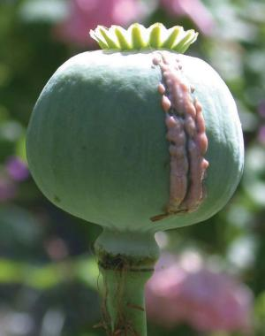
What are they?
Poppy plant Papaver somniferum
Opiate: derivative of opium poppy
Morphine
Codeine
Opium
Opioid: any compound that binds to opiate receptors
Semisynthetic (heroin=derived from morphine, buprenorphine from Thebaine,
oxy + hydrocodone, oxy + hydromorphone)
Synthetic (Dextropropoxyphene, Fentanyl, Methadone, Tramadol)
Route of Administration: Oral, transdermal, intravenous and implantable formulations
Narcotic: legal designation
Notes:
Opiates are derived from the poppy plant Papaver somniferum and include morphine, codeine and opium. There are also synthetic or semisynthetic (man- made) compounds produced from derivatives of the opium poppy. For instance, heroin is derived from morphine, and buprenorphine is derived from Thebaine. Synthetic compounds include Fentanyl, Methadone and Tramadol. Opiates and opioids can be taken orally and intravenously. Additionally, there are implantable versions such as long-acting buprenorphine (probuphine) which is active for six months, and patches that can be placed on the skin to deliver the medication as in the case of fentanyl patches.
IMAGE CREDITS:
Left: Wikimedia Commons.
Right: Flickr purchased image.

Slide 12
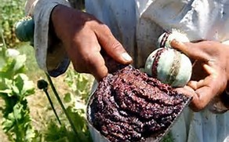
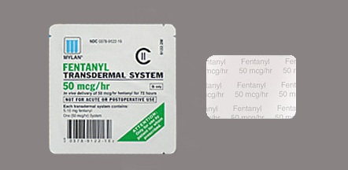
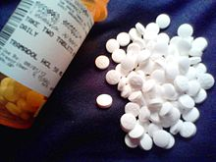
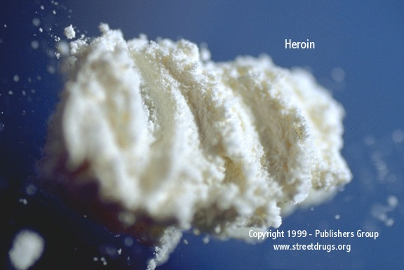
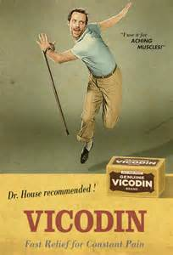
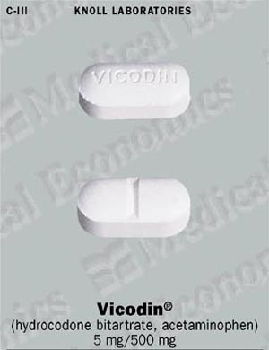
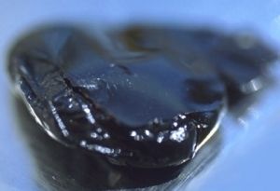
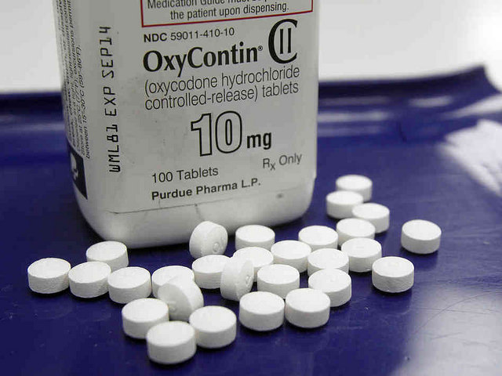
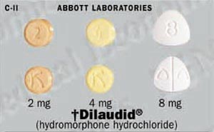
Opioids
Notes:
This slide shows several different types of opioids including opium, heroin (powder and tar forms) along with several types of prescription opioids including OxyContin, Fentanyl, Vicodin and Tramadol. Opioids are designated a “narcotic” and are incredibly effective at relieving pain, reducing severe coughs and diarrhea.
IMAGE CREDITS:
Center Image: Pixabay.com Free Photo.
Top Right Image: Wikimedia Commons.
Middle Right Image: DEA.Gov/Media Library National Drug Take-Back Day.
Bottom Right Image: OxyContin/Michael Tam/Flickr labeled for non-commercial reuse.
Bottom Left Image: Powdered Heroin from Asia DEA.Gov/Media Library.
Middle Left Image: DEA.Gov/Media Library.
Top Left Image: Wikimedia Commons.

Slide 13
Opiate vs. Opioid – Is there a Difference?
The short answer is YES!
Opiates are derived directly from the opium poppy by departing and purifying the various chemicals in the poppy.
Opioids include all opiates but also include chemicals that have been synthesized in some way.
Morphine is an opioid and also an opiate
Methadone is an opioid but not an opiate
Notes:
Opiates is a term used to describe drugs or medications derived directly from the opium poppy. Opioids include all opiates, but also include chemicals that have been synthesized. Opioid is a broader term of encompassing opiates that operate on the opioid receptor and produce similar effects to that of morphine. Most noted for their pain relief and euphoric effects, opioids produce a predictable response and equally predictable set of side-effects

Slide 14
What do they do?
Description:
Opium-derived or synthetic compounds that are usually prescribed to treat pain; reduce the signaling of pain messages to the brain and reduce pain. Act on the opioid receptors to produce morphine-like effects including dependence, and can relieve symptoms during withdrawal from morphine addiction.
Route of administration:
Intravenous, smoked, intranasal, oral, intrarectal, and implantable
Notes:
As mentioned previously, opioids can be derived directly from the opium poppy, or can be a synthetically produced compound
and are generally prescribed to treat pain by interrupting the signaling of pain messages in the brain.
The onset of action for the various opioids can depend upon the route of administration with injecting and smoking be the quickest way to get the desired effect.
REFERENCE: Drug Enforcement Administration. (2017). Methamphetamine Lab Incidents, 2004-2014, reported by EPIC. Accessed March 7, 2017 from https://www.dea.gov/resource-center/meth-lab-maps.shtml.

Slide 15
Opioid Receptors
Receptor types
mu, delta, kappa
Receptors located throughout body (brain, spine and gut)
Pain relief: central and peripheral nervous system
Reward and reinforcement: deep brain structures
Side effects: constipation, sedation, itch, mental status changes
Receptor interactions
Full agonists
Partial agonists
Antagonists
Notes:
There are actually four opioid receptors, though most often the mu, delta and kappa receptors are designated as being responsible for the notable analgesic properties of opioids. Opioids also activate the dopamine reward pathway resulting in a sense of euphoria. Today we will discuss three receptor interactions-full agonists, such as morphine, heroin and other opioids; partial agonists including buprenorphine; and the antagonistic effects of naloxone, naltrexone and extended-release naltrexone.
REFERENCE:
Al-Hasani, R. & Bruchas, M.R. (2011). Molecular mechanisms of opioid receptor-dependent signaling and behavior. Anesthesiology, 115(6), 1363-1381.

Slide 16
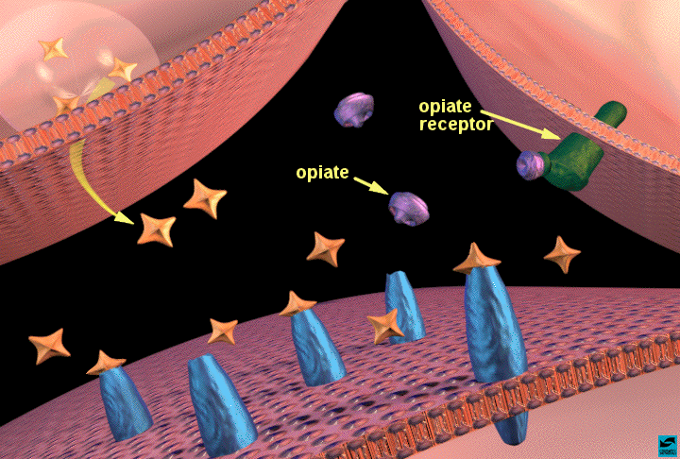
Opiates and Reward
Opiates bind to opiate receptors in the nucleus accumbens: increased dopamine release
Notes:
Opioids look like chemicals in your brain and body that attach to tiny parts on nerve cells called opioid receptors. Scientists have found three types of opioid receptors: mu, delta, and kappa (named after letters in the Greek alphabet). Each of these receptors plays a different role. For example, mu receptors are responsible for opioids’ pleasurable effects and their ability to relieve pain.
Opioids act on many places in the brain and nervous system, including:
The limbic system, which controls emotions. Here, opioids can create feelings of pleasure, relaxation, and contentment.
The brainstem, which controls things your body does automatically, like breathing. Here, opioids can slow breathing, stop coughing, and reduce feelings of pain.
The spinal cord, which receives sensations from the body before sending them to the brain. Here too, opioids decrease feelings of pain, even after serious injuries
REFERENCE:
National Institute on Drug Abuse; National Institutes of Health; U.S. Department of Health and Human Services.

Slide 17
Effects of Opioids on the Brain
Opioids are highly addictive
Brain cells can become dependent to the extent that users need it in order to function in their daily routine.
Opioids initially cause a rush of pleasure
Opioids slow down the way you think, slows down reaction time, and slows down memory. This affects the way you act and make decisions.
Notes:
Opioids act by attaching to and activating opioid receptor proteins, which are found on nerve cells in the brain, spinal cord, gastrointestinal tract, and other organs in the body. When these drugs attach to their receptors, they inhibit the transmission of pain signals. Opioids can also produce drowsiness, mental confusion, nausea, constipation, and respiratory depression, and since these drugs also act on brain regions involved in reward, they can induce euphoria, particularly when they are taken at a higher-than-prescribed dose or administered in other ways than intended.
REFERENCE:
Gutstein H, & Akil, H. (2006). Opioid Analgesics. In: Goodman & Gilman’s the Pharmacological Basis of Therapeutics. 11th ed. McGraw-Hill, pages 547-590.

Slide 18
Acute Effects of Opioids
Euphoria
Pain relief
Suppresses cough reflex
Histamine release
Warm flushing of the skin
Dry mouth
Drowsiness and lethargy
Sense of well-being
Depression of the central nervous system (mental functioning clouded)
Notes:
People who use heroin report feeling a "rush" (a surge of pleasure, or euphoria). However, there are other common effects, including:
dry mouth
warm flushing of the skin
heavy feeling in the arms and legs
nausea and vomiting
severe itching
clouded mental functioning
going "on the nod," a back-and-forth state of being conscious and semiconscious
REFERENCE:
National Institute on Drug Abuse; National Institutes of Health; U.S. Department of Health and Human Services. Available at:
https://www.drugabuse.gov/publications/drugfacts/heroin.
IMAGE CREDIT:
GoodFreePhotos.com

Slide 19
Acute Effects of Opioids, continued
Sedation
Pupil constriction
Slurred speech
Impaired attention/memory
Constipation, urinary retention
Nausea
Confusion, delirium
Seizures
Slowed heart rate
Respiratory depression
Notes:
19
Heroin often contains additives, such as sugar, starch, or powdered milk, that can clog blood vessels leading to the lungs, liver, kidneys, or brain, causing permanent damage. Also, sharing drug injection equipment and having impaired judgment from drug use can increase the risk of contracting infectious diseases such as HIV and hepatitis (see "Injection Drug Use, HIV, and Hepatitis").
REFERENCE:
National Institute on Drug Abuse; National Institutes of Health; U.S. Department of Health and Human Services. Available at:
https://www.drugabuse.gov/publications/drugfacts/heroin.

Slide 20
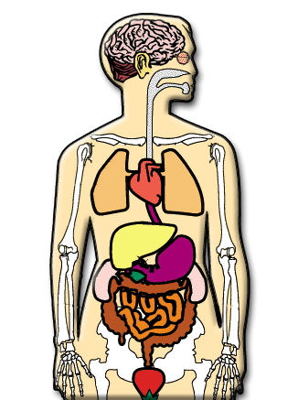
Long-Term Effects of Opioids
Fatal overdose
Collapsed veins (intravenous use)
Infectious diseases
Higher risk of HIV/AIDS and hepatitis
Infection of the heart lining and valves
Pulmonary complications & pneumonia
Respiratory problems
Abscesses
Liver disease
Low birth weight and developmental delay
Constipation
Cellulitis
Notes:
People who inject drugs such as heroin are at high risk of contracting the HIV and hepatitis C (HCV) virus. These diseases are transmitted through contact with blood or other bodily fluids, which can occur when sharing needles or other injection drug use equipment. HCV is the most common blood born infection in the United States. HIV (and less often HCV) can also be contracted during unprotected sex, which drug use makes more likely.
REFERENCE:
National Institute on Drug Abuse; National Institutes of Health; U.S. Department of Health and Human Services.
https://www.drugabuse.gov/publications/drugfacts/heroin

Slide 21
Opioids: Basic Facts
Withdrawal symptoms:
Intensity of withdrawal varies with level and chronicity of use
Cessation of opioids causes a rebound in functions depressed by chronic use
First signs occur shortly before next scheduled dose
For short-acting opioids (e.g., heroin), peak of withdrawal occurs 36 to 72 hours after last dose
Acute symptoms subside over 3 to 7 days
Ongoing symptoms may linger for weeks or months
Notes:
Continued use of the drug causes issues, such as health problems and failure to meet responsibilities at work, school, or home. An SUD can range from mild to severe, the most severe form being addiction.
Those who are addicted to heroin and stop using the drug abruptly may have severe withdrawal. Withdrawal symptoms—which can begin as early as a few hours after the drug was last taken—include:
restlessness
severe muscle and bone pain
sleep problems
diarrhea and vomiting
cold flashes with goose bumps ("cold turkey")
uncontrollable leg movements ("kicking the habit")
severe heroin cravings
Researchers are studying the long-term effects of opioid addiction on the brain. Studies have shown some loss of the brain’s white matter associated with heroin use, which may affect decision-making, behavior control, and responses to stressful situations.
REFERENCES: Li, W., Li, Q., Zhu, J., et al. (2013). White matter impairment in chronic heroin dependence: a quantitative DTI study. Brain Res, 1531, 58-64. doi:10.1016/j.brainres.2013.07.036.
Liu, J., Qin, W., Yuan, K., et al. (2011). Interaction between dysfunctional connectivity at rest and heroin cues-induced brain responses in male abstinent heroin-dependent individuals. PloS One, 6(10), e23098. doi:10.1371/journal.pone.0023098.
Qiu, Y., Jiang, G., Su, H., et al. (2013). Progressive white matter microstructure damage in male chronic heroin dependent individuals: a DTI and TBSS study. PloS One, 8(5), e63212. doi:10.1371/journal.pone.0063212.
National Institute on Drug Abuse; National Institutes of Health; U.S. Department of Health and Human Services. Available at:
https://www.drugabuse.gov/publications/drugfacts/heroin.

Slide 22
Symptoms of Opioid Withdrawal
Dysphoric mood
Nausea or vomiting
Diarrhea
Tearing or runny nose
Dilated pupils
Muscle aches
Goosebumps
Sweating
Yawning
Fever
Insomnia
Notes:
Once the body becomes accustomed to an opioid being present, it may react if the opioid is removed. The intensity of the withdrawal symptoms will depend on the level of use (dose and type of opioid) and the frequency and duration of use (chronicity). Withdrawal symptoms are basically a rebound effect; those functions that have been depressed or altered by the opioid suddenly emerge again. Withdrawal symptoms are often the opposite of symptoms seen when actively using the opioid (e.g., people get constipated when taking opioids and have diarrhea when withdrawing). The length of withdrawal depends upon the half-life of the opioid. Opioids with short half-lives (e.g., heroin) have acute withdrawal symptoms that peak at 3-4 days and then subside by days 3-7. Opioids with longer half-lives have longer acute withdrawal periods. Regardless of the length of the acute withdrawal, there are protracted withdrawal symptoms (e.g., aches and pains, general malaise) that persist for weeks or months after use ceases. Protracted withdrawal symptoms are less severe than the acute symptoms, but are still experienced as extremely disruptive and uncomfortable.

Slide 23
Opioids and Opiates What we’ll cover today
What are they? & What do they do?
Where do they come from?
Why do we care?
Who’s using them?
How did we get here?
What is being done about it?
Notes:
This is a transition slide. The next portion of the presentation will focus on where opioids are produced and how they get to the United States.

Slide 24
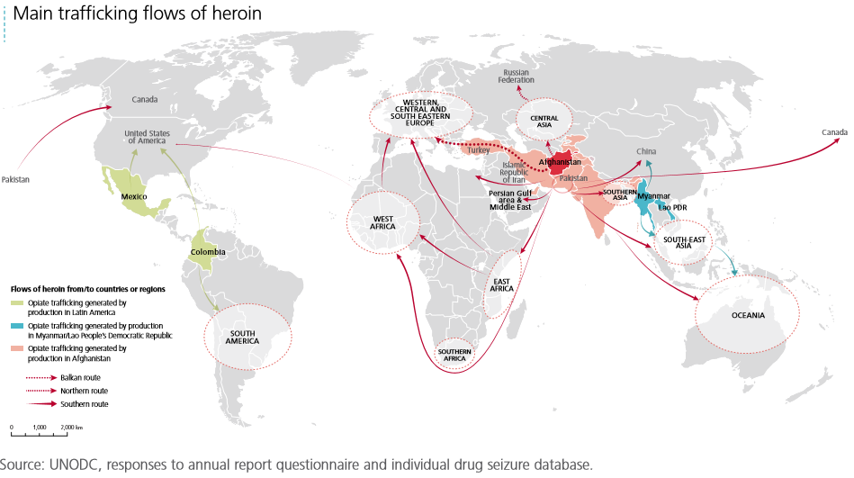
Where does heroin come from?
Notes:
While the majority of the world’s heroin is produced in Afghanistan, and 90% of the heroin making its way to Canada is from Afghanistan, the United States heroin market is supplied through Central and South America, though this may be changing.
REFERENCE: http://www.unodc.org/doc/wdr2016/WDR_2016_Chapter_1_Opiates.pdf

Slide 25
Global Poppy Cultivation and Opium Production
Notes:
Afghanistan remains the world’s largest opium producer, yielding nearly 70 per cent of global opium production; followed by Myanmar, at 14 per cent. Opium production in Latin America has doubled over the last 20 years where the majority of heroin entering the United States is produced.
REFERENCE: United Nations Office on Drugs and Crime, Illicit Crop Monitoring 2015. https://www.unodc.org/unodc/en/crop-monitoring/

Slide 26
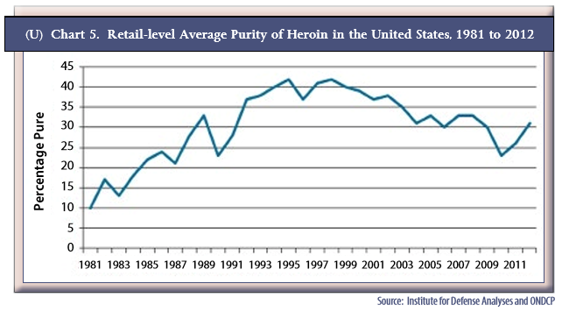
Notes:
These two graphs indicate the average purity of heroin and the average price of heroin per gram from 1981 through 2012. As you can see, the cost of a gram of pure heroin has come down significantly over the years and while there has been some fluctuation in the average purity, once again the purity is increasing.

Slide 27
Notes:
This slide shows the regional drug transportation corridors throughout the United States as provide by the Justice Department. Mexican drug trafficking organizations dominate the transportation of illicit drugs across the Southwest US Border. They typically use commercial trucks and private and rental vehicles to smuggle drugs through the land points of entry as well as through sparsely populated areas of desert and mountainous between formal points of entry. The majority of illicit drugs are smuggled overland into the United States, while a relatively small portion are flown in. The majority of illicit drugs shipped into the United States are usually concealed on container and cruise ships, fishing boats and recreational vessels. Drug trafficking organizations also use very modern boats including self-propelled semisubmersibles which typically ride only a couple inches above the surface, are difficult to detect and can carry a multi-ton payloads.
REFERENCE:
U.S. Department of Justice, National Drug Intelligence Center. (2010). National Drug Threat Assessment, February 2010. Available at:
https://www.justice.gov/archive/ndic/pubs38/38661/movement.htm.

Slide 28
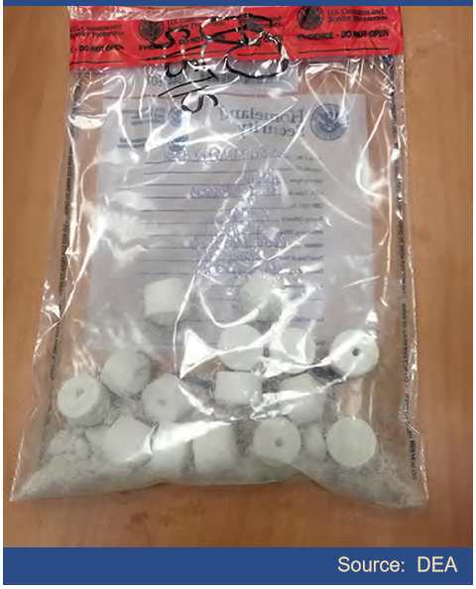
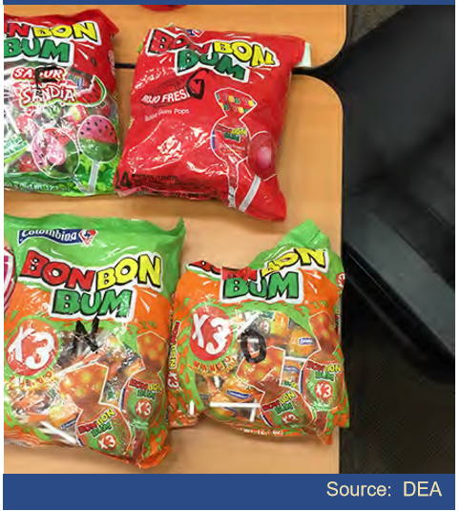
Notes:
These next few slides are photos taken by the United States Drug Enforcement Administration of heroin concealed in various formats as a mean to smuggle the drug through customs checkpoints without detection. Here are several packages of “heroin pops” camouflaged as lollipop candies. As you can see, the level of sophistication spares no expense.
IMAGE CREDIT:
United States Drug Enforcement Administration; 2https://www.dea.gov/pr/multimedia-library/image-gallery/year_in_pictures_16/2016.shtml015-16.

Slide 29
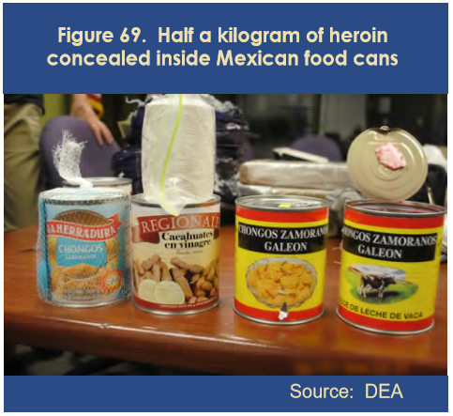
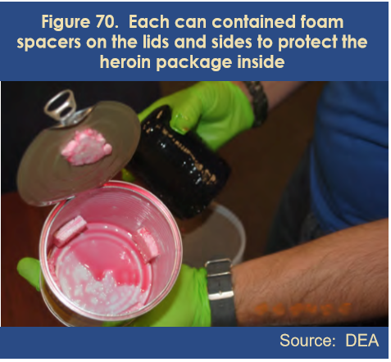
Notes:
In these two photos, also taken by the United States Drug Enforcement Administration, heroin is concealed in large cans of beans to avoid detection. As the stakes have increased, so has the level of sophistication as it relates to the logistics and distribution of the product.
IMAGE CREDIT:
United States Drug Enforcement Administration, https://www.dea.gov/pr/multimedia-library/image-gallery/year_in_pictures_16/2016.shtml015-16.

Slide 30
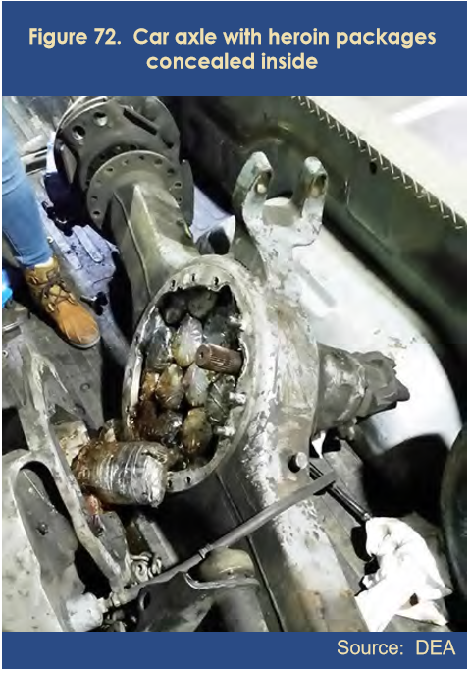
Notes:
And yet, the old fashion ways continued to be utilized because they work. Other methods include the use of “mules”
IMAGE CREDIT:
United States Drug Enforcement Administration, https://www.dea.gov/pr/multimedia-library/image-gallery/year_in_pictures_16/2016.shtml015-16.

Slide 31
“Drug Mules”
Notes:
In the two photos on this slide, the one on the left is an x-ray of a suspected drug smuggler (“mule”) who ingested large quantities of cocaine in an effort to smuggle the drugs undetected into the country. Notice the uniform shapes of the packages. On the right side are packages of heroin that actually passed through a hospitalized “drug mule.” This form of smuggling is fairly common, though incredibly dangerous. Human cadavers stuffed with drugs have been detected and seized by U.S. Customs officials.
IMAGE CREDITS:
National Geographic Channels; Inside Cocaine Wars: Drug Mules.

Slide 32
Opioids and Opiates What we’ll cover today
What are they? & What do they do?
Where do they come from?
Why do we care?
Who’s using them?
How did we get here?
What is being done about it?
Notes:
One-fourth of people ages 12 and older who had been told by a doctor they had HIV/AIDS engaged in binge drinking in the past month, and nearly one-third used illegal drugs in the past month. Injection drug use and needle sharing are responsible for about 10% of HIV cases annually, and one in six people with HIV/AIDS have used an illegal drug intravenously in their lifetime. In this next section we are going to talk about the impact opioids and opioid use has had on the public health of our country.
According to the HIV/AIDS and Substance Use report (CDC), in the United States, about 1.1 million people live with HIV, and about one in six (more than 180,000) do not know they are infected. One-fourth of people ages 12 and older who had been told by a doctor they had HIV/AIDS engaged in binge drinking in the past month, and nearly one-third used illegal drugs in the past month. Injection drug use and needle sharing are responsible for about 10% of HIV cases annually, and one in six people with HIV/AIDS have used an illegal drug intravenously in their lifetime. In particular, studies have shown a strong link between methamphetamine use and the transmission of HIV among men who have sex with men, a population group disproportionately affected by HIV and AIDS.

Slide 33
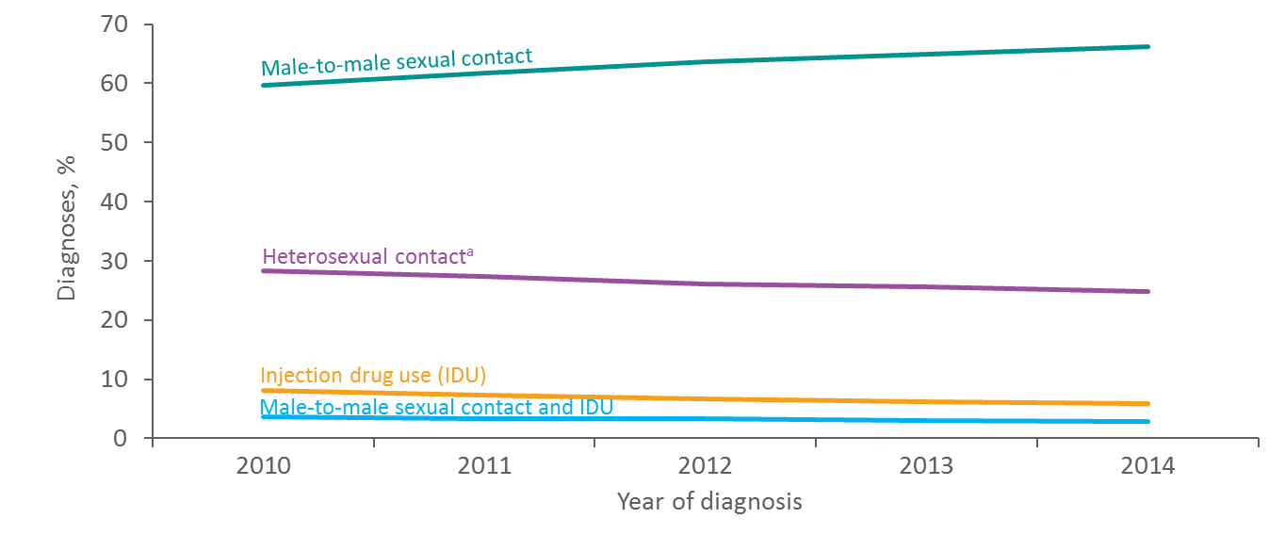
Diagnoses of HIV Infection among Adults and Adolescents, by Transmission Category, 2010–2014 United States and 6 Dependent Areas
Note. Data include persons with a diagnosis of HIV infection regardless of stage of disease at diagnosis. Data have been statistically adjusted to account for missing transmission category. “Other” transmission category not displayed as it comprises less than 1% of cases.
ª Heterosexual contact with a person known to have, or to be at high risk for, HIV infection.
33
Notes:
Heterosexuals and people who inject drugs also continue to be affected by HIV. In 2015:
Heterosexual contact accounted for 24% (9,339) of HIV diagnoses.
Women accounted for 19% (7,402) of HIV diagnoses. Diagnoses among women are primarily attributed to heterosexual contact (86%, or 6,391) or injection drug use (13%, or 980).
Six percent (2,392) of HIV diagnoses in the United States were attributed to injection drug use (IDU) and another 3% (1,202) to male-to-male sexual contact and IDU.
REFERENCES:
https://www.cdc.gov/hiv/statistics/overview/ataglance.html

Slide 34
Deaths of Persons with Diagnosed HIV Infection Attributed to Injection Drug Use by Race/Ethnicity, 2014—United States and 6 Dependent Areas
Note. Data include persons with a diagnosis of HIV infection regardless of stage of disease at diagnosis. Deaths of persons with diagnosed HIV infection may be due to any cause. Data have been statistically adjusted to account for missing transmission category. Data exclude men with HIV infection attributed to male-to-male sexual contact and injection drug use.
ª Includes Asian/Pacific Islander legacy cases.
^{b} Hispanics/Latinos can be of any race.
^{c} Because column totals for numbers were calculated independently of the values for the subpopulations, the values in each column may not sum to the column total.
34
Notes:
During 2014 in the United States and 6 dependent areas, approximately 3,897 deaths occurred among adults and adolescents with diagnosed HIV infection and who injected drugs. Blacks/African Americans accounted for the highest percentage of deaths among persons who injected drugs (48%), followed by Hispanics/Latinos (25%) and whites (21%). Persons of multiple races accounted for approximately 6% of deaths among persons who injected drugs. American Indians/Alaska Natives, Asians, and Native Hawaiians/other Pacific Islanders each accounted for less than 1% of deaths among persons who injected drugs.
Data include persons with a diagnosis of HIV infection regardless of stage of disease at diagnosis. Deaths of persons with diagnosed HIV infection may be due to any cause (may or may not be HIV-related). Data have been statistically adjusted to account for missing transmission category. Because column totals for numbers were calculated independently of the values for the subpopulations, the values in each column may not sum to the column total.
Data exclude men with HIV infection attributed to male-to-male sexual contact and injection drug use.
The Asian category includes Asian/Pacific Islander legacy cases (cases that were diagnosed and reported under the pre-1997 Office of Management and Budget race/ethnicity classification system). Hispanics/Latinos can be of any race.
Co-infection with hepatitis C occurs in a quarter of Americans living with HIV. Among injection drug users and needle sharers, rates of co-infection are even higher (80%). Most people with hepatitis C are unaware of their infection and, for many, this can result in significant damage to the liver including the development of life-threatening conditions such as cirrhosis or hepatocellular carcinoma. Among people living with HIV, liver disease due to hepatitis C is the most common cause of non-AIDS related death.
REFERENCE:
Center for Disease Control and Prevention, available at: https://www.cdc.gov/hiv/statistics/overview/ataglance.html.

Slide 35
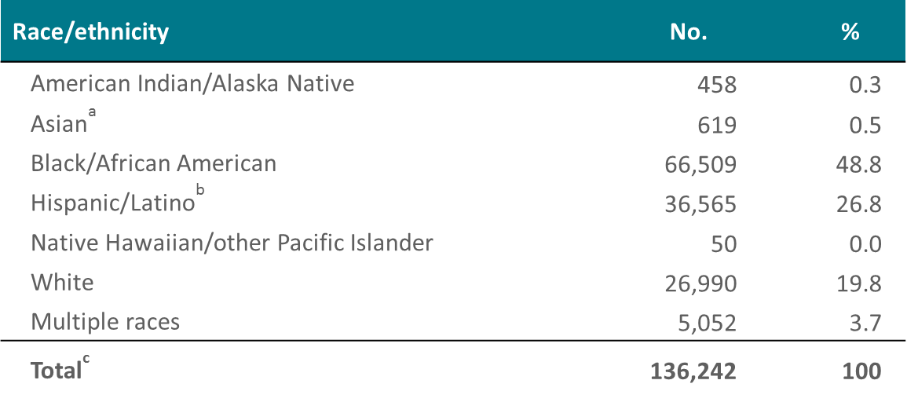
Persons Living with Diagnosed HIV Infection Attributed to Injection Drug Use by Race/Ethnicity, Year-end 2014—United States and 6 Dependent Areas
Note. Data include persons with a diagnosis of HIV infection regardless of stage of disease at diagnosis. Data have been statistically adjusted to account for missing transmission category. Data exclude men with HIV infection attributed to male-to-male sexual contact and injection drug use.
ª Includes Asian/Pacific Islander legacy cases.
^{b} Hispanics/Latinos can be of any race.
^{c} Because column totals for numbers were calculated independently of the values for the subpopulations, the values in each column may not sum to the column total.
35
Notes:
At the end of 2014 in the United States and 6 dependent areas, approximately 136,242 adults and adolescents were living with diagnosed HIV infection that was attributed to injection drug use (IDU). Approximately 49% were black/African American, 27% were Hispanic/Latino, and 20% were white. Persons of multiple races accounted for approximately 4% of those living with diagnosed HIV infection that was attributed to IDU. American Indians/Alaska Natives, Asians, and Native Hawaiians/other Pacific Islanders each accounted for 1% or less of those living with diagnosed HIV infection that was attributed to IDU.
Data include persons with a diagnosis of HIV infection regardless of stage of disease at diagnosis. Data have been statistically adjusted to account for missing transmission category. Because column totals for numbers were calculated independently of the values for the subpopulations, the values in each column may not sum to the column total.
Data exclude men with HIV infection attributed to male-to-male sexual contact and injection drug use.
The Asian category includes Asian/Pacific Islander legacy cases (cases that were diagnosed and reported under the pre-1997 Office of Management and Budget race/ethnicity classification system).
Hispanics/Latinos can be of any race.
REFERENCE:
Centers for Disease Control and Prevention, available at: https://www.cdc.gov/hiv/statistics/overview/ataglance.html.

Slide 36
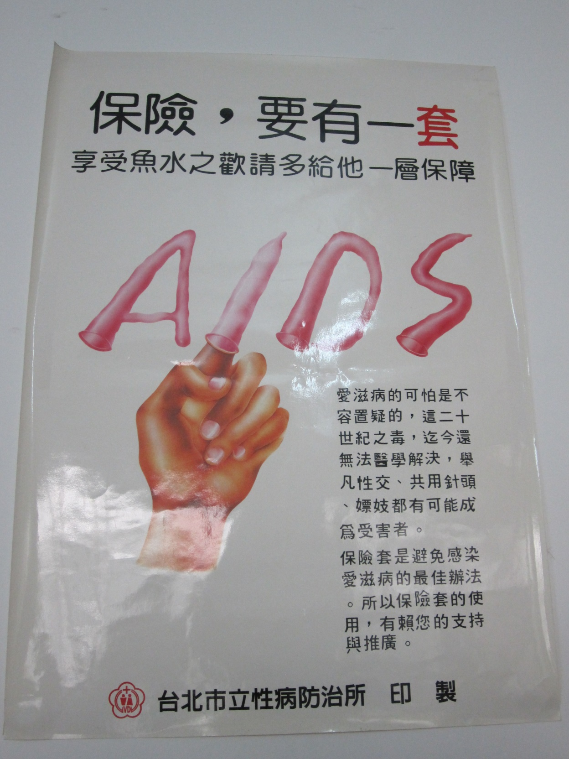
Notes:
Slide 36: AIDS, a worldwide epidemic is being addressed across the globe through the use of educational materials as depicted in the photo on the left taken in Guangxi China promoting the use of condoms, and by making syringes available to the public as seen here in a vending machine on the streets of Porto, Portugal.
IMAGE CREDITS:
Albert L. Hasson, personal collection (Guangxi, China, and Porto, Portugal).

Slide 37
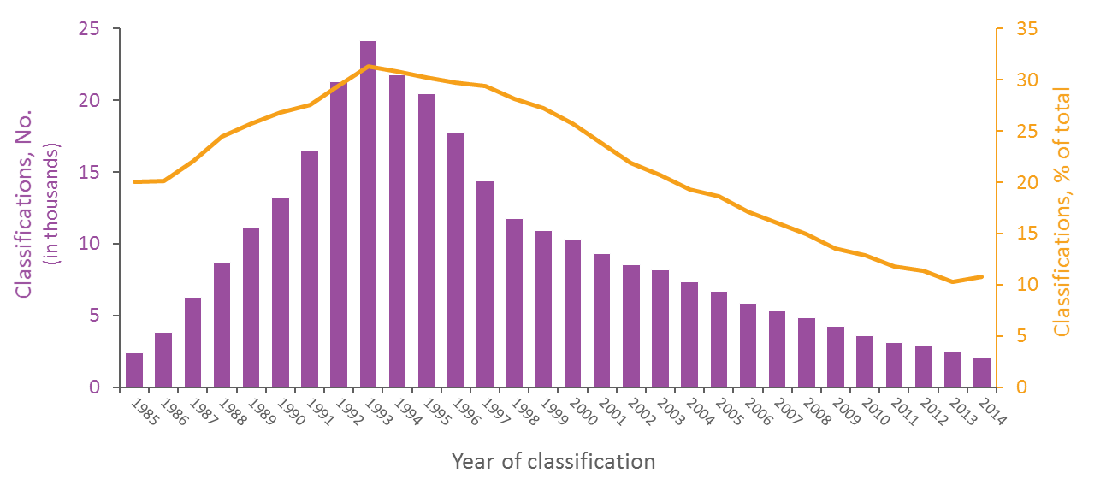
Diagnosed HIV Infections Classified as Stage 3 (AIDS) among Persons Who Inject Drugs, 1985–2014—United States and 6 Dependent Areas
Note. Data have been statistically adjusted to account for missing transmission category. Data exclude men with HIV infection attributed to male-to-male sexual contact and injection drug use.
37
Notes:
During 1985–2014, the percentage of HIV infections classified as stage 3 (AIDS) that were attributed to injection drug use (IDU) ranged from a minimum of 10% to a maximum of 31% in the United States and 6 dependent areas: 20% in 1985 with a gradual increase through 1993; 31% in 1993; gradual decrease from 1994-onward; and 11% in 2014. The greatest number of stage 3 (AIDS) classifications among persons who inject drugs was 24,144 in 1993.
Data have been statistically adjusted to account for missing transmission category.
Data exclude men with HIV infection attributed to male-to-male sexual contact and injection drug use.
REFERENCE:
Centers for Disease Control and Prevention, available at: https://www.cdc.gov/hiv/statistics/overview/ataglance.html.

Slide 38
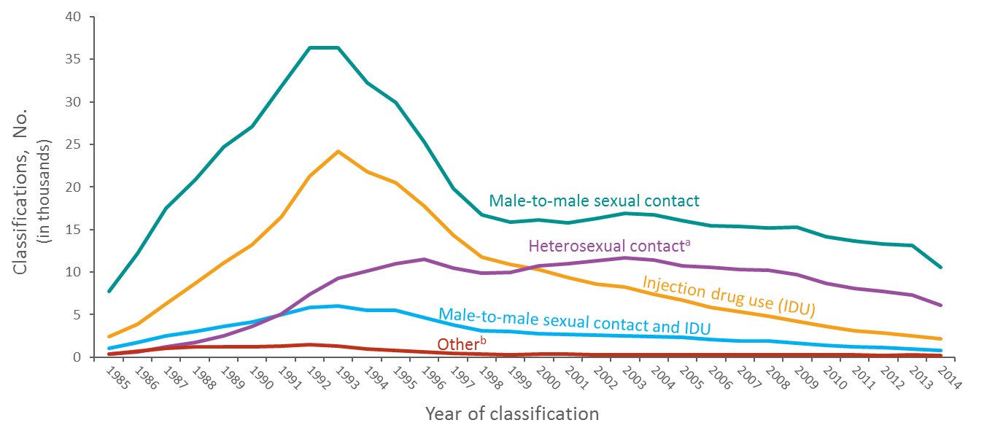
Stage 3 (AIDS) Classifications among Adults and Adolescents with Diagnosed HIV Infection, by Transmission Category and Year of Classification, 1985–2014 United States and 6 Dependent Areas
Note. Data have been statistically adjusted to account for missing transmission category.
ª Heterosexual contact with a person known to have, or to be at high risk for, HIV infection.
^{b} Includes hemophilia, blood transfusion, perinatal exposure, and risk factor not reported or not identified.
38
Notes:
The number of HIV infections classified as stage 3 (AIDS) among persons with infection attributed to male-to-male sexual contact continues to represent the highest number stage 3 (AIDS) classifications each year. Stage 3 (AIDS) among persons with HIV infection attributed to injection drug use have continued to decline while heterosexual contact has increased. Stage 3 (AIDS) among persons with HIV infection attributed to heterosexual contact surpassed the number of those attributed to injection drug use for the first time in 2001 and have continued to account for the second highest number of infections classified as stage 3 (AIDS) annually since that time.
Data have been statistically adjusted to account for missing transmission category.
Heterosexual contact is with a person known to have, or to be at high risk for, HIV infection.
The “Other” category includes hemophilia, blood transfusion, perinatal exposure, and risk factor not reported or not identified.
REFERENCE:
Centers for Disease Control and Prevention, available at: https://www.cdc.gov/hiv/statistics/overview/ataglance.html.

Slide 39
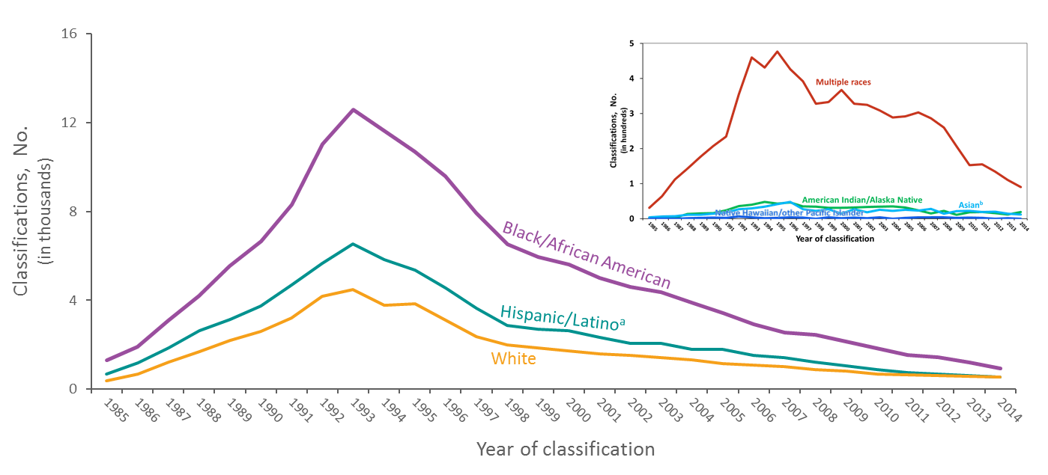
Diagnosed HIV Infections Classified as Stage 3 (AIDS) among Persons Who Inject Drugs, by Race/Ethnicity and Year of Classification, 1985–2014—United States and 6 Dependent Areas
Note. Data have been statistically adjusted to account for missing transmission category. Data exclude men with HIV infection attributed to male-to-male sexual contact and injection drug use.
ª Hispanics/Latinos can be of any race.
^{b} Includes Asian/Pacific Islander legacy cases.
39
Notes:
This slide presents the racial/ethnic trends in diagnoses of HIV infection classified as stage 3 (AIDS) in the United States and 6 dependent areas during 1985 through 2014 among adult and adolescent persons who inject drugs (PWID). Rates by race and ethnicity, important for understanding the impact of HIV on racial/ethnic groups, are not presented for PWID because of the absence of denominator data from the U.S. Census Bureau (i.e., the denominator data used to compute rates come from the U.S. Census Bureau, but the U.S. Census Bureau does not collect data on injection drug use).
Noteworthy is the decline from 1993 through 2014 in stage 3 (AIDS) classifications among black/African American, Hispanic/Latino, and white PWID. Despite this decline, the largest number of stage 3 (AIDS) classifications among PWID each year was in blacks/African Americans. The second largest number of stage 3 (AIDS) classifications among PWID was in Hispanics/Latinos, followed by whites, except for 2014. Since 1985, very few stage 3 (AIDS) classifications among PWID were in American Indians/Alaska Natives, Asians, Native Hawaiians/other Pacific Islanders, and persons of multiple races.
Data have been statistically adjusted to account for missing transmission category.
Data exclude men with HIV infection attributed to male-to-male sexual contact and injection drug use.
Hispanics/Latinos can be of any race.
The Asian category includes Asian/Pacific Islander legacy cases (cases that were diagnosed and reported under the pre-1997 Office of Management and Budget race/ethnicity classification system).
REFERENCE:
Centers for Disease Control and Prevention, available at: https://www.cdc.gov/hiv/statistics/overview/ataglance.html.

Slide 40
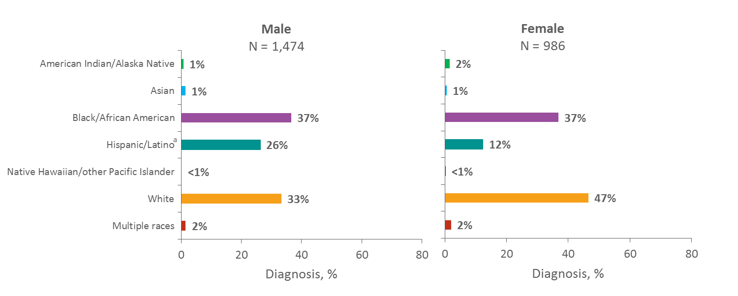
Diagnoses of HIV Infection among Persons Who Inject Drugs, by Sex and Race/Ethnicity, 2015—United States and 6 Dependent Areas
Note. Data include persons with a diagnosis of HIV infection regardless of stage of disease at diagnosis. Data for the year 2015 are preliminary and based on 6 months reporting delay. Data have been statistically adjusted to account for missing transmission category.
ª Hispanics/Latinos can be of any race.
40
Notes:
In 2015 in the United States and 6 dependent areas, among male adults and adolescents with diagnosed HIV infection attributed to injection drug use (IDU), approximately 37% were among blacks/African Americans, 33% among whites, and 26% among Hispanics/Latinos. Among female adults and adolescents with diagnosed HIV infection attributed to IDU, 47% were among whites, 37% among blacks/African Americans, and 12% among Hispanics/Latinos.
Among both sexes, American Indian/Alaska Native, Asian, Native Hawaiian/other Pacific Islander, and persons of multiple races each comprised 2% or less of persons with HIV infection attributed to IDU.
Data include persons with a diagnosis of HIV infection regardless of stage of disease at diagnosis. Data for the year 2015 are preliminary and based on 6 months reporting delay. Data have been statistically adjusted to account for missing transmission category.
Data on injection drug use among males do not include men with HIV infection attributed to male-to-male sexual contact and injection drug use.
Hispanics/Latinos can be of any race.
REFERENCE:
Centers for Disease Control and Prevention, available at: https://www.cdc.gov/hiv/statistics/overview/ataglance.html.

Slide 41
Notes:
Switching gears from HIV to more the more direct impact of opioid use, the Centers for Disease Control and Prevention reports that each day more than 1,000 people are treated in emergency departments across the country as a result of the misuse of prescriptions for opioids.
REFERENCE:
Centers for Disease Control and Prevention, available at: https://www.cdc.gov/drugoverdose/epidemic/index.html.

Slide 42
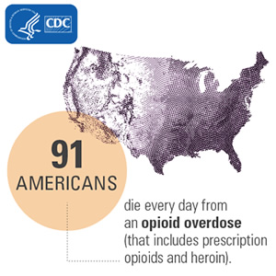
Notes:
Drug overdose deaths and opioid-involved deaths continue to increase in the United States. The majority of drug overdose deaths (more than six out of ten) involve an opioid. Since 1999, the number of overdose deaths involving opioids (including prescription opioids (https://www.cdc.gov/drugoverdose/opioids/prescribed.html) and heroin (https://www.cdc.gov/drugoverdose/opioids/heroin.html) quadrupled. From 2000 to 2015 more than half a million people died from drug overdoses. 91 Americans die every day from an opioid overdose.
We now know that overdoses from prescription opioids are a driving factor in the 15-year increase in opioid overdose deaths. Since 1999, the amount of prescription opioids sold in the U.S. nearly quadrupled, yet there has not been an overall change in the amount of pain that Americans report. Deaths from prescription opioids—drugs like oxycodone, hydrocodone, and methadone—have more than quadrupled since 1999.
REFERENCES:
Centers for Disease Control and Prevention, available at: https://www.cdc.gov/drugoverdose/epidemic/index.html.
Rudd, R.A., Seth, P., David, F., & Scholl, L. (2015). Increases in drug and opioid-involved overdose deaths – United States, 2010-2015. MMWR Morbidity and Mortality Weekly Report, ePub 16. DOI: http://dx.doi.org/10.15585/mmwr.mm6550e.
Centers for Disease Control and Prevention. (2016). Wide-ranging online data for epidemiologic research (WONDER). Atlanta, GA: CDC, National Center for Health Statistics. Available at http://wonder.cdc.gov.
Chang, H., Daubresse, M., Kruszewski, S., et al. (2014). Prevalence and treatment of pain in emergency departments in the United States, 2000 – 2010. Amer J of Emergency Med, 32(5), 421-31.
Daubresse, M., Chang, H., Yu, Y., Viswanathan, S., et al. (2013). Ambulatory diagnosis and treatment of nonmalignant pain in the United States, 2000 – 2010. Medical Care, 51(10), 870-878.

Slide 43
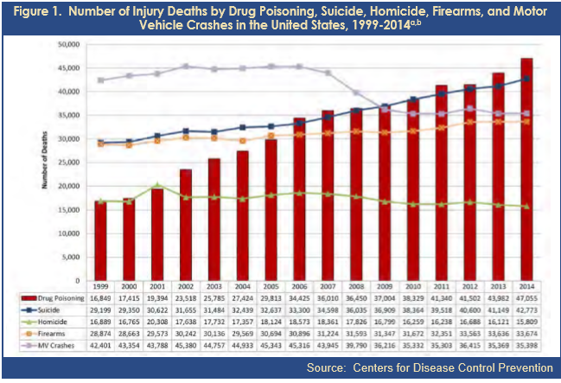
Notes:
This slide shows a comparison of injury deaths by drug poisoning (red bars), suicide (blue line), homicide (green line), firearms (orange line), and motor vehicle crashes (light purple) for 2014. The red bars show increasing number of deaths drug poisoning. In 2015 we lost more people to drug poisoning than young men we lost in the whole Vietnam war-more than 55,000. In 2016, in the United States we exceeded 60,000 lost souls as a direct result of drug poisoning.
REFERENCE:
Centers for Disease Control and Prevention, available at: https://www.cdc.gov/drugoverdose/epidemic/index.html.

Slide 44
OD Deaths by Type of Opioid
44
Notes:
Not the sharp increase of deaths related to heroin and synthetic opioids, including fentanyl-the blue and orange lines. These events are driven by what is happening in the Northeast, New York, New Hampshire, Maine and Vermont, and the Mid-west and South, Ohio, West Virginia, Indiana, Tennessee and Kentucky.
REFERENCE:
Centers for Disease Control and Prevention, National Vital Statistics System, Mortality. CDC WONDER Atlanta, Georgia, U.S. Department of Health and Human Services, CDC; 2016. http://wonder.cdc.gov.

Slide 45
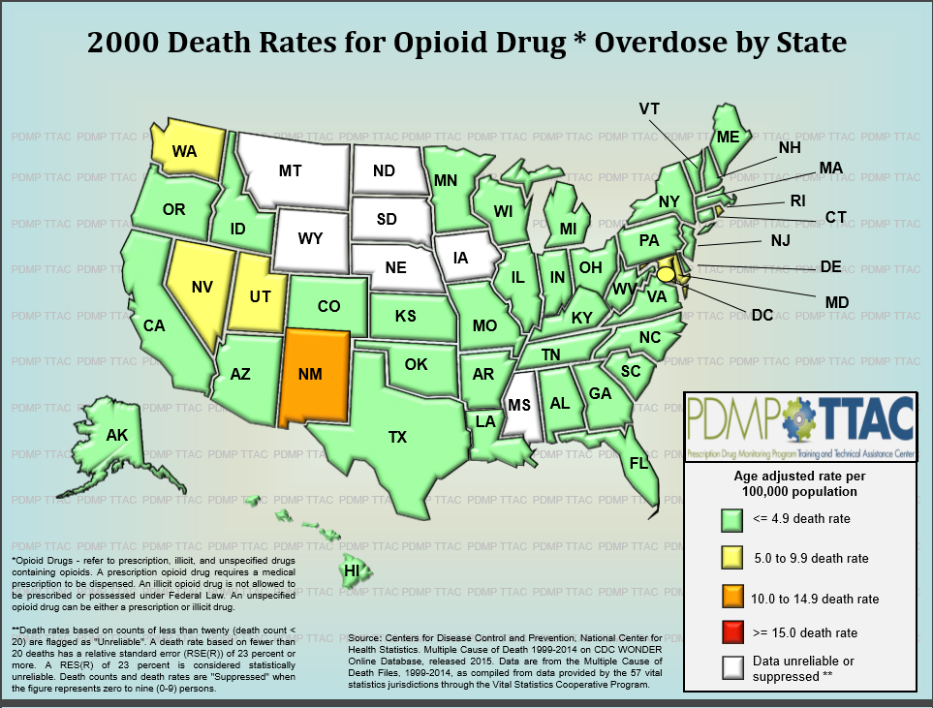
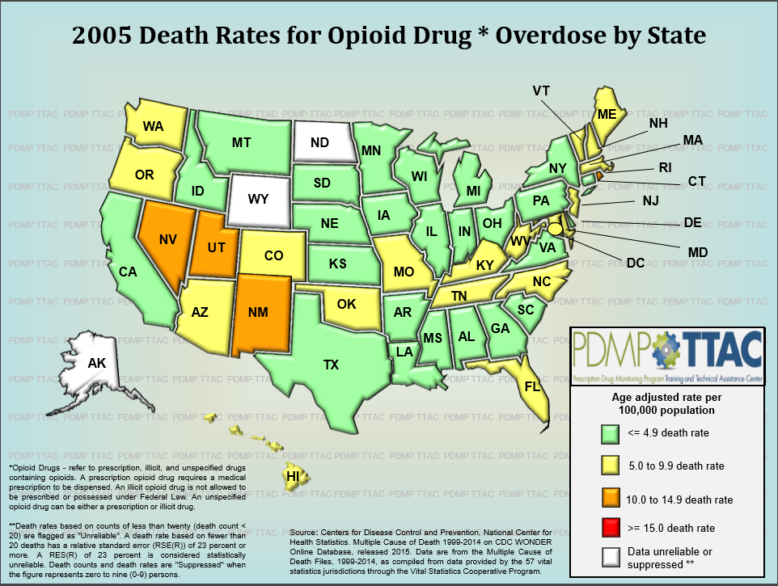
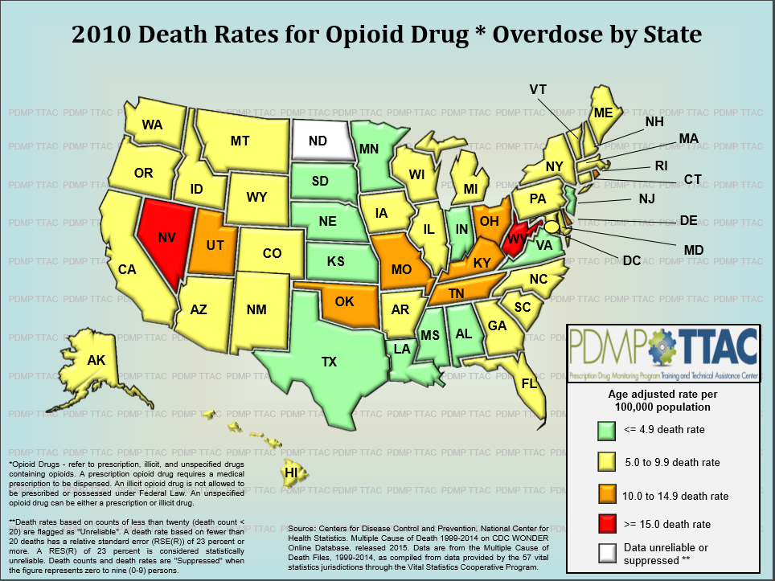
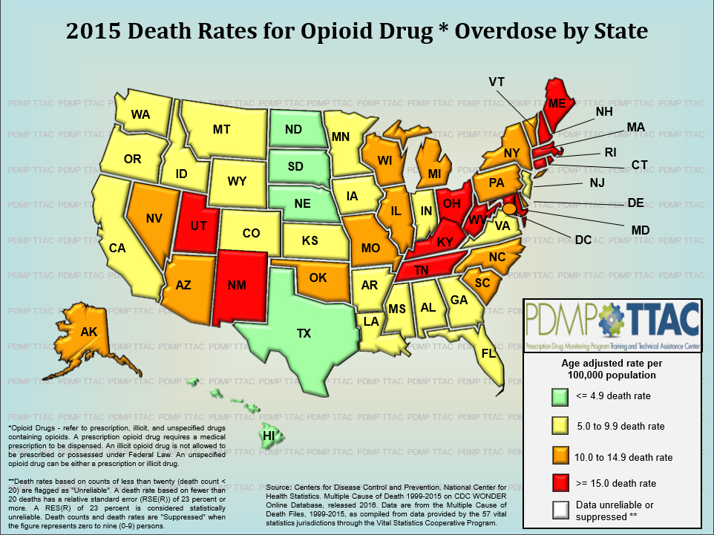
Notes:
This next slide illustrates the increase in opioid overdose deaths by state for the years 2000 (top left), 2005 (top right) 2010, (bottom left) and 2015 (bottom right.) These are age-adjusted rates per 100,000 where the light green is less than 4.9, the yellow is 5.0 to 9.9, the orange 10.0 to 14.9 and the red is greater than 15.
REFERENCES:
Prescription Drug Monitoring Program, Training and Technical Assistance Center, http://www.pdmpassist.org/.

Slide 46
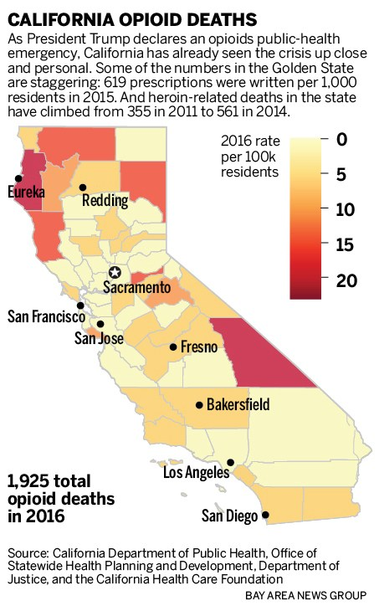
Notes:
This slide depicts the rate of opioid deaths in California in 2016. The darker the shading, the higher the rate of deaths. In total, there were 1,925 opioid deaths during calendar year 2016.

Slide 47
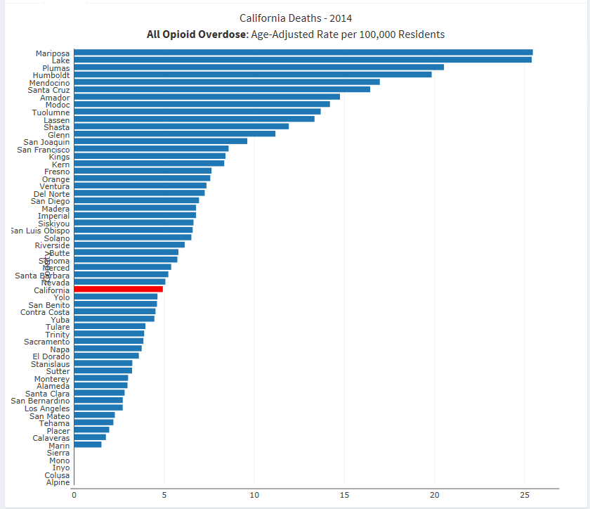
Notes:
As you can see by this and the previous slide, the counties that are impacted the most by opioids are dominated by the most northern-rural counties.

Slide 48
Notes:
The DEA has issued a number of alerts regarding the drug fentanyl and fentanyl analogues being introduced into the United States illicit drug market as counterfeit prescription pills.
REFERENCE: United States Drug Enforcement Administration, Headquarter News, March 18, 2015.

Slide 49
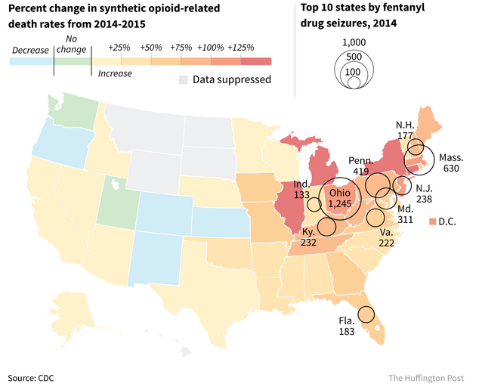
Notes:
Illegally-made fentanyl use is on the rise. Overdose deaths involving synthetic opioids other than methadone, which includes fentanyl, increased by 72% from 2014 to 2015.³ Roughly 9,500 people died from overdoses involving synthetic opioids other than methadone in 2015.
Reports from law enforcement indicate that much of the synthetic opioid overdose increase may be due to illegally made fentanyl. According to data from the National Forensic Laboratory Information System, confiscations, or seizures, of fentanyl increased by nearly 7x from 2012 to 2014. There were 4,585 fentanyl confiscations in 2014. This suggests that the sharp rise in fentanyl-related deaths may be due to increased availability of illegally made, non-pharmaceutical fentanyl, and not prescribed fentanyl.
The number of states reporting 20 or more fentanyl confiscations every six months is increasing. From July to December 2014, 18 states reported 20 or more fentanyl drug confiscations (See Figure 1). By comparison, six states reported 20 or more fentanyl drug confiscations from July to December 2013.
REFERENCE:
Centers for Disease Control and Prevention .

Slide 50
Fentanyl and Fentanyl Analogues Seized
Notes:
The DEA's Special Testing and Research Laboratory’s Emerging Trends Program compiled the data for this report to monitor new psychoactive substance (NPS) trends in the United States through queries of archived seizure and analysis information from drug evidence analyzed by the DEA laboratory system.
This Fourth Quarter 2016 Report includes NPS seized and identified in the fourth quarter of CY2016. For opioids and analgesics, this report indicates that "Acryl fentanyl and P-Fluorobutyrylfentanyl were reported for the first time in the fourth quarter of 2016. The relative percentage of fentanyl identifications decreased from between 65 and 70% in previous quarters to 50% due to the significant increase (300%) in furanyl fentanyl identifications during the fourth quarter.“
REFERENCE:
U.S. Drug Enforcement Administration. (2017). Emerging Threat Report, Fourth Quarter 2016. Available at: https://ndews.umd.edu/sites/ndews.umd.edu/files/u1486/dea_emerging_threat_report_2016_quarter_4.pdf.

Slide 51
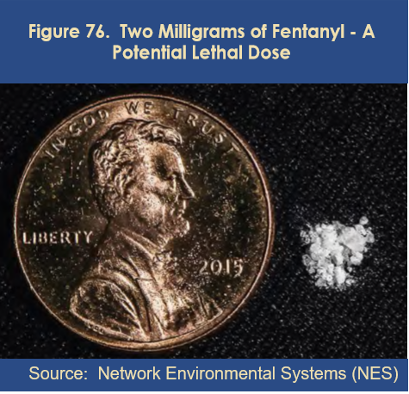
A lethal dose of carfentanil 1/100th of the amount shown next to the penny.
Notes:
This image depicts a potential lethal dose of fentanyl along side a U.S. penny. Imagine that a dose of the fentanyl analogue, carfentanil, approximately 1/100th of what is pictured, or 200 micrograms, is a lethal dose. Hazmat suits are to be worn during the manufacturing process. Carfentanil is 100 times more potent than fentanyl, 5000 times more potent than heroin and 10,000 times more potent than morphine. Carfentanil was first produced in 1974 at Janssen Pharmaceutica.
REFERENCE:
National Environmental Systems.

Slide 52
A kilo of heroin nets a dealer $60,000. A kilo of fentanyl? $1.2 million.
Notes:
Investigators nicknamed the street mixture “Gray Death” which is behind overdoses in Alabama, Georgia and Ohio. It looks like concrete and varies in texture from a sandy-like powder to hard and chunky. Often the mixture is a combination of several opioids including heroin, fentanyl, carfentanil. Carfentanil is used to tranquilize large animals. Usually the ingredients of this mixture are unknown to users, which is what makes it so lethal. Touching the substance puts an individual at risk.
Last year, the U.S. Drug Enforcement Administration listed U-47700 in the category of the most dangerous drugs it regulates, saying it was associated with dozens of fatalities, mostly in New York and North Carolina. Some of the pills taken from Prince's estate after the musician's overdose death last year contained U-47700.
REFERENCE:
The Associated Press.
IMAGE CREDIT:
The Associated Press.

Slide 53
Opioids and Opiates What we’ll cover today
What are they? & What do they do?
Where do they come from?
Why do we care?
Who’s using them?
How did we get here?
What is being done about it?
Notes:
Now we have a pretty good understanding of what opioids do, where they come from and their devastating impact. Let’s find out who’s using them.

Slide 54
Notes:
A number of risk factors exist for prescription opioid abuse and overdose, including overlapping prescriptions from multiple providers, high daily dosages, concurrent mental illness or other substance use disorder, and the combination of poverty and living in a rural area.
REFERENCE:
National Institute on Drug Abuse.

Slide 55
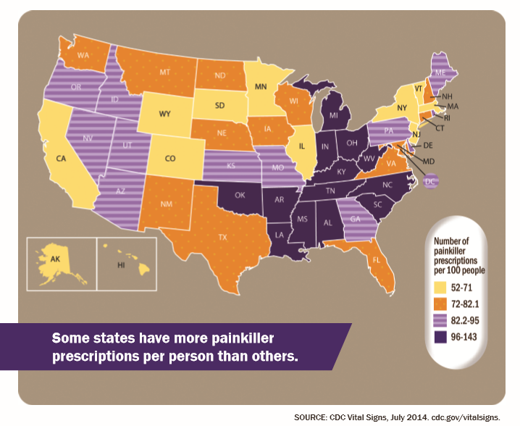
Health care providers wrote 259 million prescriptions for opioid painkillers in 2012
Notes:
Many more were written in some states than others – according to a Vital Signs report released today by the Centers for Disease Control and Prevention that highlights the danger of overdose. The report also has an example of a state that reversed its overdose trend.
Health care providers in the highest prescribing state, Alabama, wrote almost three times as many of these prescriptions per person as those in the lowest prescribing state, Hawaii.
Most of the highest prescribing states were in the South. Previous research has shown that regional variation in use of prescriptions cannot be explained by the underlying health status of the population.
The Vital Signs report also contains a study highlighting the success of Florida in reversing prescription drug overdose trends. Results showed that after statewide legislative and enforcement actions in 2010 and 2011, the death rate from prescription drug overdose decreased 23 percent between 2010 and 2012. Florida officials had taken these actions in response to a 28 percent increase in the drug overdose death rate over the preceding years (2006-2010).
Declines in death rates in Florida for specific prescription painkillers (oxycodone, methadone, and hydrocodone) and sedatives paralleled declines in prescribing rates for those drugs. This report was based on Florida Medical Examiners Commission data from 2006 to 2012 and IMS Health National Prescription Audit data from 2008 to 2012.
Sales of prescription opioids in the U.S. nearly quadrupled from 1999 to 2014, but there has not been an overall change in the amount of pain Americans report.
During the time period, prescription opioid overdose deaths increased similarly.
REFERENCE:
CDC Vital Signs, July 2014, available at: https://www.cdc.gov/drugoverdose/data/prescribing.html.
IMAGE CREDIT:
Centers for Disease Control and Prevention.

Slide 56
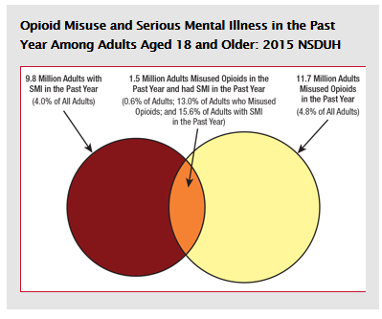
Notes:
According to the 2015 National Survey on Drug Use and Health, about 11.7 million adults have misused opioids in the past year (4.8%) and 9.8 million adults had a serious mental illness (SMI) in the past year (4.0%).
The misuse of opioids includes any use of heroin in the past year and the misuse of prescription pain relievers in the past year. SMI is defined in NSDUH as adults who in the past year have had a diagnosable mental, behavioral, or emotional disorder (excluding developmental and substance use disorders) of sufficient duration to meet diagnostic criteria and has resulted in serious functional impairment substantially interferes with major life activities.
Little is known about the co-occurrence of opioid misuse and SMI among adults. In 2015, 1.5 million adults aged 18 or older with a past year SMI have misused opioids in the past year. These 1.5 million adults with both SMI and opioid misuse represent 0.6 percent of all adults. Another way of thinking about 1.5 million people with co-occurring SMI and opioid misuse is to look at what percentage they represent among people with SMI and among people who have misused opioids in the past year. About 1 in 8 (13.0%) past year opioid misusers also had SMI in the past year. Alternatively, about 1 in 7 (15.6%) adults with SMI in the past year were past year misusers of opioids.
Since the prevalence of HIV among people in mental health care is four times higher than for the general population, those with HIV and their family members require appropriate access to supports and information. Mental health conditions may be of concern prior to as well as after HIV infection.
REFERENCE:
National Surveys on Drug Use and Health (NSDUH), 2015.
IMAGE CREDIT:
http://www.samhsa.gov/data/.

Slide 57
Prescription opioid use is a risk factor for heroin use
Notes:
Of people entering treatment for heroin addiction who began abusing opioids in the 1960s, more than 80 percent started with heroin. Of those who began abusing opioids in the 2000s, 75 percent reported that their first opioid was a prescription drug (Cicero et al., 2014).
According to general population data from the National Survey on Drug Use and Health, less than 4 percent of people who had abused prescription opioids started using heroin within 5 years (Muhuri et al., 2013). This suggests that prescription opioid abuse is just one factor in the pathway to heroin. Furthermore, analyses suggest that those who transition to heroin use tend to be frequent users of multiple substances (polydrug users) (Jones et al., 2015).
REFERENCES:
National Institute on Drug Abuse. 2015, available at: https://www.drugabuse.gov/publications/research-reports/relationship-between-prescription-drug-heroin-abuse/prescription-opioid-use-risk-factor-heroin-use.
Cicero, T.J., Ellis, M.S., Surratt, H.L., & Kurtz, S.P. (2014). The changing face of heroin use in the United States: A retrospective analysis of the past 50 years. JAMA Psychiatry, 71(7), 821-826.
Jones, C.M. (2013). Heroin use and heroin use risk behaviors among nonmedical users of prescription opioid pain relievers – United States, 2002-2004 and
2008-2010. Drug Alcohol Depend, 132(1-2), 95-100.
Lankenau, S.E., Teti, M., Silva, K., Jackson Bloom, J., Harocopos, A., & Treese, M. (2012). Initiation into prescription opioid misuse amongst young injection drug users. Int J Drug Policy, 23(1), 37-44.
Muhuri, P.K., Gfroerer, J.C., & Davies, M.C. (2013). Substance Abuse and Mental Health Services Administration. Associations of nonmedical pain reliever use and initiation of heroin use in the United States. CBHSQ Data Review. Available at: http://www.samhsa.gov/data/2k13/DataReview/DR006/nonmedical-pain-reliever-use-2013.pdf.

Slide 58
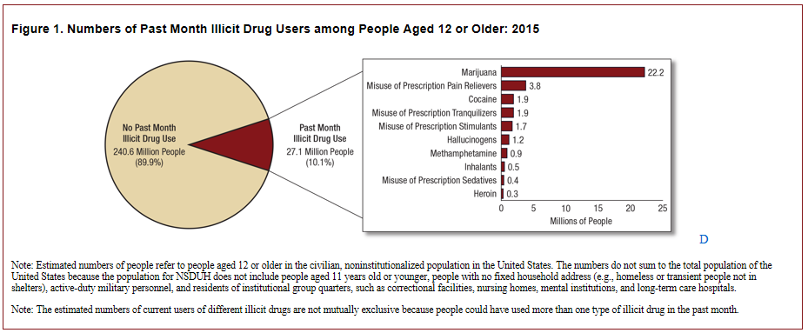
Illicit Drug Use age 12+ 2015
Notes:
NSDUH obtains information on 10 categories of illicit drugs: marijuana, cocaine (including crack), heroin, hallucinogens, inhalants, and methamphetamine, as well as the misuse of prescription pain relievers, tranquilizers, stimulants, and sedatives; see the section on the misuse of psychotherapeutic drugs for the definition of misuse. Estimates of "illicit drug use" reported from NSDUH reflect the data from these 10 drug categories. Changes in measurement for 7 of the 10 illicit drug categories—hallucinogens, inhalants, methamphetamine, and the misuse of prescription pain relievers, tranquilizers, stimulants, and sedatives—may have affected the comparability of the measurement of these illicit drugs between 2015 and prior years. Therefore, only 2015 estimates are presented for these seven illicit drug categories. Also, only 2015 estimates are presented for the use of any illicit drug.
In 2015, an estimated 27.1 million Americans aged 12 or older were current (past month) illicit drug users, meaning that they had used an illicit drug during the month prior to the survey interview. The most commonly used illicit drug in the past month was marijuana, which was used by 22.2 million people aged 12 or older. An estimated 6.4 million people reported misusing psychotherapeutic drugs in the past month, including 3.8 million people who were misusers of prescription pain relievers. Thus, the number of current misusers of pain relievers was second to marijuana among specific illicit drugs. Smaller numbers of people in 2015 were current users of the other illicit drugs shown.
REFERENCE:
Center for Behavioral Health Statistics and Quality. (2016). Key substance use and mental health indicators in the United States: Results from the 2015 National Survey on Drug Use and Health (HHS Publication No. SMA 16-4984, NSDUH Series H-51). Retrieved from http://www.samhsa.gov/data/.

Slide 59
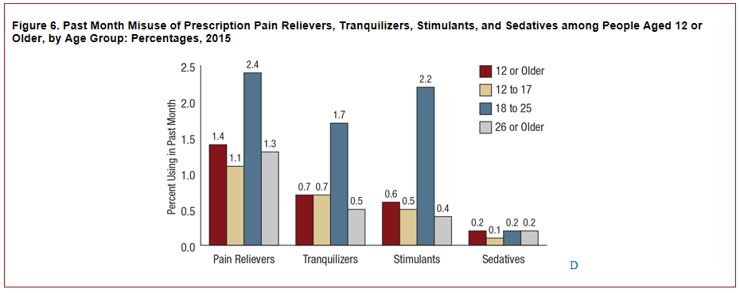
Past Month Misuse
Notes:
An estimated 3.8 million people aged 12 or older in 2015 were current misusers of pain relievers, which represents 1.4 percent of the population aged 12 or older. In 2015, an estimated 276,000 adolescents aged 12 to 17 were current misusers of pain relievers, which corresponds to 1.1 percent of adolescents. An estimated 829,000 young adults aged 18 to 25 misused pain relievers in the past month, which represents 2.4 percent of young adults. An estimated 2.7 million adults aged 26 or older were current misusers of pain relievers, which corresponds to 1.3 percent of adults aged 26 or older.
REFERENCE:
Center for Behavioral Health Statistics and Quality. (2016). Key substance use and mental health indicators in the United States: Results from the 2015 National Survey on Drug Use and Health (HHS Publication No. SMA 16-4984, NSDUH Series H-51). Retrieved from http://www.samhsa.gov/data/
IMAGE CREDIT:
Center for Behavioral Health Statistics and Quality. (2016). Key substance use and mental health indicators in the United States: Results from the 2015 National Survey on Drug Use and Health (HHS Publication No. SMA 16-4984, NSDUH Series H-51). Retrieved from http://www.samhsa.gov/data/

Slide 60
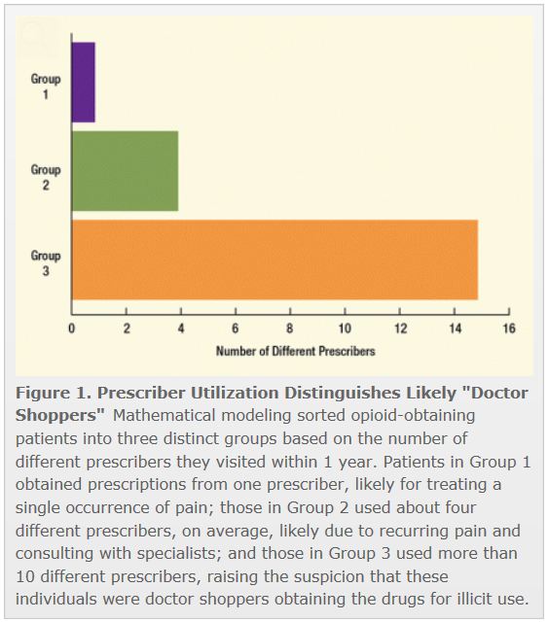
“Extreme Opioid Users”
Notes:
One out of every 143 U.S. patients who received a prescription for an opioid painkiller in 2008 obtained prescriptions from multiple physicians in a pattern that suggests misuse or abuse of the drugs, according to a recent estimate. While these “doctor shoppers” comprised only 0.7 percent of all patients with opioid prescriptions, they purchased almost 2 percent of all such prescriptions and 4 percent of the total amount of opioid drugs measured by weight.
Dr. Douglas McDonald and Kenneth Carlson of the research firm Abt Associates, Inc., of Cambridge, Massachusetts, derived national estimates from a massive dataset of 146.1 million records of opioid prescriptions dispensed by 76 percent of U.S. retail pharmacies in 2008. The prescriptions were for 9 different opioid drugs, including buprenorphine, methadone, and oxycodone, and were written by 908,000 prescribers for 48.4 million individual patients.
To identify elusive doctor shoppers from the vast majority of patients legitimately procuring opioids, the researchers sorted patients into groups based on their opioid purchasing patterns. This approach netted an “extreme” group of 135,000 likely doctor shoppers, who, on average, obtained 32 opioid prescriptions from 10 different physicians over a 10-month period.
REFERENCES:
https://www.drugabuse.gov/news-events/nida-notes/2014/05/although-relatively-few-doctor-shoppers-skew-opioid-prescribing
McDonald, D.C., and Carlson, K.E. (2013). Estimating the prevalence of opioid diversion by “doctor shoppers” in the United States. PLOS ONE, 8(7), e69241.

Slide 61
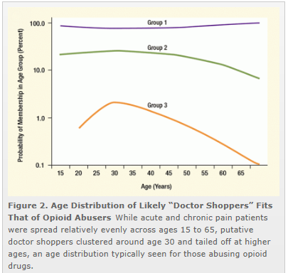
“Extreme Opioid Users” continued
Notes:
For instance, the age distribution of this group peaked between ages 26 and 35. This distribution corresponds to the age range with the highest prevalence of self-reported prescription drug abuse in the 2010 National Survey on Drug Use and Health by the U.S. Department of Health and Human Services.
Dr. McDonald and Mr. Carlson also calculated that this extreme group had purchased a total of 11.1 million grams of drug, which, when averaged per patient, was the equivalent of 109 milligrams of morphine per day for a whole year. More than 100 milligrams of morphine per day puts patients at high risk for overdose.
“For every day out of the year, that’s a lot of drug,” says Dr. McDonald. For example, the Centers for Medicare & Medicaid Services flags Medicare beneficiaries taking a daily dose of 120 milligrams or more of morphine equivalents for 90 days as at risk for overdose.
Going forward, Dr. McDonald and Mr. Carlson suggest that improvements in health care information technology should focus on improving the accessibility of PMPs. Currently, physicians can access these PMP databases to pull up a patient’s prescription history, but they often omit doing so because of time constraints and cumbersome access procedures. In addition, current PMP systems often do not detect doctor shoppers who hop state borders. Effectively addressing these limitations would mean linking all state PMP data and integrating prescription history data into patients’ electronic medical records.
REFERENCES:
https://www.drugabuse.gov/news-events/nida-notes/2014/05/although-relatively-few-doctor-shoppers-skew-opioid-prescribing.
McDonald, D.C., and Carlson, K.E. (2013). Estimating the prevalence of opioid diversion by “doctor shoppers” in the United States. PLOS ONE, 8(7), e69241.

Slide 62
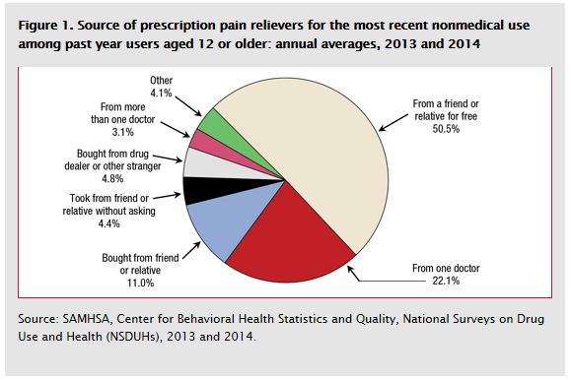
Source of pain relievers
Notes:
According to combined 2013 and 2014 NSDUH data, an annual average of 10.7 million people aged 12 or older misused prescription pain relievers in the past year. This represents 4.1 percent of the population.
NSDUH respondents who misused prescription pain relievers were asked to identify where they obtained the prescription pain relievers that they had most recently misused. The most common source was "from a friend or relative for free" (50.5 percent; Figure 1). About 1 in 5 people said that they obtained the prescription pain relievers they had most recently misused from one doctor (22.1 percent), and an additional 3.1 percent said they obtained them from more than one doctor. Only 4.8 percent of people who misused prescription pain relievers in the past year indicated that they had bought the prescription pain relievers they had most recently misused from a drug dealer or other stranger. About 4.4 percent of people who misused prescription pain relievers in the past year said they took the pain relievers from a friend or relative without asking. About 4.1 percent of people who misused prescription pain relievers indicated that they obtained their most recently misused pain relievers from other sources.
REFERENCE:
Center for Behavioral Health Statistics and Quality. (2015). Behavioral health trends in the United States: Results from the 2014 National Survey on Drug Use and Health (HHS Publication No. SMA 15-4927, NSDUH Series H-50). Retrieved from http://samhsa.gov/data/.

Slide 63
Source/% Users & Days of Use
Notes:
As the frequency of use increases, the sources begin to merge, most notable the gray bar denoting “Given by a friend or relative for free.” The source at initiation is dominated by “friend or relative for free.” As the number of days of Past Year “non-medical” use increases, so does the number of drug dealer/stranger, purchases from a friend or relative.
REFERENCE:
National Surveys on Drug Use and Health (NSDUH), 2008-2011.

Slide 64
Notes:
Here are some things that States have done to reduce the impact prescription opioids have on their residents. Other measures include:
Consider ways to increase use of prescription drug monitoring programs, which are state-run databases that track prescriptions for painkillers and can help find problems in overprescribing. Use of these programs is greater when they make data available in realtime, are universal (used by all prescribers for all controlled substances), and are actively managed (for example, send alerts to prescribers when problems are identified). Consider policy options (including laws and regulation) relating to pain clinics to reduce prescribing practices that are risky to patients.
Evaluate their own data and programs and consider ways to assess their Medicaid, workers' compensation programs, and state-run health plans to detect and address inappropriate prescribing of painkillers.
Identify opportunities to increase access to substance abuse treatment and consider expanding first responder access to naloxone, a drug used when people overdose.
REFERENCE:
July 2014 CDC Vital Signs, available at: https://www.cdc.gov/vitalsigns/opioid-prescribing/.

Slide 65
RX Drug Abuse in Older Adults
Older Adults account for 13% of US population but use 1/3 of all medications prescribed.
7.2 million (21.7%) receive at least 1 Rx annually.
Older adults use Rx drugs 3 times more than the general population.
On average, older persons take 4.5 medications per day.
Nationally, 2.8 million (8.4%) of older adults abuse Rx drugs in the last year while in California, 812,000 (3.7%).
SAMHSA, 2006; NIDA, 2005
Notes:
Persons aged 65 years and older comprise only 13 percent of the population, yet account for more than one-third of total outpatient spending on prescription medications in the United States. Older patients are more likely to be prescribed long-term and multiple prescriptions, and some experience cognitive decline, which could lead to improper use of medications. Alternatively, those on a fixed income may abuse another person's remaining medication to save money.
The high rates of comorbid illnesses in older populations, age-related changes in drug metabolism, and the potential for drug interactions may make any of these practices more dangerous than in younger populations. Further, a large percentage of older adults also use OTC medicines and dietary supplements, which (in addition to alcohol) could compound any adverse health consequences resulting from prescription drug abuse.
REFERENCE:
National Institute on Drug Abuse, available at: https://www.drugabuse.gov/publications/research-reports/prescription-drugs/trends-in-prescription-drug-abuse/older-adults.

Slide 66
Gender Differences in Prescription Painkiller Abuse
Study included 662 non-cancer patients with chronic pain who took opioid painkillers
Men and women had similar rates of opioid abuse
Drug misuse by women is motivated more by emotional issues and psychological distress
Women who misuse pain drugs are more likely to admit to being sexually or physically abused or have a history of psychiatric or psychological problems
In men, this behavior usually stems from problematic social and behavioral problems that lead to substance abuse
SOURCE: Jamison, et al. (2010). Journal of Pain, 11 (4): 310 - 320
Notes:
In a study by Jamison and colleagues published in the Journal of Pain in 2010, they could that while male and female research participants had similar rates of opioid abuse, women who misused prescription painkillers were more likely to admit to a history of sexual or physical abuse or a history of psychiatric problems. Men, on the other hand, tended to misuse painkillers because of problematic social and behavioral issues. The researchers recommend that women who are taking opioids to treat non-cancer chronic pain and show signs of "significant affective stress" should receive treatment for the mood disorder and counseling on the dangers of relying on opioids to reduce stress and improve sleep. For male patients taking opioids for non-cancer chronic pain, doctors should closely monitor known or suspected behavioral problems, conduct frequent urine screenings, pill counts and compliance monitoring.
REFERENCE: Jamison, R.N., Butler, S.F., Budman, S.H., Edwards, R.R., & Wasan, A.D. (2010). Gender differences in risk factors for aberrant prescription opioid use. Journal of Pain, 11(4), 312-320.

Slide 67
Opioids and Opiates What we’ll cover today
What are they? & What do they do?
Where do they come from?
Why do we care?
Who’s using them?
How did we get here?
What is being done about it?
Notes:
Some dispute exists over how the prescription opioid epidemic came about, and who is responsible, though it might be good to defer to an individual who might know best-Dr. Nora Volkow, Director of the National Institute on Drug Abuse

Slide 68
Nora Volkow, MD, Director, national institute on Drug Abuse
Notes:
This slide contains a movie clip that will play when the trainer clicks on the mouse one time. In order for this to work, the connection between the PowerPoint presentation and the video file must be maintained. When moving the PowerPoint file to another location on your computer or to another computer, make sure to always move the video file along with it. If the link becomes broken, the video will need to be reinserted. Delete the still video image that appears on the screen. From the insert menu in PowerPoint, select “movie.” Select the video file that was included for this training. When asked, indicate that the movie should play automatically. It will appear as a black box on the screen.
As you will see from this video clip, Dr. Volkow believes the medical community is responsible for the prescription opioid epidemic.
VIDEO SOURCE:
Quality Talks: Available at: www.youtube.com/watch?v=R5qbz4A92PQ.

Slide 69
Pain: The Fifth Vital Sign
JCAHO* Guidelines 2000:
Mandated pain assessment and treatment
Nurse and physician education required
When opioids prescribed properly for pain, addiction is rare in patients without underlying risk factors
Vulnerabilities same as for other addictions: genetic, peer and social influences, trauma and abuse history
(*JCAHO-Joint Commission on Accreditation of Health Care Organizations)
Notes:
In 2001, as part of a national effort to address the widespread problem of under assessment and under treatment of pain, The Joint Commission (formerly The Joint Commission on the Accreditation of Healthcare Organizations or JCAHO) introduced standards for organizations to improve their care for patients with pain. For over a decade, experts had called for better assessment and more aggressive treatment, including the use of opioids. Many doctors were afraid to prescribe opioids despite a widely cited article suggesting that addiction was rare when opioids were used for short-term pain. Education, guidelines, and advocacy had not changed practice, and leaders called for stronger methods to address the problem. The standards were based on the available evidence and the strong consensus opinions of experts in the field. After initial accolades and small studies showing the benefits of following the standards, reports began to emerge about adverse events from overly aggressive treatment, particularly respiratory depression after receiving opioids. A report from The Institute for Safe Medication Practices (ISMP) asked, “Has safety been compromised in our noble efforts to alleviate pain?” In response to these unintended consequences, the standards and related materials were quickly changed to address some of the problems that had arisen. But lingering criticisms of the standards continue to this day, often based on misperceptions of what the current standards actually say.
REFERENCE:
Baker, D.W. (2017). The Joint Commission’s Pain Standards: Origins and Evolution. Oakbrook Terrace, Il; The Joint Commission.

Slide 70
Pain Control and Addiction
“Pseudoaddiction”:
Presence of drug-seeking behavior in context of inadequate pain control
Behavior stops with adequate pain relief
Description of a clinical interaction (not a true diagnosis)
Physical dependence
with continued use, withdrawal syndrome produced by rapid dose reduction; occurs via neuroadaptation
Not synonymous with addiction
Notes:
Pseudoaddiction is a phenomenon that is commonly misconstrued as a form of drug-seeking behavior with the primary aim of abuse. It involves patient behaviors that may occur when pain is under-treated (e.g., increased focus on obtaining medications or “drug seeking,” “clock watching,” use of illicit drugs, or deception) and that can be mistaken for true addiction. You may also see “hyperalgesia,” which is increased pain with increasing opioid doses. Definitions
REFERENCE:
American Society of Addiction Medicine. (2001). Definitions Related to the Use of Opioids for the Treatment of Pain: Consensus Statement of The American Academy of Pain Medicine, the American Pain Society, and the American Society of Addiction Medicine, available at: https://www.asam.org/docs/default-source/public-policy-statements/1opioid-definitions-consensus-2-011.pdf.

Slide 71
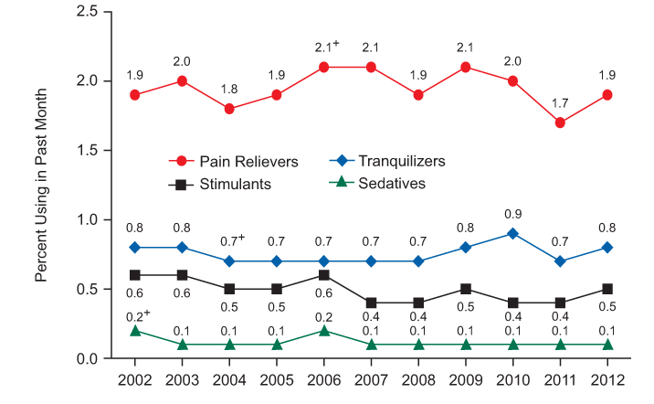
Percentage of US Population with Past Month Use of Pharmaceuticals, by Type
SOURCE: SAMHSA, NSDUH, 2012 Results.
Notes:
phoenix may 2004
71
The number and percentage of persons aged 12 or older who were current nonmedical users of pain relievers in 2012 (4.9 million or 1.9 percent) were similar to those in 2011 (4.5 million or 1.7 percent) and in 2007 to 2010 (ranging from 4.7 million to 5.3 million and from 1.9 to 2.1 percent)
While prescription opioid abuse is a growing risk factor for starting heroin use, only a small fraction of people who abuse pain relievers switch to heroin use. According to general population data from the National Survey on Drug Use and Health, less than 4 percent of people who had abused prescription opioids started using heroin within 5 years. This suggests that prescription opioid abuse is just one factor in the pathway to heroin. Furthermore, analyses suggest that those who transition to heroin use tend to be frequent users of multiple substances (Poly Drug Users).
REFERENCES:
Muhuri, P.K., Gfroerer, J.C., & Davies, M.C. (2013). Substance Abuse and Mental Health Services Administration. Associations of nonmedical pain reliever use and initiation of heroin use in the United States. CBHSQ Data Review. Available at: http://www.samhsa.gov/data/2k13/DataReview/DR006/nonmedical-pain-reliever-use-2013.pdf.
Jones, C.M., Logan, J., Gladden, R.M., & Bohm, M.K. (2015). Vital signs: demographic and substance use trends among heroin users – United States, 2002-2013. Morbidity and Mortality Weekly Report (MMWR). Atlanta, GA: Centers for Disease Control and Prevention. Availablet at: https://www.drugabuse.gov/publications/research-reports/relationship-between-prescription-drug-abuse-heroin-use/subset-users-may-naturally-progress-rx-opioids-to-heroin.

Slide 72
Notes:
In the bar graph on the left you can see the increasing number of oxycodone (blue bars) and hydrocodone prescriptions (red bars) written in the United States covering the years 1998 through 2012, with nearly 250 million prescriptions written for opioids in 2012.
In the graph on the right (blue bars) covering 1999 through 2013 the number of prescription opioid related deaths, with the blue line representing the number male and the red line representing the number of female fatalities. As the number of prescriptions increases, so do the associated number of fatalities. This is not a coincidence.
REFERENCE:
Centers for Disease Control and Prevention, available at: http://wonder.cdc.gov/.

Slide 73
Notes:
We’ve seen the increase in prescription drug use over the past 15 years, and an associated increase in heroin use, which has yet to plateau. The graph on the left shows past year reported heroin use has more than doubled from the period beginning 2002 and ending in 2014. As is expected, as heroin use has increased, so too have heroin related overdoses over the same period of time.
REFERENCE:
National Survey on Drug Use and Health (NSDUH), 2015.

Slide 74
Notes:
Following its introduction mid-2010, the use of OxyContin begins to taper off, and it’s not a coincidence the heroin use began increasing as the same time. The graph on the right shows that 70% respondents who endorsed having used OxyContin in the past month, ultimately ended up switching to heroin. This further highlights what Dr. Volkow was talking about how the medical community directly contributed to this most recent opioid epidemic.
REFERENCE:
Cicero, T.J., Ellis, M.S., Surratt, H.L., & Kurtz, .SP. (2014). The changing face of heroin use in the United States: A retrospective analysis of the past 50 years. JAMA Psychiatry, 71(7), 821-826.

Slide 75
Opioids and Opiates What we’ll cover today
What are they? & What do they do?
Where do they come from?
Why do we care?
Who’s using them?
How did we get here?
What are we doing about it?
Notes:
Now that we understand opioids, where they come from, their impact, who’s using them and how we got to where we are, let’s take at what we are doing about the epidemic.

Slide 76
Treatment for Opioid Addiction
Notes:
Buprenorphine, methadone, and depot naltrexone (a long-acting formulation of the opioid antagonist naltrexone)—a group of treatments known as medication-assisted treatments or MAT—have been demonstrated to help patients recover from opioid use disorder, improve their social functioning, and reduce their risks for overdose and for contracting HIV or hepatitis C; buprenorphine and methadone have also been shown to lessen patients’ risk of criminal activity.
Although these medications are highly cost-effective and far more successful at preventing relapse and illicit drug use than detoxification followed by abstinence, fewer than half of private treatment programs offer them. In those that do, only 34.4% of patients actually are prescribed them. This is why increasing the adoption of MAT—and overcoming the misconceptions and stigma that have stood in the way of using medications to treat drug addiction—is a central prong of the recently announced HHS and White House initiatives on combating the opioid problem in America. One problem that we are facing is that treatment need currently exceeds treatment capacity.
REFERENCE:
https://www.hhs.gov/about/news/2015/06/11/opioid-epidemic-medication-assisted-treatment-need-significantly-exceeds-capacity.html.

Slide 77
Nora Volkow, MD
Notes:
This slide contains a movie clip that will play when the trainer clicks on the mouse one time. In order for this to work, the connection between the PowerPoint presentation and the video file must be maintained. When moving the PowerPoint file to another location on your computer or to another computer, make sure to always move the video file along with it. If the link becomes broken, the video will need to be reinserted. Delete the still video image that appears on the screen. From the insert menu in PowerPoint, select “movie.” Select the video file that was included for this training. When asked, indicate that the movie should play automatically. It will appear as a black box on the screen.
In this, the second video, Dr. Volkow speaks to the tools that clinicians have to address the opioid epidemic. Let’s hear what she has to say.
VIDEO SOURCE:
Quality Talks: Available at: https://www.youtube.com/watch?v=R5qbz4A92PQ.

Slide 78
What are we doing about it?
CDC Prescribing Guidelines
Educational initiatives delivered in school and community settings (primary prevention)
Supporting consistent use of prescription drug monitoring programs (PDMPs)
Implementation of overdose education and naloxone distribution programs to issue naloxone directly to opioid users and potential bystanders
Aggressive law enforcement efforts to address doctor shopping and pill mills
Diverting individuals with substance use disorders to Drug Courts
Expansion of access to MAT
Abuse-deterrent formulations for opioid analgesics
Notes:
The medical community has responded to the opioid epidemic in a rather systematic and comprehensive manner by evaluating and updating prescribing guidelines, developing educational initiatives, funding prescription drug monitoring programs, implementing overdose education, and naloxone distribution programs, cracking down on pill mills and reducing doctor shopping, enhancing the availability of drug courts, expanding access to medication-assisted-treatment and finally by developing abuse-deterrent-formulations. As you will see in the coming slides, we have the tools and knowledge to address the opioid epidemic.
REFERENCE:
https://www.drugabuse.gov/about-nida/legislative-activities/testimony-to-congress/2016/what-federal-government-doing-to-combat-opioid-abuse-epidemic

Slide 79
A Brief History of Opioid Treatment
1964: Methadone is evaluated for the treatment of opioid use disorder
Civil Commitment Programs are approved
1974: Narcotic Treatment Act limits methadone treatment to specifically licensed Opioid Treatment Programs (OTPs).
1984: Naltrexone is approved, but has continued to be rarely used (approved in 1994 for alcohol addiction).
1993: Levo-Alpha-Acetylmethadol (ORLAAM) is approved (for non-pregnant patients only),
Notes:
The history of opioid treatment is relatively brief, though really hasn’t changed much in the last 60 years. Methadone and naltrexone are being used, and new comers to the market like buprenorphine and the implantable version of buprenorphine, Probuphine are being prescribed by primary care providers with what is referred to as the “X” Waiver provided to physicians who take a special course in the treatment of opioid use disorders with medications.
REFERENCES:
https://www.ncbi.nlm.nih.gov/books/NBK64157/
https://www.samhsa.gov/medication-assisted-treatment/buprenorphine-waiver-management

Slide 80
A Brief History of Opioid Treatment, Continued
2000: Drug Addiction Treatment Act of 2000 (DATA 2000) expands the clinical context of medication-assisted opioid treatment.
2002: Tablet formulations of buprenorphine (Subutex®) and buprenorphine/naloxone (Suboxone®) were approved by the Food and Drug Administration (FDA).
2004: Sale and distribution of ORLAAM® is discontinued.
2016 Probuphine (implantable buprenorphine is approved by the FDA
Notes:
The Drug Addiction Treatment Act of 2000 (DATA 2000) expands the clinical context of medication-assisted opioid dependency treatment. Qualified physicians are permitted to dispense or prescribe specifically approved Schedule III, IV, and V narcotic medications (medications that have a lower risk for abuse, like buprenorphine) in settings other than an opioid treatment program (OTP) such as a methadone clinic. OTPs provide medication-assisted treatment (MAT) for people diagnosed with an opioid use disorder. This is a really big deal as for the first time in 90 years physicians can provide medication to individuals diagnosed with opioid use disorder outside of the confines of an OTP.
REFERENCE: https://www.samhsa.gov/medication-assisted-treatment/buprenorphine-waiver-management

Slide 81
Notes:
This diagram was taken from the National Institute on Drug Abuse, Principles of Addiction Treatment, A Research-Based Guide which describes all the necessary components of effective treatment for substance use disorders. As you can see this is a comprehensive plan meant to address complicated issues cutting across the whole of an individual’s existence.
REFERENCE:
National Institute on Drug Abuse, National Institutes of Health, U.S. Department of Health and Human Services. (2012). Principles of Addiction Treatment, A Research-Based Guide, Third Edition, NIH Publication No. 12–4180. Available at: https://www.drugabuse.gov/sites/default/files/podat_1.pdf.

Slide 82
Principles of Drug Addiction Treatment: A Research-Based Guide
Addiction is a complex but treatable disease that affects brain function.
No single treatment is appropriate for everyone.
Treatment needs to be readily available.
Effective treatment attends to multiple needs of the individual, not just his or her drug use.
Remaining in treatment for an adequate period of time is critical
Behavioral therapies-including individual, family, or group counseling-are the most commonly used forms of drug us treatment.
Medications are an important element of treatment for many patients, especially when combined with counseling and other behavioral therapies.
An individual’s treatment and services plans must be assessed continually and modified as necessary to ensure that it meets his or her changing needs.
Many drug-addicted individuals also have other mental disorders.
Medically assisted detoxification is only the first stage of addiction treatment and by itself does little to change long-term drug use.
Treatment does not need to be voluntary to be effective.
Drug use during treatment must be monitored continuously, as lapses during tx occur.
Treatment programs should test for HIV/AIDS, Hepatitis B and C, tuberculosis and other infectious diseases as well as provide targeted risk-reduction counseling, linking patients to treatment as necessary.
Notes:
Listed here are the 13 principles of effective treatment that a panel of national experts agreed should guide the provision of treatment.
REFERENCE:
National Institute on Drug Abuse, National Institutes of Health, U.S. Department of Health and Human Services. (2012). Principles of Addiction Treatment, A Research-Based Guide, Third Edition, NIH Publication No. 12–4180. Available at: https://www.drugabuse.gov/sites/default/files/podat_1.pdf.

Slide 83
Notes:
This bar graph shows the number of folks entering publically funded treatment programs by illicit drug. While not an illicit drug, alcohol continues to dominate overall treatment admissions. In 2013 there were just under 500,000 treatment admissions to publically fund programs. This does not include admissions to private programs which would drive the number higher yet. The number of people reporting current heroin use tripled between 2007 (161,000) and 2014 (435,000.) Deaths due to synthetic opioids increased 79% from 2013 to 2014.
REFERENCES:
Substance Abuse and Mental Health Services Administration, Center for Behavioral Health Statistics and Quality. Treatment Episode Data Set (TEDS): 2004-2013. National Admissions to Substance Abuse Treatment Services. BHSIS Series S-84, HHS Publication No. (SMA) 16-4986. Rockville, MD: Substance Abuse and Mental Health Services Administration, 2015.
U.S. Drug Enforcement Administration. (2016). National Heroin Threat Assessment Summary.

Slide 84
FDA Approved Medications
Naltrexone
Methadone
Buprenorphine
Buprenorphine/Naloxone
Notes:
In this next set of slides we will look at several medications that have been approved by the Food and Drug Administration for the treatment of opioid use disorders, including naltrexone, naloxone, methadone, buprenorphine and the combination of buprenorphine/naloxone. Patients on methadone were over four times more likely to stay in treatment and had 33 percent fewer opioid-positive drug tests compared to patients treated with placebo; Methadone treatment significantly improves treatment outcomes alone and when added to counseling; long-term (beyond six months) outcomes are better for patients receiving methadone, regardless of counseling received; Buprenorphine treatment significantly decreased the number of opioid-positive drug tests, multiple studies found a 75-80 percent reduction in the number of patients testing positive for opioid use; Methadone and buprenorphine are equally effective at reducing opioid use; no differences were found in opioid-positive drug tests or self-reported heroin use when treating with these medications.

Slide 85
Naltrexone
Revia ® or Depade ®
Notes:
Let’s first take a look at the narcotic antagonist Naltrexone which also goes by the brand names Revia and Depade.

Slide 86
How do Opioids Work?
Partial vs. Full Opioid Agonist
Full Agonist
(e.g., methadone)
Opioid
Effect
Partial Agonist
(e.g. buprenorphine)
Antagonist
(e.g. naloxone)
Dose of Opioid
Notes:
86
This slide graphically depicts the different types of opioids (whether they are prescribed medications such as Vicodin or methadone, or an illicit substance, like heroin).
Move forward to reveal first line (full agonist)
Full agonists (e.g., heroin, opium, Vicodin, methadone, etc.) fully activate the receptors so that the more you use, the more effect you experience. If someone continues to use, they will eventually experience overdose and, possibly, death.
The following metaphor may be helpful in explaining the differences between the types of opioids:
Opioid agonists work like having the right key to a door. You put the key in the lock, the lock turns and the door opens completely.
Move forward to reveal the next line (antagonists)
Opioid antagonists (e.g., naltrexone, naloxone) fill the receptors and block the action of other opioids. If the person has used an opioid agonist, the antagonist will replace it on the receptor and the person will experience withdrawal. If the person is stable on an antagonist, and uses another opioid, the antagonist will block the effects, preventing the user from experiencing the high.
The door metaphor continued:
Opioid antagonists work like having the wrong key to a door. You put the key in the lock; the door remains locked and will not open. Additionally, since the key is in the lock, no other key can be put in the lock (even if it is the right key for that door) until the wrong key is removed.
Move forward to reveal the last line (partial agonists)
Opioid partial agonists (e.g., buprenorphine) are in the middle. At lower doses, they work just like agonists, filling the receptor and preventing withdrawal symptoms. However, as the dose increases, a ceiling effect occurs so that if more is used, no more effect is achieved. This ceiling effect applies both to opioid euphoria (they don’t feel high), and to the respiratory suppression (making overdose less likely).
The door metaphor continued:
Opioid partial agonists work like having the right key to a door, but the chain is on the door. The key goes in and opens the door, but it will only open so far.

Slide 87
Naltrexone for Extended-Release Injectable Suspension
Vivitrol®
Notes:
This is the long-acting (28 days) injectable formulation of Naltrexone. The pill formulation of naltrexone comes in a 50 mg pill and can be taken on a daily basis or 3 times weekly doses of 100 mg on Mon and Wed and 150 mg on Friday. The major difference between the tablet and the injectable formulation, besides the duration of action has to do with medication compliance. With the injectable formulation, a decision to remain on the medication only has to be made once per month, while with the tablet a decision must be made daily, or several times weekly.

Slide 88
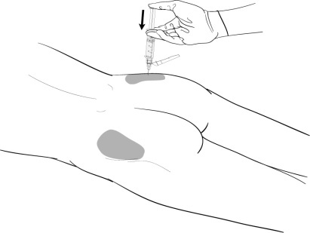
Extended-Release Naltrexone Administration
Amount: one 380mg injection
Method: deep muscle in the buttock
Frequency: every 4 weeks
Must be administered by a healthcare professional and should alternate
buttocks each month.
Notes:
88
The medication should be stored in a refrigerator and should be allowed to warm to room temperature prior to the injection. It should be noted that the gauge of the syringe is relatively large and patients routinely complain about the pain.
REFERENCE:
Substance Abuse and Mental Health Services Administration. (2012). An Introduction to Extended-Release Injectable Naltrexone for the Treatment of People With Opioid Dependence. Advisory, Volume 11, Issue 1.

Slide 89
How Does Extended-release Naltrexone Work?
Extended-release naltrexone works in the brain exactly like oral naltrexone.
Blocks opioid receptors for one entire month compared to approximately 28 doses of oral naltrexone to receive the same longevity.
Since it is an intramuscular injection and not an implanted device, it is not possible to remove it from the body once extended-release naltrexone has been injected.
Notes:
89
Read through the slide touching on each of the bullet points regarding the similarity between the two formulations, tablet and extended-release, the duration of action, 28 days and the difficulty of removing the medication once it has been injected.
Re-review the information on antagonists that you just presented on slide #86. This is something that people don’t always get on the first pass, so a second presentation of the material is usually welcomed.
Opioid antagonists (e.g., naltrexone, naloxone) fill the receptors and block the action of other opioids. If the person has used an opioid agonist, the antagonist will replace it on the receptor and the person will experience withdrawal. If the person is stable on an antagonist, and uses another opioid, the antagonist will block the effects, preventing the user from experiencing the high.
The door metaphor continued:
Opioid antagonists work like having the wrong key to a door. You put the key in the lock; the door remains locked and will not open. Additionally, since the key is in the lock, no other key can be put in the lock (even if it is the right key for that door) until the wrong key is removed.
REFERENCE:
Substance Abuse and Mental Health Services Administration. (2012). An Introduction to Extended-Release Injectable Naltrexone for the Treatment of People With Opioid Dependence. Advisory, Volume 11, Issue 1.

Slide 90
Additional Information for Extended-Release Naltrexone
Addictive Properties: Not addictive, no high abuse liability, does not build tolerance, nor produce withdrawal symptoms when the medication is ceased. There were no reports of misuse, such as injection, smoking or prescription deviation during the clinical trials. However, administering naltrexone will invoke opioid withdrawal symptoms in patients who are physically dependent on opioids.
Cost: The price of extended-release naltrexone varies from $1,350 to nearly $1,700 per injection.
Third-Party Payer Acceptance: Approximately 90% of patients thus far have received insurance coverage with no restrictions. In addition, extended-release naltrexone now has a J code for payors.
Notes:
90
Does not produce a physical dependence, nor tolerance. It does not produce withdrawal symptoms and generally there is no “street value.”
The cost has gone up significantly in the last few years and has a purchase price from $1,350 to $1,700.
The majority of individuals accessing extended-release naltrexone are doing so through their insurance or third-party coverage.

Slide 91
Research About Extended-Release Naltrexone
When compared to placebo, those receiving extended release naltrexone:
Had fewer opioid positive urines
Stayed in treatment longer
Had less craving
Showed greater improvement in the mental component of quality of life and overall health status
Krupitsky, et al., 2010
Notes:
This was a double-blind, placebo-controlled, randomized trial with patients diagnosed with opioid use disorder. Inclusion criteria: aged 18 years or over, with 30 days or less of inpatient detoxification and 7 days or more off all opioids. There were 13 clinical sites in Russia (Russia does not have, or allow opioid agonist treatment.) Patients were randomly assigned patients 380 mg XR-NTX or placebo. Participants also received 12 biweekly counselling sessions. The primary endpoint was abstinence for weeks 5–24, assessed by urine drug screens and self-report.
REFERENCE:
Krupitsky, E., Nunes, E.V., Ling, W., Illiperuma, A., Gastfriend, D.R., & Silverman, B.L. (2011). Injectable extended-release naltrexone for opioid dependence: a double-blind, placebo-controlled, multicenter randomised trial. Lancet, 377, 1506-1513. DOI:10.1016/S0140-6736(11)60358-9.

Slide 92
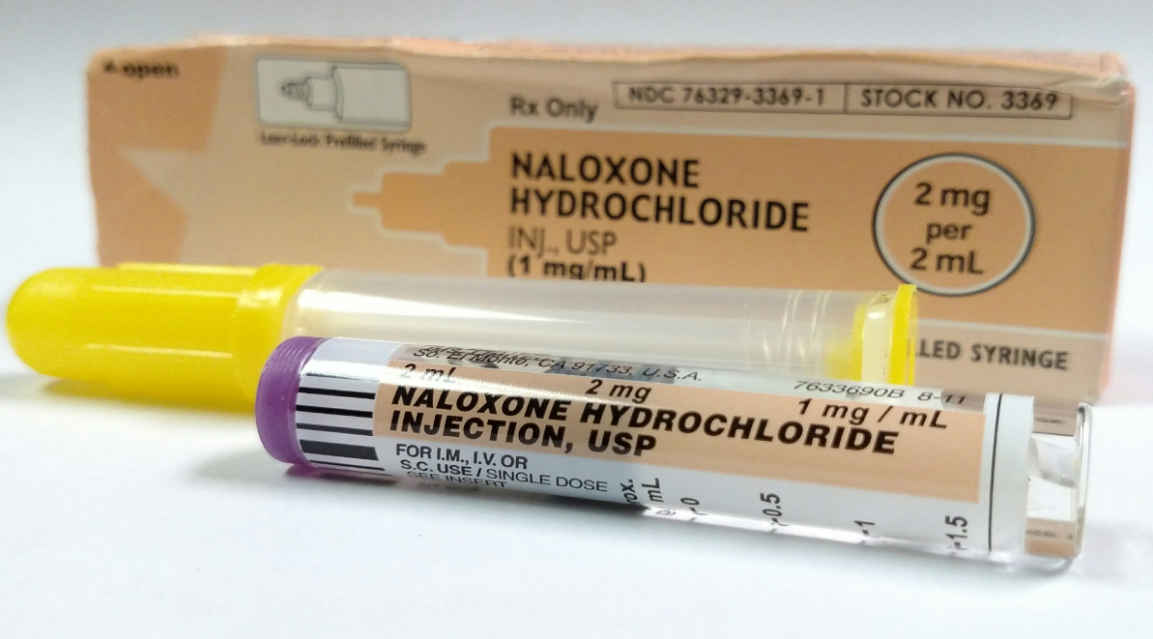
Naloxone for Opioid Overdose
Notes:
We’re going to shift gears here and talk about saving lives through the use of the narcotic antagonist Naloxone.
IMAGE CREDIT:
Wikimedia Commons.

Slide 93
Naloxone-Narcotic Antagonist
Used to counteract life-threatening depression of the central nervous system and respiratory system.
Non-scheduled.
Non-addictive.
Works only if opioids are present.
No abuse potential.
Can be injected or used nasally.
Wears off in 20 – 90 minutes.
Notes:
Naloxone is a medication designed to rapidly reverse opioid overdose. It is an opioid antagonist—meaning that it binds to opioid receptors and can reverse and block the effects of other opioids. It can very quickly restore normal respiration to a person whose breathing has slowed or stopped as a result of overdosing with heroin or prescription opioid pain medications.

Slide 94
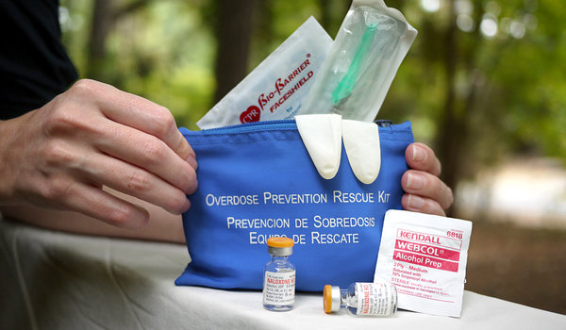
Notes:
The FDA has approved three formulations of naloxone:
Injectable (professional training required):
Generic brands of injectable naloxone vials are offered by a variety of companies that are listed in the FDA Orange Book under “naloxone” (look for "injectable").
Note: There has been widespread use of improvised emergency kits that combine an injectable formulation of naloxone with an atomizer that can deliver naloxone intranasally. Use of this product requires the user to be trained on proper assembly and administration. These improvised intranasal devices may not deliver naloxone levels equivalent to FDA-approved products. In fact, the manufacturer of an intranasal atomizer device issued a voluntary recall on October 27, 2016 noting that some of the devices “may not deliver a fully atomized plume of medication, making the drug potentially less effective.”An approved, prefilled nasal spray is now available (see below).
Prepackaged Nasal Spray:
NARCAN® Nasal Spray is a prefilled, needle-free device that requires no assembly and is sprayed into one nostril while patients lay on their back.
Note: Both NARCAN® Nasal Spray and EVZIO® are packaged in a carton containing two doses to allow for repeat dosing if needed. They are relatively easy to use and suitable for home use in emergency situations.
REFERENCE:
National Institute on Drug Abuse (2016), available at: https://www.drugabuse.gov/related-topics/opioid-overdose-reversal-naloxone-narcan-evzio.
IMAGE CREDIT: Harm Reduction Coalition, photo by Nabarun Dasgupta, 2018.

Slide 95
Narcan Nasal Spray
Adapt Pharma
Partnership through the Clinton Health Matters Initiative-Free to all high schools and colleges in the U.S.
Local & state government agencies $75.00 per dual pack.
Without a prescription $110.00 through a local pharmacy.
Notes:
On January 25, 2016, Adapt Pharma announced a partnership with the Clinton Health Matters Initiative, an initiative of the Clinton Foundation, as part of its work to scale naloxone access efforts nationally. Through this partnership and in close collaboration with state departments of education, Adapt Pharma will offer a free carton of NARCAN® Nasal Spray to all high schools in the United States.
NARCAN® Nasal Spray is available for public interest pricing through U.S. Communities Cooperative Purchasing Program, an organization providing products at a discounted price to local and state government agencies, school districts (K-12), higher education institutions, and nonprofits. Through this cooperative, NARCAN® Nasal Spray is available at $75 per dual-pack ($37.50 per dose).
At the time of this writing, CVS pharmacy carried Narcan, though Walgreens did not.
Adapt Pharma/Clinton Health Matters Initiative Collaboration: One-time Experience Donation of Narcan Nasal Spray, April 2017.
REFERENCE: National Institute on Drug Abuse. (2016), available at: https://www.drugabuse.gov/related-topics/opioid-overdose-reversal-naloxone-narcan-evzio.
IMAGE CREDIT:
Flikr, labeled for non-commercial re-use.

Slide 96
Naloxone auto-injector
Designed to be used by people who do not have medical training
Includes verbal instructions to guide its use
When pressed against the thigh, the needle automatically injects, delivers medicine, and retracts
Contains one 0.4 mg dose of naloxone
Notes:
EVZIO® is a prefilled auto-injection device that makes it easy for families or emergency personnel to inject naloxone quickly into the outer thigh. Once activated, the device provides verbal instruction to the user describing how to deliver the medication, similar to automated defibrillators. “In 2014, when Evzio was approved in the US, the list price was $575 for a two-pack. Now, it has a list price of $4,500 — an increase of 680%.” (Business Insider, February 2017)
REFERENCE: National Institute on Drug Abuse. (2016), available at: https://www.drugabuse.gov/related-topics/opioid-overdose-reversal-naloxone-narcan-evzio.

Slide 97
Naloxone: Important Considerations
Not a replacement for emergency medical treatment
After using the pen, client must immediately seek medical care
Many opioids are long-acting, and naloxone may not last as long as the opioid
If overdose symptoms return, a second dose may be needed
Notes:
The duration of action of most opioids is likely to exceed that of naloxone, resulting in a return of respiratory or central nervous system depression after an initial improvement in symptoms. Therefore, emergency medical assistance must be sought immediately after delivering the first dose from a naloxone auto-injector or nasal spray. In addition, the patients must remain under continued surveillance, and repeat doses of naloxone from a new auto-injector or nasal spray should be administered as necessary. Additional supportive and resuscitative measures may be helpful while awaiting emergency medical assistance.
REFERENCE:
Prescribers Digital Reference, available at: http://www.pdr.net/drug-summary/Narcan-naloxone-hydrochloride-3837.

Slide 98
Notes:
With the increase on opioid overdoses, law enforcement officers may be first on the scene of a suspected overdose, consequently more and more departments are equipping officers with naloxone as an antidote to reverse the opioid effects. That brings up the issue of legal liability.
Leo Beletsky and colleagues at Northeastern University searched legal databases to see of administration of naloxone raised the risk of legal liability for law enforcement administering naloxone and found that the risk is not increased.
“We discovered no cases brought as a result of naloxone administration by [law enforcement officers], which is perhaps not surprising because that practice is relatively new,” the researchers wrote, noting that some 220 law enforcement agencies in 24 states now carry the drug. “However,” they added, “we also did not find any cases regarding the prescription, distribution, or administration of naloxone via community distribution programs, which have been operating for more than a decade and have been involved in more than 10,000 reversals.”
REFERENCE:
News@Northeastern, Health, Jason Kornwitz, Legal Experts: Law Enforcement Officers Should Be Authorized to Administer Overdose Antidote, June 15, 2015.

Slide 99
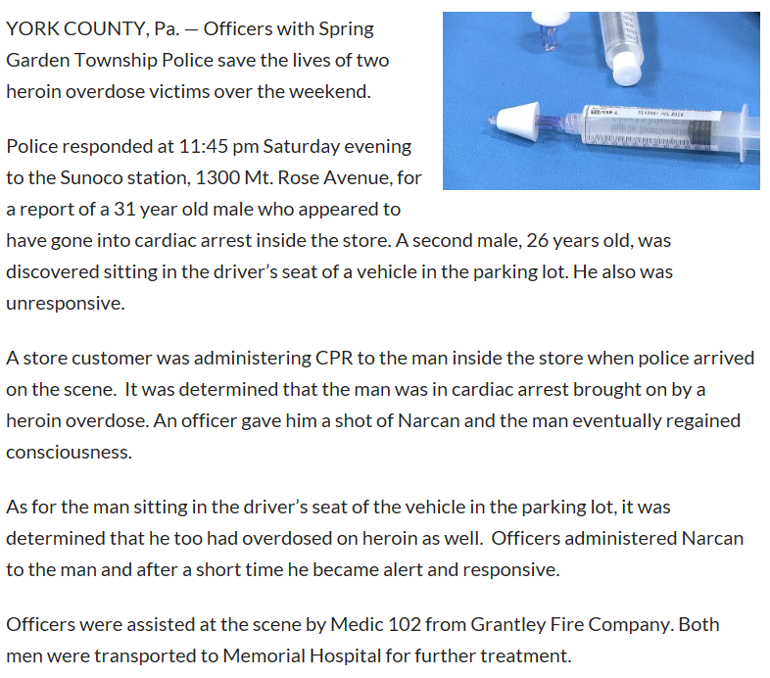
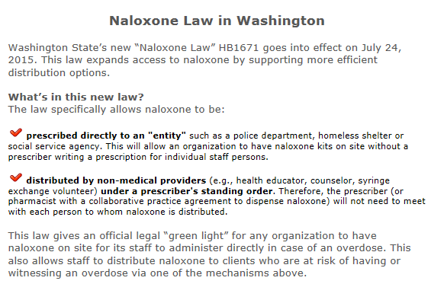
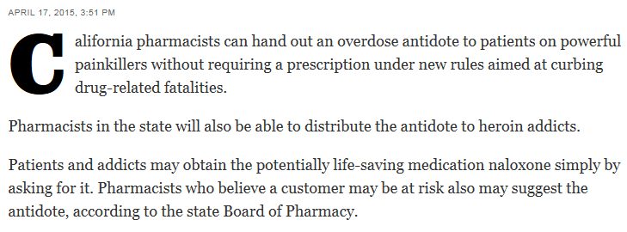
Notes:
This slide show the images of a number of news releases and newspaper articles regarding the use of naloxone by family members, and first responders.
REFERENCES:
Los Angeles Times, April 17, 2015.
Food and Drug Administration. Information about Naloxone
https://www.fda.gov/drugs/drugsafety/postmarketdrugsafetyinformationforpatientsandproviders/ucm472923.htm.
Washington State Department of Health
http://www.doh.wa.gov/YouandYourFamily/PoisoningandDrugOverdose/OpioidMisuseandOverdosePrevention.

Slide 100
Notes:
To encourage people to seek out medical attention for an overdose or for follow-up care after naloxone has been administered, 37 states and the District of Columbia have enacted some form of a Good Samaritan or 911 drug immunity law. These laws generally provide immunity from arrest, charge or prosecution for certain controlled substance possession and paraphernalia offenses when a person who is either experiencing an opiate-related overdose or observing one calls 911 for assistance or seeks medical attention. State laws are also increasingly providing immunity from violations of pretrial, probation or parole conditions and violations of protection or restraining orders.
The scope of what offenses and violations are covered by immunity provisions varies by state. Some states have opted for more restricted immunity while others, like Vermont, have provided immunity from a more expansive list of controlled substance offenses.
These laws often require a caller to have a reasonable belief that someone is experiencing an overdose emergency and is reporting that emergency in good faith. Good faith is often defined to exclude seeking help during the course of the execution of an arrest or a search warrant. Some laws also specify that immunity for covered offenses is not ground for suppression of evidence of other crimes. Other requirements frequently include remaining on scene until help arrives and cooperating with emergency personnel when they arrive.
REFERENCE:
National Conference of State Legislatures. Good Samaritan Overdose Immunity Laws, available at: http://www.ncsl.org/research/civil-and-criminal-justice/drug-overdose-immunity-good-samaritan-laws.aspx.

Slide 101
Notes:
“Get Naloxone Now is an online resource to train people to respond effectively to an opioid-associated overdose emergency. Get Naloxone Now advocates for widespread access to overdose education and training in how to administer naloxone, the life-saving antidote for opioid-associated overdose. Get Naloxone Now seeks to increase the number of lives saved by bystanders and professional first responders (police officers, firefighters and EMTs). Find out how you can contribute to reducing overdose deaths by accessing our online training modules.”
Funding to develop the training modules was provided by the National Institutes of Health, National Institutes on Drug Abuse, Grant #1R43D033746-01 and Grant #1R43DAO29358-01A1.
REFERENCE:
http://www.getnaloxonenow.org/

Slide 102
Methadone
Dolophine ®
Methadose ®
Notes:
Methadone has been used for decades to treat people who are addicted to heroin and narcotic pain medicines. When taken as prescribed, it is safe and effective. It allows people to recover from their addiction and to reclaim active and meaningful lives. For optimal results, patients should also participate in a comprehensive medication-assisted treatment (MAT) program that includes counseling and social support.
REFERENCE:
https://www.samhsa.gov/medication-assisted-reatment/treatment/methadone.
IMAGE CREDIT:
Matrix Institute, 2018.
Methadone is a long-acting synthetic opioid agonist medication that can prevent withdrawal symptoms and reduce craving in opioid-addicted individuals. It can also block the effects of illicit opioids. It has a long history of use in treatment of opioid dependence in adults and is taken orally. Methadone maintenance treatment is available in all but one State (Wyoming) through specially licensed opioid treatment programs or methadone maintenance programs.
Methadone (Dolophine® or Methadose®) is a slow-acting opioid agonist. Methadone is taken orally so that it reaches the brain slowly, dampening the “high” that occurs with other routes of administration while preventing withdrawal symptoms. Methadone has been used since the 1960s to treat heroin addiction and is still an excellent treatment option, particularly for patients who do not respond well to other medications. Methadone is only available through approved outpatient treatment programs, where it is dispensed to patients on a daily basis.

Slide 103
Notes:
Patients taking methadone to treat opioid addiction must receive the medication under the supervision of a physician. After a period of stability (based on progress and proven, consistent compliance with the medication dosage), patients may be allowed to take methadone at home between program visits. By law, methadone can only be dispensed through an opioid treatment program (OTP) certified by SAMHSA.
The length of time in methadone treatment varies from person to person. According to the National Institute on Drug Abuse publication Principles of Drug Addiction Treatment: A Research-Based Guide – 2012, the length of methadone treatment should be a minimum of 12 months. Some patients may require treatment for years. Even if a patient feels that they are ready to stop methadone treatment, it must be stopped gradually to prevent withdrawal. Such a decision should be supervised by a doctor.
Patients who develop a problem with methadone or have questions can access information through SAMHSA's find help.
REFERENCES:
https://www.samhsa.gov/medication-assisted-reatment/treatment/methadone.
http://dpt2.samhsa.gov/treatment/directory.aspx.

Slide 104
Methadone General Facts
(information from medication package insert)
Generic Name:
methadone hydrochloride
Marketed As:
Methadose® and Dolophine®
(among others)
Purpose:
To discourage illicit opioid use due to cravings or the desire to alleviate opioid withdrawal symptoms.
Indication:
For the treatment of moderate to severe pain not responsive to non-narcotic analgesics; for detoxification treatment of opioid addiction; for maintenance treatment of opioid addiction, in conjunction with appropriate social and medical services.
Year of FDA-Approval: 1964
Notes:
104
Methadone works by changing how the brain and nervous system respond to pain. It lessens the painful symptoms of opiate withdrawal and blocks the euphoric effects of opiate drugs such as heroin, morphine, and codeine, as well as semi-synthetic opioids like oxycodone and hydrocodone.
Methadone is offered in pill, liquid, and wafer forms and is taken once a day. Pain relief from a dose of methadone lasts about four to eight hours. SAMHSA's TIP 43: Medication-Assisted Treatment for Opioid Addiction in Opioid Treatment Programs – 2008 shows that methadone is effective in higher doses, particularly for heroin users, helping them stay in treatment programs longer.
As with all medications used in medication-assisted treatment (MAT), methadone is to be prescribed as part of a comprehensive treatment plan that includes counseling and participation in social support programs.
REFERENCES:
https://www.samhsa.gov/medication-assisted-reatment/treatment/methadone
Package Insert: http://www.google.com/url?sa=t&rct=j&q=&esrc=s&source=web&cd=1&cad=rja&uact=8&ved=0ahUKEwjVmu6O6qzVAhXEw1QKHcX5BeoQFggmMAA&url=http%3A%2F%2Fwww2.mallinckrodt.com%2FWorkArea%2FDownloadAsset.aspx%3Fid%3D2147492636&usg=AFQjCNGOq3rFAOSjTjRJ86dEI3h_doBYWQ.
IMAGE CREDIT:
Matrix Institute, 2018.

Slide 105
Additional METHADONE Information
(information from medication package insert)
Pregnancy:
Methadone is the preferred method of treatment for medication-assisted treatment for opioid dependence in pregnant women. An expert review of published data on experiences with methadone use during pregnancy concludes that it is unlikely to pose a substantial risk. But, there is insufficient data to state that there is no risk.
Methadone has not been adequately tested on pregnant women. Therefore, methadone has a Pregnancy Category C designation, meaning that it should be used during pregnancy only if the potential benefit justifies the potential risk to the fetus. Caution should be exercised when using methadone with this population.
Notes:
105
While the controversy around the use of methadone in the treatment of opioid use disorders seems to be subsiding as the impact of the opioid epidemic continues, regardless of the science in favor of, the controversy and philosophical discussion around the use of methadone and buprenorphine during pregnancy continues to rage.
Pregnant or Breastfeeding Women and Methadone. Women who are pregnant or breastfeeding can safely take methadone. When withdrawal from an abused drug happens to a pregnant woman, it causes the uterus to contract and may bring on miscarriage or premature birth. Methadone’s ability to prevent withdrawal symptoms helps pregnant women better manage their addiction while avoiding health risks to both mother and baby.
Undergoing methadone maintenance treatment while pregnant will not cause birth defects, but some babies may go through withdrawal after birth. This does not mean that the baby is addicted. Infant withdrawal usually begins a few days after birth but may begin two to four weeks after birth.
Mothers taking methadone can still breastfeed. Research has shown that the benefits of breastfeeding outweigh the effect of the small amount of methadone that enters the breast milk. A woman who is thinking of stopping methadone treatment due to breastfeeding or pregnancy concerns should speak with her doctor first.
Learn more from the SAMHSA publication Methadone Treatment for Pregnant Women – 2009.
REFERENCES:
Center for Substance Abuse Treatment. (2005). Medication-Assisted Treatment for Opioid Addiction in Opioid Treatment Programs, Treatment Improvement Protocol (TIP) Series, No. 43, SMA 12-4214. Rockville (MD): Substance Abuse and Mental Health Services Administration. Available at:
https://www.ncbi.nlm.nih.gov/books/NBK64148/.

Slide 106
Additional METHadone Information
(information from medication package insert)
Pregnancy:
Detoxification is relatively contraindicated unless done in hospital with monitoring.
Babies born to mothers who have been taking opioids regularly prior to delivery may be physically dependent and may experience opioid withdrawal symptoms. It is known that methadone is excreted through breast milk, and a decision should be made whether to discontinue nursing or to discontinue the medication, taking into account the importance of the medication to the mother and continued illicit opioid use.
Notes:
106
Heroin use during pregnancy can result in neonatal abstinence syndrome (NAS). NAS occurs when heroin passes through the placenta to the fetus during pregnancy, causing the baby to become dependent along with the mother. Symptoms include excessive crying, fever, irritability, seizures, slow weight gain, tremors, diarrhea, vomiting, and possibly death. NAS requires hospitalization and treatment with medication (often morphine) to relieve symptoms; the medication is gradually tapered off until the baby adjusts to being opioid-free. Methadone maintenance combined with prenatal care and a comprehensive drug treatment program can improve many of the outcomes associated with untreated heroin use for both the infant and mother, although infants exposed to methadone during pregnancy typically require treatment for NAS as well.
REFERENCES:
Methadone: https://www.samhsa.gov/medication-assisted-treatment/treatment/methadone
Center for Substance Abuse Treatment. (2005). Medication-Assisted Treatment for Opioid Addiction in Opioid Treatment Programs, Treatment Improvement Protocol (TIP) Series, No. 43, SMA 12-4214. Rockville (MD): Substance Abuse and Mental Health Services Administration. Available at:
https://www.ncbi.nlm.nih.gov/books/NBK64148/.
Package Insert: http://www.google.com/url?sa=t&rct=j&q=&esrc=s&source=web&cd=1&cad=rja&uact=8&ved=0ahUKEwjVmu6O6qzVAhXEw1QKHcX5BeoQFggmMAA&url=http%3A%2F%2Fwww2.mallinckrodt.com%2FWorkArea%2FDownloadAsset.aspx%3Fid%3D2147492636&usg=AFQjCNGOq3rFAOSjTjRJ86dEI3h_doBYWQ.

Slide 107
How does methadone work?
Methadone binds to the same receptor sites as other opioids.
Orally effective
Slow onset of action
Long duration of action
Slow offset of action
Notes:
Methadone works by changing how the brain and nervous system respond to pain. It lessens the painful symptoms of opiate withdrawal and blocks the euphoric effects of opiate drugs such as heroin, morphine, and codeine, as well as semi-synthetic opioids like oxycodone and hydrocodone.
Onset of analgesia occurs 10-20 minutes following parenteral administration and 30-60 minutes after oral administration. Oral administration results in a delay in onset, lower peak concentration and longer duration of action. Following single oral doses effects may last 6-8 hours, increasing to 22-48 hours in cases of chronic administration.
REFERENCE: Kreek, M.J. (1992) Rationale for maintenance pharmacotherapy of opiate dependence. Research Publications – Association for Research in Nervous and Mental Disease, 70, 205-230.
National Highway Traffic Safety Administration, Drugs and Human Performance Fact Sheets, available at:
https://one.nhtsa.gov/people/injury/research/job185drugs/methadone.htm.

Slide 108
Methadone Maintenance: Advantages
Suppresses opioid withdrawal and reduces craving
Oral administration (syrup or tablet forms used)
Once daily doses enable lifestyle changes
Counselling promotes long-term lifestyle changes
Reduced participation in crime
Reduced transmission of blood borne viruses
Few long-term side-effects.
Notes:
There are a few long-term health effects from use of methadone. Those known include:
weight gain, possibly influenced by fluid retention and dietary changes
reduced production of saliva – may contribute to dental problems
endocrine changes – may result in impotence, low libido, disrupted menstrual cycle
may be harmful in presence of underlying disease; e.g. kidney or liver problems
some effects disappear when dose is adjusted.
The health benefits of methadone include those listed along with the following:
Reduction in the use of illicit drugs
Reduction in criminal activity
Reduction in needle sharing
Reduction in HIV infection rates and transmission
Cost-effectiveness
Reduction in commercial sex work
Reduction in the number of reports of multiple sex partners
Improvements in social health and productivity
Improvements in health conditions
Retention in addiction treatment
Reduction in suicide
Reduction in lethal overdose
REFERENCE:
NIDA International Program, Methadone Research Web Guide, available at: https://www.samhsa.gov/medication-assisted-treatment/treatment/methadone.

Slide 109
Advantages of Methadone
Heroin, Painkillers
Methadone
Serum level
8AM
Noon
4PM
8PM
MN
4AM
8AM
Notes:
This slide has several animations demonstrating the half-life of heroin and short acting painkillers or opioid analgesics versus that of methadone.
What we are trying to show is an individual using heroin must re-administer the drug multiple times over the course of her/his day, generally every four to six hours. This repeated administration requires that the individual spend all of their waking hours hustling to get money to purchase the drug, finding and hooking up with their connection or drug dealer, finding a suitable location where she/he can use without being disturbed and enjoy the effects of the drug. This routine leaves little time in one’s day to do anything else.
Methadone on the other hand can be administered once daily in most instances and will allow for an individual to take part in recovery activities including attend group and individual therapy, medical and mental health appointments, pursuing vocational and educational goals, becoming a better citizen, and repairing relationships and legal issues. What was presented on the previous slides is not an all inclusive list of recovery related activities, but rather to highlight the value of not constantly being in withdrawals, or fear of withdrawals an spending every waking moment trying to obtain enough heroin to stay well.

Slide 110
Methadone Maintenance: Disadvantages
Opioid dependence is maintained
Withdrawal from methadone can be difficult
Daily travel and time commitment
Variable duration of action
Diversion
Notes:
Committing oneself to Methadone Maintenance Therapy (MMT) can be off­puting to many and interferes with work activities or travel arrangements by directing greater attention to the quality of treatment.
In their article, “A risk-benefit analysis of methadone maintenance treatment, Bell and Zador characterize the advantages and disadvantages like this: “Methadone maintenance treatment for heroin (diamorphine) addiction has been extensively researched. There is consistent evidence that while in treatment, heroin addicts are at a lower risk of death, are less involved in crime, and feel and function better than while using heroin.
Despite the research evidence supporting methadone treatment, there remains widespread public skepticism about this form of treatment. This skepticism is frequently expressed in terms of the perceived risks of methadone treatment. The perceived risk that methadone treatment may maintain people in an addicted lifestyle is not supported by research literature. The risks of treatment include an increased risk of death during induction into treatment, and risks of diversion of drugs to the black market. For some patients, adverse effects of methadone pose a problem and the availability of new pharmacotherapies may provide useful options for these patients. Risks can be reduced and benefits increased by directing greater attention to the quality of treatment.
REFERENCE:
Bell, J., & Zador, D. (2000). A risk-benefit analysis of methadone maintenance treatment. Drug Safety, 22(3), 179-90.

Slide 111
Methadone Safety Overview
Safe medication (acute and chronic dosing)
Primary side effects: like other mu agonist opioids (e.g., nausea, constipation), but may be less severe
No evidence of significant disruption in cognitive or psychomotor performance with Methadone maintenance
No evidence of organ damage with chronic dosing
Notes:
Methadone can be addictive, so it must be used exactly as prescribed. This is particularly important for patients who are allowed to take methadone at home and aren’t required to take medication under supervision at an OTP. Methadone medication is specifically tailored for the individual patient (as doses are often adjusted and readjusted) and is never to be shared with or given to others. Patients should share their complete health history with health providers to ensure the safe use of the medication.
Other medications may interact with methadone and cause heart conditions. Even after the effects of methadone wear off, the medication’s active ingredients remain in the body for much longer. Taking more methadone can cause unintentional overdose.
The following tips can help achieve the best treatment results:
Never use more than the amount prescribed, and always take at the times prescribed. If a dose is missed, or if it feels like it’s not working, do not take an extra dose of methadone.
Do not consume alcohol while taking methadone.
Be careful driving or operating machinery on methadone.
Call 911 if too much methadone is taken or if an overdose is suspected.
Take steps to prevent children from accidentally taking methadone.
Store methadone at room temperature and away from light.
Dispose of unused methadone by flushing it down the toilet.
Learn more from the SAMHSA publication Follow Directions: How to Use Methadone Safely – 2009 (also available in Spanish).
REFERENCES:
Substance Abuse and Mental Health Services Administration, available at: https://www.samhsa.gov/medication-assisted-treatment/treatment/methadone.

Slide 112
Effective Methadone Treatment
As long as necessary
Higher doses = > 60mg methadone.
Make treatment as available as possible.
Include counseling and ancillary services.
Promote quality of therapeutic relationship.
Notes:
This is a brief overview of a few aspects of effective treatment, which by any means cannot cover all the aspects of effective treatment. You are encouraged to revisit the NIDA Principles of Addiction Treatment: A Research Based Guide.
REFERENCES:
National Institute on Drug Abuse, National Institutes of Health, U.S. Department of Health and Human Services. (2012). Principles of Addiction Treatment, A Research-Based Guide, Third Edition, NIH Publication No. 12–4180. Available at: https://www.drugabuse.gov/sites/default/files/podat_1.pdf.

Slide 113
Evidence Supporting Methadone Maintenance
Notes:
The next section will review several studies supporting the use of methadone as a treatment for opioid use disorder. You may notice that these studies are not new, which is the exact reason we are presenting these day. Evidence to support the use of methadone is not new, and yet our biases and stigma against using methadone persists.)

Slide 114
Notes:
This slide demonstrates the nice dose response curve of methadone. The higher the dose the less heroin use. Vincent Dole, Marie Nyswander and Mary Jeanne Kreek were pioneers in utilizing methadone for the treatment of heroin addiction. Eric Strain and His colleagues at Johns Hopkins University in their study “Methadone dose and treatment outcome” (not shown here) evaluated two relatively low methadone doses, 50 mg and 20 mg and were also able to show that patients receiving 50 mg of methadone having significantly lower rates of opioid positive urines (36% vs. 60–73%), and self-reporting a lower frequency of heroin use (3 days vs. 11–12 days per month.
REFERENCES:
Dole, V.P. (1989). Methadone treatment and the acquired immunodeficiency syndrome epidemic. J. Am. Med. Assoc., 262, 1681-1682
Strain, E.C., Stitzer, M.L., Leibson, I.A. & Bigelow, G.D. (1993). Methadone dose and treatment outcome, Drug and Alcohol Dependence, 33(2), 105-117.

Slide 115
Reduction of Heroin Use by Length of Stay in Methadone Maintenance Treatment (Ball and Ross, 1991)
N = 617
115
Notes:
The research of Ball and Ross highlights the importance of retention in treatment as demonstrated by the reduction in heroin use 617 methadone maintained individuals. We know that recovery is not about medication alone, which is why it is so important for patients to remain in treatment, and attend to other aspects of their life including relationships, vocational and education pursuits, hobbies, spirituality, etc. Developing a recovery is more than not using drugs.
REFERENCE:
Ball, J.C., & Ross, A. The Effectiveness of Methadone Maintenance Treatment. New York: Springer-Verlag.

Slide 116
Crime Among 491 Patients Before and During MMT at 6 Programs
Crime Days Per Year
Adapted from Ball & Ross - The Effectiveness of Methadone Maintenance Treatment, 1991
116
Notes:
In the same Ball and Ross 1991 evaluation of the effectiveness of methadone treatment, they looked at crime days per year across six sites, in 491 patients before and during treatment and found significant differences across all sites.
REFERENCE:
Ball, J.C., & Ross, A. The Effectiveness of Methadone Maintenance Treatment. New York: Springer-Verlag.

Slide 117
HIV Infection Rates In and Out of Methadone Treatment (Metzger et al. 1993)
Out %
In %
117
Notes:
This slide illustrates data from this study showing differences in HIV infection rates among IDUs in and out of substitution treatment. As you can see the rates of infection were much higher in those not in treatment.
REFERENCES:
Metzger, D.S., Woody, G.E., McLellan, A.T., et al. (1993). Human immunodeficiency virus seroconversion among in- and out-of-treatment intravenous drug users: an 18-month prospective follow-up. J Acquir Immune Defic Syndr, 6, 1049-1056.

Slide 118
Relapse to IV Drug Use After Termination of Methadone Maintenance Treatment
Percentage
Months Since Drop Out
Ball, JC & Ross A The Effectiveness of Methadone Maintenace Treatment, Springer-Verlag, New York, 1991
Notes:
Ball and Ross followed their cohort of individuals after their termination from methadone maintenance treatment. Their data shows the time course of relapse following termination from treatment out to 12 months. More than 80% of the individuals relapsed to IV drug use. This could be the result of a number of factors, including their not having developed a comprehensive recovery and recovery network prior to the termination of treatment.
REFERENCE:
Ball, J.C., & Ross, A. The Effectiveness of Methadone Maintenance Treatment. New York: Springer-Verlag.

Slide 119
Mortality Rates in Treatment and 12 Months after Discharge Zanis and Woody, 1998
Notes:
Of discharged patients, 8.2% (9/110) had died, of which six were caused by heroin overdose. None of the discharged clients were in treatment at the time of death. All deaths were among clients who either dropped out of treatment or were discharged unfavorably from the program. Comparatively, only 1% (4/397) of patients died while enrolled in treatment.
REFERENCE:
Zanis, D.A., & Woody, G.E. (1998). One-year mortality rates following methadone treatment discharge. Drug and Alcohol Dependence, 52(3), 257-260.

Slide 120
The Global Response: UN and WHO Support for Maintenance Treatment
WHO / UNODC / UNAIDS position paper: Maintenance Therapy in the Management of Opioid Dependence and HIV/AIDS Prevention
“Opioid maintenance treatment is an effective, safe and cost-effective modality for the management of opioid dependence. Repeated rigorous evaluation has demonstrated that such treatment is a valuable and critical component of the effective management of opioid dependence and the prevention of HIV among IDUs.”
Notes:
The United Nations Office on Drugs and Crime, UNAIDS and the World Health Organization have come out in support the use of medications in the treatment of opioid use disorder.
REFERENCE:
World Health Organization, United Nations Office on Drugs and Crime, Joint United Nations Programme on HIV/AIDS, 2004.

Slide 121
Buprenorphine/ Naloxone
Subutex ®
Suboxone ®
Notes:
Now were going to talk somewhat about another medication in our tool kit for the treatment of opioid use disorder, Buprenorphine, and the combination Buprenorphine/naltrexone.
Buprenorphine is used in medication-assisted treatment (MAT) to help people reduce or quit their use of heroin or other opiates, such as pain relievers like morphine.
Approved for clinical use in October 2002 by the Food and Drug Administration (FDA), buprenorphine represents the latest advance in medication-assisted treatment (MAT). Medications such as buprenorphine, in combination with counseling and behavioral therapies, provide a whole-patient approach to the treatment of opioid dependency. When taken as prescribed, buprenorphine is safe and effective.
Unlike methadone treatment, which must be performed in a highly structured clinic, buprenorphine is the first medication to treat opioid dependency that is permitted to be prescribed or dispensed in physician offices, significantly increasing treatment access. Under the Drug Addiction Treatment Act of 2000 (DATA 2000), qualified U.S. physicians can offer buprenorphine for opioid dependency in various settings, including in an office, community hospital, health department, or correctional facility.
SAMHSA’s buprenorphine waiver management.
REFERENCE:
Substance Abuse and Mental Health Services Administration, available at: Clinical Guidelines for the Use of Buprenorphine in the Treatment of Opioid Addiction: Quick Guide for Physicians Based on TIP 40 – 2005.
IMAGE CREDITS:
Wikimedia Commons.

Slide 122
How Does Buprenorphine Work?
Partial Opioid Agonist
Produces a ceiling effect at higher doses
Has effects of typical opioid agonists—these effects are dose dependent up to a limit
Binds strongly to opiate receptor and is long-acting
Notes:
122
Buprenorphine has unique pharmacological properties that help:
Lower the potential for misuse
Diminish the effects of physical dependency to opioids, such as withdrawal symptoms and cravings
Increase safety in cases of overdose
Buprenorphine is an opioid partial agonist. This means that, like opioids, it produces effects such as euphoria or respiratory depression. With buprenorphine, however, these effects are weaker than those of full drugs such as heroin and methadone.
Buprenorphine’s opioid effects increase with each dose until at moderate doses they level off, even with further dose increases. This “ceiling effect” lowers the risk of misuse, dependency, and side effects. Also, because of buprenorphine’s long-acting agent, many patients may not have to take it every day.
REFERENCES:
Buprenorphine
Substance Abuse and Mental Health Services Administration, available at: Clinical Guidelines for the Use of Buprenorphine in the Treatment of Opioid Addiction: Quick Guide for Physicians Based on TIP 40 – 2005

Slide 123
The dose-response curve is probably the most iconic graph from the science of pharmacology. The graph above shows the dose-response curves for three common opioid painkillers. Notice that fentanyl is 70 times more potent than heroin, but addicts and drug abusers generally prefer heroin. Buprenorphine is about 25 times more potent than heroin but it has a lower intrinsic efficacy (IE). As a result, the solid blue buprenorphine line never crosses the dashed red total apnea line. This means that even a massive overdose of buprenorphine will not cause total apnea (total cessation of breathing), so doctors can safely give buprenorphine to recovering addicts. More details on the course home graphic. (Image courtesy of Zak Fallows.) CC-BY.
Notes:
While the graph in this slide looks complicated, it’s not. What this graph shows is the following:
The mustard color dashed line is the “normal” response of a single Vicodin tablet.
The blue dashed line is the amount of medication that someone would receive for serious pain in a hospital setting.
The red dashed line is the point where someone stops breathing, as a result of taking too much of an opioid.
As you can see, the blue line, that of buprenorphine, regardless of the dose does not put an individual at risk for total apnea or a cessation of their breathing.
In contrast, it takes a much smaller dose of fentanyl, which is 25 more times potent than heroin to cause total apnea and an overdose. The more heroin, fentanyl, or other opioid an individual takes, the greater the likelihood of an overdose.
This is not the case with buprenorphine as even in high doses it does not cause total apnea-hence, the “high safety profile.” Buprenorphine’s opioid effects increase with each dose until at moderate doses they level off, even with further dose increases. This “ceiling effect” lowers the risk of misuse, dependency, and side effects. Also, because of buprenorphine’s long-acting agent, many patients may not have to take it every day.
REFERENCES:
Buprenorphine
Substance Abuse and Mental Health Services Administration
https://www.samhsa.gov/medication-assisted-treatment/treatment/methadone
Clinical Guidelines for the Use of Buprenorphine in the Treatment of Opioid Addiction: Quick Guide for Physicians Based on TIP 40 – 2005

Slide 124
Research on Buprenorphine
Buprenorphine is marketed for opioid treatment under the trade names of Subutex® (buprenorphine) and Suboxone® (buprenorphine/naloxone)
Over 25 years of research
Over 5,000 patients exposed during clinical trials
Proven safe and effective for the treatment of opioid addiction
Notes:
124
Buprenorphine has been extensively evaluated for the treatment of opioid use disorder having undergone rigorous clinical trials comparing buprenorphine against placebo and against methadone in effectiveness.
REFERENCE:
Ling, W. et al. (2010). From research to the real world: Buprenorphine in the decade of the Clinical Trials Network. Journal of Substance Abuse Treatment, 38(Suppl 1), S53-S60.

Slide 125
Research ON Buprenorphine
Clinical trials have established the effectiveness of buprenorphine for the treatment of heroin addiction. The Effectiveness of buprenorphine has been compared to:
Placebo (Johnson et al. 1995; Ling et al. 1998; Kakko et al. 2003)
Methadone (Johnson et al. 1992; Strain et al. 1994a, 1994b; Ling et al. 1996; Schottenfield et al. 1997; Fischer et al. 1999)
Methadone and LAAM (Johnson et al. 2000)
Notes:
The American Academy of Pediatrics (in an article published online 8/22/16) recommends increasing resources to improve access to MAT of opioid-addicted adolescents and young adults. They recommend that the pediatricians consider offering MAT to adolescents and young adults with severe opioid use disorder, or discuss referrals to other providers for it.
REFERENCE:
Committee on Substance Use and Prevention. (2016). Medication-Assisted Treatment of Adolescents With Opioid Use Disorders. Pediatrics, originally published online August 22, 2016. DOI: 10.1542/peds.2016-1893.

Slide 126
Advantages of Buprenorphine/Naloxone
Combination tablet is being marketed in the U.S.
Discourages IV use
Diminishes diversion
Allows for take-home dosing
High safety profile
Notes:
Buprenorphine has unique pharmacological properties that help:
Lower the potential for misuse
Diminish the effects of physical dependency to opioids, such as withdrawal symptoms and cravings
Increase safety in cases of overdose
Buprenorphine is an opioid partial agonist. This means that, like opioids, it produces effects such as euphoria or respiratory depression. With buprenorphine, however, these effects are weaker than those of full drugs such as heroin and methadone.
Buprenorphine’s opioid effects increase with each dose until at moderate doses they level off, even with further dose increases. This “ceiling effect” lowers the risk of misuse, dependency, and side effects. Also, because of buprenorphine’s long-acting agent, many patients may not have to take it every day.
REFERENCE:
Substance Abuse and Mental Health Services Administration, available at: Clinical Guidelines for the Use of Buprenorphine in the Treatment of Opioid Addiction: Quick Guide for Physicians Based on TIP 40 – 2005.

Slide 127
Disadvantages of Buprenorphine
Maintains dependence
Allows for drug diversion
Withdrawal can be difficult
Generally requires daily or multiple-times daily dosing
Expense
Notes:
Buprenorphine’s side effects are similar to those of opioids and can include:
Nausea, vomiting, and constipation
Muscle aches and cramps
Cravings
Inability to sleep
Distress and irritability
Fever
Because of buprenorphine’s opioid effects, it can be misused, particularly by people who do not have an opioid dependency.
REFERENCE:
Substance Abuse and Mental Health Services Administration, available at: Clinical Guidelines for the Use of Buprenorphine in the Treatment of Opioid Addiction: Quick Guide for Physicians Based on TIP 40 – 2005.

Slide 128
Buprenorphine Implant
Notes:
Medications like buprenorphine and methadone have revolutionized the treatment of people with opioid use disorder, including those with severe disorders (addiction). By controlling cravings and withdrawal symptoms without producing a high, these medications enable the patient to engage in treatment and make healthier choices while balance is gradually restored in brain circuits involved in reward and self-control. In people with severe disorders, these circuits are greatly disrupted.
One of the challenges with all addiction medications, however, is making sure patients adhere to their prescribed regimen. For the medication to be effective, the patient must take their prescription or show up at the clinic on a daily basis. This can be challenging for anyone managing life’s responsibilities, especially in times of stress. Failing at this challenge can mean relapse, which can delay recovery.
This subdermal (under the skin) implant delivers a constant low dose of buprenorphine over a six-month time span, the first such tool in the treatment of opioid use disorder. The implant is approved for individuals with opioid dependence who have already been treated with, and are medically stable on, existing orally absorbed buprenorphine formulations. It thus gives physicians a valuable new therapeutic tool for this subset of patients.
Medications like buprenorphine and methadone have revolutionized the treatment of people with opioid use disorder, including those with severe disorders (addiction). By controlling cravings and withdrawal symptoms without producing a high, these medications enable the patient to engage in treatment and make healthier choices while balance is gradually restored in brain circuits involved in reward and self-control. In people with severe disorders, these circuits are
greatly disrupted.
One of the challenges with all addiction medications, however, is making sure patients adhere to their prescribed regimen. For the medication to be effective, the patient must take their prescription or show up at the clinic on a daily basis. This can be challenging for anyone managing life’s responsibilities, especially in times of stress. Failing at this challenge can mean relapse, which can delay recovery.
This subdermal (under the skin) implant delivers a constant low dose of buprenorphine over a six-month time span, the first such tool in the treatment of opioid use disorder. The implant is approved for individuals with opioid dependence who have already been treated with, and are medically stable on, existing orally absorbed buprenorphine formulations. It thus gives physicians a valuable new therapeutic tool for this subset of patients.
REFERENCE:
National Institute on Drug Abuse: Advancing Addiction Science. Nora’s Blog, available at: https://www.drugabuse.gov/about-nida/noras-blog/2016/05/probuphine-game-changer-in-fighting-opioid-dependence.
IMAGE CREDIT:
Braeburn Pharmaceuticals

Slide 129
Final Note: Behavioral Treatments
The FDA labeling on these medications is clear:
The medications should be used in combination with behavior treatments for addiction
Good treatment is holistic, integrated and multifaceted, taking into account the physical, behavioral and spiritual wellbeing of the individual.
Medications can help us take care of the physical… …we need to do the rest
Notes:
As mentioned throughout this presentation, in order to be effective, the treatment of substance use disorders must be comprehensive taking into consideration the bio-psycho-social components of an individual’s life.
REFERENCES:
National Institute on Drug Abuse, National Institutes of Health, U.S. Department of Health and Human Services. (2012). Principles of Addiction Treatment, A Research-Based Guide, Third Edition, NIH Publication No. 12–4180. Available at: https://www.drugabuse.gov/sites/default/files/podat_1.pdf.

Slide 130
What did you learn?
Notes:
INSTRUCTIONS
The purpose of the following five (5) questions is to test the pre-training level of cocaine, methamphetamine, and HIV knowledge amongst the training participants. The questions are formatted as either multiple choice or true/false questions. Read each question and the possible responses aloud, and give training participants time to jot down their response before moving on to the next question. It is now time to reveal the answers to the questions.

Slide 131
Post-Test Question
1. While Opioids and Opiates belong to the same family they are derived by a different process.
True
False
Notes:
Answer Key:
#1 – correct response is A (True)

Slide 132
Post-Test Question
Opioids act as a(n) __________ at the mu, kappa and delta receptors.
Partial agonist
Full agonist
Antagonist
Agnostic
Notes:
Answer Key:
#2 – correct response is B (Full Agonist)

Slide 133
Post-Test Question
While the majority of the world’s opium production is generated in Afghanistan, the majority of heroin coming into the United States comes from Mexico and South America.
True
False
Notes:
Answer Key:
#3 – correct response is A (True)

Slide 134
Post-Test Question
4. While Persons Who Inject Drugs account for a diminishing percentage of individuals diagnosed with HIV, injection drug use continues to present as a significant risk factor for HIV.
True
False
Notes:
Answer Key:
#4 – correct response is A (True)

Slide 135
Post-Test Question
5. People generally get their prescription pain relievers for non-medical use from which of the following sources:
Multiple doctors
A single doctor
From family or friends
From a drug dealer
All of the above
Notes:
Answer Key:
#5 – correct response is C (From family or friends)

Slide 136
Thank you for your attention
What additional questions
do you have?
www.uclaisap.org www.psattc.org
Notes:
This concludes the presentation. Thank the participants for their time and address any last-minute questions about the content. Encourage participants to reach out to the Pacific Southwest ATTC or the LA Region PAETC, should they have questions or concerns following the training session.

