Slide 1
Opioid Overdose Prevention Recognition and Response
California Opioid Maintenance providers training
October 1, 2015

Slide 3
BACKGROUND
Overdose epi Data
Naloxone Programs

Slide 4
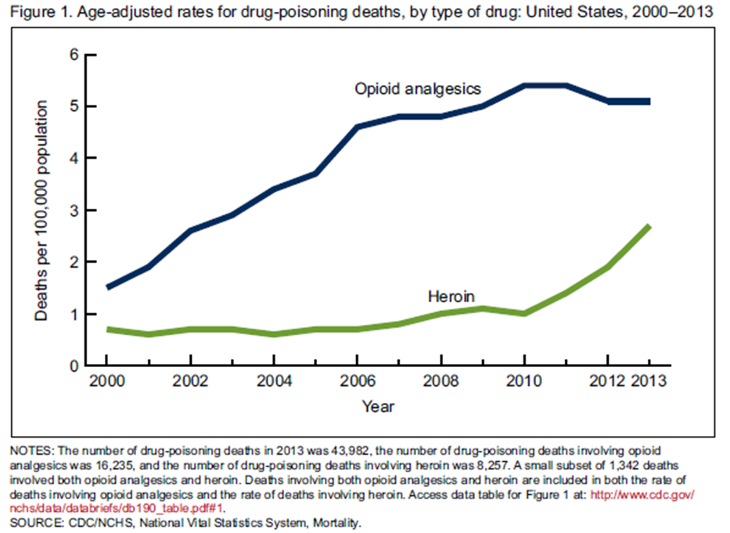
Drug Overdose Deaths in the US:
In 2013, there were 43,982 accidental overdose deaths in the US, more than motor vehicle accident deaths.
Among these, 16,235 (37%) were associated with prescription opioid analgesics (e.g., oxycodone and hydrocodone) and 8,257 (19%) with heroin

Slide 5
Notes:
This does not end with tighter regulation and increased monitoring on opioid prescription
PEOPLE TRANSITION TO CHEAPER MORE ACCESSIBLE HEROIN – DRIVING INCREASE IN HEROIN USE IN THE US

Slide 7
Video: A Miracle Drug in the Fight Against Overdose
Al Jazeera: http://bit.ly/1ML9O8H

Slide 8
Community response and naloxone
Notes:
When we talk about "tolerance" we're actually bundling a lot of
different physiological things together. We develop tolerance to
different physiological effects of opioids at different rates. No-one
ever develops tolerance to the pupil miosis (constriction). We *do*
develop tolerance to the respiratory depression effects of opioids [red
line on graph], but not as fast as we develop tolerance to the euphoric
effects of opioids [blue line].
The impact of this is that for someone with no tolerance to opioids, the
gap between the amount it takes them to get high as a kite and the
amount it takes them to stop breathing [left hand side of graph] is
actually pretty big. Whereas someone with a huge habit who is using 5
grams of heroin a day, the gap between what it takes to make them feel
high, or even what it takes to stop them feeling dopesick, and what it
takes them to stop breathing is pretty small - it's really easy for that
person to overshoot and overdose.
This is one of the reasons we see the counter-intuitive thing of most of
the people who die of overdose are people in their 30s and 40s who have
been using heroin for years - you'd expect it to be people who have only
just started using who have no idea what they're doing.

Slide 9
Concept of Lay Naloxone
Overdose usually witnessed – at least 85% ^{(McGregor, Addiction 1998)}
Death takes a while (Sporer, Ann Intern Med 1999)
EMS not routinely accessed – 50% (Coffin, Ann Emerg Med, 2009)
Naloxone very safe and very effective
( http://www.fda.gov/downloads/Drugs/NewsEvents/UCM300866.pdf)
More rapid reversal with naloxone improves outcomes – early intervention
^{(Gonzva, Am J Emerg Med 2013)}
Possible behavior change – empowerment + responsibility (Lankenau, J Comm Hlth 2013, Kral J Urb Hlth, 2005)
Notes:
Mostly Heroin research – some differences will come up over time
Fort Bragg – North Carolina - 8/mo ED, 12 death/ year – to 0 reported deaths & reversals
Major reductions – saturation – Massachsetts Model – more naloxone we get out in a community the less mortality we will see

Slide 10
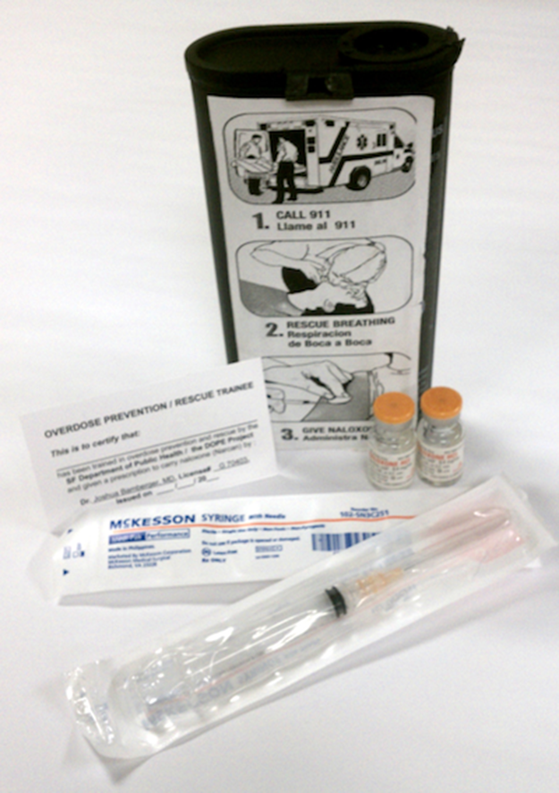
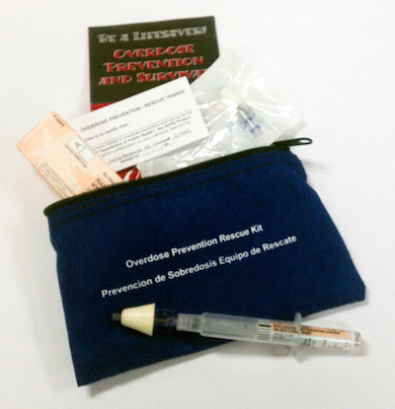
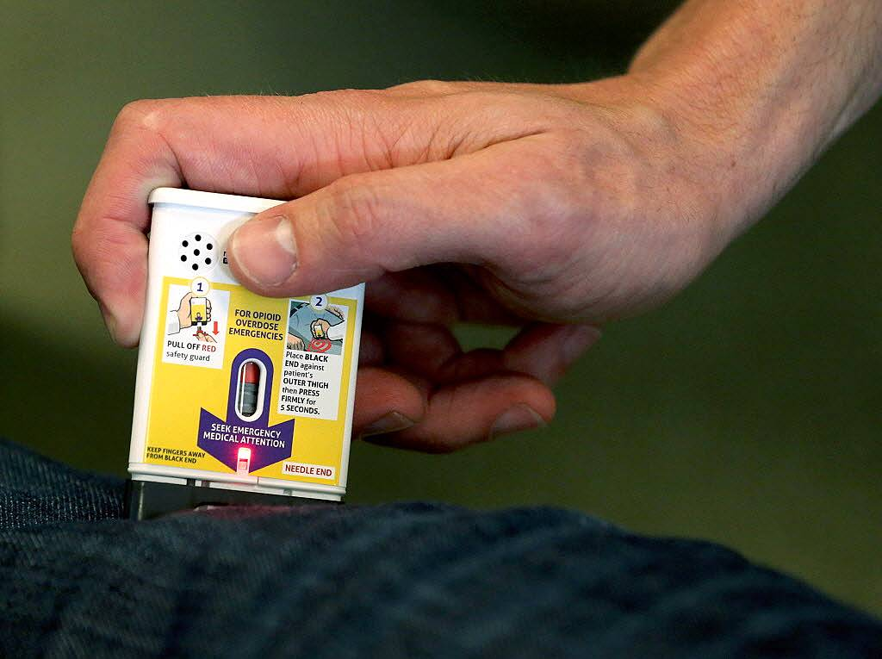
What is naloxone

Slide 11
Naloxone (Narcan)
Opioid antagonist (“blocker”) which reverses opioid overdose
Can be administered intravenously, intramuscularly, subcutaneously or intranasally
Only works for about 20-90 minutes
Causes sudden withdrawal in the opioid dependent person – an unpleasant experience
Doesn’t get a person “high” and is not addictive
Has no effect if an opioid is not present
Notes:
To be more precise: The naloxone has a higher affinity for the receptors rather than “pushing” off the other opioids. Buprenorphine has even a higher affinity so naloxone is not effective at low doses.

Slide 12
Naloxone Safety Profile
Short-acting (30-90 minutes)
Only contraindication is a known allergy to naloxone – nothing in literature
Opioid withdrawal symptoms generally mild at lay-distributed doses – dosage & setting
Opioid effect will return, a significant concern mostly for long-acting opioids, so call 911
Essentially no effects if opioids not present

Slide 13
US Naloxone Distribution 2014
Number* and location of local drug overdose prevention programs providing naloxone to laypersons, as of June 2014, and age-adjusted rates† of drug overdose deaths§ in 2013 — United States
1996-2014:
152,283 trained
26,463 reversals reported
82% PWUD received kits
83% of reversals were PWUD
*Wheeler E, Jones TS, Gilbert M, Davidson PJ . Opioid Overdose Prevention Programs Providing Naloxone to Laypersons—United States, 2014. MMWR Morb Mortal Wkly Rep 2015 ; 64:631-635.
Notes:
136 programs with 644 sites: 84 CBOs, 18 healthcare facilities, 10 VA systems, 18 state or local health departments
152,283 laypersons trained, 26463 reversals reported.

Slide 14
Overdose prevention programs:
Make drug user health, safety and survival a priority
Endorse the idea of drug users as capable and concerned with their community
Educate family, friends and loved ones of people who use drugs about overdose prevention
Can be empowering for people who have experienced multiple traumas
Save lives

Slide 15
Exchange and Direct Service Providers

Slide 16
Protecting and expanding the public health model of naloxone distribution
Public health model—naloxone distributed for free to drug users, friends, family along with education, outreach and training—has evidence base & success reaching at-risk people for nearly 20 years
Communities in MA with high implementation had a nearly 50% lower opioid overdose mortality rate compared to communities with no naloxone (Walley 2013)
California counties with a program saw statistically significant reductions in rate of overdose compared to counties without 1999-2012 (Davidson et al under review)
Drug users who were trained did not increase drug use and drug users who used naloxone were more likely to stop heroin use (Seal 2005)

Slide 17
Legal Framework
Notes:
Naloxone is not controlled but does require a prescription

Slide 18
California Law: AB635, Jan 2014
Designed to encourage CA healthcare providers and community programs to widely distribute naloxone. Expands previous naloxone legislation in CA:
Allows for prescription & distribution throughout the state to friends, family and “other persons who can assist” those at risk of overdose including law enforcement.
Protects licensed health care professionals from civil & criminal liability when they prescribe, dispense, or oversee distribution via a standing order of naloxone via an overdose prevention program or as part of their medical practice.
Permits individuals to possess and administer naloxone in an emergency and protects these individuals from civil action, criminal prosecution, and/or professional review for good faith actions.
Encourages co-prescription licensed providers to prescribe naloxone to individual patients who are being prescribed opioids for chronic pain.
Notes:
Replaces a p
Minimum care would involve ensuring patients know:
When to administer naloxone
How to administer naloxone
To alert others about the medication and how to use it
Broader education, usually for dispensing under standing orders, is undefined but generally includes:
Opioid overdose risk factors
Recognizing and responding to an “overdose”
Stimulation (sternal rub)
calling 911
Administering naloxone
performing rescue breathing
stay with person
rior law which provided immunity in 7 named counties with high rates of opioid overdose.

Slide 19
California Law: AB1535, Jan 2015
Allows pharmacists to provide naloxone without a prescription to people at risk of overdose and those close to them (family, friends)
Pharmacist must receive training under a protocol developed by the Board of Pharmacy and approved by the Medical Board of California
http://www.pharmacy.ca.gov/publications/naloxone_media_release.pdf for more details

Slide 20
CA Good Samaritan Law AB472 (Jan 2013)
CA’s 911 Good Samaritan Law protects a person calling 911 for an overdose (and the overdose victim) from charges relating to being under the influence or possession for personal use of drugs or paraphernalia.
Does not provide immunity for sales or distribution, forcible administration, DUI or drugged driving, or violation of probation/parole conditions.
AB472 seeks to encourage people to QUICKLY seek medical care for a person who is overdosing
Notes:
According to CDPH, more Californians die from accidental overdose death than motor vehicle accidents

Slide 21
BASIC TRAINING

Slide 22
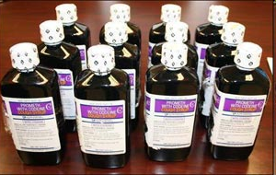
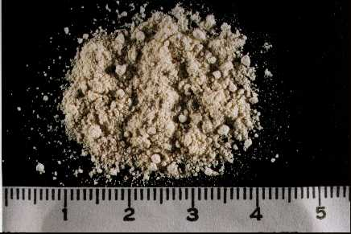
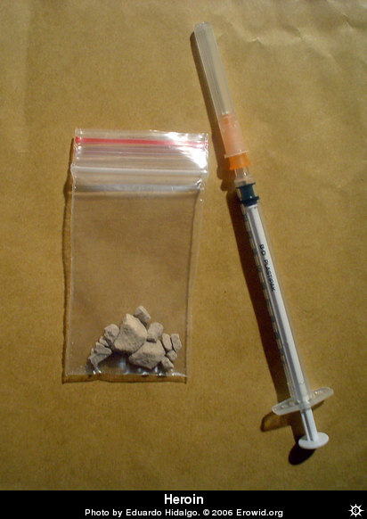
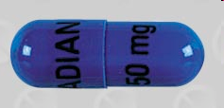
Opioids
Opiates and opioids are classes of depressant analgesics derived from or chemically similar to substances found in the opium poppy.
Naturally occurring and synthetic substances.

Slide 23
Are all opioids equal? Strength & time on your brain
Notes:
Also hystematic side effects

Slide 25
How the overdose occurs
Opioids repress the urge to breathe
Carbon dioxide levels increase
Oxygen levels decrease
Process takes time
There is time to respond, but no time to waste
1
Slow breathing
2
Breathing stops
3
Lack of oxygen may cause brain damage
4
Heart stops
5
Death
Notes:
Progression to death takes time

Slide 27
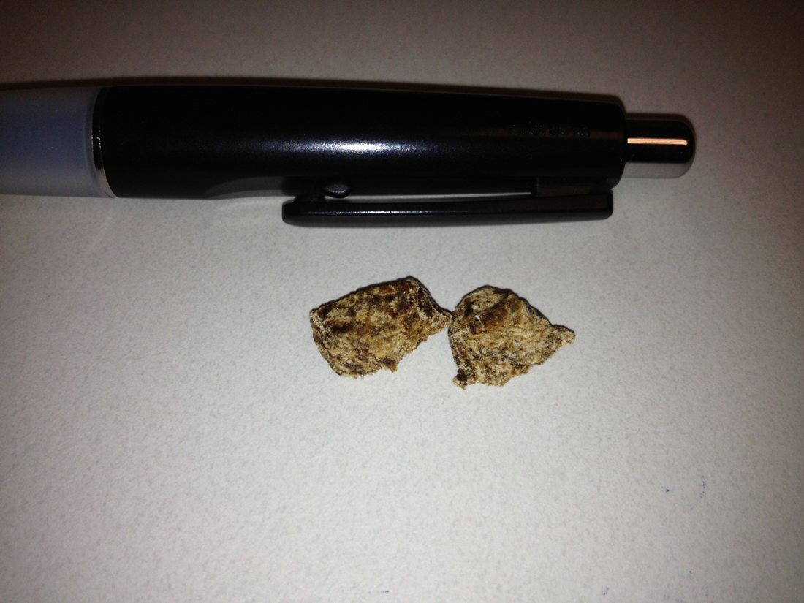
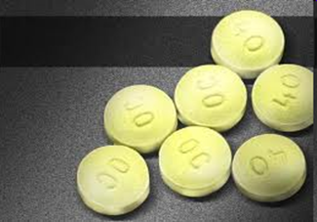
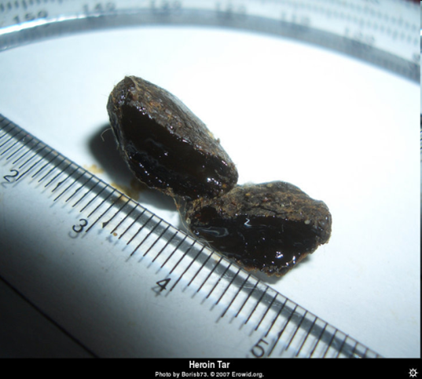
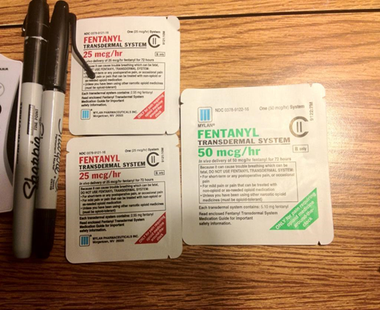
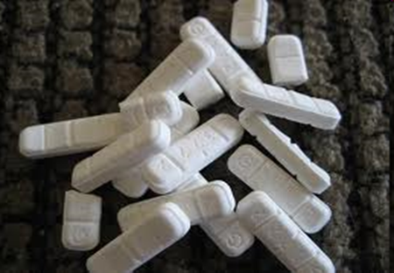
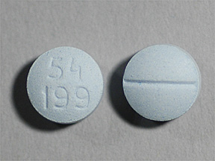
What puts people at risk for ODs?
Variation in strength and content of ‘street’ drugs (purity), or strength/dosage of pharmaceuticals
Switching mode of admin (snorting to injecting, eating pills to snorting, etc.)
Physical Health (liver functioning, weight loss, asthma, immune system problems, dehydration, malnutrition, etc.)
Mixing Drugs (central nervous system depressants)
Tolerance changes (getting out of jail, leaving treatment, relapsing)

Slide 28
What puts people at risk for FATAL ODs?
Using alone
Behind closed or locked door
Out of line of sight

Slide 29
A few words about benzos…
Long acting
Impair short-term memory
Common and easily obtained
Cheaper than heroin
Often prescribed to treat anxiety and as a sleep aid
People often use benzos to get well
Enhance the effects of opiates
Often used as “cut”
Notes:
They are long acting (at least a day, usually)
They impair your short-term memory. So you can actually forget how many benzos or how much heroin you have used in the last 24 hours- this could put someone in danger for an OD!!
They are really really common and easy to find on the street
They are cheaper than heroin
They are frequently necessary for mental health reasons- there is a high comorbidity between substance abuse disorders and mental illness like anxiety, depression, and post-traumatic stress disorder
People use benzos to get well- makes people who are in withdrawal feel better
People use benzos to get jammed- enhances the effects of heroin (or methadone, etc)
Drugs could be cut or enhanced with benzos without the user knowing

Slide 30
A few words about speedballing
What is it?
Slang: Any combination of a stimulant (upper) and a depressant (downer) taken together and injected into the bloodstream
Will speedballing “balance me out?”
No. Speedballing does not cancel out overdose risk.
The more drugs the body has to process, the harder it is to process which increases the chances of overdosing
People who speedball often use more frequently than people who use only heroin which increases the chances of overdosing

Slide 31
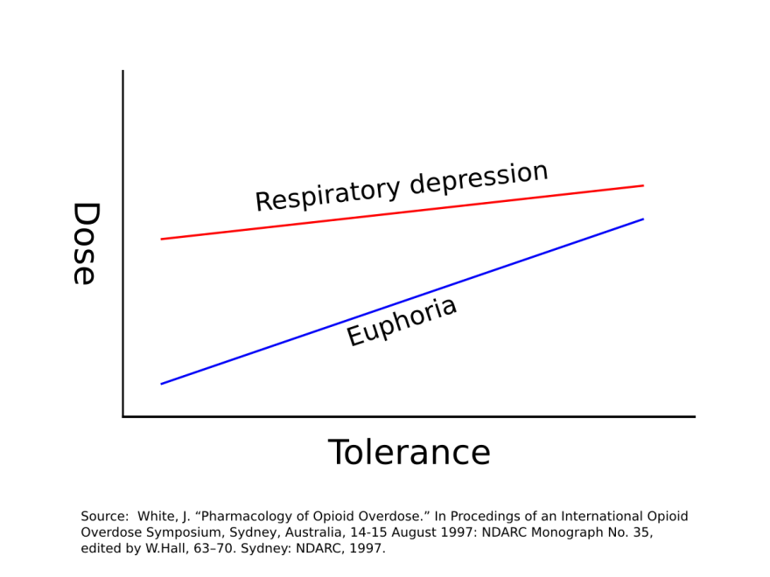
Tolerance

Slide 32
Prevention

Slide 33
How can you avoid an overdose?
Know your tolerance
Know your supplier
Control your own high
Injection techniques
Be aware of the risks of mixing drugs
Try not to use alone
Make a plan
Talk with other users

Slide 34
Recognition

Slide 35
Recognizing a Depressant OD
REALLY HIGH | OVERDOSE
Muscles become relaxed | Deep snoring or gurgling (death rattle) or wheezing
Speech is slowed/slurred | Blue skin tinge- usually lips and fingertips show first
Sleepy looking | Pale, clammy skin
Will respond to stimulation like yelling, sternum rub, pinching, etc. | Heavy nod, will not respond to stimulation
Nodding out | Breathing is very slow, irregular, or has stopped/faint pulse

Slide 37
Response

Slide 38
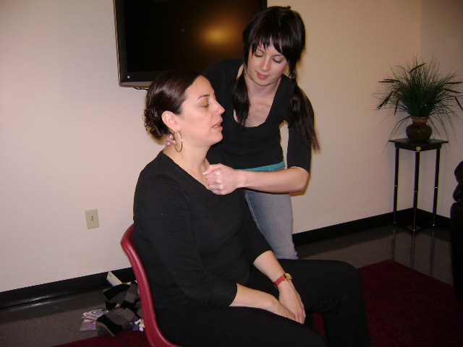
Notes:
Shake foot

Slide 39
Call 911
As you determine that the person is unresponsive, have someone call 911 and state that the person is NOT BREATHING, UNRESPONSIVE, YOU CAN SAY POSSIBLE OVERDOSE.
CA 911 Good Samaritan protections

Slide 40
Barriers to calling 911 from user’s perspective
Fear of legal risk (outstanding warrants, probation/parole, DCFS involvement, loss of public housing)
Fear of judgment from family/community
Personal embarrassment/shame
Other punitive measures (students lose federal financial aid, eviction)

Slide 41
Storage
Protect from direct sunlight
Protect from extreme temperature (keep within 59-86 degrees)
Check expiration dates regularly (two year shelf life from manufacture)

Slide 42
Using Naloxone
Administer one dose intramuscularly into the upper arm, thigh (auto-injector) or nasally, one half in each nostril.
Start Rescue Breathing
Naloxone should work in about 1-3 minutes, if it doesn’t work in 3 minutes or so give 2nd dose
OD could come back, stay with the person or transfer care to EMS.

Slide 43
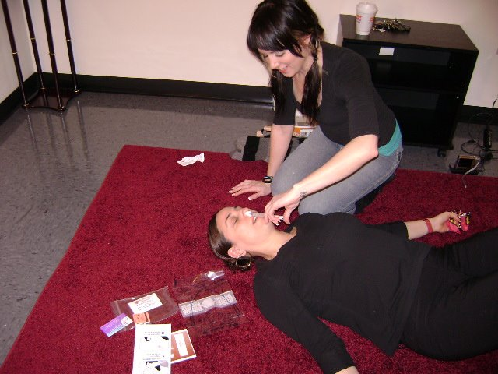

Slide 44
IM Kit Contents
For 10ml vials: at least 10 muscle syringes.
For 1ml vials of naloxone, include at least two vials in the kit, with 2 muscle syringes.
3ml 25g 1” syringes are recommended, but different gauges and point lengths are sometimes used, like 3ml 22g 1 ½”. Either one is ok as long as the point is at least 1” long so that it can reach the muscle.
Fitpak or hard container to keep naloxone safe and hold syringes

Slide 45
IN kit Contents
For intranasal administration, include two boxes of 2mg/2ml naloxone/needleless luer-lock syringes
2 atomizers (Mucosal Atomization Device)
Nylon bags, plastic bags, glasses cases, make-up bags and other creative solutions have been developed by programs to package their kits
Optional items for the kits include:
Alcohol pads
Rescue breathing masks
Rubber gloves
Prescription cards and stickers
Educational insert
You can put your kits in plastic baggies, or you can purchase bags with zippers.

Slide 47
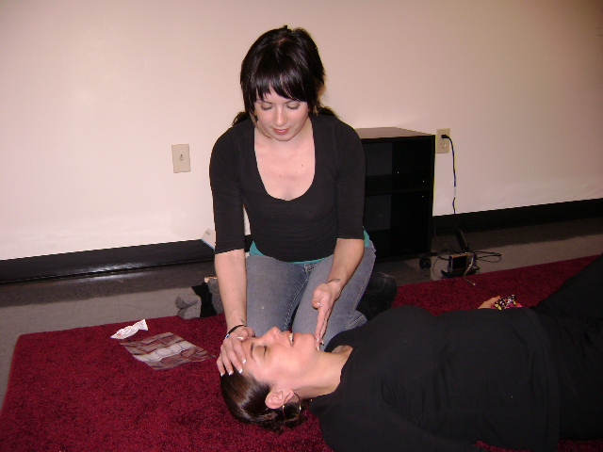
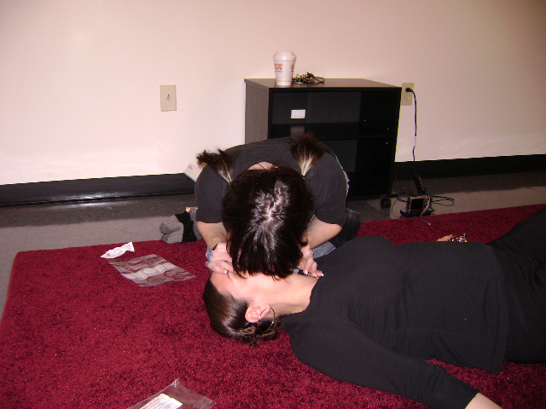
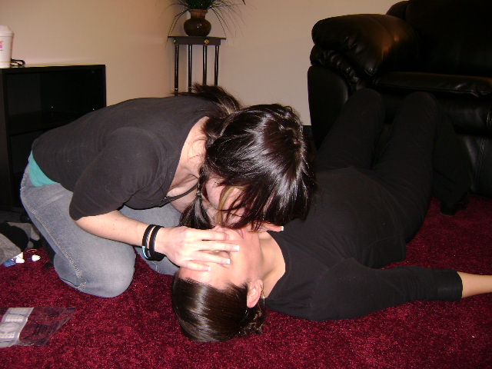
Notes:
chin-lift method to open the airway
hand under chin bone and lift
2 slow breaths
Blow enough air into their lungs to make chest rise
Turn head after each breath to ensure the chest is rising and falling
If it doesn’t work, tilt the head back more

Slide 48
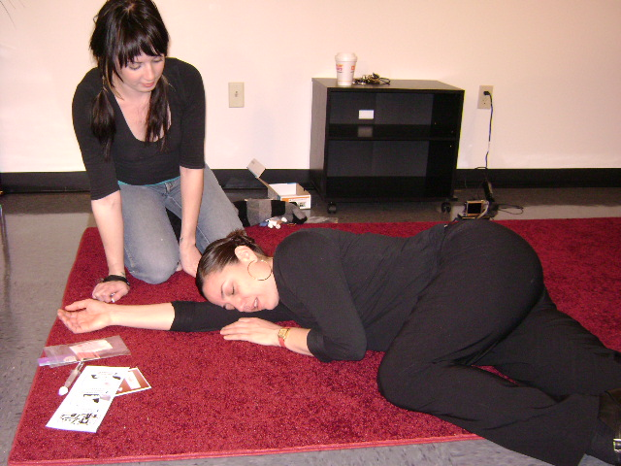
Recovery Position

Slide 49
Street methods: debunking the myths

Slide 50
1. Don’t leave the person alone—they could stop breathing!
2. Don’t put them in a bath—they could drown!
3. Don’t induce vomiting—they could choke!
4. Don’t give them something to drink—they could throw up!

Slide 51
5. Don’t try to stimulate them in a way that could cause harm!
6. Don’t put ice down their pants- it’ll make their pants wet!
7. Don’t inject them with anything (saltwater, cocaine, milk)!
Notes:
5. harm- slapping too hard, kicking in the testicles, burning the bottom of the feet, etc. can cause long-term damage
6. Cooling down the core body temperature of someone who is ODing is dangerous because it will slow down their body function even more than just the OD
7. it won’t work any more than physical stimulation and can waste time or make things worse depending on what you inject; a salt injection, for instance, could cause someone to go into cardiac arrest if they already have high sodium levels in their system. Also, every injection brings a risk of bacterial infection, abscesses, endocarditis, cellulitis, etc.

Slide 52
Other Community Program Models

Slide 53
Jail

Slide 54
Families & Community Support Groups

Slide 55
Social Service & SU Treatment Settings

Slide 56
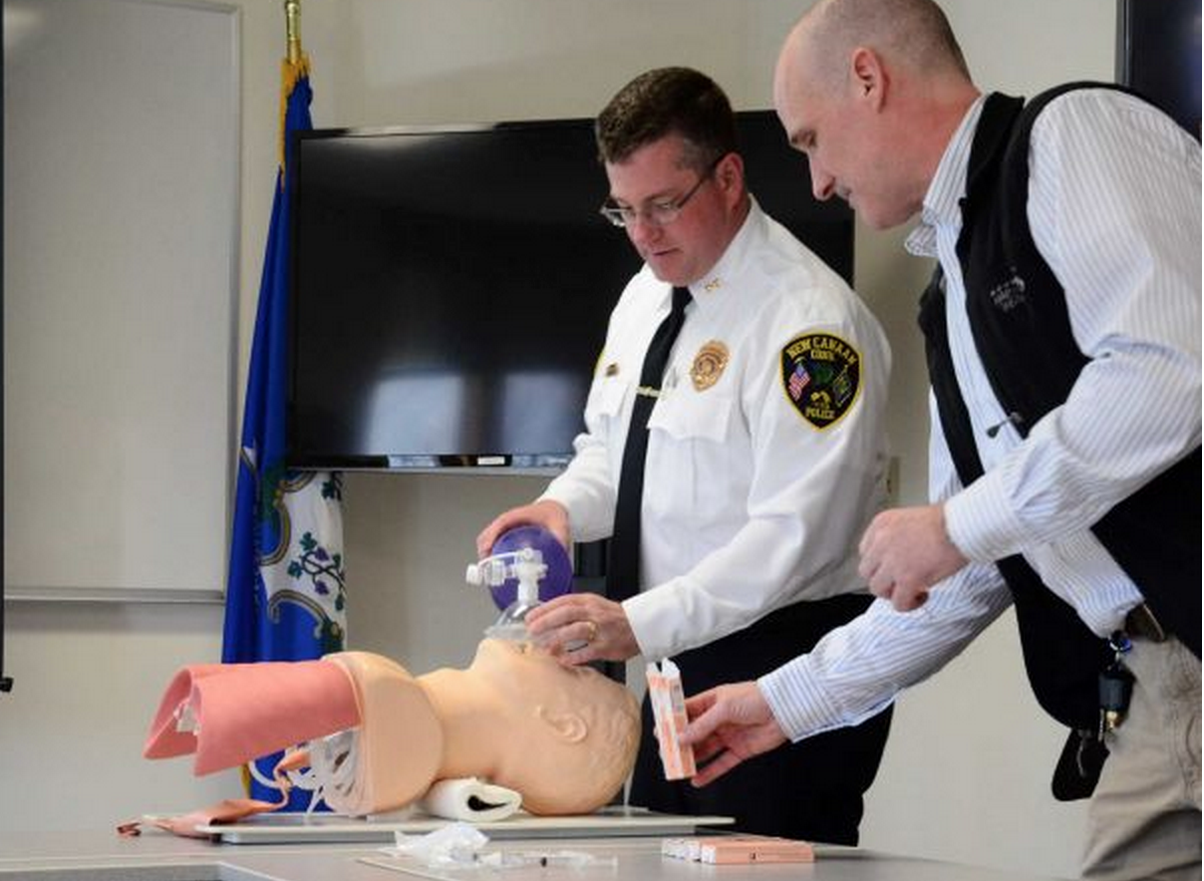
Law Enforcement and Emergency Responders
http://www.nchrc.org/law-enforcement/us-law-enforcement-who-carry-naloxone/

Slide 57
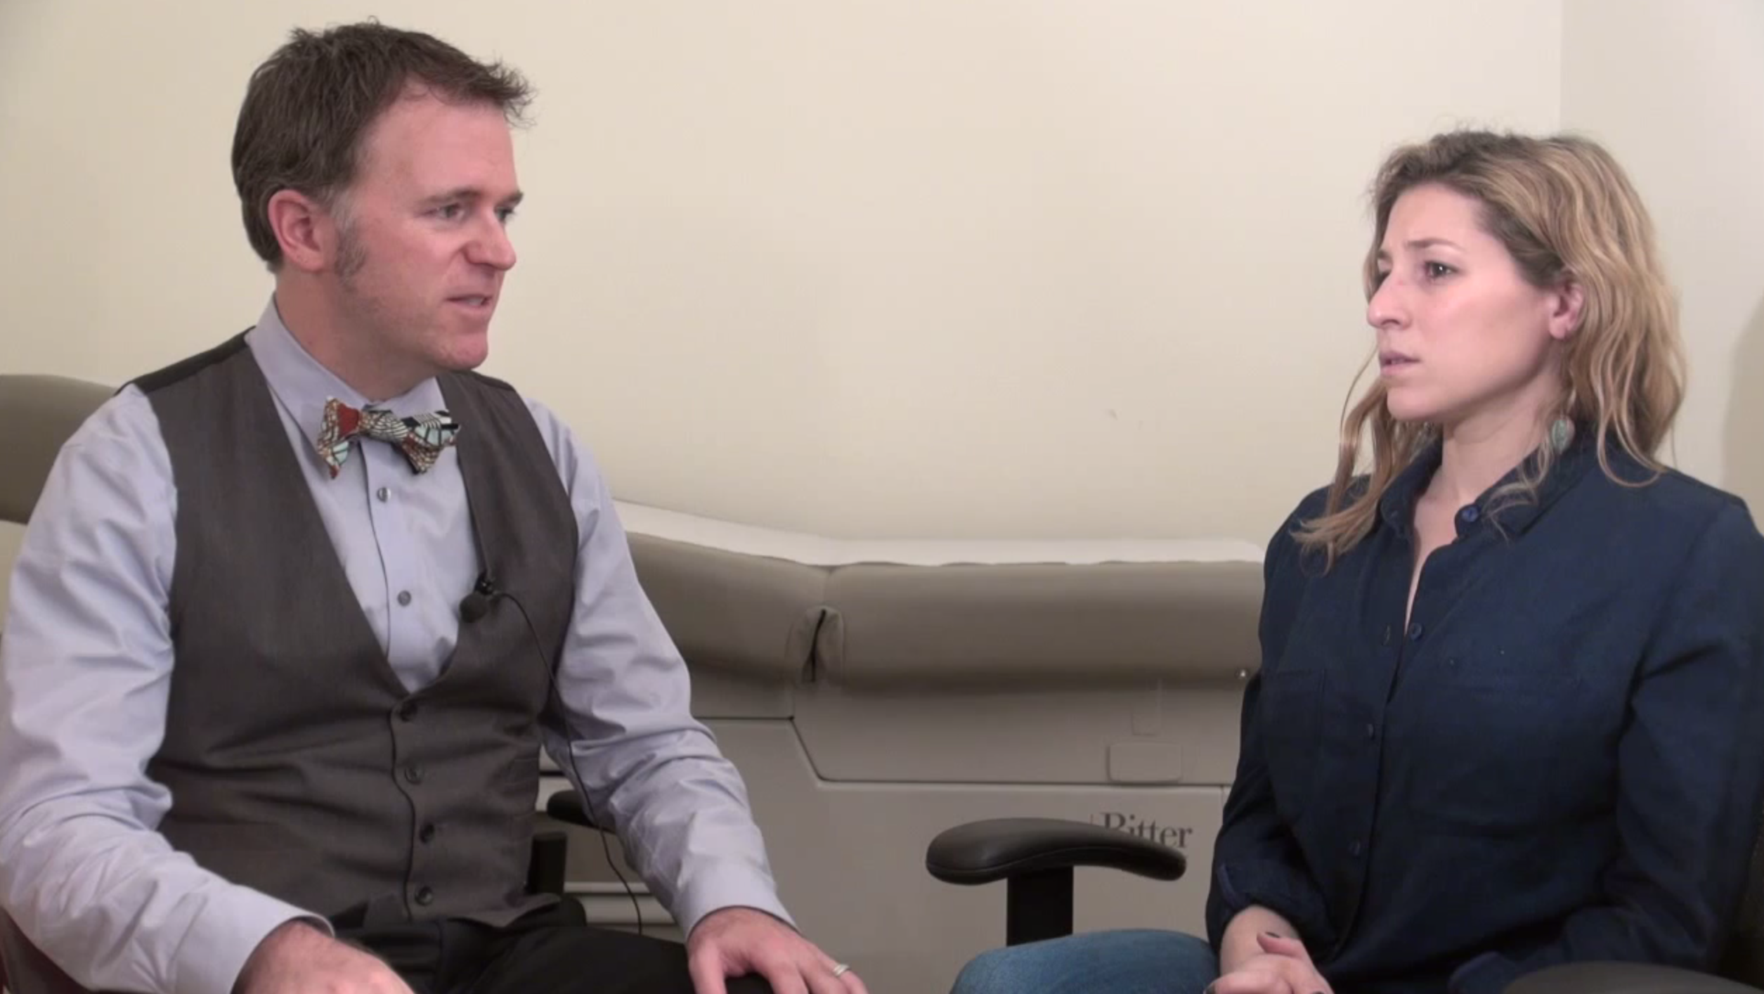
PHYSICIAN/ CLINICAL
Provider writes prescription, patient fills at pharmacy.
Insurance & pharmacy ready (special nasal order)
Provider writes prescription & dispenses pre-assembled kit
Prescriber writes non-patient specific standing order for CBO, treatment program staff to train & distribute pre-assembled kits

Slide 58
Pharmacy Naloxone Sales

Slide 59
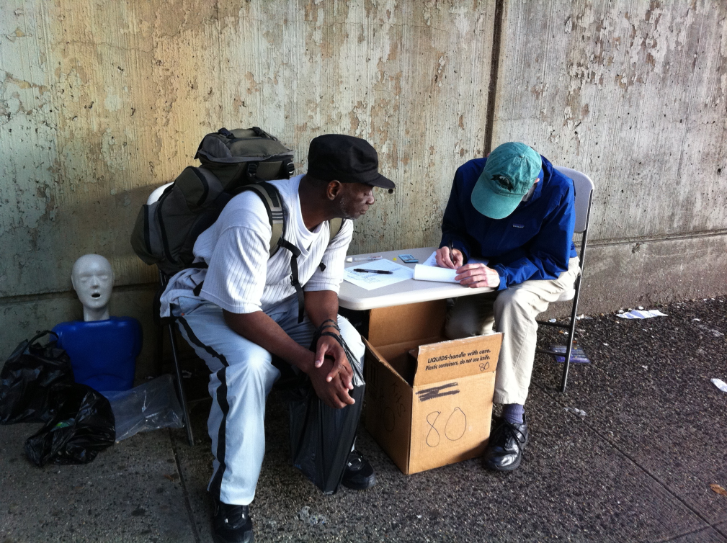
Trainings
Length - 10 minutes→60 minutes in length - setting and experience of trainees
Groups, pairs, individuals, classroom-style
Special considerations (parents groups, drug treatment staff, etc.)
Know your audience!

Slide 60
Groups (45mins – 1hr)
Topics
What is an overdose
Overdose risk factors
Overdose prevention strategies
Recognizing and responding to an overdose, using naloxone
After-care
Ask what they know
Demo kit
Demonstrate - have them handle naloxone
Complete necessary documentation

Slide 61
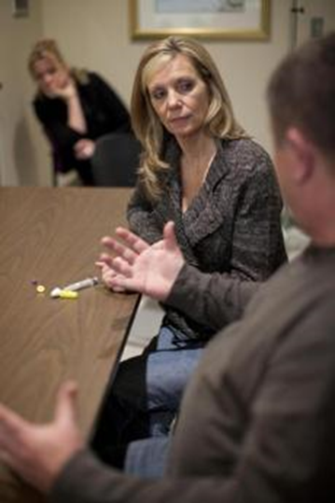
Trainings (10-45mins)
assess existing knowledge, fill in gaps and answer questions.
demo kit participant can see and handle actual naloxone.

Slide 62
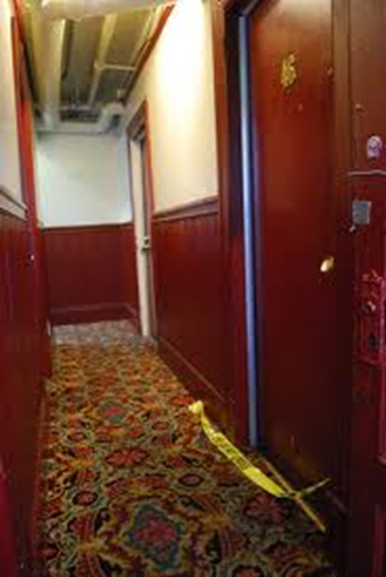
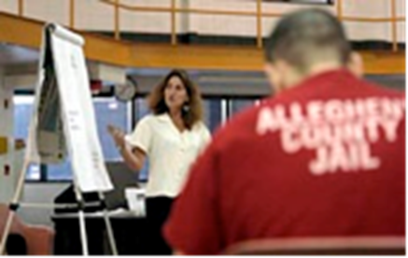
Where will you provide naloxone?
Where will you reach at-risk drug users where they will feel comfortable engaging for at least 10 minutes or in group settings?
Where will you engage friends/family members?

Slide 63
Different Audiences/ Different Needs

Slide 64
Enrollment Considerations for Users
People may have a short amount of time
People may have reversed ODs in the past and be offended if they perceive criticism of their methods
People should be advised that Narcan shouldn’t be used as punishment or revenge

Slide 65
Enrollment Considerations for Users
Respect participant & staff confidentiality
A methadone counselor may have arranged for a group, but a client could suffer negative outcomes if their counselor discovers their poly-drug use
Approach groups by asking—instead of telling—what they know about each topic
Allows for a more interactive session
Recognizes that participants may already have some knowledge on the topic
Discuss options for people who don’t want to use—especially if they are in treatment
Some programs—like needle exchanges—could put them at risk or expose them to triggers (like a NEP)

Slide 66
Resources for Active Drug Users
Videos about naloxone, opioid safety/overdose,
and how to respond in emergencies:
**** https://www.youtube.com/watch?v=U1frPJoWtkw
How to find California community-based harm reduction programs including naloxone distribution programs:
http://harmreduction.org/connect-locally/california/

Slide 67
Enrollment Considerations Friends & Family
Make time for group to have a discussion about the perceived ethical dilemma surrounding Narcan
TIME TO PROCESS/ GRIEF
Friends & family of users may need
Referrals for support groups/grief counseling
To address their anger that Narcan was not previously made available
To be told at the beginning of the group that it will explicitly deal with OD and could be personally painful
Not for punishment
Notes:
OD prevention session with groups of non-users
Usually, these kinds of group need a few minutes to have a discussion about the perceived ethical dilemma providing Narcan
Friends & family of users may need
referrals for support groups/grief counseling
to address their anger that Narcan was not previously made available
to be told at the beginning of the group that it will explicitly deal with OD and could be personally painful
Discussing implications of involuntary drug treatment (ie Section 35) on overdose risk may be a heated and lengthy conversation, so plan time accordingly
Groups for professionals/staff of other agencies will usually want to know what is the legal basis for the project
All groups should be reminded that using Narcan as punishment if someone is not in an OD is very likely to be counterproductive

Slide 68
Resources for Families
Learn to Cope: online discussion forum for parents of drug users:
http://www.learn2cope.org/
Grief Recovery from a Substance Passing (GRASP), for people who have lost a loved one to overdose:
http://grasphelp.org/
Broken No More, a support group and advocacy organization for parents interested in advocating for drug policy reform:
http://broken-no-more.org/
Al-anon and Nar-anon, 12 step recovery groups for families and friends affected by another person’s drinking or drug use.

Slide 69
Enrollment Considerations Providers
Involuntary drug treatment: x want to be there, not looking to quit
Court mandated
Family (under 18)
Social negotiation
Groups of professionals/agency staff will usually want to know the legal basis for the project
Remind participants that using Narcan as punishment if someone is not in an OD is likely to be very counterproductive
Notes:
OD prevention session with groups of non-users
Usually, these kinds of group need a few minutes to have a discussion about the perceived ethical dilemma providing Narcan
Friends & family of users may need
referrals for support groups/grief counseling
to address their anger that Narcan was not previously made available
to be told at the beginning of the group that it will explicitly deal with OD and could be personally painful
Discussing implications of involuntary drug treatment (ie Section 35) on overdose risk may be a heated and lengthy conversation, so plan time accordingly
Groups for professionals/staff of other agencies will usually want to know what is the legal basis for the project
All groups should be reminded that using Narcan as punishment if someone is not in an OD is very likely to be counterproductive

Slide 70
Resources for Providers
Naloxone Program Implementation Manual and online resources:
www.harmreduction.org/issues/overdose-prevention/tools- best-practices
AHRQ description of Massachusetts naloxone program:
http://www.innovations.ahrq.gov/content.aspx?id=3912
Clinic-based prescribing information and guidelines:
www.prescribetoprevent.org
Pharmacy resources:
www.stopoverdose.org
Advocacy film and materials: Reach for Me: Fighting to End the American Drug Overdose Epidemic www.reach4me.org
Research updates and other overdose-related news:
www.overdosepreventionalliance.org
CSAM webinar & videos about talking with patients & handouts:
http://www.csam-asam.org/naloxone-resources

Slide 71
Resources for Law Enforcement
Federal Bureau of Justice Law Enforcement Naloxone Toolkit
https://www.bjatraining.org/tools/naloxone/Naloxone%2BBackground

Slide 73
Questions?
Shoshanna S. Scholar
Executive Director
LA Community Health Project
scholar@chpla.org
213.483.5846

