Slide 1
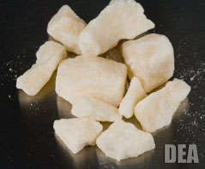

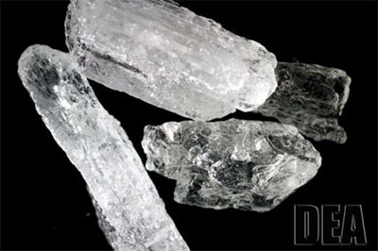



Cocaine, Methamphetamine, and HIV:
What Clinicians Need to Know
TRAINER’S NAME
TRAINING DATE
TRAINING LOCATION
Notes:
The purpose of this introductory training is to provide HIV clinicians (including, but not limited to physicians, dentists, nurses, and other allied medical staff, therapists and social workers, and counselors, specialists, and case managers) with an overview of cocaine, methamphetamine, and HIV. The duration of the training is approximately 120-150 minutes (2-2 ½ hours), depending on whether the trainer chooses to present all of the slides, or a selection of slides.
Pre- and post-test questions have been inserted at the beginning and end of the presentation to assess a change in the audience’s level of knowledge after the information has been presented. An answer key is provided in the Trainer’s notes in slides 4-8 and slides 118-122.
Audience Response System can be utilized, if available, when facilitating the pre- and post-test question sessions, as well as the questions contained on slides 22, 23, 74, and 104.
In addition, a brief group discussion and two case studies have been inserted throughout the presentation to encourage dialogue among the training participants, and to illustrate how the information contained within the presentation can be used clinically.
Image Credits (L-R): Drug Enforcement Administration, various publications.

Slide 2
Training Collaborators and Special Acknowledgements
LA Region Pacific AIDS Education and Training Center
Pacific Southwest Addiction Technology Transfer Center
UCLA Integrated Substance Abuse Programs
Jane C. Maxwell, PhD, University of Texas at Austin, Addiction Research Institute
Notes:
This PowerPoint presentation, Trainer Guide, and companion fact sheet were developed by Beth Rutkowski, MPH (Associate Director of Training of UCLA ISAP) and Thomas E. Freese, PhD (Director of Training of UCLA ISAP and Director of the Pacific Southwest ATTC) through supplemental funding provided by the Pacific AIDS Education and Training Center, based at Charles R. Drew University of Medicine and Science. We wish to acknowledge Phil Meyer, LCSW, Kevin-Paul Johnson, Maya Gil Cantu, MPH, and Thomas Donohoe, MBA, from the LA Region PAETC.
We would also like to recognize the contributions of Dr. Jane Maxwell from the University of Texas at Austin, Addiction Research Institute.

Slide 3

Test Your Knowledge
Notes:
INSTRUCTIONS
The purpose of the following five (5) questions is to test the pre-training level of cocaine, methamphetamine, and HIV knowledge amongst the training participants. The questions are formatted as either multiple choice or true/false questions. Read each question and the possible responses aloud, and give training participants time to jot down their response before moving on to the next question. Do not reveal the answers to the questions until the end of the training session (when you re-administer the questions that appear on slides 118-122).

Slide 4
Pre-Test Question
Pre-Test Question
Which stimulant is associated with the largest release of dopamine in the user’s brain?
  Methamphetamine
  Cocaine
  They both result in the same dopamine spike
Notes:
Answer Key:
#1 – correct response is A (Methamphetamine)

Slide 5
Pre-Test Question
Cocaine works by:
  Causing a release of excess dopamine
  Activating dopamine receptors
  Blocking dopamine transporters
  Selectively inhibiting serotonin re-uptake
Notes:
Answer Key:
#2 – correct response is C (Blocking dopamine transporters)

Slide 6
Pre-Test Question
Methamphetamine is non-toxic to nerve cells in the brain.
  True
  False
Notes:
Answer Key:
#3 – correct response is B (False)

Slide 7
Pre-Test Question
Methamphetamine use during pregnancy is associated with:
  Decreased rates of premature delivery
  Placental abruption
  Small size at birth
  Heart and brain abnormalities
  All except A
Notes:
Answer Key:
#4 – correct response is E (All except A)

Slide 8
Pre-Test Question
FDA-approved medications are available to treat cocaine and methamphetamine use disorders.
  True
  False
Notes:
Answer Key:
#5 – correct response is B (False)

Slide 9

Introductions
Briefly tell us:
What is your name?
Where do you work and
what you do there?
Who is your favorite
musician or performer?
What is one reason you
decided to attend this training session?
Notes:
INSTRUCTIONS
In an effort to break the ice and encourage group interaction, take a few minutes to ask training participants to briefly share the answers to these four questions. You can ask for several volunteers to share their responses, if the size of your audience prevents all participants from sharing.
If the group is too large for formal introductions, the trainer can quickly ask participants the following two questions to gauge their work setting and professional training:
1. How many [case managers, LMFTs or LCSWs, counselors, administrators, physicians, PAs, nurse practitioners, nurses, medical assistants, dentists, etc.] are in the room? Did I miss anyone? {elicit responses}
2. How many people work in a [substance use disorder, mental health, primary care, infectious disease] setting? Did I miss any settings? {elicit responses}

Slide 10
Educational Objectives
At the end of this training session, participants will be able to:
Review the epidemiology, neurobiology, and medical consequences of cocaine and methamphetamine use
Discuss at least two (2) ways that cocaine or methamphetamine use can lead to increased HIV risk
Notes:
INSTRUCTIONS
Briefly review each of the educational objectives with the audience.

Slide 11
Educational Objectives, continued
At the end of this training session, participants will be able to:
Explain the key concepts of at least three (3) effective behavioral interventions for cocaine and methamphetamine use disorders
Describe at least three (3) specific risk reduction strategies HIV clinicians can use to improve health outcomes for stimulant users
Notes:
INSTRUCTIONS
Continue by briefly reviewing the remaining two educational objectives with the audience.

Slide 12

Patterns and Trends in the
Use of Methamphetamine and Cocaine
Notes:
TRANSITION SLIDE
The next portion of the presentation will provide training participants with a detailed overview of patterns and trends in stimulant use in the United States. No single drug abuse indicator can tell the full story of the extent or impact of crack/cocaine use. Therefore, data from several available indicators are presented in an attempt to paint a comprehensive picture of who uses crack cocaine, powder cocaine, and methamphetamine, and the populations in which it is most prevalent.

Slide 13
Greatest Drug Threat Represented Regionally as Reported by State and Local Agencies: 2013-2015
Source: National Drug Threat Summary, 2015 (slide courtesy of Jane C. Maxwell, PhD).
Notes:
Data from a variety of sources, including methamphetamine seizures, survey data, price and purity data, and law enforcement reporting indicate methamphetamine continues to be readily available throughout the United States. This map shows the regional patterns in the greatest drug threat, as reported by state and local agencies between 2013 and 2015. Methamphetamine was the greatest drug threat in the Pacific, Southwest, West Central, and Florida/Caribbean regions.
CPD = Controlled Prescription Drugs
Slide courtesy of Jane C. Maxwell, PhD

Slide 14
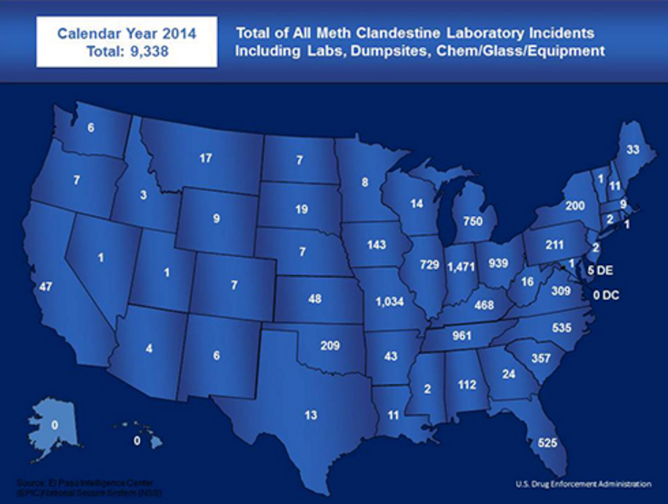
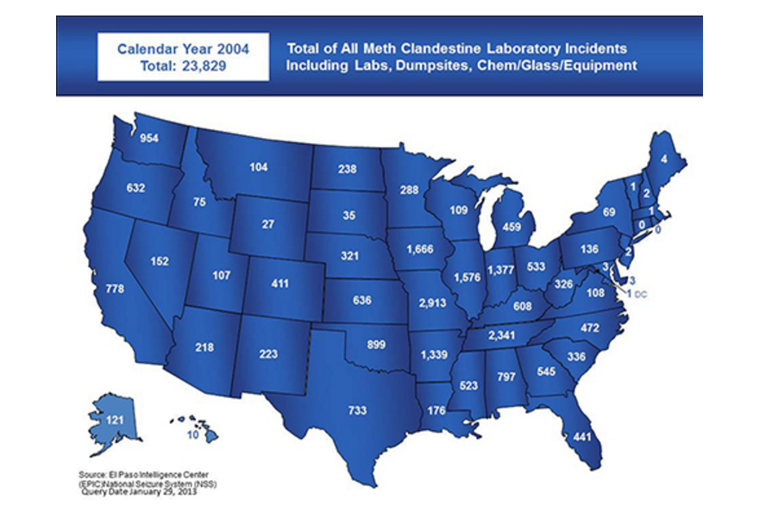
Methamphetamine Lab Incidents:
2004 vs. 2014
SOURCE: El Paso Intelligence Center (EPIC), 2017.
Notes:
**ANIMATIONS**
This slide contains animations. Trainers should practice presenting this information so they can see the timing of the animations and how new content appears on the slide. This slide includes two graphs – one showing 2004 lab incidents, and a second showing 2014 incidents. The 2004 map appears automatically. To show the 2014 map, click once, and the 2004 map will disappear and the 2014 map will appear in its place.
This map shows the number of methamphetamine lab incidents reported to the Drug Enforcement Administration, including laboratories, dumpsites, or chemical, glass, and equipment seizures. As a matter of comparison, there were nearly 15,000 more incidents in 2004 as compared to 2014. The overall number of lab incidents west of the Mississippi River decreased dramatically, as did seizures in the southern United States. The number of lab incidents in the Great Lake region of the country increased, as did incidents in many New England states. Missouri has led the country in methamphetamine lab incidents for nearly the entire 11-year period, followed by states such as Indiana, Mississippi, Kentucky, and Oklahoma.
The Combat Methamphetamine Epidemic Act was passed in 2005, and since then, there has been a trend away from domestic “superlab” large scale methamphetamine production to the “shake and bake” method, a crude cooking method that requires pseudoephedrine and a handful of common household ingredients, such as ether, ammonia nitrate, and lithium. Drug cartels continue to meet much of the demand by manufacturing large quantities of methamphetamine in Mexico and smuggling it over the US/Mexico border.
REFERENCE:
Drug Enforcement Administration. (2017). Methamphetamine Lab Incidents, 2004-2014, reported by EPIC. Accessed March 7, 2017 from https://www.dea.gov/resource-center/meth-lab-maps.shtml.

Slide 15
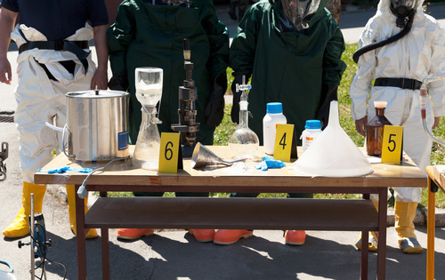
Environmental Effects of Meth
Methamphetamine production leaves behind 5 to 6 pounds of toxic waster per pound of meth produced.
Toxic by-products contaminate production sites, posing serious
health and
environmental hazards
to those who live and
work nearby.
The estimated cost to
clean up 1 meth lab
often exceeds $4,000.
SOURCE: Koch Crime Institute.
Notes:
For each pound of meth produced, there are five to six pounds of toxic waste. Those toxic wastes are often dumped down household drains, in fields and yards, or on rural roads, which has the potential of contaminating the drinking water supplies, soils, and air. Toxic by-products contaminate sites where meth is produced, posing serious health and environmental hazards to those nearby. Think of the innocent children who live in homes where meth is being produced. There has not been enough research done on those children to know the long-term health effects they may suffer. In addition, the cost to clean up one meth lab often exceeds $4,000. Federal, state, and local taxpayers pay this cost.
Image Credit: Fotolia, purchased image, 2017.

Slide 16
Percentage of Items Identified in DEA’s National Forensic Laboratory Information System: January 2005-September 2015
SOURCE: National Forensic Laboratory Information System, 2005-2015 (slide courtesy of Jane C. Maxwell, PhD).
Notes:
This graph depicts the percentage of items identified in the Drug Enforcement Administration’s National Forensic Laboratory Information System (NFLIS). The NFLIS system is responsible for systematically collecting results from drug chemistry analyses conducted by state, local, and federal forensic laboratories located across the U.S. As a result, NFLIS provides timely and detailed information about drugs seized by law enforcement. The percentage of items identified as methamphetamine has been on the rise since 2010. In contrast, the percentage of items identified as cocaine has been on the decline since 2006.
Slide courtesy of Jane C. Maxwell, PhD

Slide 17
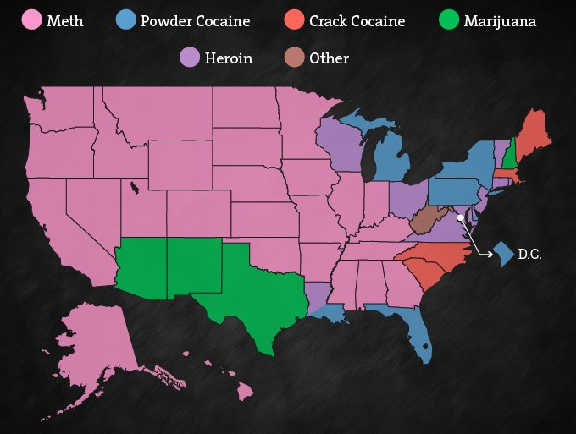
Top Drug Offenses, by State
SOURCE: U.S. Sentencing Commission, 2016.
Notes:
According to the U.S. Sentencing Commission, nearly 50% of all inmates in federal prisons throughout the U.S. are serving a sentence for a drug-related offense. Methamphetamine was the specific drug offense in 27 of 50 states, including the majority of western, Midwest, and southern states. Powder cocaine produced the most or tied for the most in seven states, including Washington, D.C. And despite the fact that marijuana is the most widely illicit substance in the U.S., but was only responsible for the highest number of drug offenses in four states.
REFERENCE:
Abadi, M. (2016). This graphic shows just how widespread meth is in the United States. Business Insider, accessed March 8, 2017 from www.businessinsider.com.

Slide 18
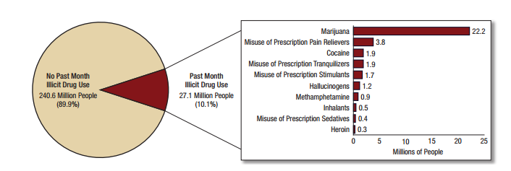
Numbers of Past Month Illicit Drug Users among People Aged 12 or Older: 2015
SOURCE: SAMHSA, National Survey on Drug Use and Health, 2015 results.
Notes:
According to the 2015 results of the National Survey on Drug Use and Health, an estimated 27.1 million people aged 12 or older were current illicit drug users in 2015, representing 10.1% of the population aged 12 or older. In other words, 1 in 10 individuals aged 12 or older in the United States used illicit drugs in the past month.
In 2015, approximately 1.9 million people aged 12 or older reported past month use of cocaine, including about 394,000 who were current users of crack. These numbers correspond to about 0.7% of the population aged 12 or older who were current users of cocaine and 0.1% who were current users of crack. The 2015 estimate for current cocaine use was similar to the estimates in most years between 2007 and 2013, but it was higher than the estimate in 2014. The 2015 estimate of crack use was similar to the estimates in most years from 2008 to 2014. The 2015 estimates of both cocaine and crack use were lower than most of the estimates between 2002 and 2006.
Note: Estimated numbers of people refer to people aged 12 or older in the civilian, noninstitutionalized population in the United States. The numbers do not sum to the total population of the United States because the population for NSDUH does not include people aged 11 years old or younger, people with no fixed household address (e.g., homeless or transient people not in shelters), active-duty military personnel, and residents of institutional group quarters, such as correctional facilities, nursing homes, mental institutions, and long-term care hospitals.
Note: The estimated numbers of current users of different illicit drugs are not mutually exclusive because people could have used more than one type of illicit drug in the past month.
In 2015, approximately 897,000 people aged 12 or older were current users of methamphetamine, which rounds to the estimate of 0.9 million people. This number represents 0.3% of the population aged 12 or older.
Note: Prior to 2015, questions about methamphetamine use were asked in the context of questions about the misuse of prescription stimulants because methamphetamine is legally available by prescription (Desoxyn®). However, most methamphetamine that is now used in the United States is produced and distributed illicitly rather than through the pharmaceutical industry. Therefore, for 2015, a new set of questions specific to methamphetamine was created and administered separately from the questions about the misuse of prescription stimulants. Because of these changes, estimates of methamphetamine use in 2015 are not compared with estimates from prior years.
REFERENCE:
Center for Behavioral Health Statistics and Quality. (2016). Key substance use and mental health indicators in the United States: Results from the 2015 National Survey on Drug Use and Health (HHS Publication No. SMA 16-4984, NSDUH Series H-51). Rockville, MD: Substance Abuse and Mental Health Services Administration.

Slide 19
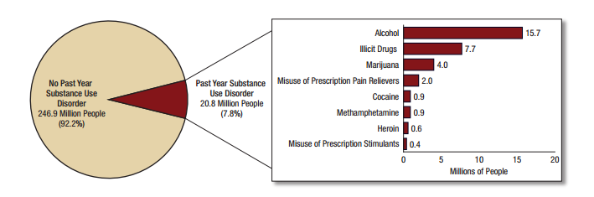
The Prevalence of Substance Use Disorders in the General US Population: 2015
SOURCE: SAMHSA, National Survey on Drug Use and Health, 2015 results.
Notes:
A similar number of people in the U.S. reported a substance use disorder related to cocaine and methamphetamine. In 2015, approximately 20.8 million people aged 12 or older had an SUD in the past year, including 15.7 million people who had an alcohol use disorder and 7.7 million people who had an illicit drug use disorder. About 896,000 people aged 12 or older in 2015 had a cocaine use disorder in the past year, rounding to 0.9 million people. This number represents 0.3% of the population aged 12 or older. The percentage of the population aged 12 or older with a cocaine use disorder remained stable between 2010 and 2015. However, the percentage in 2015 was lower than the percentages in 2002 to 2009. An estimated 872,000 people aged 12 or older had a methamphetamine use disorder in 2015, representing about 0.3% of people aged 12 or older.
REFERENCE:
Center for Behavioral Health Statistics and Quality. (2016). Key substance use and mental health indicators in the United States: Results from the 2015 National Survey on Drug Use and Health (HHS Publication No. SMA 16-4984, NSDUH Series H-51). Rockville, MD: Substance Abuse and Mental Health Services Administration.

Slide 20
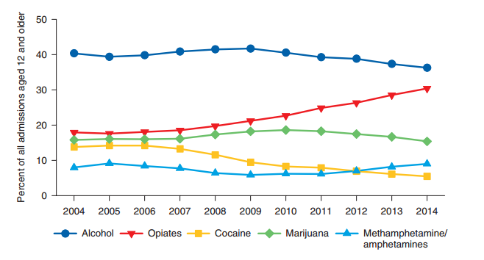
Primary Substance of Abuse at Admission: 2004-2014
SOURCE: SAMHSA, Treatment Episode Data Set, 2014 results.
Notes:
According to SAMHSA’s Treatment Episode Data Set, the proportion of cocaine admissions has been on the decline, from 14% of admissions aged 12 and older in 2004 to 5% in 2014. Smoked cocaine (crack) represented 72% of all primary cocaine admissions in 2004; it was 66% in 2014. The proportion of stimulant admissions aged 12 and older (98 to 99% of these admissions were for methamphetamine or amphetamine abuse) ranged from 6% to 9% of admissions aged 12 and older between 2004 and 2014.
Additional Information for the Trainer(s):
Fifty-nine percent (59%) of primary smoked cocaine admissions and 69% of primary non-smoked cocaine admissions were male. The average age at admission among primary smoked cocaine admissions was 44 years; among primary non-smoked cocaine admissions, the average age was 38 years. Among primary smoked cocaine admissions, 56% were non-Hispanic Black, 32% were non-Hispanic White, and 8% were of Hispanic origin. Among primary non-smoked cocaine admissions, 43% were non-Hispanic White, 34% were non-Hispanic Black, and 19% were of Hispanic origin. Seventy-nine percent (79%) of primary non-smoked cocaine admissions reported inhalation as their route of administration, and 11% reported injection.
Fifty-four percent (54%) of primary methamphetamine/amphetamine admissions were male. For primary methamphetamine/amphetamine admissions, the average age at admission was 33 years. About two-thirds (67%) of primary methamphetamine/amphetamine admissions were non-Hispanic White, 18% were of Hispanic origin, and 4% were non-Hispanic Blacks. Sixty-one percent (61%) of primary methamphetamine/amphetamine admissions reported smoking as the usual route of administration, 26% reported injection, and 8% reported inhalation.
REFERENCE:
Substance Abuse and Mental Health Services Administration, Center for Behavioral Health Statistics and Quality. (2016). Treatment Episode Data Set (TEDS): 2004-2014. National Admissions to Substance Abuse Treatment Services. BHSIS Series S-84, HHS Publication No. (SMA) 16-4986. Rockville, MD: Author.

Slide 21
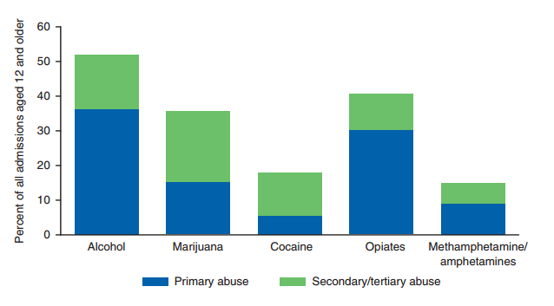
A Pattern of Poly Substance Use is the Norm, Rather than the Exception among Stimulant Treatment Admissions: 2014
SOURCE: SAMHSA, Treatment Episode Data Set, 2014 results.
Notes:
Poly substance use is the norm, rather than the exception, among treatment admissions reported to TEDS, with 63% of admissions reported using more than one substance. Marijuana/hashish, alcohol, and powder cocaine were the most commonly reported secondary and tertiary substances. Methamphetamine/amphetamines were reported more often as a primary substance than as a secondary or tertiary substance. Fifteen percent (15%) of all admissions reported methamphetamine/amphetamine abuse, with 9% reporting primary abuse and 6% reporting secondary or tertiary abuse. Cocaine was reported more often as secondary or tertiary substances than as a primary substance. Cocaine was a primary substance for 5% of admissions, but was a secondary or tertiary substance for an additional 12%. Thus 18% of all treatment admissions involved cocaine abuse.
REFERENCE:
Substance Abuse and Mental Health Services Administration, Center for Behavioral Health Statistics and Quality. (2016). Treatment Episode Data Set (TEDS): 2004-2014. National Admissions to Substance Abuse Treatment Services. BHSIS Series S-84, HHS Publication No. (SMA) 16-4986. Rockville, MD: Author.

Slide 22
What Do You Think?
Nationally, the racial/ethnic group with the highest treatment admissions for crack cocaine is:
  Hispanic/Latino
  White/Caucasian
  Black/African American
  Other
Notes:
Answer Key:
#2 – correct response is C (Black/African American)

Slide 23
What Do You Think?
Nationally, the racial/ethnic group with the highest treatment admissions for methamphetamine is:
  Hispanic/Latino
  White/Caucasian
  Black/African American
  Other
Notes:
Answer Key:
#2 – correct response is B (White/Caucasian)

Slide 24
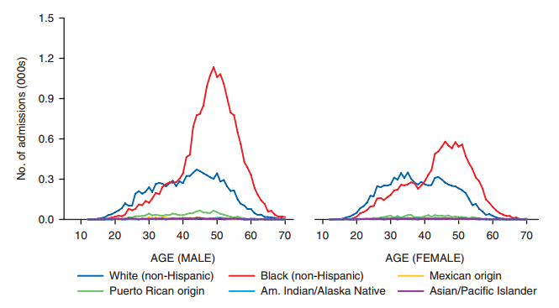
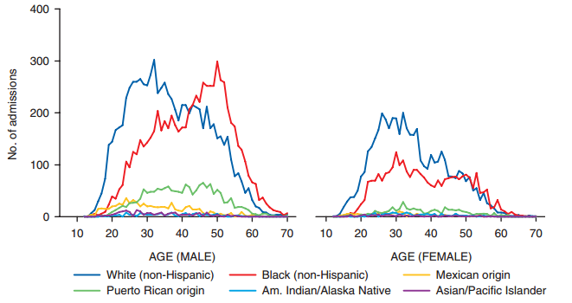
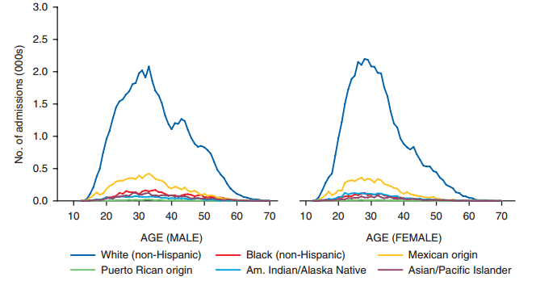
Stimulant Treatment Admissions, by Gender, Age, and Race/Ethnicity: 2014
Crack Cocaine
Powder Cocaine
Meth/Other Amph
SOURCE: SAMHSA, Treatment Episode Data Set, 2014 results.
Notes:
According to TEDS, primary smoked cocaine admissions were more likely than all admissions combined to be aged 35 or older (79% vs. 46%). The average age at admission for primary smoked cocaine was 44%. Admissions among non-Hispanic Black males peaked at 49 years; admissions among non-Hispanic White males peaked at 44 years of age. Non-Hispanic Blacks accounted for 56% of primary smoked cocaine admissions (34% were males and 21% were females), and non-Hispanic Whites accounted for 32% (17% were males and 15% were females).
The average age at admission for primary non-smoked cocaine admissions was 38 years. The peak age among non-Hispanic White male admissions was 18 years younger than the peak age among non-Hispanic Black male admissions (32 vs. 50 years of age). Admissions among both non-Hispanic White females and non-Hispanic Black females peaked in their early 30s. Non-Hispanic Whites accounted for 43% of primary non-smoked cocaine admissions (27% were males and 15% were females), and non-Hispanic Black males accounted for 34% (24% were males and 10% were females).
Primary methamphetamine/amphetamine admissions were on average 33 years old at admission. Admissions for both genders in all race/ethnicities peaked in the late 20s and early 30s. Non-Hispanic Whites accounted for 67% of primary methamphetamine/amphetamine admissions (35% were males and 32% were females). Eleven percent (11%) of primary methamphetamine/amphetamine admissions were of Mexican origin (7% were males and 5% were females).
REFERENCE:
Substance Abuse and Mental Health Services Administration, Center for Behavioral Health Statistics and Quality. (2016). Treatment Episode Data Set (TEDS): 2004-2014. National Admissions to Substance Abuse Treatment Services. BHSIS Series S-84, HHS Publication No. (SMA) 16-4986. Rockville, MD: Author.

Slide 25
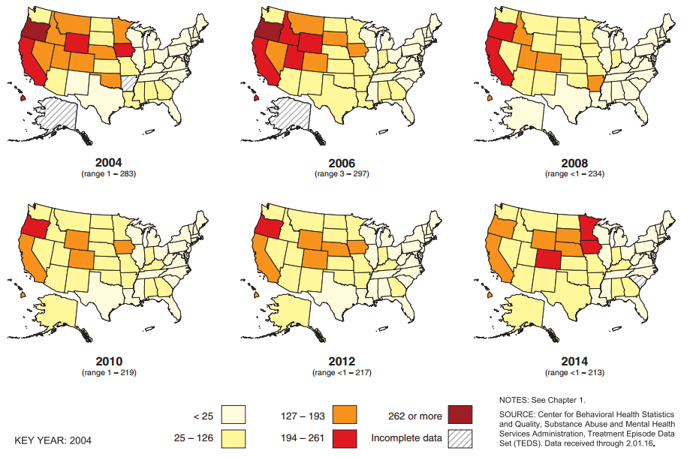
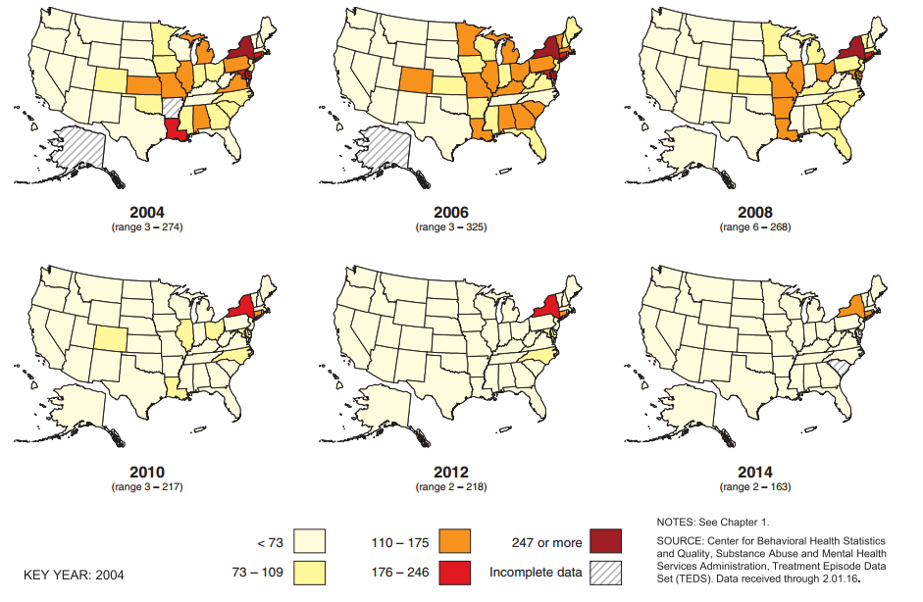
Primary Stimulant Rates, by State/Jurisdiction: 2004-2014
COCAINE
METH/AMPH
SOURCE: SAMHSA, Treatment Episode Data Set, 2014 results.
Notes:
**ANIMATION INSTRUCTIONS**
This slide contains animations. Trainers should practice presenting this information so they can see the timing of the animations and how new content appears on the slide. A separate set of maps appears for cocaine rates by state/jurisdiction and methamphetamine/ amphetamine rates by state/jurisdiction. The cocaine maps appear automatically; click once to reveal the methamphetamine/amphetamine maps.
This series of maps show long-term trends in population-adjusted (per 100,000 population) treatment admission rates among people age 12 and older for cocaine (crack/powder) and methamphetamine and other amphetamines. The firs set of maps correspond to trends in primary cocaine admission rates from 2004 to 2014 (the latest year for which data is available from the TEDS system). As you can see, rates of primary cocaine admissions decreased from 2004 to 2014 (the colors of the map lightened over time). The treatment admission rate for primary cocaine was 68% higher in 2004, at 100 per 100,000 population aged 12 and older, than in 2014 (32 per 100,000). Treatment admission rates were between 36% and 78% higher in 2004 than in 2014 in the nine Census divisions. Cocaine admission rates were higher in 2004 than in 2014 in 47 of the 48 states and jurisdictions reporting in both years and higher in 1 jurisdiction (Puerto Rico). From 2004 to 2014, cocaine treatment admission rates were consistently highest in the Middle Atlantic division.
The second set of maps correspond to trends in primary methamphetamine/other amphetamine admission rates from 2004-2014. Unlike what we see with cocaine, there has been changing pattern in the rate of meth/other amphetamine admissions, with decreases in the late 2000s, followed by increases in 2012 and 2014. The treatment admission rate for methamphetamine/ other amphetamines was 8& higher in 2004, at 57 per 100,000 population aged 12 and older, than in 2014 (53 per 100,000). Treatment admission rates peaked in 2005 at 69 per 100,000, then declined in every year through 2011 and increased from 2012 through 2014.
REFERENCE:
Substance Abuse and Mental Health Services Administration, Center for Behavioral Health Statistics and Quality. (2015). Treatment Episode Data Set (TEDS): 2004-2014. State Admissions to Substance Abuse Treatment Services. BHSIS Series S-85, HHS Publication No. (SMA) 16-4987. Rockville, MD: Author.

Slide 26
Past 3o Day Use of Stimulants among
8th, 10th, and 12th Graders: 2016
SOURCE: Monitoring the Future Study, 2016 results.
Notes:
The 2016 Monitoring the Future survey, which annually surveys teen attitudes and drug use, reported a significant decline in 30-day prevalence of powder cocaine, crack cocaine, methamphetamine, and other amphetamine use (prescription stimulants) among 8th, 10th, and 12th graders from peak use in the late 1990s/early 2000s. Of the four types of stimulants, students in all three grade levels were most likely to report current use of other amphetamines.
REFERENCE:
Johnston, L.D., Miech, R.A., O'Malley, P.M., Bachman, J.G., & Schulenberg, J.E. (2016). Teen use of any illicit drug other than marijuana at new low, same true for alcohol. University of Michigan News Service: Ann Arbor, MI. Retrieved March 9, 2017 http://www.monitoringthefuture.org.

Slide 27
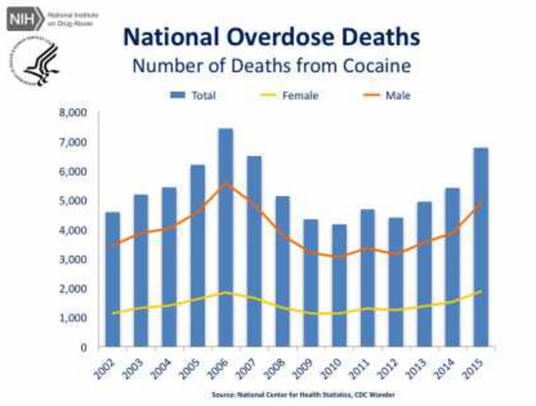
SOURCE: National Center for Health Statistics, CDC Wonder, 2001-2014 results.
Notes:
The national overdose death data presented in this slide are from the Centers for Disease Control and Prevention (CDC) Wonder system, maintained by the National Center for Health Statistics. The peak year for cocaine-related overdose deaths was 2006. Since then, there have been fluctuations in the number of cocaine-related deaths, with the past four years (2012-15) showing an upward trend. Further, from the lowest number in 2010 to 2015, there has been a 1.6-fold increase in the total number of deaths.
In rare instances, sudden death can occur on the first use of cocaine or unexpectedly thereafter. Cocaine-related deaths are often a result of cardiac arrest or seizures.
Additional Information for the Trainer(s):
CDC Wonder also tracks the number of deaths from cocaine, with and without opioid involvement (data not shown). Since 2010, the number of deaths involving both cocaine and opioids have more than doubled, while cocaine deaths not involving opioids only increased by 9%.
REFERENCE:
National Institute on Drug Abuse. (2017). Overdose Death Rates. Available at: https://www.drugabuse.gov/related-topics/trends-statistics/overdose-death-rates.

Slide 28
Stimulant Use and HIV Testing Status among LA County Treatment Discharges: FY 2015-16
 | Discharged Patients (N = 23,781)
Primary Substance Use Disorder
Methamphetamine | 10.2% (2,415)
Cocaine | 4.6% (1,087)
Secondary Substance Use Disorder
Methamphetamine | 12.2% (2,890)
Cocaine | 4.6% (1,098)
HIV Testing at Discharge
Tested for HIV/AIDS^{i} | 40.7% (8,650)
Returned for Results^{i} | 35.7% (7,568)
^{I}Totals and percentages reflect missing data.
SOURCE: Los Angeles County DPH /SAPC, LAPRS, FY 2015-16 results.
Notes:
This table depicts the prevalence of select substances of abuse and HIV testing status among discharge records located in the Los Angeles County Participant Reporting System, maintained by the County of Los Angeles Department of Public Health, Substance Abuse Prevention and Control (SAPC). Approximately 20% of discharged patients reported methamphetamine as a primary or secondary drug of abuse. For cocaine, roughly 10% reported cocaine as a primary or secondary drug use abuse. With regards to HIV testing status at discharge, approximately 41% of all patients were tested for HIV, and of those, 36% returned for their results.

Slide 29
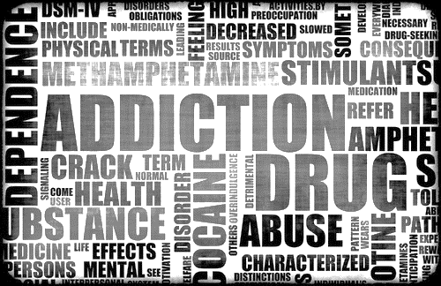
Stimulants:
What are We Talking About?
Notes:
TRANSITION SLIDE
The next section of the presentation describes, in detail, cocaine and methamphetamine. Topics include formulations, manufacturing processes, the impact on the user’s brain and body, acute and chronic physical and mental/cognitive effects, use during pregnancy, and cocaine vs. methamphetamine comparisons.
Image Credit: File: Fotolia, purchased image, 2017.

Slide 30
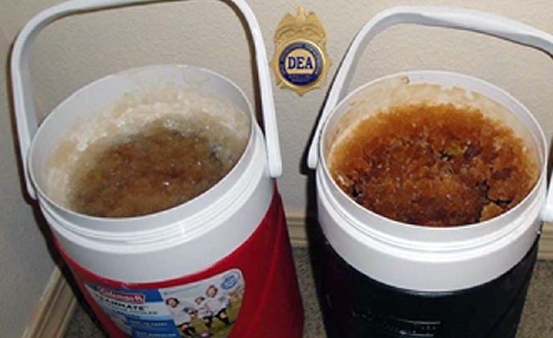
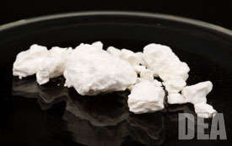
The Broader Classification: Stimulants
Methamphetamine
Powder and Crack Cocaine
Notes:
The main types of stimulants are methamphetamine, amphetamines (not pictured), crack cocaine, and powder cocaine. Stimulants increase alertness and arousal by stimulating the central nervous system.
Image Credits: Drug Enforcement Administration, various publications.

Slide 31
Forms of Cocaine
Powder cocaine
(Hydrochloride salt)
Smokeable cocaine
(crack, rock, freebase)
Cocaine half-life: ~1-2 hours
SOURCE: NIDA InfoFacts; http://emedicine.medscape.com.
Notes:
The powdered hydrochloride salt form of cocaine can be snorted or dissolved in water and injected. Powder cocaine is most often snorted. Crack is the form of cocaine that has not been neutralized by an acid to make the hydrochloride salt. This form of cocaine comes in a rock crystal that can be heated and its vapors smoked. Crack may be smoked in a pipe bowl containing 50-100 mg or in a cigarette with as much as 300 mg. The term "crack" refers to the crackling sound heard when the mixture is smoked (heated). The cocaine high is most intense if you smoke or inject cocaine. Smoking crack bypasses the vasoconstriction that results when cocaine is snorted; therefore, the effects are similar to taking cocaine intravenously.
Common street names can differ by region. Ask the audience to offer additional street names. Many other street names exist for crack, and the popularity of these names varies by geographic region of the U.S. Additional street names include: 24-7; Badrock; Beat; Candy; Chemical; Cloud; Cookies; Crumbs; Crunch & munch; Devil drug; Dice; Electric kool-aid; Fat bags; French fries; Glo; Gravel; Grit; Hail; Hard ball; Hard rock; Hotcakes; Ice cube; Jelly beans; Nuggets; Paste; Piece; Prime time; Product; Raw; Rock(s); Scrabble; Sleet; Snow coke; Tornado; and Troop.
Additional Information for the Trainer:
The half-life of cocaine depends on the route of administration. The following table summarizes
the duration of effects and half-life, by route of administration.
Smoking:
Onset: 7 seconds
Peak Effect (min): 1-5 minutes
Duration (min): 20 minutes
Half-Life (min): 40-60 minutes
Injection:
Onset: 15 seconds
Peak Effect (min): 3-5 minutes
Duration (min): 20-30 minutes
Half-Life (min): 40-60 minutes
Nasal/Inhalation:
Onset: 3 minutes
Peak Effect (min): 15 minutes
Duration (min): 45-90 minutes
Half-Life (min): 60-90 minutes
Oral:
Onset: 10 minutes
Peak Effect (min): 60 minutes
Duration (min): 60 minutes
Half-Life (min): 60-90 minutes
Image Credits: Drug Enforcement Administration, various publications.

Slide 32
Crack in More Detail
Freebase form of cocaine
that has been processed
from the powdered cocaine
hydrochloride form to a substance that can be smoked.
Processed with ammonia or sodium bicarbonate (baking soda) and water, and heated to remove the hydrochloride.
User experiences a high in less than 10 seconds.
Inexpensive both to produce and to buy.
Notes:
Crack can be administered in many ways, but is most often smoked. Crack is widely available in various geographic regions. The crack high is quick, intense, and short term, and requires the use of more crack almost immediately to maintain the high.
Additional Information for the Trainer:
The intensity and duration of cocaine’s effects—which include increased energy, reduced fatigue,
and mental alertness—depend on the route of drug administration. The faster cocaine is
absorbed into the bloodstream and delivered to the brain, the more intense the high.
TAKING COCAINE BY MOUTH
This is the safest way to do coke, but by far the least efficient. Users can absorb cocaine through
the mucous membrane of the inner cheeks and gums. It can also be swallowed but the drug loses
much of its effectiveness in the stomach. While the rate of absorption is slow, the effects last
longer.
SNORTING COCAINE
Snorting, or sniffing through the nose, is the next safest method. The effects peak sooner and
don’t last as long this way. It can lead to a burning sensation in the nostrils after cocaine’s
anesthetic effects wear off. Cocaine highly constricts blood vessels and prolonged use can lead
to nasal tissue being destroyed. Cocaine powder must be divided into very fine particles. Snorters
should be careful to use a clean instrument to snort with, such as a straw or hollowed out pen.
Don’t share this with others as blood-borne viruses and infections can result as the nasal linings
are quite fragile. Don’t use paper money, it will have all sorts of bacteria on it (and possibly
viruses) and can lead to infections.
SMOKING COCAINE
Freebase or crack cocaine is most often accomplished using a glass pipe or a small length of a
radio antenna or similar metal tube. Like injecting, smoking leads to intense short-lived effects
but it does bypass some of the risks posed by injecting, like infections from bacteria or viruses.
The danger of overdose is lowered to some extent, but still risky.
INJECTING COCAINE
Injecting cocaine provides the highest blood levels of drug in the shortest amount of time. Upon
injection, cocaine reaches the brain in a matter of seconds, and the exhilarating rush that follows
can be so intense that it induces some users to vomit uncontrollably. The euphoria passes
quickly. Make sure you use a 0.2 wheel filter to get rid of bacteria and fillers.
One effect of cocaine is a restricting of your veins. They get harder to find, so rotate your sites
and take care if you are on a binge. An injected mixture of cocaine and heroin is a dangerous
combination, as the converse effects of the drugs actually complement each other, but may
also mask the symptoms of an overdose.
Image Credit: Drug Enforcement Administration, NIDA website, 2016.

Slide 33

Methamphetamine
Methamphetamine Powder
Users’ Description: Beige/yellowy/off-white powder
Base / Paste Methamphetamine
Users’ Description: ‘Oily’, ‘gunky’, ‘gluggy’ gel, moist, waxy
Crystalline Methamphetamine
Users’ Description: White/clear crystals/rocks; ‘crushed glass’ / ‘rock salt’
Notes:
Methamphetamine is commonly found in a few forms – methamphetamine powder, base/paste methamphetamine, and crystal methamphetamine. The information on this slide is provided to describe the differences between each form of methamphetamine.
Image Credit: Drug Enforcement Administration, 2017.

Slide 34

A Quick History of Methamphetamine
Before 1970, amphetamine could be purchased over the counter
1970-1980: Meth made using the P2P phenylpropanone method. Bikers carried the product in their “crank cases”
1980: P2P becomes schedule II in the US but is still legal in Mexico. Meth in US is made from pseudoephedrine (PSE)
2005: PSE regulated by CMEA in US and
banned in Mexico
2009: Significant shift from PSE to P2P as
precursor
2014: New alternative P2P recipe (nitrostyrene) emerging
34
SOURCE: Slide courtesy of Jane C. Maxwell, PhD.
Notes:
This slide depicts a brief history of the methods used to produce methamphetamine, both domestically and internationally.
CMEA = The Combat Methamphetamine Epidemic Act of 2005.
Slide courtesy of Jane C. Maxwell, PhD
Image Credit: PBS website, 2017.

Slide 35

Methamphetamine Manufacturing Processes – Three Methods
1. Ephedrine/Pseudoephedrine Based
“Nazi Method”-lithium, anhydrous
ammonia
Cold method-red phosphorus, iodine crystals
“One Pot” and “Shake and Bake” cooking using dry ammonia nitrite and cough syrup rather than liquid anhydrous ammonia
2. P2P/Phenylacetone (Illegal in US-Schedule II, precursors legal in Mexico). Now cooked in large laboratories in Mexico with expert chemists
3. New synthetic method emerging with P2P precursor and phenylacetic acid as pre-precursor—nitrostyrene
SOURCE: Slide courtesy of Jane C. Maxwell, PhD.
Notes:
This slide explains the different processes used to manufacture methamphetamine. The new synthetic profile from Mexico is beginning to pop up along the US/Mexico border and in states along the Mississippi River.
Slide courtesy of Jane C. Maxwell, PhD
Image credit: National Drug Threat Assessment Summary, 2015.

Slide 36
Purity vs. Potency
Purity is a measure of the amount of an illicit substance compared to other substances such as adulterants or solvents.
Potency is the measure of drug activity in terms of the dosage required to exert an effect on the body.
Methamphetamine has 2 isomers:
The /-isomer form is sold over-the-counter and exhibits vasoconstrictive effects (Vicks inhaler).
The d-isomer form is 3-5 times stronger on the central nervous system activity. (Ciccarone 2011). Crystalline meth is highly purified for smoking and associated with increased incidence of dependence as the l-isomer and releases dopamine (McKetin et al., 2006).
Mendelson et al., 2008, BMC Cln Pharm 21; 8-5; Ciccarone, 2011, Prim Care 38, 41-58; McKetin et al, 2006, DAD 85, 198-204.
Notes:
This slide provides the definition of purity and potency. With regards to the two isomers of methamphetamine, the key message is this: If drug is 100% potent, it’s all d-form. If 0% potent, is all l-form.
Slide courtesy of Jane C. Maxwell, PhD
REFERENCES:
Ciccarone, D. (2011). Stimulant abuse: Pharmacology, cocaine, methamphetamine, treatment, attempts at pharmacology. Primary Care, 28(1), 41-58.
McKetin, R., McLaren, J., Lubman, D.I., & Hides, L. (2006). The prevalence of psychotic symptoms amoung methamphetamine users. Addiction, 101(10), 1473-1478.

Slide 37
Differences in PSE and P2P Methods of Methamphetamine Manufacture
PSE | P2P
Made in homes and rural areas in small amounts; source is OTC medicines | Large-scale Mexican labs with expert chemists; source is local dealers
Either cooked for personal use or brought from local dealers | Imported from Mexico and often sold by cartels (which often traffic heroin)
Costs include clean up of lab sites, burns and chemical reactions | P2P has no clean-up costs in the U.S.
Similar societal and public health costs
SOURCE: Slide courtesy of Jane C. Maxwell, PhD.
Notes:
This slide details the differences in the ephedrine/pseudoephedrine-based method and P2P/phenylacetone method of manufacturing methamphetamine.
Slide courtesy of Jane C. Maxwell, PhD

Slide 38

Let’s Take a Look at
Normal Dopamine Functioning
SOURCE: Meth Inside Out.
Notes:
INSTRUCTIONS
[This slide contains a movie clip that will play when the trainer clicks on the black box. In
order for this to work, the connection between the PowerPoint presentation and the video
file must be maintained. When moving the PowerPoint file to another location
on your computer or to another computer, make sure to always move the video file along
with it.
If the link becomes broken, the video will need to be reinserted. Delete the black box. From
the insert menu in PowerPoint, select “movie.” Select the video file that was included for
this training. When asked, indicate that the movie should play automatically. It will appear
as a black box on the screen. The video should play when the slide show is being viewed
when the trainer clicks on the black box]
In order to understand the impact of crack/cocaine on the brain, you first need to understand the way that the brain works normally (in the absence of these substances). It is then possible to see how stimulants like crack change this functioning. A movie will play here depicting the normal dopamine transmission process.
Video Source: Meth Inside Out, http://www.methinsideout.com/.

Slide 39
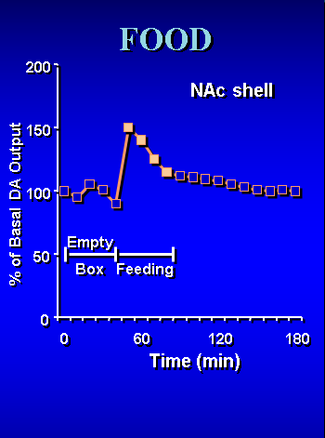
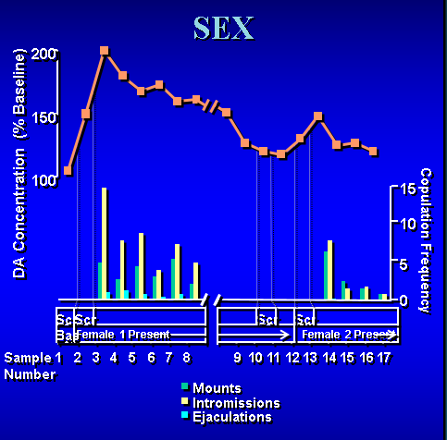
Natural Rewards Elevate Dopamine Levels
SOURCE: Bassareo & Di Chiara, 1999; Fiorino & Phillips, 1997.
Notes:
One of the neurotransmitters affected by cocaine and methamphetamine, and by most drugs of abuse, is dopamine. The release of dopamine within the reward or pleasure circuits in the brain produces immediate feelings of pleasure and elation. Anything that causes you to feel pleasure will cause a spike in your dopamine levels. Even things like food and sex cause dopamine spikes.
The figure on the left illustrates what happens when a food-deprived rat is given food. When the food is introduced to the rat in the feeding box, the rat’s dopamine level increases from a baseline of about 100 to a high of about 150.
The figure on the right illustrates what happens when a sex-deprived male rat is introduced to a female rat. When the rats are brought together to do what sex deprived rats will do, their dopamine level increases from that same baseline level of about 100 to a high of 200 (which indicates that sex has a bigger effect on dopamine levels than food).
REFERENCES:
Bassareo, V., & Di Chiara, G. (1999). Differential responsiveness of dopamine transmission to food-stimuli in nucleus accumbens shell/core compartments. Neuroscience, 89(3), 637-641.
Fiorino, D.F., & Phillips, A.G. (1997). Dynamic changes in nucleus accumbens dopamine efflux during the Coolidge effect in male rats. Journal of Neuroscience, 17(12), 4849-4855.

Slide 40
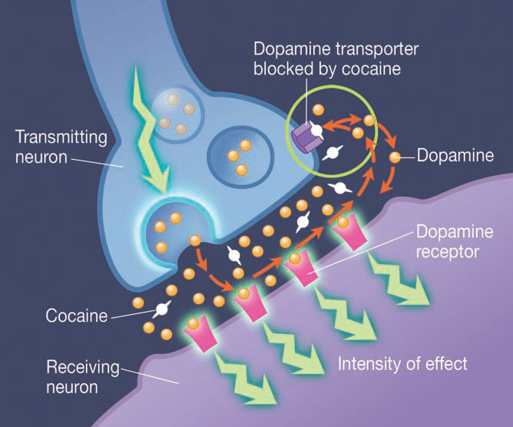
How Does Cocaine Work in the Brain?
SOURCE: NIDA, Cocaine Research Report Series, 2016.
Notes:
The most extensively studied effect of cocaine on the central nervous system is the blockage of the dopamine transporter protein. In the normal communication process, dopamine is released by a neuron into the synapse, where it can bind to dopamine receptors on neighboring neurons.
Normally, dopamine is then recycled back into the transmitting neuron by a specialized protein called the dopamine transporter. Cocaine acts by preventing the dopamine from being recycled, causing excessive amounts of the neurotransmitter to build up, amplifying the message to and response of the receiving neuron, and ultimately disrupting normal communication. It is this excess of dopamine that is responsible for cocaine’s euphoric effects.
With repeated use, cocaine can cause long-term changes in the brain’s reward system and in other brain systems as well, which may eventually lead to addiction. With repeated use, tolerance to the cocaine high also often develops. Many cocaine abusers report that they seek but fail to achieve as much pleasure as they did from their first exposure. Some users will increase their dose in an attempt to intensify and prolong the euphoria, but this can also increase the risk of adverse psychological or physiological effects.
Dopamine-rich brain regions such as the ventral tegmental area, nucleus accumbens, and prefrontal cortex are frequent targets of cocaine addiction research.

Slide 41
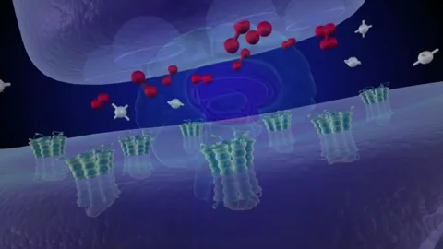
How the Brain Responds to Cocaine
41
SOURCE: National Institute on Drug Abuse.
Notes:
INSTRUCTIONS
[This slide contains a movie clip that will play when the trainer clicks on the mouse one
time. In order for this to work, the connection between the PowerPoint presentation and
the video file must be maintained. When moving the PowerPoint file to another location
on your computer or to another computer, make sure to always move the video file along
with it.
If the link becomes broken, the video will need to be reinserted. Delete the still video image
that appears on the screen. From the insert menu in PowerPoint, select “movie.” Select the
video file that was included for this training. When asked, indicate that the movie should
play automatically. It will appear as a still image on the screen.
As was previously stated, normally, dopamine is then recycled back into the transmitting neuron by a specialized protein called the dopamine transporter. Cocaine acts by preventing the dopamine from being recycled, causing excessive amounts of the neurotransmitter to build up, amplifying the message to and response of the receiving neuron, and ultimately disrupting normal communication. It is this excess of dopamine that is responsible for cocaine’s euphoric effects. With repeated use, cocaine can cause long-term changes in the brain’s reward system and in other brain systems as well, which may eventually lead to addiction. With repeated use, tolerance to the cocaine high also often develops. Many cocaine abusers report that they seek but fail to achieve as much pleasure as they did from their first exposure. Some users will increase their dose in an attempt to intensify and prolong the euphoria, but this can also increase the risk of adverse psychological or physiological effects.
Video Source: National Institute on Drug Abuse, The Reward Circuit: How the Brain Responds to Cocaine, available at: https://www.youtube.com/watch?v=yeAN26kJuTQ.

Slide 42
Acute Effects of Crack/Cocaine
Euphoria or affective blunting
Changes in sociability
Hypervigilance
Interpersonal sensitivity
Anxiety, tension, or anger
Impaired judgment
Impaired social or occupational functioning
SOURCE: slide courtesy of Gloria Miele, PhD.
Notes:
Acute intoxication with stimulants resembles hypermania or a manic state. In low doses, a user’s libido is stimulated and sexual performance is enhanced. In high doses, spontaneous ejaculation and orgasm can occur. With increasing doses comes poor judgment, indiscretions, sexual acting-out, and other bizarre behaviors or mental alterations. Acute stimulant intoxication can result in seizures, confusion, respiratory depression, chest pain, or cardiac arrhythmias (Gold and Miller, 1997). The acute physical effects of cocaine intoxication include constricted blood vessels, dilated pupils, and increased temperature, heart rate, and blood pressure. The duration of cocaine’s immediate euphoric effects, which include hyperstimulation, reduced fatigue, and mental alertness, depends on the route of administration. The faster the absorption, the more intense the high. On the other hand, the faster the absorption, the shorter the duration of action. The high from snorting may last 15 to 30 minutes, while that from smoking may last 5 to 10 minutes. Increased use can reduce the period of time a user feels high and increases the risk of addiction. Taken in small amounts, cocaine usually makes the user feel euphoric, energetic, talkative, and mentally alert, especially to the sensations of sight, sound, and touch. Cocaine can also temporarily decrease the need for food and sleep. Some users find that the drug helps them perform simple physical and intellectual tasks more quickly, while others experience the opposite effect. Acute effects of cocaine are similar to other stimulants, such as methamphetamine. Cocaine users are hypervigilant. Cocaine users will initially feel as if their thinking is ‘clear and focused.’
Slide courtesy of Gloria Miele, PhD

Slide 43
Dopamine (D2) Receptor Availability
SOURCE: NIDA Research Report, 2016.
Notes:
This slide features brain images showing decreased dopamine (D2) receptors in the brain of a person addicted to cocaine versus D2 receptors in the brain of a non-drug user. The dopamine system is important for conditioning and motivation, and alterations such as this are likely responsible, in part, for the diminished sensitivity to natural rewards that develops with addiction.
The scan on the left side of the screen depicts the brain of a non-drug using control. Notice the bright colors (red and orange) in the reward center (the egg-shaped areas towards the top of the scan). Bright colors indicate that there is a lot of activity occurring in the scanned individual’s reward center. The scan on the right side of the screen depicts the brain of a cocaine abuser who has been matched to the control in terms of age, race, etc. Notice that there are no bright red and orange colors in the reward center. Essentially, you see virtually no dopamine activity in the reward centers of the cocaine abuser’s brain, suggesting very severe disruption of the dopamine neurons. If you were to apply emotions to the cocaine abuser, how would he/she be feeling? He/she would feel depressed, sad, distraught, etc.
Additional Video Resources for the Trainer(s):
Why do people lose control over their cocaine use? (Video): https://www.youtube.com/watch?v=UsBXtJi5t4M
The reward circuit: how the brain responds to cocaine (Video): https://www.youtube.com/watch?v=yeAN26kJuTQ

Slide 44
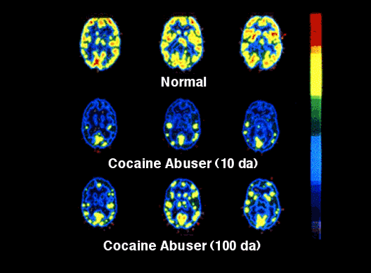
Long-Term Impact of Cocaine Use
SOURCE: NIDA, 2007; Volkow et al., 1993; Volkow et al., 1992.
Notes:
This set of PET scan images shows how the brain is affected by long term use of a stimulant drug such as cocaine. In the set of scans, the level of brain function is indicated in yellow. The top row shows a normal-functioning brain without drugs. You can see a lot of brain activity. In other words, there is a lot of yellow color. The middle row shows a cocaine addict’s brain after 10 days without any cocaine use. Less yellow means less normal activity occurring in the brain - even after the cocaine abuser has abstained from the drug for 10 days. The bottom row shows the same person’s brain after 100 days without any cocaine. You can see a little more yellow, so there is some improvement, or more brain activity, as this state of early recovery. But the person’s brain is still not back to a normal level of functioning more than 3 months later. Scientists are concerned that there may be areas in the brain that may never fully recover from drug abuse and addiction.
REFERENCES:
National Institute on Drug Abuse. (2007). Bringing the Power of Science to Bear on Drug Abuse and Addiction, Long Term Effects of Drug Abuse, available at: https://www.drugabuse.gov/publications/teaching-packets/power-science/section-ii/4-long-term-effects-drug-abuse.
Volkow, N.D., Fowler, J.S., Wang, G.-J., Hitzemann, R., Logan, J., Schlyer, D., Dewey, S., & Wolf, A.P. (1993). Decreased dopamine D2 receptor availability is associated with reduced frontal metabolism in cocaine abusers. Synapse, 14, 169-177.
Volkow, N.D., Hitzemann, R., Wang, G.-J., Fowler, J.S., Wolf, A.P., & Dewey, S.L. (1992). Long-term frontal brain metabolic changes in cocaine abusers. Synapse 11, 184-190.

Slide 45
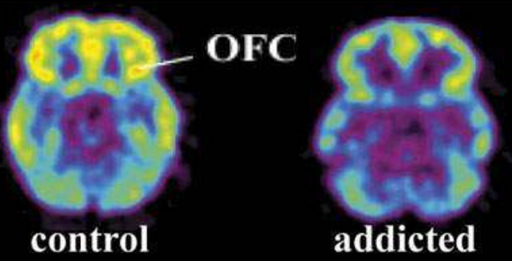
Beyond Dopamine Reward Circuitry:
Brain Glucose Metabolism
SOURCE: Volkow et al. (2011).
Notes:
Chronic cocaine use impacts more than the dopamine reward system. According to a study by Dr. Nora Volkow and colleagues, they found that research subjects (in this case animals) who were addicted to cocaine had decreased glucose metabolism in the orbitofrontal cortex (OFC), an indicator of reduced activity. In this brain image, the brain of a control subject is on the left side, and the brain of an animal addicted to cocaine is on the right. Poor decision-making, an inability to adapt to negative consequences of drug use, and a lack of self-insight all appear to be related to diminished functioning in the OFC.
REFERENCE:
Volkow, N.D., Want, G.-J., Fowler, J.S., Tomasi, D., & Teland, F. (2011). Addiction: Beyond dopamine reward circuitry. Proc Natl Acad Sci USA, 108(37), 15037-15042.

Slide 46
Long-Term Effects of Crack/Cocaine
Addiction
Irritability and mood disturbances
Restlessness
Paranoia
Auditory hallucinations
Notes:
As a result of long-term use of cocaine, an appreciable tolerance to cocaine’s high may develop,
with many individuals reporting that they seek but fail to achieve as much pleasure as they did
from their first experience. Some cocaine users will frequently increase their doses to intensify
and prolong the euphoric effects. While tolerance to the high can occur, users can also become
more sensitive (sensitization) to cocaine’s anesthetic and convulsing effects, without increasing
the dose taken. This increased sensitivity may explain some deaths occurring after apparently low
doses of cocaine. Long-term effects can lead to long-term mental health problems, legal
problems, and problems with SUD and HIV treatment adherence.

Slide 47
Medical Consequences of Crack/Cocaine
Cardiovascular effects
  Disturbances in heart rhythm; heart attacks
Respiratory effects
  Chest pain; respiratory failure
Neurological effects
  Strokes; seizures; headaches
Gastrointestinal complications
  Abdominal pain; nausea
Paranoia
Notes:
Cocaine is a powerful stimulant that causes the heart to work harder and strains the vascular system. Chronic use can cause heart attacks and strokes. Cocaine increases blood pressure, and has other medical impacts as described on this slide.

Slide 48
Stimulant Intoxication and Withdrawal Syndromes (DSM-5)
 | Intoxication (2 or more) | Withdrawal (** plus 2)
 | Tachycardia or bradycardia | Dysphoric Mood**
 | Pupillary dilation | Cessation (or reduction in) prolonged use
 | Elevated or lowered blood pressure | Fatigue
 | Perspiration or chills | Vivid/unpleasant dreams
 | Nausea or vomiting | Insomnia or hyposomnia
 | Evidence of weight loss
 | Psychomotor agitation or retardation | Increased appetite
 | Muscular weakness, respiratory depression, chest pain, or cardiac arrhythmias | Psychomotor retardation or agitation
 | Confusion, seizues, dyskinesias, dystonias, or coma
SOURCE: Barnhorst, A. (2015).
Notes:
Stimulant withdrawal is not medically life threatening and, unlike alcohol or barbiturate withdrawal, does not require pharmacological intervention. A characteristic withdrawal-type syndrome usually develops within hours to days after cessation of prolonged and heavy stimulant use. Stimulant withdrawal symptoms seem to be most severe in the initial days following cessation of use (Cornish and O'Brien, 1996; Gold and Miller, 1997).Cocaine intoxication is characterized by the presence of two or more symptoms listed in the left column. Cocaine withdrawal often has no visible physical symptoms, like the vomiting and shaking that accompanies withdrawal from heroin or alcohol. Dysphoric mood must ALWAYS be present when assessing for cocaine withdrawal, plus at least 2 of the other withdrawal symptoms listed in the right column. The level of craving, irritability, delayed depression, and other symptoms produced by cocaine withdrawal rivals or exceeds that felt with other withdrawal syndromes. A common symptom of cocaine withdrawal is the “cocaine crash,” which is the craving for another dose of cocaine. Other common withdrawal symptoms include fatigue, depression, restless behavior, and a feeling of anxiety or paranoia. During withdrawal, individuals may also experience a period of malaise when they just do not feel like doing anything at all. Many individuals who have experienced cocaine withdrawal report very unpleasant and vivid dreams.
DSM-5 criteria for stimulant intoxication are (1) recent use of an amphetamine-type substance, cocaine, or other stimulant; (2) clinically significant problematic behavioral or psychological changes that develop during, or shortly after, use of a stimulant; and (3) two or more signs or symptoms (left hand side of table) developing during, or shortly after, stimulant use.
DSM-5 criteria for stimulant withdrawal are (1) cessation or (or reduction in) prolonged amphetamine-type substance, cocaine, or other stimulant use; (2) dysphoric mood and two (or more) physiologic changes developing within a few hours to several days (right hand side of table).
REFERENCE:
Barnhorst, A. (2015). Amphetamine-Related Psychiatric Disorders Clinical Presentation. Available at http://emedicine.medscape.com/article/289973-clinical.

Slide 49
Adverse Effects of Cocaine Differ by Route of Administration
Snorting: leads to loss of the sense of smell, nosebleeds, problems with swallowing, hoarseness, and a chronically runny nose.
Orally ingesting: can cause severe bowel gangrene due to reduced blood flow.
Injecting: can cause severe allergic reactions and, as with all injecting drug users, cocaine injectors are at increased risk for contracting HIV and other blood-borne diseases.
SOURCE: NIDA InfoFacts: Crack and Cocaine, 2016.
Notes:
Different methods of taking cocaine can produce different adverse effects. Regular intranasal use (snorting) of cocaine, for example, can lead to loss of the sense of smell; nosebleeds; problems with swallowing; hoarseness; and a chronically runny nose. Ingesting cocaine can cause severe bowel gangrene as a result of reduced blood flow. Injecting cocaine can bring about severe allergic reactions and increased risk for contracting HIV/AIDS and other blood-borne diseases. Binge-patterned cocaine use may lead to irritability, restlessness, and anxiety. Cocaine abusers can also experience severe paranoia—a temporary state of full-blown paranoid psychosis—in which they lose touch with reality and experience auditory hallucinations. (NIDA InfoFacts). Snorting can cause short term and long term adverse affects on nose/lungs. Ingesting can cause severe stomach problems. Injection increases the risk of HIV and other infectious diseases.
REFERENCE:
National Institute on Drug Abuse. (2016). Cocaine. Available at: https://www.drugabuse.gov/publications/drugfacts/cocaine.

Slide 50

Effects of Cocaine Use During Pregnancy
Maternal migraines and seizures
Premature membrane rupture
Separation of placental lining
from uterus prior to delivery
High blood pressure
Spontaneous miscarriage
Preterm labor
Difficult delivery
SOURCE: Cain et al., 2013; NIDA, 2016; Volkow, 2005.
Notes:
This slide details the effect that cocaine use may have during pregnancy. Possible effects found in the few human studies that exist include increased rates of premature delivery, placental abruption (early separation of a normal placenta from the wall of the uterus), retarded fetal growth, and cardiac and brain abnormalities. Cain and colleagues estimate that there are approximately 750,000 cocaine-exposed pregnancies each year.
REFERENCES:
Cain, M.A., Bornick, P., & Whiteman, V. (2013). The maternal, fetal, and neonatal effects of cocaine exposure in pregnancy. Clin Obstet Gynecol, 56(1), 124-132.
National Institute on Drug Abuse. (2016). Cocaine. Available at: https://www.drugabuse.gov/publications/research-reports/cocaine.
Volkow, N. (April 21, 2005). Testimony Before the Subcommittee on Labor, Health, and Human Services; Education; and Related Agencies. Committee on Appropriations, U.S. Senate. Available at: www.hhs.gov/asl/testify/t050425b.html.
Image Credit: NIDA website, 2017.

Slide 51
A Long-Term Research Study
Debunks the “Crack Baby” Myth
A large-scale, 25-year study of the “crack baby” epidemic reveals no statistically significant differences in long-term health and life outcomes between full-term babies exposed to cocaine in-utero vs. those who were not exposed
Poverty, not drugs, is a key determining factor in how cocaine-exposed children perform later in life
SOURCE: Betancourt et al., 2011.
Notes:
Betancourt and colleagues studied children who were exposed to cocaine in utero to determine if prenatal cocaine exposure has latent effects on neurocognitive outcomes that do not usually manifest themselves until adolescence or young adulthood. The research team examined neurocognitive function using five tasks designed to tap into inhibitory control, working memory, receptive language, and incidental memory. They found that there was no evidence on latent effects of gestational cocaine exposure on inhibitory control, working memory, or receptive language.
While the cocaine-exposed children and control group performed about the same on the tests, both groups lagged on developmental and intellectual measures compared to the norm. The research team began to think the factor affecting long-term outcomes as poverty. As time went on, the research team conducted several evaluations in an attempt to determine if environmental factors could be responsible for affecting their development. What they found is that children who were in a nurturing home, with caregiver warmth, affection, and language stimulation, did better than those in a less nurturing home. With regards to crime and exposure to violence, those children who were exposed to high levels of violence were more likely to show signs of depression and anxiety and had lower self-esteem.
REFERENCE:
Betancourt, L.M., Yang, W., Brodsky, N.L., Gallagher, P.R., Malmud, E.K., Giannetta, J.M., Farah, M.J., & Hurt, H. (2011). Adolescents with and without gestational cocaine exposure: Longitudinal analysis of inhibitory control, memory and receptive language. Neurotoxicol Teratol, 22(1), 33-46.

Slide 52
Methamphetamine
Acute Physical Effects
Increases
Heart rate
Blood pressure
Pupil size
Respiration
Sensory acuity
Energy
Decreases
  Appetite
  Sleep
  Reaction time
Notes:
At the outset, methamphetamine is a seductive drug because its effects during the early stages of use are very pleasurable and reduce appetite and fatigue. People take the drug to help them work longer hours, lose weight, study longer, become more athletic, and have more and better sex. When a person uses methamphetamine, heart rate and blood pressure increase, as do pupil size, sensory acuity, and energy. Concomitantly, it decreases appetite, sleep, and reaction time. People find these effects useful.

Slide 53
How the Brain Responds to Meth
SOURCE: Meth Inside Out.
Notes:
INSTRUCTIONS
[This slide contains a movie clip that will play when the trainer clicks on the mouse one
time. In order for this to work, the connection between the PowerPoint presentation and the
video file must be maintained. When moving the PowerPoint file to another location
on your computer or to another computer, make sure to always move the video file along
with it.
If the link becomes broken, the video will need to be reinserted. Delete the still video image
that appears on the screen. From the insert menu in PowerPoint, select “movie.” Select the
video file that was included for this training. When asked, indicate that the movie should
play automatically. It will appear as a black box on the screen.
As you will see from this video clip, the effects of methamphetamine on the brain are different than what we see from other stimulants such as cocaine. While the methamphetamine molecule is structurally similar to amphetamine and to the neurotransmitter dopamine, it is quite different from cocaine. Although these stimulants have similar behavioral and physiological effects, there are some major differences in the basic mechanisms of how they work. According to NIDA, “in contrast to cocaine, which is quickly removed from and almost completely metabolized in the body, methamphetamine has a much longer duration of action, and a larger percentage of the drug remains unchanged in the body. Methamphetamine therefore remains in the brain longer, which ultimately leads to prolonged stimulant effects. Although both methamphetamine and cocaine increase levels of dopamine, administration of methamphetamine in animal studies leads to much higher levels of dopamine, because nerve cells respond differently to the two drugs. Cocaine prolongs dopamine actions in the brain by blocking the re-absorption (re-uptake) of the neurotransmitter by signaling nerve cells. At low doses, methamphetamine also blocks the re-uptake of dopamine, but it also increases the release of dopamine, leading to much higher concentrations in the synapse (the gap between neurons), which can be toxic to nerve terminals.”
Video Source: Meth Inside Out, http://www.methinsideout.com/.

Slide 54
Effects of Drugs on Dopamine Release
1500
1000
500
0
METHAMPHETAMINE
COCAINE
400
Accumbens
Accumbens
300
DA
DOPAC
% of Basal Release
HVA
% Basal Release
200
100
0
1
2
3hr
0
Time After Methamphetamine
Time After Cocaine
250
NICOTINE
250
Accumbens
ETHANOL
200
Accumbens
200
Dose (g/kg ip)
Caudate
0.25
150
0.5
% of Basal Release
1
% of Basal Release
2.5
100
150
100
0
0
1
2
3 hr
0
Time After Nicotine
0
1
2
3
4hr
Time After Ethanol
54
Source: Di Chiara & Imperato, 1988; Shoblock et al., 2003.
Notes:
The same phenomenon of dopamine release can be seen with drugs of abuse, but to an even larger extent than is seen with food and sex. Cocaine causes a spike in dopamine to about 350. Alcohol increases dopamine levels to 125, and nicotine increases dopamine levels to 225. But with methamphetamine, you see an unparalleled spike in dopamine to a level of about 1,100. Nothing that exists in nature can have as large an impact on dopamine levels than methamphetamine.
REFERENCES:
Di Chiara, G., & Imperato, A. (1988). Drugs abused by humans preferentially increase synaptic dopamine concentrations in the mesolimbic system of freely moving rats. Proc Natl Acad Sci U.S.A., 85(14), 5274-5278.
Shoblock, J.R., Sullivan, E.B., Maisonneuve, I.M., & Glick, S.D. (2003). Neurochemical and behavioral differences between d-methamphetamine and d-amphetamine in rats. Psychopharmacolgy (Berl), 165(4), 359-369.

Slide 55
Methamphetamine
Acute Psychological Effects
Increases
Confidence
Alertness
Mood
Sex drive
Energy
Talkativeness
Decreases
Boredom
Loneliness
Timidity
Notes:
Like the initial medical effects of methamphetamine, the initial psychological effects are also generally pleasant: methamphetamine increases confidence, alertness, positive mood, sex drive, energy, and talkativeness. It also decreases boredom, loneliness, and timidity.

Slide 56
Methamphetamine
Chronic Physical Effects
Tremor
Weakness
Dry mouth
Weight loss
Cough
Sinus infection
Sweating
Burned lips; sore nose
Oily skin/complexion
Headaches
Diarrhea
Anorexia
Notes:
Over time, the effects of methamphetamine change. As methamphetamine is repeatedly applied to the brain, it changes brain chemistry, structure, and function. Some structures of the brain develop tolerance to the drug’s effects and require an increased dosage to produce the desired effects. However, other areas of the brain become sensitized to the effects of methamphetamine, causing even small doses to produce very powerful reactions. Simply put, over time, part of the brain reacts to the drug by needing more of it, while other parts of the brain respond in exactly the opposite manner. Methamphetamine is a powerful stimulant that causes the heart to work harder and strains the vascular system. Chronic use can cause heart attacks and strokes. It increases blood pressure and thickens heart valves. Methamphetamine constricts blood vessels on the skin surface, causing the skin to feel tingly. Users will frequently vigorously scratch their skin in response to this sensation (meth bugs, speed bumps). Some of the effects to the left are due to the method the user uses to get the drug into his/her body. And what started as a weight loss of a few pounds ends up being an uncontrollable level of weight loss.
Infective Endocarditis (i.e., staphylococcus aureus) is frequent among injection drug users (IDUs). About 8-16% of hospital admissions for IDUs are accounted for by infective endocarditis. Essentially, an organism colonizes the heart (mostly the right side). Most common symptoms of endocarditis are chest pain, cough, fever, chills, and arthralgia. The condition can be treated with antibiotics or surgery.

Slide 57
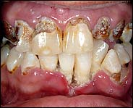
Meth Use Leads to Severe Tooth Decay
“Meth mouth” is characterized by severe tooth decay and gum disease
Teeth often break or fall out
SOURCE: American Dental Association, 2017.
Notes:
The phenomenon of “Meth Mouth” has received substantial attention by the media because the dental problems associated with methamphetamine use are severe, and photographs of the dental disease experienced by methamphetamine users are quite dramatic and unsightly. The constriction of blood vessels caused by methamphetamine reduces the blood flow to the gums and teeth. Over time, this restriction of blood flow can result in inadequate nourishment reaching the gums and teeth, causing tooth death.
Methamphetamine also causes a decrease in saliva output. Lack of saliva, along with the almost universal poor dental hygiene of methamphetamine users, can promote the formation of cavities. Further, methamphetamine use causes bruxism (teeth grinding) in many users. This phenomenon can also substantially damage the enamel on the teeth and cause serious dental wear. For those who smoke meth, some research suggests that the direct effects of the meth vapor that is drawn into the mouth via smoking may also have direct damaging effects on the teeth.
Image Credit: American Dental Association website 2017.

Slide 58
Methamphetamine
Chronic Psychological Effects
Confusion
Concentration
Hallucinations
Fatigue
Memory loss
Insomnia
Irritability
Paranoia
Panic reactions
Depression
Anger
Psychosis
Notes:
As dramatic as the chronic physical effects of methamphetamine are, the chronic psychological effects are even more profound. During initial stages of use, methamphetamine produces feelings of optimism, enthusiasm, and sociability. Over time, however, these positive effects are replaced with much more troublesome and pathological symptoms. In fact, the major presenting problems for methamphetamine users are psychological symptoms such as confusion, depression, anxiety, delusions, paranoid reactions, hallucinations, and suicidal ideation.

Slide 59

Effects of Maternal Methamphetamine Use
Increased rates of premature
delivery
Placental abruption
Small size and lethargy
Cardiac and brain abnormalities
Neurological problems
  Decreased arousal
  Increased stress
  Attention impairments
SOURCE: American Congress of Obstetricians and Gynecologists, 2017.
Notes:
According to the American College of Obstetricians and Gynecologists (ACOG), Committee on Health Care for Underserved Women, as is the case with cocaine, the use of methamphetamine during pregnancy can endanger the health of the mother, and increase the risk of low birth weight and small for gestational age babies, and may also increase the risk for neurodevelopmental problems in children.
REFERENCE:
American College of Obstetricians and Gynecologists. (2011, reaffirmed 2017). Methamphetamine Abuse in Women of Reproductive Age. Available at: https://www.acog.org/Resources-And-Publications/Committee-Opinions/Committee-on-Health-Care-for-Underserved-Women/Methamphetamine-Abuse-in-Women-of-Reproductive-Age.

Slide 60

Infant Development, Environment, and Lifestyle Study (IDEAL)
Multi-site study involved more than 1,600 research subjects at four clinical centers (84 exposed to methamphetamine and 1,534 who were not)
Methamphetamine-exposed children
were 3.5 times more likely to be small
for gestational age
Mothers who used tobacco during
pregnancy were 2 times more likely
to have a small infant
Less maternal weight gain during
pregnancy was more likely to result
in a small infant
Prenatal methamphetamine exposure is associated with fetal growth restrictions
SOURCE: Smith et al, 2006.
Notes:
The IDEAL study was a longitudinal, multi-site research study that looked at the neonatal growth effects of babies prenatally exposed to methamphetamine. This slide outlines the key findings related to small-for-gestational age infants. The fours study sites were Los Angeles, California, Des Moines, Iowa, Tulsa, Oklahoma, and Honolulu, Hawaii.
REFERENCE:
Smith, L.M., LaGasse, L.L., Derauf, C., Grant, P., Shah, R., Arria, A., Huestis, M., Haning, W., Strauss, A., Della Grotta, S., Liu, J., & Lester, B.M. (2006). The Infant Development, Environment, and Lifestyle Study: Effects of prenatal methamphetamine exposure, polydrug exposure, and poverty on intrauterine growth. Pediatrics, 118(3), 1149-1156.
Image Credit; Fotolia purchased image, 2017.

Slide 61
IDEAL Follow-up Study – School-Aged Outcomes
7.5-year follow-up study involved 290 children originally enrolled in IDEAL
Key finding – a supportive home environment may reduce behavioral and emotional issues among methamphetamine-exposed children
Poverty and continued drug use by parent contributes to issues
Strong relationship seen between pre-natal methamphetamine exposure and rule-breaking and aggressive behavior
Other early adverse conditions associated with behavioral problems included changes in primary care giver, sexual abuse of the caregiver, and maternal depression
SOURCE: Nwando, et al., 2016.
Notes:
In the IDEAL follow-up study, the research team followed methamphetamine-exposed children to seven and one-half years of age and found that while prenatal exposure may lead to targeted behavioral problems, a more supportive home environment could make a difference in the children’s behavioral and emotional control, decreasing the severity and risk of such issues. The slide details other factors that may contribute to behavioral and emotional problems among the methamphetamine-exposed children.
REFERENCE:
Nwando, E., Smith, L.M., LaGasse, L.L., Derauf, C., Newman, E., Arria, A., Huestis, M.A., Della Grotta, S.A., Dansereau, L.M., Neal, C.,& Lester, B. (2016). School-aged outcomes following prenatal methamphetamine exposure: 7.5-year follow-up from the Infant Development, Environment, and Lifestyle Study. Journal of Pediatrics, 170, 34-38.

Slide 62
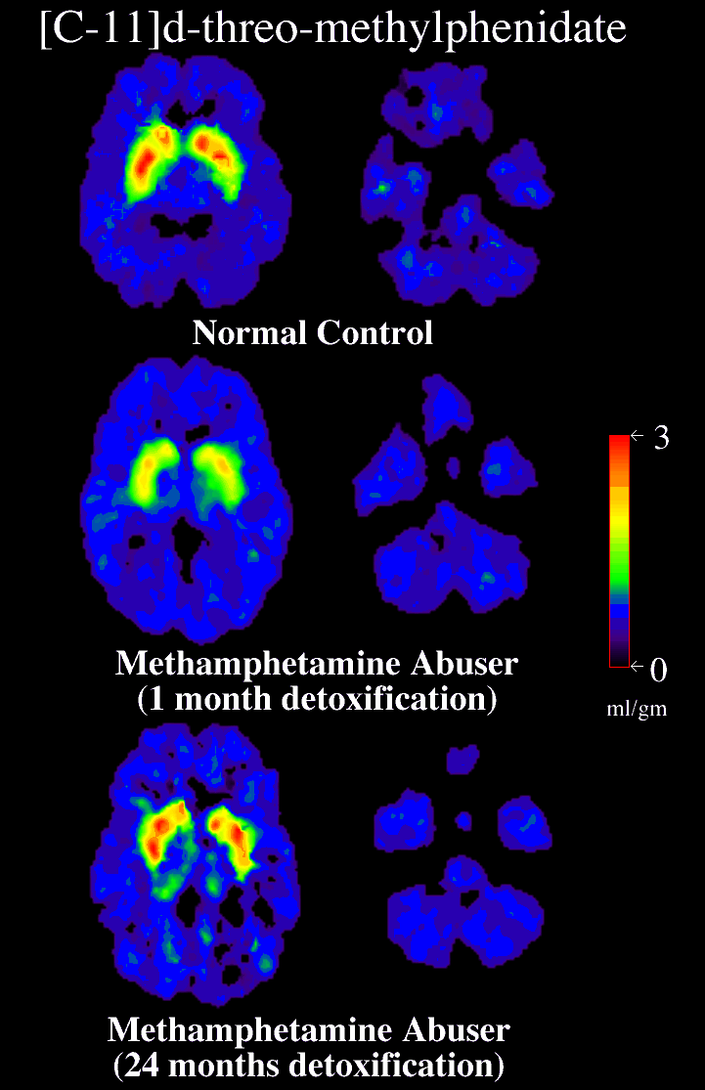
Partial Recovery of Brain Dopamine Transporters in Methamphetamine Abuser After Protracted Abstinence
3
0
ml/gm
Normal Control
METH Abuser
(1 month detox)
METH Abuser
(24 months detox)
SOURCE: Volkow et al., 2001.
Notes:
It would be unethical to give a human being who has never been exposed to methamphetamine a dose of the drug to see what happens to his/her brain. So when brain imaging researchers wish to study the effects of methamphetamine on the human brain, they match non-using controls to methamphetamine abusers (by gender, age, socioeconomic status, etc.). In this study, researchers examined the PET scans of chronic methamphetamine users who had achieved two years of abstinence from methamphetamine. The scans showed a return to virtually normal dopamine levels. While this is good news, and suggests that the brain has an amazing ability to repair itself, the subjects in the study did not regain all of the lost cognitive function associated with the damage, which could suggest an incomplete recovery. While the fact that the brain recovers is good news, the not-so-good news is that the recovery takes months, not days. Treatment and recovery are long-term processes.
REFERENCE:
Volkow, N.D., Chang, L., Wang, G.-L., Fowler, J.S., Franceschi, D., Sedler, M., Gatley, S.J., Miller, E., Hitzemann, R., Ding, Y.-S., & Logan, J. (2001). Loss of dopamine transporters in methamphetamine abusers recovers with protracted abstinence. The Journal of Neuroscience, 21(23), 9414-9418.

Slide 63
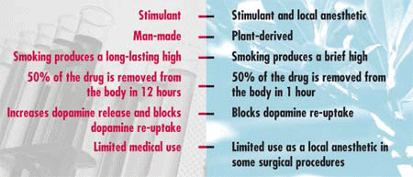
Cocaine vs. Methamphetamine
Methamphetamine
Cocaine
SOURCE: National Institute on Drug Abuse, 2013.
Notes:
Methamphetamine is structurally similar to amphetamine, but it is quite different from cocaine. Although these stimulants have similar behavioral and physiological effects, there are some major differences in their basic mechanisms of action. In contrast to cocaine, which is quickly removed and almost completely metabolized in the body, methamphetamine has a much longer duration of action and a larger percentage of the drug remains unchanged in the body. This results in methamphetamine being present in the brain longer, which ultimately leads to prolonged stimulant effects. The half-life of methamphetamine is about 10 hours, vs. a half-life of cocaine of approximately 2 hours. Although both methamphetamine and cocaine increase levels of the brain chemical dopamine, animal studies reveal much higher levels of dopamine following administration of methamphetamine due to the different mechanisms of action within nerve cells in response to these drugs. Cocaine prolongs dopamine’s action in the brain by blocking dopamine re-uptake. While at low doses, methamphetamine blocks dopamine re-uptake, methamphetamine also increases the release of dopamine, leading to much higher concentrations in the synapse, which can be toxic to nerve terminals. Methamphetamine is neurotoxic, but cocaine does not appear to be neurotoxic. Methamphetamine-induced paranoia can last as long as 7 to 14 days (or longer), whereas cocaine paranoia usually subsides within about 4-8 hours following drug cessation.
REFERENCE:
National Institute on Drug Abuse. (2013). Methamphetamine. Available at: https://www.drugabuse.gov/publications/research-reports/methamphetamine.

Slide 64
Differences in Patterns of Use: Methamphetamine vs. Cocaine
Methamphetamine Users | Cocaine Users
Take the drug at the beginning of the day and take additional doses at 2 to 4 hour intervals throughout the day | Take the drug in the evening, and take additional doses continuously over a period of several hours
SOURCE: Simon et al., 2002.
Notes:
Dr. Sara Simon and colleagues conducted a study of 120 methamphetamine abusers and 63 cocaine abusers to determine patterns of stimulant use. According to Dr. Simon, “the typical methamphetamine abuser reported using the drug when he or she first got up in the morning, then using approximately every 2 to 4 hours during their waking day. Most of the descriptions of use more closely resembled taking a medication than using a drug for pleasure.“…"Cocaine abusers reported patterns that fit a picture of recreational use: They began in the evening and continued until all the cocaine on hand had been used.”
These differing patterns of use may be a result in the differential impacts the individual drugs have on the user’s brain and body. Understanding the differing patterns of use may help treatment providers and patients identify the circumstances (triggers, different times of the day or places) that may lead to relapse.
REFERENCE:
Simon, S.L., Richardson, K., Dacey, J., Glynn, S., Domier, C.P., Rawson, R.A., & Ling, W. (2002). A comparison of patterns of methamphetamine and cocaine use. Journal of Addictive Diseases, 21(1), 35-44.

Slide 65

Differences between Stimulant and Comparison Groups on tests requiring perceptual speed
65
SOURCE: Simon et al., 2002.
Notes:
In a separate study from the one described on slide 64, Dr. Simon and colleagues evaluated the effects of stimulants on learning and memory. The study involved 40 methamphetamine abusers and 40 cocaine abusers not currently engaged in treatment and 80 individuals who had never used either stimulant (comparison group). A variety of tests were administered to evaluate memory, perceptual speed, verbal fluency, and executive function.
Methamphetamine abusers performed more poorly than the comparison group in tests of word recall, perceptual speed, ability to manipulate information, and abstract thinking. Cocaine abusers scored more poorly than the comparison group in tests measuring the ability to recall words and pictures and working memory.
While both drugs were associated with similar cognitive deficits, the most striking difference was that those individuals who abuse methamphetamine had more trouble than those individuals who abuse cocaine at tasks requiring attention and the ability to organize information. From a treatment implication perspective, methamphetamine abusers would benefit from using pictures to relay their feelings than words.
Additional Information for the Trainer(s):
The Digit Symbol test is similar to the old Batman decoder ring, where you had to match letters to numbers to open the ring. In the study conducted by Dr. Simon, it took the comparison group less time than the stimulant users to complete the task.
Trail Making A and B are complicated “connect the dots” tasks. In both tasks, it once again took the comparison group less time that the stimulant users to complete the tasks.
REFERENCE:
Simon, S.L., Domier, C.P., Sim, T., Richardson, K., Rawson, R.A., & Ling, W. (2002). Cognitive performance of current methamphetamine and cocaine abusers. Journal of Addiction Diseases, 21(1), 61-74.

Slide 66
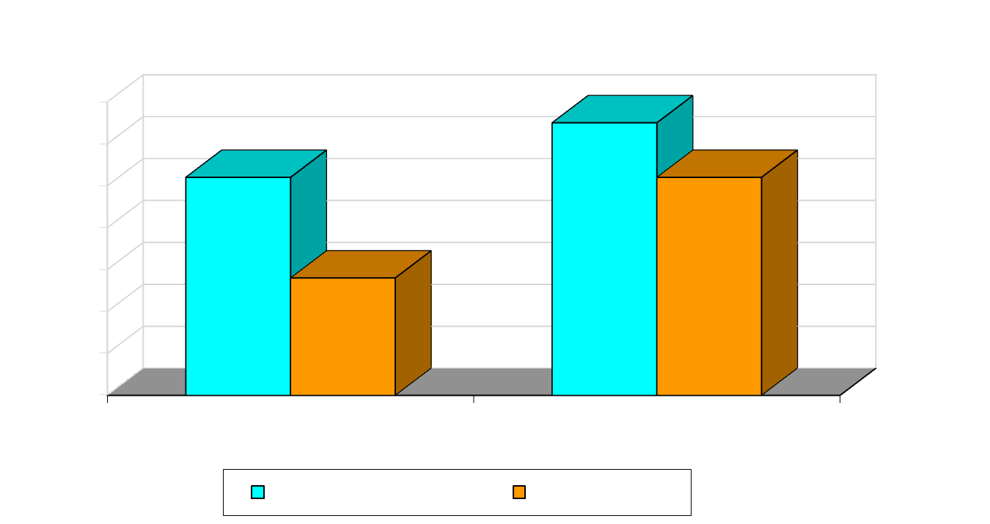
Memory Difference between Stimulant and Comparison Groups
66
SOURCE: Simon et al., 2002.
Notes:
In a separate study from the one described on slide 64, Dr. Simon and colleagues evaluated the effects of stimulants on learning and memory. The study involved 40 methamphetamine abusers and 40 cocaine abusers not currently engaged in treatment and 80 individuals who had never used either stimulant (comparison group). A variety of tests were administered to evaluate memory, perceptual speed, verbal fluency, and executive function.
Methamphetamine abusers performed more poorly than the comparison group in tests of word recall, perceptual speed, ability to manipulate information, and abstract thinking. Cocaine abusers scored more poorly than the comparison group in tests measuring the ability to recall words and pictures and working memory.
While both drugs were associated with similar cognitive deficits, the most striking difference was that those individuals who abuse methamphetamine had more trouble than those individuals who abuse cocaine at tasks requiring attention and the ability to organize information.
These cognitive findings reveal a major treatment implication. Stimulant abusers, more specifically methamphetamine abusers, are unable to remember words. So when designing treatment programs, it is better to avoid focusing entirely on talking or verbal information exchange, and instead incorporate pictures or written information transfer into the treatment process. It is not the case that the methamphetamine abusers are in denial when they say that they forgot an appointment or a group session. They truly cannot remember.
Additional Information for the Trainer(s):
The Word Recall test involves telling participants a series of 30 unrelated words (dog, house, grass, tree, car, etc.), and asking them to tell the research team how many of the words they can recall. The Picture Recall task is similar to the word recall task, but slightly easier overall.
REFERENCE:
Simon, S.L., Domier, C.P., Sim, T., Richardson, K., Rawson, R.A., & Ling, W. (2002). Cognitive performance of current methamphetamine and cocaine abusers. Journal of Addiction Diseases, 21(1), 61-74.

Slide 67
The Street Cost of Stimulants
Powder and Crack Cocaine
Methamphetamine
$100-120/gram (powder)
A single line of cocaine is roughly 50 mg, so 1 gram yields 20 uses
  $3-50/piece (crack) for 1/10 to ½ gram, but normally available for $10-20.
$80/gram
$200 for an 8-ball
(3.5 gram)
$20 for a single dose (~1/4 gram)
SOURCE: RehabCenter.net.
Notes:
The street price of drugs can vary significantly from city to city, depending on many factors such as source and purity. These prices are averages, and may or may not match the street price in some cities.
According to the DEA’s domestic STRIDE data (Jan 2007-Dec 2013), the price of methamphetamine (price per gram, PPG), decreased 74.5% from $276/gram to $70/gram, while the purity increased 143.1% from 38% pure to 94% pure.

Slide 68
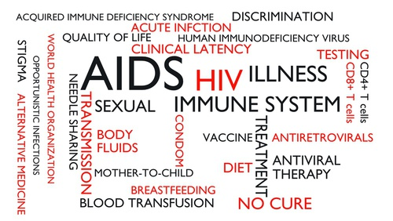
“Linked Epidemics”:
Stimulant Use Disorders and HIV/AIDS
Notes:
TRANSITION SLIDE
The next portion of the presentation corresponds to the relationship between substance use disorders in general and HIV/AIDS. Injection of drugs such as heroin, cocaine, and methamphetamine accounts for more than a third of new AIDS cases. Injection drug use is also a major factor in the spread of hepatitis C, a serious, potentially fatal liver disease. Injection drug use is not the only way that drug abuse contributes to the spread of infectious diseases. All drugs of abuse cause some form of intoxication, which interferes with judgment and increases the likelihood of risky sexual behaviors. This, in turn, contributes to the spread of HIV/AIDS, hepatitis B and C, and other sexually transmitted diseases.
Image Credit: Fotolia, purchased image, 2017.

Slide 69
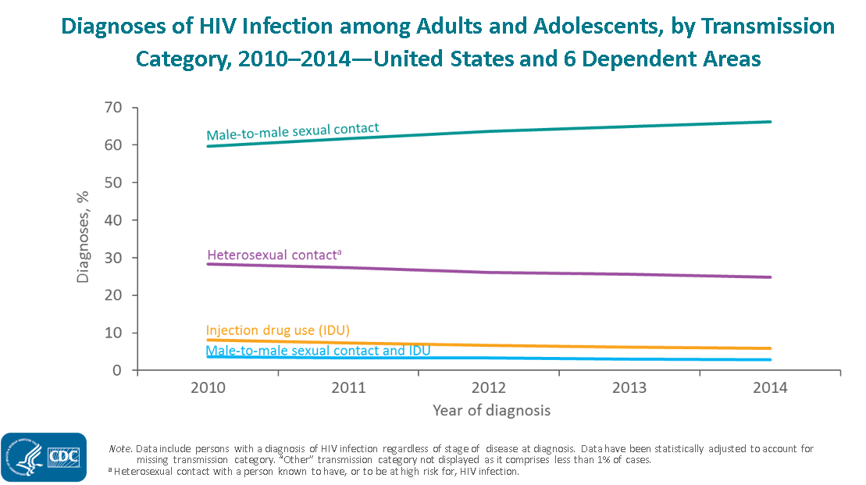
The Scope and Impact of HIV in the United States
SOURCE: CDC, 2015.
Notes:
According to HIV surveillance data maintained by the Centers for Disease Control and Prevention, the percentage of adults and adolescents with diagnosed HIV infection attributed to male-to-male sexual contact increased from 60% in 2010 to 66% in 2014. The percentages of diagnosed HIV infections attributed to injection drug use, male-to-male sexual contact and injection drug use, and heterosexual contact decreased from 2010 through 2014. The “Other” transmission category is not displayed as it comprises less than 1% of cases. The category includes hemophilia, blood transfusion, perinatal exposure, and risk factor not reported or not identified. Data include persons with a diagnosis of HIV infection regardless of stage of disease at diagnosis. Data have been statistically adjusted to account for missing transmission category. Heterosexual contact is with a person known to have, or to be at high risk for, HIV infection.
REFERENCE:
Centers for Disease Control and Prevention. (2015). Epidemiology of HIV Infection through 2015 Slide Set. Available at:
https://www.cdc.gov/hiv/library/slideSets/index.html.
69

Slide 70
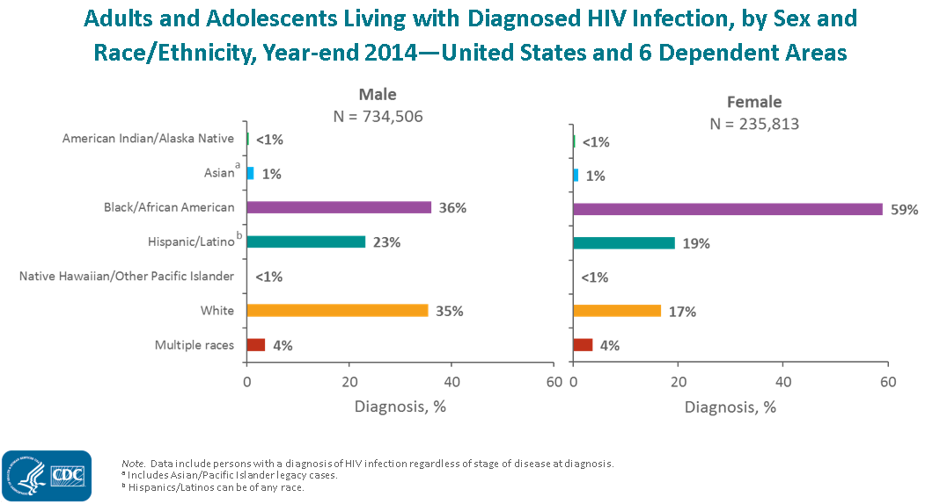
The Scope and Impact of HIV in the United States
SOURCE: CDC, 2015.
Notes:
At the end of calendar year 2014, there were nearly one million adults and adolescents living with diagnosed HIV infection in the US and six dependent areas (970,319). Among the 734,506 males living with diagnosed HIV infection, 36% were black/African American, 35% were white, and 23% were Hispanic/Latino. Approximately 4% were males of multiple races and approximately 1% were Asian. Less than 1% each were American Indian/Alaska Native and Native Hawaiian/other Pacific Islander. Among the 235,813 females living with diagnosed HIV infection, 59% were black/African American, 19% were Hispanic/Latino, and 17% were white. Approximately 4% were females of multiple races and approximately 1% were Asian. Less than 1% each were American Indian/Alaska Native and Native Hawaiian/other Pacific Islander.
The data presented on this slide include persons with a diagnosis of HIV infection regardless of stage of disease at diagnosis. The Asian category includes Asian/Pacific Islander legacy cases (cases that were diagnosed and reported under the pre-1997 Office of Management and Budget race/ethnicity classification system). Hispanics/Latinos can be of any race. Persons living with diagnosed HIV infection are classified as adult or adolescent based on age at year-end 2014.
REFERENCE:
Centers for Disease Control and Prevention. (2015). Epidemiology of HIV Infection through 2015 Slide Set. Available at:
https://www.cdc.gov/hiv/library/slideSets/index.html.

Slide 71

Why is it important that we know about the HIV & STD risk behavior of our patients?
Notes:
INSTRUCTIONS
If time permits, engage the audience in a brief group discussion. Ask this question to the group, “Why is it important that we know about the HIV & STD risk behavior of our patients?” Touch on any reasons they may have missed.
Possible discussion points include:
HIV stats – how it affects us
Comorbidities/complications (add to current problems)
Infecting others (MSM – heterosexual contact; link with drug use, minority infection rate)
Help them connect with resources
Many of our patients are infected and it’s our job to help them
Image Credit: Fotolia, purchased image, 2017.

Slide 72
Special Populations: MSM, Sexual Risk, and HIV
Methamphetamine is closely connected to sexual identity and sexual expression for many gay-identified MSM
Sexual behaviors associated with meth use present extreme HIV risks
    Changes in sexual behaviors
    Changes in decision-making processes
Non gay-identified MSM may have less exposure to prevention messages, placing both themselves and their sex partners at extreme risk
Notes:
A variety of research studies have shown that methamphetamine use is intricately connected to both sexual identity and sexual expression in may gay-identified men who have sex with men (MSM). Changes in sexual behaviors and changes in decision-making processes present extreme HIV risks, especially when methamphetamine is involved.

Slide 73
Substance Use and HIV Risk
Alcohol and drug intoxication affects users' mental status and judgment and increases the likelihood that they will engage in high-risk sexual behavior
Substance use increases users' exposure to unprotected sex as a means to obtain drugs
Physiological consequences of substance use may alter susceptibility to infection and interact with HIV medications
SOURCE: National Institute on Drug Abuse, 2016.
Notes:
The use of alcohol and other drugs can impair a person’s decision making ability and compromise judgement. When this happens, the person puts him/herself at risk for risky sexual behaviors, which may include trading sex for drugs, sharing needles, and having unprotected sexual intercourse.
REFERENCE:
National Institute on Drug Abuse. (2016). Cocaine Research Report Series. Available at: https://www.drugabuse.gov/publications/research-reports/cocaine.

Slide 74
What do you think?
All of the following is true about cocaine and HIV except:
Cocaine users are more likely to develop new AIDS-defining illnesses than non-users
Cocaine interacts negatively with HIV antiretrovirals
HIV-positive cocaine users are less likely to have received HIV care
Cocaine users have greater CD4 cell loss and higher HIV-1 RNA levels
Notes:
Answer Key:
#2 – correct response is B (cocaine interacts negatively with HIV antiretrovirals)

Slide 75

Crack/Cocaine Users and
Access to Medical Care
HIV-positive crack users are:
  More likely than their HIV-negative counterparts to have never been in HIV primary care
  Less likely to have access to basic medical services
  Less likely to have a regular healthcare provider
  Less likely to initiate medical care and treatment
SOURCES: Cunningham et al., 2006; Metsch et al., 2009.
Notes:
Many HIV+ crack/cocaine users live in disadvantaged and impoverished communities, which can present a multitude of health care barriers, including limitations to regular primary and HIV-related medical care.
REFERENCES:
Cunningham, C.O., Sohler, N.L., Berg, K.M., et al. (2006). Type of substance use and access to HIV-
related health care. AIDS Patient Care and STDs, 20, 399-407.
Metsch, L.R., Bell, C., Pereyra, M., et al. (2009). Hospitalized HIV-infected patients in the era of
highly active antiretroviral therapy. American Journal of Public Health, 99, 1045-9.
Image Credit: Fotolia, purchased image, 2017.

Slide 76
Cocaine and Its Impact on HIV Infection and Disease Progression
Cocaine use:
  Accelerates HIV infection
  Impairs immune cell function
  Promotes replication of the HIV virus
  Potentiates the damaging effects of HIV on cells in the brain and spinal cord
  Accelerates the development of HIV-related neurological conditions
  Increases the risk for hepatitis C co-infection
SOURCE: National Institute on Drug Abuse, 2016.
Notes:
Numerous research studies have been conducted to better understand the impact that cocaine use has on HIV infection and disease progression. This slide lists several of the key findings. NeuroAIDS, as is mentioned in the final bullet is a term that encompasses neurological conditions that are associated with HIV infection. Symptoms include memory loss, movement problems, and vision impairment.
Individuals who use cocaine and are living with HIV disease often have advanced progression of the disease, including increased viral load and accelerated decreases in CD4+ cell counts. In addition, being infected with HIV can increase a person’s risk for co-infection with hepatitis C. This co-infection can lead to a variety of serious illnesses, including immune system, neurological, and liver complications.
REFERENCE:
National Institute on Drug Abuse. (2016). Cocaine Research Report Series. Available at: https://www.drugabuse.gov/publications/research-reports/cocaine.

Slide 77
Cocaine Use and Immune System Disruption
Using cocaine makes people more susceptible to becoming infected with HIV
Cocaine mediates its effects directly, inducing minimal changes in the physiology of T-cells
Cocaine use increases the pool of CD4 T-cells in the human body
  Increases the odds for productive infection
  Increase the viral reservoir
SOURCES: Kim et al., 2011.
Notes:
According to a recent animal study conducted at the University of California, Los Angeles by Kim and colleagues, further evidence was compiled that cocaine use disrupts the immune system, making people who use the drug more likely to become infected with HIV, because cocaine blunts the potency of the body’s defense against the virus. The next stage of Kim’s research will be to determine how cocaine abuse might affect HIV transmission in mucosal membranes; how pre- and post-exposure prophylaxis (PrEP and PEP) can be affected by cocaine exposure; how cocaine might affect viral latency; and how cocaine may alter the body’s immune defenses from other viral infections.
REFERENCE:
Kim, S.G., Lowe, E.L., Dixit, D., Youn, C.S., Kim, I.J., Jung, J.B., Rovner, R., Zack, J.A., & Vatakis, D.N. (2015). Cocaine-mediated impact on HIV infection in humanized BLT mice. Scientific Reports, 5(10010), 1-11.

Slide 78

Cocaine Use a Significant
Risk Factor for Teens
Teens with a history of crack or
powder cocaine use are significantly more likely to engage in unprotected sex than youth who have never used these drugs, putting themselves at increased risk for HIV.
Teens who used crack and/or powder cocaine at least once were SIX TIMES more likely to use condoms inconsistently.
Crack cocaine appears to have more of an influence on risky teen behaviors than other factors, like alcohol and marijuana use.
SOURCE: Tolou-Shams et al., 2010.
Notes:
This study is one of the first to look at the link between crack and powder cocaine use and HIV risk behaviors in adolescents. Teens with a history of crack or powder cocaine use are significantly more likely to engage in unprotected sex than youth who have never used these drugs, putting themselves at increased risk for HIV.
REFERENCE:
Tolou-Shams, M., Feldstein Ewing, S.W., Tarantino, N., & Brown, L.K. (2010). Crack and cocaine use among adolescents in psychiatric treatment: Associations with HIV risk. Journal of Child and Adolescent Substance Abuse, 19(2), 122-134.
Image Credit: Fotolia, purchased image, 2017.

Slide 79

Cocaine and HIV
Antiretrovirals
According to the latest research,
there are NO known drug interactions between cocaine and HIV antiretrovirals (e.g., NNRTIs, NRTIs, Protease Inhibitors, CCR5 Inhibitors, or Integrase Inhibitors)
In general, cocaine may increase rate of HIV viral replication in vitro, and is associated with:
  Hypertension, cardiac dysrhythmias, myocardial infarction, seizures, depression, and anxiety.
SOURCE: NY/NJ AIDS Education and Training Center, 2014.
Notes:
The NY/NJ AIDS Education and Training Center (AETC) developed a pocket guide entitled, “Recreational Drugs and HIV Antiretrovirals: A Guide to Interactions for Clinicians, 2014.” The guide outlines known drug interactions for a variety of street drugs, including: alcohol, amphetamines, cocaine, ecstasy, etc. At this time, according to research conducted through November 2009, there are no known drug interactions between cocaine and the HIV antiretrovirals.
The full guide can be downloaded from: http://www.nynjaetc.org/documents/2014_RecreationalDrugInteractionGuide.pdf.

Slide 80
Methamphetamine and HIV in MSM:
A Time-to-Response Association?
80
SOURCE: Shoptaw & Reback, 2006.
Notes:
This series of statistics demonstrate the point that the farther along that an MSM is in the treatment system, the more likely he is to be diagnosed with HIV. By starting at the left side of the graph, HIV prevalence is lower in samples of MSM seeking prevention or non-intervention projects. As you move to the right, the prevalence increases, with very high prevalence observed in the treatment samples.
REFERENCE:
Shoptaw, S., & Reback, C.J. (2006). Associations between methamphetamine use and HIV among men who have sex with men: A model for guiding public policy. Journal of Urban Health: Bulletin of the New York Academy of Science, 83(6), 1151-1157.

Slide 81
Implications for Interventions
High
HIV Prevalence (Percent)
Intensity of Resources
Low
HIV Prevention
81
Drug Abuse Treatment
SOURCE: Shoptaw & Reback, 2006.
Notes:
According to Shoptaw and Reback, this “time-to-response” association has implications for guiding interventions, with lower-intensity prevention likely sufficient to help recreational and chronic users reach drug and sexual risk-behavior goals and high-intensity treatments likely necessary for MSM with dependence to reach drug and sexual risk-behavior goals.
REFERENCE:
Shoptaw, S., & Reback, C.J. (2006). Associations between methamphetamine use and HIV among men who have sex with men: A model for guiding public policy. Journal of Urban Health: Bulletin of the New York Academy of Science, 83(6), 1151-1157.

Slide 82
Methamphetamine and Its Impact on
HIV Infection and Disease Progression
Methamphetamine use:
  Lowers sexual inhibitions, impairs judgment, and provides energy and confidence to engage in sexual activity for long periods of time
  Causes erectile dysfunction
  Causes mucosal dryness
  Decreases adherence to HIV treatment and medical follow-up
  Increases HIV replication
  Accelerates progress of HIV-related dementia
SOURCE: Yeon & Albrech, 2007.
Notes:
The connection between crystal meth use and HIV transmission has been well established by researchers. Individuals who use methamphetamine are more likely to become infected with HIV and transmit the virus to others. Studies have also documented more substantial brain damage and cognitive impairment people who use meth and are infected with HIV, as compared to people living with HIV who do not use meth.
REFERENCE:
Yeon, P.A., & Albrecht, H. (2007). Crystal meth and HIV/AIDS: The perfect storm? NEJM Journal Watch, December 3, 2007.

Slide 83
Methamphetamine Use May Accelerate HIV Reproduction
In test tube studies, when methamphetamine is added to immune cells, it significantly increased HIV replication
  Particularly in CD4 cells and monocytes
In mouse models, methamphetamine activated a portion of the HIV genetic code (long terminal repeat – LPR), prompting cells to release a protein tied to more rapid HIV disease progression
SOURCE: Toussi et al., 2009.
Notes:
According to a paper published by Toussi and colleagues in 2009, methamphetamine speeds up HIV replication in both test tube and animal studies. This slide details the key findings from the test tube studies and mouse model studies.
REFERENCE:
Toussi, S.S., Joseph, A., Zheng, J.H., Dutta, M., Santambrogio, L., & Goldstein, H. (2009). Short communication: Methamphetamine treatment increases in vitro and in vivo HIV replication. AIDS Research and Human Retroviruses, 25(17), 1117-1121.

Slide 84
The Effect of Methamphetamine on the Brain of a Person Infected with HIV
HIV and meth are thought to have synergistic cognitive and neurological impacts
In the presence of HIV, methamphetamine can cause:
  Even greater dopamine release and cellular damage
  Additive damage to the frontal cortex and basal ganglia
  Difficulty in adhering to antiretroviral regimen
  Deficits in attention/working memory, abstract decision-making, and psychomotor speed
SOURCE: Cherner, 2013.
Notes:
Cherner published an article in the APA Psychology and AIDS Exchange Newsletter in 2013 about the effects of methamphetamine on the brain of a person infected with HIV. This slide details the key findings.
REFERENCE:
Cherner, M. (2013). The HIV+ brain on drugs: Focus on methamphetamine. American Psychological Association, Psychology and AIDS Exchange Newsletter.

Slide 85
Functional Deficits due to HIV and Methamphetamine Use
What is the burden that methamphetamine use and HIV disease impose on an individual’s daily functioning
UCSD researchers assessed daily functioning in four key areas:
  Everyday cognitive symptoms (memory, communication, intellectual performance)
  Instrumental (skilled) activities of daily living (medication and financial management, grocery shopping, planning social activities)
  Basic activities of daily living (housekeeping, home repairs, bathing, dressing)
  Employment
SOURCE: Blackstone et al., 2013.
Notes:
Blackstone and colleagues from the University of San Diego, Translational Methamphetamine AIDS Research Center conducted a study to assess daily functioning among nearly 800 individuals who are HIV positive and use methamphetamine. They assessed daily functioning in four key areas – everyday cognitive symptoms, instrumental (skilled) activities of daily living, basic activities of daily living, and employment. The next slide contains the key findings from the study.
REFERENCE:
Blackstone, K., Iudicello, J.E., Morgan, E.E., Weber, E., Moore, D.J., Franklin, D.R., Ellis, R.J., Grant, I., Woods, S.P., and the TMARC Group. (2013). HIV infection heightens concurrent risk of functional dependence in persons with chronic methamphetamine use. Journal of Addiction Medicine, 7(4), 255-263.

Slide 86
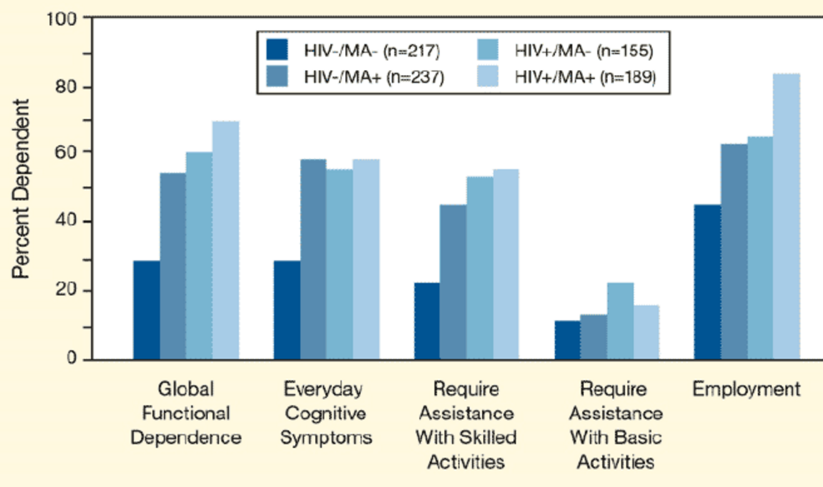
Functional Deficits due to HIV and Methamphetamine Use
SOURCE: Blackstone et al., 2013.
Notes:
Participants who use methamphetamine or are infected with HIV showed similar increases in functional dependence (need for assistance), as compared to participants who were not infected with HIV and did not use methamphetamine. Study participants who were infected with HIV and used methamphetamine showed the highest levels of functional impairment in most domains of daily life. The greatest disparities were seen in everyday cognitive abilities and skilled activities of daily life (2nd and 3rd set of bars from the left).
One clinical implication of this research study is the need for clinicians to carefully monitor medication compliance among patients who use methamphetamine, are infected with HIV, or both.
REFERENCE:
Blackstone, K., Iudicello, J.E., Morgan, E.E., Weber, E., Moore, D.J., Franklin, D.R., Ellis, R.J., Grant, I., Woods, S.P., and the TMARC Group. (2013). HIV infection heightens concurrent risk of functional dependence in persons with chronic methamphetamine use. Journal of Addiction Medicine, 7(4), 255-263.

Slide 87

Case Study #1:
Determining Service Needs
Ricardo , a 23-year old Latino, used methamphetamine for a little over a year on weekends to party and attend sex parties with guys he met online. He recently switched to cocaine because he was having more and more trouble “going back to life” after a weekend meth binge. He is HIV negative. You are a hospital case manager who is sent to meet with Ricardo. He doesn’t know the details of why he is there, except that a stranger called an ambulance and he woke up at the hospital.
What are the issues that need to be addressed?
What providers should be involved in his care?
What strategies would you employ to coordinate care among the various providers?
Notes:
INSTRUCTIONS
Read the case study aloud. Ask participants to break into pairs or small groups (depending on the size of the audience), and spend 5-10 minutes discussing the three questions. De-brief as a full group for 5-10 minutes. Ask for volunteers to briefly share responses to the three questions.
Image Credit: YMSM+LGBT Center of Excellent LGBT Curriculum (purchased image).

Slide 88

Effective Treatment Interventions for Stimulant Use Disorders
Notes:
TRANSITION SLIDE
Behavioral treatments help engage people in drug abuse treatment, modifying their attitudes and behaviors related to drug abuse and increasing their life skills to handle stressful circumstances and environmental cues that may trigger intense craving for drugs and prompt another cycle of compulsive abuse. Moreover, behavioral therapies can help people remain in treatment longer. Length of time in treatment is the #1 predictor of a successful treatment experience. The longer you can keep a person engaged in treatment, the more likely he/she is to be successful. Behavioral interventions—particularly, cognitive-behavioral therapy—have been shown to be effective for decreasing cocaine use and preventing relapse. Treatment must be tailored to the individual patient’s needs in order to optimize outcomes—this often involves a combination of treatment, social supports, and other services. Early engagement techniques should be utilized to ensure that the client comes back for his/her group and individual sessions. The following section pertains to effective behavioral treatment interventions for stimulant users.
Additional Information for the Trainer:
Several manuals have been developed for use with cocaine abusers.
Cognitive-Behavioral Approach: Treating Cocaine Addiction (Manual 1)
Community Reinforcement Approach: Treating Cocaine Addiction (Manual 2)
Individual Drug Counseling Approach to Treat Cocaine Addiction: The Collaborative Cocaine Treatment Study Model (Manual 3)
Drug Counseling for Cocaine Addiction: The Collaborative Cocaine Treatment Study Model (Manual 4)
Brief Strategic Family Therapy for Adolescent Drug Abuse (Manual 5)
The manuals are available for download at no cost on the NIDA website. Visit http://www.nida.nih.gov/DrugPages/Cocaine.html for more information.
Image Credit: Fotolia, purchased image, 2017.

Slide 89
What Treatments are Effective for Stimulant Users?
Stimulant use and addiction is a complex problem involving biological changes in the brain as well as a myriad of social, familial, and environmental factors.
Treatment strategies need to assess the psychobiological, social, and pharmacological aspects of the patient's drug abuse.
SOURCE: National Institute on Drug Abuse, 2016.
Notes:
Currently, the only effective treatments for cocaine and methamphetamine addiction are behavioral in nature. While several medications have shown promise in clinical trials, no medications have been approved for use with individuals who are addicted to cocaine or methamphetamine. If a medication is found to be effective in treating cocaine and/or methamphetamine, it will be important to combine use of the medication with a comprehensive behavioral therapy program. Research shows that this combination of pharmacological and behavioral interventions is the most effective method to reduce drug use in the long term.
Successful Outpatient Treatment Predictors:
Durations over 90 days (with continuing care for another 9 months)
Techniques and clinic practices that improve treatment retention are critical.
Treatment should include 3-5 clinic visits per week for at least 90 days.
Employ evidence-based practices (i.e., CBT, CM, CRA, MI, Matrix Model)
Family involvement and 12-step programs appear to improve outcome.
Urine testing (at least weekly is recommended).
REFERENCE:
National Institute on Drug Abuse. (2016). Cocaine. Rockville, MD: Author.

Slide 90
What about
Pharmacological Interventions?
To date, there are NO FDA-approved pharmacological interventions for stimulant use disorders
Several medications are currently being investigated for their safety and efficacy in treating cocaine and methamphetamine addiction.
These medications will hopefully:
  Block/reduce effects of the stimulant
  Alleviate severe craving
Notes:
Currently, there are NO medications approved for use in treating cocaine or methamphetamine use disorders. Topiramate and modafanil have shown promising signals as potential cocaine treatment agents. Baclofen, a GABA-B agonist, showed promise in a subgroup of cocaine addicts with heavy use patterns. Because of mood changes experienced during the early stages of cocaine abstinence, antidepressant drugs have been shown to be of some benefit. Researchers are seeking to develop medications that help alleviate the severe craving associated with cocaine addiction, as well as medications that counteract cocaine-related relapse triggers, such as stress. Several compounds are currently being investigated for their safety and efficacy, including a vaccine that would sequester cocaine in the bloodstream and prevent it from reaching the brain.

Slide 91
Behavioral Treatments
Cognitive/Behavioral Therapy (CBT)
Matrix Model of Outpatient Treatment
Motivational Interviewing (MI)
Contingency Management (CM)
12-Step Facilitation Therapy
Community Reinforcement Approach (CRA)
Red Road to Wellbriety
Traditional Healing
Notes:
This slide includes a list of behavioral interventions that have been shown to be effective with individuals with cocaine and/or methamphetamine use disorders. The slides that follow will include more detailed information about each intervention, with the exception of Community Reinforcement Approach (CRA), Red Road to Wellbriety and Traditional Healing.
Community Reinforcement Approach (CRA) includes behavioral skills training, social and recreational counseling, marital therapy, job counseling, and relapse prevention.
The Red Road to Wellbriety: In the Native American Way is a guide to alcohol and drug recovery and sobriety especially for American Indians, Alaska Natives, and First Nations people. It has also found enthusiastic acceptance among Indigenous people from other parts of the world, as well as by Non-Native people.

Slide 92
Behavioral Approach #1:
Cognitive Behavioral Therapy (CBT)
Also known as Relapse Prevention
Underlying assumption = learning processes play an important role in the development and continuation of cocaine abuse and dependence.
CBT attempts to help patients recognize the situations in which they are most likely to use cocaine, avoid these situations when appropriate, and cope more effectively with a range of problems and problematic behaviors associated with drug abuse.
CBT is compatible with a range of other treatments patients may receive, such as pharmacotherapy.
SOURCE: NIDA Research Report Series – Cocaine Abuse and Addiction, 2010.
Notes:
Cognitive Behavioral Therapy (CBT) seeks to help patients recognize, avoid, and cope with the situations in which they are most likely to abuse drugs. Thoughts cause feelings and behaviors, not external things, like people, situations, and events. You can change the way we think to feel / act better even if the situation does not change.
CBT is a short-term, evidenced-based, focused approach which has been used to help individuals with substance abuse disorders. CBT is a flexible, individualized approach that can be adapted to a wide range of clients and treatment settings. CBT emphasizes learning of skills to be used to achieve abstinence, and addresses other problems, including initiation and mastery of skills through practice, role playing, and extra-sessions tasks. NIDA published a CBT manual, which can be downloaded from: http://www.nida.nih.gov/pdf/CBT.pdf.

Slide 93
What CBT Skills can Clinicians Use when Working with People who Use Stimulants?
Functional analysis and patterns of use
Coping with craving
Addressing ambivalence and coping with thoughts
Refusal skills
Seemingly irrelevant decisions
Planning for emergencies
Problem solving skills
HIV risk reduction
Notes:
This slide lists the CBT skills that clinicians can use with patients who use stimulants.

Slide 94
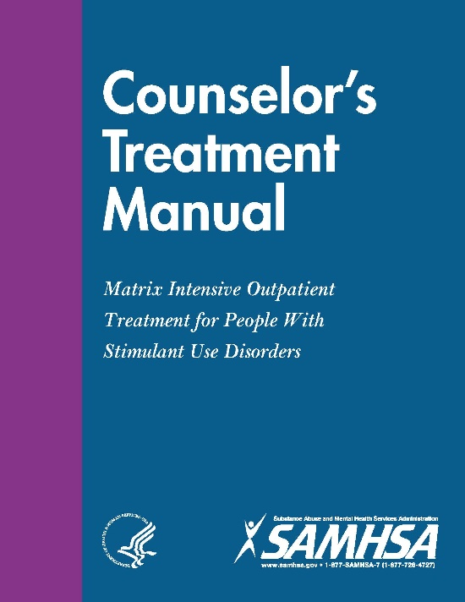
Behavioral Approach #2:
Matrix Model
16-week intensive outpatient treatment approach
More than 30 years of real-world treatment implementation
Therapist functions as teacher and coach
Incorporates a variety of approaches
  CBT
  CM
  MI
  12-Step Facilitation
  Family Involvement
  Person-centered therapy
SOURCE: Center for Substance Abuse Treatment, 2006.
Notes:
The Matrix Model is an intensive, outpatient treatment approach for individuals with substance use disorders, which was developed through 30 years of experience in real-world treatment settings. The intervention integrates aspects of several treatment approaches, including cognitive-behavioral therapy, contingency management, motivational interviewing, 12-step facilitation, family involvement, and supportive/person-centered therapy.
Core components consist of early recovery groups, relapse-prevention groups, family education, social-support groups, and individual counseling delivered over a 16-week period. Clients learn about issues critical to addiction and relapse, such as cue-induced craving and related behaviors. Clients also receive direction and support from a trained therapist, become familiar with self-help programs, and are monitored for drug use by urine and breath testing. Family members receive education to help understand and support the recovery process.
The therapist functions simultaneously as teacher and coach, fostering a positive, encouraging relationship with the client and using that relationship to reinforce positive behavior change. The interaction between the therapist and the client is realistic and direct, but not confrontational or paternalistic. Therapists are trained to conduct treatment sessions in a way that promotes self-esteem, dignity, and self-worth.
Matrix Model: http://www.nrepp.samhsa.gov/ProgramProfile.aspx?id=182; http://store.samhsa.gov/list/series?name=Matrix-Manuals
REFERENCE:
Center for Substance Abuse Treatment. (2006). Counselor’s Treatment Manual: Matrix Intensive Outpatient Treatment for People With Stimulant Use Disorders. HHS Publication No. (SMA) 13-4152. Rockville, MD: Substance Abuse and Mental Health Services Administration.

Slide 95
Behavioral Approach #3:
Motivational Interviewing (MI)
“…a directive, client-centered method for enhancing intrinsic motivation for change by exploring and resolving ambivalence (Miller & Rollnick, 2002).
“…a way of being with a client, not just a set of techniques for doing counseling” (Miller and Rollnick, 1991).
SOURCE: Miller, & Rollnick, 2012.
Notes:
Compared with non-directive counseling, motivational interviewing is more focused and goal-directed. The examination and resolution of ambivalence is its central purpose, and the counselor is intentionally directive in pursuing this goal.
Additional Information for the Trainer regarding the “MI Spirit”:
The spirit of MI can be characterized in a few key points. The following information was excerpted
directly from www.motivationalinterview.org:
Motivation to change is elicited from the client, and not imposed from without. Other motivational approaches have emphasized coercion, persuasion, constructive confrontation, and the use of external contingencies (e.g., the threatened loss of job or family). Such strategies may have their place in evoking change, but they are quite different in spirit from motivational interviewing which relies upon identifying and mobilizing the client's intrinsic values and goals to stimulate behavior change.
It is the client's task, not the counselor's, to articulate and resolve his or her ambivalence. Ambivalence takes the form of a conflict between two courses of action (e.g., indulgence versus restraint), each of which has perceived benefits and costs associated with it. Many clients have never had the opportunity of expressing the often confusing, contradictory and uniquely personal elements of this conflict, for example, "If I stop smoking I will feel better about myself, but I may also put on weight, which will make me feel unhappy and unattractive." The counselor's task is to facilitate expression of both sides of the ambivalence impasse, and guide the client toward an acceptable resolution that triggers change.
Direct persuasion is not an effective method for resolving ambivalence. It is tempting to try to be "helpful" by persuading the client of the urgency of the problem about the benefits of change. It is fairly clear, however, that these tactics generally increase client resistance and diminish the probability of change (Miller, Benefield and Tonigan, 1993, Miller and Rollnick, 1991).
The counseling style is generally a quiet and eliciting one. Direct persuasion, aggressive confrontation, and argumentation are the conceptual opposite of motivational interviewing and are explicitly proscribed in this approach. To a counselor accustomed to confronting and giving advice, motivational interviewing can appear to be a hopelessly slow and passive process. The proof is in the outcome. More aggressive strategies, sometimes guided by a desire to "confront client denial," easily slip into pushing clients to make changes for which they are not ready.
The counselor is directive in helping the client to examine and resolve ambivalence. Motivational interviewing involves no training of clients in behavioral coping skills, although the two approaches not incompatible. The operational assumption in motivational interviewing is that ambivalence or lack of resolve is the principal obstacle to be overcome in triggering change. Once that has been accomplished, there may or may not be a need for further intervention such as skill training. The specific strategies of motivational interviewing are designed to elicit, clarify, and resolve ambivalence in a client-centered and respectful counseling atmosphere.
Readiness to change is not a client trait, but a fluctuating product of interpersonal interaction. The therapist is therefore highly attentive and responsive to the client's motivational signs. Resistance and "denial" are seen not as client traits, but as feedback regarding therapist behavior. Client resistance is often a signal that the counselor is assuming greater readiness to change than is the case, and it is a cue that the therapist needs to modify motivational strategies.
The therapeutic relationship is more like a partnership or companionship than expert/recipient roles. The therapist respects the client's autonomy and freedom of choice (and consequences) regarding his or her own behavior.
REFERENCE:
Miller, W.R., & Rollnick, S. (2012). Motivational Interviewing: Helping People Change, 3rd Edition. New York, NY: The Guilford Press.

Slide 96
MI: Basic Principles and Micro-Skills
Motivational Interviewing Principles:
  Express empathy
  Develop discrepancy
  Roll with resistance
  Support self-efficacy
Motivational Interviewing Micro-Skills (OARS):
  Open-Ended Questioning
  Affirming
  Reflective Listening
  Summarizing
SOURCE: Miller, & Rollnick, 2012.
Notes:
96
The strategic goals of MI are to: (a) resolve ambivalence; (b) avoid eliciting or strengthening resistance; (c) elicit “Change Talk” from the client; (d) enhance motivation and commitment for change; and (e) help the client move through the Stages of Change. A series of MI micro-skills (which will be described on the next slide) can be used to move a patient/client through the Stages of Change to elicit and reinforce self-motivational statements (a.k.a., Change Talk). Empathy may be the most crucial principle. It creates an environment conducive to change, instills a sense of safety and a sense of being understood and accepted, and reduces defensiveness. Empathy sets the tone within which the entire communication occurs. Without it, other components may sound like mechanical techniques. By developing discrepancy, the clinician can help the client to become more aware of the discrepancy between their addictive behaviors and their more deeply-held values and goals. Part of this is helping client to recognize and articulate negative consequences of use. It is more effective if the client does this, not the clinician. With regards to rolling with resistance, in general, it is not helpful to argue with clients. Confrontation elicits defensiveness, which predicts a lack of change. It is particularly counter-therapeutic for a clinician to argue that there is a problem while the client argues that there isn’t one. The client does not need to accept a diagnostic label (e.g. “addict” or “alcoholic”) for change to occur. Supporting self-efficacy can be conceptualized as a specific form of optimism, that is, a “can-do” belief in one’s ability to accomplish a particular task or change. This principle is crucial to help the client see and experience his/her own ability to make positive changes. Part of this is the clinician believing in the client’s ability to change.
Open-ended questions: (a) solicits information in a neutral way; (b) helps the person elaborate his/her own view of the problem and brainstorm possible solutions; (c) helps the therapist avoid prejudgments; (d) keeps communication moving forward; (e) allows the client to do most of the talking. Affirmations should be focused on achievements of the individual, and are intended to: (a) support the individual’s persistence; (b) encourage continued efforts; (c) assist the individual in seeing the positive in the situation; and (d) support the individual’s proven strengths. With reflective listening, one should: (a) listen to both what the person says and to what the person means; (b) check out assumptions; (c) create an environment of empathy (nonjudgmental); and (d) be aware of intonation (statement, not question). The clinician does not have to agree with the client. Summaries capture both sides of the ambivalence (You say that ___________ but you also mentioned that ________________.) They demonstrate the clinician has been listening carefully. Summaries also prompt clarification and further elaboration from the person. Lastly, summaries prepare clients to move forward.

Slide 97
Behavioral Approach #4:
Contingency Management (CM)
Showing positive results in many cocaine-addicted populations
CM is also known as Motivational Incentives
May be particularly useful for helping patients achieve initial abstinence from cocaine.
Some CM programs use a voucher-based system to give positive rewards for staying in treatment and remaining cocaine free.
  Based on drug-free urine tests, the patients earn points, which can be exchanged for items that encourage healthy living, such as joining a gym, or going to a movie and dinner.
SOURCE: National Institute on Drug Abuse, 2016.
Notes:
Contingency management (CM) is a tool to enhance treatment and facilitate recovery, and is used as an adjunct to other therapeutic clinical methods. CM targets specific behaviors that are part of a patient treatment plan. CM helps to celebrate the success of behavioral changes chosen by therapist and patient. CM can be used to help motivate patients through stages of change to achieve an identified goal.
REFERENCE:
National Institute on Drug Abuse. (2016). Cocaine. Available at: https://www.drugabuse.gov/publications/research-reports/cocaine.

Slide 98
Behavioral Approach #5:
12-Step Facilitation Therapy
An active engagement strategy to:
  Increase the likelihood of an individual becoming affiliated with and actively involved in 12-step self-help groups
  Promote abstinence from alcohol and other drugs
Three key aspects, including:
  Acceptance
  Surrender
  Active Involvement
SOURCES: Carroll et al., 2000; Donovan & Wells, 2007; Project MATCH Research Group, 1997.
Notes:
Acceptance includes the realization that drug addiction is a chronic, progressive disease over which one has no control, that life has become unmanageable because of drugs, that willpower alone is insufficient to overcome the problem, and that abstinence is the only alternative. Surrender involves giving oneself over to a higher power, accepting the fellowship and support structure of other recovering addicted individuals, and following the recovery activities laid out by the 12-step program. While the efficacy of 12-step programs (and 12-step facilitation) in treating alcohol dependence has been established, the research on other abused drugs is more preliminary but promising for helping drug abusers sustain recovery. 12-Step meeting dates, times, and locations can be found by visiting: http://www.aa.org (Alcoholics Anonymous); www.ca.org (Cocaine Anonymous); www.na.org (Narcotics Anonymous).
REFERENCES:
Carroll, K.M.; Nich, C.; Ball, S.A.; McCance, E.; Frankforter, T.L.; and Rounsaville, B.J. (2000). One-
year follow-up of disulfiram and psychotherapy for cocaine and alcohol users: Sustained effects
of treatment. Addiction, 95(9), 1335-1349.
Donovan D.M., and Wells E.A. (2007). "Tweaking 12-step": The potential role of 12-Step self-help
group involvement in methamphetamine recovery. Addiction, 102(Suppl. 1), 121-129.
Project MATCH Research Group. (1997). Matching alcoholism treatments to client heterogeneity:
Project MATCH posttreatment drinking outcomes. Journal of Studies on Alcohol, 58(1), 7-29.

Slide 99
Therapeutic Communities (TCs)
Residential programs with planned lengths of stay of 6 to 12 months.
A focus on re-socialization of the individual to society, and can include on-site vocational rehabilitation and other supportive services.
Variation exists with regards to the types of therapeutic processes offered in TCs.
SOURCE: National Institute on Drug Abuse, 2016.
Notes:
Peer influence is used to help individuals learn and assimilate social norms and develop more
effective social skills. Treatment staff and those in recovery are key agents of change. The second
fundamental TC principle is "self-help," which implies that the individuals in treatment are the
main contributors to the change process.
REFERENCE:
National Institute on Drug Abuse. (2016). Cocaine. Available at: https://www.drugabuse.gov/publications/research-reports/cocaine.

Slide 100
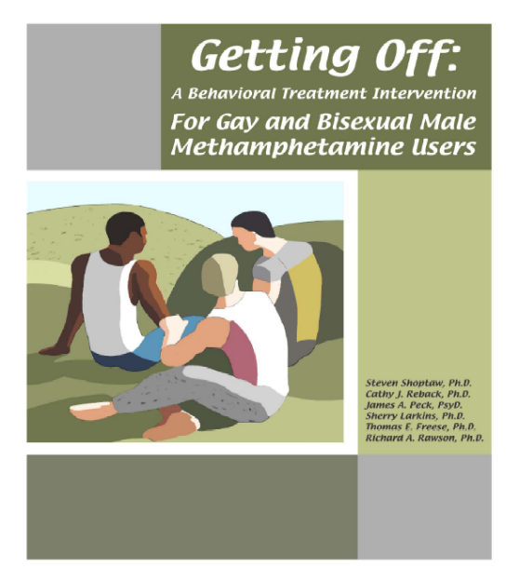
Getting Off: A Behavioral Treatment Intervention for Gay and Bisexual Male Methamphetamine Users
Contingency Management (CM): | Provide increasingly valuable reinforcers for successive urine samples documenting drug abstinence
Gay-specific Cognitive Behavioral Therapy (GCBT): | Cognitive Behavioral strategies for instilling abstinence and preventing relapse in a gay-specific HIV risk reduction intervention
SOURCE: Reback et al., 2014.
Notes:
Gay-Specific Cognitive Behavioral Therapy (GCBT): CBT that is culturally tailored to address gay-specific issues, and emphasizes HIV risk reduction. At Friends Getting Off, formerly Friends La Brea, is a community-based outpatient treatment program located at Friends Community Center, a division of Friends Research Institute, Inc. The program offers CM+GCBT to help gay and bisexual men to stop using methamphetamine and to change risk behavior related to HIV and other substance use. Since 2007, the Getting Off Intervention has been adopted by multiple other community-based treatment programs.
The Getting Off manual can be downloaded from: http://www.uclaisap.org/assets/documents/Shoptawetal_2005_tx%20manual.pdf.
REFERENCE:
Reback, C.J., Veniegas, R., & Shoptaw, S. (2014). Getting Off: Development of a model program for gay and bisexual male methamphetamine users. Journal of Homosexuality, 61, 540-553.
100

Slide 101
A Gay-Specific Cognitive Behavioral Therapy Intervention
In addition to cognitive behavioral therapy, the gay
specific treatment intervention (GCBT) focused on:
    Gay culture (bars/clubs, social and sexual contexts)
    Gay identity (multiple stigmas, internalized homophobia → low self-esteem, shame, guilt
    Gay sex (sex-drug link; conditioned response)
    HIV
    Recreating a gay life independent from methamphetamine use
SOURCE: Reback et al., 2014.
Notes:
101
The Gay-Specific Cognitive Behavioral Therapy (GCBT) intervention is based upon the theoretical concepts of CBT and relapse prevention therapy, and includes eight core elements: (1) Matrix Intensive Outpatient Treatment for Stimulant Use Disorders; (2) HIV prevention; (3) use of small-group sessions; (4) identification of methamphetamine use and sexual risk situations; (5) retaining participants who test positive for methamphetamine use; (6) referral of participants to higher levels of substance use disorder treatment as indicated; (7) delivery of the intervention by a counselor trained in CBT principles; and (8) supervision of counselors by a clinically trained project director.
REFERENCE:
Reback, C.J., Veniegas, R., & Shoptaw, S. (2014). Getting Off: Development of a model program for gay and bisexual male methamphetamine users. Journal of Homosexuality, 61, 540-553.

Slide 102
A Gay-Specific Cognitive Behavioral Therapy Intervention
 | Standard CBT | GCBT
External Triggers | Sporting Events Concerts Movies | Gay Pride Festival Bathhouse Halloween
Relapse Justification | “I Just got injured, I might as well use.” | “My friend just died [of AIDS] and using will make me forget for awhile.”
One Day at a Time | “Tomorrow something will happen to ruin this.” | “I seroconverted even though I knew about safer sex.”
Specific Topics:
]Coming Out All Over Again: Reconstructing Your Gay Identity
Being Gay and Doing Gay
Preventing Relapse to High-Risk Sex
Living in an HIV World
Several sessions involve “Aunt Tina” (fictional character)
Notes:
This slide details the key differences between standard CBT and GCBT.
“Aunt Tina” is a fictional character who represents someone to whom men might turn to for emotional and social support while stopping their methamphetamine use.
REFERENCE:
Reback, C.J., Veniegas, R., & Shoptaw, S. (2014). Getting Off: Development of a model program for gay and bisexual male methamphetamine users. Journal of Homosexuality, 61, 540-553.
102

Slide 103

NREPP – Other Evidence-Based Interventions for Stimulant Users
Cocaine-Specific Coping Skills Training http://www.nrepp.samhsa.gov/ProgramProfile.aspx?id=102
Prize Incentives Contingency Management for Substance Abuse
http://legacy.nreppadmin.net/ViewIntervention.aspx?id=344
Project ASSERT http://legacy.nreppadmin.net/ViewIntervention.aspx?id=222
Reinforcement-Based Therapeutic Workplace http://legacy.nreppadmin.net/ViewIntervention.aspx?id=380
Notes:
NREPP stands for SAMHSA’s National Registry of Evidence-Based Programs and Practices. It is a searchable online registry of more than 350 substance use and mental health interventions. It was originally developed to help the public learn more about evidence-based interventions that are available for intervention. The URL is http://nrepp.samhsa.gov/landing.aspx.

Slide 104
What Do You Think?
The behavioral approach that makes the most sense to me and/or would work best with my patients:
Cognitive/Behavioral Therapy (CBT)
Matrix Model of Outpatient Treatment
Motivational Interviewing (MI)
Contingency Management (CM)
12-Step Facilitation Therapy
Other (not on this list)
Notes:
The purpose of this question is to have a mini-discussion with the training participants about the behavioral approach they feel makes the most sense to them as providers, or the one they believe would work the best with their patients. This is an opinion question, as such, there are no wrong answers.

Slide 105

Some Final Clinical Considerations for Working with Stimulant Users
Notes:
TRANSITION SLIDE
The next few slides provide a set of clinical considerations and tips for providers (clinical and non-clinical) who work with stimulant users, regardless of their HIV status.
Image Credit: NIDA website, 2017.

Slide 106
Tip #1: Become Comfortable with the Topics You will Discuss on a Regular Basis
In order to help the participants feel comfortable disclosing this highly personal material, they must know that the interviewer will not judge them for what they have to say. This means that the provider must be able to:
  Ask the questions comfortably;
  Explain the meaning of any behavior in a language that the respondent understands;
  Hear responses without reaction or judgment
Notes:
It is critical that providers become comfortable with the information they’ll be discussing with their patients.

Slide 107
Tip #2: Identify Multiple Ways of Describing Sexual Risk Behaviors
Sometimes patients do not know the technical terms for the most basic of sexual risk behaviors
Generate ideas of ways of describing behaviors that are natural or comfortable for you
Notes:
Some patients may not know the technical terms for the sexual risk behaviors you ask them to describe.

Slide 108
Tip #3: Practice Asking
Questions Out Loud
Many topics are not generally polite to talk about
Patients will notice if you are uncomfortable giving you the answer
Practice with a friend or colleague so you get used to hearing the words in your voice
Audio tape your practice and listen to yourself
Notes:
Practice asking the questions you’ll be asking patients out loud to get used to how the words sound. This will help to raise your level of comfort with asking questions that are not generally polite to talk about with people who do not know well.

Slide 109
Tip #4: Keep it Professional and Be Prepared
If you expect to hear this kind of information, you will be less likely to react with shock if it is presented
Our jobs are to help them with the issues that they are struggling with, not to judge their behavior
If often takes time and practice to learn not to react to surprising information
Don’t disclose personal information about these topics.
Set limits with clients who are simply trying to be shocking
Notes:
With regards to keeping things professional, the provider should practice re-directing personal questions by (1) asking the person what the answer would mean to them; (2) focusing on the needs of the client; and (3) clarifying professional roles and boundaries.
With regards to maintaining boundaries, the provider can (1) keep focused on them and the information that you are gathering. Tangents may be opportunities for inappropriate comments or behavior; (2) remember that your safety comes first and maintaining boundaries helps to keep the client safe, as well; and (3) take a break if needed.

Slide 110
Tip #5: Discuss Issues of Sex, Sexuality, HIV Disclosure, and Stigma
Frank and honest discussions of sex, sex and drug interconnectivity, sober sex, and safer sex practices are imperative
Discussions should occur in a non-judgmental fashion that allows the patient to speak freely to the provider
Although HIV status disclosure is known to decrease risky sexual behaviors, the stigma associated with being infected can make disclosure difficult
Provide adequate support and counseling around HIV disclosure issues and reassure patients of the safeguards in place to maintain their confidentiality
SOURCE: https://www.mentalhelp.net/articles/couples-who-use-meth-tips-for-sobriety-and-success/.
Notes:
Methamphetamine use is closely connected to sexual expression and sexuality. Use of the drug is associated with transmission of HIV and other STIs, particularly among men who have sex with men. Reductions in methamphetamine use are associated with a marked lowering of sexual risk behaviors, which has huge individual and public health benefits. Individuals who use methamphetamine are less likely than non-users to disclose their HIV status to sex partners.
REFERENCES:
Brecht, M.L., Stein, J., Evans, E., et al. (2009). Predictors of intention to change HIV sexual and injection risk behaviors among heterosexual methamphetamine-using offenders in drug treatment: A test of the AIDS Risk Reduction Model. Behav Health Serv Res, 36(2), 247-266.
Brown, A.H., Domier, C.P., & Rawson, R.A. (2005). Stimulants, sex, and gender. Sexual Addiction and Compulsivity: The Journal of Treatment and Prevention, 12(2-3), 169-80.
Gonzales, R., Marinelli-Casey, P., Hillhouse, M., et al. (2008). Hepatitis A and B infection among methamphetamine-dependent users. Journal of Substance Abuse Treatment, 35(3), 351-352.
Halkitis, P. (2009). The impact of crystal methamphetamine use on HIV-positive individuals. GMHC Treatment Issues, June, 1-3.
Larkins, S., Reback, C.J., Shoptaw, S, et al. (2005). Methamphetamine dependent gay men's disclosure of their HIV status to sexual partners. AIDS Care, 17(4), 521-532.
Shoptaw, S., Reback, C., Peck, J., et al. (2005). Behavioral treatment approaches for methamphetamine dependence and HIV related sexual risk behaviors among urban gay and bisexual men. Drug and Alcohol Dependence, 78(2), 125-34.

Slide 111

Case Study #2:
Referring for Services
Sonya is a 34 year old African American
woman. She was recently treated in the ER for severe chest pains. In the ER, she disclosed that she use crack cocaine “occasionally” but didn’t think it was a problem. Medical records that she brought with her to her session indicate her cocaine use is significantly related to her cardiac symptoms. Sonya is willing to talk to you about medical care, but does not think her crack use is a problem.
What strategies can you use to connect Sonya with appropriate care?
What interventions would be helpful in helping her to address her cocaine use?
Notes:
INSTRUCTIONS
Read the case study aloud. Ask participants to break into pairs or small groups (depending
on the size of the audience), and spend 5-10 minutes discussing the two questions. De-brief
as a full group for 5-10 minutes. Ask for volunteers to briefly share responses to the two
questions.
Image Credit: Fotolia, purchased image, 2016.

Slide 112
Infectious Disease Risk-Reduction Strategies: Smoking Stimulants
Use a mouthpiece to prevent burns from the crack pipe
Avoid using a cracked pipe, as cuts are a way for bacteria and viruses to get into your body
Don’t share your mouthpiece/pipe
Use petroleum jelly to protect lips when smoking
A pipe screen is the safest type of screen for your crack pipe
SOURCE: Midwest AIDS Education and Training Center.
Notes:
A mouthpiece can prevent burns from the pipe, and can be made from a rubber spark plug cover/boot (available at local auto supply store), or rubber bands. Place either item on the mouth end of the pipe to act as a barrier between your lips and the hot metal or glass. Also, glass pipes are usually cooler than metal. If a mouthpiece is not available, the pipe should be let to cool down before the next hit, and petroleum jelly can be used to protect the lips.
Using a longer pipe will cause less burns, as the temperature will be lower. Cracked pipes should be avoided, as cuts are a way for bacteria and viruses to enter the body. Mouthpieces and pipes should not be shared with anyone else. If it is necessary to share, clean equipment with bleach or alcohol first.
A pipe screen (available at head shops) is the safest type of screen for a crack pipe. A small piece of household copper scrubbing pad can also be used. Burn the pad a bit first to mold it into the pipe. The copper scrubbing pad screen should be changed often to prevent it from hurting your mouth.

Slide 113
Infectious Disease Risk-Reduction Strategies: Injecting Stimulants
Use new syringes
Prepare for injection on a clean surface
Heat crack for at least 15 seconds
Use ascorbic acid to dissolve crack for injection; use distilled/bottle (tap, if needed) to dissolve methamphetamine
SOURCE: Midwest AIDS Education and Training Center.
Notes:
A new syringe should be used each time, as well as new cookers, cotton filters and water. If new syringes are not available from either a local syringe/needle exchange or pharmacy, syringes should be cleaned well with room-temperature water or bleach, flushing them at least three times.
Preparation should occur on a clean surface, such as an unread section of newspaper or magazine. The stimulant should be cooked at least 15 seconds to prevent infection. To protect veins, pure ascorbic acid should be used to dissolve crack for injection, rather than vinegar or lemon juice. Using lemon juice can cause serious eye problems. Crack can also be crushed between two spoons to turn it into a powder. Methamphetamine should be mixed with distilled or bottled water (tap water can be used, if that is all that is available).
For more information, download the safer injection guide complete with pictures from The Chicago Recovery Alliance at http://www.anypositivechange.org/bvcsi.html.

Slide 114
Infectious Disease Risk-Reduction Strategies: Having Sex While Using Stimulants
Use condoms, dental dams, and a water-based lubricant for vaginal and anal sex
  If you cannot use condoms, use water-based lubricant to reduce risk
Use condoms and dental dams/plastic wrap for oral sex
SOURCE: Midwest AIDS Education and Training Center.
Notes:
Use condoms. If you cannot use condoms, use plenty of water-based lube to reduce your risk. Apply a drop of lube inside the tip of the condom for better sensation. Use condoms and dental dams / plastic wrap for oral sex:
o If you have burns on your lips, cuts on your lips, or the roof of your mouth is irritated from smoking crack, avoid giving oral sex without a condom – flavored condoms are a nice option.
o If you do give oral sex without a condom, it is best for your partner not to come in your mouth. This will help you avoid HIV and other STIs.

Slide 115

PrEP/PEP
Pre-exposure prophylaxis (or
PrEP): people at high risk for HIV
take HIV medicines daily to lower
their chances of getting infected
The CDC reports that PrEP reduces
the risk of getting HIV from by sex more than 90% (if taken daily)
Post-exposure prophylaxis (or PEP) means taking ART after being exposed to HIV to prevent infection
SOURCE: Centers for Disease Control and Prevention, 2017.
Notes:
Pre-exposure prophylaxis (or PrEP) is when people at very high risk for HIV take HIV medicines daily to lower their chances of getting infected. A combination of two HIV medicines (tenofovir and emtricitabine), sold under the name Truvada® (pronounced tru vá duh), is approved for daily use as PrEP to help prevent an HIV-negative person from getting HIV from a sexual or injection-drug-using partner who’s positive. Studies have shown that PrEP is highly effective for preventing HIV if it is used as prescribed. PrEP is much less effective when it is not taken consistently.
If PrEP is taken daily, the presence of the medicine in the person’s bloodstream can often stop HIV from taking hold and spreading in the body. If PrEP is not taken every day, there may not be enough medicine in the person’s bloodstream to block the virus.
PrEP can be prescribed only by a health care provider, so it is important for interested individuals to talk to their provider to see if PrEP is the right HIV prevention strategy. PrEP must be taken daily for it to work. Also, the person must take an HIV test before beginning PrEP to be sure they don’t already have HIV, and repeat testing should be done every 3 months.
The cost of PrEP is covered by many health insurance plans, and a commercial medication insurance program provides free PrEP to people with limited income and no insurance to cover PrEP care.
PEP (post-exposure prophylaxis) means taking antiretroviral medicines (ART) after being potentially exposed to HIV to prevent becoming infected. PEP should be used only in emergency situations and must be started within 72 hours after a recent possible exposure to HIV. If a person thinks he/she has recently been exposed to HIV during sex or through sharing needles and works to prepare drugs or if he/she has been sexually assaulted, he/she should talk to a health care provider or an emergency room doctor about PEP right away.
More information is available at www.cdc.gov/hiv.

Slide 116
Concluding Thoughts
While drug use trends are changing, cocaine and methamphetamine remain major drugs of abuse
Stimulant use remains high among some populations and in many geographic locations
Both cocaine and methamphetamine are shown to increase risk of HIV and other infectious disease transmission
Notes:
Cocaine and methamphetamine are major drugs of abuse in the United States, and impact individuals of all ages and racial/ethnic backgrounds. Both cocaine and methamphetamine are shown to increase the risk of HIV and other infectious disease transmission. Fortunately, strategies exist to lessen the risk of becoming infected infectious diseases.

Slide 117
What Did You Learn?
Notes:
INSTRUCTIONS
The purpose of the following five post-test questions is to test the change in stimulant and HIV knowledge among training participants. The five questions are identical to the pre-test questions. Read each question and possible responses aloud, and give training participants adequate time to jot down each response before moving onto the next question. Reveal the answer before moving on to the next question.

Slide 118
Post-Test Question
Which stimulant is associated with the largest release of dopamine in the user’s brain?
  Methamphetamine
  Cocaine
  They both result in the same dopamine spike
Notes:
Answer Key:
#1 – correct response is A (Methamphetamine)

Slide 119
Post-Test Question
Cocaine works by:
  Causing a release of excess dopamine
  Activating dopamine receptors
  Blocking dopamine transporters
  Selectively inhibiting serotonin re-uptake
Notes:
Answer Key:
#2 – correct response is C (Blocking dopamine transporters)

Slide 120
Post-Test Question
Methamphetamine is non-toxic to nerve cells in the brain.
  True
  False
Notes:
Answer Key:
#3 – correct response is B (False)

Slide 121
Post-Test Question
Methamphetamine use during pregnancy is associated with:
  Decreased rates of premature delivery
  Placental abruption
  Small size at birth
  Heart and brain abnormalities
  All except A
Notes:
Answer Key:
#4 – correct response is E (All except A)

Slide 122
Post-Test Question
FDA-approved medications are available to treat cocaine and methamphetamine use disorders.
  True
  False
Notes:
Answer Key:
#5 – correct response is B (False)

Slide 123
Take Home Points for Clinicians
Know your local resources (substance use disorders treatment facilities, 12-step meetings, mental health resources, etc.).
Remember stimulant use disorders are treatable and every clinic visit is an opportunity for intervention and prevention messages.
Encourage Patients and staff to discuss the challenges of stimulant use and remind them of the importance of continued HIV care.
Notes:
It is important to be familiar with local resources, including substance use disorders treatment facilities, 12-step meetings, and mental health resources. Stimulant use impacts the user’s brain and body, but can be treated. Continue to dialogue with patients about their stimulant use and the importance of using HIV risk reduction strategies.

Slide 124
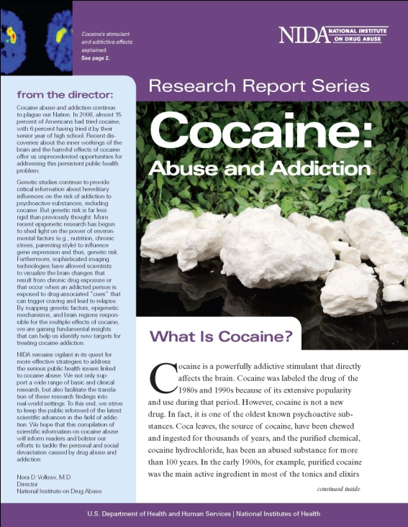


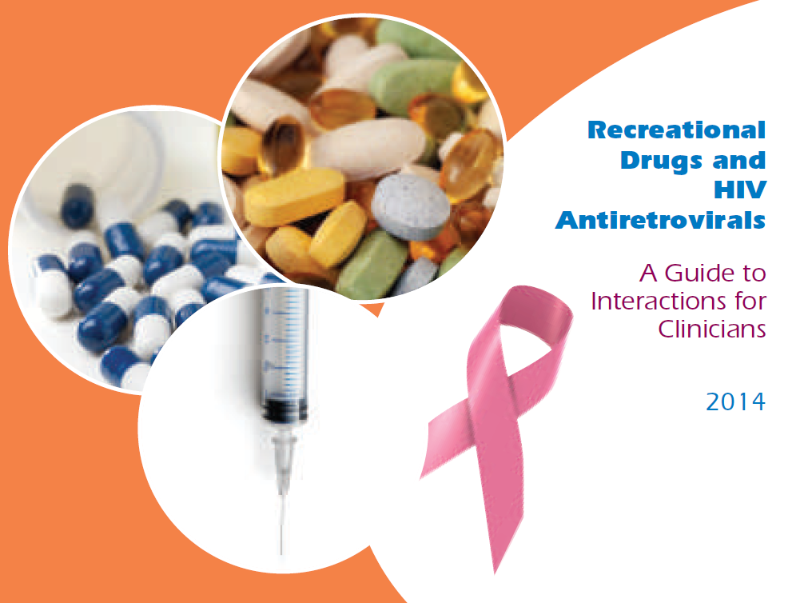
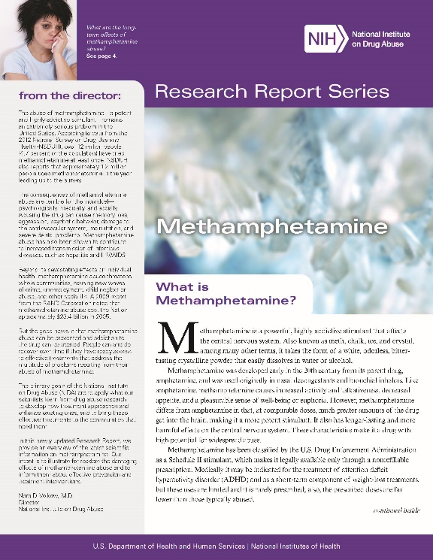
Key Resources
Notes:
This slide contains a variety of free resources available for viewing and downloading. The images include hyperlinks to the source material. The URLs are as follows:
Cocaine Research Report Series - https://d14rmgtrwzf5a.cloudfront.net/sites/default/files/1141-cocaine.pdf
Drugs, Brains, and Behavior: The Science of Addiction - https://d14rmgtrwzf5a.cloudfront.net/sites/default/files/soa_2014.pdf
Meth Inside Out - http://www.methinsideout.com/
Methamphetamine Research Report Series - https://d14rmgtrwzf5a.cloudfront.net/sites/default/files/methrrs.pdf
Recreational Drugs and HIV Antiretrovirals: A Guide to Interactions for Clinicians, 2014 - http://www.nynjaetc.org/documents/2014_RecreationalDrugInteractionGuide.pdf

Slide 125
Thank you for your time!
For more information:
Beth Rutkowski: brutkowski@mednet.ucla.edu
Thomas E. Freese: tfreese@mednet.ucla.edu
Kevin-Paul Johnson: kevinpaul@HIVtrainingCDU.org
Pacific Southwest ATTC: http://www.psattc.org
PAETC Training calendar: http://www.HIVtrainingCDU.org
Notes:
This concludes the presentation. Thank the participants for their time and address any last-minute questions about the content. Encourage participants to reach out to the Pacific Southwest ATTC or the LA Region PAETC, should they have questions or concerns following the training session.
Image Credit (L-R): Drug Enforcement Administration, various publications.

