Slide 1

Alcohol and HIV:
What clinicians need to know
2nd edition - 2019 update
Notes:
OPENING SLIDE
The purpose of this introductory training is to provide HIV clinicians (including, but not limited to physicians, dentists, nurses, and other allied medical staff, therapists and social workers, and counselors, specialists, and case managers) with a detailed overview of alcohol abuse and the behavioral and medical approaches for treating individuals with an alcohol use disorder. The introductory training (which was initially developed in 2012) has been updated, and includes a 126-slide PowerPoint presentation, Trainer Guide, and a companion 2-page fact sheet. The duration of the training is approximately 3 hours, if the trainer chooses to present all of the slides. The training duration can be shortened slightly by eliminating select slides. For example, slides 50-58 represent a general introduction of HIV/AIDS, and can be eliminated if your audience already has a broad knowledge base with regards to HIV/AIDS education.
“Test Your Knowledge” questions have been inserted at the beginning and end of the presentation to assess a change in the audience’s level knowledge after the key content has been presented. An answer key is provided in the Trainer’s notes for slides 7-11 and slides 121-125. Poll Everywhere, or a similar audience polling system can be utilized, if available, when facilitating the Test Your Knowledge question sessions. For more information, visit: https://www.polleverywhere.com/.
In addition, a series of case studies (slide 74 and slide 115) and additional questions (slides 96-99) have been inserted throughout the presentation to encourage dialogue among the training participants, and to illustrate how the information presented can be used clinically.
IMAGE CREDIT
Purchased Image, Adobe Stock, 2019.

Slide 2




Training collaborators
Charles R. Drew University of Medicine and Science
Pacific AIDS Education and Training Center – LA Region
UCLA Integrated Substance Abuse Programs
Pacific Southwest Addiction Technology Transfer Center – HHS Region 9
Notes:
This PowerPoint presentation, Trainer Guide, and companion fact sheet were developed by Beth Rutkowski, MPH (Director of Training of UCLA ISAP and Co-Director of the Region 9 PSATTC) and Thomas E. Freese, PhD (Co-Director of UCLA ISAP and Co-Director of the Pacific Southwest ATTC) through supplemental funding provided by the Pacific AIDS Education and Training Center, based at Charles R. Drew University of Medicine and Science. We wish to acknowledge Thomas Donohoe, MBA, Sandra Cuevas, Maya Gil Cantu, MPH, and Kevin-Paul Johnson, from the LA Region PAETC.

Slide 3

Training Roadmap
Mechanism of action and acute and chronic effects of alcohol
Patterns and trends in alcohol use
The intersection of alcohol and HIV
Evidence-based screening and assessment procedures and behavioral and medical interventions for treating people with alcohol use disorders
Notes:
Part 1 of the training will provide an overview of the mechanism of action of alcohol and its acute and chronic effects. Part 2 of the training will focus on the epidemiology of alcohol use. Part 3 of the training will focus on the intersection of alcohol use and HIV. Finally, Part 4 of the training will focus on evidence-based screening and assessment procedures and behavioral and medical treatments for alcohol use disorders.
IMAGE CREDIT
Purchased image, Fotolia, 2018.

Slide 4

Introductions
Briefly tell us:
  What is your name?
  Where do you work and what do you do there?
  Who is your favorite musician or performer?
  What is one reason you decided to attend this training?
Notes:
INSTRUCTIONS
In an effort to break the ice and encourage group interaction, take a few minutes to ask training participants to briefly share the answers to these four questions. You can ask for several volunteers to share their responses, if the size of your audience prevents all participants from sharing.
If the group is too large for formal introductions, the trainer can quickly ask participants the following two questions to gauge their work setting and professional training:
How many [case managers, LMFTs or LCSWs, counselors, administrators, psychologists, physicians, PAs, nurse practitioners, nurses, medical assistants, dentists, etc.] are in the room? Did I miss anyone? {elicit responses}
How many people work in a [HIV/infectious disease, substance use disorder, mental health, primary care, integrated treatment] setting? Did I miss any settings? {elicit responses}
IMAGE CREDIT
Purchased Image, Adobe Stock, 2019.

Slide 5

Educational Objectives
Define at least three key terms related to alcohol and at-risk drinking
Review the neurobiology, medical consequences, and epidemiology of alcohol use
Discuss the intersection of alcohol use and HIV/AIDS
Explain the key concepts of at least three effective behavioral and three effective medical interventions for alcohol use disorders
Notes:
INSTRUCTIONS
Briefly review each of the educational objectives with the audience.
IMAGE CREDIT
Purchased image, Adobe Stock, 2019.

Slide 6

Test your knowledge
Notes:
INSTRUCTIONS
The purpose of the following five questions is to test the current level of alcohol and HIV knowledge amongst training participants. The five questions are formatted as either multiple choice or true/false questions. Read each question and the possible responses aloud, and give training participants time to jot down their response before moving on to the next question. Do not reveal the answers to the questions until the end of the training session (when you re-administer the questions that appear on slides 121-125).
IMAGE CREDIT
Purchased Image, n.d.

Slide 7

Test your knowledge – question 1
At-risk drinking levels are the same, regardless of the drinker’s age or gender:
  True
  False
Notes:
INSTRUCTIONS
Read the question and choices, and review audience responses out loud.
IMAGE CREDIT
Purchased Image, Adobe Stock, 2019.

Slide 8
Test your knowledge – question 2
The four main neurotransmitters relevant to alcohol are:
  Dopamine, serotonin, GABA, and glutamate
  Serotonin, GABA, endorphin, and norepinephrine
  Endogenous opioids, glutamate, GABA, and dopamine
  Endogenous opioids, glutamate, endorphin, and norepinephrine
Notes:
INSTRUCTIONS
Read the question and choices, and review audience responses out loud.
IMAGE CREDIT
Purchased Image, Adobe Stock, 2019.

Slide 9
Test your knowledge – question 3
Nationwide, binge drinking rates are higher among men than women:
  True
  False
Notes:
INSTRUCTIONS
Read the question and choices, and review audience responses out loud.
IMAGE CREDIT
Purchased Image, Adobe Stock, 2019.

Slide 10
Test your knowledge – question 4
Decreasing alcohol use among HIV patients can reduce which of the following:
  Medical and psychiatric consequences of alcohol consumption
  Other drug use
  HIV transmission
  All of the above
Notes:
INSTRUCTIONS
Read the question and choices, and review audience responses out loud.
IMAGE CREDIT
Purchased Image, Adobe Stock, 2019.

Slide 11
Test your knowledge – question 5
The goal(s) of effective medication-assisted treatment for alcohol use disorder should be:
  Short-term stabilization and withdrawal
  A treatment of last resort
  Ongoing maintenance
  A and C
  None of the above
Notes:
INSTRUCTIONS
Read the question and choices, and review audience responses out loud.
IMAGE CREDIT
Purchased Image, Adobe Stock, 2019.

Slide 12
Defining some key terms
At-risk drinking: alcohol use that exceeds the recommended per-occasion or weekly amounts; also called “heavy” drinking (see slide 14)
Standard drink: an alcoholic beverage that contains roughly 14 grams of pure alcohol (see slide 15)
Hazardous drinking: a quantity or pattern of alcohol consumption that places a person at risk for adverse health events
Notes:
This slide includes the definitions for several alcohol-related key terms that will be used throughout the presentation.
For more information on each term, please visit:
At-risk drinking: NIAAA (https://www.rethinkingdrinking.niaaa.nih.gov/how-much-is-too-much/is-your-drinking-pattern-risky/whats-at-risk-or-heavy-drinking.aspx)
Standard drink: NIAAA (https://www.rethinkingdrinking.niaaa.nih.gov/How-much-is-too-much/What-counts-as-a-drink/Whats-A-Standard-Drink.aspx)
Hazardous drinking: JAMA (https://jamanetwork.com/journals/jamainternalmedicine/fullarticle/1105638)

Slide 13
Here are A few more key terms
Harmful drinking: alcohol consumption that results in adverse events (e.g., physical/psychological harm)
Binge drinking: a pattern of drinking that brings a person’s blood alcohol concentration (BAC) to 0.08 grams percent or above; usually happens when men consume 5+ drinks or women consume 4+ drinks in ~2 hours
Alcohol Use Disorder: a chronic relapsing brain disease characterized by compulsive alcohol use, loss of control over alcohol intake, and a negative emotional state when not using
Notes:
This slide continues the list of definitions for several alcohol-related key terms that will be used throughout the presentation.
For more information on each term, please visit:
Harmful drinking: JAMA (https://jamanetwork.com/journals/jamainternalmedicine/fullarticle/1105638)
Binge drinking: NIAAA (https://www.cdc.gov/alcohol/fact-sheets/binge-drinking.htm)
Alcohol use disorder: NIAAA (https://www.niaaa.nih.gov/alcohol-health/overview-alcohol-consumption/alcohol-use-disorders)

Slide 14
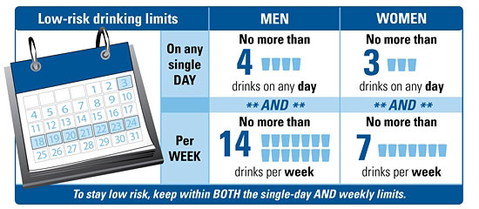
How do we define risk?
Notes:
We ask our clients and patients screening questions to identify risk. But how is risk defined? The U.S.-based National Institute on Alcohol and Alcoholism (NIAAA) defines risk as drinking more than the recommended limits. According to this image, the recommended limit for men is no more than 4 drinks per day and no more than 14 drinks per week. For women, the limit is no more than 3 drinks per day and no more than 7 drinks per week. Older adults (men and women over the age of 65) are generally advised to have no more than 3 drinks on a day and 7 per week.
According to research, women show signs of alcohol-related problems at lower drinking levels than men. Women, on average, weigh less than men, and women have less water in their bodies than men (this is relevant because alcohol disperses in body water).
REFERENCE
National Institute on Alcohol Abuse and Alcoholism (NIAAA). (2019). What’s “low risk” drinking for AUD? Retrieved from: https://www.rethinkingdrinking.niaaa.nih.gov/How-much-is-too-much/Is-your-drinking-pattern-risky/Whats-Low-Risk-Drinking.aspx.

Slide 15
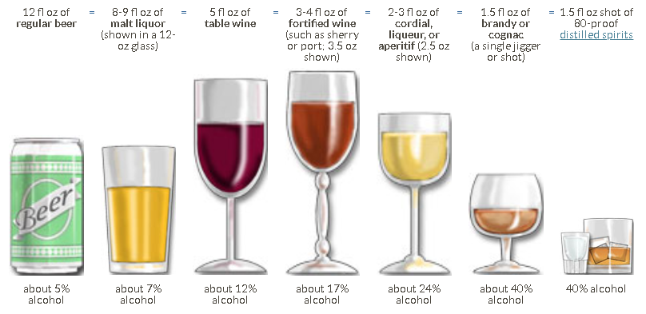
What is a standard drink?
Notes:
**ACTIVITY**
Standard drink demonstration (use plastic glasses and water with food coloring to show the audience a standard-sized pour of regular beer, table wine, and 80-proof distilled spirits)
People have different personal definitions of what exactly constitutes an alcoholic “drink.” The National Institute on Alcohol Abuse and Alcoholism has developed a definition of a standard drink. A standard drink can be a 12 ounce beer, 8-9 ounces of malt liquor, 5 ounces of table wine, 3-4 ounces of fortified wine, 2-3 ounces of cordial, 1.5 ounces of brandy, or 1.5 ounces of spirits such as vodka, gin, or scotch. So, a drink for one person may be a “40-ouncer” of beer, which, if you use NIAAA’s definition of a standard drink, would equal 3 1/3 standard drinks. It is very important for alcohol dependent patients to understand what is meant by “a drink” when you are assessing the level of risk associated with their alcohol consumption.
REFERENCE
National Institute on Alcohol Abuse and Alcoholism (NIAAA). (2019). What’s a “standard” drink? Retrieved from: https://www.rethinkingdrinking.niaaa.nih.gov/How-much-is-too-much/What-counts-as-a-drink/Whats-A-Standard-Drink.aspx.

Slide 16
Part 1 – Mechanism of action and acute and chronic effects
Notes:
TRANSITION SLIDE
This next section (Part 1) of the presentation provides more detail on the mechanism of action of alcohol and its acute and chronic effects on the user’s brain and body.

Slide 17

How does alcohol produce intoxication?
Notes:
This brief, 2-minute video explains the mechanism of action of alcohol. How alcohol acts on the central nervous system to produce intoxication is still poorly understood. In this video, the narrator summarizes current perspectives on the neural effects of alcohol, emphasizing its recognized actions on GABA and glutamate receptors along with some of its systemic effects.
Video Source: https://www.youtube.com/watch?v=1D2uyrNcGuo.
TRANSCRIPT:
Welcome to 2 minute neuroscience, where I explain neuroscience topics in 2 minutes or less. In this installment I will discuss alcohol. How alcohol acts in the central nervous system is still poorly understood. Two of the best known effects of alcohol, however, are its actions on GABA and glutamate receptors. Alcohol increases GABA activity at a subtype of the GABA receptor known as GABAa. The mechanism by which this occurs is still not clear, but it is thought that alcohol may act as a positive allosteric modulator, meaning it binds to a site on the receptor that is separate from where GABA binds, and increases the effect GABA has when it binds to the receptor itself. The immediate effect of this action typically is the inhibition of neural firing. Alcohol also inhibits the activity of glutamate receptors. Again, the mechanism for this is not fully understood but because glutamate is generally excitatory, inhibition by alcohol initially leads to the reduction of neural activity. A long list of other synaptic actions have been linked to alcohol, including (but not limited to): activation of serotonin receptors, enhancement of glycine receptor function, inhibition of adenosine reuptake, inhibition of calcium channels, activation of potassium channels, and modulation of nicotinic acetylcholine receptor function. It’s not clear, however, how relevant each of these effects are to the human use of alcohol. There are also some large-scale effects associated with alcohol. For example, alcohol stimulates dopamine transmission in the mesolimbic dopamine pathway--an action thought to be associated with the reinforcement of alcohol consumption. Alcohol affects motor coordination and balance, potentially in part through its influence on neurons in the cerebellum. And it inhibits long-term potentiation and other mechanisms of synaptic plasticity in the hippocampus, which may contribute to its memory-disrupting effects.
REFERENCES
Abrahao, K.P., Salinas, A.G., & Lovinger, D.M. (2017). Alcohol and the brain: Neuronal molecular targets, synapses, and circuits. Neuron, 96(6),1223-1238. doi: 10.1016/j.neuron.2017.10.032.
Goldin, M., & Marshall, E.J. (2016). Alcohol: Pharmacokinetics and pharmacodynamics. In: Wolf, K., White, J., & Karch, S., Eds. The SAGE Handbook of Drug & Alcohol Studies : Biological Approaches. London: Sage Publications.

Slide 18
Four main neurotransmitters are relevant to alcohol (1)
Endogenous opioids
Deadens pain and causes euphoria
Dopamine
Makes you happy
Notes:
As was demonstrated in the brief video, two processes occur simultaneously when alcohol is consumed. One process acts on the naturally occurring opioids in the brain (which deaden pain and cause feelings of euphoria), and dopamine (which makes things feel good). The next slide shows the other process.

Slide 19
Four main neurotransmitters are relevant to alcohol (2)
Glutamate
Excitatory neurotransmitter
GABA
Inhibitory neurotransmitter
Speeds you up
Slows you down
Notes:
Two processes occur simultaneously when alcohol is consumed. As you saw on the previous slide, the first process acts on the naturally occurring opioids in the brain (which deaden pain and cause feelings of euphoria), and dopamine (which makes things feel good). The second process operates on glutamate (the excitatory neurotransmitter that wakes you up) and GABA (the inhibitory neurotransmitter that slows you down). The next few slides detail each process separately.

Slide 20
Alcohol Neuronal activity (1)
Alcohol is used
Endogenous opioids are released into the pleasure centers of the brain
In response to this increased endogenous opioid activity, dopamine is released
Dopamine makes the drinker feel good. This reinforces the behavior and increases the likelihood it will recur.
Notes:
In the first process, a person drinks alcohol and this causes the release of the endogenous, or naturally occurring, opioids to be released in the pleasure centers of the brain. This in turn, causes the release of dopamine. Since dopamine makes the person feel good, drinking is reinforced and this increases the likelihood of repeated use. A subsequent section of this training will review two medications used to treat alcohol directly by addressing the pleasurable effects of alcohol.

Slide 21
Alcohol Neuronal activity (2)
GABA is increased, slowing the brain down
Over time, the brain reacts to the over-abundance of GABA by creating more receptors for glutamate
The increased effect of glutamate energizes the system and restores balance
Notes:
At the same time that alcohol is making the person feel good, a second process occurs. When the person drinks, GABA (the inhibitory neurotransmitter) is released and this slows down the brain. This results in the symptoms of intoxication from alcohol, such as difficulty with coordination, drowsiness, slurring speech, etc. With repeated use, the brain attempts to correct for the overabundance of GABA by creating more receptors for glutamate. This increases the effectives of glutamate, and the system is energized and balance is restored.

Slide 22

The Excitatory and Inhibitory Balance (1)
GABA
Inhibitory Neurotransmitter
Glutamate
Excitatory Neurotransmitter
Notes:
**ANIMATIONS**
GABA is the brain’s main inhibitory neuron. When it is stimulated, the brain slows down. For instance, when you are relaxing in the evening and start to get sleepy, GABA is beginning to surge forward preparing you to sleep.
Glutamate is the major excitatory neuron. Glutamate surges to alert the brain of the need for increased activity making neurotransmitters ready to fire.
GABA and Glutamate should work in balance with each other, so that one or the other surges forward depending on need, maintaining function and overall balance in the brain.
[Click once to move animation forward] When alcohol is introduced, it causes a surge in GABA and with repeated drinks, the glutamate system becomes less able to keep up and maintain balance.
Over time, as alcohol continues to be consumed, the brain’s compensatory mechanisms kick in and works to restore balance by creating more [upregulating] glutamate [NMDA] receptors.
[Click once to move animation forward] This restores balance again.
[Advance to next slide]
IMAGE CREDIT
Purchased Image, n.d.

Slide 23
The Excitatory and Inhibitory Balance (2)
GABA
Inhibitory Neurotransmitter
Glutamate
Excitatory Neurotransmitter
Notes:
**ANIMATIONS**
Now in order to feel that intoxicating feeling, more alcohol needs to be consumed. [Click once to move animation forward]
This again results in a surge in GABA, [click once to move animation forward] overwhelming the glutamate system again.
This process repeating over time results in what we know as tolerance. You will hear more about tolerance on slide 24.
The compensatory mechanisms continue, [click once to move animation forward] more glutamate [NMDA] receptors are again added to system and balance is again restored.
[Advance to next slide]
IMAGE CREDIT
Purchased Image, n.d.

Slide 24
The Excitatory and Inhibitory Balance (3)
GABA
Inhibitory Neurotransmitter
Glutamate
Excitatory Neurotransmitter
Notes:
**ANIMATIONS**
Now we have a brain that is held in balance with alcohol boosting GABA, and a supercharged glutamate system with greatly upregulated numbers of glutamate [NMDA] receptors.
[Click to move animation forward] What happens when a person stops drinking?
[Click to move animation forward] GABA levels fall to normal or below. Because there are way too many NMDA receptors that are not being counterbalanced, the brain goes into overdrive and is over excited in many areas. This leads to the experience of withdrawal such as shakiness, sweating, loss of appetite, agitation, restlessness, irritability, nausea or vomiting, anxiety or nervousness, fast heart rate, tremor, disorientation, headache, insomnia, or seizures.
IMAGE CREDIT
Purchased Image, n.d.

Slide 25
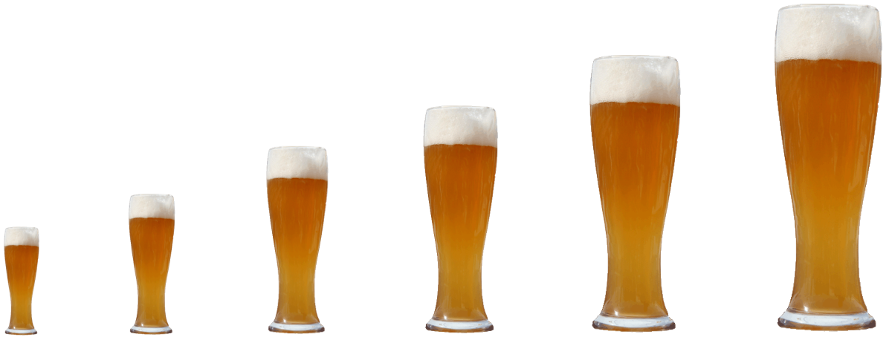
Tolerance
As the brain desired, up-regulation works, and the imbalance is corrected
Now, if the individual continues to drink, it takes more alcohol to override the glutamate system again and feel the same level of intoxication
This effect is known as tolerance
Notes:
As was previously mentioned and demonstrated, alcohol consumption interferes with many bodily functions and affects behavior. And after chronic alcohol consumption, the drinker often develops tolerance to at least some of alcohol's effects. Tolerance means that after continued drinking, consumption of a constant amount of alcohol produces a lesser effect or increasing amounts of alcohol are necessary to produce the same effect.
IMAGE CREDIT
Purchased Image, n.d.

Slide 26

Alcohol – basic facts
Description: Alcohol or ethyl alcohol (ethanol) is present in varying amounts in beer, wine, and liquors
Route of administration: Oral
Acute effects: Sedation, euphoria, lower heart rate and respiration, slowed reaction time, impaired coordination, coma, death
Notes:
Alcohol relaxes the brain and body, which some people find pleasurable. Many people find that moderate drinking (a drink or two of alcohol a day) helps relieve stress, encourages relaxation and acts as an appetite stimulant. Its acute effects, however, can also alter mood and lead to physical, psychological and social problems. Even small amounts of alcohol can have an effect on your coordination, reactions, and judgments. Binge drinking can lead to poor coordination, vomiting, exaggerated emotional reactions (including sadness, tearfulness, anger, and aggression) and can lead to unconsciousness. Women who are pregnant or planning to become so, are advised to avoid alcohol. A hangover, which may include a headache, dry mouth, feeling sick, and tired, is a common consequence of heavy drinking. These effects are caused by dehydration and toxicities. Extremely heavy drinking can lead to coma and even death.
IMAGE CREDIT
Purchased Image, n.d.

Slide 27
Chronic effects and alcohol withdrawal
Individuals should be hospitalized for intensive medical management of withdrawal if they have:
  Severe withdrawal symptoms
  History of withdrawal seizures or complications
  Delirium tremens or history of them
  Depression with suicidal ideation
  Severe coexisting medical/psychiatric conditions
  An unstable living situation
Mild to moderate symptoms:
  Mild tremors
  Mild anxiety
  Headache
  Diaphoresis
  Palpitations
  Anorexia
  Gastrointestinal upset
Notes:
Alcohol withdrawal refers to symptoms that may occur when a person who has been drinking too much alcohol suddenly stops. Alcohol withdrawal symptoms usually occur within 5-10 hours after the last drink, but can occur days later. Symptoms get worse in 48-72 hours, and may persist for weeks. People with moderate to severe symptoms of alcohol withdrawal may require inpatient treatment at a hospital or other facility that treats alcohol withdrawal. You will be watched closely for hallucinations and other signs of delirium tremens. Treatment may include: (1) monitoring of blood pressure, body temperature, heart rate, and blood levels of different chemicals in the body; (2) IV fluids or medications; and (3) sedation using benzodiazepines until withdrawal is complete. Those with mild to moderate symptoms of withdrawal may be treated in an outpatient program.
Mild to moderate withdrawal symptoms can be safely and effectively managed as outpatients using non-pharmacologic therapy or benzodiazepines to treat symptoms. Daily contact with the treating clinician and a friend or family member to administer medications is optimal for these patients. Benzodiazepines should be used on a short-term basis and should be tapered as soon as possible. Delirium tremens is a medical emergency associated with untreated alcohol withdrawal. It occurs 3-14 days after drinking is stopped. Delirium tremens include agitation, restlessness, gross tremor, disorientation, fluid and electrolyte imbalance, sweating and high fevers, visual hallucinations, and paranoia. The estimated prevalence of DTs is < 5% of alcohol dependent patients, but it is possible for DTs to lead to death.

Slide 28
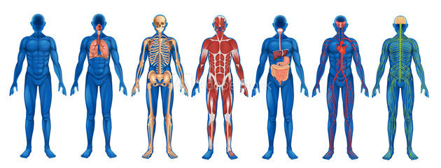
Long-term effects of alcohol
Decrease in blood cells leading to anemia, disease, and slow-healing wounds
Brain damage, loss of memory, blackouts, poor vision, slurred speech, and decreased motor control
Increased risk of high blood pressure, hardening of arteries, and heart disease
Liver cirrhosis, jaundice, and diabetes
Immune system dysfunction
Stomach ulcers, hemorrhaging, and gastritis
Thiamine and other deficiencies
Testicular and ovarian atrophy
Harm to fetus during pregnancy
Notes:
Long-term, chronic alcohol use affects almost every organ system of the body, potentially resulting in serious illnesses, including liver disease, impaired heart function (known as cardiomyopathy), and inflammation of the pancreas (called pancreatitis). Even one-time acute alcohol consumption, such as binge drinking, can temporarily alter the activity of many organ systems. Furthermore, heavy alcohol consumption by a pregnant woman can harm her fetus and lead to fetal abnormalities ranging from mild learning deficits to full-blown fetal alcohol syndrome (FAS).
IMAGE CREDIT
Purchased image, Adobe Stock, 2019.

Slide 29
Alcohol Use Disorder and Depressive Disorders
Psychiatric disorders commonly co-occur with AUD
Prevalence of major depressive disorder is about 10-15%; dysthymia is less common (~2%)
Depressive disorders are most common psychiatric disorder among people with AUD (2.3x more likely to have MDD and 1.7x more likely to have dysthymia)
  Co-occurrence is associated with greater severity and worse prognosis than other disorder alone (incl. increased risk of suicidal behavior)
Notes:
In 2019, McHugh and Weiss published a review paper focused on alcohol use disorder (AUD) and depressive disorders. The aim of the article was to describe the prevalence, course, and treatment of co-occurring AUD and depressive disorders. This slide features data on the co-occurrence of AUD and depressive disorders (major depressive disorder and dysthymia).
REFERENCE
McHugh, R.K, & Weiss, R.D. (2019). Alcohol use disorder and depressive disorders. Alcohol Research: Current Reviews, 40(1), e1-e8.

Slide 30
The dangers of Binge drinking
Unintentional injuries
Violence
Sexually transmitted diseases
Unintended pregnancy
Poor pregnancy outcomes
Fetal alcohol spectrum disorders (FASD)
Sudden infant death syndrome
Chronic diseases
A variety of cancers
Memory problems
Learning problems
Alcohol dependence
Notes:
A myriad of health problems are associated with binge drinking. This slides lists several of them. Unintentional injuries include car crashes, falls, burns, and alcohol poisoning. Violence includes homicide, suicide, intimate partner violence, and sexual assault. Poor pregnancy outcomes include miscarriage and stillbirth. Chronic diseases include high blood pressure, stroke, heart disease, and liver disease. Cancers include breast, mouth, throat, esophagus, liver, and colon.
REFERENCES
Centers for Disease Control and Prevention. (2018). Fact Sheets – Binge Drinking. Available at:
https://www.cdc.gov/alcohol/fact-sheets/binge-drinking.htm.
World Health Organization. (2018). Global Status Report on Alcohol and Health. Geneva, Switzerland: Author.
Naimi, T.S., Lipscomb, L.E., Brewer, R.D., & Colley, B.G. (2003). Binge drinking in the preconception period and the risk of unintended pregnancy: Implications for women and their children. Pediatrics, 111(5 Pt 2), 1136-1141.
Iyasu, S., Randall, L.L., Welty, T.K., et al. (2002). Risk factors for sudden infant death syndrome among northern plains Indians. JAMA, 288(21), 2717-2723.

Slide 31
Critical signs and symptoms of an alcohol overdose
Mental confusion, stupor
Difficulty remaining conscious; inability to wake up
Vomiting
Seizures
Slow breathing (<8 breaths/min)
Irregular breathing (10 sec between breaths)
Slow heart rate
Clammy skin
Dulled responses (no gag reflex)
Extremely low body temperature
Bluish skin color
Paleness
Notes:
This slide presents the various signs and symptoms that someone may exhibit if they are experiencing an alcohol overdose.
REFERENCE
National Institute on Alcohol Abuse and Alcoholism (NIAAA). (2018). Understanding the Dangers of Alcohol Overdose. Available at: https://www.niaaa.nih.gov/sites/default/files/publications/overdoseFact_2018.pdf.

Slide 32
Alcohol use disorder – a comparison between DSM-IV and DSM-5
DSM-5 integrates alcohol abuse and alcohol dependence into a single disorder called alcohol use disorder (AUD)
  Mild, moderate, and severe sub-classifications
Anyone meeting any two of 11criteria during the same 12-month period receives a diagnosis of AUD
DSM-5 eliminates legal problems as a criterion
DSM-5 adds craving as a criterion for an AUD diagnosis
DSM-5 revised criteria descriptions with updated language
Notes:
In May 2013, the American Psychiatric Association issued the 5th edition of the Diagnostic and Statistical Manual of Mental Disorders (DSM-5). This slide details the important differences between the previous version (DSM-IV) and current version (DSM-5).
The DSM-5 criteria for AUD include: (1) had times when you ended up drinking more, or longer, than you intended; (2) more than once wanted to cut down or stop drinking, or tried, but could not; (3) spent a lot of time drinking or being sick or getting over aftereffects; (4) wanted a drink so badly you could not think of anything else; (5) found that drinking or being sick from drinking often interfered with taking care of your home or family or caused job or school troubles; (6) continued to drink even if it was causing trouble with family and friends; (7) gave up or cut back on activities that were important or interesting to you, or gave you pleasure in order to drink; (8) more than once got into situations while drinking or after drinking that increased chance of getting hurt; (9) continued to drink even though it was making you feel depressed or anxious, added to another health problem, or after having a memory blackout; (10) had to drink much more than you once did to get the effect you want or found that your usual number of drinks had much less effect than before; and (11) found that when the effects of alcohol were wearing off, you had withdrawal symptoms.
The severity of an AUD is defined as:
Mild – presence of 2-3 symptoms
Moderate – presence of 4-5 symptoms
Severe – presence of 6+ symptoms
REFERENCE
National Institute on Alcohol Abuse and Alcoholism (NIAAA). (2016). Alcohol Use Disorder: A Comparison between DSM-IV and DSM-5, NIH Publication No. 13-7999. Retrieved from:
https://www.niaaa.nih.gov/publications/brochures-and-fact-sheets/alcohol-use-disorder-comparison-between-dsm.

Slide 33
Part 2 – Patterns and Trends in the use of alcohol in the united states
Notes:
TRANSITION SLIDE
The next portion of the presentation (Part 2) will provide training participants with a detailed overview of patterns and trends in alcohol use in the United States. No single drug abuse indicator can tell the full story of the extent or impact of prescription opioids. Therefore, data from several available indicators are presented in an attempt to paint a comprehensive picture of who abuses alcohol, and the populations in which abuse and dependence is most prevalent.

Slide 34
Prevalence of alcohol use disorder in the united states
Notes:
This slide presents annual and lifetime prevalence data from the National Epidemiologic Survey on Alcohol and Related Conditions III (NESARC). The survey provides data on the prevalence, correlates, psychiatric comorbidity, associated disability, and treatment of DSM-5 AUD diagnoses. Face to face interviews are conducted with a representative sample of non-institutionalized, civilian adults (age 18 and older). In 2012-13, a total of 36,309 individuals were interviewed. Prevalence was highest for a variety of sub-populations, included Native Americans, younger individuals, Whites, and men.
REFERENCE
Grant, B.F., Goldstein, R.B., Saha, T.D., et al. (2015). Results from the National Epidemiologic Survey on Alcohol and Related Conditions III. JAMA Psychiatry, 72(8), 757-766.

Slide 35
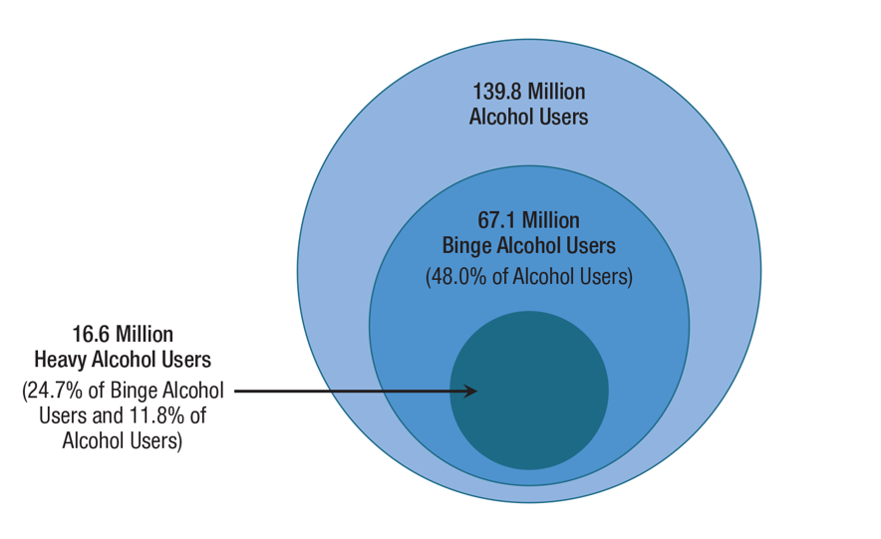
Current, Binge, and Heavy Alcohol Use among People aged 12 and older, 2018
Notes:
The National Survey on Drug Use and Health (NSDUH) is an annual survey that provides national indicators of substance use and mental health among people aged 12 or older in the civilian, noninstitutionalized population of the United States. Results are provided for the overall category of people aged 12 or older and by age subgroups. In 2018, approximately 139.8 million Americans aged 12 or older were current alcohol users, 67.1 million were binge drinkers in the past month, and 16.6 million were heavy drinkers in the past month. Nearly half of current alcohol users were binge drinkers (48.0 percent), and 1 in 8 current alcohol users were heavy drinkers (11.8 percent). Among binge drinkers, about 1 in 4 (24.7 percent) were heavy drinkers.
REFERENCE
Substance Abuse and Mental Health Services Administration. (2019). Key substance use and mental health indicators in the United States: Results from the 2018 National Survey on Drug Use and Health (HHS Publication No. PEP19-5068, NSDUH Series H-54). Rockville, MD: Center for Behavioral Health Statistics and Quality, Substance Abuse and Mental Health Services Administration. Retrieved from https://www.samhsa.gov/data/.

Slide 36
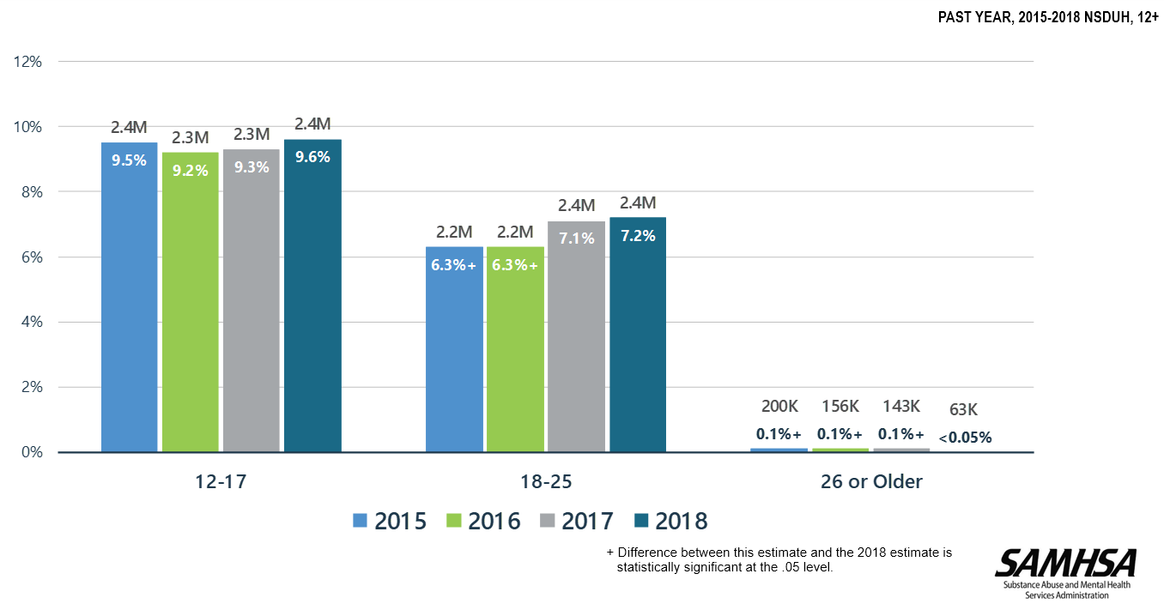
Alcohol initiates, 2015-2018
Notes:
Approximately 4.9 million people aged 12 and older used alcohol for the first time in 2018. In other words, on each day in 2018, approximately 13,400 people initiated alcohol use. This graph provides the number of alcohol initiates by age group and survey year. The numbers were greatest among those individuals aged 12 to 17.
REFERENCE
Substance Abuse and Mental Health Services Administration. (2019). Key substance use and mental health indicators in the United States: Results from the 2018 National Survey on Drug Use and Health (HHS Publication No. PEP19-5068, NSDUH Series H-54). Rockville, MD: Center for Behavioral Health Statistics and Quality, Substance Abuse and Mental Health Services Administration. Retrieved from https://www.samhsa.gov/data/.

Slide 37
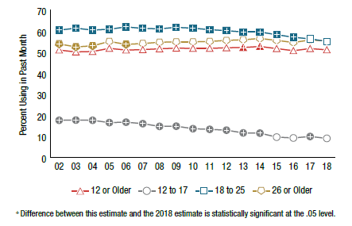
current alcohol use by people aged
12 and older, 2002-2018
Notes:
As was previously stated, there were an estimated 139.8 million current alcohol users aged 12 or older in 2018, corresponding to slightly more than half of the people in the population (51.1%). The 2018 estimate of past month alcohol use was similar to the estimates in most years from 2002 to 2017. An estimated 9.0% of adolescents aged 12 to 17 in 2018 were current alcohol users, which corresponds to 2.2 million adolescents who drank alcohol in the past month. The percentage of adolescents who were current alcohol users in 2018 was lower than the percentages in most years from 2002 through 2017. Although the estimate of current alcohol use among adolescents decreased between 2002 and 2018, about 1 in 11 adolescents were current alcohol users in 2018. In 2018, an estimated 55.1% of young adults aged 18 to 25 were current alcohol users, which corresponds to about 18.8 million young adults. The percentage of young adults in 2018 who drank alcohol in the past month was lower than the percentages in 2002 through 2016, but it was similar to the percentage in 2017. More than half of adults aged 26 or older in 2018 (55.3%) were current alcohol users. This percentage corresponds to about 118.8 million adults in this age group who drank alcohol in the past month. In each year between 2002 and 2018, slightly more than half of adults aged 26 or older were current alcohol users (ranging from 52.5% to 56.5%).
REFERENCE
Substance Abuse and Mental Health Services Administration. (2019). Key substance use and mental health indicators in the United States: Results from the 2018 National Survey on Drug Use and Health (HHS Publication No. PEP19-5068, NSDUH Series H-54). Rockville, MD: Center for Behavioral Health Statistics and Quality, Substance Abuse and Mental Health Services Administration. Retrieved from https://www.samhsa.gov/data/.

Slide 38
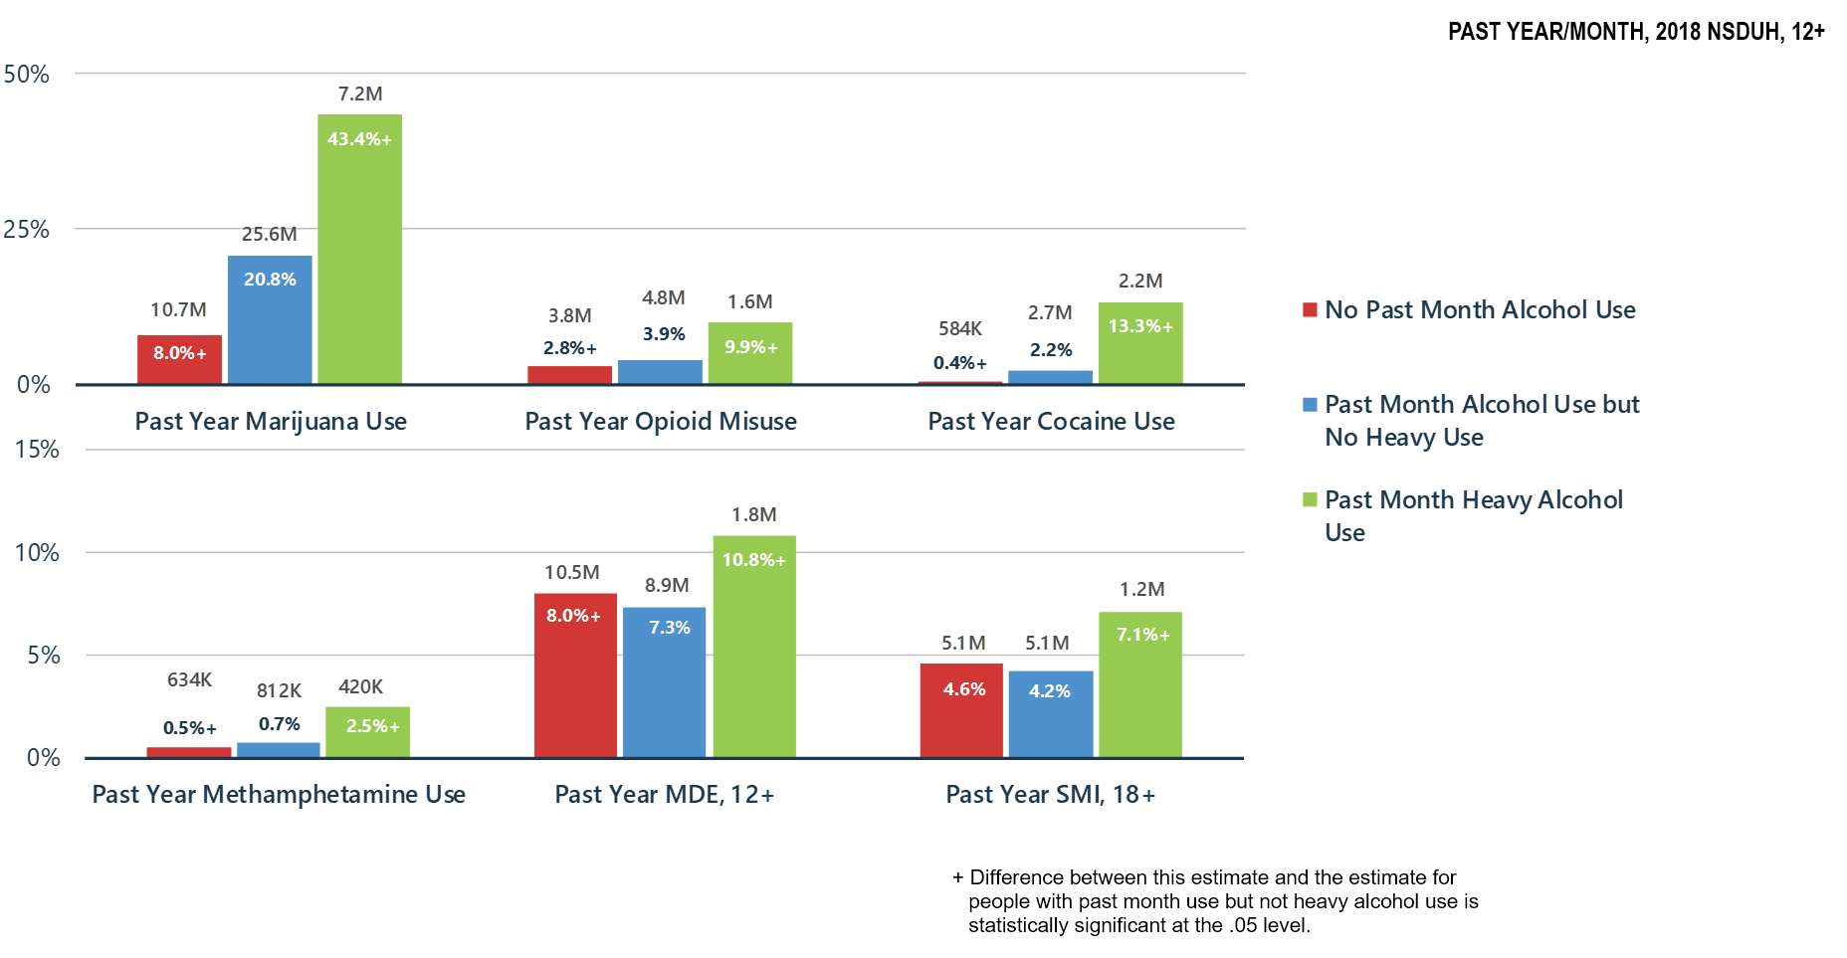
Alcohol use related to other substance use, major depressive Episode, and serious mental illness
Notes:
This bar graph shows the relationship of alcohol use related to past year marijuana use, past year opioid misuse, past year cocaine use, past year methamphetamine use, past year major depressive episode, and past year serious mental illness. Those individuals who had past month heavy alcohol use were most likely to report past month use of all other substances, as well as past year major depressive episode or past year serious mental illness than those who used alcohol in the past month but no heavy use, and those who did not use alcohol at all in the past month.
REFERENCE
Substance Abuse and Mental Health Services Administration. (2019). Key substance use and mental health indicators in the United States: Results from the 2018 National Survey on Drug Use and Health (HHS Publication No. PEP19-5068, NSDUH Series H-54). Rockville, MD: Center for Behavioral Health Statistics and Quality, Substance Abuse and Mental Health Services Administration. Retrieved from https://www.samhsa.gov/data/.

Slide 39
Trends in lifetime use of alcohol, 2018
Notes:
Monitoring the Future is an ongoing study of the behaviors, attitudes, and values of Americans from adolescence through adulthood. Each year, a total of approximately 50,000 8th, 10th and 12th grade students are surveyed (12th graders since 1975, and 8th and 10th graders since 1991). In addition, annual follow-up questionnaires are mailed to a sample of each graduating class for a number of years after their initial participation. The Monitoring the Future Study has been funded under a series of investigator-initiated competing research grants from the National Institute on Drug Abuse, and conducted at the Survey Research Center in the Institute for Social Research at the University of Michigan.
This bar chart features data from the 2018 Monitoring the Future Survey. At the far left is the percentage of 8th (23.5%), 10th (43%), and 12th (58.5%) graders who reported any lifetime alcohol use. In the middle is the percentage of 8th (9.2%), 10th (26.2%), and 12th (42.9%) graders who reported ever being drunk. To the right is the percentage of 8th (18%), 10th (35.9%), and 12th (50.4%) graders who reported lifetime consumption of flavored alcohol beverages.
REFERENCE
Johnston, L.D., Miech, R.A., O’Malley, P.M., Bachman, J.G., Schulenberg, J.E., & Patrick, M.E. (2019). Monitoring the Future national survey results on drug use 1975-2018: Overview, key findings on adolescent drug use. Ann Arbor: Institute for Social Research, University of Michigan.

Slide 40
Trends in Current use of alcohol, 2018
Notes:
This bar chart features additional data from the 2018 MTF survey. At the far left is the percentage of 8th (8.2%), 10th (18.6%), and 12th (30.2%) graders who reported any alcohol use in the past 30 days. In the middle is the percentage of 8th (2.1%), 10th (8.4%), and 12th (17.5%) graders who reported being drunk in the past 30 days. To the right is the percentage of 8th (4.9%), 10th (11.8%), and 12th (18.1%) graders who reported past 30 day consumption of flavored alcohol beverages.
REFERENCE
Johnston, L.D., Miech, R.A., O’Malley, P.M., Bachman, J.G., Schulenberg, J.E., & Patrick, M.E. (2019). Monitoring the Future national survey results on drug use 1975-2018: Overview, key findings on adolescent drug use. Ann Arbor: Institute for Social Research, University of Michigan.

Slide 41
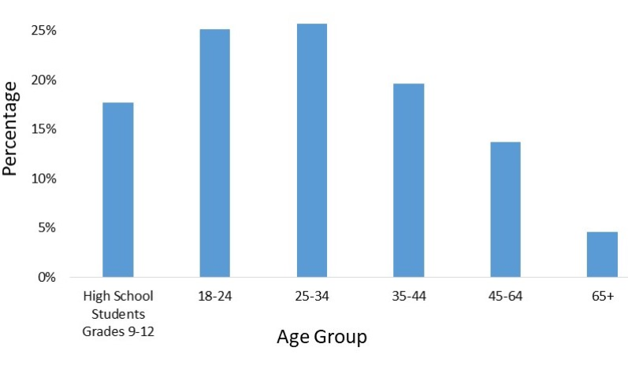
Characteristics of Binge drinkers
1 in 6 U.S. adults binge drink about four times per month
Binge drinking is most common among adults 18-34 years of age
Binge drinking is twice as common among men than among women
  Four in five binge drinks are consumed by men
Notes:
This slide presents data for binge drinking by age group, according to findings from the 2015 Youth Risk Behavior Surveillance System and Behavioral Risk Factor Surveillance System.
REFERENCES
Centers for Disease Control and Prevention (CDC). (2018). Fact Sheets – Binge Drinking. Available at: https://www.cdc.gov/alcohol/fact-sheets/binge-drinking.htm.
Kanny, D., Naimi, T.S., Liu, Y., Lu, H., & Brewer, R.D. (2018). Annual total binge drinks consumed by U.S. adults, 2015. Am J Prev Med, 54, 486-496.

Slide 42
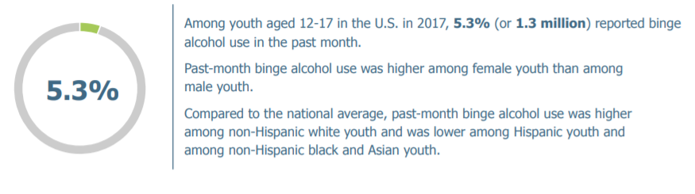
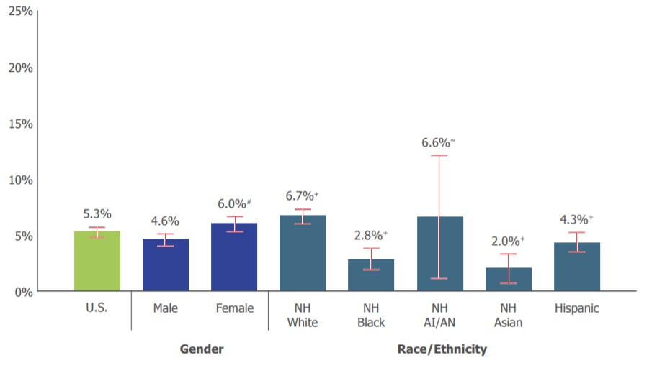
Binge alcohol use among young people
Notes:
With regards to binge drinking, according to the National Survey on Drug Use and Health, 5.3% of youth aged 12 to 17 reported binge alcohol use in the past month in 2018. Binge alcohol use was higher among females than males and higher among non-Hispanic white and American Indian/Alaska Native youth. As a sake of comparison, among young adults aged 18 to 25, 36.9% reported binge alcohol use in the past month.
REFERENCE
Substance Abuse and Mental Health Services Administration. (2019). Behavioral Health Barometer: United States, Volume 5: Indicators as measured through the 2017 National Survey on Drug Use and Health and the National Survey of Substance Abuse Treatment Services. HHS Publication No. SMA–19–Baro-17-US. Rockville, MD: Author.

Slide 43
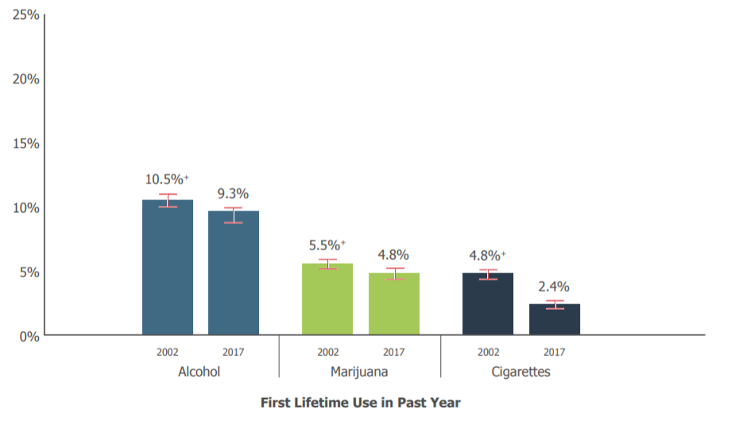
Some good news – decreases in first use of alcohol seen among young people
Notes:
This slide shows data on the first use of alcohol, marijuana, and cigarettes (also known as past-year initiation). In 2017, 9.3% of youth aged 12-17 used alcohol for the first time. This is a significant decrease from the rate seen in 2002 (10.5%). Significant decreases were also seen with marijuana use and cigarette use.
REFERENCE
Substance Abuse and Mental Health Services Administration. (2019). Behavioral Health Barometer: United States, Volume 5: Indicators as measured through the 2017 National Survey on Drug Use and Health and the National Survey of Substance Abuse Treatment Services. HHS Publication No. SMA–19–Baro-17-US. Rockville, MD: Author.

Slide 44
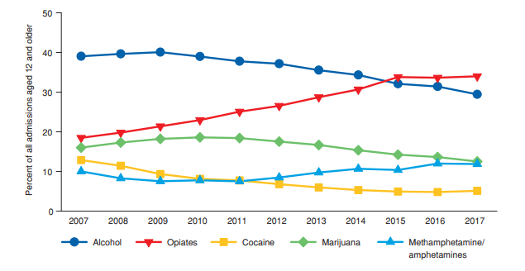
Primary substance of abuse at time of admission, 2006-2016
Notes:
Between 2007 and 2017, five substance groups accounted for between 93% and 97% of the primary substances reported among treatment admissions aged 12 years and older: alcohol, opiates, marijuana/hashish, cocaine, and methamphetamine/amphetamines. However, the proportions of admissions by primary substance used changed considerably during the period for most substances. The most frequently reported primary substances in 2017 were: opiates (34%), alcohol (29%), marijuana/hashish (13%), stimulants (12%), and cocaine (5%), accounting for 93% of all admissions aged 12 years and older
The proportion of admissions with alcohol use reported as the primary substance ranged between 39-40% from 2007 through 2010, before declining to 29% in 2017. The average age at admission among alcohol-only admissions was 43 years, whereas the average age among admissions for primary use of alcohol with secondary drug use was 39 years. Almost two thirds (63%) of alcohol-only admissions aged 12 years or older were non-Hispanic Whites, 14% were of Hispanic origin, and 14% were non-Hispanic Blacks. Among admissions for primary alcohol with secondary drug use, 56% were non-Hispanic Whites, 22% were non-Hispanic Blacks, and 14% were of Hispanic origin.
REFERENCE
Substance Abuse and Mental Health Services Administration, Center for Behavioral Health Statistics and Quality. (2019). Treatment Episode Data Set (TEDS): 2017. Admissions to and Discharges from Publicly-Funded Substance Use Treatment. Rockville, MD: Author.

Slide 45
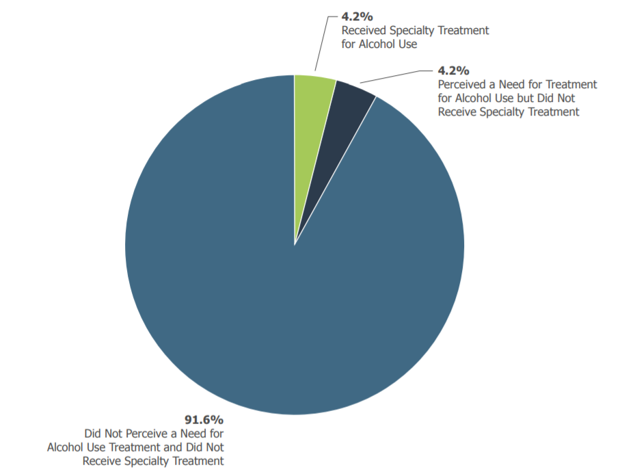
The Alcohol Treatment gap
Notes:
About 9 in 10 people (91.6%) with a past-year alcohol use disorder did not receive specialty treatment and did not perceive a need for treatment for their alcohol use.
REFERENCE
Substance Abuse and Mental Health Services Administration. (2019). Behavioral Health Barometer: United States, Volume 5: Indicators as measured through the 2017 National Survey on Drug Use and Health and the National Survey of Substance Abuse Treatment Services. HHS Publication No. SMA–19–Baro-17-US. Rockville, MD: Author.

Slide 46
Patterns of Alcohol-Related
Injuries and deaths
Alcohol contributes to more than 200 diseases and injury-related health conditions
Globally, alcohol misuse is the 5th leading risk factor for premature death
An estimated 88,000 people in the U.S. die from alcohol-related causes each year (3rd leading preventable cause of death)
Alcohol-impaired driving accounted for nearly 10,000 deaths in 2014 (31% of all driving fatalities)
Notes:
This slide presents statistics on alcohol-related injuries and deaths, both nationally and internationally. Alcohol is the third leading preventable cause of death in the United States, following tobacco (1st) and physical inactivity (2nd).
REFERENCE
National Institute on Alcohol Abuse and Alcoholism (NIAAA). (2018). Alcohol Facts and Statistics. Rockville, MD: NIH. Available at: https://www.niaaa.nih.gov/sites/default/files/publications/AlcoholFactsAndStats.pdf.

Slide 47
Alcohol and the Human body
In 2015, there were 78,529 liver disease deaths (47% involved alcohol)
  48% of cirrhosis deaths were alcohol-related
Alcohol-related liver disease deaths increased 65% between 1999-2016
  Individuals aged 25-34 were disproportionately impacted
Alcohol-related liver disease accounts for nearly 1 in 3 liver transplants in the U.S.
Alcohol consumption increases the risk for cancer of the mouth, esophagus, pharynx, larynx, liver, and breast
Notes:
This slide presents statistics on the effects of alcohol on the human body, most notably the liver. With regards to the increase in alcohol-related liver disease deaths between 1999 and 2016, the highest increase (about 10.5% each year) was seen among adults aged 25-34.
REFERENCES
National Institute on Alcohol Abuse and Alcoholism (NIAAA). Alcohol Facts and Statistics. Rockville, MD: NIH. Available at: https://www.niaaa.nih.gov/sites/default/files/publications/AlcoholFactsAndStats.pdf.
Tapper, E., & Parikh, N.D. (2018). Mortality due to cirrhosis and liver cancer in the United States, 1999-2016: Observational study. British Medical Journal, 362, k2817.

Slide 48
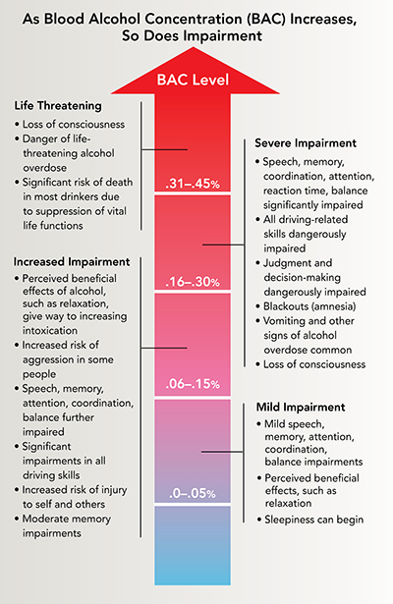
The relationship between blood alcohol concentration and impairment
Notes:
This graphic presents the relationship between rising blood alcohol concentration (BAC) and the level of impairment in the individual. As BAC increases, so do the effects of alcohol. Even at very low BACs a person can exhibit mild impairment in speech, memory, attention, etc.
REFERENCE
National Institute on Alcohol Abuse and Alcoholism (NIAAA). Understanding the Dangers of Alcohol Overdose. Available at: https://www.niaaa.nih.gov/sites/default/files/publications/overdoseFact_2018.pdf.

Slide 49
Part 3 –
The intersection of alcohol and HIV/AIDS
Notes:
TRANSITION SLIDE
The next portion of the presentation (Part 3) corresponds to the relationship between alcohol use and HIV/AIDS.

Slide 50
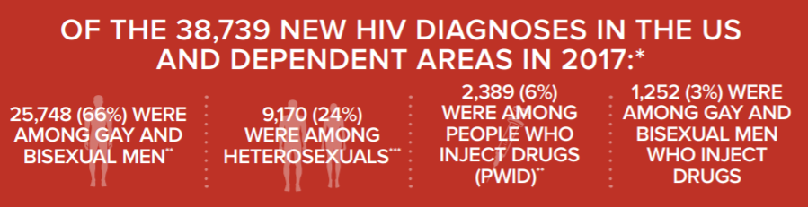
HIV in the U.S. and Dependent Areas
Notes:
This image depicts the breakdown of new HIV diagnoses (in 2017). With regards to the most prevalent transmission category, the majority of new HIV diagnoses were among gay and bisexual men, followed by heterosexual men and women. At the end of 2015, there were an estimated 1,122,900 people living with HIV in the United States.
REFERENCE
Centers for Disease Control and Prevention (CDC). (2019). HIV in the United States and Dependent Areas. Available at: https://www.cdc.gov/hiv/pdf/statistics/overview/cdc-hiv-us-ataglance.pdf.

Slide 51
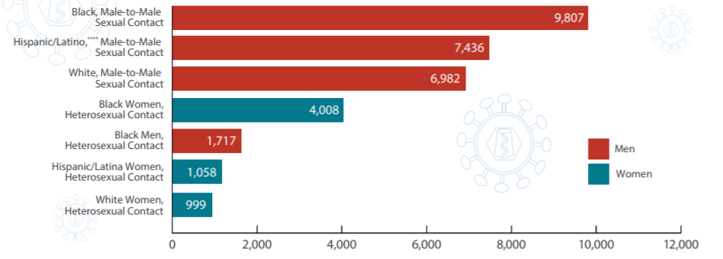
New HIV diagnoses in the U.S. and Dependent Areas for the most affected populations, 2017
Notes:
This graph shows the number of new HIV diagnoses for the most affected sub-populations. The highest numbers were seen among black men who have sex with men (MSM), followed by Hispanic/Latino male-to-male sexual contact, White MSM, and black heterosexual women.
REFERENCE
Centers for Disease Control and Prevention (CDC). (2019). HIV in the United States and Dependent Areas. Available at: https://www.cdc.gov/hiv/pdf/statistics/overview/cdc-hiv-us-ataglance.pdf.

Slide 52
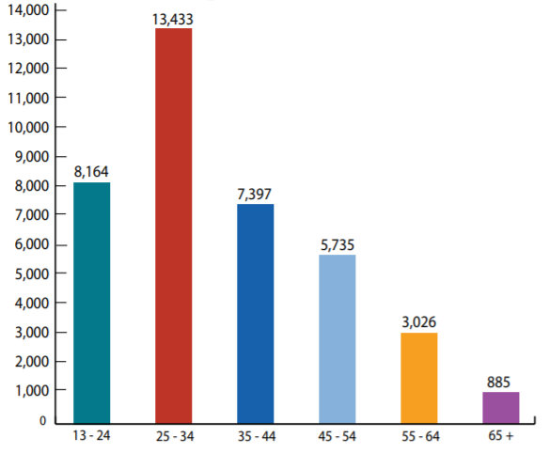
NEW HIV diagnoses by Age in the U.S. and Dependent areas, 2017
Notes:
The age group with the greatest number of new HIV diagnoses was the 25-34 age group, followed by 13-24 year olds and then 35-44 year olds.
REFERENCE
Centers for Disease Control and Prevention (CDC). (2019). HIV in the United States and Dependent Areas. Available at: https://www.cdc.gov/hiv/pdf/statistics/overview/cdc-hiv-us-ataglance.pdf.

Slide 53
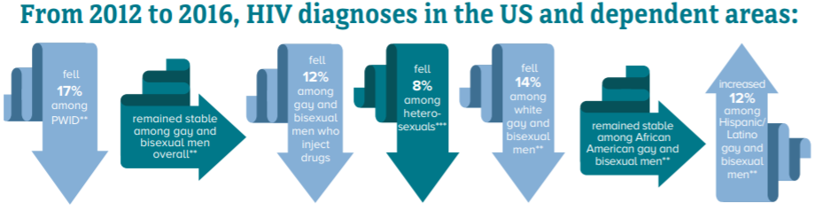
What has happened over time with regards to HIV diagnoses?
Notes:
Reductions were seen in many transmission categories, including among people who inject drugs (PWID), gay and bisexual men who inject drugs, heterosexuals, and white gay and bisexual men. The category in which the number of HIV diagnoses increased was among Hispanic/Latino gay and bisexual men. Diagnoses remained stable among gay and bisexual men overall and among African American gay and bisexual men.
REFERENCE
Centers for Disease Control and Prevention (CDC). (2019). HIV in the United States and Dependent Areas. Available at: https://www.cdc.gov/hiv/pdf/statistics/overview/cdc-hiv-us-ataglance.pdf.

Slide 54
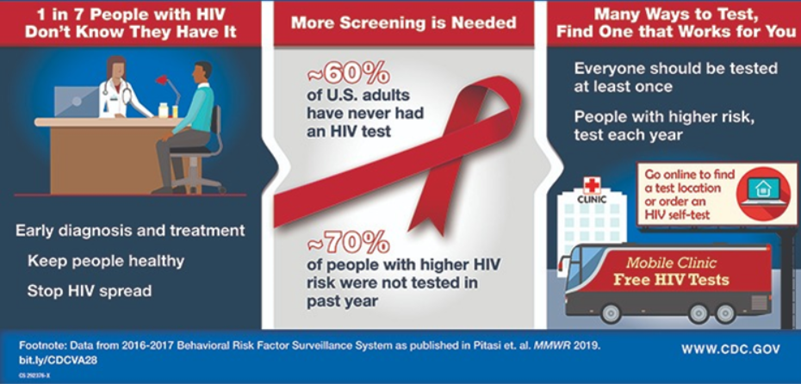
The Importance of HIV testing
Notes:
This CDC infographic presents data on HIV testing gathered as part of the 2016-2017 Behavioral Risk Factor Surveillance System. One in seven people with HIV do not know they are infected with the virus. More screening is needed, as evidenced by the fact that 60% of U.S. adults have never had an HIV test, and 70% of those with higher HIV risk were not tested in the past year. Everyone should be tested at least once in their lives, and those with higher risk should be tested annually.
REFERENCE
Pitasi, M.A., Delaney, K.P., Brooks, J.T., DiNenno, E.A., Johnson, S.D., & Prejean, J. (2019). HIV testing in 50 local jurisdictions accounting for the majority of new HIV diagnoses and seven states with disproportionate occurrence of HIV in rural areas, 2016-2017. MMWR, 68(25), 561-573.

Slide 55
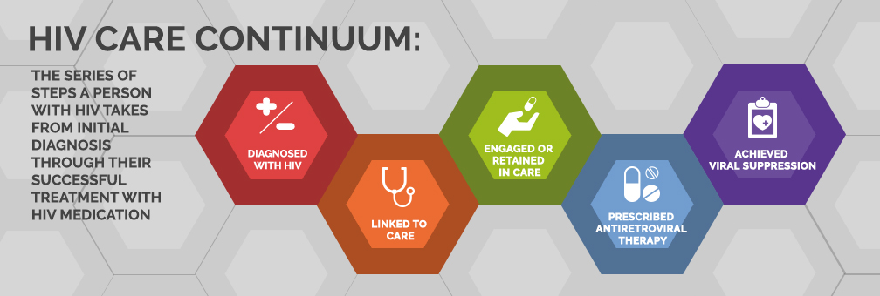
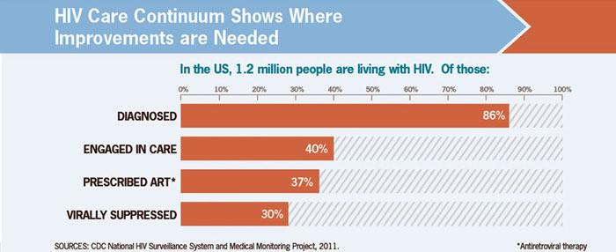
HIV care Continuum
Notes:
The HIV Care Continuum, also known as the HIV Treatment Cascade, is a model developed by Dr. Edward Gardner and colleagues in 2011 that outlines the sequential steps of HIV medical care that people living with HIV go through from initial diagnosis to viral suppression. The top image depicts the care continuum. The bottom image shows where improvements are needed in the care continuum. According to recent data available from the CDC, of the 1.2 million people living with HIV in the U.S. in 2011, 86% were diagnosed, 40% were engaged in HIV medical care, 37% were prescribed ART, and 30% had achieved viral suppression. Stated in another way, only 3 in 10 people living with HIV had the virus under control.
REFERENCE
HIV.gov. (2016). What is the HIV Care Continuum? Available at: https://www.hiv.gov/federal-response/policies-issues/hiv-aids-care-continuum.

Slide 56
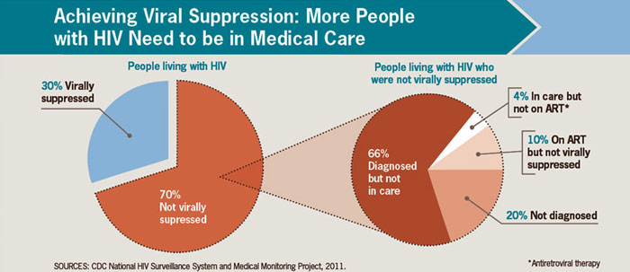
What is needed to achieve viral suppression?
Notes:
In an analysis conducted by the CDC in 2014, among the nearly 840,000 people who had not achieved viral suppression (~70%), 20% did not know they were infected, 66% had been diagnosed but were not engaged in regular HIV medical care, 4% were in HIV care, but not prescribed ART, and 10% had been prescribed ART, but had not yet achieved viral suppression.
“This underscores the importance of continued and intensified efforts to reach more people with testing and to make sure that those with the virus receive prompt, ongoing care and treatment to help them live longer, healthier lives and prevent the spread of HIV to others.”
REFERENCE
HIV.gov. (2016). What is the HIV Care Continuum? Available at: https://www.hiv.gov/federal-response/policies-issues/hiv-aids-care-continuum.

Slide 57
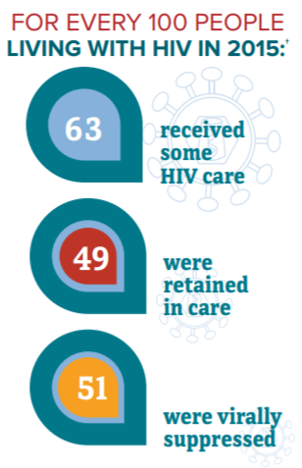
What does more recent data tell us?
Notes:
For every 100 people living with HIV in 2015, 63 received some HIV care; 49 were retained in care; and 51 were virally suppressed. At the end of 2015, there were 1.12 million people living with HIV in the United States. Of those, about 15% had not received a diagnosis (162,500). Young people are most likely to be unaware of their HIV status. In 2016, there were 15,807 deaths among people diagnosed with HIV in the United States.
REFERENCE
Centers for Disease Control and Prevention (CDC). (2019). HIV in the United States and Dependent Areas. Available at: https://www.cdc.gov/hiv/pdf/statistics/overview/cdc-hiv-us-ataglance.pdf.

Slide 58
90-90-90 – An Ambitious Target to End
The AIDS Epidemic By 2020…
90% will know HIV status
90% will receive ART
90% receiving ART will have viral suppression
Notes:
By 2020, 90% of all people living with HIV will know their HIV status. By 2020, 90% of all people with diagnosed HIV infection will receive sustained antiretroviral therapy. By 2020, 90% of all people receiving antiretroviral therapy will have viral suppression.
REFERENCE
UNAIDS. (2017). 90-90-90 – An Ambitious Treatment Target to End the AIDS Epidemic. Available at: https://www.unaids.org/en/resources/documents/2017/90-90-90.

Slide 59
Alcohol and HIV: An overview (1)
Alcohol is common among persons living with HIV
  >50% of persons with HIV consume any amount of alcohol
  In one sample, 27% of people screened positive for unhealthy alcohol use.
Unhealthy alcohol use includes risky or hazardous use, heavy episodic use (e.g., binge drinking) and AUD
Notes:
On July 10, 2019, the U.S. Department of Health and Human Services released Guidelines for the Use of Antiretroviral Agents in Adults and Adolescents with HIV. In a section on considerations for antiretroviral use in special patient populations, key considerations and recommendations were provided for people with SUD and HIV. This slide and the next slide feature those key considerations and recommendations. Additional information is available at: https://aidsinfo.nih.gov/guidelines/html/1/adult-and-adolescent-arv/22/substance-use-disorders-and-hiv.
REFERENCE
U.S. Department of Health and Human Services. (2019). Guidelines for the Use of Antiretroviral Agents in Adults and Adolescents Living with HIV. Downloaded on July 11, 2019 from: https://aidsinfo.nih.gov/guidelines.

Slide 60
Alcohol and HIV: An overview (2)
People who test positive for HIV are nearly twice as likely to use alcohol than people in the general population
Alcohol use can thwart prevention efforts and treatment for those already infected
Alcohol use can impair judgment, leading to high-risk sexual behaviors
Notes:
A complex relationship exists between alcohol use and HIV. Alcohol use is common among people at risk for HIV and has a central modifiable effect on their health outcomes, especially now that those with HIV are living longer with the disease. Up to 50% of adults with HIV infection have a history of alcohol problems (3,4). Alcohol use among people with HIV can affect medication adherence and antiretroviral resistance, as well as increase risky sexual behavior.
Heterosexual sex is now a primary route for HIV transmission. Alcohol use is one of the factors that increases the risk of HIV transmission among heterosexuals. Particularly among women, a strong association has been seen between alcohol and other drug abuse, infection with HIV, and progression to AIDS (5). Although additional studies are needed to further define alcohol use patterns among infected and at-risk people, it is clear that alcohol use is closely intertwined with the spread of HIV.
A history of heavy alcohol use has been correlated with a lifetime tendency toward high-risk sexual behaviors, including multiple sex partners, unprotected intercourse, sex with high-risk partners (e.g., people who inject drug, sex workers), and the exchange of sex for money or drugs (6-9).
Additional Information for the Trainer(s)
People who drink alcohol tend to delay getting tested for HIV and, if they do test positive, tend to postpone seeking treatment. And when receiving HIV treatment, alcohol abusers may have difficulty following a complex medication regimen.
REFERENCES
(1) AIDSinfo. (2019). HIV and Specific Populations. Available at: https://aidsinfo.nih.gov/understanding-hiv-aids/fact-sheets/25/84/hiv-and-drug-and-alcohol-users.
(2) National Institute on Alcohol Abuse and Alcoholism (NIAAA). (2010). Alcohol Alert: Alcohol and HIV/AIDS – Intertwining Stories, Number 80. Rockville, MD: U.S. Department of Health and Human Services.
(3) Lefevre, F., O’Leary, B., Moran, M., et al. (1995). Alcohol consumption among HIV-infected patients. Journal of General Internal Medicine, 10(8), 458-460.
(4) Samet, J.H., Phillips, S.J., Horton, N.J., et al. (2004). Detecting alcohol problems in HIV-infected patients: Use of the CAGE questionnaire. AIDS Research and Human Retroviruses, 20(2), 151-155.
(5) NIAID. (2004). Women’s Health in the United States: Research on Health Issues Affecting Women. NIH Pub. No. 04-4697. Bethesda, MD: Author.
(6) Windle, M. (1997). The trading of sex for money or drugs, sexually transmitted diseases (STDs), and HIV-related risk behaviors among multi-substance using alcoholic inpatients. Drug and Alcohol Dependence, 49(1), 33-38.
(7) Avins, A.L., Woods, W.J., Lindan, C.P., et al. (1994). HIV infection and risk behaviors among heterosexuals in alcohol treatment programs. Journal of the American Medical Association, 271(7), 515-518.
(8) Boscarino, J.A., Avins, A.L., Woods, W.J., et al. (1995). Alcohol-related risk factors associated with HIV infection among patients entering alcoholism treatment: Implications for prevention. Journal of Studies on Alcohol, 56(6), 642-653.
(9) Malow, R.M., Dévieux, J.G., Jennings, T., et al. (2001). Substance-abusing adolescents at varying levels of HIV risk: Psychosocial characteristics, drug use, and sexual behavior. Journal of Substance Abuse, 13, 103-117.

Slide 61
Alcohol use and risky sexual behaviors
Unhealthy alcohol use has been linked to HIV acquisition
  Any alcohol use, unhealthy alcohol use, and alcohol use in sexual contexts were all associated with unprotected sex among persons living with HIV
Unhealthy alcohol use is associated with interruptions in all steps of the HIV care continuum, including lower adherence to ART
Notes:
With regards to the relationship between alcohol use and ART adherence, studies have shown both temporal and dose-related relationships. ART is more likely to be missed on a given drinking day and day after drinking, with a stronger association on heavy/binge drinking days. Studies have also demonstrated an association between unhealthy alcohol use and the loss of durable viral suppression, greater time spent with a viral lode of >1,500 copies/mL after ART initiation, increased risk of viral rebound, lower retention in care, and increased mortality.
Research suggests that people who strongly believe that alcohol enhances sexual arousal and performance are more likely to practice risky sex after drinking. Further, some people deliberately use alcohol during sexual encounters to provide an excuse for socially unacceptable behavior or to reduce conscious awareness of risk.
REFERENCE
U.S. Department of Health and Human Services. (2019). Guidelines for the Use of Antiretroviral Agents in Adults and Adolescents Living with HIV. Downloaded on July 11, 2019 from: https://aidsinfo.nih.gov/guidelines.

Slide 62
How does substance use affect a person living with HIV?
Alcohol and drugs can weaken the immune system
Alcohol and drugs can damage the liver and cause liver disease
Some psychoactive substances can interact with HIV medicines
Alcohol and drug use can make it difficult to take HIV medicines every day
Notes:
Substance use in general can have several negative impacts on a person living with HIV, including a weakened immune system, damage to the liver, interactions with HIV medicines, and issues with adherence to medication regimens.
REFERENCE
AIDSinfo. (2019). HIV and Specific Populations. Available at: https://aidsinfo.nih.gov/understanding-hiv-aids/fact-sheets/25/84/hiv-and-drug-and-alcohol-users.

Slide 63
The importance of monitoring alcohol use among patients living with HIV
Even intermittent use can complicate the clinical management of people living with HIV by:
  Diminishing adherence to medications
  Increasing risk of liver injury
  Reducing the patient’s ability to practice safer sex
  Increasing the risk of side effects from medications
  Changing pharmacokinetics of prescribed medications
Notes:
Clinicians may often miss alcohol problems in patients with clinically stable HIV infection and those without evidence of liver disease, which underscores the importance of screening all patients for alcohol use. The role of the primary care clinician in the management of the patient who abuses alcohol or is dependent on alcohol is as follows: (1) identify the problem; (2) present the diagnosis; (3) work to engage and motivate the patient; and (4) participate in the initiation of treatment and continuum of care.
REFERENCES
Molina, P.E., Simon, L., Amadee, A.M., Welsh, D.A., & Ferguson, T.F. (2018). Impact of alcohol on HIV disease pathogenesis comorbidities and aging; Integrating preclinical and clinical findings. Alcohol and Alcoholism, 53(4), 439-447.
National Institute on Alcohol Abuse and Alcoholism (NIAAA). (2010). Alcohol Alert: Alcohol and HIV/AIDS – Intertwining Stories, Number 80. Rockville, MD: U.S. Department of Health and Human Services.

Slide 64
Alcohol’s effect on HIV virus growth
Alcohol has direct and indirect effects on how the HIV virus develops and how quickly it causes disease
Alcohol can increase how fast the HIV virus replicates, leading to higher amounts of virus (i.e., viral load) in the body
  This can, in turn, increase the spread of disease
  In one study, women receiving ART who drank at least moderately were more likely to have higher levels of HIV, making it easier for them to transmit HIV to others
Notes:
HIV-positive people who drink heavily and who are not on anti-HIV drugs tend to have lower CD4 counts (a measure of immune system function) than moderate drinkers. While the same difference in CD4 count isn’t true for heavy drinkers who are taking anti-HIV drugs, they are more likely to miss doses of their treatment than those who abstain from drinking alcohol.
REFERENCE
National Institute on Alcohol Abuse and Alcoholism (NIAAA). (2010). Alcohol Alert: Alcohol and HIV/AIDS – Intertwining Stories, Number 80. Rockville, MD: U.S. Department of Health and Human Services.

Slide 65
Alcohol, ART, and the Liver
Liver disease is a major cause of illness and death since the advent of ART
ARTs not only are processed in the liver, but also have toxic effects on the organ
A large proportion of people who are living with HIV are also co-infected with hepatitis C
  Alcohol use can significantly increase the risk of liver damage in people with HIV alone or with HCV co-infection
Notes:
Alcohol use has been associated with decreased adherence to anti-retroviral therapy (ART). Studies have varied in the measurement of alcohol consumption, and a dose-response relationship has not been defined; however, hazardous or risky alcohol use has been shown to negatively influence adherence by causing patients to miss doses or take medications off schedule (1-4). In one study, hazardous and binge drinkers were more likely to have detectable viral load (5), which may be attributable to diminished adherence. Alcohol intake is a modifiable risk factor for decreased adherence.
Clinicians should routinely ask patients about alcohol consumption during adherence assessments. Screening for alcohol use can be accomplished with a few simple questions to identify patients who will benefit from further interventions. HIV patients who have liver disease are sometimes with the grim choice of continuing ART to prevent the progression of the virus to AIDS—thereby risking further liver damage—or stopping ART to prevent liver damage and progressing to AIDS.
Research suggests that alcohol may interfere directly with ART medications used for HIV, essentially blocking their effectiveness (6). Moreover, patients who drink are nine times more likely to fail to comply with their medication regimens compared with sober patients (7-8). When HIV-infected drinkers fail to take their medications or do not take them correctly, it can lead to a higher viral load and an increasing likelihood that the virus will become resistant to the therapy.
ART, alcohol consumption, and HIV infection can be harmful in other ways as well. HIV patients typically experience declines in organ function earlier in life than do uninfected people. And because people with HIV tend to drink heavily well into their middle and older years, these organs are even more at risk for injury. For example, both HIV infection and certain types of ART medications increase a person’s risk for heart disease, because they change the balance of different fats—such as cholesterols—in blood, induce inflammation, and affect the blood-clotting process. Both excessive alcohol use and infection with hepatitis C virus further enhance the risk. Also, the medicines used to treat cholesterol problems can be particularly harmful when taken by patients with liver damage from alcohol abuse or hepatitis C virus. Heavy alcohol consumption (more than six drinks per day) has been linked to heart disease in HIV-infected people; thus, stopping or cutting down on their drinking may help to reduce the risk of heart disease (9).
Additional Information for the Trainer(s)
Alcohol can also damage the liver, and a healthy liver is important for the body to process some antiretroviral medicines effectively. The blood fat increases caused by some anti-HIV drugs can be made worse by heavy drinking. There are no significant interactions between any of the currently available anti-HIV drugs and alcohol but alcohol can react badly with certain medicines (e.g. rifampicin, rifabutin, metronidazole). It is important to check with your pharmacist that alcohol is safe to drink with any medicines you are prescribed. All patients with hepatitis C virus (HCV) infection who use alcohol should be educated about the effects of alcohol on the course of HCV and HIV infection. Patients with HCV and heavy alcohol intake have increased progression of hepatic fibrosis and increased risks of cirrhosis, hepatocellular carcinoma, and death.
REFERENCES
(1) National Institute on Alcohol Abuse and Alcoholism (NIAAA). (2010). Alcohol Alert: Alcohol and HIV/AIDS – Intertwining Stories, Number 80. Rockville, MD: U.S. Department of Health and Human Services.
(2) Bryant, K.J., Nelson, S., Braithwaite, R.S., & Roach, D. (2010). Integrating HIV/AIDS and alcohol research. Alcohol Research and Health, 33(3), 167-178.
(3) Braithwaite, R.S. & Bryant, K. (2010). Influence of alcohol consumption on adherence to and toxicity of antiretroviral therapy and survival. Alcohol Research and Health, 33(3), 280-287.
(4) Braithwaite, R.S., McGinnis, K.A., Conigliaro, J., et al. (2005). A temporal and dose-response association between alcohol consumption and medication adherence among veterans in care. Alcoholism: Clinical and Experimental Research, 29(7), 1190-1197.
(5) Barve, S., Kapoor, R., Moghe, A., Ramirez, J.A., Easton, J.W., Gobejishvili, L., Joshi-Barve, S., & McClain, C.J. Focus on the liver: Alcohol use, highly active antiretroviral therapy, and liver disease in HIV-infected patients. Alcohol Research and Health, 33(3), 229-236.
(6) Pandrea, I., Happel, K.I., Amedee, A.M., Bagby, G.J., & Nelson, S. (2010). Alcohol’s role in HIV transmission and disease progression. Alcohol Research and Health, 33(3), 203-218.
(7) Palepu, A., Tyndall, M.W., Li, K., et al. (2003). Alcohol use and incarceration adversely affect HIV-1 RNA suppression among injection drug users starting antiretroviral therapy. Journal of Urban Health, 80(4), 667-675.
(8) Parsons, J.T., Rosof, E., & Mustanski, B. (2008). The temporal relationship between alcohol consumption and HIV-medication adherence: A multilevel model of direct and moderating effects. Health Psychology, 27(5), 628-637.
(9) Freiburg, M.S. & Kraemer, K.L. (2010). Focus on the heart: alcohol consumption, HIV infection, and cardiovascular disease. Alcohol Research and Health, 33(3), 237-246.

Slide 66
The impact of Alcohol and HIV on the lungs
Patients who drink alcohol or who are living with HIV are more likely to suffer from pneumonia and to have chronic conditions such as emphysema
Lung infections remain a major cause of illness and death in those living with HIV
  Chronic alcohol consumption has been found to increase the rate at which viruses infect the lungs and aid in the emergence of opportunistic infections
Notes:
Scientists do not yet know if alcohol and HIV together raise the risk for injury to the lung. However, studies using animals suggest that this combination does indeed increase the risk for problems. Lung infections remain a major cause of illness and death in those with HIV. Opportunistic infections are rare viruses that infect only people whose immune systems are weakened by a condition like HIV infection.
REFERENCES
National Institute on Alcohol Abuse and Alcoholism (NIAAA). (2010). Alcohol Alert: Alcohol and HIV/AIDS – Intertwining Stories, Number 80. Rockville, MD: U.S. Department of Health and Human Services.
Quintero, D. & Guidot, D.M. (2010). Focus on the lung. Alcohol Research and Health, 33(3), 219-228.
Bagby, G.J., Stoltz, D.A., Zhang, P., et al. (2003). The effect of chronic binge ethanol consumption on the primary stage of SIV infection in rhesus macaques. Alcoholism: Clinical and Experimental Research, 27, 495-502.

Slide 67
The impact of Alcohol and HIV on the brain
In studies comparing patients with and AUD, HIV infection, or both, people with an AUD had more changes in the brain structure and abnormalities in brain tissue than those with HIV alone
Patients with HIV infection and an AUD were especially likely to have difficulty remembering and experiencing problems with coordination and attention
Those with AUD whose HIV infection progressed to AIDS had the greatest changes in brain structure
Notes:
Advances in imaging techniques have revealed another organ at risk for HIV and alcohol injury—the brain. Alcohol can act directly on the brain to reduce inhibitions and diminish risk perception. Alcohol may also increase the severity of AIDS-related brain damage, which is characterized in its severest form by profound dementia and a high death rate.
REFERENCES
National Institute on Alcohol Abuse and Alcoholism (NIAAA). (2010). Alcohol Alert: Alcohol and HIV/AIDS – Intertwining Stories, Number 80. Rockville, MD: U.S. Department of Health and Human Services.
Fauci, A.S. & Lane, H.C. (2001). Human immunodeficiency virus (HIV) disease: AIDS and related disorders. In: Braunwald, E.; Fauci, A.S.; Kasper, D.L.; et al. (Eds.). Harrison’s Principles of Internal Medicine, 15th Edition. New York, NY: McGraw-Hill, pp. 1852-1913.
Meyerhoff, D.J. (2001). Effects of alcohol and HIV infection on the central nervous system. Alcohol Research & Health 25(4), 288-298.

Slide 68
Indirect effects of alcohol on increasing HIV risk
Alcohol consumption often occurs in bars an clubs where people meet potential sex partners
High-risk sexual behaviors make people who use alcohol more likely to be infected with other sexually transmitted infections; increasing susceptibility to HIV infection
People who use alcohol are more likely to use other illicit substances, which can involve other risky behaviors such as needle sharing
Notes:
This slide reviews several possible indirect effects of alcohol on increasing HIV risk, including the settings in which alcohol is often abused, the high-risk behaviors that coincide with the abuse of alcohol, and the use of alcohol in combination with other illicit substances and prescription medications.
REFERENCES
National Institute on Alcohol Abuse and Alcoholism (NIAAA). (2010). Alcohol Alert: Alcohol and HIV/AIDS – Intertwining Stories, Number 80. Rockville, MD: U.S. Department of Health and Human Services.
Cooper, M.L. (2002). Alcohol use and risky sexual behavior among college students and youth: Evaluating the evidence. Journal of Studies on Alcohol (Suppl. 14), 101–117.
MacDonald, T.K., MacDonald, G., Zanna, M.P., &Fong, G.T. (2000). Alcohol, sexual arousal, and intentions to use condoms in young men: Applying alcohol myopia theory to risky sexual behavior. Health Psychology 19(3), 290–298.
Fromme, K., D’Amico, E., & Katz, E.C. (1999). Intoxicated sexual risk taking: An expectancy or cognitive impairment explanation? Journal of Studies on Alcohol 60(1), 54–63.

Slide 69
The impact of Alcohol consumption on the survival of individuals living with HIV
Non-hazardous alcohol consumption decreased survival by more than one year if the frequency of consumption was once per week or greater and by 3.3 years with daily consumption
Hazardous alcohol consumption decreased overall survival by more than 3 years if frequency was once per week or greater and by 6. 4 years with daily consumption
Notes:
Alcohol consumption is associated with decreased antiretroviral adherence, and decreased adherence results in poorer outcomes. However the magnitude of alcohol’s impact on survival is unknown. Our objective was to use a calibrated and validated simulation of HIV disease to estimate the impact of alcohol on survival. Braithwaite and colleagues incorporated clinical data describing the temporal and dose-response relationships between alcohol consumption and adherence in a large observational cohort (N=2,702). Individuals were categorized as nondrinkers (no alcohol consumption), hazardous drinkers (consume 5 or more standard drinks on drinking days), and nonhazardous drinkers (consume less than 5 standard drinks on drinking days). The results suggest that alcohol is an underappreciated yet modifiable risk factor for poor survival among individuals with HIV.
REFERENCE
Braithwaite, R.S., Conigliaro, M.S., Roberts, M.S., Shechter, S., Shaefer, A., McGinnis, K., Rodriguez, M.C., Rabeneck, L., Bryant, K., & Justice, A.C. (2007). Estimating the impact of alcohol consumption on survival for HIV individuals. AIDS Care, 19(4), 459-466.

Slide 70
Alcohol treatment as HIV prevention
Decreasing alcohol use among patients living with HIV can reduce medical and psychiatric consequences associated with alcohol consumption
  It can also decrease other drug use and HIV transmission
SBIRT for alcohol is an integral part of clinical care for people living with HIV
Bottom line – alcohol treatment can be considered primary HIV prevention
Notes:
Excessive drinking within the HIV-infected population is associated with numerous adverse effects; thus, interventions to prevent alcohol misuse in this population are urgently needed. Decreasing alcohol use among HIV patients not only reduces the medical and psychiatric consequences associated with alcohol consumption but also decreases other drug use and HIV transmission. Thus, alcohol and other drug abuse treatment can be considered primary HIV prevention as well.
REFERENCE
National Institute on Alcohol Abuse and Alcoholism (NIAAA). (2010). Alcohol Alert: Alcohol and HIV/AIDS – Intertwining Stories, Number 80. Rockville, MD: U.S. Department of Health and Human Services.

Slide 71
Medications for HIV infection
The current goals for the use of medications to treat HIV are to:
  Control the growth of the virus
  Improve overall immune system function and status
  Suppress symptoms
  Produce as few side effects as possible
Notes:
Doctors recommend a combination of HIV drugs from at least two of the main classes. This combination is called highly active antiretroviral therapy (HAART). It helps combat new resistant strains of the virus that emerge as HIV makes copies of itself. HAART also decreases the rate of opportunistic infections.

Slide 72
Considerations for antiretroviral use in special patient populations: SUD and HIV (1)
Persons with SUD and HIV should be screened for additional mental health disorders
Persons with HIV and SUDs should be offered evidence-based pharmacotherapy as part of comprehensive HIV care
Ongoing substance use is NOT a contraindication to ART
Persons who use alcohol and/or drugs CAN achieve and maintain viral suppression with ART
Notes:
On July 10, 2019, the U.S. Department of Health and Human Services released Guidelines for the Use of Antiretroviral Agents in Adults and Adolescents with HIV. In a section on considerations for antiretroviral use in special patient populations, key considerations and recommendations were provided for people with SUD and HIV. This slide and the next slide feature those key considerations and recommendations. Additional information is available at: https://aidsinfo.nih.gov/guidelines/html/1/adult-and-adolescent-arv/22/substance-use-disorders-and-hiv.
REFERENCE
U.S. Department of Health and Human Services. (2019). Guidelines for the Use of Antiretroviral Agents in Adults and Adolescents Living with HIV. Downloaded on July 11, 2019 from: https://aidsinfo.nih.gov/guidelines.

Slide 73
Considerations for antiretroviral use in special patient populations: SUD and HIV (2)
Substance use may increase:
  Likelihood of risk-taking behaviors
  Potential for drug-drug interactions
  Risk of severity of substance-associated toxicities
Selection of ART regimen should take potential adherence barriers, comorbidities which could impact care, potential drug-drug interactions, and possible adverse events into account
ART regimens with once-daily dosing of single-tablet regiments, high barriers to resistance, low hepatotoxicity, and low potential for drug-drug interactions are preferred
Notes:
On July 10, 2019, the U.S. Department of Health and Human Services released Guidelines for the Use of Antiretroviral Agents in Adults and Adolescents with HIV. In a section on considerations for antiretroviral use in special patient populations, key considerations and recommendations were provided for people with SUD and HIV. This slide and the previous slide feature those key considerations and recommendations. Additional information is available at: https://aidsinfo.nih.gov/guidelines/html/1/adult-and-adolescent-arv/22/substance-use-disorders-and-hiv.
REFERENCE
U.S. Department of Health and Human Services. (2019). Guidelines for the Use of Antiretroviral Agents in Adults and Adolescents Living with HIV. Downloaded on July 11, 2019 from: https://aidsinfo.nih.gov/guidelines.

Slide 74
Case study #1
A 25-year old African American patient recently tested positive for HIV and has come to your office for assistance in developing an ongoing care plan. She discloses that she just moved in with her older girlfriend in South LA. She has a history of experimenting with “some drugs,” but no regular use, and drinks 2-3 beers several nights a week.
What additional information do you need to know?
What services are most important to initiate her care?
Notes:
INSTRUCTIONS
Read the case study aloud. Ask participants to break into pairs or small groups (depending on the size of the audience), and spend 5-10 minutes discussing the questions. De-brief as a full group for 5-10 minutes. Ask for volunteers to briefly share responses to the two questions.

Slide 75
Part 4A – Assessing for alcohol use among your patients living with HIV
Notes:
TRANSITION SLIDE
This next section of the presentation (Part 4A) features information on screening, brief intervention, and referral to treatment (SBIRT).

Slide 76
SBIRT: An Evidence-based practice
Screening, Brief Intervention, and Referral to Treatment (SBIRT) is a comprehensive, integrated, public health approach to the delivery of early intervention and treatment services. It is used to identify:
  People who may be using alcohol and/or drugs at risky levels
  People who may already have an alcohol/substance use disorder
Screening is useful for everyone
Brief intervention has been shown to be effective for unhealthy alcohol use
Notes:
SBIRT has the potential to save lives and reduce costs. It is estimated that unhealthy and unsafe alcohol and drug use result in more than 100,000 deaths each year, and costs to society are more than $600 billion annually.
SBIRT includes screening for both alcohol and drug use; supports the view that behavioral health is part of one’s overall health; and follows a population health approach that emphasizes prevention and early intervention. And although brief intervention for other substances has not been proven effective, it has been suggested that BI may need to be conducted over the course of many more visits in order to be effective.

Slide 77
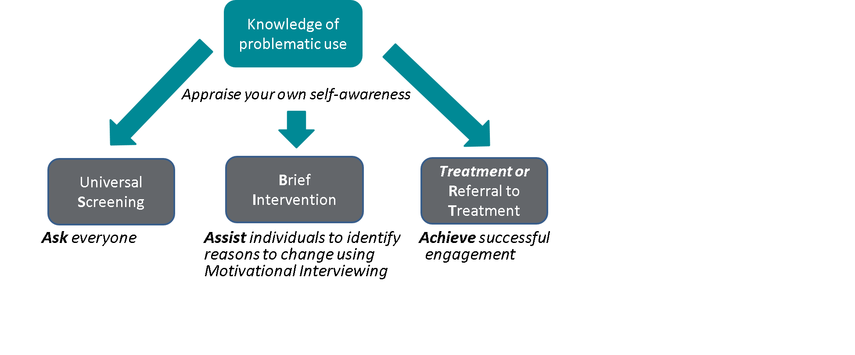
What are the SBIRT Core competencies?
Notes:
In summary, SBIRT consists of a few basic competencies. Ask everyone. Don’t assume you know who is engaging in risky use. Might it be the middle aged pastor, the 65 year retired teacher, or the 22 y/o medical student? Assist individuals to identify reasons to change using MI techniques. I know you heard about MI in the previous ECHO, but we’ll do a quick review of how MI is used in SBIRT in a moment. Achieve successful engagement- whether to pursue a treatment plan or not – according to the patient’s choice. And in order to do all of this, we all have to become better informed about what constitutes problematic use and to reflect on our own self-awareness- because the better we understand our own beliefs and emotional responses to risky alcohol use, the better able we will be to intervene effectively.

Slide 78
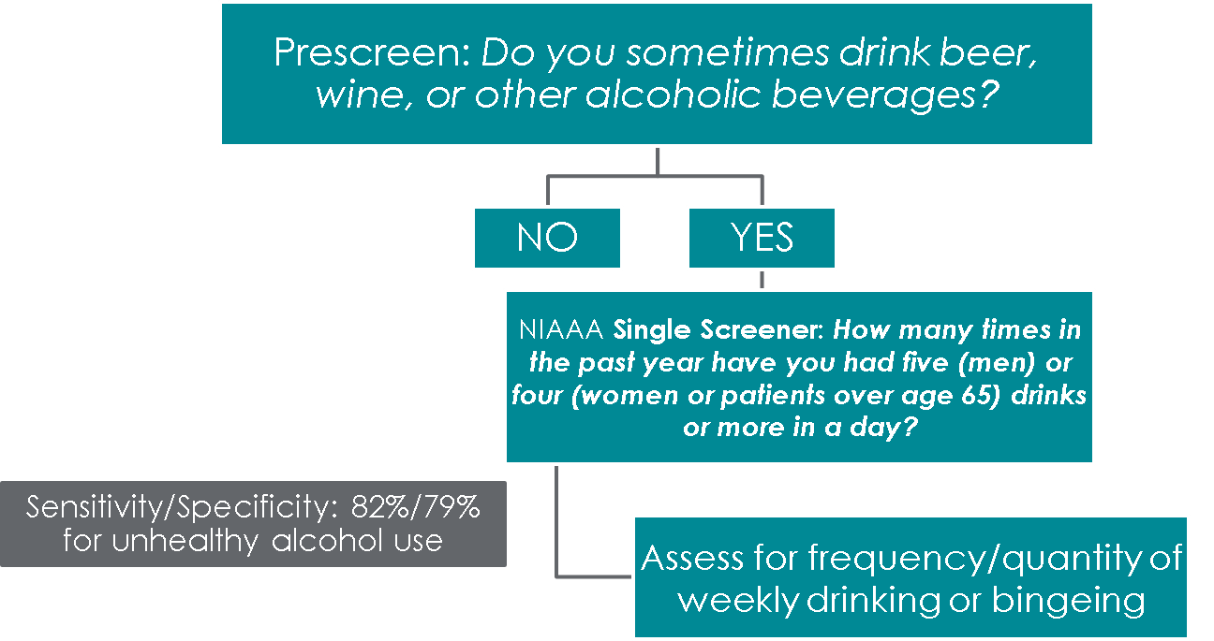
One-item alcohol PRE-screen
Notes:
NIAAA developed a single-item screener to detect risky drinking, which has been validated and is used in many different primary care settings throughout the United States.
In medical diagnosis, test sensitivity is the ability of a test to correctly identify those with the disease (true positive rate), whereas test specificity is the ability of the test to correctly identify those without the disease (true negative rate).
REFERENCE
Smith, P.C., Schmidt, S.M., Allensworth-Davies, D., & Saitz, R. (2009). Primary care validation of a single-question alcohol screening test. J Gen Intern Med 24(7), 783-788.

Slide 79
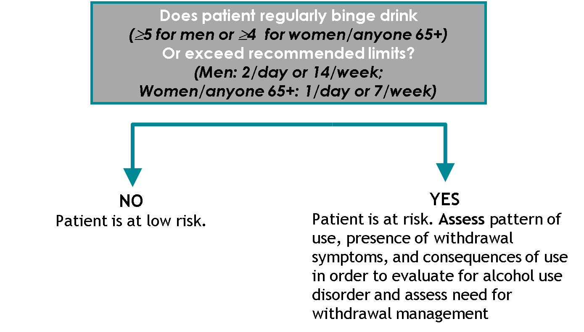
What happens next?
Notes:
Many people are surprised by how few drinks can increase a person’s risk of developing a variety of health problems. These guidelines come from NIAAA and are based on studies looking at what level of alcohol intake is associated with increased risk for harm. If risky use is detected then assess for alcohol use disorder/risk for withdrawal syndrome. AUDIT (Alcohol Use Disorders Identification Test) can be helpful for data gathering. The AUDIT consists of 10 questions- self-administered or through an interview and addresses recent alcohol use, alcohol dependence symptoms, and alcohol-related problems.

Slide 80
AUDIT – Alcohol Screener
10-question alcohol use screening instrument (scores for each question range from 0-4)
Originally developed for use in primary care, but can also be used in mental health settings, HIV clinics, school counseling centers, etc.
Score | Level | Action
0-7 | Low | Encouragement
8-15 | Low/Moderate | BI
16-19 | Moderate | BI/Brief Treatment
20+ | High | BI/Referral to Tx
Notes:
The Alcohol Use Disorders Identification Test (AUDIT) was developed in the 1980s to identify alcohol use, abuse, and possible dependence. The AUDIT has 10 questions. It has been validated for use with diverse groups of people. It was originally designed for use in primary care settings, but can be used in mental health and college/university campus settings, as well.
Like most screens, the AUDIT gives you a score. The table on the slide provides action steps to take based on the score. The scores correlate to risk levels (low, moderate, and high). For example, a score of 0 to 7 is considered low risk and the appropriate response from the provider is to tell the patient he/she is at low risk, which is great. They should then encourage them to continue these low-risk behaviors. Scores between 8 and 19 suggests low to moderate risk. People in this risk range should receive a brief intervention focused on lowering their risk. People at the higher end of the moderate risk range—people who score 16 to 19—should be given a brief intervention and possibly the opportunity for brief treatment, which means additional counseling sessions. Again the goal is to help them to identify strategies to lower their risk of developing problems. A person at the very high end, with a score of 20 or higher, may have alcohol dependence. This person needs a referral to specialized care. A brief intervention should be conducted, but now the focus should be on helping the person to choose to accept and follow through on a referral to treatment.
A self-report version of the AUDIT is available at: https://www.drugabuse.gov/sites/default/files/files/AUDIT.pdf.

Slide 81
Conducting a brief intervention
F
Feedback
Set the stage and provide screening results
L
Listen and Understand
Explore pros and cons, explain importance of change, assess readiness to change
O
Options Explored
Discuss change options and plan for follow-up
Notes:
This slide depicts an outline of the three steps of the FLO brief intervention and what happens at each step.
You start the conversation with Feedback, which involves giving patients their screening results and explaining what the results mean.
Listen and Understand is where you get into the motivational interviewing work of exploring the meaning of patients’ substance use, the pros and cons of using (also known as the decisional balance), and the important concern patients’ bring to the visit (which may or may not be substance use). During this step, you also assess what kinds of changes patients want to make and their level of readiness.
Lastly, Options Explored is where you discuss options that patients themselves identify to support change. You always want to encourage a follow up appointment so that we can check on the patients’ progress and provide support.

Slide 82
Let’s Practice!
Part 1 “Repeat After Me”
Notes:
Total length of activity = 20-25 minutes (7-10 minutes for each role play and 5-6 minutes for the debrief.
INSTRUCTIONS:
Break into pairs and refer to the handout you received when you arrived at the training this morning. In the first part of the exercise, one person will role play an HIV provider (medical assistant, nurse, care manager, etc.) and the second person will role play a patient. For this part, please refer to the “Repeat After Me” section of the handout. Like in a play, read the script exactly as it is written.
The intention of part 1 is to give you practice getting comfortable screening for and talking with your patients about their alcohol use, and how this use may impact their HIV care.

Slide 83
Now try it without a script!
Part 2 “In Your Own Words”
Notes:
Total length of activity = 20-25 minutes (7-10 minutes for each role play and 5-6 minutes for the debrief.
INSTRUCTIONS:
For this part, please refer to the “In Your Own Words” section of the handout. You’ll notice that instead of reading from a detailed script, you will need to follow the outline and repeat the exercise using your own words.
The intention of part 2 is to give you even more practice getting comfortable screening for and talking with your patients about their alcohol use, and how this use may impact their HIV care. Over time, it will become easier for you to use your own words to explore alcohol use and its impact on HIV treatment with your patients.
After part 2, spend a few minutes facilitating a full-group debrief with the audience. What did they like about this activity? What was challenging? How might they incorporate screening practices into their daily clinical work?

Slide 84
Treatment referrals
Approximately 5% of patients screened will require referral to more formal substance use assessment and treatment
A “warm hand-off” approach to referrals is most effective
Facilitate hand-off by:
  Calling to make appointment for patient
  Providing directions and clinic hours
  Coordinating transportation when needed
Notes:
Approximately 5% of patients screened will score in the high-risk range for a potential substance use disorder. These patients have experienced serious medical, social, legal, or interpersonal problems associated with their substance use. Even though these patients have serious issues with substance use, it is still advisable to conduct a brief intervention with these patients before making a referral to specialty care. The reason for this is that the brief intervention can help the patient become more open to making a change. In order to help patients initiate treatment for substance use disorders, clinicians need to take an active role in the referral process. By “warm hand-off” we mean that clinicians make the transition to the treatment facility as smooth as possible for the patient.

Slide 85
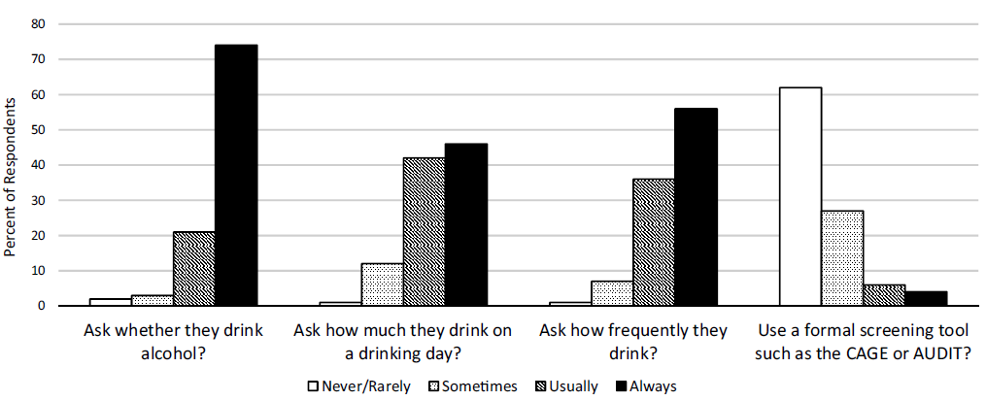
Alcohol screening practices among HIV Primary care providers
Notes:
In 2016, Chander and colleagues published an article on screening, knowledge, and behaviors related to alcohol interventions among HIV primary care providers. When you look at the data related to alcohol screening practices, you see that the majority of providers who responded to the cross-sectional survey always ask their patients whether they drink alcohol. That’s the good news. A smaller percentage always ask how much the drink on a drinking day and how frequently they drink. The bad news, or the area in which HIV primary care providers could use the most improvement, is in the use of a validated screening tool, such as the AUDIT. The majority of providers who responded to the survey rarely or never use a validated screening instrument. In fact, only 10% usually or always used a validated screening tool.
REFERENCE
Chander, G., Monroe, A.K., Crane, H.M., Hutton, H.E., Saag, M.S., Cropsey, K., Eron, J.J., et al. (2016). HIV primary care providers – Screening, knowledge, attitudes and behaviors related to alcohol interventions. Drug and Alcohol Dependence, 161, 59-66.

Slide 86
Part 4B – Effective behavioral treatment interventions for alcohol use disorders
Notes:
TRANSITION SLIDE
The following section (Part 4B) pertains to effective behavioral treatment interventions for alcohol use disorders. Behavioral treatments help engage people in substance use disorders treatment, modifying their attitudes and behaviors related to alcohol and other drug use and increasing their life skills to handle stressful circumstances and environmental cues that may trigger intense craving for alcohol and drugs and prompt another cycle of compulsive use. Moreover, behavioral therapies can help people remain in treatment longer. Behavioral interventions—particularly, cognitive-behavioral therapy—have been shown to be effective for decreasing alcohol and drug use and preventing relapse. Length of time in treatment is the #1 predictor of a successful treatment experience. The longer you can keep a person engaged in treatment, the more likely he/she is to be successful. Treatment must be tailored to the individual patient’s needs in order to optimize outcomes—this often involves a combination of treatment, social supports, and other services. Early engagement techniques should be utilized to ensure that the client comes back for his/her group and individual sessions.

Slide 87
Behavioral interventions
It is imperative that pharmacotherapies are
paired with some form of evidence-based
behavioral therapeutic intervention
Notes:
It is critical to emphasize that pharmacotherapies that are FDA-approved for treatment of alcohol use disorder should be used in conjunction with psycho-social-educational-spiritual therapy. Therefore, medications can be used as a part of treatment, but only one part.

Slide 88
Individualized treatment planning
Treatment teams must evaluate the appropriateness of including pharmacotherapies into a patient’s individualized treatment plan
Many factors contribute to a patient’s individualized treatment plan, and sometimes medications are not appropriate for all patients or situations
Notes:
Treatment planning involves a series of steps or special considerations, including: (1) information gained during an initial assessment –physical history, treatment history, ability to manage medications; (2) role of the prescriber – does the patient have an existing relationship with a prescriber? Can the patient be appropriately monitored during treatment? Are there other medications that will interact?; (3) fits with the patient – effectiveness and treatment goals; (4) current level and type of substance abuse – interactions with other substances; (5) treatment compliance – previous experience with other pharmacotherapies and psychosocial therapy; and (6) ability to pay – insurance coverage, out-of-pocket, Medicare/ Medicaid, etc.

Slide 89
Behavioral approach #1:
Contingency Management (CM)
Also known as Motivational Incentives
May be particularly useful for helping patients achieve initial abstinence
Some programs use a voucher-based system to give positive rewards for staying in treatment and remaining abstinent
  Based on negative urine screens or attendance, patients earn points that can be exchanged for items that encourage healthy living, such as joining a gym, going grocery shopping, or going to dinner and a movie
Notes:
Contingency management is a tool to enhance treatment and facilitate recovery, and is used as an adjunct to other therapeutic clinical methods. CM targets specific behaviors that are part of a patient treatment plan. CM helps to celebrate the success of behavioral changes chosen by therapist and patient. CM can be used to help motivate patients through stages of change to achieve an identified goal.

Slide 90
Behavioral approach #2:
Cognitive Behavioral Therapy (CBT)
Relapse Prevention
Underlying assumption – learning processes play an important role in the development and continuation of an AUD/SUD
CBT attempts to help patients recognize the situations in which they are most likely to use alcohol/drugs, avoid these situations when appropriate, and cope more effectively with a range of problems and behaviors associated with use of substances
CBT is compatible with a range of other treatment interventions, such as pharmacotherapy
Notes:
CBT seeks to help patients recognize, avoid, and cope with the situations in which they are most likely to abuse drugs. Thoughts cause feelings and behaviors, not external things, like people, situations, and events. You can change the way we think to feel / act better even if the situation does not change.

Slide 91
Behavioral approach #3:
Therapeutic communities (TC)
Residential programs with planned lengths of stay of 6-12 months
A focus on re-socialization of the individual; can include vocational rehabilitation and other supportive services
Variation exists with regards to the types of therapeutic processes offered in TCs
Notes:
Peer influence is used to help individuals learn and assimilate social norms and develop more effective social skills. Treatment staff and those in recovery are key agents of change. The second fundamental TC principle is "self-help," which implies that the individuals in treatment are the main contributors to the change process.

Slide 92
Behavioral Approach #4:
Motivational Interviewing (MI)
“A collaborative conversation style for strengthening a person’s own motivation and commitment to change.”
The overall style of MI is guiding, which lies between directing and following styles
Ambivalence is a normal part of preparing for change
People are more likely to be persuaded by what they hear themselves say
Notes:
Compared with non-directive counseling, motivational interviewing is more focused and goal-directed. The examination and resolution of ambivalence is its central purpose, and the counselor is intentionally directive in pursuing this goal.
REFERENCE
Miller, W.R., & Rollnick, S. (2012). Motivational Interviewing: Helping People Change, 3rd Edition. New York, NY: Guilford Press.

Slide 93
Basic MI principles and micro-Skills
Principles
  Express empathy
  Develop discrepancy
  Roll with resistance
  Support self-efficacy
Micro-Skills
  Open-Ended Questioning
  Affirmations
  Reflective Listening
  Summarizing
Notes:
The strategic goals of MI are to: (a) resolve ambivalence; (b) avoid eliciting or strengthening resistance; (c) elicit “Change Talk” from the client; (d) enhance motivation and commitment for change; and (e) help the client move through the Stages of Change. A series of MI micro-skills (which will be described on the next slide) can be used to move a patient/client through the Stages of Change to elicit and reinforce self-motivational statements (a.k.a., Change Talk).
Empathy may be the most crucial principle. It creates an environment conducive to change, instills a sense of safety and a sense of being understood and accepted, and reduces defensiveness. Empathy sets the tone within which the entire communication occurs. Without it, other components may sound like mechanical techniques. By developing discrepancy, the clinician can help the client to become more aware of the discrepancy between their addictive behaviors and their more deeply-held values and goals. Part of this is helping client to recognize and articulate negative consequences of use. It is more effective if the client does this, not the clinician.
With regards to rolling with resistance, in general, it is not helpful to argue with clients. Confrontation elicits defensiveness, which predicts a lack of change. It is particularly counter-therapeutic for a clinician to argue that there is a problem while the client argues that there isn’t one. The client does not need to accept a diagnostic label (e.g. “addict” or “alcoholic”) for change to occur.
Supporting self-efficacy can be conceptualized as a specific form of optimism, that is, a “can-do” belief in one’s ability to accomplish a particular task or change. This principle is crucial to help the client see and experience his/her own ability to make positive changes. Part of this is the clinician believing in the client’s ability to change.
Open-ended questions: (a) solicits information in a neutral way; (b) helps the person elaborate his/her own view of the problem and brainstorm possible solutions; (c) helps the therapist avoid prejudgments; (d) keeps communication moving forward; (e) allows the client to do most of the talking.
Affirmations should be focused on achievements of the individual, and are intended to: (a) support the individual’s persistence; (b) encourage continued efforts; (c) assist the individual in seeing the positive in the situation; and (d) support the individual’s proven strengths.
With reflective listening, one should: (a) listen to both what the person says and to what the person means; (b) check out assumptions; (c) create an environment of empathy (nonjudgmental); and (d) be aware of intonation (statement, not question). The clinician does not have to agree with the client.
Summaries capture both sides of the ambivalence (You say that ___________ but you also mentioned that ________________.) They demonstrate the clinician has been listening carefully. Summaries also prompt clarification and further elaboration from the person. They prepare clients to move forward.
REFERENCE
Miller, W.R., & Rollnick, S. (2012). Motivational Interviewing: Helping People Change, 3rd Edition. New York, NY: Guilford Press.

Slide 94
Behavioral Approach #5:
12-Step Facilitation Therapy
An active engagement strategy to:
  Increase likelihood of an individual becoming affiliated with and actively involved in 12-step self-help program
  Promote abstinence from alcohol and other drugs
Involves three key aspects:
  Acceptance
  Surrender
  Active Involvement
Notes:
Acceptance includes the realization that drug addiction is a chronic, progressive disease over which one has no control, that life has become unmanageable because of drugs, that willpower alone is insufficient to overcome the problem, and that abstinence is the only alternative. Surrender involves giving oneself over to a higher power, accepting the fellowship and support structure of other recovering addicted individuals, and following the recovery activities laid out by the 12-step program. While the efficacy of 12-step programs (and 12-step facilitation) in treating alcohol dependence has been established, the research on other abused drugs is more preliminary but promising for helping drug abusers sustain recovery. Twelve-step meeting dates, times, and locations can be found by visiting: http://www.aa.org (Alcoholics Anonymous); www.ca.org (Cocaine Anonymous); www.na.org (Narcotics Anonymous).
REFERENCES
Donovan D.M. & Wells E.A. (2007). Tweaking 12-step: The potential role of 12-Step self-help group involvement in methamphetamine recovery. Addiction, 102(Suppl. 1), 121-129.
Carroll, K.M., Nich, C., Ball, S.A., McCance, E., Frankforter, T.L., & Rounsaville, B.J. (2000). One-year follow-up of disulfiram and psychotherapy for cocaine and alcohol users: Sustained effects of treatment. Addiction 95(9), 1335-1349.
Project MATCH Research Group. (1997). Matching alcoholism treatments to client heterogeneity: Project MATCH posttreatment drinking outcomes. Journal of Studies on Alcohol, 58(1), 7-29.

Slide 95
Part 4C – Effective medical treatment interventions for alcohol use disorders
Notes:
TRANSITION SLIDE
The following section (Part 4C) pertains to effective medical treatment interventions for alcohol use disorder. Medication assisted treatment (MAT) is any alcohol use disorder treatment that includes an FDA-approved medication for the detoxification or maintenance treatment of alcohol use disorder. MAT may be provided in an Narcotic Treatment Program (NTP)/Opioid Treatment Program (OTP), a medication unit affiliated with a NTP/OTP, a physician’s office, or another health care setting. It includes comprehensive maintenance, medical maintenance, interim maintenance, detoxification, and medically supervised withdrawal. MAT increases the likelihood for cessation of alcohol.

Slide 96

The use of medicines to treat AUD – what do you think? – question 1
My patients should have access to medicines to treat their alcohol use disorder.
  True
  False
Notes:
INSTRUCTIONS
This series of four questions is meant to gauge the beliefs (and potential bias) that the audience may have as it relates to medications for alcohol use disorders. Read the question and possible responses.
Medication can be an effective part of treatment. The idea that medications cannot be a part of substance use disorder treatment is held both by some treatment programs and by some individual practitioners. The reality is that medications are used in the treatment of many chronic, relapsing diseases, including SUD. Medical decisions must be made by trained and certified medical providers. It is important to remember that it is beyond the scope of practice for most substance use disorder treatment providers to make specific recommendations about the use of medications. All medical decisions should be made by a medical provider who has received specific training for the treatment of these conditions. Lastly, decisions about the use of medications should be based on an objective assessment of the individual client’s needs.
Additional Information for the Trainer(s)
The pharmacotherapies that are FDA-approved for treatment of alcohol and opioid use disorders should be used in conjunction with psycho-social-educational-spiritual therapy. Therefore, medications can be used as a part of treatment, but only one part.
It is important to emphasize the fourth key point. It is beyond the scope of practice for most substance use disorder treatment providers to make specific recommendations about medications. All medical decisions should be made by a medical provider who has received specific training for the treatment of these conditions.
IMAGE CREDIT
Purchased Image, Adobe Stock, 2019.

Slide 97
The use of medicines to treat AUD – what do you think? – question 2
Medications are drugs and you cannot be in recovery if you are taking any.
  Strongly disagree
  Disagree
  Neutral
  Agree
  Strongly agree
Notes:
INSTRUCTIONS
This series of four questions is meant to gauge the beliefs (and potential bias) that the audience may have as it relates to medications for alcohol use disorders. Read the question and possible responses.
The SUD treatment field needs to change its terminology to reflect current trends. “Drugs” are illicit psychoactive substances that are used to achieve a “high.” “Medications,” on the other hand, are available by prescription and are used to treat an illness, disorder, or disease. For example, millions of Americans use Zyban or nicotine patches to quit smoking, and this practice is widely encouraged by SUD treatment professionals. The goal of SUD treatment is to assist a person in stopping his or her compulsive use of drugs or alcohol and live a normal, functional life. If appropriately administered, medication-assisted treatment for SUD will not produce euphoric effects. Clinical data suggest that clients perform better in treatment when psycho-social-educational-spiritual therapy is combined with appropriate pharmacotherapies. This myth relates to the previous myth and is one of the reasons that people believe that medications should not be a part of treatment. It is CRITICAL to emphasize that there is a difference between physical dependence on a substance and addiction. Anyone who takes certain kinds of medications (opioids, certain blood pressure meds, etc.) for an extended period of time will become physically dependent on the medication. This means that they will have withdrawal symptoms if they suddenly stop taking it. This does not mean that they are “addicted.”
IMAGE CREDIT
Purchased Image, Adobe Stock, 2019.

Slide 98
The use of medicines to treat AUD – what do you think? – question 3
Alcoholics Anonymous and Narcotics Anonymous do not support the use of medicines for AUD.
  Strongly disagree
  Disagree
  Neutral
  Agree
  Strongly agree
Notes:
INSTRUCTIONS
This series of four questions is meant to gauge the beliefs (and potential bias) that the audience may have as it relates to medications for alcohol use disorders. Read the question and possible responses.
AA/NA literature and founding members did not speak or write against using medications. In fact, AA/NA endorses participants to use medicines as prescribed for the treatment of medical conditions. In Chapter 9 of the Big Book, it says: “But this does not mean that we disregard human health measures. God has abundantly supplied this world with fine doctors, psychologists, and practitioners of various kinds. Do not hesitate to take your health problems to such persons. Most of them give freely of themselves, that their fellows may enjoy sound minds and bodies. Try to remember that though God has wrought miracles among us, we should never belittle a good doctor or psychiatrist. Their services are often indispensable in treating a newcomer and in following his case afterward.” [Chapter 9, p. 133 (emphasis added)].
Additional Information for the Trainer(s)
This is the 1996 NA bulletin about methadone (available at: http://www.na.org/?ID=bulletins-bull29). It seems to indicate that people who attend NA meetings on methadone treatment should not speak and cannot lead meetings. Some NA groups are hostile to methadone treatment.
IMAGE CREDIT
Purchased Image, Adobe Stock, 2019.

Slide 99
The use of medicines to treat AUD – what do you think? – question 4
Medications for AUD are not effective.
  Strongly disagree
  Disagree
  Neutral
  Agree
  Strongly agree
Notes:
INSTRUCTIONS
This series of four questions is meant to gauge the beliefs (and potential bias) that the audience may have as it relates to medications for alcohol use disorders. Read the question and possible responses.
MAT is believed to be less effective than the research suggests, partly because our experience is based on the cases we’ve seen. The classic Clinician’s Illusion results from seeing "prevalence" sample – those currently with disease. The probability that a case will appear in a prevalence sample is proportional to its duration, thus clinicians thus biased toward cases of long duration and therefore greater intractability. In correctional settings we tend to be exposed most to severe cases and relapsers who return often (“frequent flyers”). Patients who get better generally do not return to these settings. This situation produces a cognitive bias (availability bias) in which our pessimism is formed by remembering severe cases who relapse and return. (SOURCE: NIDA, Treatment Approaches for Drug Addiction, retrieved from http://www.nida.nih.gov/Infofacts/TreatMeth.html). Formal clinical trials research has demonstrated the efficacy of each of the medications that have been FDA approved for addiction treatment. Some of this data will be reviewed during the remainder of this training. We tend to have a biased perception that patients who improve, leave the program and are forgotten, while those patients who do not improve return frequently and are remembered. This perception leads us to think that most patients do not improve…contrary to scientific data.
IMAGE CREDIT
Purchased Image, Adobe Stock, 2019.

Slide 100
How can we treat alcohol use disorders medically?
Medications for alcohol use disorders can:
  Reduce post-acute withdrawal
  Block or ease euphoria from alcohol
  Discourage drinking by creating an unpleasant association with alcohol
Notes:
FDA-approved medications that are used to treat alcohol use disorders can help to reduce the agitation associated with post-acute withdrawal, block the pleasurable effects of alcohol, or discourage drinking by making the making the person sick if they drink.

Slide 101
FDA-Approved Medication #1: Disulfiram
Marketed under the trade name of Antabuse®
Approved by the FDA in 1951
Indication: An aid in the management of selected chronic alcohol patients who want to remain in a state of enforced sobriety
Discourages drinking by making the patient physically ill when alcohol is consumed
Not addictive; no reports of misuse
Notes:
Disulfiram was approved by the FDA in 1951. It works by maintaining a state of enforced sobriety. It does this by making the individual sick of they consume alcohol. Disulfiram has no known addictive properties and there have been no reports of misuse.
Disulfiram is covered by most major insurance carriers, Medicare, Medicaid, and the VA. The dosing is one 250-mg tablet once per day; can be crushed, diluted, or mixed with food. It must be taken at least 12 hours after the last use of alcohol.

Slide 102
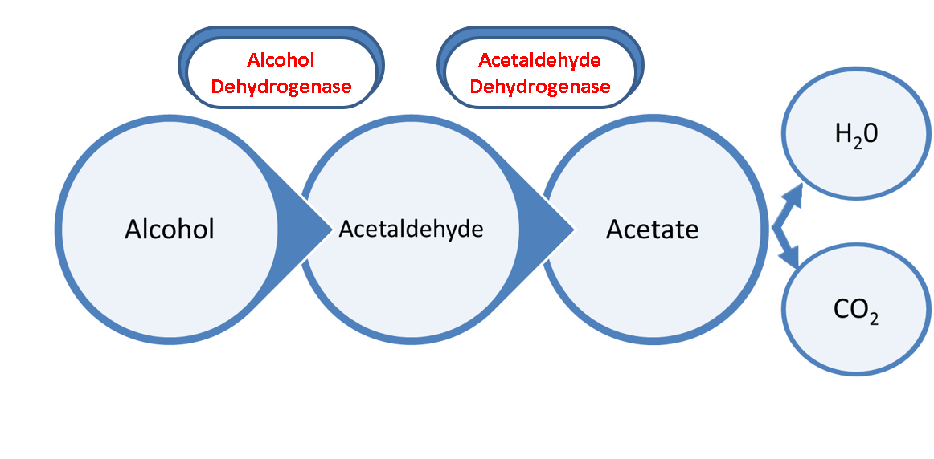
How does disulfiram work (1)?
Disulfiram works by blocking the enzyme acetaldehyde dehydrogenase
This causes acetaldehyde to accumulate in the blood at 5 to 10 times higher the amount than would normally occur with alcohol alone
Disulfiram-alcohol reaction
Notes:
When an individual drinks alcohol, it is broken down in three stages. First, the enzyme Alcohol Dehydrogenase converts alcohol into Acetaldehyde. Acetaldehyde is actually a toxic compound and therefore must be broken down further and eliminated. This occurs through the enzyme acetaldehyde dehydrogenase. It converts that acetaldehyde into acetate. Finally, Acetate is converted into water and carbon dioxide and eliminated from the body.
Disulfiram works by blocking the effect of acetaldehyde dehydrogenase. This causes a build of up the toxic acetaldehyde to levels 5-10 times greater than would normally occur of alcohol was breaking down normally. Since acetaldehyde is poisonous, a build-up of it produces a highly unpleasant series of symptoms, which is commonly referred to as the “disulfiram-alcohol reaction.” This reaction can be serious, and lead to respiratory suppression, heart attack, convulsions, and even death.

Slide 103
How does disulfiram work (2)?
As long as there is alcohol in the blood, the disulfiram-alcohol reaction will continue
Symptoms are usually fully developed when the patient’s blood alcohol concentration is 50mg per 100 mL, but mild reactions can occur in sensitive patients with level as low as 5-10mg per 100 mL
The disulfiram-alcohol reaction can be triggered when alcohol is consumed 1-2 weeks after the last dose of medication was taken
Notes:
It’s important to note that this reaction will continue for as long as there is alcohol remaining in the blood. The symptoms can occur in some very sensitive patients even with extremely low concentrations of alcohol. The reaction will also continue for 1-2 weeks following the last dose of disulfiram.
Generally, the severe reaction lasts 30-60 minutes, but it can continue for hours depending on how much alcohol is consumed. Because the disulfiram-alcohol reaction is potentially dangerous, it should never be administered to someone who has recently used alcohol. Additionally, patients should be warned against the use of other substances that contain alcohol such as cough syrup or tonics. Environmental exposure to cologne or perfume, solvents, paint or paint thinner, nail polish remover and similar substances may also case the person to become sick.

Slide 104
What does the research say about disulfiram?
Participants treated with disulfiram did not maintain complete abstinence more frequently than those treated with placebo
Participants treated with disulfiram had a greater reduction in the number of drinking days during the entire study than those treated with placebo
According to a 2014 meta-analysis, based on open-label studies, disulfiram is a safe and efficacious treatment for alcohol use disorder
Notes:
Previous research demonstrated that when compared to placebo, individuals receiving disulfiram were NOT more likely to maintain complete abstincence during the trial—probably because patients test themselves to see of alcohol does indeed make them sick. Results do demonstrate that those receiving disulfirm had fewer drinking days during the study, demonstrating its efficacy in helping people stay way from alcohol.
According to a 2014 meta-analysis conducted by Skinner and colleagues, they found that ”blinded studies were incapable of distinguishing a difference between treatment groups, and thus were incompatible with disulfiram research. Based on results with open-label studies, disulfiram is a safe and efficafious treatment compared to other abstinence supportive pharmacological treatments or to no disulfiram in supervised studies for problems of alcohol abuse or dependence.”
REFERENCE
Skinner, M.D., Lahmek, P., Pham, H., & Aubin, H.J. (2014). Disulfiram efficacy in the treatment of alcohol dependence: a meta-analysis. PloS one, 9(2), e87366. doi:10.1371/journal.pone.0087366

Slide 105
FDA-Approved Medication #2: Acamprosate
Marketed under the trade name of Campral®
Approved by the FDA in 2004
Indication: For the maintenance of abstinence from alcohol in patients with alcohol use disorder who are abstinent at treatment initiation by reducing post-acute withdrawal symptoms
Not addictive; no reports of misuse
Notes:
Acamprosate was approved in 2004 for the maintenance of abstinence by reducing post-acute withdrawal symptoms. It has no known addictive properties.
Acamprosate is covered by most major insurance carriers, Medicare, and Medicaid. The VA will cover the medication, but only if naltrexone is contraindicated for the patient. Forest Laboratories also offers a patient assistance program for those who cannot afford the medication. Dosing may be an issue for some patients. It requires taking two fairly large tablets three times per day. The tablets have a coating on them that allows them to pass through the stomach intact and then release the medication in the small intestines.

Slide 106
How does Acamprosate Work?
Acamprosate is thought to be a glutamate receptor modulator
When a person stops drinking, glutamate continues to behave normally; because there is no alcohol present, this activity is way too high for normal functioning – resulting in acute alcohol withdrawal
After acute withdrawal is resolved, it takes time for glutamate to return to normal levels
Acamprosate helps to dampen the effects of glutamate and to help the individual feel more normal (e.g., less anxious/agitated)
Notes:
It is not known exactly how acamprosate works, but it is thought be a glutamate receptor modulator. To understand what this means, let’s review how alcohol works. When alcohol is repeatedly consumed the depressive effects of alcohol are counteracted by increasing the glutamate receptors. This energizes the system and counteracts the alcohol present in the system.
When alcohol is not present in the person’s body, glutamate behaves normally. Since there are more glutamate receptors and no alcohol to counteract it, glutamate activity skyrockets. The normal balance between inhibitory and excitatory neurotransmitters is altered, resulting in alcohol withdrawal.
After the acute withdrawal is resolved, it takes time for the glutamate to return to normal levels. During that time, the individual continues to feel anxious and agitated. This is a frequent source of relapse for individuals. Acamprosate helps to dampen the effects of glutamate and to help the individual feel more normal.
Acamprosate is thought to reduce the amount of glutamate released, and reduce the activity of the glutamate receptors. It does so both by reducing the release of glutamate from the pre-synaptic nerve terminal, and by reducing the overactivation of glutamate receptors post-synaptically. Acamprosate “cushions” the brain against the stimuli and symptoms that often lead to relapse. In an individual who is committed to abstinence, this can make the difference between success and failure in avoiding relapse.

Slide 107
What does the research say about Acamprosate?
Participants treated with acamprosate were able to maintain complete abstinence more frequently than those treated with placebo
Participants treated with acamprosate had a greater reduction in the number of drinking days during the entire study than those treated with placebo
In the studies, participants treated with acamprosate were able to regain complete abstinence after one relapse more frequently than those treated with placebo
Notes:
Four studies were considered by the FDA in approving acamprosate for use. In summary, when compared to placebo, individuals treated with acamprosate were able to maintain complete abstinence throughout the trial more frequently. They had a greater reduction in the total number of drinking days during the trial, and among those who had a relapse, those treated with acamprosate were able to regain complete abstinence after only one relapse more frequently.
REFERENCES
Mason, B.J., Goodman, A.M., Chabac, S., & Lehert, P. (2006). Effect of oral acamprosate on abstinence in patients with alcohol dependence in a double-blind, placebo-controlled trial: The role of patient motivation. Journal of Psychiatric Research, 40, 383-393.
Pelc, I., Verbanck, P., Le Bon, O., et al. (1997). Efficacy and safety of acamprosate in the treatment of detoxified alcohol-dependent patients: A 90-day placebo-controlled dose-finding study. British Journal of Psychiatry, 171, 73-77.
Sass, H., Soyka, M., Mann, K., & Zieglgansberger, W. (1996). Relapse prevention by acamprosate: Results from a placebo-controlled study on alcohol dependence. Archives of General Psychiatry, 53, 673-680.
Paille, F.M., Guelfi, J.D., Perkins, A.C., et al. (1995). Double-blind randomized multicentre trial of acamprosate in maintaining abstinence from alcohol. Alcohol, 30, 239-247.

Slide 108
FDA-Approved Medication #3: Naltrexone
Marketed under the trade name of Revia® or Depade®
Approved by the FDA in 1994 (for AUD)
Indication: Used in the treatment of alcohol or opioid use disorder and for the blockage of the effects of exogenous administered opioids and/or decreasing the pleasurable effects experienced by consuming alcohol
Has not been found to be addictive or produce withdrawal symptoms when medication is discontinued
Notes:
Naltrexone hydrochloride is approved for the treatment of alcohol or opioid use disorder and works by blocking the effects of opioids and reducing the pleasurable effects of alcohol. It has no known addictive properties, but should only be administered to individuals who are abstinent from opioids (as administering naltrexone will invoke opioid withdrawal symptoms in patients who are physically dependent on opioids).
Naltrexone is covered by most public and private insurers. Dosing requires taking one pill once per day and it can be crushed and/or mixed with food. Abstinence from opioids for at least 7-10 days is essential to avoid causing withdrawal symptoms. Abstinence from alcohol is not required prior to initiation.

Slide 109
How does naltrexone work?
Naltrexone works as an opioid receptor antagonist and blocks opioid receptors
This prevents the effects of self-administered opioids
It also diminishes the release of dopamine when alcohol is consumed, thus reducing the pleasurable effects
Naltrexone has been shown to reduce alcohol priming (e.g., increased desire to drink), which may reduce likelihood of heavy drinking
Notes:
Naltrexone works as an opioid receptor antagonist. This means that it binds strongly to the opioid receptor. It does not cause an effect at the receptor site and block other opioids from stimulating the receptors. This prevents intoxicating effects from self-administered opioids. It also diminishes the pleasurable effects of alcohol.

Slide 110
What does the research say about naltrexone?
Participants treated with naltrexone were not able to maintain complete abstinence more frequently than those treated with placebo
Participants treated with naltrexone had a greater reduction in relapse during the study than those treated with placebo
Naltrexone reduces the risk of re-imprisonment and lowers the risk of opioid use with or without psychological support
Notes:
Research on using naltrexone for alcohol, demonstrated that when compared to placebo, naltrexone users were not able to maintain complete abstinence more frequently, but it did result in a great reduction in overall use during the course of the study.
Studies of naltrexone have demonstrated that use of naltrexone reduces the risk of returning to opioid use and lowers the risk of re-imprisonment. Compliance is often an issue for patients, however. Providers should work with patients receiving the medication to develop strategies to increase medication compliance. By using the injectable form of the medication, compliance issues are reduced, due to the fact that once the injection is given, it continues to be clinically effective for a month.
The primary side effect from the use of naltrexone is nausea (especially for the injectable form). However, tolerance usually develops quickly for this side effect. Generally, patients tolerated the medication well and people on active medication had lower rates of opioid use that those receiving placebo. Additional improvements in the treated group include lower use of CNS depressants , improved legal status, and lowered psychiatric symptoms.
REFERENCES
O'Malley, S.S. (1995). Strategies to maximize the efficacy of naltrexone for alcohol dependence. In L.S. Onken, J.D. Blaine, & J.J. Boren (Eds.). Integrating Behavioral Therapies with Medications in the Treatment of Drug Dependence, National Institute of Drug Abuse Monograph #150, NIH Publication No. 95-3899. Bethesda, MD: National Institutes of Health, pp. 53–64.
Volpicelli, J.R., Alterman, A.I., Hayashida, M., & O'Brien, C.P. (1992). Naltrexone in the treatment of alcohol dependence. Archives of General Psychiatry 49, 876–880.

Slide 111
FDA-Approved medication #4: Extended-Release naltrexone
Marketed under the trade name of Vivitrol®
Approved by the FDA in 2006 (for AUD)
Indication: Blocks the euphoric effects of opioids; reduce the number of days of heavy drinking
Blocks opioid receptors for one entire month; it is not possible to remove it from the body once it has been injected
Notes:
Extended-release injectable naltrexone was approved in 2006 to treat patients with an alcohol use disorder, and in 2010 to treat patients with an opioid use disorder. The medication provides the opportunity for patients to take it once a month, as opposed to daily dosing required by some of the medications. The dose is one 380-mg injection deep in the muscle of the buttock. It must be administered by a healthcare professional and should alternate buttocks each month.
The medication the blocks the opioid receptors for 4 weeks—this would require 28 doses of oral naltrexone. Once it is in, there is no way to remove it. Therefore, the person is prevented from experiencing the effects of opioids and/or alcohol.

Slide 112
How does Extended-Release naltrexone work?
It works in the brain exactly like oral naltrexone
It blocks opioid receptors for one entire month compared to 28 doses of oral naltrexone
Notes:
Naltrexone works as an opioid receptor antagonist. This means that it binds strongly to the opioid receptor. It does not cause an effect at the receptor site and block other opioids from stimulating the receptors. This prevents intoxicating effects from self-administered opioids. It also diminishes the pleasurable effects of alcohol.
REFERENCE
SAMHSA. (2012). SAMHSA Advisory: An Introduction to Extended-Release Injectable Naltrexone for the Treatment of People with Opioid Dependence. Available at: https://www.integration.samhsa.gov/Intro_To_Injectable_Naltrexone.pdf.

Slide 113
What does the research say about extended-release Naltrexone?
Participants did not maintain complete abstinence more frequently than those receiving placebo
Participants had a greater reduction in the number of heavy drinking days than those receiving placebo
Participants with a 7-day abstinence period from alcohol prior to treatment initiation had a greater reduction in the number of heavy drinking days than those receiving placebo
Notes:
Research on the extended release formulation of naltrexone, demonstrated that when compared to placebo, patients receiving the medication. Did not maintain complete abstinence more frequently, but they did have a greater reduction in the total number of drinking days/opioid use. When used for alcohol, those with a 7-day abstinence period prior to the first injection had fewer heavy drinking days.
During the clinical trials, there was an increase in suicidal ideation (but not attempts) noted in patients receiving the extended release naltrexone. Counselors working with these patients should closely monitor for suicidal ideation. Additionally, if opioids are required for pain relief (in the case of emergency, for instance), it will require significantly more and the patient is likely to need respiratory support. Patients receive naltrexone in either oral or injectable form should be encouraged to carry an information card documenting that they are receiving the medication.

Slide 114
Medications for AUD and Potential Interaction with ARV medications
Medication | Potential Interaction with ARV Medications | Comments
Acamprosate | No significant interactions with ARV medications expected | Contraindicated in patients with CrCl <30mL/min
Disulfiram | Use with caution when prescribing an ARV oral solution that contains ethanol and/or propylene glycol | Counsel patients regarding disulfiram reaction when taken with alcohol
Naltrexone | No significant interactions with ARV medications expected | Has the greatest efficacy of all FDA-approved medications for AUD
Notes:
This table includes the three FDA-approved medications for the treatment of alcohol use disorder and the corresponding potential interactions with anti-retroviral medications. Of note is disulfiram, in that you should use with caution when prescribing ARV oral solution that contains ethanol and/or propylene glycol.
REFERENCE
U.S. Department of Health and Human Services. (2019). Guidelines for the Use of Antiretroviral Agents in Adults and Adolescents Living with HIV. Downloaded on July 11, 2019 from: https://aidsinfo.nih.gov/guidelines.

Slide 115
Case study #2
A 23-year old Latino male reports a series of unprotected sexual encounters following episodes of binge drinking. He comes to you for help. Upon further discussion, it is discovered that the patient drinks large amounts of alcohol daily (5-7 standard drinks), and increases consumption on the weekend. The patient was recently diagnosed with an alcohol use disorder and was released from medical detox yesterday.
What are the critical issues that need to be addressed?
Should an FDA-approved medication be considered? If so, which medication do you think might be most appropriate?
Notes:
INSTRUCTIONS
Read the case study aloud. Ask participants to break into pairs or small groups (depending on the size of the audience), and spend 5-10 minutes discussing the questions. De-brief as a full group for 5-10 minutes. Ask for volunteers to briefly share responses to the two questions.

Slide 116
Concluding thoughts
Notes:
TRANSITION SLIDE
This final section of the presentation features take-home points for clinicians, key resources, and post-test questions to gauge key learning among training participants.

Slide 117
Take home points for clinicians (1)
Know you local resources (SUD treatment facilities, 12-step meetings, etc.)
Remember that alcohol use disorder is treatable and every clinic visit is an opportunity for intervention and prevention messages
Encourage patients and staff to discuss the challenges of alcohol use and remind patients of the importance of continued HIV care
Notes:
It is important to be familiar with local resources, including substance use disorders treatment facilities, 12-step meetings, and mental health resources. Alcohol use impacts the user’s brain and body, but can be treated. Continue to dialogue with patients about their alcohol use and the importance of continued HIV care.
Additional Information for the Trainer(s)
Patients with an alcohol use disorder should be engaged in a treatment programs. HIV clinicians should be familiar with local resources for SUD/AUD treatment and related psychiatric care, including inpatient or residential treatment, outpatient treatment, and support groups such as Alcoholics Anonymous. In addition, clinicians should assess for potential withdrawal symptoms. Clinicians should also consider the use of pharmacotherapy if warranted. Medications are available that target neurotransmitters involved in the reinforcing effects of alcohol use. Pharmacotherapy for AUD in combination with behavioral counseling can reduce relapse and help maintain abstinence. HIV clinics offer a number of advantages as a site for alcohol pharmacotherapy. These clinics are involved in long-term patient care, are generally characterized by integration of a variety of specialty services (e.g., psychiatric and ob/gyn services), and have access to funding for prescription medications. Further, many HIV clinics use intensive case management models that promote outreach to and retention of patients who are often challenging to treat.

Slide 118
Take home points for clinicians (2)
Offer patients an HIV test as regular part of medical care
Offer patients STI testing and treatment services
Prescribe ART as needed to make sure the amount of HIV virus is as low as possible
Make sure people living with HIV get continued medical care
Provide HIV prevention counseling to patients and refer to other prevention services (e.g., partner counseling) as needed
Notes:
It is important to be familiar with local resources, including substance use disorders treatment facilities, 12-step meetings, and mental health resources. Alcohol abuse impacts the user’s brain and body, but can be treated. Continue to dialogue with patients about their alcohol use and the importance of continued HIV care.

Slide 119
Alcohol overdose danger signs and tips for acting quickly
Be prepared to provide information to first responders (e.g., amount and type of alcohol consumed)
Do not leave an intoxicated person alone
Help a person who is vomiting
Stay alert
Notes:
If you suspect that someone has had an alcohol overdose, call 911 immediately. This slide presents practical tips for you to consider as you wait for first responders to arrive.
REFERENCE
NIAAA. (2018). Understanding the Dangers of Alcohol Overdose. Available at: https://www.niaaa.nih.gov/sites/default/files/publications/overdoseFact_2018.pdf.

Slide 120
What did you learn?
Notes:
The purpose of the following four questions is to see how much the audience learned about the factual questions that were first queried at the beginning of the training.
IMAGE CREDIT
Purchased Image, n.d.

Slide 121

What did you learn? – question 1
At-risk drinking levels are the same, regardless of the drinker’s age or gender:
  True
  False
Notes:
ANSWER KEY
#1 – correct response is B (False)
IMAGE CREDIT
Purchased Image, Adobe Stock, 2019.

Slide 122
What did you learn? – question 2
The four main neurotransmitters relevant to alcohol are:
  Dopamine, serotonin, GABA, and glutamate
  Serotonin, GABA, endorphin, and norepinephrine
  Endogenous opioids, glutamate, GABA, and dopamine
  Endogenous opioids, glutamate, endorphin, and norepinephrine
Notes:
ANSWER KEY
#2 – correct response is C (Endogenous opioids, glutamate, GABA, and dopamine)
IMAGE CREDIT
Purchased Image, Adobe Stock, 2019.

Slide 123
What did you learn? – question 3
Nationwide, binge drinking rates are higher among men than women:
  True
  False
Notes:
ANSWER KEY
#3 – correct response is A (True)
IMAGE CREDIT
Purchased Image, Adobe Stock, 2019.

Slide 124
What did you learn? – question 4
Decreasing alcohol use among HIV patients can reduce which of the following:
  Medical and psychiatric consequences of alcohol consumption
  Other drug use
  HIV transmission
  All of the above
Notes:
ANSWER KEY
#4 – correct response is D (All of the above)
IMAGE CREDIT
Purchased Image, Adobe Stock, 2019.

Slide 125
What did you learn? – question 5
The goal(s) of effective medication-assisted treatment for alcohol use disorder should be:
  Short-term stabilization and withdrawal
  A treatment of last resort
  Ongoing maintenance
  A and C
  None of the above
Notes:
ANSWER KEY
#5 – correct response is D (A and C)
IMAGE CREDIT
Purchased Image, Adobe Stock, 2019.

Slide 126
Thank you for your time
For more information:
  Beth Rutkowski: brutkowski@mednet.ucla.edu
  Thomas E. Freese: tfreese@mednet.ucla.edu
  Tom Donohoe: tdonohoe@mednet.ucla.edu
  Pacific Southwest ATTC: http://www.psattc.org
  Pacific AETC website: http://paetc.org/
  PAETC online course site: https://hivtrainingcdu.remote-learner.net/
  MINT website: http://www.motivationalinterview.org
Notes:
FINAL SLIDE
This concludes the presentation. Thank the participants for their time and address any last-minute questions about the content. Encourage participants to reach out to the Pacific Southwest ATTC or Pacific AETC, should they have questions or concerns following the training session.
Prepared in 2019 by: Pacific Southwest Addiction Technology Transfer Center
11075 Santa Monica Boulevard, Suite 200
Los Angeles, California 90025
T: (310) 267-5408
F: (310) 312-0538
pacificsouthwestca@attcnetwork.org
At the time of writing, Thomas E. Freese, Ph.D. served as the Principal Investigator and Director of the HHS Region 9, Pacific Southwest Addiction Technology Transfer Center, based at UCLA Integrated Substance Abuse Programs and Beth A. Rutkowski, MPH served as Co-Director of the HHS Region 9, Pacific Southwest Addiction Technology Transfer Center. Humberto M. Carvalho, MPH, served as the ATTC Government Project Officer. Dr. Louis Trevisan currently serves as Director of the Center for Substance Abuse Treatment, Substance Abuse and Mental Health Services Administration. The opinions expressed herein are the views of the authors and do not reflect the official position of the Pacific Southwest ATTC/SAMHSA-CSAT. No official support or endorsement of the Pacific Southwest ATTC/SAMHSA-CSAT for the opinions described in this document is intended or should be inferred.

