Slide 1
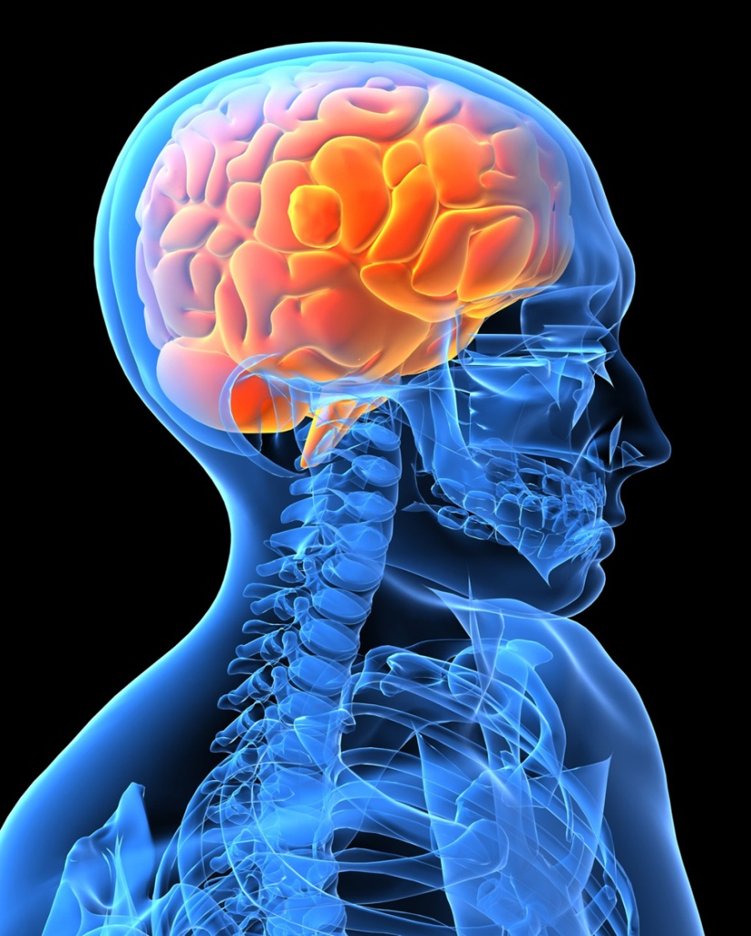
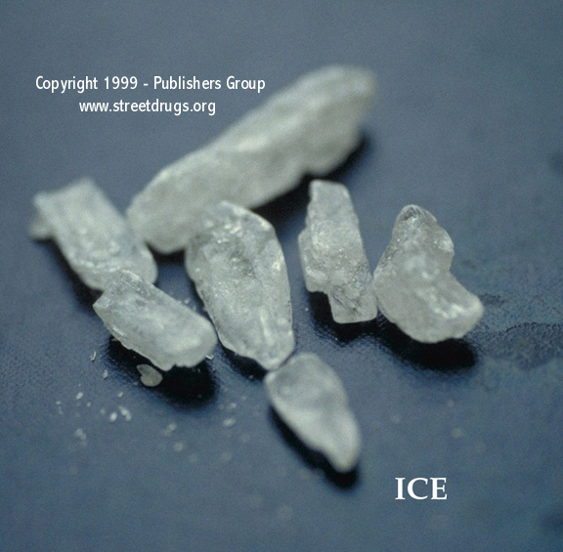
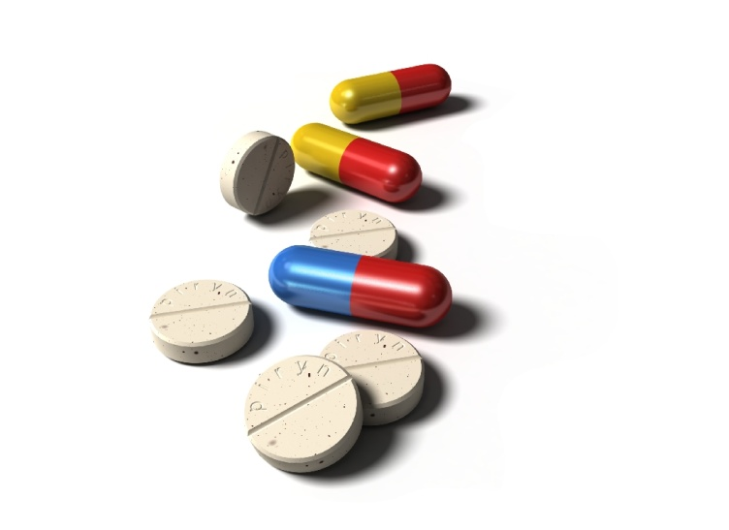
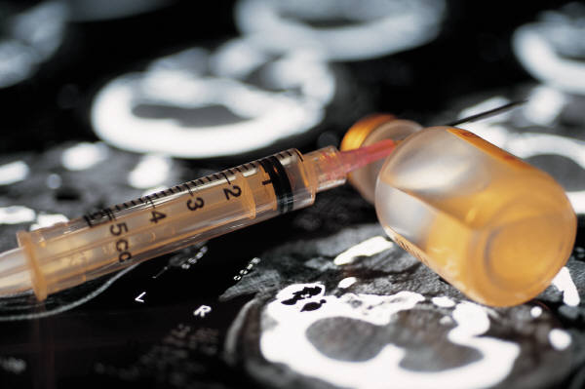
Stimulant Use Among Patients on Medication for Opioid Use Disorder (MOUD): Do We Have Any Answers?
Richard Rawson, Ph.D.
Professor Emeritus, UCLA Integrated Substance Abuse Programs
Research Professor, University of Vermont
December 6, 2018

Slide 2
Disclosures
I have no conflicts of interest to disclose.

Slide 3
Agenda
Stimulant Use Among Patients on Medication for Opioid Use Disorder (MOUD) – Richard Rawson, Ph.D.
Addressing Stimulant Use in Clinical Practice – Joe Sepulveda, M.D.
Questions/Discussion

Slide 4
Cocaine use by patients on methadone: We’ve been here before
In the late 1980s and 1990s, the cocaine epidemic seriously damaged the treatment progress of many patients on methadone.
In many OTPs, 70% + of UAs were positive of cocaine.
The treatment progress for many patients on methadone and who had not used illicit drugs for years was seriously degraded by high levels of cocaine use. This was particularly true once crack became available.
Dramatic increases in injection drug use, HIV, Hep C and drug-related crime were associated with the elevated cocaine use. Premature treatment termination/drop-out rates increased dramatically.
Many OTPs became locations for cocaine dealing and associated behaviors

Slide 5
Methamphetamine use among patients with chronic opioid use is on the rise
Ellis, MS, Kasper, ZA, Cicero, TJ (2018). Twin epidemics: The surging rise of methamphetamine use in chronic opioid users. Drug and Alcohol Dependence, v193, 1 Dec 2018, 14-20.
Notes:
Fig. 1. The percent of SKIP respondents (N = 13,521) who endorsed past month use of methamphetamine by year from 2011, quarters 2–4, to 2017, quarter 1.

Slide 6
Meth Use by Gender, Race, Urbanicity and Regionality
Notes:
Tables show stimulant use by demographic. Note in the lower right corner, the West is indicated by the red line, demonstrating the largest increase in meth use in the Western region.

Slide 7
What do patients on MOUD say about stimulant use?
VERY modest exploratory interview project in Vermont with 12 patients on MOUD who were current, or recent users of stimulants.
6 men; 6 women
8 use or used cocaine; 4 meth
6 injected; 6 smoked
8 were current users; 4 had stopped for at least 3 months.
8 on methadone; 4 on buprenorphine

Slide 8
What did the patients say?
Reported availability of cocaine (and more recently meth) has greatly increased in past year. Is available from people who previously only sold opioids
Drug history: 11 of 12 had used cocaine before using opioids. 3 of those individuals said they started opioids (pills) to “mellow out” from cocaine effects.
8 reported that they felt the effects of stimulants were more “addicting” than opioids. (They were referring to the fact that their opioid use was driven to avoid withdrawal. Their stimulant use was driven by a response to craving and desire for drug effect.)

Slide 9
What did the patients say (continued) ?
What are/were the challenges of stopping stimulant use?
Love the drug effect and in a perfect world would use all the time
Craving/desire is very powerful and ambivalent about stopping
Drug is widely available in inexpensive dosage forms
Craving is triggered by many things
Coming to the clinic
Standing in long dosing lines with drug conversations
Parts of town
Drug using friends
Dealers phone calls
Boredom

Slide 10
Continued: What did the patients say?
Was any form of treatment useful?
2 people reported that drug court was the key to their stopping
2 people had previously been in a study of contingency management and found it very useful
With both of these “interventions” patients said the immediate certain consequences resulting from the results of a UA gave them something to “hold on to”. Although in drug court the main focus is on the negative contingency, the 2 patients talked about how rewarding it was to get the praise from the drug court folks and the judge for giving stimulant free samples.

Slide 11
Methadone vs Buprenorphine: Is there a different response to stimulant use?
Don’t know. We do not have good data on rates of stimulant use comparing patients on methadone with those on buprenorphine.
Preclinical research in the 80s and 90s suggested that buprenorphine may be useful in reducing stimulant use.
Several studies compared methadone and buprenorphine for the treatment of individuals who used opioids and cocaine. Both studies showed that both medications reduced opioid use but did not affect cocaine use.
Ling et al 2016 reported mixed results when buprenorphine was used to treat cocaine dependent individuals. Some measures indicated a reduction of cocaine use, other measures concluded no effect.

Slide 12
Important Clinical Issues When Treating Stimulant Users

Slide 13
Clinical Challenges with Stimulant Dependent Individuals
Limited Understanding of Stimulant Addiction
Ambivalence about need to stop use**
Cognitive Impairment and poor memory
Short attention span
Anhedonia
Powerful Pavlovian trigger-craving response
Sleep Disorders
Poor Retention in Outpatient Treatment
Elevated Rates of Psychiatric Co-morbidity
***Especially true for individuals on MOUD

Slide 14
Special treatment consideration should be made for the following groups of individuals:
Female stimulant users (higher rates of depression; very high rates of previous and present sexual and physical abuse; responsibilities for children).
Injection users (very high rates of psychiatric symptoms; severe withdrawal syndromes; high rates of hepatitis).
Users who take stimulants daily or in very high doses.
Homeless, chronically mentally ill and/or individuals with high levels of psychiatric symptoms at admission.
Individuals under the age of 21.

Slide 15
Craving for stimulants is a central and very powerful component of stimulant dependence
Classical conditioning and craving
The brain and addiction
Craving is automatic and creates a powerful push to use
For many the craving seems overpowering and uncontrollable.
The craving is triggered by external (people, places, things, times of day) and internal (emotional states) stimuli.
Managing exposure to triggers and responses to triggers is important

Slide 16
TRIGGERS
“Triggers” are people, places, things, times of day, emotions that have been associated with cocaine/MA use.
When users come in contact with these triggers they “automatically” begin to crave drugs and are at risk to use

Slide 17
Triggers to Use
Trigger Thought Craving Use
Notes:
Slide 10
Environmental stimuli (external triggers) or emotional conditions (internal triggers) will often cause the recovering addict to think of using drugs and/or alcohol. For example, the patient runs into his old source of drugs at the market. Or, the patient gets into a fight with her husband, and immediately thinks of having a drink. Historically, she has always had a drink after fighting with her spouse. A single thought of drinking or using will typically pass through one’s mind in 30 to 90 seconds, allowing one to continue thinking about AODs. AOD use is often the beginning of the relapse process. This inflames the neurochemistry of the addiction and moves the brain into the craving stage. At this craving stage, it is very difficult, if not impossible, to stop the slide into drug or alcohol use. To the actively using addict/alcoholic or the substance abuser in early recover, the Trigger - Thought - Craving - Use sequence feels as if it happens simultaneously. You feel triggered, and you immediately want to use. Knowing this process can be very helpful to the recovering addict/alcoholic. The successful key in dealing with the process is to avoid it getting started. It is extremely important to stop the thought when it first begins and to prevent it from building into an overpowering craving. It is vitally important to do this as soon as you recognize the thoughts occurring. This can be accomplished by using a number of Thought Stopping techniques.

Slide 18
Key Points with clinical implications
Powerful reflexive, conditioned cravings.
Requires behavior change
Avoid drug using friends
Treatment sessions can trigger cravings.
Cognitive impairment.
With currently active users, memory is impaired
Long therapy sessions are pointless
Provide simple, redundant, information
Schedule. Write it down.

Slide 19
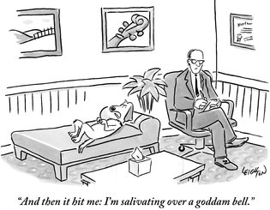
Insight is not enough…
“And then it hit me: I’m salivating over a damn bell.”

Slide 20
Research on “What Works”

Slide 21
First, What Doesn’t Work
Intensive, process group therapy sessions discussing stimulant use or emotionally volatile content.
Confrontation
Medications
Insight-oriented psychotherapy
Generic CBT
Kicking people out of treatment (Really, really bad idea).

Slide 22
Contingency Management = Motivational Incentives

Slide 23
MI Programs

Slide 24
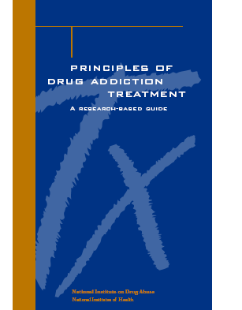
Why talk about contingency management?
It has been “endorsed” by NIDA (1999)
It appears on most every list of evidence-based practices for treating substance use disorders (e.g., ADAI, 2005)
It has been singled out, along with CBT and MI as being an effective psychotherapy for treating substance use disorders (Carroll & Onken, 2005)

Slide 25
A meta-analysis reports that Contingency Management results in a successful treatment episode 61% of the time while other treatments with which it has been compared result in a successful treatment episode 39% of the time (Prendergast, Podus, Finney, Greenwell & Roll, 2005)

Slide 26
Behavior can be modified by:
Rewards
Punishments

Slide 27
Reinforcements

Slide 28
Positive Reinforcement

Slide 29
How Incentives Could Work For You
Give Incentive
Patient attends
treatment,
gives negative samples
More patients
attend treatment
give negative samples

Slide 30
Basic Behavioral Principles
1. Frequently monitor target behavior
2. Provide incentive when target behavior occurs
3. Remove incentive when target behavior does not occur

Slide 31
Research on Contingency Management/Motivational Incentives

Slide 32
Research studies on CM: Higgins, et al; Petry et al; Roll et al; Rawson et al.
All studies compare a treatment group vs a treatment group with CM added.
In all studies, treatment plus CM produced very large positive effects over the treatment alone.
CM reduced stimulant use, improved attendance, produced long periods of sustained abstinence.

Slide 33
Contingency Management: Higgins et al., 1993

Slide 34
CM with Methamphetamine Users Roll et al, 2006
NIDA Clinical Trials Network
113 methamphetamine users
TAU, or TAU plus CM
12 week; 2 urine samples per week
Fishbowl drawings (50% “good job”; 42% worth $1-$5; 8% worth $20; 1 worth $80-$100)
Max possible about $400

Slide 35
CM with Methamphetamine Users (Cont.) Roll et al, 2006
t=2.55 p=.01
t=2. 38 p=.02

Slide 36
Motivational Incentives for Enhanced Drug Abuse Recovery
Incentives Improve Outcomes in Methamphetamine Users
Percentage of drug-free urine samples
Week
Roll, et al. 2006
Notes:
The CTN study also found that incentives improve outcomes in methamphetamine users.
At week 3 – 70% of those receiving incentives submitted drug-free urine samples for methamphetamines compared with the 41% of those receiving no incentives.
At week 8 – 52% of the incentive group were still drug-free for methamphetamines compared to 28% of those in the treatment as usual group.
In the final week of the study – 45% of the incentive group compared with 29% of the treatment as usual group submitted drug-free urine samples for methamphetamines.

Slide 37
Retention
Treatment as Usual
Incentive
Percent of Patients Retained
Weeks
Petry et al., 2000
Notes:
The intermittent schedule of incentives significantly increased retention and reduced drug/alcohol use.
Research conducted with cocaine abusers in drug-free and methadone treatment involves three central tenets:
Substance use is readily detected;
Tangible and immediate incentives when abstinence is demonstrated;
Withhold incentives when drug use is detected. *
This graph indicates that at week 8, 80% of patients in the incentive group were retained versus only 20% of the treatment as usual group.
* Stitzer, Petry, & Peirce (December 14, 2000)

Slide 38
Percent Positive for Any Illicit Drug
Treatment as Usual
Incentive
Percent
Petry et al., 2000
Notes:
Dr. Petry and others found in their 2000 study that 43% of the treatment as usual participants tested positive for any illicit drug at 8 weeks; an increase from 17% at intake.
Whereas, only 10% of the incentives participants tested positive for any illicit drug at 8 weeks; a decrease from 21% at intake.

Slide 39
.
Research with cocaine using patients on methadone. Rawson, et al 2002
160 patients on methadone who were cocaine dependent randomly assigned to one of 4 conditions, each 16 weeks long:
1. Methadone maintenance treatment as usual (MMTP-only)
2. MM with 3X weekly CBT groups (CBT)
3. MM with 3X weekly UAs and contingency management (CM)
4. MM with 3x weekly CBT and CM (CBT+CM)
All patients completed batteries of assessments at 17 weeks (end of study, 26 weeks and 52 weeks)

Slide 40
Days of cocaine-free Uas out of 48 (Rawson et al 2002)

Slide 41
Percent of participants who achieve 3 consecutive weeks of cocaine abstinence

Slide 42
Application of Contingency Management

Slide 43
The 3 Essential Elements

Slide 44
Choice of Reinforcer

Slide 45
Other examples of reinforcers
Donuts, cookies, pizza for attendance or urine results
Grocery-gasoline, etc vouchers/credit cards
Preferred parking or dosing hours
Certificates or plaques for accomplishments
Local businesses may donate

Slide 46
Fishbowl Method

Slide 47
Fishbowl Ticket Ratios

Slide 48
Challenges

Slide 49
Low Cost Incentives: Challenges

Slide 50
Implementation Tips
Give reinforcement frequently
Easy to earn initially (set the bar low)
Reinforcers should be items of use and value to patients
Reinforcement should be connected to specific, observable behavior
Minimize delay in reinforcement delivery; greater delay, weaker effect
Focus on small steps; any improvement
Simple is better

Slide 51
The Matrix Model
The Matrix Model is a collection of treatment materials that are organized to provide an outpatient treatment program for individuals addicted to drugs and alcohol. The Matrix manual has been developed and tested with individuals dependent upon cocaine and MA, but is commonly used with other alcohol and drug users.
Evidence of efficacy with patients with MA dependence. Rawson, et al, 2004).
However, not practical, nor are there data to support use with patients on MOUD.
Specific CBT exercises and tools from the Matrix materials may be useful with patients on MOUD.

Slide 52
Elements of CBT

Slide 53
Cognitive Behavioral Therapy & Relapse Prevention
Cognitive Behavioral Therapy (CBT) (also referred to in the addiction field as “Relapse Prevention Therapy”) is a form of talk therapy that emphasizes modification of cognitions and behaviors as a strategy to reduce drug use.
CBT involves coaching and teaching patients about the cognitions and behaviors critical to reducing drug and alcohol use.
CBT can be delivered in individual and group sessions.

Slide 54
The 5 Ws
The time periods when the client uses drugs
The places where the client uses and buys drugs
The external cues and internal emotional states that can trigger drug craving (why)
The people with whom the client uses drugs or the people from whom she or he buys drugs
The effects the client receives from the drugs ─ the psychological and physical benefits (what happened)

Slide 55
Behavioral CBT Concepts
In the early stages of CBT treatment, strategies emphasize behavior change, and include:
Setting a schedule to promote engagement in behaviors that are inconsistent with substance use
Recognizing and avoiding “high risk” situations
Avoiding drug-using friends
Engaging in new positive activities promoting abstinence (eg. Exercise and AA/NA groups)

Slide 56
Cognitive CBT Concepts
As CBT treatment continues into later phases of recovery, more emphasis is given to the “cognitive” part of CBT. This includes:
Keep track of days of use and reward reduction
Psychoeducation regarding addiction
Teaching clients about triggers and cravings
Teaching clients cognitive skills (e.g., “thought stopping” and “urge surfing”)
When relapse occurs, examine factors that led to use.

Slide 57
Summary
Behavioral strategies in CBT include scheduling and avoiding high risk situations.
Cognitive strategies include recognizing triggers and cravings, thought stopping, recognizing “red flag thoughts,”and analysis of the chain of events that result in a “slip” or “lapse.”
Optimally, CBT strategies can be used while practicing a style of interaction that is consistent with M.I.
CBT effects are robust across substances of abuse.

Slide 58
Exercise

Slide 59
Rationale to Study Exercise for Substance Use Disorders
Exercise increases dopamine levels in the brain (Hattori et al., 1994)
Negative affect states (depression, anxiety) may predispose individuals to relapse.
Cognitive deficits evident after prolonged substance use.
Emerging evidence from animal and human studies that exercise may be useful in treatment and prevention of SUDs (Thanos et al., 2010; Brown et al., 2010; Buchowski et al., 2011)
Positive effects on tobacco cravings, withdrawal symptoms, and smoking-related behaviors (Taylor et al., 2007; Bock et al., 1999)

Slide 60
Aerobic Exercise for Methamphetamine (MA) Dependence: Study Design
A study (Rawson et al., 2012) compared effects of an aerobic and resistance exercise intervention (“Exercise”) compared to health education (“Education”) among MA users during and after residential drug treatment .
An 8 week, three times per week, one hour session of aerobic and strength training, monitored by a professional trainer was compared to the same schedule of health education sessions with a health educator.

Slide 61
Exercise Results
Lower severity methamphetamine users had significantly fewer positive urine results at the 3 follow-up points
Exercise group participants had significantly lower scores on a measure of depression compared to the ED group over the 8-week treatment period.
Exercise group participants had significantly lower scores on a measure of anxiety compared to the ED group over the 8-week treatment period.

Slide 62
Aerobic Exercise for Methamphetamine Dependence: Results
Exercise significantly reduced anxiety and depression symptoms in the first 8 weeks of MA withdrawal.
Exercise reduced weight gain and increased strength and heart rate variability.
Exercise produced more rapid regrowth of D2 receptors and transporters
Exercise reduced post-discharge MA relapse for all except the most severe patients.

Slide 63
Exercise Summary
MA users can engage in exercise
Resistance and aerobic exercise delivered 3 Xs/week over just 8 weeks confers benefits to physical health, mood, and dopamine receptor availability in MA users
Optimal type and duration of exercise unknown
Further exploration of exercise in conjunction with other forms of therapy as well as effects on drug use is warranted

Slide 64
The Use of Technology in Addiction Treatment

Slide 65
Thank you Richard Rawson, Ph.D. rrawson@mednet.ucla.edu RRAWSON@UVM.EDU

Slide 66
Addressing Stimulant Use in Clinical Practice
Joe Sepulveda, M.D.
Assistant Medical Director, Family Health Centers of San Diego (FHCSD)

Slide 67
Questions/Discussion

