Slide 1
Part 4: Stigma and Substance Use Disorders (SUDs)
Notes:
This is the fourth part in a 5-part Curriculum Infusion Package (CIP) on Opioid Use Disorders (OUD) developed in 2019 by the Pacific Southwest Addiction Technology Transfer Center (PSATTC). The main developers were Beth Rutkowski, MPH, and Nancy Roget, MS, with additional guidance and editing support provided by Drs. Thomas E. Freese and Michael Shafer.
The OUD CIP was developed for college/university faculty to infuse brief, science-based OUD-specific content into existing substance use disorder(SUD)-related course syllabi (e.g., foundations of addiction, screening and assessment, etc.). Instructors can select the content to infuse throughout the duration of the course, depending on specific needs of the learners. Each slide contains notes for the instructor to provide guidance and references when possible.
Part 4 provides a brief overview of the importance of using language that helps decrease stigma associated with SUDs. The slide deck is designed to be used by academic faculty in behavioral health programs, trainers, behavioral health providers, and state/county agency staff members for a variety of audiences. If you require further information on this topic, please do not hesitate to contact the Pacific Southwest ATTC (http://www.psattc.org). You are free to use these slides and pictures, but please give credit to the Pacific Southwest ATTC when using them by keeping the logo on each slide and referencing the PSATTC at the beginning of your presentation.
The Pacific Southwest ATTC (HHS Region 9) is part of the SAMHSA-funded ATTC network that offers training/technical assistance (TA) services through a partnership with UCLA Integrated Substance Abuse Programs, Arizona State University School of Social Work , and University of Nevada-Reno Center for the Application of Substance Abuse Technologies. HHS Region 9 is comprised of Arizona, California, Hawaii, Nevada, and the six U.S.-affiliated Pacific Jurisdictions (American Samoa, Commonwealth of the Northern Mariana Islands, Federated States of Micronesia, Guam, Republic of the Marshall Islands, and Republic of Palau). For additional information, please access its website at http://www.psattc.org. Additional resources are available to enhance and support the information provided in this brief presentation.
IMAGE CREDIT:
Shutterstock (purchased image).

Slide 2
Stigma associated with having a SUD has been identified as a constant obstacle to entering treatment or seeking support from mutual aid groups; only 1/3 of individuals sought treatment or support in 2016
Be a Champion for Decreasing Stigma Related to SUDs
SOURCES: Ashford et al. (2018); Grant et al. (2016)
Notes:
According several studies (only two listed here), stigma associated with having a SUD serves as a constant obstacle to getting help/support. With at least 2/3 of individuals stating that they probably have a SUD but have not sought treatment or support groups is concerning. If stigma around SUDs can be decreased, individuals may more readily seek treatment/support. Remind students that they can be champions for decreasing stigma related to SUDs simply by changing their language and asking others to change their language as well. There are current guidelines for preferred SUD language usage and research that identifies stigmatizing words, which will be discussed in this brief slide deck.
REFERENCES:
Ashford, R.D., Brown, A.M., & Curtis, B. (2018). Abusing addiction: Our language still isn’t good enough. Alcoholism Treatment Quarterly, 1-16. doi: 10.1080/07347324.2018.1513777
Grant, B. F., Saha, T. D., Ruan, W. J., Goldstein, R. B., Chou, S. P., Jung, J., . . . Hasin, D. S. (2016). Epidemiology of DSM-5 drug use disorder: Results from the national epidemiologic survey on alcohol and related conditions–III. JAMA Psychiatry, 73(1), 39–47. doi:10.1001/jamapsychiatry.2015.2132
IMAGE CREDIT:
Shutterstock (purchased image).

Slide 3
Stigma is a complex phenomenon that involves various levels of identities, culture, values, power, and beliefs, and occurs across public, personal, and structural spheres (Link & Phelan, 2013; Bos, Pryor, Reeder, & Stutterheim, 2013)
Public stigma and self-stigma are directly related to one another and have a negative effect on help-seeking behaviors (Bathje &Pryor, 2011; Keyes et al., 2010; Vogel, Wade, & Hackler, 2007)
SOURCE: Ashford, Curtis, & Brown. (2018)
Notes:
This slide discusses the concept of stigma and public stigma, and includes several articles for further reading.
Stigma is a mark of disgrace associated with a particular circumstance, quality, or person. Social stigma is the disapproval of, or discrimination against, a person based on perceivable social characteristics that serve to distinguish them from other members of a society.
REFERENCES:
Ashford, R.D., Brown, A.M., & Curtis, B. (2018): Abusing addiction: Our language still isn’t good enough. Alcoholism Treatment Quarterly, 1-16 doi: 10.1080/07347324.2018.1513777.
Bathje, G. & Pryor, J. (2011). The relationships of public and self-stigma to seeking mental health services. Journal of Mental Health Counseling, 33(2), 161–176. doi:10.17744/mehc.33.2.g6320392741604l1
Bos, A.E., Pryor, J.B., Reeder, G.D., & Stutterheim, S.E. (2013). Stigma: Advances in theory and research. Basic and Applied Social Psychology, 35(1), 1–9. doi:10.1080/01973533.2012.746147
Keyes, K.M., Hatzenbuehler, M.L., McLaughlin, K.A., Link, B., Olfson, M., Grant, B.F., & Hasin, D. (2010). Stigma and treatment for alcohol disorders in the United States. American Journal of Epidemiology, 172(12), 1364–1372. doi:10.1093/aje/kwq304
Link, B.G., & Phelan, J.C. (2013). Labelling and Stigma in C.S. Aneshensel et al. (Eds.), Handbook of the Sociology of Mental Health, Second Edition. Netherlands: Springer.
Vogel, D.L., Wade, N.G., & Hackler, A.H. (2007). Perceived public stigma and the willingness to seek counseling: The mediating roles of self-stigma and attitudes toward counseling. Journal of Counseling Psychology, 54(1), 40. doi:10.1037/0022-0167.54.1.40
IMAGE CREDIT:
Shutterstock (purchased image).

Slide 4
Research on SUD Stigma
SUD is among the most stigmatized conditions in the US and around the world (McGinty et al., 2014)
People do not want to work with, be related to, or even see people with a SUD in public. Further, many believe people with a SUD can or should be denied housing, employment, social services, and health care (https://www.ncbi.nlm.nih.gov/books/NBK384923/)
Health care providers treat patients who have SUDs differently (Kelly et al., 2010; 2015)
Clinicians have lower expectations for health outcomes for patients with SUDs; this in turn can affect whether the provider believes the patient is deserving of treatment. Some health care providers, falsely believing that SUDs are within a person’s control, cite feelings of frustration and resentment when treating patients with SUDs (VanBoekel et al., 2013)
Notes:
Most of the content on this slide is taken from a document created by SAMHSA’s Center for the Application of Prevention Technologies (CAPT) for prevention specialists as well as treatment providers, except for the last bullet which comes from an article by Ashford and colleagues. Review the points in each slide. The references cited on the slide are included in these notes.
REFERENCES:
Ashford, R.D., Brown, A.M., & Curtis, B. (2018): Abusing addiction: Our language still isn’t good enough. Alcoholism Treatment Quarterly, 1-16 DOI: 10.1080/07347324.2018.1513777.
Barry, C.L., McGinty, E.E., Pescosolido, B.A., & Goldman, H.H. (2014). Stigma, discrimination, treatment effectiveness, and policy: Public views about drug addiction and mental illness. Psychiatric Services, 65(10), 1269-1272.
Committee on the Science of Changing Behavioral Health Social Norms; Board on Behavioral, Cognitive, and Sensory Sciences; Division of Behavioral and Social Sciences and Education; National Academies of Sciences, Engineering, and Medicine. Ending Discrimination Against People with Mental and Substance Use Disorders: The Evidence for Stigma Change. Washington (DC):National Academies Press (US); 2016 Aug 3. 2, Understanding Stigma of Mental and Substance Use Disorders. Available from: https://www.ncbi.nlm.nih.gov/books/NBK384923/.
Kelly, J.F., Dow, S.J., & Westerhoff, C. (2010). Does our choice of substance-related terms influence perceptions of treatment need? An empirical investigation with two commonly used terms. Journal of Drug Issues, 40, 805–818.
Kelly, J.F., Wakeman, S.E., & Saitz, R. (2015). Stop talking 'dirty': Clinicians, language, and quality of care for the leading cause of preventable death in the United States. American Journal of Medicine, 128, 8–9.
Van Boekel, L.C., Brouwers, E.P., Van Weeghel, J., & Garretsen, H.F. (2013). Stigma among health professionals towards patients with substance use disorders and its consequences for healthcare delivery: systematic review. Drug and Alcohol Dependence, 131(1), 23-35.
Brener, L., von Hippel, W., von Hippel, C., Resnick, I., & Treloar, C. (2010). Perceptions of discriminatory treatment by staff as predictors of drug treatment completion: Utility of a mixed methods approach. Drug and Alcohol Review, 29(5), 491-497.
Keyes, K.M., Hatzenbuehler, M.L., McLaughlin, K.A., Link, B., Olfson, M., Grant, B.F., & Hasin, D. (2010). Stigma and treatment for alcohol disorders in the United States. American Journal of Epidemiology, 172(12), 1364-1372.
Words Matter: How Language Choice Can Reduce Stigma (Nov 2017). SAMHSA Center for the Application of Prevention Technologies. https://www.samhsa.gov/capt/sites/default/files/resources/sud-stigma-tool.pdf.

Slide 5
Research on SUD Stigma, continued
People with SUD who expect or experience stigma have poorer outcomes (Brenner et al., 2010; Keyes et al., 2010)
People who experience stigma are less likely to seek out treatment services and access those services. When they do, those who experience stigma are more likely to drop out of care earlier. Both of these factors compound and lead to worse outcomes overall
SUD goes largely untreated in North America, with only about 1/3 of individuals ever seeking assistance, including from mutual-aid groups, over a lifetime and that low treatment numbers may indicate “persistent barriers related to stigma” (Grant et al., 2016; Ashford, Brown, & Curtis, 2018)
Notes:
As a continuation of the previous slide, most of the content on this slide is taken from a document created by SAMHSA’s Center for the Application of Prevention Technologies (CAPT) for prevention specialists as well as treatment providers, except for the last bullet which comes from an article by Ashford and colleagues. Review the points in each slide. The references cited on the slide and included in these notes.
REFERENCES:
Ashford, R.D., Brown, A.M., & Curtis, B. (2018): Abusing addiction: Our language still isn’t good enough. Alcoholism Treatment Quarterly, 1-16 doi: 10.1080/07347324.2018.1513777.
Barry, C.L., McGinty, E.E., Pescosolido, B.A., & Goldman, H.H. (2014). Stigma, discrimination, treatment effectiveness, and policy: Public views about drug addiction and mental illness. Psychiatric Services, 65(10), 1269-1272.
Committee on the Science of Changing Behavioral Health Social Norms; Board on Behavioral, Cognitive, and Sensory Sciences; Division of Behavioral and Social Sciences and Education; National Academies of Sciences, Engineering, and Medicine. Ending Discrimination Against People with Mental and Substance Use Disorders: The Evidence for Stigma Change. Washington (DC): National Academies Press (US); 2016 Aug 3. 2, Understanding Stigma of Mental and Substance Use Disorders. Available from: https://www.ncbi.nlm.nih.gov/books/NBK384923/.
Kelly, J.F., Dow, S.J., & Westerhoff, C. (2010). Does our choice of substance-related terms influence perceptions of treatment need? An empirical investigation with two commonly used terms. Journal of Drug Issues, 40, 805–818.
Kelly, J.F., Wakeman, S.E., & Saitz, R. (2015). Stop talking 'dirty': Clinicians, language, and quality of care for the leading cause of preventable death in the United States. American Journal of Medicine, 128, 8–9.
Van Boekel, L.C., Brouwers, E.P., Van Weeghel, J., & Garretsen, H.F. (2013). Stigma among health professionals towards patients with substance use disorders and its consequences for healthcare delivery: systematic review. Drug and Alcohol Dependence, 131(1), 23-35.
Brener, L., von Hippel, W., von Hippel, C., Resnick, I., & Treloar, C. (2010). Perceptions of discriminatory treatment by staff as predictors of drug treatment completion: Utility of a mixed methods approach. Drug and Alcohol Review, 29(5), 491-497.
Keyes, K.M., Hatzenbuehler, M.L., McLaughlin, K.A., Link, B., Olfson, M., Grant, B.F., & Hasin, D. (2010). Stigma and treatment for alcohol disorders in the United States. American Journal of Epidemiology, 172(12), 1364-1372.
Words Matter: How Language Choice Can Reduce Stigma (Nov 2017). SAMHSA Center for the Application of Prevention Technologies. https://www.samhsa.gov/capt/sites/default/files/resources/sud-stigma-tool.pdf.

Slide 6
‘They have to hit bottom before they are ready for help/treatment’
NO!
https://www.drugabuse.gov/about-nida/noras-blog/2015/06/addiction-disease-free-will
Notes:
This slide provides a concrete example of stigma regarding use of drugs and alcohol. No other medical disorder or condition includes a recommendation that medical treatment services be withheld until the patient is ready and willing to follow proposed treatment services. Until recently, some SUD treatment providers would advise family members or significant others that behavioral and medical interventions were a waste of time until the individual had ‘hit bottom’ (condition had worsened) and was ready for treatment.
QUICK GROUP ACTIVITY: Ask students if they can think of a medical condition where the patient’s family is advised to wait until the individual’s condition has worsened and they are now scared enough to agree to treatment services. Process students’ responses to this question.
Stigma related to SUDs is connected to misinformation. For example, the belief that SUDs is a moral weakness (individuals do not have the willpower or personal strength to stop their use) is the rationale used to distance ‘those people with the condition’ away from those without the condition (e.g., those people can’t control their drinking; those people let their drug use interfere with taking care of their home and kids; those people could stop if they really wanted to but they choose not to, etc.). Therefore, it is important to understand what the science says about SUDs and correct myths or misunderstandings.
IMAGE CREDIT:
Shutterstock (purchased image).

Slide 7
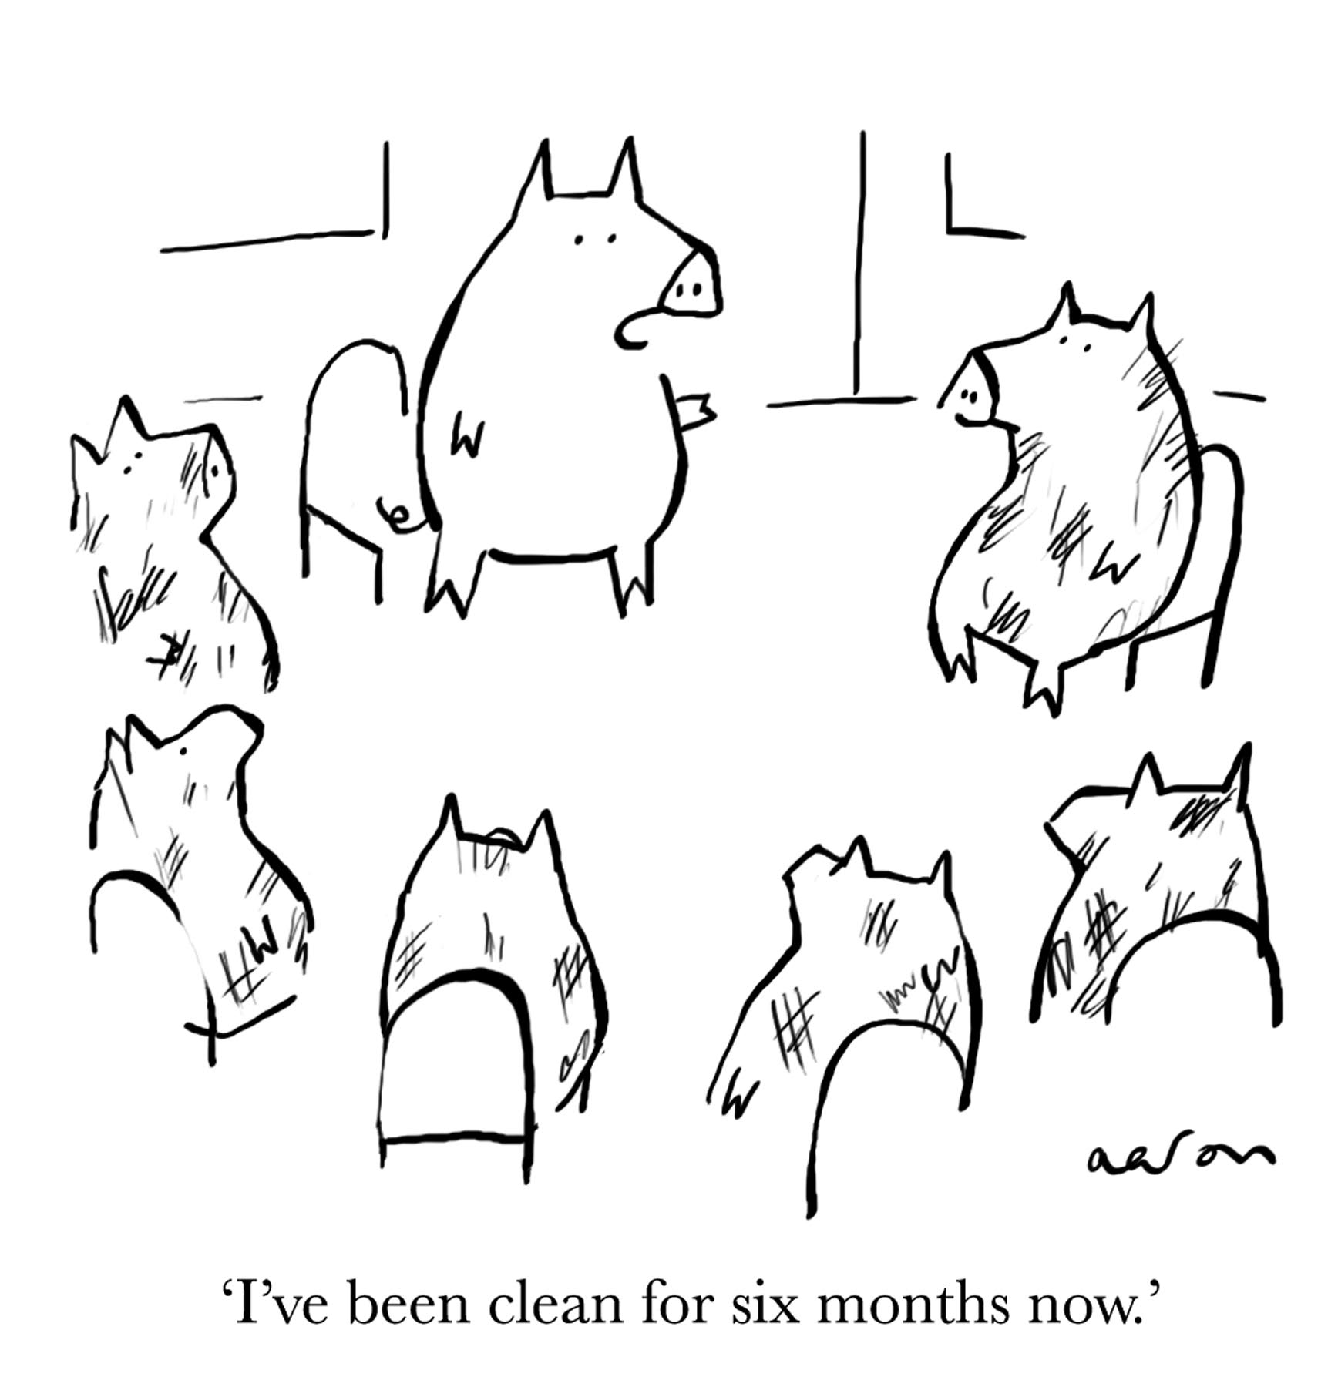
LANGUAGE
Notes:
ACTIVITY: The previous slide established the vast amount and different types of recovery experience in the room. For this activity, adhere two flip charts to the wall—one labeled “Words to describe people” and one labeled “Words to describe recovery.” On the first flip chart, ask the class to come up with as many terms for people who have a problem with drug and/or alcohol addiction. Examples include: person with the disease of addiction, alcoholic, addict, junkie, druggie, problem user, etc. Encourage students to come up with as many terms as possible. On the second flip chart, ask the class to come up with terms for recovery or people in recovery.
Examples include: recovered, clean, sober, recovery-oriented systems of care, addiction management, substance use treatment, rehab, etc. Again, encourage as many terms as possible.
Once the group has listed all the terms they can think of, facilitate a discussion about which terms the group feels are appropriate. Which words do they respond to positively and which negatively? There may not be a correct answer, and it’s important to acknowledge that terms may be offensive to some people but proud identifiers for others. The goal of the conversation is to develop some norms around how to talk about people in recovery, with a focus on person-centered language that highlights the problem of addiction rather than moral qualities of the people who struggle with addiction. Circle the terms that the group agrees are most supportive and person-centered. You may also want to have the group agree on some norms around language to use for the day.
IMAGE CREDIT:
CartoonStock (purchased image).

Slide 8
Notes:
This slide was created by the Network Coordinating Office of the SAMHSA-funded Addiction Technology Transfer Centers (ATTCs). It highlights two important concepts regarding the use of affirming language (e.g., words have power and people first). It has become standard practice in the ATTC Network for trainers and educators to insert this slide into their first lectures of the semester/quarter and/or at the beginning of each training session. This helps students and training participants use affirming language when asking questions or talking about issues related to SUDs and mental health related issues.
REFERENCE:
Words Matter: How Language Choice Can Reduce Stigma (Nov 2017). SAMHSA Center for the Application of Prevention Technologies. https://www.samhsa.gov/capt/sites/default/files/resources/sud-stigma-tool.pdf.

Slide 9
Negative Language Promotes Negative Attitudes Towards Individuals with SUDs
ADDICTS, JUNKIES, ALCOHOLICS
out
Personal Experience as Professional Judgment
SOURCE: Jensen. (1992)
Notes:
This slide has two main points. First, it give examples of negative language that is used sometimes for individuals with substance use disorders (SUDs). In most cases these terms increase stigma and negative views of individuals who use substances or have SUDs.
An easy point to make about how these terms are stigmatizing is this quick exercise. Ask students to close their eyes and picture an addict or junkie or dope fiend walking past them on the street. Then ask them to open their eyes and request volunteers to share what they saw. Most students will describe an individual who is dressed poorly; maybe intoxicated or under the influence; and male. Rarely when doing this exercise do students describe a woman or an individual in an earlier stage of the condition. Process students’ responses and questions.
Next, it is important to have students reflect on their personal experiences with an individual with a SUD (private reflection is better than sharing openly in class), as many times stigma relating to SUD comes from personal experience with individual(s) with SUDs. This personal experience can creep into professional judgment and/or service delivery. This is true for both professionals in recovery (lived experience) and professionals who had/have a close relationship with individual(s) with SUDs. Jensen (1992) cautioned professionals in recovery to avoid using their own personal experiences with SUDs and recovery as the roadmap for how treatment/recovery should be done.
Go to the next slide to complete this point.
REFERENCE:
Jensen, J. (1992). Treatment planning part 2: Personal experience as professional judgment.
IMAGE CREDIT:
Shutterstock (purchased image).

Slide 10
Your own experience with:
Drug/alcohol usage
Recovery from SUDs
A loved-one/family member with SUDs
Will influence how you help individuals with SUDs
Notes:
When talking about being aware of how your ‘personal experience with SUDs may impact your delivery of services with individuals with SUDs,’ the above list is what is meant by personal experience. Literature supports that behavioral health and healthcare professionals should be vigilant in examining how their own personal experiences with individuals with SUDs might negatively impact their service delivery and ability to be empathic and kind.
These two pictures can be used in a variety of ways to demonstrate the importance of being aware of stigma associated with individuals with SUDs for behavioral health professionals, so feel free to add your own interpretation or class exercise. Using the photos, ask students if the young man on the left would be treated with the same empathy and kindness as the child on the right if both were brought to the Emergency Room by paramedics? Process students’ responses. Remind students to be aware of how stigma regarding SUDs can interfere with how individuals with SUDs are served.
IMAGE CREDIT: Shutterstock (purchased images).

Slide 11
5 Suggestions for Checking Your Language
Make sure to use First Person Language
Make distinctions between a person who has used heroin and a person who has been diagnosed with an Opioid Use Disorder (OUD)
Use technical language with a single clear meeting instead of words with inconsistent definitions
Make sure not to use sensational or fear-based language
Make sure to not unintentionally perpetuate drug-related moral panic
Notes:
These five suggestions are helpful to assist professionals in checking their language. Bullets one and two are fairly self-explanatory (ensure that you avoid saying someone is a person with an SUD if you don’t know if they have been diagnosed). An example that is useful for explaining bullet 3 is the term ‘clean’ or ‘dirty’ urine tests. Instead, when referring to alcohol/drug urine test results use the phrase, “Mary’s urine test results were positive for marijuana”. This communicates a clear consistent message rather than saying, “Mary had a dirty urine test” which does not provide specific information. Also, the word ‘dirty’ possesses a negative connotation. Example for the last two bullets include, “Joe is a really bad alcoholic” and “Now we are going to see a surge of these drug babies, which will negatively impact our schools.” Both of these comments are unhelpful and do nothing to increase understanding and empathy.
REFERENCES:
International Society of Addiction Journal Editors. Addiction Terminology Statement. Annual meeting, Budapest, Hungary, August 31-September 2, 2015. http://www.parint.org/isajewebsite/terminology.htm.
Kelly, J.F. (2004). Toward an Addictionary: A Proposal for More Precise Terminology. Alcoholism Treatment Quarterly, 22(2), 79-87.
Kelly, J.F., Wakeman, S.E., & Saitz, R. (2015). Stop talking 'dirty': Clinicians, language, and quality of care for the leading cause of preventable death in the United States. American Journal of Medicine, 128, 8–9.
Miller, P.G. (2007). Media reports of heroin overdose spates: Public health messages, moral panics or risk advertisements?. Critical Public Health, 17(2), 113-121.
Kerr, T., Small, W., Hyshka, E., Maher, L., & Shannon, K. (2013). ‘It's more about the heroin’: Injection drug users' response to an overdose warning campaign in a Canadian setting. Addiction, 108(7), 1270-1276.
Stengel, C. (2014). The risk of being ‘too honest’: Drug use, stigma and pregnancy. Health, Risk & Society, 16(1), 36-50.

Slide 12
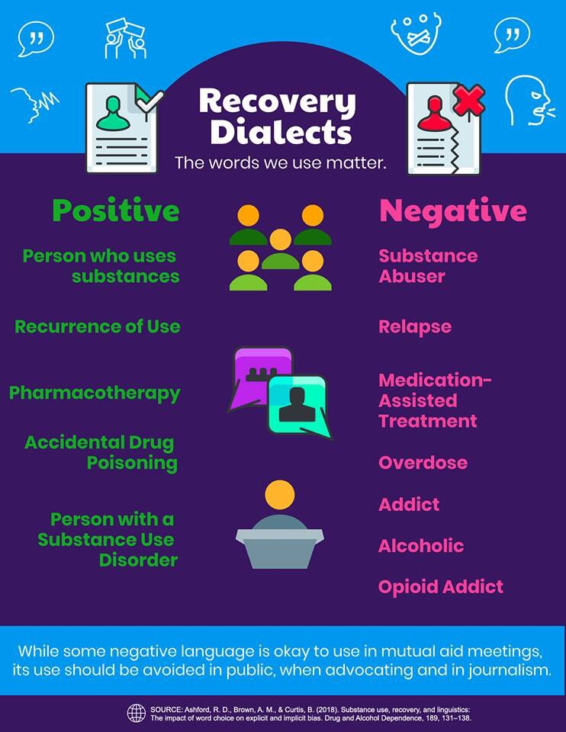
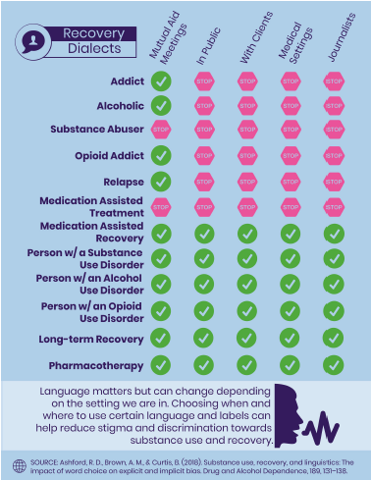
Suggested Language
Use of Language in Different Settings
SOURCE: Ashford, Brown, & Curtis. (2018)
Notes:
These two charts come from a recent article and study by Ashford and colleagues (2018). Results from the study recommended that the use of terms addict, alcoholic, opioid addict, and substance abuser be stopped as their use helped increase stigma and decrease understanding of individuals with SUDs. These charts provide suggestions regarding how to replace stigma producing words with less stigmatizing words or a ‘recovery dialect’. Finally, the terms Medication-Assisted Recovery and Long-term Recovery are positive terms that according to the authors can be used without promoting stigma. Specifically for OUDs, the research showed that the term Pharmacotherapy is less stigmatizing than Medication Assisted Treatment and that Accidental Drug Poisoning should be used rather than Overdose.
Review these two charts with students. The chart on the right is helpful because it recommends where certain terms can or cannot be used.
REFERENCE:
Ashford, R.D., Brown, A.M., & Curtis, B. (2018). Substance use, recovery, and linguistics; The impact of word choice on explicit and implicit bias. Drug and Alcohol Dependence, 189, 131-138.

Slide 13
GOAL … more effective and more respectful treatment for people struggling with substance use, as well as their families.
Even bigger GOAL … to change the conversation
from the language of stigma to the language of growth
from defects to strengths
from shame to pride and an open heart
from punishment and confrontation to an invitation to truly change
to change that conversation, rely on Science and Kindness
https://motivationandchange.com/about-cmc/
Notes:
The language on this slide is taken from the Motivation and Change website. The language used here is an example of how changes can be made regarding communicating to and about individuals with SUDs. Ask a student to volunteer to read the goals of the Motivation and Change website out loud (the instructor can read it if no one volunteers) and after it is read, ask for students’ reactions. When heard out loud the message is even more powerful.
REFERENCE: Center for Motivation and Change website, https://motivationandchange.com/about-cmc.

Slide 14
Protest any labels that turn people into things.
Words are important.
If you want to care for something, you call it a ‘flower;’ if you want to kill something, you call it a ‘weed.’
Don Coyhis
http://www.williamwhitepapers.com/blog/2013/07/moral-panics-the-limits-of-science-professional-responsibility.html
http://www.williamwhitepapers.com/blog/2015/12/is-it-time-for-person-first-language-in-addiction-treatment-william-white-and-alisha-white.html
Notes:
Finally, this slide uses a quote with an analogy that helps bring the point home about the powerful impact of language. Citations are included from the William White Papers website, which is where the quote is attributed specifically to Don Coyhis. William White is a prolific author in the SUD and recovery support field. His website is filled with interesting articles.
Additional components of the PSATTC’s OUD CIP include the following:
Part 1: Mechanism of Action of Opioids and the Impact on the User’s Brain and Body
Part 2: Review of the FDA-approved Medications for the Treatment of Opioid Use Disorders
Part 3: Prevention of Opioid Overdose
Part 5: Recovery Supports and Treatment Recommendations
The full CIP is available for viewing and downloading from http://www.psattc.org.
REFERENCE:
http://www.williamwhitepapers.com/blog/2013/07/moral-panics-the-limits-of-science-professional-responsibility.html.
This product was created by the Pacific Southwest Addiction Technology Transfer Center (PSATTC) under a cooperative agreement (5UR1TI080211) from the Substance Abuse and Mental Health Services Administration (SAMHSA). The opinions expressed are the views of the presentation developers and do not reflect the official position of the Department of Health and Human Services (DHHS), SAMHSA or CSAT. No official support or endorsement of DHHS, SAMHSA, or CSAT for the opinions described in this program is intended or should be inferred.

